Slide 1
12.9) Stationary points

Slide 2
Worked example
Your turn
Find the least value of
$$f\left(x\right)=x^{2}+6x−9$$
Find the least value of
$$f\left(x\right)=x^{2}−4x+9$$
$$5$$

Slide 3
Worked example
Your turn
Find the turning point of
$$y=\sqrt[4]{x}−2x$$
Find the turning point of
$$y=\sqrt{x}−x$$
$$\left(\frac{1}{4},\frac{1}{4}\right)$$

Slide 4
Worked example
Your turn
Find the coordinates of the turning/stationary point(s) of the curves by differentiation:
$$y=x^{2}+6x−2$$
$$y=2x^{3}+6x^{2}−4$$
Find the coordinates of the turning/stationary point(s) of the curves by differentiation:
$$y=x^{3}+3x^{2}−4$$
$(−2, 0)$ and $(0, −4)$

Slide 5
Worked example
Your turn
Find the coordinates of the turning/stationary point(s) of the curves by differentiation:
$$y=\frac{2}{3}x^{3}−3.5x^{2}+3x+5$$
Find the coordinates of the turning/stationary point(s) of the curves by differentiation:
$$y=x^{3}+\frac{1}{2}x^{2}−2x+4$$
$(−1,\frac{11}{2})$ and $(\frac{2}{3},\frac{86}{27})$

Slide 6
Worked example
Your turn
Find the stationary points on the curve $y={\frac{5}{3}x}^{3}−80x$
Find the stationary points on the curve $y=x^{3}−12x$
$(−2, 16)$ and $(2, −16)$

Slide 7
Worked example
Your turn
Find the stationary point on the curve with equation $y=x^{4}−108x$, and determine whether it is a local maximum, a local minimum or a point of inflection.
Find the stationary point on the curve with equation $y=x^{4}−32x$, and determine whether it is a local maximum, a local minimum or a point of inflection.
$(2, −48)$ Local minimum

Slide 8
Worked example
Your turn
Find the coordinates of the stationary points on the curve with equation $y=4x^{3}+30x^{2}+48x−3$ and use the second derivative to determine their nature
Find the coordinates of the stationary points on the curve with equation $y=2x^{3}−15x^{2}+24x+6$ and use the second derivative to determine their nature
$(1, 17)$ Local maximum
$\left(4, −10\right)$ Local minimum

Slide 9
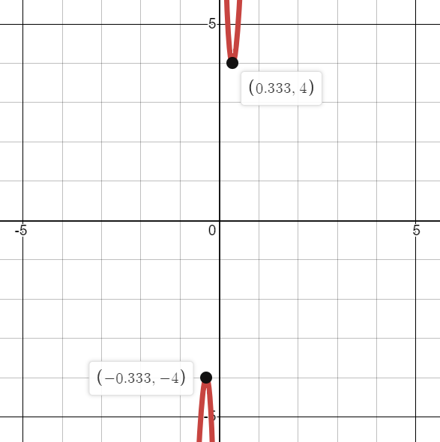
Worked example
Your turn
Sketch the graph of $y=\frac{1}{x}+\frac{256}{3}x^{3}$ labelling the stationary points.
Sketch the graph of $y=\frac{1}{x}+27x^{3}$ labelling the stationary points.

