Slide 1
12.6) Gradients, tangents and normal

Slide 2
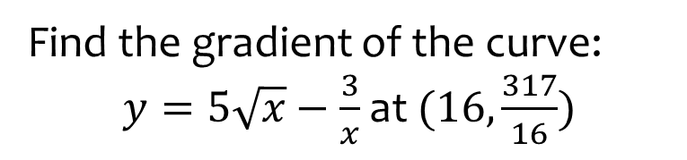

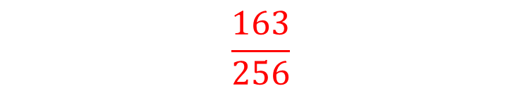
Worked example
Your turn
Find the gradient of the curve:
$y=8\sqrt{x}+\frac{48}{x}$ at $(4, 28)$
$y=\frac{3}{x^{2}}−\frac{18}{\sqrt{x}}$ at $(9, −\frac{161}{27})$
Find the gradient of the curve:
$y=5\sqrt{x}−\frac{3}{x}$ at $(16,\frac{317}{16})$
$$\frac{163}{256}$$

Slide 3
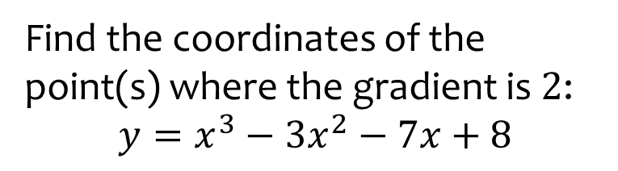
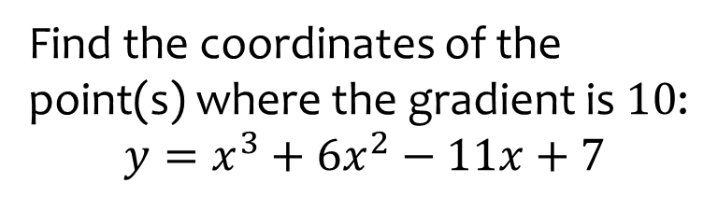
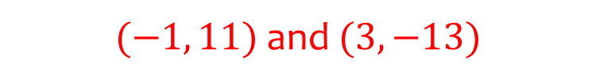
Worked example
Your turn
Find the coordinates of the point(s) where the gradient is $10$:
$$y=x^{3}+6x^{2}−11x+7$$
Find the coordinates of the point(s) where the gradient is $2$:
$$y=x^{3}−3x^{2}−7x+8$$
$(−1, 11)$ and $(3, −13)$

Slide 4
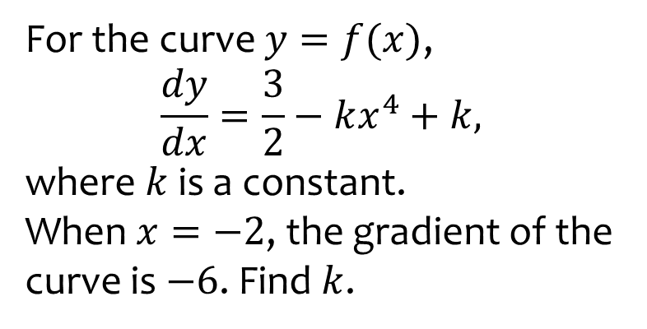
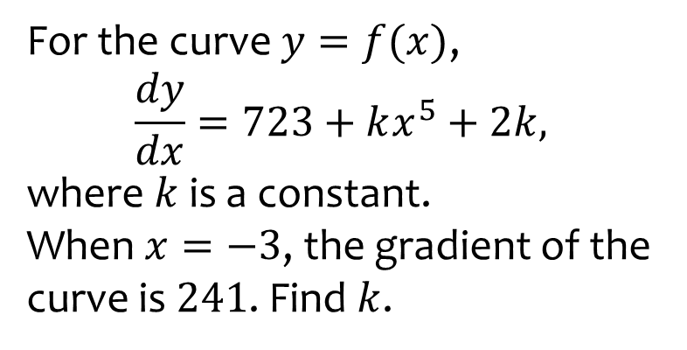
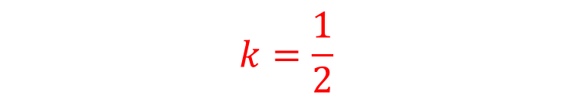
Worked example
Your turn
For the curve $y=f(x)$,
$$\frac{dy}{dx}=723+kx^{5}+2k,$$
where $k$ is a constant.
When $x=−3$, the gradient of the curve is $241$. Find $k$.
For the curve $y=f(x)$,
$$\frac{dy}{dx}=\frac{3}{2}−kx^{4}+k,$$
where $k$ is a constant.
When $x=−2$, the gradient of the curve is $−6$. Find $k$.
$$k=\frac{1}{2}$$

Slide 5
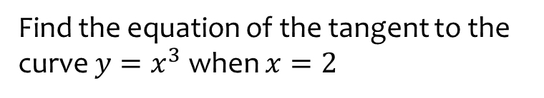
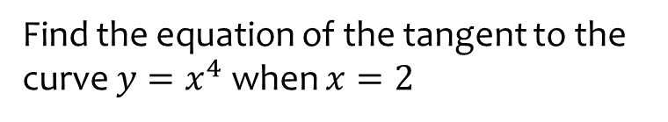
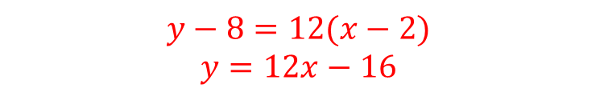
Worked example
Your turn
Find the equation of the tangent to the curve $y=x^{4}$ when $x=2$
Find the equation of the tangent to the curve $y=x^{3}$ when $x=2$
$$y−8=12(x−2)$$
$$y=12x−16$$

Slide 6
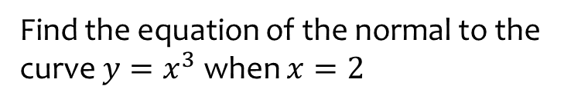
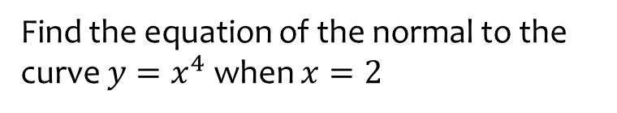
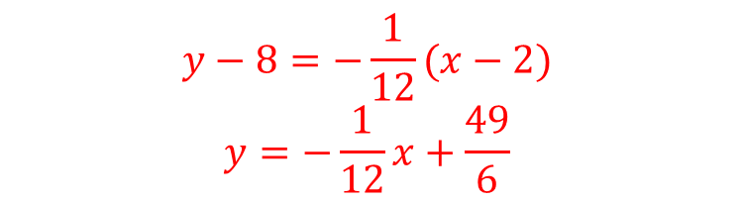
Worked example
Your turn
Find the equation of the normal to the curve $y=x^{4}$ when $x=2$
Find the equation of the normal to the curve $y=x^{3}$ when $x=2$
$$y−8=−\frac{1}{12}(x−2)$$
$$y=−\frac{1}{12}x+\frac{49}{6}$$

Slide 7
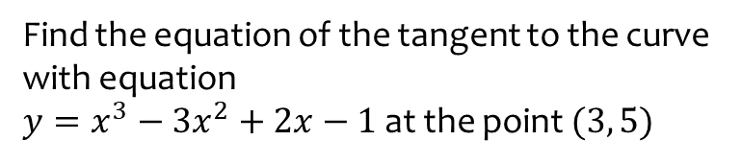
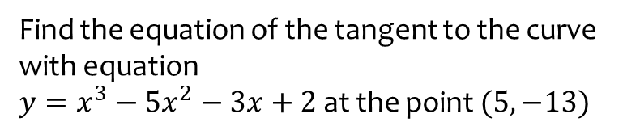
Worked example
Your turn
Find the equation of the tangent to the curve with equation
$y=x^{3}−5x^{2}−3x+2$ at the point $(5, −13)$
Find the equation of the tangent to the curve with equation
$y=x^{3}−3x^{2}+2x−1$ at the point $(3, 5)$
$$y=11x−28$$

Slide 8
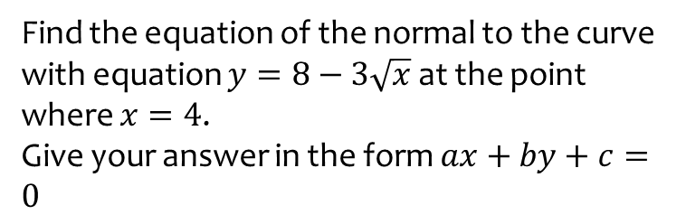
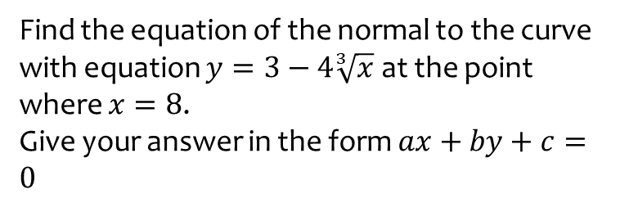
Worked example
Your turn
Find the equation of the normal to the curve with equation $y=3−4\sqrt[3]{x}$ at the point where $x=8$.
Give your answer in the form $ax+by+c=0$
Find the equation of the normal to the curve with equation $y=8−3\sqrt{x}$ at the point where $x=4$.
Give your answer in the form $ax+by+c=0$
$$3y−4x+10=0$$

Slide 9
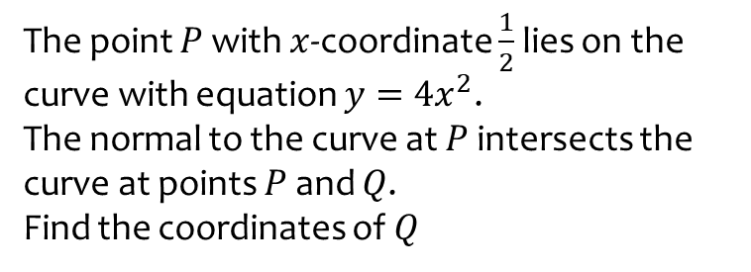
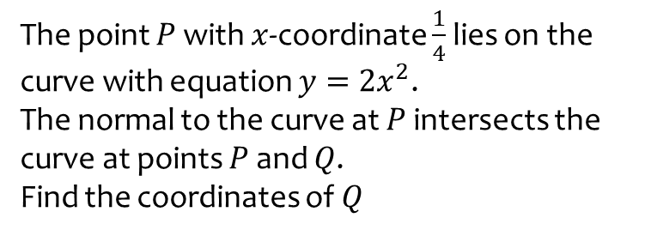
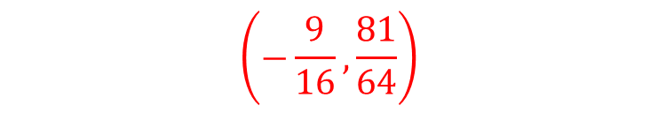
Worked example
Your turn
The point $P$ with $x$-coordinate $\frac{1}{4}$ lies on the curve with equation $y=2x^{2}$.
The normal to the curve at $P$ intersects the curve at points $P$ and $Q$.
Find the coordinates of $Q$
The point $P$ with $x$-coordinate $\frac{1}{2}$ lies on the curve with equation $y=4x^{2}$.
The normal to the curve at $P$ intersects the curve at points $P$ and $Q$.
Find the coordinates of $Q$
$$\left(−\frac{9}{16},\frac{81}{64}\right)$$

