Slide 1
12.5) Differentiating functions with two or more terms

Slide 2
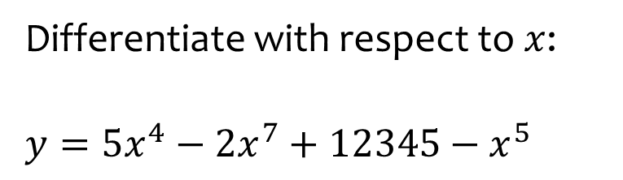

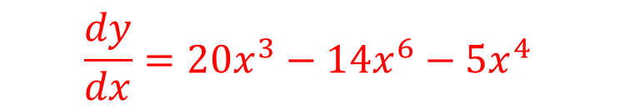
Worked example
Your turn
Differentiate with respect to $x$:
$$y=4x^{3}+3x^{2}+2x+1$$
$$f\left(x\right)=x^{3}−2x^{5}−3x^{−2}−2$$
Differentiate with respect to $x$:
$$y=5x^{4}−2x^{7}+12345−x^{5}$$
$$\frac{dy}{dx}=20x^{3}−14x^{6}−5x^{4}$$

Slide 3
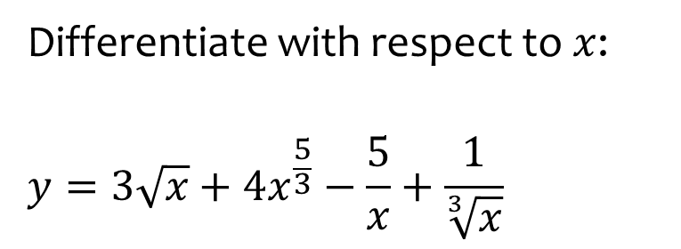
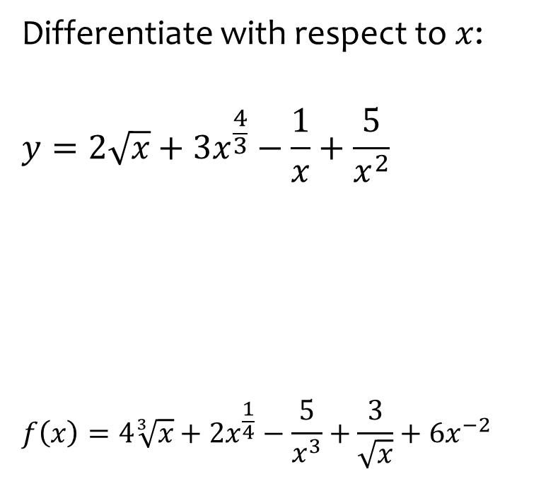
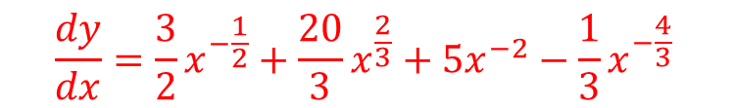
Worked example
Your turn
Differentiate with respect to $x$:
$$y=2\sqrt{x}+3x^{\frac{4}{3}}−\frac{1}{x}+\frac{5}{x^{2}}$$
$$f\left(x\right)=4\sqrt[3]{x}+2x^{\frac{1}{4}}−\frac{5}{x^{3}}+\frac{3}{\sqrt{x}}+6x^{−2}$$
Differentiate with respect to $x$:
$$y=3\sqrt{x}+4x^{\frac{5}{3}}−\frac{5}{x}+\frac{1}{\sqrt[3]{x}}$$
$$\frac{dy}{dx}=\frac{3}{2}x^{−\frac{1}{2}}+\frac{20}{3}x^{\frac{2}{3}}+5x^{−2}−\frac{1}{3}x^{−\frac{4}{3}}$$

Slide 4



Worked example
Your turn
Differentiate with respect to $x:$
$$y=x^{4}\left(x−5\right)$$
$$f(x)=x^{3}\left(x+2\right)$$
Differentiate with respect to $x$:
$$f(x)=x^{2}\left(x−3\right)$$
$$f^{′}\left(x\right)=3x^{2}−6x$$

Slide 5
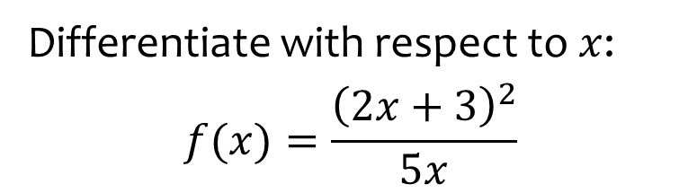


Worked example
Your turn
Differentiate with respect to $x:$
$$y=\frac{{\left(x+3\right)}^{2}}{x}$$
$$f(x)=\frac{{\left(3x−2\right)}^{2}}{5x}$$
Differentiate with respect to $x$:
$$f(x)=\frac{{\left(2x+3\right)}^{2}}{5x}$$
$$f^{′}\left(x\right)=\frac{4}{5}−\frac{9}{5}x^{−2}$$
$$=\frac{4}{5}−\frac{9}{5x^{2}}$$

Slide 6



Worked example
Your turn
Differentiate with respect to $x:$
$$y=\frac{x^{3}+2}{\sqrt{x}}$$
$$f(x)=\frac{x^{2}−5}{\sqrt[3]{x}}$$
Differentiate with respect to $x$:
$$f(x)=\frac{x^{2}+3}{\sqrt{x}}$$
$$f^{′}\left(x\right)=\frac{3}{2}x^{\frac{1}{2}}−\frac{3}{2}x^{−\frac{3}{2}}$$

Slide 7
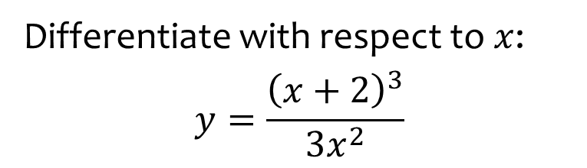
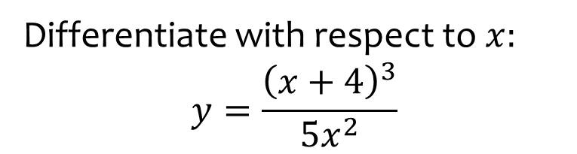
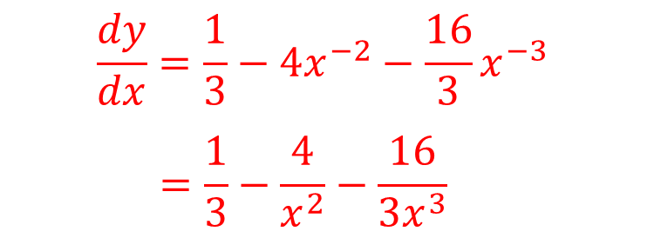
Worked example
Your turn
Differentiate with respect to $x:$
$$y=\frac{{\left(x+4\right)}^{3}}{5x^{2}}$$
Differentiate with respect to $x$:
$$y=\frac{{\left(x+2\right)}^{3}}{3x^{2}}$$
$$\frac{dy}{dx}=\frac{1}{3}−4x^{−2}−\frac{16}{3}x^{−3}$$
$$=\frac{1}{3}−\frac{4}{x^{2}}−\frac{16}{3x^{3}}$$

Slide 8
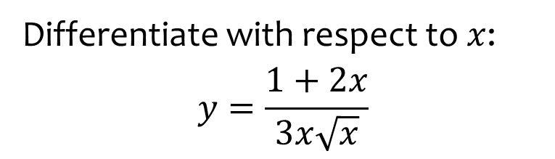
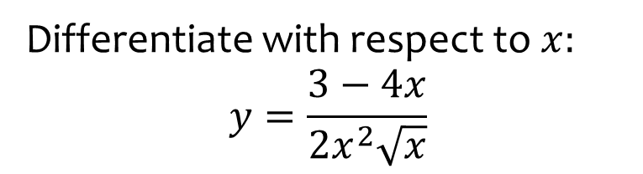

Worked example
Your turn
Differentiate with respect to $x:$
$$y=\frac{3−4x}{2x^{2}\sqrt{x}}$$
Differentiate with respect to $x$:
$$y=\frac{1+2x}{3x\sqrt{x}}$$
$$\frac{dy}{dx}=−\frac{1}{2}x^{−\frac{5}{2}}−\frac{1}{3}x^{−\frac{3}{2}}$$

