Slide 1
12.4) Differentiating quadratics

Slide 2
Worked example
Your turn
Find the gradient of the curve:
$y=x^{2}+3x+2$ at $(4, 30)$
$y=2x^{3}−x+5$ at $(−1, 4)$
Find the gradient of the curve:
$y=3x^{2}−2x+1$ at $(−2, 17)$
$$−14$$

Slide 3
Worked example
Your turn
Find the coordinates of the point(s) where the gradient is $4$:
$$y=x^{2}−8x+3$$
$$y=5x^{2}−x+7$$
Find the coordinates of the point(s) where the gradient is $3$:
$$y=3x^{2}−9x+7$$
$$(2, 1)$$

Slide 4
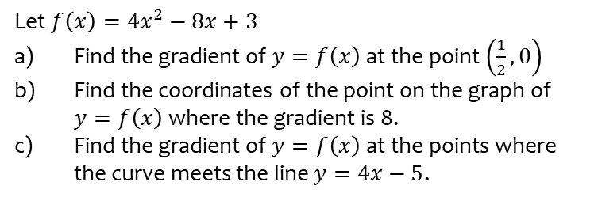
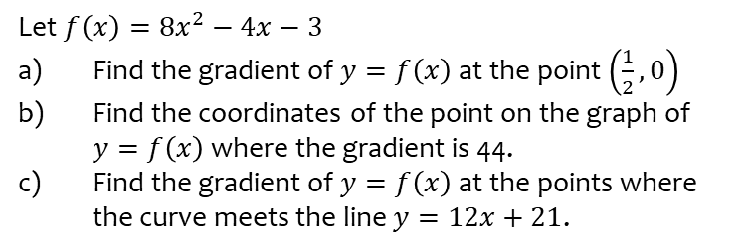
Worked example
Your turn
Let $f\left(x\right)=8x^{2}−4x−3$
Find the gradient of $y=f\left(x\right)$ at the point $\left(\frac{1}{2},0\right)$
Find the coordinates of the point on the graph of $y=f\left(x\right)$ where the gradient is 44.
Find the gradient of $y=f\left(x\right)$ at the points where the curve meets the line $y=12x+21$.
Let $f\left(x\right)=4x^{2}−8x+3$
Find the gradient of $y=f\left(x\right)$ at the point $\left(\frac{1}{2},0\right)$
Find the coordinates of the point on the graph of $y=f\left(x\right)$ where the gradient is 8.
Find the gradient of $y=f\left(x\right)$ at the points where the curve meets the line $y=4x−5$.
a) $−4$
b) $(2, 3)$
c) At $(1, −1)$ gradient $=0$
At $(2, 3)$ gradient $=8$

