Slide 1
12.4) Application to mechanics

Slide 2



Worked example
Your turn
Convert these vectors to scalar form:
A force of $\left(\begin{matrix}1 \\ −3 \\ 4\end{matrix}\right) N$
An acceleration of $\left(\begin{matrix}0 \\ 0 \\ 2\end{matrix}\right) ms^{−2}$
A displacement of $\left(\begin{matrix}−6 \\ 8 \\ −24\end{matrix}\right) m$
A velocity of $\left(\begin{matrix}8 \\ −6 \\ 0\end{matrix}\right) ms^{−1}$
Convert these vectors to scalar form:
A force of $\left(\begin{matrix}3 \\ 4 \\ −1\end{matrix}\right) N$
An acceleration of $\left(\begin{matrix}1 \\ 0 \\ 1\end{matrix}\right) ms^{−2}$
A displacement of $\left(\begin{matrix}12 \\ −3 \\ 4\end{matrix}\right) m$
A velocity of $\left(\begin{matrix}0 \\ 4 \\ −3\end{matrix}\right) ms^{−1}$
A force of $5.10 N$ (3 sf)
An acceleration of $1.41 ms^{−2}$ (3 sf)
A distance of $13 m$
A speed of $5 ms^{−1}$

Slide 3
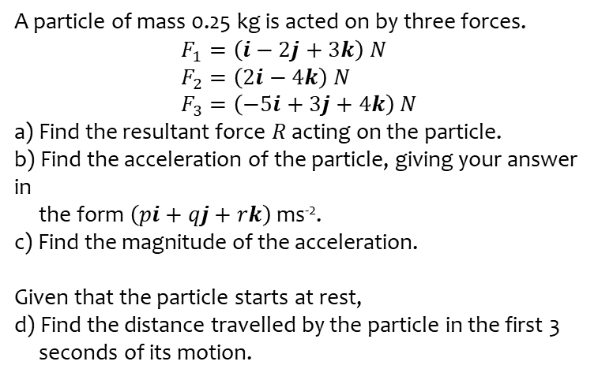
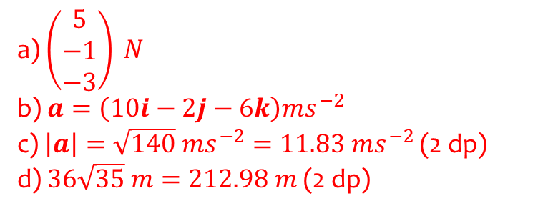
Worked example
Your turn
A particle of mass 0.25 kg is acted on by three forces.
$$F_{1}=\left(i−2j+3k\right) N \\ F_{2}=\left(2i−4k\right) N \\ F_{3}=\left(−5i+3j+4k\right) N$$
a) Find the resultant force $R$ acting on the particle.
b) Find the acceleration of the particle, giving your answer in
the form $\left(pi+qj+rk\right)$ ms⁻².
c) Find the magnitude of the acceleration.
Given that the particle starts at rest,
d) Find the distance travelled by the particle in the first 3
seconds of its motion.
A particle of mass 0.5 kg is acted on by three forces.
$$F_{1}=\left(2i−j+2k\right) N \\ F_{2}=\left(−i+3j−3k\right) N \\ F_{3}=\left(4i−3j−2k\right) N$$
a) Find the resultant force $R$ acting on the particle.
b) Find the acceleration of the particle, giving your answer in
the form $\left(pi+qj+rk\right)$ ms⁻².
c) Find the magnitude of the acceleration.
Given that the particle starts at rest,
d) Find the distance travelled by the particle in the first 6
seconds of its motion.
a) $\left(\begin{matrix}5 \\ −1 \\ −3\end{matrix}\right) N$
b) $a=\left(10i−2j−6k\right)ms^{−2}$
c) $\left|a\right|=\sqrt{140} ms^{−2}=11.83 ms^{−2}$ (2 dp)
d) $36\sqrt{35} m=212.98 m$ (2 dp)

