Slide 1
12.2) Vectors in 3D

Slide 2
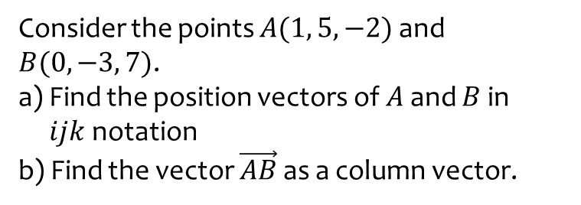
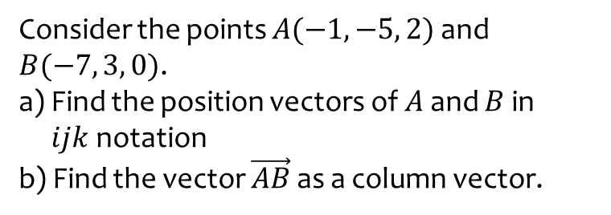
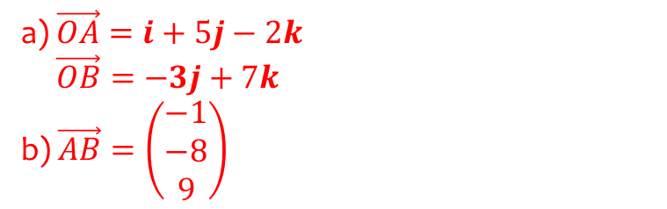
Worked example
Your turn
Consider the points $A(−1, −5, 2)$ and $B(−7, 3, 0)$.
a) Find the position vectors of $A$ and $B$ in
$ijk$notation
b) Find the vector $\vec{AB}$ as a column vector.
Consider the points $A(1, 5, −2)$ and $B(0, −3, 7)$.
a) Find the position vectors of $A$ and $B$ in
$ijk$notation
b) Find the vector $\vec{AB}$ as a column vector.
a) $\vec{OA}=i+5j−2k$
$\vec{OB}=−3j+7k$
b) $\vec{AB}=\left(\begin{matrix}−1 \\ −8 \\ 9\end{matrix}\right)$

Slide 3
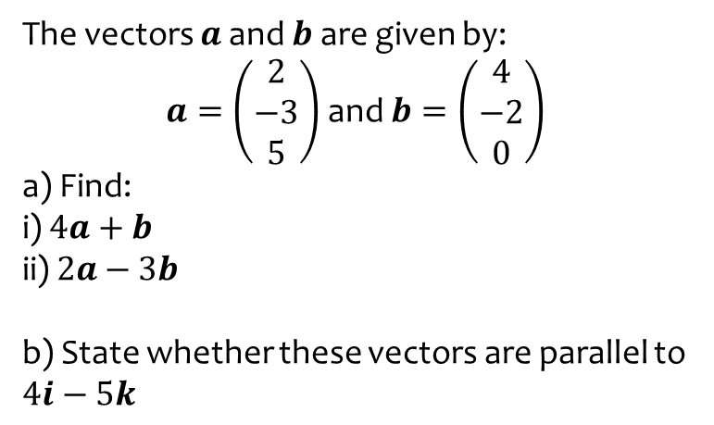
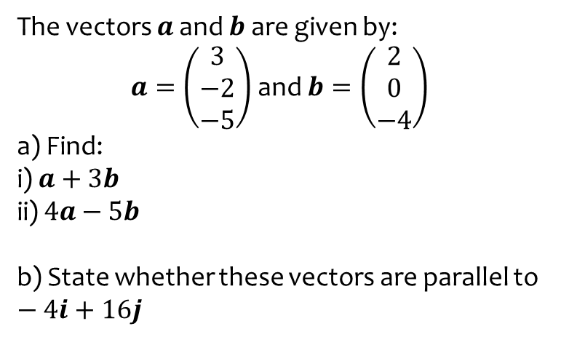
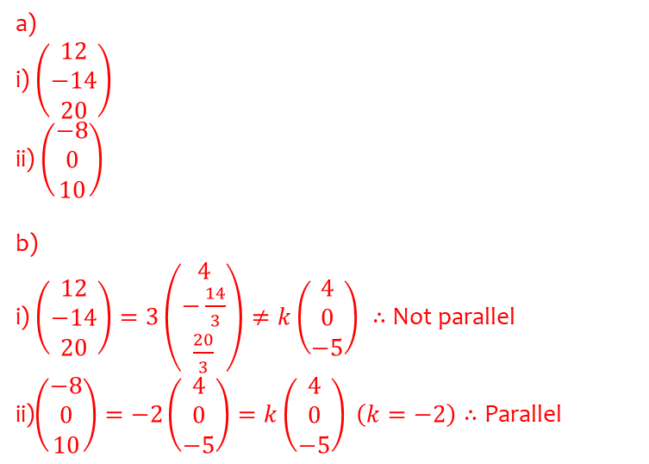
Worked example
Your turn
The vectors $a$ and $b$ are given by:
$a=\left(\begin{matrix}3 \\ −2 \\ −5\end{matrix}\right)$ and $b=\left(\begin{matrix}2 \\ 0 \\ −4\end{matrix}\right)$
a) Find:
i) $a+3b$
ii) $4a−5b$
b) State whether these vectors are parallel to $−4i+16j$
The vectors $a$ and $b$ are given by:
$a=\left(\begin{matrix}2 \\ −3 \\ 5\end{matrix}\right)$ and $b=\left(\begin{matrix}4 \\ −2 \\ 0\end{matrix}\right)$
a) Find:
i) $4a+b$
ii) $2a−3b$
b) State whether these vectors are parallel to $4i−5k$
a)
i) $\left(\begin{matrix}12 \\ −14 \\ 20\end{matrix}\right)$
ii) $\left(\begin{matrix}−8 \\ 0 \\ 10\end{matrix}\right)$
b)
i) $\left(\begin{matrix}12 \\ −14 \\ 20\end{matrix}\right)=3\left(\begin{matrix}4 \\ −\frac{14}{3} \\ \frac{20}{3}\end{matrix}\right)≠k\left(\begin{matrix}4 \\ 0 \\ −5\end{matrix}\right) ∴$ Not parallel
ii)$\left(\begin{matrix}−8 \\ 0 \\ 10\end{matrix}\right)=−2\left(\begin{matrix}4 \\ 0 \\ −5\end{matrix}\right)=k\left(\begin{matrix}4 \\ 0 \\ −5\end{matrix}\right) \left(k=−2\right)∴$ Parallel

Slide 4


Worked example
Your turn
Find the magnitude of the vector $\left(\begin{matrix}6 \\ 8 \\ 24\end{matrix}\right)$
Find the magnitude of the vector $\left(\begin{matrix}3 \\ 4 \\ 12\end{matrix}\right)$
$$13$$

Slide 5
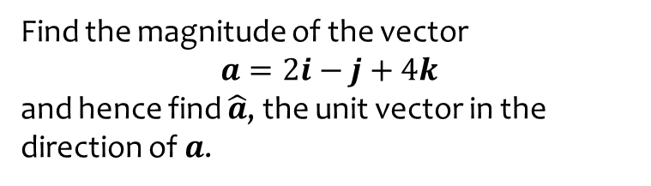
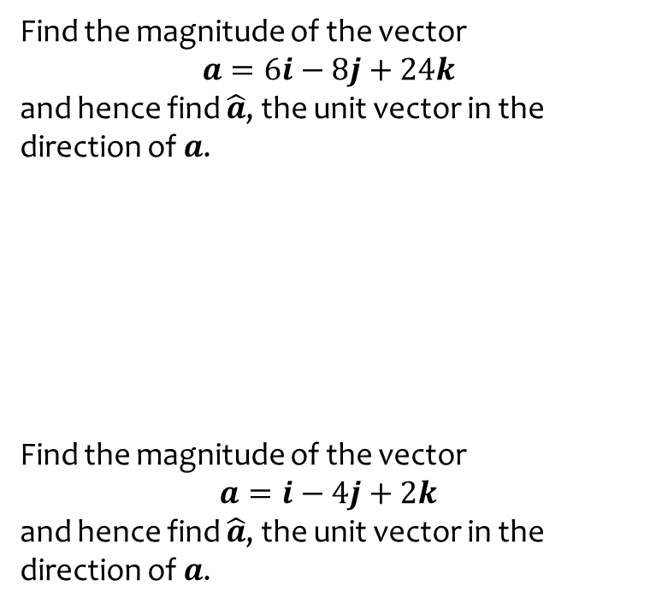

Worked example
Your turn
Find the magnitude of the vector
$$a=6i−8j+24k$$
and hence find $\hat{a}$, the unit vector in the direction of $a$.
Find the magnitude of the vector
$$a=i−4j+2k$$
and hence find $\hat{a}$, the unit vector in the direction of $a$.
Find the magnitude of the vector
$$a=2i−j+4k$$
and hence find $\hat{a}$, the unit vector in the direction of $a$.
$$\hat{a}=\frac{1}{\sqrt{21}}\left(2i−j+4k\right)$$

Slide 6
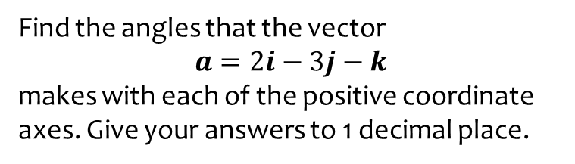
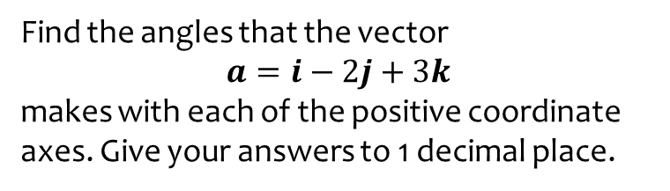

Worked example
Your turn
Find the angles that the vector
$$a=i−2j+3k$$
makes with each of the positive coordinate axes. Give your answers to 1 decimal place.
Find the angles that the vector
$$a=2i−3j−k$$
makes with each of the positive coordinate axes. Give your answers to 1 decimal place.
$$θ_{x}=57.7°$$
$$θ_{y}=143.3° \\ θ_{z}=105.5°$$

Slide 7
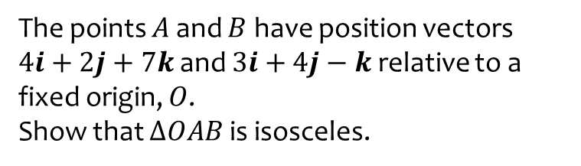
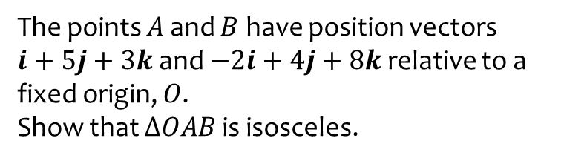
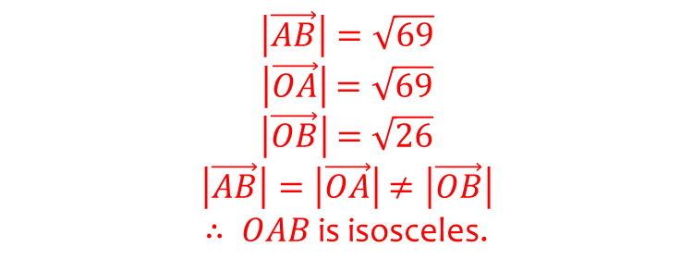
Worked example
Your turn
The points $A$ and $B$ have position vectors
$i+5j+3k$ and $−2i+4j+8k$ relative to a fixed origin, $O$.
Show that $ΔOAB$ is isosceles.
The points $A$ and $B$ have position vectors
$4i+2j+7k$ and $3i+4j−k$ relative to a fixed origin, $O$.
Show that $ΔOAB$ is isosceles.
$$\left|\vec{AB}\right|=\sqrt{69}$$
$\left|\vec{OA}\right|$ $=\sqrt{69}$
$\left|\vec{OB}\right|$ $=\sqrt{26}$
$\left|\vec{AB}\right|=\left|\vec{OA}\right|$ $≠\left|\vec{OB}\right|$
$∴ OAB$ is isosceles.

Slide 8
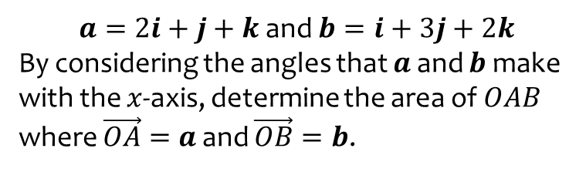
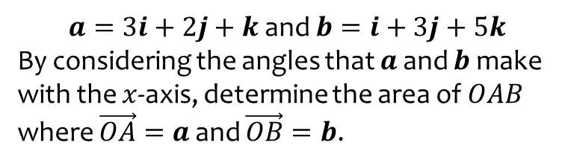

Worked example
Your turn
$a=3i+2j+k$ and $b=i+3j+5k$
By considering the angles that $a$ and $b$ make with the $x$-axis, determine the area of $OAB$ where $\vec{OA}=a$ and $\vec{OB}=b$.
$a=2i+j+k$ and $b=i+3j+2k$
By considering the angles that $a$ and $b$ make with the $x$-axis, determine the area of $OAB$ where $\vec{OA}=a$ and $\vec{OB}=b$.
$2.90$ (3 sf)

Slide 9
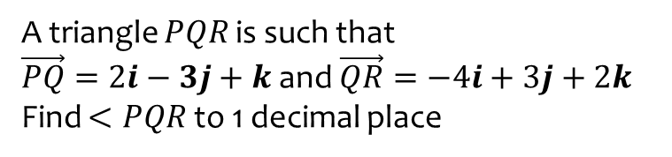
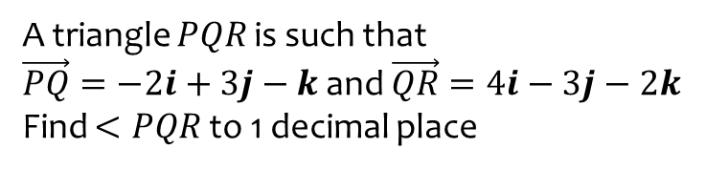
Worked example
Your turn
A triangle $PQR$ is such that
$\vec{PQ}=−2i+3j−k$ and $\vec{QR}=4i−3j−2k$
Find $<PQR$ to 1 decimal place
A triangle $PQR$ is such that
$\vec{PQ}=2i−3j+k$ and $\vec{QR}=−4i+3j+2k$
Find $<PQR$ to 1 decimal place
$$41.9°$$

