Slide 1
12.2) Finding the derivative

Slide 2
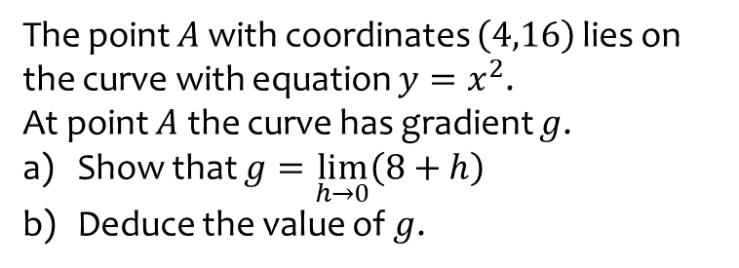
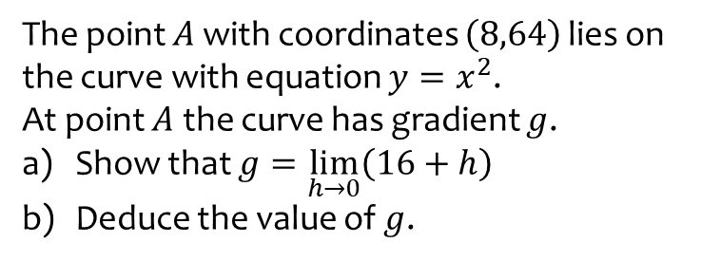
Worked example
Your turn
The point $A$ with coordinates $\left(8,64\right)$ lies on the curve with equation $y=x^{2}$.
At point $A$ the curve has gradient $g$.
Show that $g=\lim_{h→0}\left(16+h\right)$
Deduce the value of $g$.
The point $A$ with coordinates $\left(4,16\right)$ lies on the curve with equation $y=x^{2}$.
At point $A$ the curve has gradient $g$.
Show that $g=\lim_{h→0}\left(8+h\right)$
Deduce the value of $g$.
Shown

Slide 3
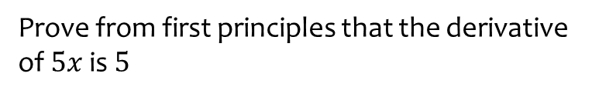
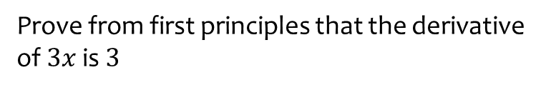
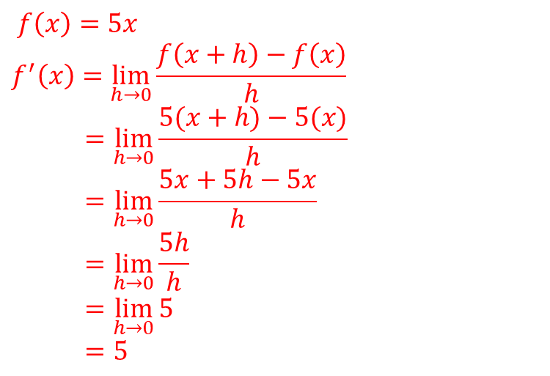
Worked example
Your turn
Prove from first principles that the derivative of $3x$ is $3$
Prove from first principles that the derivative of $5x$ is $5$
$$f\left(x\right)=5x$$
$$f^{′}\left(x\right)=\lim_{h→0}{\frac{f\left(x+h\right)−f\left(x\right)}{h}}$$
$$=\lim_{h→0}{\frac{5(x+h)−5(x)}{h}}$$
$$=\lim_{h→0}{\frac{5x+5h−5x}{h}}$$
$$=\lim_{h→0}{\frac{5h}{h}}$$
$$=\lim_{h→0}{5}$$
$$=5$$

Slide 4
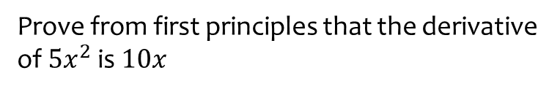
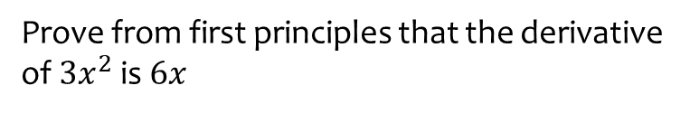
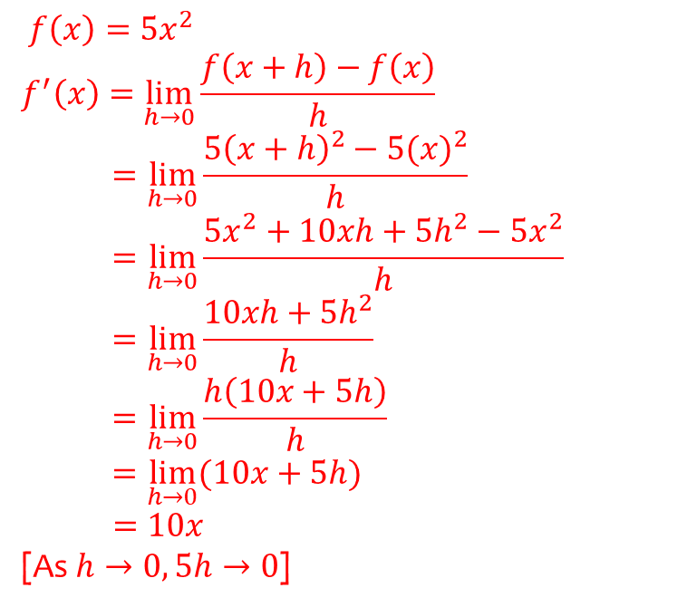
Worked example
Your turn
Prove from first principles that the derivative of $3x^{2}$ is $6x$
Prove from first principles that the derivative of $5x^{2}$ is $10x$
$$f\left(x\right)=5x^{2}$$
$$f^{′}\left(x\right)=\lim_{h→0}{\frac{f\left(x+h\right)−f\left(x\right)}{h}}$$
$$=\lim_{h→0}{\frac{{5\left(x+h\right)}^{2}−5{(x)}^{2}}{h}}$$
$$=\lim_{h→0}{\frac{5x^{2}+10xh+5h^{2}−5x^{2}}{h}}$$
$$=\lim_{h→0}{\frac{10xh+5h^{2}}{h}}$$
$$=\lim_{h→0}{\frac{h\left(10x+5h\right)}{h}}$$
$$=\lim_{h→0}{(10x+5h})$$
$=10x$
[As $h→0, 5h→0$]

Slide 5
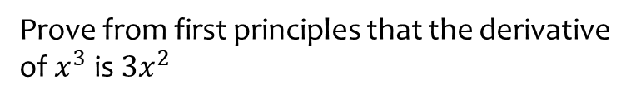
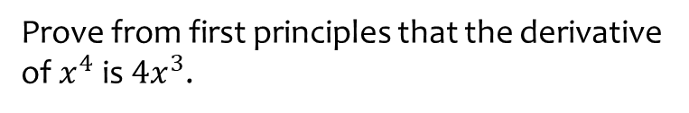
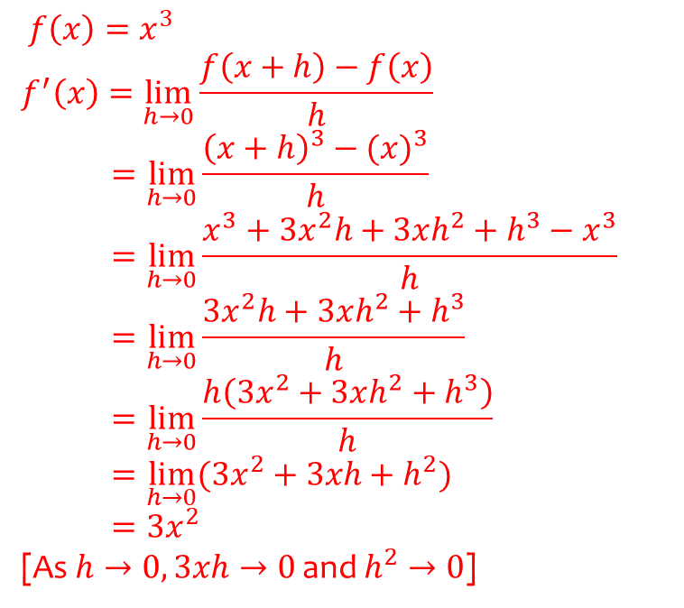
Worked example
Your turn
Prove from first principles that the derivative of $x^{4}$ is $4x^{3}$.
Prove from first principles that the derivative of $x^{3}$ is $3x^{2}$
$$f\left(x\right)=x^{3}$$
$$f^{′}\left(x\right)=\lim_{h→0}{\frac{f\left(x+h\right)−f\left(x\right)}{h}}$$
$$=\lim_{h→0}{\frac{{\left(x+h\right)}^{3}−{(x)}^{3}}{h}}$$
$$=\lim_{h→0}{\frac{x^{3}+3x^{2}h+3xh^{2}+h^{3}−x^{3}}{h}}$$
$$=\lim_{h→0}{\frac{3x^{2}h+3xh^{2}+h^{3}}{h}}$$
$$=\lim_{h→0}{\frac{h\left(3x^{2}+3xh^{2}+h^{3}\right)}{h}}$$
$$=\lim_{h→0}{(3x^{2}}+3xh+h^{2})$$
$$=3x^{2}$$
[As $h→0, 3xh→0$ and $h^{2}→0$]

