Slide 1
11.12) Integration as the limit of a sum

Slide 2
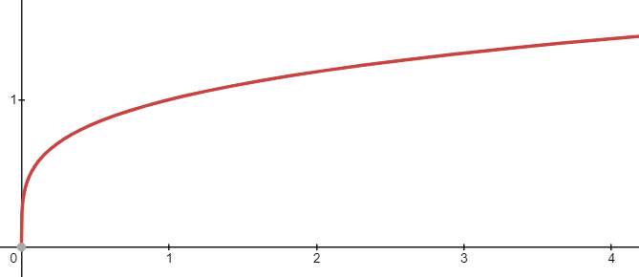
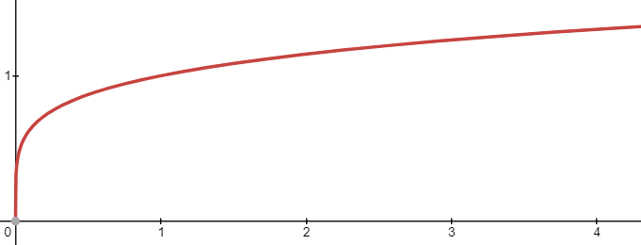
Worked example
Your turn
The diagram shows a sketch of the curve with equation $y=\sqrt[4]{x},$ $x>0$.
The area under the curve may be thought of as a series of thin strips of height $y$ and width $δx$.
Calculate to 4 significant figures:
$$\lim_{δx→0}{\sum_{2}^{3}{\sqrt[4]{x}}}δx$$
The diagram shows a sketch of the curve with equation $y=\sqrt[5]{x},$ $x>0$.
The area under the curve may be thought of as a series of thin strips of height $y$ and width $δx$.
Calculate to 4 significant figures:
$$\lim_{δx→0}{\sum_{3}^{4}{\sqrt[5]{x}}}δx$$
$$1.284$$

Slide 3
Worked example
Your turn
Calculate to four significant figures:
$$\lim_{δx→0}{\sum_{5}^{6}{\cos{x}}}δx$$
Calculate to four significant figures:
$$\lim_{δx→0}{\sum_{1}^{2}{\sin{x}}}δx$$
$$0.9564$$

