Slide 1
11.11) Modelling with differential equations

Slide 2
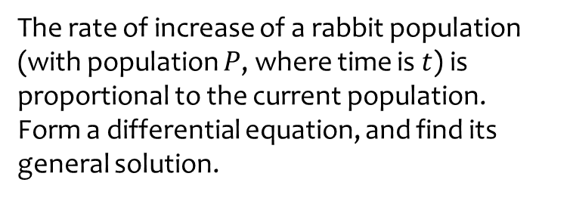
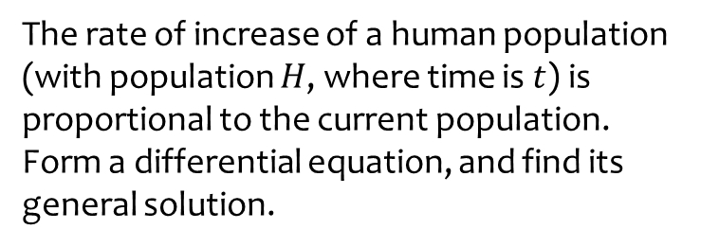
Worked example
Your turn
The rate of increase of a human population (with population $H$, where time is $t$) is proportional to the current population.
Form a differential equation, and find its general solution.
The rate of increase of a rabbit population (with population $P$, where time is $t$) is proportional to the current population.
Form a differential equation, and find its general solution.
$$P=Ae^{kt}$$

Slide 3
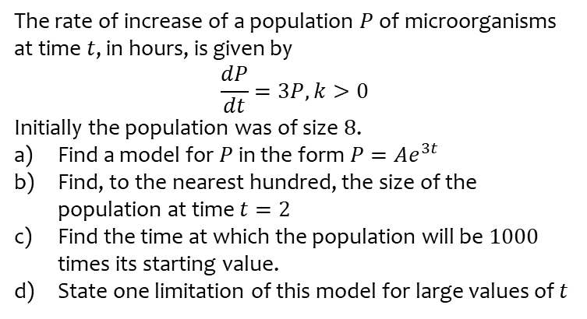
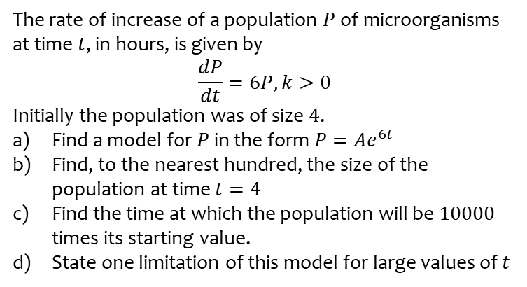
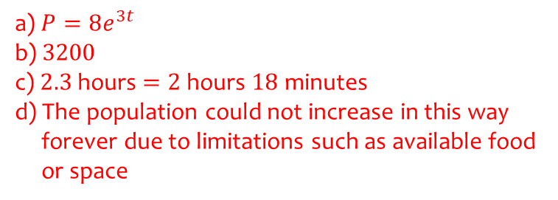
Worked example
Your turn
The rate of increase of a population $P$ of microorganisms at time $t$, in hours, is given by
$$\frac{dP}{dt}=6P, k>0$$
Initially the population was of size $4$.
Find a model for $P$ in the form $P=Ae^{6t}$
Find, to the nearest hundred, the size of the population at time $t=4$
Find the time at which the population will be $10000$ times its starting value.
State one limitation of this model for large values of $t$
The rate of increase of a population $P$ of microorganisms at time $t$, in hours, is given by
$$\frac{dP}{dt}=3P, k>0$$
Initially the population was of size $8$.
Find a model for $P$ in the form $P=Ae^{3t}$
Find, to the nearest hundred, the size of the population at time $t=2$
Find the time at which the population will be $1000$ times its starting value.
State one limitation of this model for large values of $t$
a) $P=8e^{3t}$
b) $3200$
c) $2.3$ hours $=2$ hours $18$ minutes
d) The population could not increase in this way
forever due to limitations such as available food
or space

Slide 4
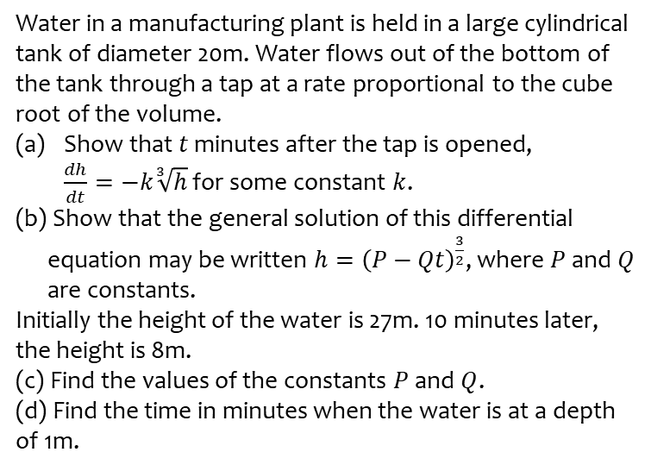
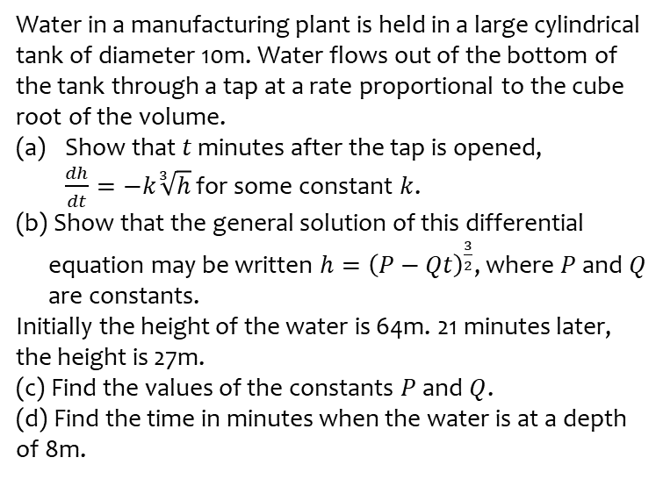
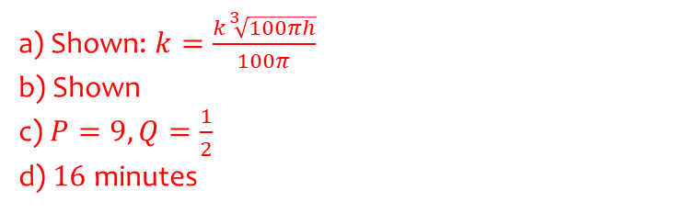
Worked example
Your turn
Water in a manufacturing plant is held in a large cylindrical tank of diameter 10m. Water flows out of the bottom of the tank through a tap at a rate proportional to the cube root of the volume.
Show that $t$ minutes after the tap is opened,
$\frac{dh}{dt}=−k\sqrt[3]{h}$ for some constant $k$.
(b) Show that the general solution of this differential
equation may be written $h={\left(P−Qt\right)}^{\frac{3}{2}}$, where $P$ and $Q$
are constants.
Initially the height of the water is 64m. 21 minutes later, the height is 27m.
(c) Find the values of the constants $P$ and $Q$.
(d) Find the time in minutes when the water is at a depth of 8m.
Water in a manufacturing plant is held in a large cylindrical tank of diameter 20m. Water flows out of the bottom of the tank through a tap at a rate proportional to the cube root of the volume.
Show that $t$ minutes after the tap is opened,
$\frac{dh}{dt}=−k\sqrt[3]{h}$ for some constant $k$.
(b) Show that the general solution of this differential
equation may be written $h={\left(P−Qt\right)}^{\frac{3}{2}}$, where $P$ and $Q$
are constants.
Initially the height of the water is 27m. 10 minutes later, the height is 8m.
(c) Find the values of the constants $P$ and $Q$.
(d) Find the time in minutes when the water is at a depth of 1m.
a) Shown: $k=\frac{k\sqrt[3]{100πh}}{100π}$
b) Shown
c) $P=9, Q=\frac{1}{2}$
d) $16$ minutes

Slide 5
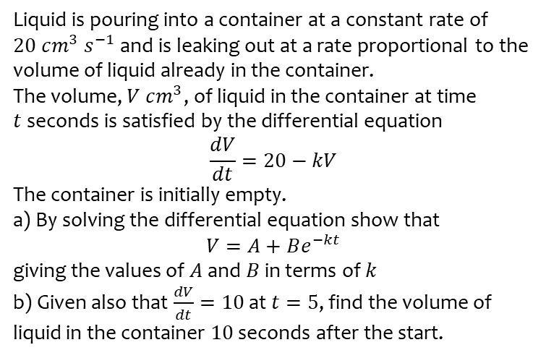
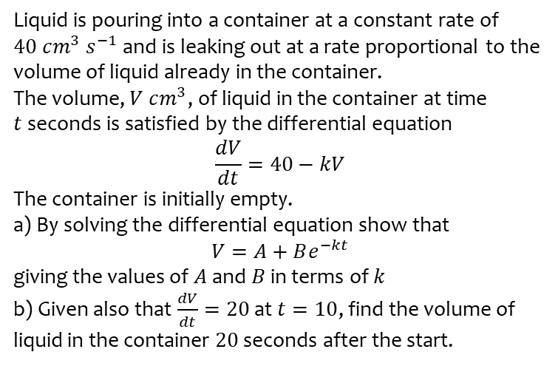
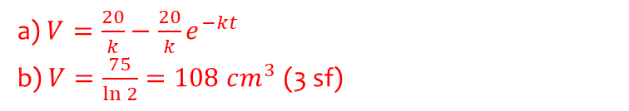
Worked example
Your turn
Liquid is pouring into a container at a constant rate of $40 cm^{3} s^{−1}$ and is leaking out at a rate proportional to the volume of liquid already in the container.
The volume, $V cm^{3}$, of liquid in the container at time $t$seconds is satisfied by the differential equation
$$\frac{dV}{dt}=40−kV$$
The container is initially empty.
a) By solving the differential equation show that
$$V=A+Be^{−kt}$$
giving the values of $A$ and $B$ in terms of $k$
b) Given also that $\frac{dV}{dt}=20$ at $t=10$, find the volume of liquid in the container $20$ seconds after the start.
Liquid is pouring into a container at a constant rate of $20 cm^{3} s^{−1}$ and is leaking out at a rate proportional to the volume of liquid already in the container.
The volume, $V cm^{3}$, of liquid in the container at time $t$seconds is satisfied by the differential equation
$$\frac{dV}{dt}=20−kV$$
The container is initially empty.
a) By solving the differential equation show that
$$V=A+Be^{−kt}$$
giving the values of $A$ and $B$ in terms of $k$
b) Given also that $\frac{dV}{dt}=10$ at $t=5$, find the volume of liquid in the container $10$ seconds after the start.
a) $V=\frac{20}{k}−\frac{20}{k}e^{−kt}$
b) $V=\frac{75}{\ln{2}}=108 cm^{3}$ (3 sf)

Slide 6
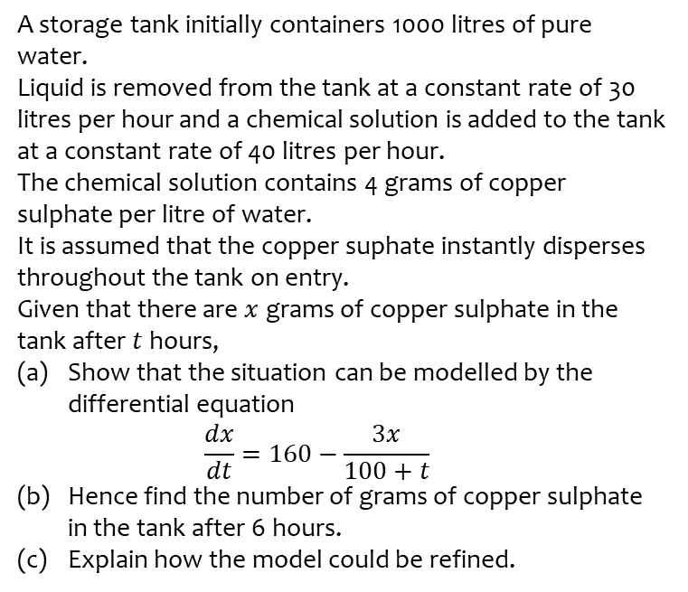
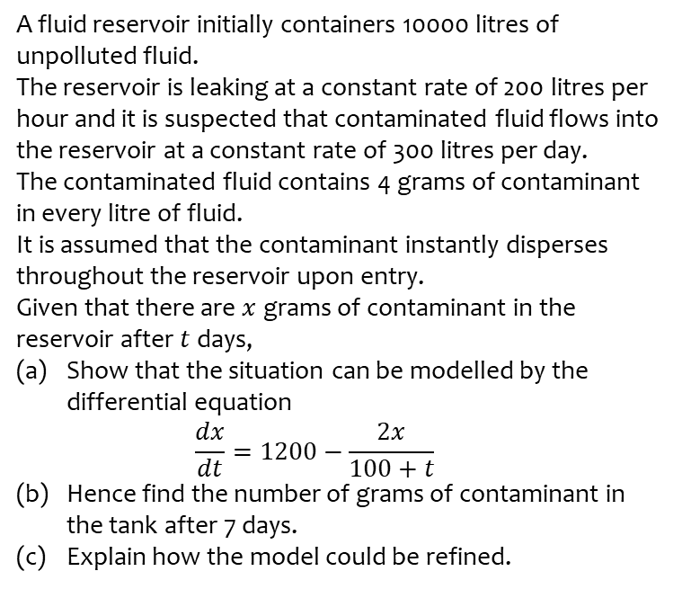
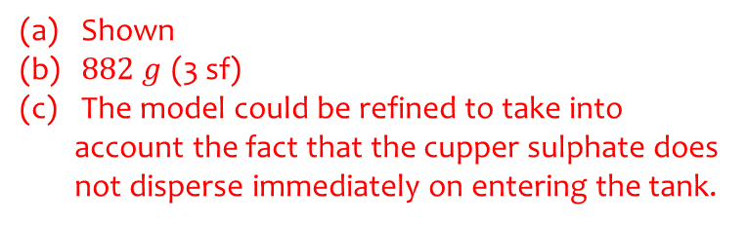
Worked example
Your turn
A fluid reservoir initially containers 10000 litres of unpolluted fluid.
The reservoir is leaking at a constant rate of 200 litres per hour and it is suspected that contaminated fluid flows into the reservoir at a constant rate of 300 litres per day.
The contaminated fluid contains 4 grams of contaminant in every litre of fluid.
It is assumed that the contaminant instantly disperses throughout the reservoir upon entry.
Given that there are $x$ grams of contaminant in the reservoir after $t$ days,
Show that the situation can be modelled by the differential equation
$\frac{dx}{dt}=1200−\frac{2x}{100+t}$
Hence find the number of grams of contaminant in the tank after 7 days.
Explain how the model could be refined.
A storage tank initially containers 1000 litres of pure water.
Liquid is removed from the tank at a constant rate of 30 litres per hour and a chemical solution is added to the tank at a constant rate of 40 litres per hour.
The chemical solution contains 4 grams of copper sulphate per litre of water.
It is assumed that the copper suphate instantly disperses throughout the tank on entry.
Given that there are $x$ grams of copper sulphate in the tank after $t$ hours,
Show that the situation can be modelled by the differential equation
$\frac{dx}{dt}=160−\frac{3x}{100+t}$
Hence find the number of grams of copper sulphate in the tank after 6 hours.
Explain how the model could be refined.
Shown
$882 g$ (3 sf)
The model could be refined to take into account the fact that the cupper sulphate does not disperse immediately on entering the tank.

