Slide 1
11.9) The trapezium rule

Slide 2
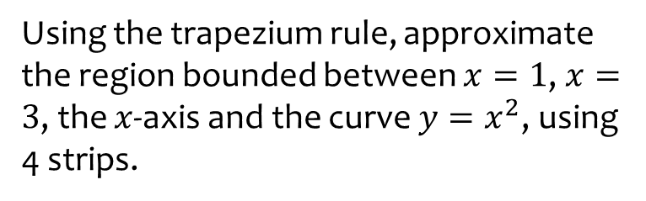
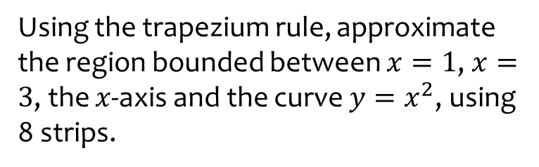
Worked example
Your turn
Using the trapezium rule, approximate the region bounded between $x=1$, $x=3$, the $x$-axis and the curve $y=x^{2}$, using 8 strips.
Using the trapezium rule, approximate the region bounded between $x=1$, $x=3$, the $x$-axis and the curve $y=x^{2}$, using 4 strips.
$$8.75$$

Slide 3
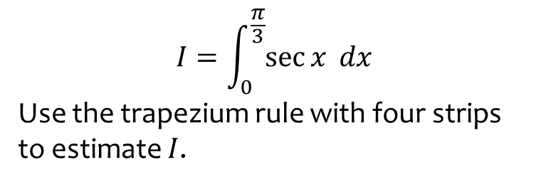
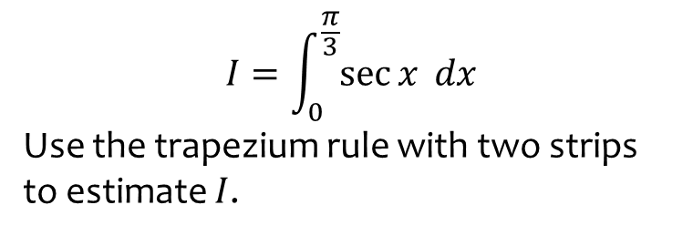

Worked example
Your turn
$$I=\int_{0}^{\frac{π}{3}}{\sec{x} dx}$$
Use the trapezium rule with two strips to estimate $I$.
$$I=\int_{0}^{\frac{π}{3}}{\sec{x} dx}$$
Use the trapezium rule with four strips to estimate $I$.
$1.34$(2 dp)

Slide 4
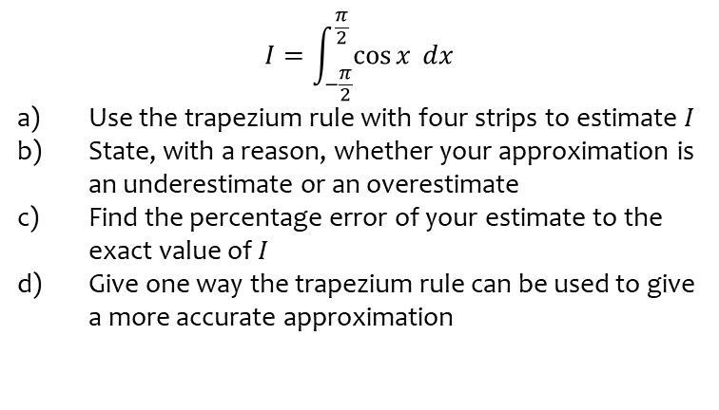
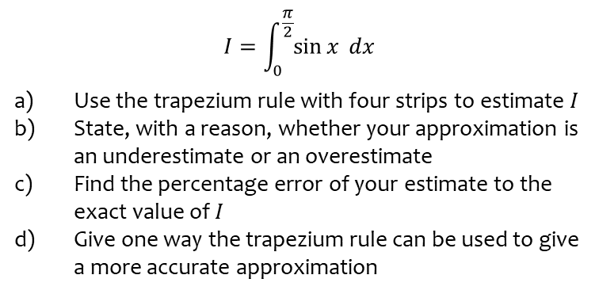
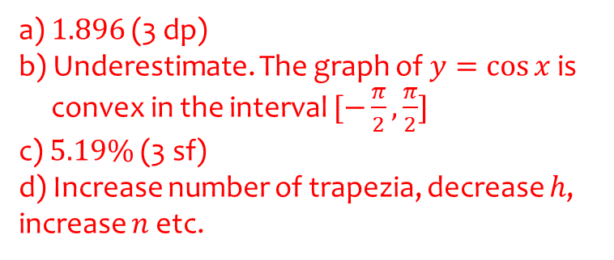
Worked example
Your turn
$$I=\int_{0}^{\frac{π}{2}}{\sin{x} dx}$$
Use the trapezium rule with four strips to estimate $I$
State, with a reason, whether your approximation is an underestimate or an overestimate
Find the percentage error of your estimate to the exact value of $I$
Give one way the trapezium rule can be used to give a more accurate approximation
$$I=\int_{−\frac{π}{2}}^{\frac{π}{2}}{\cos{x} dx}$$
Use the trapezium rule with four strips to estimate $I$
State, with a reason, whether your approximation is an underestimate or an overestimate
Find the percentage error of your estimate to the exact value of $I$
Give one way the trapezium rule can be used to give a more accurate approximation
a) $1.896$(3 dp)
b) Underestimate. The graph of $y=\cos{x}$ is
convex in the interval $[−\frac{π}{2},\frac{π}{2}]$
c) $5.19\%$ (3 sf)
d) Increase number of trapezia, decrease $h$, increase $n$ etc.

