Slide 1
11.8) Finding areas

Slide 2
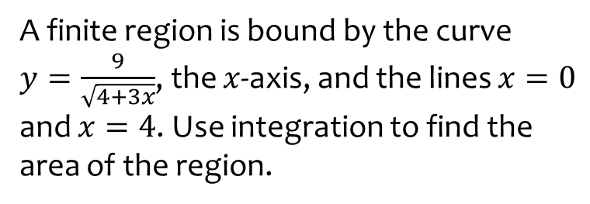
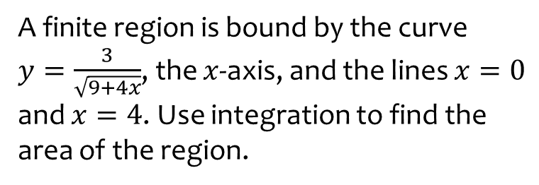
Worked example
Your turn
A finite region is bound by the curve
$y=\frac{3}{\sqrt{9+4x}}$, the $x$-axis, and the lines $x=0$ and $x=4$. Use integration to find the area of the region.
A finite region is bound by the curve
$y=\frac{9}{\sqrt{4+3x}}$, the $x$-axis, and the lines $x=0$ and $x=4$. Use integration to find the area of the region.
$$12$$

Slide 3
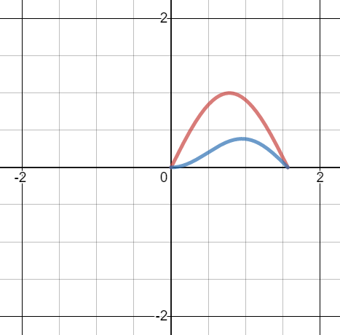
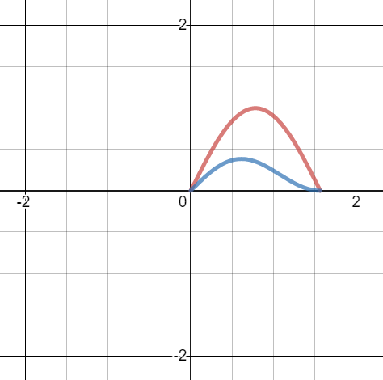
Worked example
Your turn
A finite region is bound between the curves $y=\sin{2x}$ and $y=\cos{x}\sin^{2}{x}$ where $0≤x≤\frac{π}{2}$. Use integration to find the area of the region.
A finite region is bound between the curves $y=\sin{2x}$ and $y=\sin{x}\cos^{2}{x}$ where $0≤x≤\frac{π}{2}$. Use integration to find the area of the region.
$$\frac{2}{3}$$
Graphs used with permission from DESMOS: https://www.desmos.com/

