Slide 1
11.6) Modelling with vectors

Slide 2
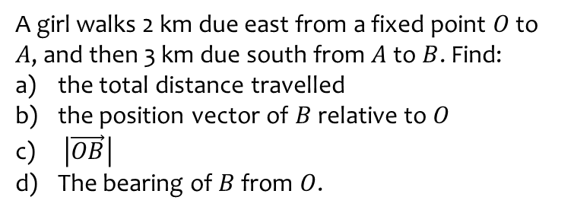
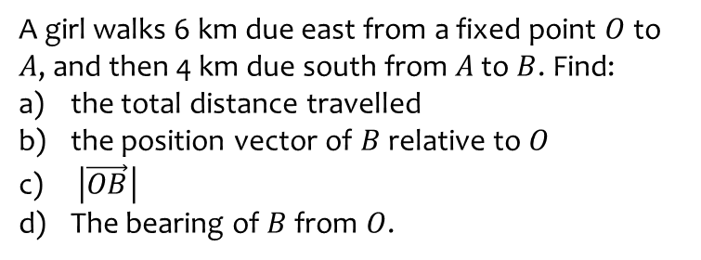
Worked example
Your turn
A girl walks 6 km due east from a fixed point $O$ to $A$, and then 4 km due south from $A$ to $B$. Find:
the total distance travelled
the position vector of $B$ relative to $O$
$\left|\vec{OB}\right|$
The bearing of $B$ from $O$.
A girl walks 2 km due east from a fixed point $O$ to $A$, and then 3 km due south from $A$ to $B$. Find:
the total distance travelled
the position vector of $B$ relative to $O$
$\left|\vec{OB}\right|$
The bearing of $B$ from $O$.
a) $5 km$
b) $\left(2i−3j\right) km$
c) $3.61 km$ (3 sf)
d) $146°$ (3 sf)

Slide 3
Worked example
Your turn
In an orienteering exercise, a cadet leaves the starting point $O$ and walks 30 km on a bearing of $150°$ to reach $A$, the first checkpoint.
From $A$ she walks 18 km on a bearing of $210°$ to the second checkpoint, at $B$.
From $B$ she returns directly to $O$.
Find:
the position vector of $A$ relative to $O$
$\left|\vec{OB}\right|$
the bearing of $B$ from $O$
the position vector of $B$ relative $O$.
In an orienteering exercise, a cadet leaves the starting point $O$ and walks 15 km on a bearing of $120°$ to reach $A$, the first checkpoint.
From $A$ he walks 9 km on a bearing of $240°$ to the second checkpoint, at $B$.
From $B$ he returns directly to $O$.
Find:
the position vector of $A$ relative to $O$
$\left|\vec{OB}\right|$
the bearing of $B$ from $O$
the position vector of $B$ relative $O$.
a) $\left(13.0i−7.5j\right) km$ (1 dp)
b) $13.1 km$ (3 sf)
c) $157°$ (3 sf)
d) $\left(5.2i−12.0j\right) km$

