Slide 1
11.5) Solving geometric problems

Slide 2
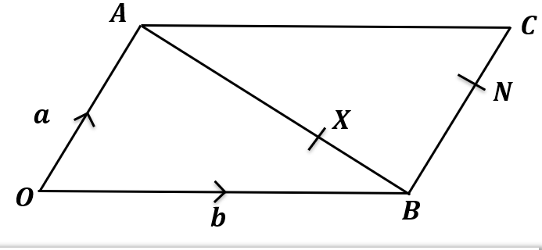
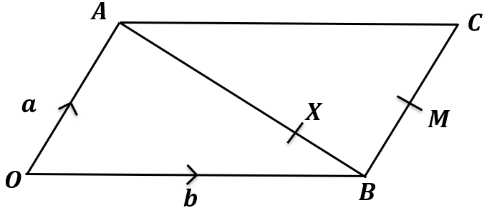
Worked example
Your turn
$OACB$ is a parallelogram.
$X$ is a point on $AB$ such that $AX:XB=2:1$. $N$ is the point such that $NC$ is half of $BN$.
Show that $\vec{XN}$ is parallel to $\vec{OC}$.
$OACB$ is a parallelogram.
$X$ is a point on $AB$ such that $AX:XB=3:1$. $M$ is the midpoint of $BC$.
Show that $\vec{XM}$ is parallel to $\vec{OC}$.
Shown

Slide 3
Worked example
Your turn
$\vec{AB}=2i−5j$ and $\vec{AC}=3i−7j$.
Determine $∠BAC$.
$\vec{AB}=3i−2j$ and $\vec{AC}=i−5j$.
Determine $∠BAC$.
$$45°$$

