Slide 1
11.4) Reverse chain rule

Slide 2

Worked example
Your turn
Find:
$$\int{x^{3}{\left(x^{4}−2\right)}^{5} dx}$$
$$\int{x^{2}{\left(x^{3}−5\right)}^{4} dx}$$
Find:
$$\int{x{\left(x^{2}+5\right)}^{3} dx}$$
$$\frac{1}{8}{\left(x^{2}+5\right)}^{4}+c$$

Slide 3
Worked example
Your turn
Find:
$$\int{\sin{x}\cos^{4}{x} dx}$$
$$\int{\sin^{3}{x}\cos{x}}dx$$
Find:
$$\int{\cos{x}\sin^{2}{x} dx}$$
$$\frac{1}{3}\sin^{3}{x}+c$$

Slide 4

Worked example
Your turn
Find:
$$\int{\frac{x^{3}}{x^{4}+1} dx}$$
$$\int{\frac{x^{2}}{4x^{3}−5} dx}$$
Find:
$$\int{\frac{x}{3x^{2}+2} dx}$$
$$\frac{1}{6}ln\left|3x^{2}+2\right|+c$$

Slide 5

Worked example
Your turn
Find:
$$\int{\frac{4x^{3}}{x^{4}+1} dx}$$
$$\int{\frac{12x^{2}}{4x^{3}−5} dx}$$
Find:
$$\int{\frac{6x}{3x^{2}+2} dx}$$
$$\ln\left|3x^{2}+2\right|+c$$

Slide 6

Worked example
Your turn
Find:
$$\int{\frac{x}{{\left(x^{2}−3\right)}^{5}}dx}$$
$$\int{\frac{x^{2}}{{\left(x^{3}−2\right)}^{4}}dx}$$
Find:
$$\int{\frac{x}{{\left(x^{2}+5\right)}^{3}}dx}$$
$$−\frac{1}{4}{\left(x^{2}+5\right)}^{−2}+c$$

Slide 7

Worked example
Your turn
Find:
$$\int{x^{3} e^{x^{4}+5} dx}$$
$$\int{x^{2} e^{x^{3}−4} dx}$$
Find:
$$\int{x e^{x^{2}+1} dx}$$
$$\frac{1}{2}e^{x^{2}+1}+c$$

Slide 8
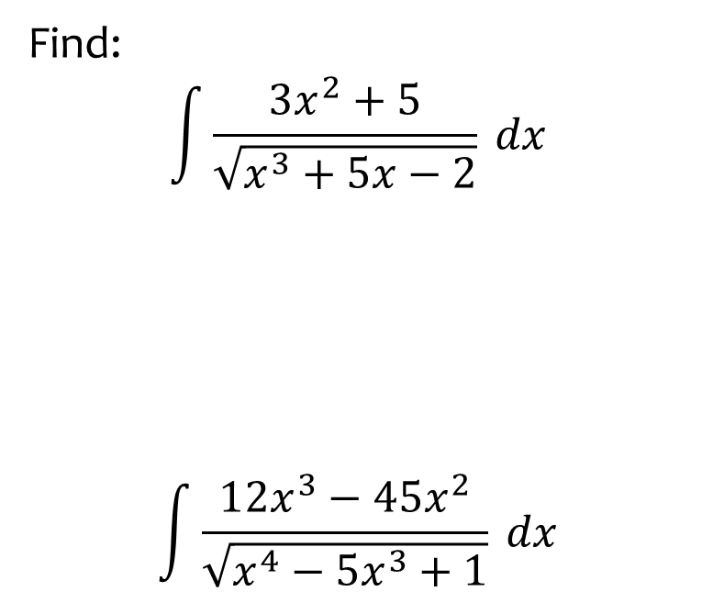
Worked example
Your turn
Find:
$$\int{\frac{3x^{2}+5}{\sqrt{x^{3}+5x−2}} dx}$$
$$\int{\frac{12x^{3}−45x^{2}}{\sqrt{x^{4}−5x^{3}+1}} dx}$$
Find:
$$\int{\frac{2x+1}{\sqrt{x^{2}+x−3}} dx}$$
$$2\sqrt{x^{2}+x−3}+c$$

Slide 9

Worked example
Your turn
Find:
$$\int{\frac{\sin{x}}{\cos{x}+5}dx}$$
$$\int{\frac{\sec^{2}{x}}{\tan{x}−3}dx}$$
Find:
$$\int{\frac{\cos{x}}{\sin{x}+2}dx}$$
$$\ln\left|\sin{x}+2\right|+c$$

Slide 10

Worked example
Your turn
Find:
$$\int{\sin{x} e^{\cos{x}}}dx$$
$$\int{\sec^{2}{x} e^{\tan{x}}}dx$$
Find:
$$\int{\cos{x} e^{\sin{x}}}dx$$
$$e^{\sin{x}}+c$$

Slide 11

Worked example
Your turn
Find:
$$\int{\sin{x}{\left(\cos{x}−1\right)}^{5} dx}$$
$$\int{\sec^{2}{x}{\left(\tan{x}+3\right)}^{6} dx}$$
Find:
$$\int{\cos{x}{\left(\sin{x}−5\right)}^{7} dx}$$
$$\frac{1}{8}{\left(\sin{x}−5\right)}^{8}+c$$

Slide 12

Worked example
Your turn
Find:
$$\int{\sec^{2}{x}\tan{x}} dx$$
$$\int{2\sec^{3}{x}\tan{x}} dx$$
Find:
$$\int{3\sec^{4}{x}\tan{x}} dx$$
$$\frac{3}{4}\sec^{4}{x}+c$$

Slide 13

Worked example
Your turn
Find:
$$\int{\frac{cosec^{2}x}{{\left(3−\cot{x}\right)}^{4}}dx}$$
$$\int{\frac{sec^{2}x}{{\left(3+\tan{x}\right)}^{2}}dx}$$
Find:
$$\int{\frac{cosec^{2}x}{{\left(2+\cot{x}\right)}^{3}}dx}$$
$$\frac{1}{2}{\left(2+\cot{x}\right)}^{−2}+c$$

Slide 14

Worked example
Your turn
Find:
$$\int{\frac{\sin{4x}}{\cos{4x}+2}dx}$$
$$\int{\frac{\sec^{2}{3x}}{\tan{3x}−5}dx}$$
Find:
$$\int{\frac{\cos{2x}}{\sin{2x}+3}dx}$$
$$\frac{1}{2}\ln\left|\sin{2x}+3\right|+c$$

Slide 15
Worked example
Your turn
Find:
$$\int{\tan{x}dx}$$
Find:
$$\int{\cot{x}dx}$$
$$\ln{|\sin{x}|}+c$$

