Slide 1
11.4) Position vectors

Slide 2
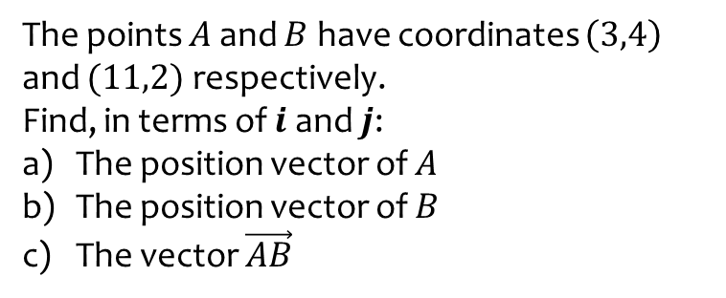
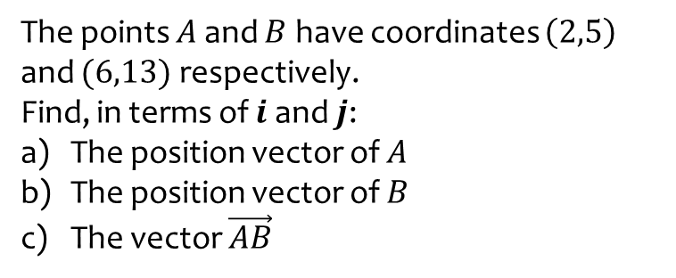
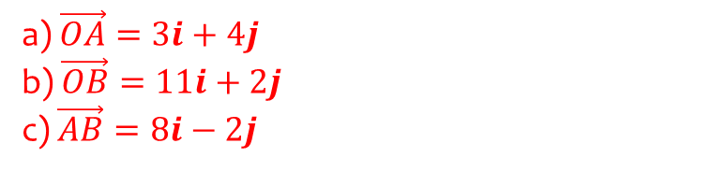
Worked example
Your turn
The points $A$ and $B$ have coordinates $\left(2,5\right)$ and $(6,13)$ respectively.
Find, in terms of $i$ and $j$:
The position vector of $A$
The position vector of $B$
The vector $\vec{AB}$
The points $A$ and $B$ have coordinates $\left(3,4\right)$ and $(11,2)$ respectively.
Find, in terms of $i$ and $j$:
The position vector of $A$
The position vector of $B$
The vector $\vec{AB}$
a) $\vec{OA}=3i+4j$
b) $\vec{OB}=11i+2j$
c) $\vec{AB}=8i−2j$

Slide 3
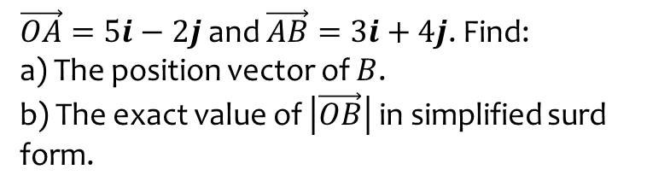
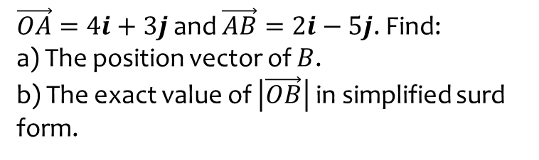
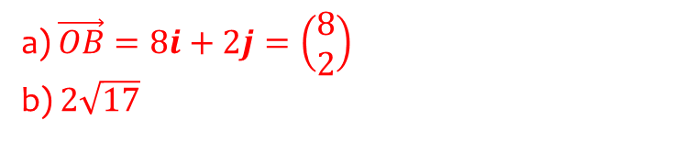
Worked example
Your turn
$\vec{OA}=4i+3j$ and $\vec{AB}=2i−5j$. Find:
a) The position vector of $B$.
b) The exact value of $\left|\vec{OB}\right|$ in simplified surd form.
$\vec{OA}=5i−2j$ and $\vec{AB}=3i+4j$. Find:
a) The position vector of $B$.
b) The exact value of $\left|\vec{OB}\right|$ in simplified surd form.
a) $\vec{OB}=8i+2j=\left(\begin{matrix}8 \\ 2\end{matrix}\right)$
b) $2\sqrt{17}$

