Slide 1
11.4) Using integration

Slide 2
Worked example
Your turn
A particle is moving on the $x$-axis.
At time $t=0$, the particle is at the point where $x=7$.
The velocity of the particle at time $t$ seconds (where $t≥0$) is $\left(8t−3t^{2}\right)$ ms⁻¹. Find:
An expression for the displacement of the particle from $O$ at time $t$ seconds.
The distance of the particle from its starting point when $t=4$.
A particle is moving on the $x$-axis.
At time $t=0$, the particle is at the point where $x=5$.
The velocity of the particle at time $t$ seconds (where $t≥0$) is $\left(6t−t^{2}\right)$ ms⁻¹. Find:
An expression for the displacement of the particle from $O$ at time $t$ seconds.
The distance of the particle from its starting point when $t=6$.
a) $x=3t^{2}−\frac{1}{3}t^{3}+5$
b) $36 m$

Slide 3
Worked example
Your turn
A particle travels in a straight line.
After $t$ seconds its velocity, $v$ ms⁻¹, is given by $v=7−6t^{2}$, $t≥0$.
Find the distance travelled by the particle in the fifth second of its motion.
A particle travels in a straight line.
After $t$ seconds its velocity, $v$ ms⁻¹, is given by $v=5−3t^{2}$, $t≥0$.
Find the distance travelled by the particle in the third second of its motion.
$$14 m$$

Slide 4
Worked example
Your turn
A particle $P$ moves on the positive $x$-axis.
The velocity of $P$ at time $t$ seconds is $\left(4t^{2}−9t+2\right)ms^{−1}$.
When $t=0, P$ is $5 m$ from the origin $O$. Find:
a) The values of $t$ when $P$ is instantaneously at rest
b) The acceleration of $P$ when $t=10$
c) The total distance travelled by $P$ in the interval $0≤t≤3$
A particle $P$ moves on the positive $x$-axis.
The velocity of $P$ at time $t$ seconds is $\left(2t^{2}−9t+4\right)ms^{−1}$.
When $t=0, P$ is $15 m$ from the origin $O$. Find:
a) The values of $t$ when $P$ is instantaneously at rest
b) The acceleration of $P$ when $t=5$
c) The total distance travelled by $P$ in the interval $0≤t≤5$
a) $t=\frac{1}{2}, t=4$
b) $11 ms^{−2}$
c) $19.4 m$ (3 sf)

Slide 5
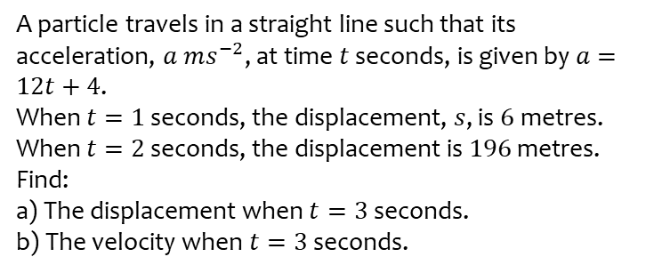
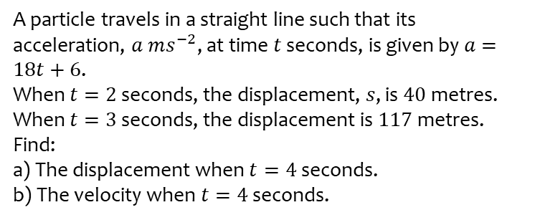
Worked example
Your turn
A particle travels in a straight line such that its acceleration, $a ms^{−2}$, at time $t$ seconds, is given by $a=18t+6$.
When $t=2$ seconds, the displacement, $s$, is $40$metres.
When $t=3$ seconds, the displacement is $117$metres.
Find:
a) The displacement when $t=4$ seconds.
b) The velocity when $t=4$ seconds.
A particle travels in a straight line such that its acceleration, $a ms^{−2}$, at time $t$ seconds, is given by $a=12t+4$.
When $t=1$ seconds, the displacement, $s$, is $6$metres.
When $t=2$ seconds, the displacement is $196$ metres.
Find:
a) The displacement when $t=3$ seconds.
b) The velocity when $t=3$ seconds.
a) $98 m$
b) $76 ms^{−1}$

