Slide 1
11.3) Using trigonometric identities

Slide 2
Worked example
Your turn
Find:
$$\int{\sin^{2}{x} dx}$$
Find:
$$\int{\cos^{2}{x} dx}$$
$$\frac{1}{2}x+\frac{1}{4}\sin{2x}+c$$

Slide 3
Worked example
Your turn
Find:
$$\int{\cot^{2}{x} dx}$$
Find:
$$\int{\tan^{2}{x} dx}$$
$$\tan{x}−x+c$$

Slide 4
Worked example
Your turn
Find:
$$\int{{\left(\sec{x}−\tan{x}\right)}^{2} dx}$$
Find:
$$\int{{\left(\sec{x}+\tan{x}\right)}^{2} dx}$$
$$2\tan{x}−2\sec{x}−x+c$$

Slide 5

Worked example
Your turn
Find:
$$\int{\sin{5x}\cos{5x} dx}$$
$$\int{\sin{\frac{x}{4}}\cos{\frac{x}{4}} dx}$$
Find:
$$\int{\sin{3x}\cos{3x} dx}$$
$$−\frac{1}{12}\cos{6x}+c$$

Slide 6
Worked example
Your turn
Find:
$$\int{{\left(\sin{x}−\cos{x}\right)}^{2}dx}$$
Find:
$$\int{{\left(\sin{x}+\cos{x}\right)}^{2}dx}$$
$$x−\frac{1}{2}\cos{2x}+c$$

Slide 7
Worked example
Your turn
Find:
$$\int{{\left(\cos{2x}+1\right)}^{2}dx}$$
Find:
$$\int{{\left(\cos{2x}−1\right)}^{2}dx}$$
$$\frac{1}{8}\sin{4x}+\frac{3}{2}x−\sin{2x}+c$$

Slide 8
Worked example
Your turn
Find:
$$\int{\frac{{\left(1+\sin{x}\right)}^{2}}{\cos^{2}{x}}dx}$$
Find:
$$\int{\frac{{\left(1+\cos{x}\right)}^{2}}{\sin^{2}{x}}dx}$$
$$−2\cot{x}−x−2 cosec x+c$$

Slide 9
Worked example
Your turn
Find:
$$\int{\frac{\cos{2x}}{\sin^{2}{x}}dx}$$
Find:
$$\int{\frac{\cos{2x}}{\cos^{2}{x}}dx}$$
$$2x−\tan{x}+c$$

Slide 10
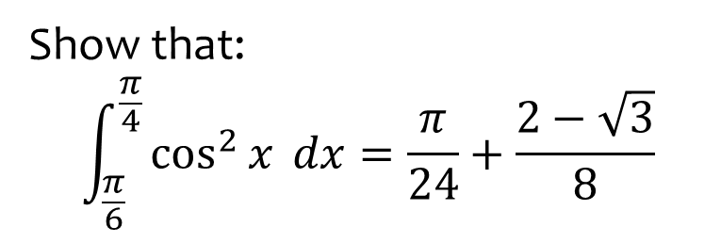
Worked example
Your turn
Show that:
$$\int_{\frac{π}{6}}^{\frac{π}{4}}{\cos^{2}{x}} dx=\frac{π}{24}+\frac{2−\sqrt{3}}{8}$$
Show that:
$$\int_{\frac{π}{12}}^{\frac{π}{8}}{\sin^{2}{x}} dx=\frac{π}{48}+\frac{1−\sqrt{2}}{8}$$
$$\frac{π}{12}$$

Slide 11

Worked example
Your turn
Find:
$$\int_{\frac{π}{6}}^{\frac{π}{3}}{\cos^{2}{3x}} dx$$
Find:
$$\int_{\frac{π}{6}}^{\frac{π}{3}}{\sin^{2}{3x}} dx$$
$$\frac{π}{12}$$

Slide 12
Worked example
Your turn
Find:
$$\int{\sin^{4}{x} dx}$$
Find:
$$\int{\cos^{4}{x} dx}$$
$$\frac{1}{32}\sin{4x}+\frac{1}{4}\sin{2x}+\frac{3}{8}x+c$$

