Slide 1
11.3) Maxima and minima problems

Slide 2
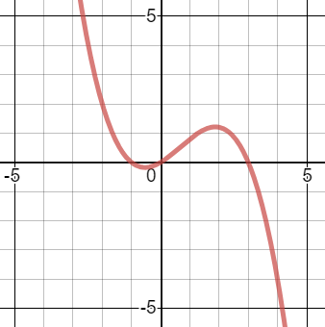
Worked example
Your turn
A child is playing with a yo-yo. The yo-yo leaves the child’s hand at time $t=0$ and travels vertically in a straight line before returning to the child’s hand. The distance, $s$ m, of the yo-yo from the child’s hand after time $t$ seconds is given by:
$$s=2.4t−0.4t^{2}−0.4t^{3}, 0≤t≤2$$
Justify the restriction $0≤t≤2$
Find the maximum distance of the yo-yo from the child’s hand, correct to 3sf.
A child is playing with a yo-yo. The yo-yo leaves the child’s hand at time $t=0$ and travels vertically in a straight line before returning to the child’s hand. The distance, $s$ m, of the yo-yo from the child’s hand after time $t$ seconds is given by:
$$s=0.6t+0.4t^{2}−0.2t^{3}, 0≤t≤3$$
Justify the restriction $0≤t≤3$
Find the maximum distance of the yo-yo from the child’s hand, correct to 3sf.
a) $s=0.2t\left(3+2t−t^{2}\right)=0.2t(3−t)(1+t)$
$t≥0$ as time cannot be negative.
If $t>3, s<0$ (but distance cannot be negative)
b) $1.21 m$ (3 sf)
Graphs used with permission from DESMOS: https://www.desmos.com/

Slide 3
Worked example
Your turn
A particle $P$ is moving along the $x$-axis. At time $t$ seconds, the velocity of $P$ in the direction of $x$ increasing, is:
$$v=\frac{5}{3}t^{3}−18t^{2}+36t$$
Find the maximum velocity of the particle
A particle $P$ is moving along the $x$-axis. At time $t$ seconds, the velocity of $P$ in the direction of $x$ increasing, is:
$v=t^{3}−16t^{2}+64t$
Find the maximum velocity of the particle
$75.9 ms^{−1}$ (3 sf)

Slide 4
Worked example
Your turn
A particle $P$ is moving along the $x$-axis. At time $t$ seconds, the velocity of $P$ in the direction of $x$ increasing, is:
$$v=3t^{2}−21t+30, t≥0$$
Find the maximum speed of the particle
A particle $P$ is moving along the $x$-axis. At time $t$ seconds, the velocity of $P$ in the direction of $x$ increasing, is:
$$v=2t^{2}−14t+20, t≥0$$
Find the maximum speed of the particle
$$20 ms^{−1}$$

