Slide 1
11.2) Representing vectors

Slide 2
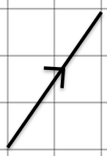
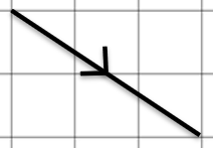
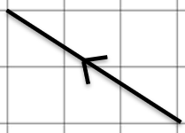
Worked example
Your turn
$$\text{Represent} \text{in} \text{column} \text{vector} \text{form}\text{:}$$
Represent in column vector form:
$$\left(\begin{matrix}3 \\ −2 \end{matrix}\right)$$

Slide 3
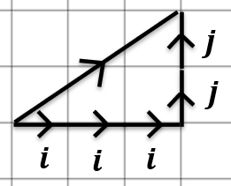
Worked example
Your turn
Draw a diagram to represent the vector:
$$2i+3j$$
$$−3i+2j$$
$$2i−3j$$
$$−2i−3j$$
$$\text{Draw} \text{a} \text{diagram} \text{to} \text{represent} \text{the} \text{vector}\text{:}$$
$$3i+2j$$

Slide 4
Worked example
Your turn
Given $a=8i−6j$ and $b=9i+7j$, find:
$4b−2a$
$−b+\frac{1}{4}a$
Given $a=5i+2j$ and $b=3i−4j$, find:
$2a−b$
$−a+\frac{1}{2}b$
$7i+8j$
$−\frac{7}{2}i−4j$

