Slide 1
11.2) Using differentiation

Slide 2
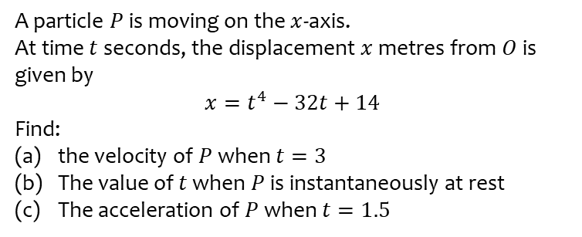
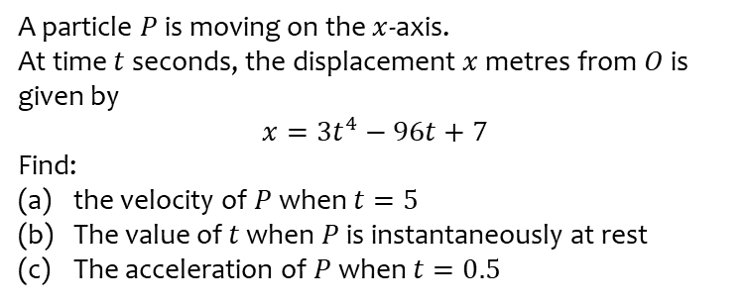
Worked example
Your turn
A particle $P$ is moving on the $x$-axis.
At time $t$ seconds, the displacement $x$ metres from $O$ is given by
$$x=3t^{4}−96t+7$$
Find:
the velocity of $P$ when $t=5$
The value of $t$ when $P$ is instantaneously at rest
The acceleration of $P$ when $t=0.5$
A particle $P$ is moving on the $x$-axis.
At time $t$ seconds, the displacement $x$ metres from $O$ is given by
$$x=t^{4}−32t+14$$
Find:
the velocity of $P$ when $t=3$
The value of $t$ when $P$ is instantaneously at rest
The acceleration of $P$ when $t=1.5$
a) $76 ms^{−1}$
b) $t=2$
c) $27 ms^{−2}$

Slide 3
Worked example
Your turn
A particle $P$ is moving on the $x$-axis.
At time $t$ seconds, the displacement $x$ metres from $O$ is given by
$$x=\frac{1}{3}t^{3}−\frac{7}{2}t^{2}+12t+15$$
Find the distance between the two points at which the particle is at rest.
A particle $P$ is moving on the $x$-axis.
At time $t$ seconds, the displacement $x$ metres from $O$ is given by
$$x=\frac{1}{3}t^{3}−\frac{11}{2}t^{2}+30t+5$$
Find the distance between the two points at which the particle is at rest.
$0.17 m$ (2s f)

