Slide 1
11.1) Functions of time

Slide 2
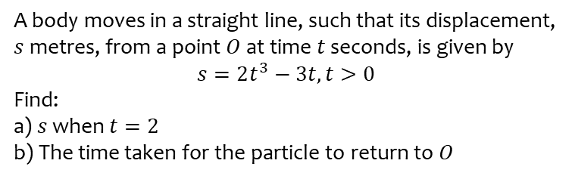
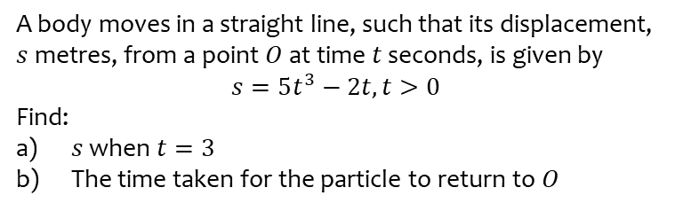
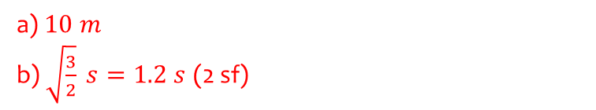
Worked example
Your turn
A body moves in a straight line, such that its displacement, $s$metres, from a point $O$ at time $t$ seconds, is given by
$$s=5t^{3}−2t, t>0$$
Find:
$s$ when $t=3$
The time taken for the particle to return to $O$
A body moves in a straight line, such that its displacement, $s$metres, from a point $O$ at time $t$ seconds, is given by
$$s=2t^{3}−3t, t>0$$
Find:
a) $s$ when $t=2$
b) The time taken for the particle to return to $O$
a) $10 m$
b) $\sqrt{\frac{3}{2}} s=1.2 s$ (2 sf)

Slide 3
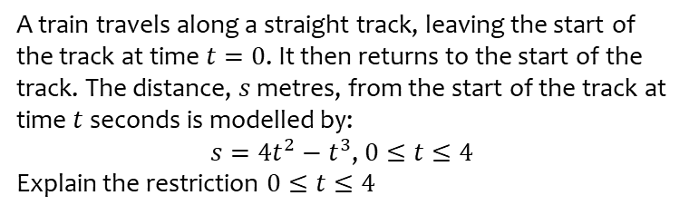
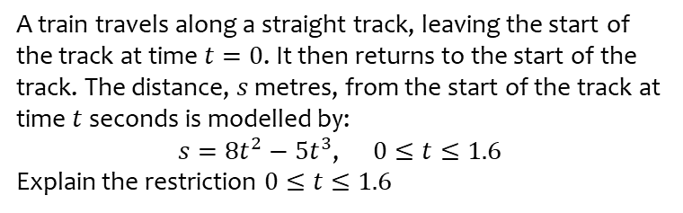
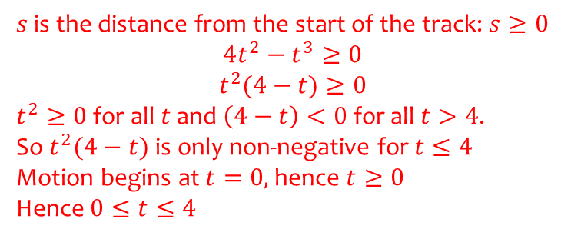
Worked example
Your turn
A train travels along a straight track, leaving the start of the track at time $t=0$. It then returns to the start of the track. The distance, $s$ metres, from the start of the track at time $t$seconds is modelled by:
$s=8t^{2}−5t^{3}$, $0≤t≤1.6$
Explain the restriction $0≤t≤1.6$
A train travels along a straight track, leaving the start of the track at time $t=0$. It then returns to the start of the track. The distance, $s$ metres, from the start of the track at time $t$seconds is modelled by:
$s=4t^{2}−t^{3}$, $0≤t≤4$
Explain the restriction $0≤t≤4$
$s$ is the distance from the start of the track: $s≥0$
$$4t^{2}−t^{3}≥0$$
$$t^{2}(4−t)≥0$$
$t^{2}≥0$ for all $t$ and $\left(4−t\right)<0$ for all $t>4$.
So $t^{2}(4−t)$ is only non-negative for $t≤4$
Motion begins at $t=0,$hence $t≥0$
Hence $0≤t≤4$

Slide 4
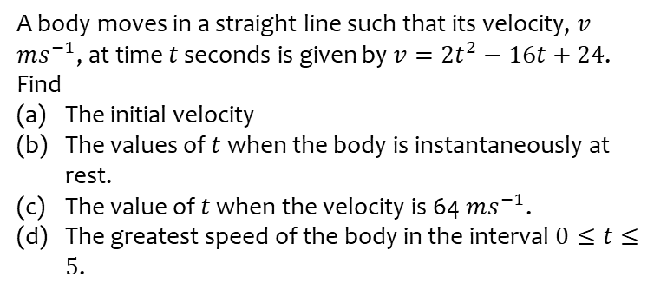
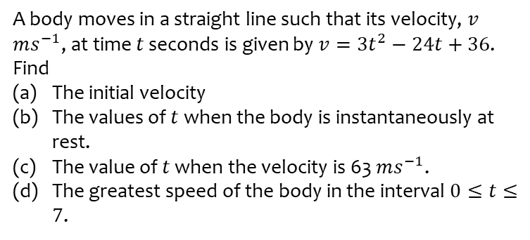
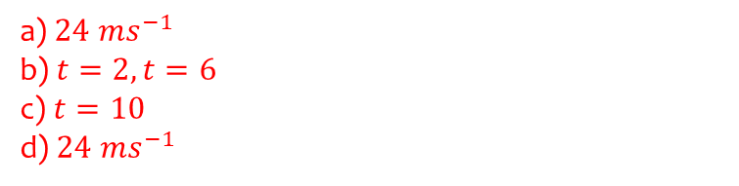
Worked example
Your turn
A body moves in a straight line such that its velocity, $v$ $ms^{−1}$, at time $t$ seconds is given by $v=3t^{2}−24t+36$. Find
The initial velocity
The values of $t$ when the body is instantaneously at rest.
The value of $t$ when the velocity is 63 $ms^{−1}$.
The greatest speed of the body in the interval $0≤t≤7$.
A body moves in a straight line such that its velocity, $v$ $ms^{−1}$, at time $t$ seconds is given by $v=2t^{2}−16t+24$. Find
The initial velocity
The values of $t$ when the body is instantaneously at rest.
The value of $t$ when the velocity is 64 $ms^{−1}$.
The greatest speed of the body in the interval $0≤t≤5$.
a) $24 ms^{−1}$
b) $t=2, t=6$
c) $t=10$
d) $24 ms^{−1}$

