Slide 1
11) Vectors
11.1) Vectors
11.2) Representing vectors
11.3) Magnitude and direction
11.4) Position vectors
11.5) Solving geometric problems
11.6) Modelling with vectors

Slide 2
11.1) Vectors
Chapter CONTENTS

Slide 3
Worked example
Your turn
$PQRS$ is a parallelogram.
$N$ is the point on $SQ$ such that $SN:NQ=3:4$
$\vec{PQ}=b$ and $\vec{PS}=a$
Express $\vec{NR}$ in terms of $a$ and $b$
$PQRS$ is a parallelogram.
$N$ is the point on $SQ$ such that $SN:NQ=3:2$
$\vec{PQ}=a$ and $\vec{PS}=b$
Express $\vec{NR}$ in terms of $a$ and $b$
$$\frac{2}{5}a+\frac{3}{5}b$$

Slide 4
Worked example
Your turn
$OAB$ is a triangle.
$\vec{OA}=b$ and $\vec{OB}=a$
$P$ is the point on $AB$ such that $AP:PB=2:3$.
Find $\vec{OP}$ in terms of $a$ and $b$
$OAB$ is a triangle.
$\vec{OA}=a$ and $\vec{OB}=b$
$P$ is the point on $AB$ such that $AP:PB=3:1$.
Find $\vec{OP}$ in terms of $a$ and $b$
$$\frac{1}{4}a+\frac{3}{4}b$$

Slide 5
Worked example
Your turn
Show that the vectors are parallel:
$3a+4b$ and $15a+20b$
$3a+4b$ and $−0.75a−b$
Show that the vectors are parallel:
$6a+8b$ and $9a+12b$
$$9a+12b=\frac{3}{2}(6a+8b)$$

Slide 6
11.2) Representing vectors
Chapter CONTENTS

Slide 7
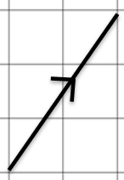
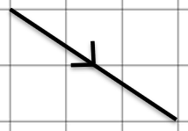
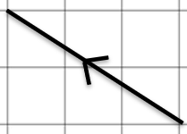
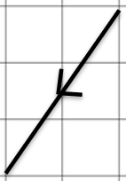
Worked example
Your turn
$$\text{Represent} \text{in} \text{column} \text{vector} \text{form}\text{:}$$
Represent in column vector form:
$$\left(\begin{matrix}3 \\ −2 \end{matrix}\right)$$

Slide 8
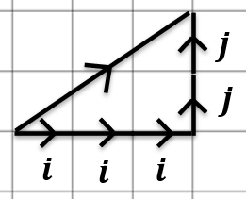
Worked example
Your turn
Draw a diagram to represent the vector:
$$2i+3j$$
$$−3i+2j$$
$$2i−3j$$
$$−2i−3j$$
$$\text{Draw} \text{a} \text{diagram} \text{to} \text{represent} \text{the} \text{vector}\text{:}$$
$$3i+2j$$

Slide 9
Worked example
Your turn
Given $a=8i−6j$ and $b=9i+7j$, find:
$4b−2a$
$−b+\frac{1}{4}a$
Given $a=5i+2j$ and $b=3i−4j$, find:
$2a−b$
$−a+\frac{1}{2}b$
$7i+8j$
$−\frac{7}{2}i−4j$

Slide 10
11.3) Magnitude and direction
Chapter CONTENTS

Slide 11
Worked example
Your turn
Find the magnitude of the vector:
$$3i+4j$$
$$−5i+12j$$
$$7i−24j$$
Find the magnitude of the vector:
$$−6i−8j$$
$$10$$

Slide 12
Worked example
Your turn
Find a unit vector in the direction of:
$$a=8i+15j$$
$$b=−9i+12j$$
Find a unit vector in the direction of:
$$c=3i−4j$$
$\hat{c}=\frac{1}{5}(3i−4j)$ or $\left(\begin{matrix}0.6 \\ −0.8\end{matrix}\right)$

Slide 13
Worked example
Your turn
Given $a=8i−6j$ and $b=9i+7j$, find
$$|2b−3a|$$
Given $a=5i+2j$ and $b=3i−4j$, find:
$$|4a−5b|$$
$$\sqrt{809}$$

Slide 14
Worked example
Your turn
Find the angle between the vector $2i+3j$ and the positive $y$-axis.
Find the angle between the vector $4i+5j$ and the positive $x$-axis.
$51.3°$ (3 sf)

Slide 15
Worked example
Your turn
Vector $a$ has magnitude $5$ and make an angle of $60°$ with $i$.
Find $a$ in $i, j$ and column vector format.
Vector $b$ has magnitude $10$ and make an angle of $30°$ with $j$.
Find $b$ in $i, j$ and column vector format.
$$b=5i+5\sqrt{3}j=\left(\begin{matrix}5 \\ 5\sqrt{3}\end{matrix}\right)$$

Slide 16
Worked example
Your turn
A vector $a=pi+qj$ has magnitude $68$ and makes an angle $θ$ with the positive $x$-axis where $\sin{θ}=\frac{8}{17}$. Find all the possible vectors
A vector $a=pi+qj$ has magnitude $26$ and makes an angle $θ$ with the positive $x$-axis where $\sin{θ}=\frac{5}{13}$. Find all the possible vectors
$$p=10, q=24$$
$$p=10, q=−24$$
$$p=−10, q=24$$
$$p=−10, q=−24$$

Slide 17
Worked example
Your turn
In triangle $PQR$, $\vec{PQ}=i+2j$ and
$\vec{PR}=8i−15j$.
Find the area of triangle $PQR$
In triangle $PQR$, $\vec{PQ}=2i+j \text{and}$
$\vec{PR}=9i−12j$.
Find the area of triangle $PQR$
$$16.5$$

Slide 18
11.4) Position vectors
Chapter CONTENTS

Slide 19
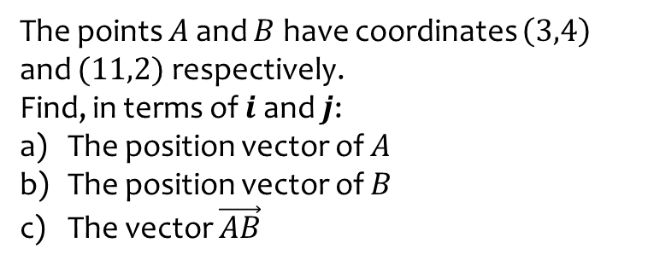
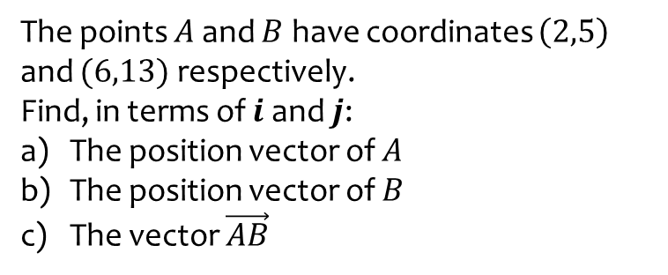
Worked example
Your turn
The points $A$ and $B$ have coordinates $\left(2,5\right)$ and $(6,13)$ respectively.
Find, in terms of $i$ and $j$:
The position vector of $A$
The position vector of $B$
The vector $\vec{AB}$
The points $A$ and $B$ have coordinates $\left(3,4\right)$ and $(11,2)$ respectively.
Find, in terms of $i$ and $j$:
The position vector of $A$
The position vector of $B$
The vector $\vec{AB}$
a) $\vec{OA}=3i+4j$
b) $\vec{OB}=11i+2j$
c) $\vec{AB}=8i−2j$

Slide 20
Worked example
Your turn
$\vec{OA}=4i+3j$ and $\vec{AB}=2i−5j$. Find:
a) The position vector of $B$.
b) The exact value of $\left|\vec{OB}\right|$ in simplified surd form.
$\vec{OA}=5i−2j$ and $\vec{AB}=3i+4j$. Find:
a) The position vector of $B$.
b) The exact value of $\left|\vec{OB}\right|$ in simplified surd form.
a) $\vec{OB}=8i+2j=\left(\begin{matrix}8 \\ 2\end{matrix}\right)$
b) $2\sqrt{17}$

Slide 21
11.5) Solving geometric problems
Chapter CONTENTS

Slide 22
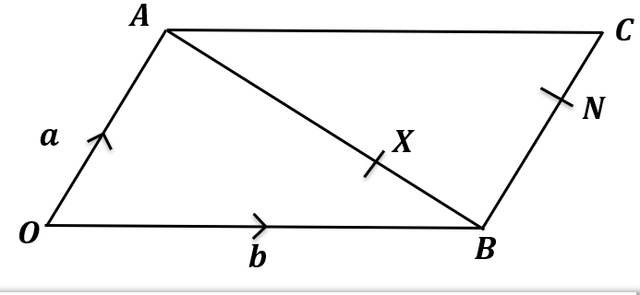
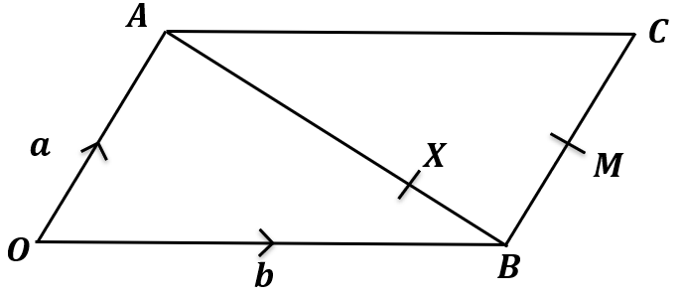
Worked example
Your turn
$OACB$ is a parallelogram.
$X$ is a point on $AB$ such that $AX:XB=2:1$. $N$ is the point such that $NC$ is half of $BN$.
Show that $\vec{XN}$ is parallel to $\vec{OC}$.
$OACB$ is a parallelogram.
$X$ is a point on $AB$ such that $AX:XB=3:1$. $M$ is the midpoint of $BC$.
Show that $\vec{XM}$ is parallel to $\vec{OC}$.
Shown

Slide 23
Worked example
Your turn
$\vec{AB}=2i−5j$ and $\vec{AC}=3i−7j$.
Determine $∠BAC$.
$\vec{AB}=3i−2j$ and $\vec{AC}=i−5j$.
Determine $∠BAC$.
$$45°$$

Slide 24
11.6) Modelling with vectors
Chapter CONTENTS

Slide 25
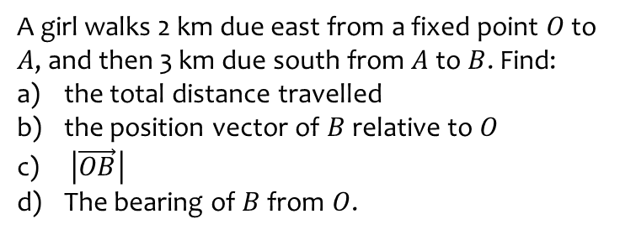
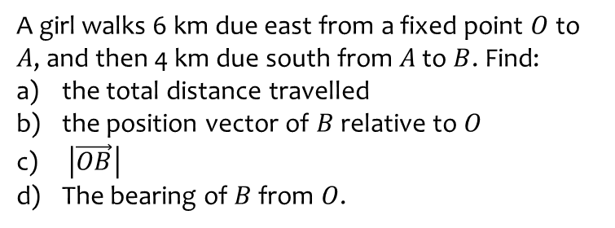
Worked example
Your turn
A girl walks 6 km due east from a fixed point $O$ to $A$, and then 4 km due south from $A$ to $B$. Find:
the total distance travelled
the position vector of $B$ relative to $O$
$\left|\vec{OB}\right|$
The bearing of $B$ from $O$.
A girl walks 2 km due east from a fixed point $O$ to $A$, and then 3 km due south from $A$ to $B$. Find:
the total distance travelled
the position vector of $B$ relative to $O$
$\left|\vec{OB}\right|$
The bearing of $B$ from $O$.
a) $5 km$
b) $\left(2i−3j\right) km$
c) $3.61 km$ (3 sf)
d) $146°$ (3 sf)

Slide 26
Worked example
Your turn
In an orienteering exercise, a cadet leaves the starting point $O$ and walks 30 km on a bearing of $150°$ to reach $A$, the first checkpoint.
From $A$ she walks 18 km on a bearing of $210°$ to the second checkpoint, at $B$.
From $B$ she returns directly to $O$.
Find:
the position vector of $A$ relative to $O$
$\left|\vec{OB}\right|$
the bearing of $B$ from $O$
the position vector of $B$ relative $O$.
In an orienteering exercise, a cadet leaves the starting point $O$ and walks 15 km on a bearing of $120°$ to reach $A$, the first checkpoint.
From $A$ he walks 9 km on a bearing of $240°$ to the second checkpoint, at $B$.
From $B$ he returns directly to $O$.
Find:
the position vector of $A$ relative to $O$
$\left|\vec{OB}\right|$
the bearing of $B$ from $O$
the position vector of $B$ relative $O$.
a) $\left(13.0i−7.5j\right) km$ (1 dp)
b) $13.1 km$ (3 sf)
c) $157°$ (3 sf)
d) $\left(5.2i−12.0j\right) km$

