Slide 1
11) Variable acceleration
11.1) Functions of time
11.2) Using differentiation
11.3) Maxima and minima problems
11.4) Using integration
11.5) Constant acceleration formulae

Slide 2
11.1) Functions of time
Chapter CONTENTS

Slide 3
Worked example
Your turn
A body moves in a straight line, such that its displacement, $s$metres, from a point $O$ at time $t$ seconds, is given by
$$s=5t^{3}−2t, t>0$$
Find:
$s$ when $t=3$
The time taken for the particle to return to $O$
A body moves in a straight line, such that its displacement, $s$metres, from a point $O$ at time $t$ seconds, is given by
$$s=2t^{3}−3t, t>0$$
Find:
a) $s$ when $t=2$
b) The time taken for the particle to return to $O$
a) $10 m$
b) $\sqrt{\frac{3}{2}} s=1.2 s$ (2 sf)

Slide 4
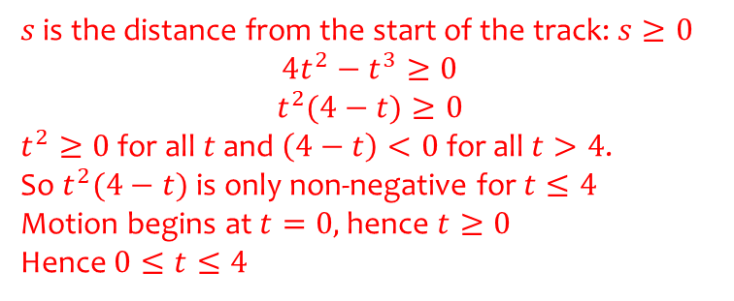
Worked example
Your turn
A train travels along a straight track, leaving the start of the track at time $t=0$. It then returns to the start of the track. The distance, $s$ metres, from the start of the track at time $t$seconds is modelled by:
$s=8t^{2}−5t^{3}$, $0≤t≤1.6$
Explain the restriction $0≤t≤1.6$
A train travels along a straight track, leaving the start of the track at time $t=0$. It then returns to the start of the track. The distance, $s$ metres, from the start of the track at time $t$seconds is modelled by:
$s=4t^{2}−t^{3}$, $0≤t≤4$
Explain the restriction $0≤t≤4$
$s$ is the distance from the start of the track: $s≥0$
$$4t^{2}−t^{3}≥0$$
$$t^{2}(4−t)≥0$$
$t^{2}≥0$ for all $t$ and $\left(4−t\right)<0$ for all $t>4$.
So $t^{2}(4−t)$ is only non-negative for $t≤4$
Motion begins at $t=0,$hence $t≥0$
Hence $0≤t≤4$

Slide 5
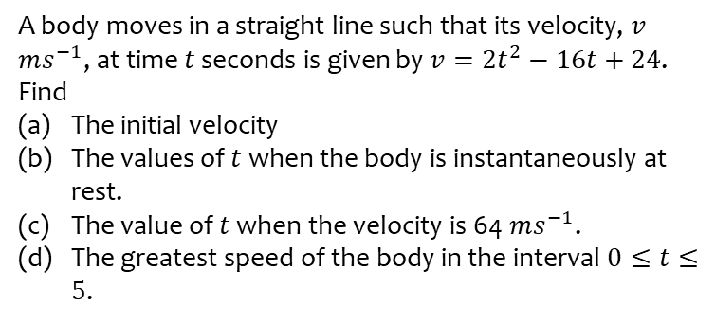
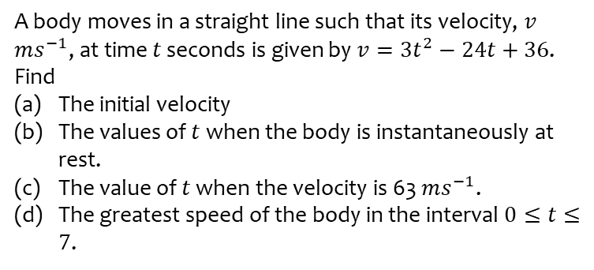
Worked example
Your turn
A body moves in a straight line such that its velocity, $v$ $ms^{−1}$, at time $t$ seconds is given by $v=3t^{2}−24t+36$. Find
The initial velocity
The values of $t$ when the body is instantaneously at rest.
The value of $t$ when the velocity is 63 $ms^{−1}$.
The greatest speed of the body in the interval $0≤t≤7$.
A body moves in a straight line such that its velocity, $v$ $ms^{−1}$, at time $t$ seconds is given by $v=2t^{2}−16t+24$. Find
The initial velocity
The values of $t$ when the body is instantaneously at rest.
The value of $t$ when the velocity is 64 $ms^{−1}$.
The greatest speed of the body in the interval $0≤t≤5$.
a) $24 ms^{−1}$
b) $t=2, t=6$
c) $t=10$
d) $24 ms^{−1}$

Slide 6
11.2) Using differentiation
Chapter CONTENTS

Slide 7
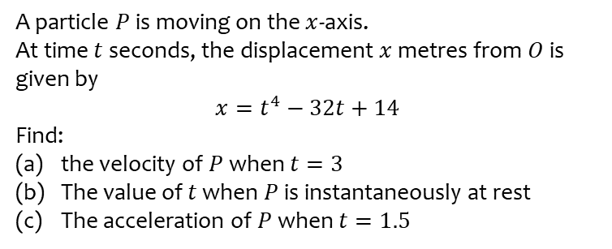
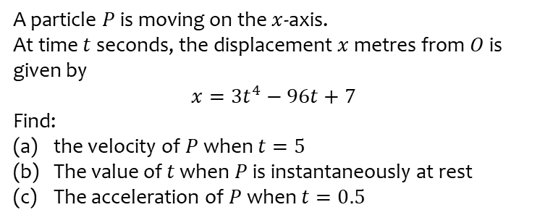
Worked example
Your turn
A particle $P$ is moving on the $x$-axis.
At time $t$ seconds, the displacement $x$ metres from $O$ is given by
$$x=3t^{4}−96t+7$$
Find:
the velocity of $P$ when $t=5$
The value of $t$ when $P$ is instantaneously at rest
The acceleration of $P$ when $t=0.5$
A particle $P$ is moving on the $x$-axis.
At time $t$ seconds, the displacement $x$ metres from $O$ is given by
$$x=t^{4}−32t+14$$
Find:
the velocity of $P$ when $t=3$
The value of $t$ when $P$ is instantaneously at rest
The acceleration of $P$ when $t=1.5$
a) $76 ms^{−1}$
b) $t=2$
c) $27 ms^{−2}$

Slide 8
Worked example
Your turn
A particle $P$ is moving on the $x$-axis.
At time $t$ seconds, the displacement $x$ metres from $O$ is given by
$$x=\frac{1}{3}t^{3}−\frac{7}{2}t^{2}+12t+15$$
Find the distance between the two points at which the particle is at rest.
A particle $P$ is moving on the $x$-axis.
At time $t$ seconds, the displacement $x$ metres from $O$ is given by
$$x=\frac{1}{3}t^{3}−\frac{11}{2}t^{2}+30t+5$$
Find the distance between the two points at which the particle is at rest.
$0.17 m$ (2s f)

Slide 9
11.3) Maxima and minima problems
Chapter CONTENTS

Slide 10
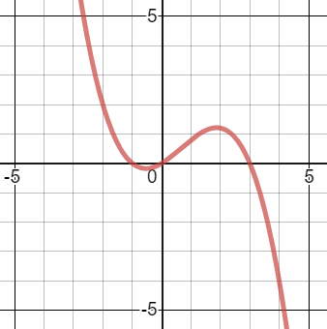
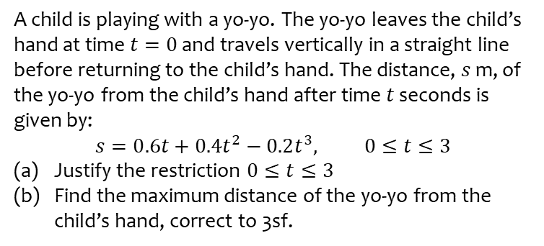
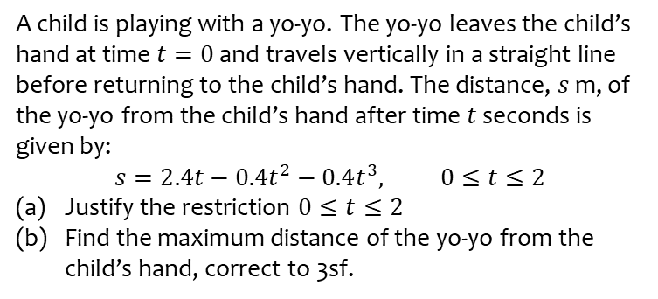
Worked example
Your turn
A child is playing with a yo-yo. The yo-yo leaves the child’s hand at time $t=0$ and travels vertically in a straight line before returning to the child’s hand. The distance, $s$ m, of the yo-yo from the child’s hand after time $t$ seconds is given by:
$$s=2.4t−0.4t^{2}−0.4t^{3}, 0≤t≤2$$
Justify the restriction $0≤t≤2$
Find the maximum distance of the yo-yo from the child’s hand, correct to 3sf.
A child is playing with a yo-yo. The yo-yo leaves the child’s hand at time $t=0$ and travels vertically in a straight line before returning to the child’s hand. The distance, $s$ m, of the yo-yo from the child’s hand after time $t$ seconds is given by:
$$s=0.6t+0.4t^{2}−0.2t^{3}, 0≤t≤3$$
Justify the restriction $0≤t≤3$
Find the maximum distance of the yo-yo from the child’s hand, correct to 3sf.
a) $s=0.2t\left(3+2t−t^{2}\right)=0.2t(3−t)(1+t)$
$t≥0$ as time cannot be negative.
If $t>3, s<0$ (but distance cannot be negative)
b) $1.21 m$ (3 sf)
Graphs used with permission from DESMOS: https://www.desmos.com/

Slide 11
Worked example
Your turn
A particle $P$ is moving along the $x$-axis. At time $t$ seconds, the velocity of $P$ in the direction of $x$ increasing, is:
$$v=\frac{5}{3}t^{3}−18t^{2}+36t$$
Find the maximum velocity of the particle
A particle $P$ is moving along the $x$-axis. At time $t$ seconds, the velocity of $P$ in the direction of $x$ increasing, is:
$v=t^{3}−16t^{2}+64t$
Find the maximum velocity of the particle
$75.9 ms^{−1}$ (3 sf)

Slide 12
Worked example
Your turn
A particle $P$ is moving along the $x$-axis. At time $t$ seconds, the velocity of $P$ in the direction of $x$ increasing, is:
$$v=3t^{2}−21t+30, t≥0$$
Find the maximum speed of the particle
A particle $P$ is moving along the $x$-axis. At time $t$ seconds, the velocity of $P$ in the direction of $x$ increasing, is:
$$v=2t^{2}−14t+20, t≥0$$
Find the maximum speed of the particle
$$20 ms^{−1}$$

Slide 13
11.4) Using integration
Chapter CONTENTS

Slide 14
Worked example
Your turn
A particle is moving on the $x$-axis.
At time $t=0$, the particle is at the point where $x=7$.
The velocity of the particle at time $t$ seconds (where $t≥0$) is $\left(8t−3t^{2}\right)$ ms⁻¹. Find:
An expression for the displacement of the particle from $O$ at time $t$ seconds.
The distance of the particle from its starting point when $t=4$.
A particle is moving on the $x$-axis.
At time $t=0$, the particle is at the point where $x=5$.
The velocity of the particle at time $t$ seconds (where $t≥0$) is $\left(6t−t^{2}\right)$ ms⁻¹. Find:
An expression for the displacement of the particle from $O$ at time $t$ seconds.
The distance of the particle from its starting point when $t=6$.
a) $x=3t^{2}−\frac{1}{3}t^{3}+5$
b) $36 m$

Slide 15
Worked example
Your turn
A particle travels in a straight line.
After $t$ seconds its velocity, $v$ ms⁻¹, is given by $v=7−6t^{2}$, $t≥0$.
Find the distance travelled by the particle in the fifth second of its motion.
A particle travels in a straight line.
After $t$ seconds its velocity, $v$ ms⁻¹, is given by $v=5−3t^{2}$, $t≥0$.
Find the distance travelled by the particle in the third second of its motion.
$$14 m$$

Slide 16
Worked example
Your turn
A particle $P$ moves on the positive $x$-axis.
The velocity of $P$ at time $t$ seconds is $\left(4t^{2}−9t+2\right)ms^{−1}$.
When $t=0, P$ is $5 m$ from the origin $O$. Find:
a) The values of $t$ when $P$ is instantaneously at rest
b) The acceleration of $P$ when $t=10$
c) The total distance travelled by $P$ in the interval $0≤t≤3$
A particle $P$ moves on the positive $x$-axis.
The velocity of $P$ at time $t$ seconds is $\left(2t^{2}−9t+4\right)ms^{−1}$.
When $t=0, P$ is $15 m$ from the origin $O$. Find:
a) The values of $t$ when $P$ is instantaneously at rest
b) The acceleration of $P$ when $t=5$
c) The total distance travelled by $P$ in the interval $0≤t≤5$
a) $t=\frac{1}{2}, t=4$
b) $11 ms^{−2}$
c) $19.4 m$ (3 sf)

Slide 17
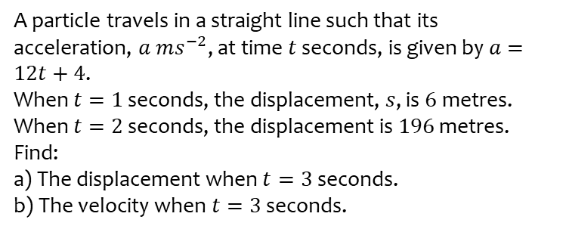
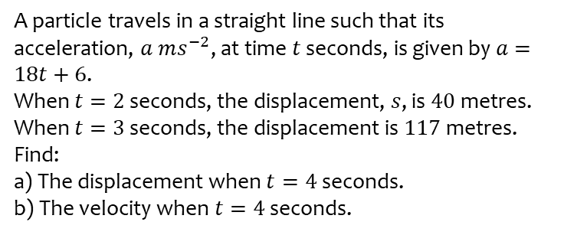
Worked example
Your turn
A particle travels in a straight line such that its acceleration, $a ms^{−2}$, at time $t$ seconds, is given by $a=18t+6$.
When $t=2$ seconds, the displacement, $s$, is $40$metres.
When $t=3$ seconds, the displacement is $117$metres.
Find:
a) The displacement when $t=4$ seconds.
b) The velocity when $t=4$ seconds.
A particle travels in a straight line such that its acceleration, $a ms^{−2}$, at time $t$ seconds, is given by $a=12t+4$.
When $t=1$ seconds, the displacement, $s$, is $6$metres.
When $t=2$ seconds, the displacement is $196$ metres.
Find:
a) The displacement when $t=3$ seconds.
b) The velocity when $t=3$ seconds.
a) $98 m$
b) $76 ms^{−1}$

Slide 18
11.5) Constant acceleration formulae
Chapter CONTENTS

Slide 19
Worked example
Your turn
A particle moves in a straight line with constant acceleration $a ms^{−2}$.
Given that its initial velocity is $u ms^{−1}$ and its initial displacement is $0 m$, prove that:
Its velocity, $v ms^{−1}$, at time $t$s is given by $v=u+at$
A particle moves in a straight line with constant acceleration $a ms^{−2}$.
Given that its initial velocity is $u ms^{−1}$ and its initial displacement is $0 m$, prove that:
Its displacement, $s$ $m$, at time $t$ s is given by $s=ut+\frac{1}{2}at^{2}$
Proof

