Slide 1
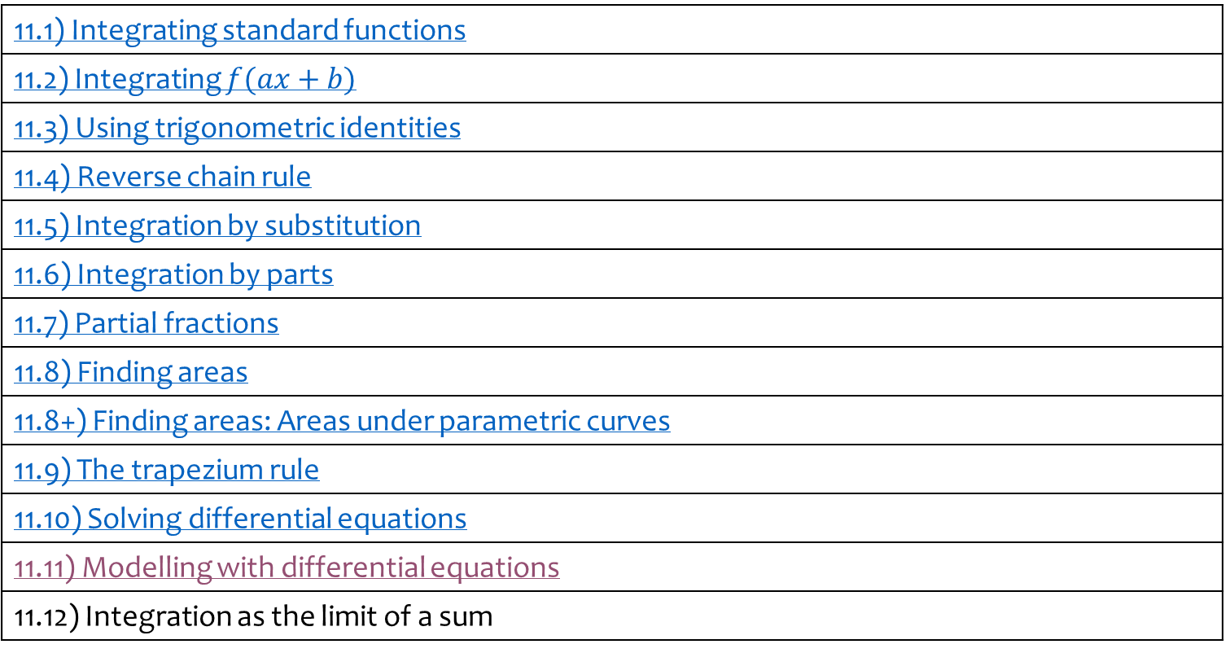
11) Integration
11.1) Integrating standard functions
11.2) Integrating $f(ax+b)$
11.3) Using trigonometric identities
11.4) Reverse chain rule
11.5) Integration by substitution
11.6) Integration by parts
11.7) Partial fractions
11.8) Finding areas
11.8+) Finding areas: Areas under parametric curves
11.9) The trapezium rule
11.10) Solving differential equations
11.11) Modelling with differential equations
11.12) Integration as the limit of a sum

Slide 2
11.1) Integrating standard functions
Chapter CONTENTS

Slide 3
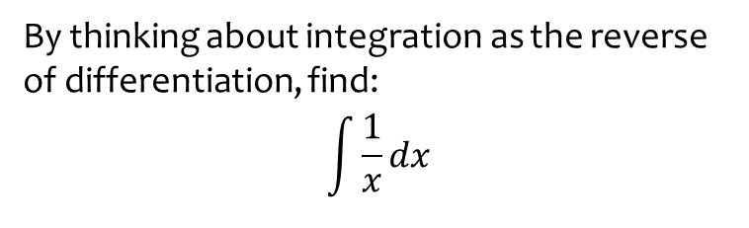

Worked example
Your turn
By thinking about integration as the reverse of differentiation, find:
$$\int{x^{n}}dx$$
$$\int{e^{x}}dx$$
By thinking about integration as the reverse of differentiation, find:
$$\int{\frac{1}{x}}dx$$
$$\ln{|x|}+c$$

Slide 4



Worked example
Your turn
By thinking about integration as the reverse of differentiation, find:
$$\int{\sin{x}}dx$$
$$\int{cosec x}\cot{x}dx$$
$$\int{\sec^{2}{x}}dx$$
By thinking about integration as the reverse of differentiation, find:
$$\int{\cos{x}}dx$$
$$\int{\sec{x}\tan{x}}dx$$
$$\int{{cosec}^{2}{x}}dx$$
$$\sin{x}+c$$
$$\sec{x}+c$$
$$−\cot{x}+c$$

Slide 5



Worked example
Your turn
By thinking about integration as the reverse of differentiation, find:
$$\int{−sin{x}}dx$$
$$\int{−cosec x}\cot{x}dx$$
$$\int{{−sec}^{2}{x}}dx$$
By thinking about integration as the reverse of differentiation, find:
$$\int{−cos{x}}dx$$
$$\int{−\sec{x}\tan{x}}dx$$
$$\int{−{cosec}^{2}{x}}dx$$
$$−\sin{x}+c$$
$$−sec{x}+c$$
$$\cot{x}+c$$

Slide 6
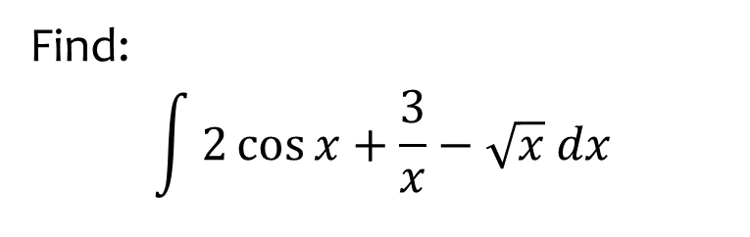
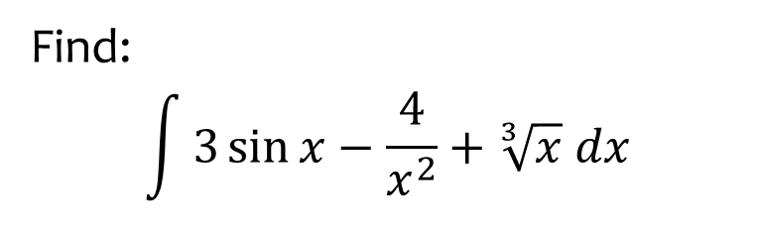
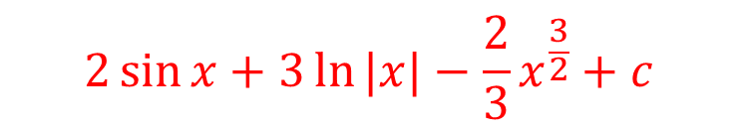
Worked example
Your turn
Find:
$$\int{3\sin{x}−\frac{4}{x^{2}}+\sqrt[3]{x} dx}$$
Find:
$$\int{2\cos{x}+\frac{3}{x}−\sqrt{x} dx}$$
$$2\sin{x}+3\ln{|x|}−\frac{2}{3}x^{\frac{3}{2}}+c$$

Slide 7



Worked example
Your turn
Find:
$$\int{\frac{\sin{x}}{\cos^{2}{x}} dx}$$
Find:
$$\int{\frac{\cos{x}}{\sin^{2}{x}} dx}$$
$$−cosec x+c$$

Slide 8
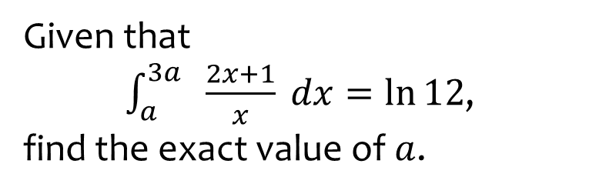
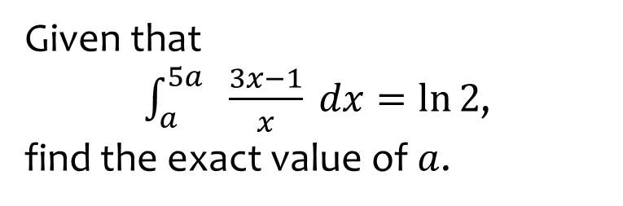

Worked example
Your turn
Given that
$\int_{a}^{5a}{ \frac{3x−1}{x} dx}=\ln{2}$,
find the exact value of $a$.
Given that
$\int_{a}^{3a}{ \frac{2x+1}{x} dx}=\ln{12}$,
find the exact value of $a$.
$$a=\frac{1}{4}\ln{4}$$

Slide 9
11.2) Integrating $f(ax+b)$
Chapter CONTENTS

Slide 10



Worked example
Your turn
Find:
$$\int{{\left(6x+1\right)}^{2} dx}$$
$$\int{{\left(5x−2\right)}^{3} dx}$$
$$\int{{\left(4x+3\right)}^{4} dx}$$
Find:
$$\int{{\left(3x−4\right)}^{5} dx}$$
$$\frac{1}{18}{\left(3x+4\right)}^{6}+c$$

Slide 11
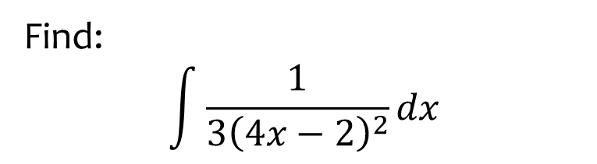


Worked example
Your turn
Find:
$$\int{\frac{1}{2{\left(3x−4\right)}^{4}}dx}$$
$$\int{\frac{1}{4{\left(2−3x\right)}^{3}}dx}$$
Find:
$$\int{\frac{1}{3{\left(4x−2\right)}^{2}}dx}$$
$$−\frac{1}{12(4x−2)}+c$$

Slide 12



Worked example
Your turn
Find:
$$\int{{\left(3x−1\right)}^{2}}$$
$$\int{(3x−1)}dx$$
$$\int{\frac{1}{3x−1}}dx$$
$$\int{\frac{1}{{\left(3x−1\right)}^{2}}}dx$$
Find:
$$\int{{\left(2x+1\right)}^{2}}$$
$$\int{(2x+1)}dx$$
$$\int{\frac{1}{2x+1}}dx$$
$$\int{\frac{1}{{\left(2x+1\right)}^{2}}}dx$$
$${\frac{1}{6}\left(2x+1\right)}^{3}+c$$
$$x^{2}+x+c$$
$$\frac{1}{2}\ln{|2x+1|}+c$$
$$−\frac{1}{2\left(2x+1\right)}+C$$

Slide 13
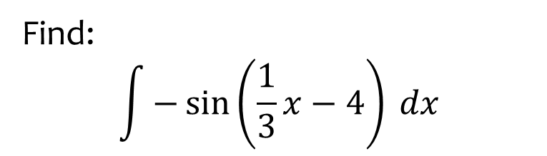


Worked example
Your turn
Find:
$$\int{\sin\left(6x+1\right) dx}$$
$$\int{−\sin\left(\frac{x}{5}−2\right) dx}$$
$$\int{\sin\left(3−4x\right) dx}$$
Find:
$$\int{−\sin\left(\frac{1}{3}x−4\right) dx}$$
$$3\cos\left(\frac{1}{3}x−4\right)+c$$

Slide 14
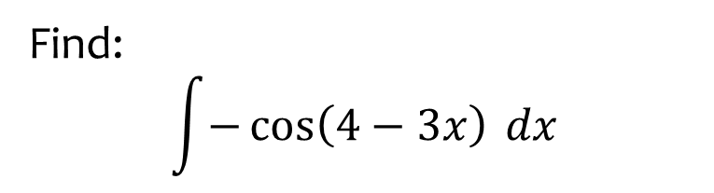


Worked example
Your turn
Find:
$$\int{\cos\left(6x+1\right) dx}$$
$$\int{−\cos\left(\frac{x}{5}−2\right) dx}$$
$$\int{\cos\left(3−4x\right) dx}$$
Find:
$$\int{−\cos\left(4−3x\right) dx}$$
$$\frac{1}{3}\sin\left(4−3x\right)+c$$

Slide 15
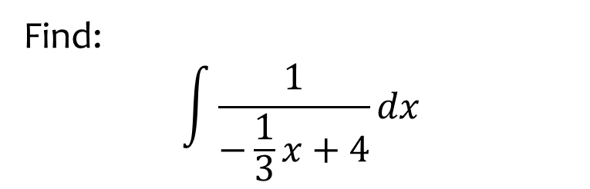


Worked example
Your turn
Find:
$$\int{\frac{1}{6x−1}dx}$$
$$\int{\frac{1}{\frac{1}{5}x+2}dx}$$
$$\int{\frac{1}{3−4x}dx}$$
Find:
$$\int{\frac{1}{−\frac{1}{3}x+4}dx}$$
$$−3\ln\left|−\frac{1}{3}x+4\right|+c$$

Slide 16
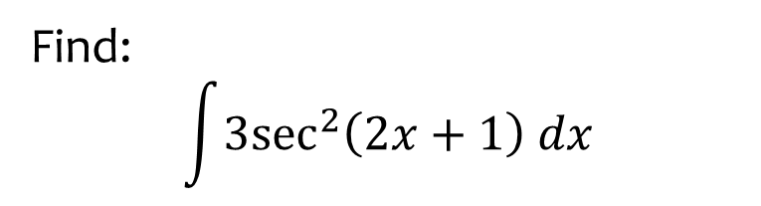


Worked example
Your turn
Find:
$$\int{\sec^{2}\left(2x−3\right) dx}$$
$$\int{{6sec}^{2}\left(5−4x\right) dx}$$
Find:
$$\int{{3sec}^{2}\left(2x+1\right) dx}$$
$$\frac{3}{2}\tan{(2x+1)}+c$$

Slide 17
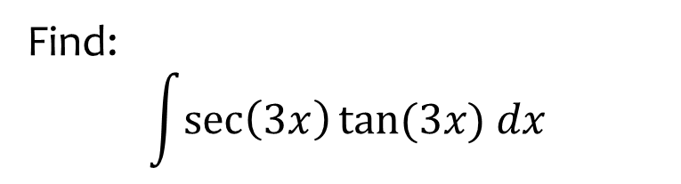


Worked example
Your turn
Find:
$$\int{\sec{5x}\tan{5x}}dx$$
$$\int{\sec{\frac{x}{4}}\tan{\frac{x}{4}}}dx$$
Find:
$$\int{\sec\left(3x\right)tan⁡(3x) dx}$$
$$\frac{1}{3}\sec\left(3x\right)+c$$

Slide 18



Worked example
Your turn
Find:
$$\int{e^{6x+1}}dx$$
$$\int{e^{\frac{1}{5}x−2}}dx$$
$$\int{e^{4−3x}}dx$$
Find:
$$\int{e^{−\frac{1}{3}x−4}}dx$$
$$−3e^{−\frac{1}{3}x−4}+c$$

Slide 19



Worked example
Your turn
Find:
$$\int{{\left(e^{x}−1\right)}^{3}}dx$$
Find:
$$\int{{\left(e^{x}+1\right)}^{2}}dx$$
$$\frac{1}{2}e^{2x}+2e^{x}+x+C$$

Slide 20
11.3) Using trigonometric identities
Chapter CONTENTS

Slide 21



Worked example
Your turn
Find:
$$\int{\sin^{2}{x} dx}$$
Find:
$$\int{\cos^{2}{x} dx}$$
$$\frac{1}{2}x+\frac{1}{4}\sin{2x}+c$$

Slide 22



Worked example
Your turn
Find:
$$\int{\cot^{2}{x} dx}$$
Find:
$$\int{\tan^{2}{x} dx}$$
$$\tan{x}−x+c$$

Slide 23
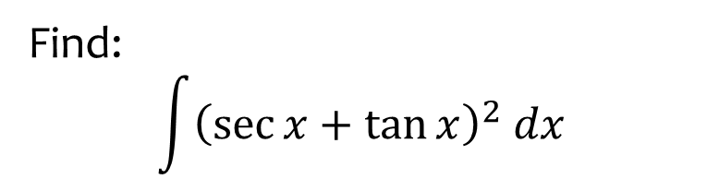
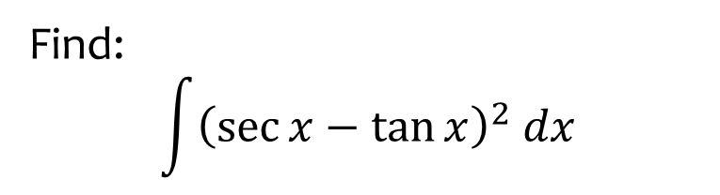

Worked example
Your turn
Find:
$$\int{{\left(\sec{x}−\tan{x}\right)}^{2} dx}$$
Find:
$$\int{{\left(\sec{x}+\tan{x}\right)}^{2} dx}$$
$$2\tan{x}−2\sec{x}−x+c$$

Slide 24
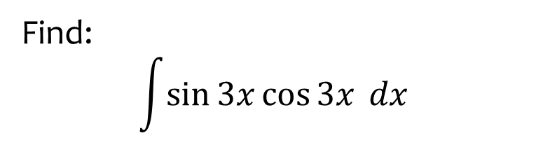


Worked example
Your turn
Find:
$$\int{\sin{5x}\cos{5x} dx}$$
$$\int{\sin{\frac{x}{4}}\cos{\frac{x}{4}} dx}$$
Find:
$$\int{\sin{3x}\cos{3x} dx}$$
$$−\frac{1}{12}\cos{6x}+c$$

Slide 25
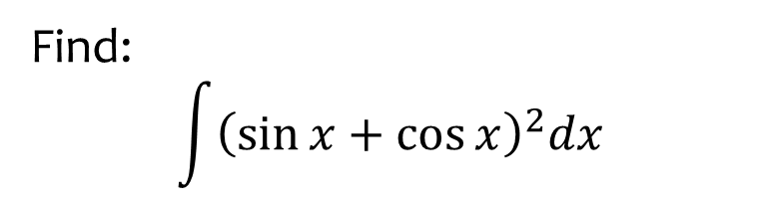
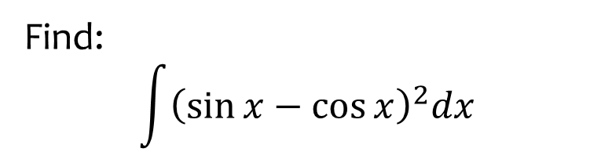

Worked example
Your turn
Find:
$$\int{{\left(\sin{x}−\cos{x}\right)}^{2}dx}$$
Find:
$$\int{{\left(\sin{x}+\cos{x}\right)}^{2}dx}$$
$$x−\frac{1}{2}\cos{2x}+c$$

Slide 26
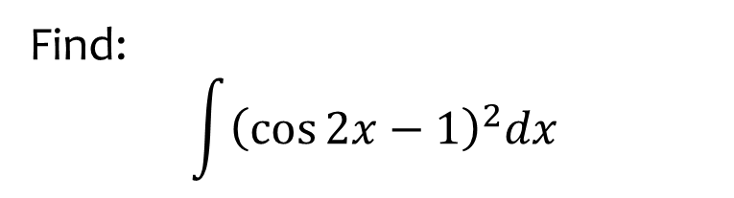
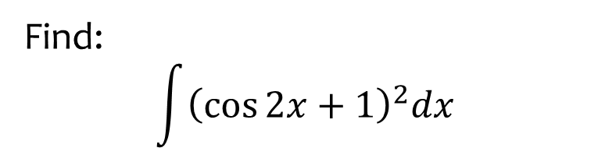
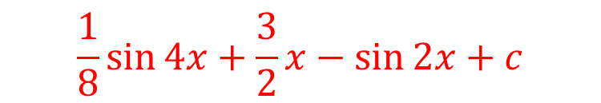
Worked example
Your turn
Find:
$$\int{{\left(\cos{2x}+1\right)}^{2}dx}$$
Find:
$$\int{{\left(\cos{2x}−1\right)}^{2}dx}$$
$$\frac{1}{8}\sin{4x}+\frac{3}{2}x−\sin{2x}+c$$

Slide 27
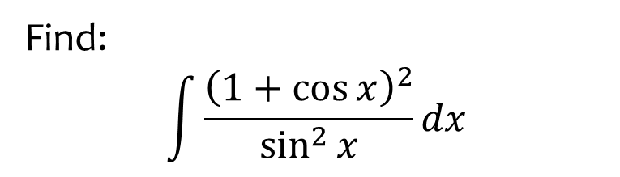
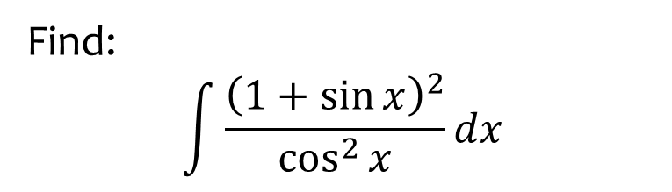

Worked example
Your turn
Find:
$$\int{\frac{{\left(1+\sin{x}\right)}^{2}}{\cos^{2}{x}}dx}$$
Find:
$$\int{\frac{{\left(1+\cos{x}\right)}^{2}}{\sin^{2}{x}}dx}$$
$$−2\cot{x}−x−2 cosec x+c$$

Slide 28



Worked example
Your turn
Find:
$$\int{\frac{\cos{2x}}{\sin^{2}{x}}dx}$$
Find:
$$\int{\frac{\cos{2x}}{\cos^{2}{x}}dx}$$
$$2x−\tan{x}+c$$

Slide 29
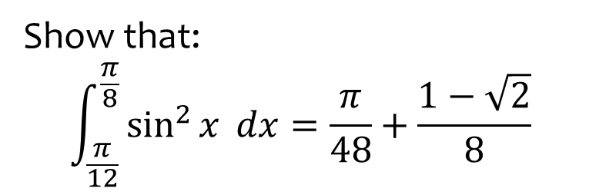
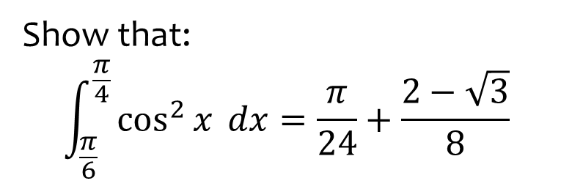

Worked example
Your turn
Show that:
$$\int_{\frac{π}{6}}^{\frac{π}{4}}{\cos^{2}{x}} dx=\frac{π}{24}+\frac{2−\sqrt{3}}{8}$$
Show that:
$$\int_{\frac{π}{12}}^{\frac{π}{8}}{\sin^{2}{x}} dx=\frac{π}{48}+\frac{1−\sqrt{2}}{8}$$
$$\frac{π}{12}$$

Slide 30
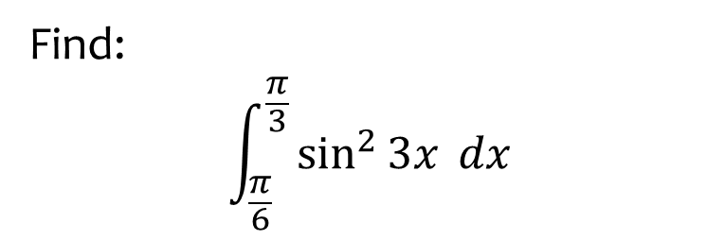

Worked example
Your turn
Find:
$$\int_{\frac{π}{6}}^{\frac{π}{3}}{\cos^{2}{3x}} dx$$
Find:
$$\int_{\frac{π}{6}}^{\frac{π}{3}}{\sin^{2}{3x}} dx$$
$$\frac{π}{12}$$

Slide 31


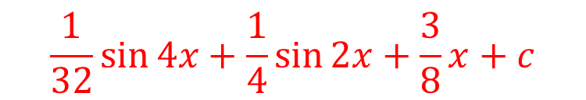
Worked example
Your turn
Find:
$$\int{\sin^{4}{x} dx}$$
Find:
$$\int{\cos^{4}{x} dx}$$
$$\frac{1}{32}\sin{4x}+\frac{1}{4}\sin{2x}+\frac{3}{8}x+c$$

Slide 32
11.4) Reverse chain rule
Chapter CONTENTS

Slide 33



Worked example
Your turn
Find:
$$\int{x^{3}{\left(x^{4}−2\right)}^{5} dx}$$
$$\int{x^{2}{\left(x^{3}−5\right)}^{4} dx}$$
Find:
$$\int{x{\left(x^{2}+5\right)}^{3} dx}$$
$$\frac{1}{8}{\left(x^{2}+5\right)}^{4}+c$$

Slide 34
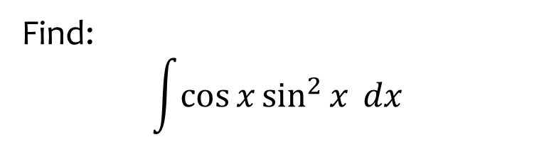


Worked example
Your turn
Find:
$$\int{\sin{x}\cos^{4}{x} dx}$$
$$\int{\sin^{3}{x}\cos{x}}dx$$
Find:
$$\int{\cos{x}\sin^{2}{x} dx}$$
$$\frac{1}{3}\sin^{3}{x}+c$$

Slide 35



Worked example
Your turn
Find:
$$\int{\frac{x^{3}}{x^{4}+1} dx}$$
$$\int{\frac{x^{2}}{4x^{3}−5} dx}$$
Find:
$$\int{\frac{x}{3x^{2}+2} dx}$$
$$\frac{1}{6}ln\left|3x^{2}+2\right|+c$$

Slide 36



Worked example
Your turn
Find:
$$\int{\frac{4x^{3}}{x^{4}+1} dx}$$
$$\int{\frac{12x^{2}}{4x^{3}−5} dx}$$
Find:
$$\int{\frac{6x}{3x^{2}+2} dx}$$
$$\ln\left|3x^{2}+2\right|+c$$

Slide 37



Worked example
Your turn
Find:
$$\int{\frac{x}{{\left(x^{2}−3\right)}^{5}}dx}$$
$$\int{\frac{x^{2}}{{\left(x^{3}−2\right)}^{4}}dx}$$
Find:
$$\int{\frac{x}{{\left(x^{2}+5\right)}^{3}}dx}$$
$$−\frac{1}{4}{\left(x^{2}+5\right)}^{−2}+c$$

Slide 38



Worked example
Your turn
Find:
$$\int{x^{3} e^{x^{4}+5} dx}$$
$$\int{x^{2} e^{x^{3}−4} dx}$$
Find:
$$\int{x e^{x^{2}+1} dx}$$
$$\frac{1}{2}e^{x^{2}+1}+c$$

Slide 39



Worked example
Your turn
Find:
$$\int{\frac{3x^{2}+5}{\sqrt{x^{3}+5x−2}} dx}$$
$$\int{\frac{12x^{3}−45x^{2}}{\sqrt{x^{4}−5x^{3}+1}} dx}$$
Find:
$$\int{\frac{2x+1}{\sqrt{x^{2}+x−3}} dx}$$
$$2\sqrt{x^{2}+x−3}+c$$

Slide 40



Worked example
Your turn
Find:
$$\int{\frac{\sin{x}}{\cos{x}+5}dx}$$
$$\int{\frac{\sec^{2}{x}}{\tan{x}−3}dx}$$
Find:
$$\int{\frac{\cos{x}}{\sin{x}+2}dx}$$
$$\ln\left|\sin{x}+2\right|+c$$

Slide 41



Worked example
Your turn
Find:
$$\int{\sin{x} e^{\cos{x}}}dx$$
$$\int{\sec^{2}{x} e^{\tan{x}}}dx$$
Find:
$$\int{\cos{x} e^{\sin{x}}}dx$$
$$e^{\sin{x}}+c$$

Slide 42



Worked example
Your turn
Find:
$$\int{\sin{x}{\left(\cos{x}−1\right)}^{5} dx}$$
$$\int{\sec^{2}{x}{\left(\tan{x}+3\right)}^{6} dx}$$
Find:
$$\int{\cos{x}{\left(\sin{x}−5\right)}^{7} dx}$$
$$\frac{1}{8}{\left(\sin{x}−5\right)}^{8}+c$$

Slide 43



Worked example
Your turn
Find:
$$\int{\sec^{2}{x}\tan{x}} dx$$
$$\int{2\sec^{3}{x}\tan{x}} dx$$
Find:
$$\int{3\sec^{4}{x}\tan{x}} dx$$
$$\frac{3}{4}\sec^{4}{x}+c$$

Slide 44



Worked example
Your turn
Find:
$$\int{\frac{cosec^{2}x}{{\left(3−\cot{x}\right)}^{4}}dx}$$
$$\int{\frac{sec^{2}x}{{\left(3+\tan{x}\right)}^{2}}dx}$$
Find:
$$\int{\frac{cosec^{2}x}{{\left(2+\cot{x}\right)}^{3}}dx}$$
$$\frac{1}{2}{\left(2+\cot{x}\right)}^{−2}+c$$

Slide 45



Worked example
Your turn
Find:
$$\int{\frac{\sin{4x}}{\cos{4x}+2}dx}$$
$$\int{\frac{\sec^{2}{3x}}{\tan{3x}−5}dx}$$
Find:
$$\int{\frac{\cos{2x}}{\sin{2x}+3}dx}$$
$$\frac{1}{2}\ln\left|\sin{2x}+3\right|+c$$

Slide 46



Worked example
Your turn
Find:
$$\int{\tan{x}dx}$$
Find:
$$\int{\cot{x}dx}$$
$$\ln{|\sin{x}|}+c$$

Slide 47
11.5) Integration by substitution
Chapter CONTENTS

Slide 48



Worked example
Your turn
Find:
$$\int{x{\left(2x−5\right)}^{9}} dx$$
using the substitution $u=2x−5$
Find:
$$\int{x{\left(5x−2\right)}^{8}} dx$$
using the substitution $u=5x−2$
$$\frac{{\left(5x−2\right)}^{10}}{250}+\frac{2{\left(5x−2\right)}^{9}}{225}+c$$

Slide 49



Worked example
Your turn
Find:
$$\int{x\sqrt{5x+2}} dx$$
using the substitution $u=5x+2$
Find:
$$\int{x\sqrt{2x+5}} dx$$
using the substitution $u=2x+5$
$$\frac{{\left(2x+5\right)}^{\frac{5}{2}}}{10}−\frac{5{\left(2x+5\right)}^{\frac{3}{2}}}{6}+c$$

Slide 50


Worked example
Your turn
Find:
$$\int{x\sqrt{5x+2}} dx$$
using the substitution $u^{2}=5x+2$
Find:
$$\int{x\sqrt{2x+5}} dx$$
using the substitution $u^{2}=2x+5$
$$\frac{{\left(2x+5\right)}^{\frac{5}{2}}}{10}−\frac{5{\left(2x+5\right)}^{\frac{3}{2}}}{6}+c$$

Slide 51



Worked example
Your turn
Find:
$$\int{\cos{x}\sin{x}{\left(2+\sin{x}\right)}^{4}} dx$$
using the substitution $u=\sin{x}+2$
Find:
$$\int{\cos{x}\sin{x}{\left(1+\sin{x}\right)}^{3}} dx$$
using the substitution $u=\sin{x}+1$
$$\frac{1}{5}{\left(\sin{x}+1\right)}^{5}−\frac{1}{4}{\left(\sin{x}+1\right)}^{4}+c$$

Slide 52



Worked example
Your turn
Find:
$$\int_{0}^{\frac{π}{2}}{\cos{x}\sin{x}{\left(2+\sin{x}\right)}^{4}}dx$$
using the substitution $u=\sin{x}+2$
Find:
$$\int_{0}^{\frac{π}{2}}{\cos{x}\sin{x}{\left(1+\sin{x}\right)}^{3}}dx$$
using the substitution $u=\sin{x}+1$
$$\frac{49}{20}$$

Slide 53


Worked example
Your turn
Find:
$$\int{\frac{3\sin{2x}}{2+\sin{x}}} dx$$
using the substitution $u=2+\sin{x}$
Find:
$$\int{\frac{2\sin{2x}}{1+\cos{x}}} dx$$
using the substitution $u=1+\cos{x}$
$$4\ln{|1+\cos{x}|}−4\cos{x}+c$$

Slide 54



Worked example
Your turn
Calculate:
$$\int_{0}^{\frac{π}{2}}{\sin{x}\sqrt{2+\cos{x}}} dx$$
using the substitution $u=\cos{x}+2$
Calculate:
$$\int_{0}^{\frac{π}{2}}{\cos{x}\sqrt{1+\sin{x}}} dx$$
using the substitution $u=\sin{x}+1$
$$\frac{2}{3}\left(2\sqrt{2}−1\right)$$

Slide 55



Worked example
Your turn
Use the substitution $u=\sqrt{x}−1$ to evaluate:
$$\int_{36}^{49}{\frac{1}{\sqrt{x}−1}}dx$$
Use the substitution $u=1+\sqrt{x}$ to evaluate:
$$\int_{16}^{25}{\frac{1}{1+\sqrt{x}}}dx$$
$$2+2\ln\left|\frac{5}{6}\right|$$

Slide 56


Worked example
Your turn
A finite region is bounded by the curve with equation $y=x^{3}\ln{(x^{2}+3)},$the $x$-axis and the lines $x=0$ and $x=\sqrt{5}$.
Use the substitution $u=x^{2}+3$ to show that the area of $R$ is $\frac{1}{2}\int_{3}^{8}{\left(u−3\right)\ln{u}}du$
A finite region is bounded by the curve with equation $y=x^{3}\ln{(x^{2}+2)},$the $x$-axis and the lines $x=0$ and $x=\sqrt{2}$.
Use the substitution $u=x^{2}+2$ to show that the area of $R$ is $\frac{1}{2}\int_{2}^{4}{\left(u−2\right)\ln{u}}du$
Shown

Slide 57


Worked example
Your turn
Using integration by substitution, prove that:
$$−\int{\frac{1}{\sqrt{1−x^{2}}}}dx=\arccos{x}+c$$
Using integration by substitution, prove that:
$$\int{\frac{1}{\sqrt{1−x^{2}}}}dx=\arcsin{x}+c$$
Shown

Slide 58



Worked example
Your turn
Use the substitution $u=\cos{x}$ to evaluate
$$\int_{0}^{\frac{π}{3}}{\sin^{3}{x}\cos^{2}{x}}dx$$
Use the substitution $u=\sin{x}$ to evaluate
$$\int_{0}^{\frac{π}{6}}{\sin^{2}{x}\cos^{3}{x}}dx$$
$$\frac{17}{480}$$

Slide 59



Worked example
Your turn
Use the substitution $x=\cos{u}$ to evaluate
$$\int_{\frac{1}{2}}^{\frac{\sqrt{3}}{2}}{x^{2}\sqrt{1−x^{2}}}dx$$
Use the substitution $x=\sin{u}$ to evaluate
$$\int_{\frac{1}{2}}^{\frac{\sqrt{3}}{2}}{x^{2}\sqrt{1−x^{2}}}dx$$
$$\frac{2π+3\sqrt{3}}{96}$$

Slide 60
11.6) Integration by parts
Chapter CONTENTS

Slide 61


Worked example
Your turn
Find:
$$\int{x\sin{x} dx}$$
Find:
$$\int{x\cos{x} dx}$$
$$x\sin{x}+\cos{x}+c$$

Slide 62


Worked example
Your turn
Find:
$$\int{x^{2}\cos{x} dx}$$
Find:
$$\int{x^{2}\sin{x} dx}$$
$$2x\sin{x}−x^{2}\cos{x}+2\cos{x}+c$$

Slide 63


Worked example
Your turn
Find:
$$\int{x^{2}e^{−x} dx}$$
Find:
$$\int{x^{2}e^{x} dx}$$
$$x^{2}e^{x}−2xe^{x}+2e^{x}+c$$

Slide 64



Worked example
Your turn
Find:
$$\int{x^{3}\ln{x} dx}$$
Find:
$$\int{x^{2}\ln{x} dx}$$
$$\frac{1}{3}x^{3}\ln{x}−\frac{1}{9}x^{3}+c$$

Slide 65


Worked example
Your turn
Evaluate:
$$\int_{1}^{4}{\ln{x}dx}$$
Evaluate:
$$\int_{1}^{2}{\ln{x}dx}$$
$$2\ln{2}−1$$

Slide 66



Worked example
Your turn
Find:
$$\int{e^{x}\cos{x} dx}$$
Find:
$$\int{e^{x}\sin{x} dx}$$
$$−\frac{1}{2}e^{x}\cos{x}+\frac{1}{2}e^{x}\sin{x}+c$$

Slide 67


Worked example
Your turn
Evaluate:
$$\int_{0}^{\frac{π}{2}}{x\cos{x} dx}$$
Evaluate:
$$\int_{0}^{\frac{π}{2}}{x\sin{x} dx}$$
$$1$$

Slide 68
11.7) Partial fractions
Chapter CONTENTS

Slide 69



Worked example
Your turn
Find:
$$\int{\frac{x+5}{\left(x−1\right)\left(x+2\right)} dx}$$
Find:
$$\int{\frac{x−5}{\left(x+1\right)\left(x−2\right)} dx}$$
$$\ln\left|\frac{{\left(x+1\right)}^{2}}{x−2}\right|+c$$

Slide 70



Worked example
Your turn
Find:
$$\int{\frac{3x+15−4x^{2}}{\left(2x+1\right){\left(x−2\right)}^{2}} dx}$$
Find:
$$\int{\frac{8x^{2}−19x+1}{\left(2x+1\right){\left(x−2\right)}^{2}} dx}$$
$$\ln\left|\left(2x+1\right){\left(x−2\right)}^{3}\right|+\frac{1}{x−2}+c$$

Slide 71



Worked example
Your turn
Evaluate:
$$\int_{0}^{2}{\frac{8x^{2}+34x+20}{(2x+1)(x+1)(x+3)}}$$
Evaluate:
$$\int_{0}^{2}{\frac{4−2x}{(2x+1)(x+1)(x+3)}}$$
$$\ln\left(\frac{125}{81}\right)$$

Slide 72



Worked example
Your turn
Find:
$$\int{\frac{4}{x^{2}−4} dx}$$
Find:
$$\int{\frac{2}{x^{2}−1} dx}$$
$$ln \left|\frac{x−1}{x+1}\right|+c$$

Slide 73



Worked example
Your turn
Find:
$$\int{\frac{x^{2}}{x−1} dx}$$
Find:
$$\int{\frac{x^{2}}{x+1} dx}$$
$$\frac{1}{2}x^{2}−x+\ln\left|x+1\right|+c$$

Slide 74



Worked example
Your turn
Find:
$$\int{\frac{x}{x−2} dx}$$
$$\int{\frac{x−2}{x}dx}$$
Find:
$$\int{\frac{x}{x−1} dx}$$
$$\int{\frac{x−1}{x}dx}$$
$$x+\ln\left|x−1\right|+c$$
$$x−\ln\left|x\right|+c$$

Slide 75



Worked example
Your turn
Find:
$$\int{\frac{x^{3}−2}{x−1} dx}$$
Find:
$$\int{\frac{x^{3}+2}{x+1} dx}$$
$$\frac{1}{3}x^{3}−\frac{1}{2}x^{2}+x+\ln\left|x+1\right|+c$$

Slide 76



Worked example
Your turn
Find:
$$\int{\frac{4x^{2}−2x−18}{4x^{2}−9} dx}$$
Find:
$$\int{\frac{9x^{2}−3x+2}{9x^{2}−4} dx}$$
$$x+\frac{1}{3}\ln\left|\frac{3x−2}{{\left(3x+2\right)}^{2}}\right|+c$$

Slide 77
11.8) Finding areas
Chapter CONTENTS

Slide 78


Worked example
Your turn
A finite region is bound by the curve
$y=\frac{3}{\sqrt{9+4x}}$, the $x$-axis, and the lines $x=0$ and $x=4$. Use integration to find the area of the region.
A finite region is bound by the curve
$y=\frac{9}{\sqrt{4+3x}}$, the $x$-axis, and the lines $x=0$ and $x=4$. Use integration to find the area of the region.
$$12$$

Slide 79





Worked example
Your turn
A finite region is bound between the curves $y=\sin{2x}$ and $y=\cos{x}\sin^{2}{x}$ where $0≤x≤\frac{π}{2}$. Use integration to find the area of the region.
A finite region is bound between the curves $y=\sin{2x}$ and $y=\sin{x}\cos^{2}{x}$ where $0≤x≤\frac{π}{2}$. Use integration to find the area of the region.
$$\frac{2}{3}$$
Graphs used with permission from DESMOS: https://www.desmos.com/

Slide 80
11.8+) Finding areas: Areas under parametric curves
Chapter CONTENTS

Slide 81


Worked example
Your turn
Determine the area bound between the curve with parametric equations
$x=t^{2}$ and $y=t−1$, the $x$-axis, and the lines $x=0$ and $x=5$.
Determine the area bound between the curve with parametric equations
$x=t^{2}$ and $y=t+1$, the $x$-axis, and the lines $x=0$ and $x=3$.
$$2\sqrt{3}+3$$

Slide 82


Worked example
Your turn
The curve $C$ has parametric equations
$$x=t\left(2+t\right), y=\frac{1}{2+t}, t≥0$$
Find the exact area of the region, bounded by $C$, the $x$-axis and the lines $x=0$ and $x=8$.
The curve $C$ has parametric equations
$$x=t\left(1+t\right), y=\frac{1}{1+t}, t≥0$$
Find the exact area of the region, bounded by $C$, the $x$-axis and the lines $x=0$ and $x=2$.
$$2−\ln{2}$$

Slide 83



Worked example
Your turn
The curve $C$ has parametric equations
$$x=1−\frac{1}{4}t, y=4^{t}−1, t≥0$$
A finite region is bounded by the curve $C$, the $x$-axis and the line $x=−1$. Find the exact area of this region.
The curve $C$ has parametric equations
$$x=1−\frac{1}{2}t, y=2^{t}−1, t≥0$$
A finite region is bounded by the curve $C$, the $x$-axis and the line $x=−1$. Find the exact area of this region.
$$\frac{15}{2\ln{2}}−2$$

Slide 84
11.9) The trapezium rule
Chapter CONTENTS

Slide 85


Worked example
Your turn
Using the trapezium rule, approximate the region bounded between $x=1$, $x=3$, the $x$-axis and the curve $y=x^{2}$, using 8 strips.
Using the trapezium rule, approximate the region bounded between $x=1$, $x=3$, the $x$-axis and the curve $y=x^{2}$, using 4 strips.
$$8.75$$

Slide 86



Worked example
Your turn
$$I=\int_{0}^{\frac{π}{3}}{\sec{x} dx}$$
Use the trapezium rule with two strips to estimate $I$.
$$I=\int_{0}^{\frac{π}{3}}{\sec{x} dx}$$
Use the trapezium rule with four strips to estimate $I$.
$1.34$(2 dp)

Slide 87



Worked example
Your turn
$$I=\int_{0}^{\frac{π}{2}}{\sin{x} dx}$$
Use the trapezium rule with four strips to estimate $I$
State, with a reason, whether your approximation is an underestimate or an overestimate
Find the percentage error of your estimate to the exact value of $I$
Give one way the trapezium rule can be used to give a more accurate approximation
$$I=\int_{−\frac{π}{2}}^{\frac{π}{2}}{\cos{x} dx}$$
Use the trapezium rule with four strips to estimate $I$
State, with a reason, whether your approximation is an underestimate or an overestimate
Find the percentage error of your estimate to the exact value of $I$
Give one way the trapezium rule can be used to give a more accurate approximation
a) $1.896$(3 dp)
b) Underestimate. The graph of $y=\cos{x}$ is
convex in the interval $[−\frac{π}{2},\frac{π}{2}]$
c) $5.19\%$ (3 sf)
d) Increase number of trapezia, decrease $h$, increase $n$ etc.

Slide 88
11.10) Solving differential equations
Chapter CONTENTS

Slide 89



Worked example
Your turn
Find the general solution to:
$$\frac{dy}{dx}=xy−y$$
Find the general solution to:
$$\frac{dy}{dx}=xy+y$$
$$y=Ae^{\frac{1}{2}x^{2}+x}$$

Slide 90



Worked example
Your turn
Find the general solution to:
$$\left(1−x^{2}\right)\frac{dy}{dx}=x\cot{y}$$
Find the general solution to:
$$\left(1+x^{2}\right)\frac{dy}{dx}=x\tan{y}$$
$$y=\arcsin\left(k\sqrt{1+x^{2}}\right)$$

Slide 91



Worked example
Your turn
Find the particular solution to:
$$\frac{dy}{dx}=−\frac{3\left(y+2\right)}{\left(2x−1\right)\left(x−2\right)}$$
given that $x=4$ when $y=5$
Find the particular solution to:
$$\frac{dy}{dx}=−\frac{3\left(y−2\right)}{\left(2x+1\right)\left(x+2\right)}$$
given that $x=1$ when $y=4$
$$y=3+\frac{3}{2x+1}$$

Slide 92


Worked example
Your turn
Find the particular solution to:
$$\frac{dy}{dx}=−\frac{5}{y\sin^{2}{x}}$$
given that $y=4$ at $x=\frac{π}{4}$
Find the particular solution to:
$$\frac{dy}{dx}=−\frac{3}{y\cos^{2}{x}}$$
given that $y=2$ at $x=\frac{π}{4}$
$$y^{2}=−6\tan{x}+10$$

Slide 93



Worked example
Your turn
Find the particular solution to:
$$\frac{dy}{dx}=xy\cos{x}$$
given that $y=1$ at $x=\frac{π}{2}$
Find the particular solution to:
$$\frac{dy}{dx}=xy\sin{x}$$
given that $y=1$ at $x=\frac{π}{2}$
$$\ln{|y|}=\sin{x}−x\cos{x}−1$$

Slide 94
11.11) Modelling with differential equations
Chapter CONTENTS

Slide 95


Worked example
Your turn
The rate of increase of a human population (with population $H$, where time is $t$) is proportional to the current population.
Form a differential equation, and find its general solution.
The rate of increase of a rabbit population (with population $P$, where time is $t$) is proportional to the current population.
Form a differential equation, and find its general solution.
$$P=Ae^{kt}$$

Slide 96



Worked example
Your turn
The rate of increase of a population $P$ of microorganisms at time $t$, in hours, is given by
$$\frac{dP}{dt}=6P, k>0$$
Initially the population was of size $4$.
Find a model for $P$ in the form $P=Ae^{6t}$
Find, to the nearest hundred, the size of the population at time $t=4$
Find the time at which the population will be $10000$ times its starting value.
State one limitation of this model for large values of $t$
The rate of increase of a population $P$ of microorganisms at time $t$, in hours, is given by
$$\frac{dP}{dt}=3P, k>0$$
Initially the population was of size $8$.
Find a model for $P$ in the form $P=Ae^{3t}$
Find, to the nearest hundred, the size of the population at time $t=2$
Find the time at which the population will be $1000$ times its starting value.
State one limitation of this model for large values of $t$
a) $P=8e^{3t}$
b) $3200$
c) $2.3$ hours $=2$ hours $18$ minutes
d) The population could not increase in this way
forever due to limitations such as available food
or space

Slide 97



Worked example
Your turn
Water in a manufacturing plant is held in a large cylindrical tank of diameter 10m. Water flows out of the bottom of the tank through a tap at a rate proportional to the cube root of the volume.
Show that $t$ minutes after the tap is opened,
$\frac{dh}{dt}=−k\sqrt[3]{h}$ for some constant $k$.
(b) Show that the general solution of this differential
equation may be written $h={\left(P−Qt\right)}^{\frac{3}{2}}$, where $P$ and $Q$
are constants.
Initially the height of the water is 64m. 21 minutes later, the height is 27m.
(c) Find the values of the constants $P$ and $Q$.
(d) Find the time in minutes when the water is at a depth of 8m.
Water in a manufacturing plant is held in a large cylindrical tank of diameter 20m. Water flows out of the bottom of the tank through a tap at a rate proportional to the cube root of the volume.
Show that $t$ minutes after the tap is opened,
$\frac{dh}{dt}=−k\sqrt[3]{h}$ for some constant $k$.
(b) Show that the general solution of this differential
equation may be written $h={\left(P−Qt\right)}^{\frac{3}{2}}$, where $P$ and $Q$
are constants.
Initially the height of the water is 27m. 10 minutes later, the height is 8m.
(c) Find the values of the constants $P$ and $Q$.
(d) Find the time in minutes when the water is at a depth of 1m.
a) Shown: $k=\frac{k\sqrt[3]{100πh}}{100π}$
b) Shown
c) $P=9, Q=\frac{1}{2}$
d) $16$ minutes

Slide 98



Worked example
Your turn
Liquid is pouring into a container at a constant rate of $40 cm^{3} s^{−1}$ and is leaking out at a rate proportional to the volume of liquid already in the container.
The volume, $V cm^{3}$, of liquid in the container at time $t$seconds is satisfied by the differential equation
$$\frac{dV}{dt}=40−kV$$
The container is initially empty.
a) By solving the differential equation show that
$$V=A+Be^{−kt}$$
giving the values of $A$ and $B$ in terms of $k$
b) Given also that $\frac{dV}{dt}=20$ at $t=10$, find the volume of liquid in the container $20$ seconds after the start.
Liquid is pouring into a container at a constant rate of $20 cm^{3} s^{−1}$ and is leaking out at a rate proportional to the volume of liquid already in the container.
The volume, $V cm^{3}$, of liquid in the container at time $t$seconds is satisfied by the differential equation
$$\frac{dV}{dt}=20−kV$$
The container is initially empty.
a) By solving the differential equation show that
$$V=A+Be^{−kt}$$
giving the values of $A$ and $B$ in terms of $k$
b) Given also that $\frac{dV}{dt}=10$ at $t=5$, find the volume of liquid in the container $10$ seconds after the start.
a) $V=\frac{20}{k}−\frac{20}{k}e^{−kt}$
b) $V=\frac{75}{\ln{2}}=108 cm^{3}$ (3 sf)

Slide 99



Worked example
Your turn
A fluid reservoir initially containers 10000 litres of unpolluted fluid.
The reservoir is leaking at a constant rate of 200 litres per hour and it is suspected that contaminated fluid flows into the reservoir at a constant rate of 300 litres per day.
The contaminated fluid contains 4 grams of contaminant in every litre of fluid.
It is assumed that the contaminant instantly disperses throughout the reservoir upon entry.
Given that there are $x$ grams of contaminant in the reservoir after $t$ days,
Show that the situation can be modelled by the differential equation
$\frac{dx}{dt}=1200−\frac{2x}{100+t}$
Hence find the number of grams of contaminant in the tank after 7 days.
Explain how the model could be refined.
A storage tank initially containers 1000 litres of pure water.
Liquid is removed from the tank at a constant rate of 30 litres per hour and a chemical solution is added to the tank at a constant rate of 40 litres per hour.
The chemical solution contains 4 grams of copper sulphate per litre of water.
It is assumed that the copper suphate instantly disperses throughout the tank on entry.
Given that there are $x$ grams of copper sulphate in the tank after $t$ hours,
Show that the situation can be modelled by the differential equation
$\frac{dx}{dt}=160−\frac{3x}{100+t}$
Hence find the number of grams of copper sulphate in the tank after 6 hours.
Explain how the model could be refined.
Shown
$882 g$ (3 sf)
The model could be refined to take into account the fact that the cupper sulphate does not disperse immediately on entering the tank.

Slide 100
11.12) Integration as the limit of a sum
Chapter CONTENTS

Slide 101




Worked example
Your turn
The diagram shows a sketch of the curve with equation $y=\sqrt[4]{x},$ $x>0$.
The area under the curve may be thought of as a series of thin strips of height $y$ and width $δx$.
Calculate to 4 significant figures:
$$\lim_{δx→0}{\sum_{2}^{3}{\sqrt[4]{x}}}δx$$
The diagram shows a sketch of the curve with equation $y=\sqrt[5]{x},$ $x>0$.
The area under the curve may be thought of as a series of thin strips of height $y$ and width $δx$.
Calculate to 4 significant figures:
$$\lim_{δx→0}{\sum_{3}^{4}{\sqrt[5]{x}}}δx$$
$$1.284$$

Slide 102


Worked example
Your turn
Calculate to four significant figures:
$$\lim_{δx→0}{\sum_{5}^{6}{\cos{x}}}δx$$
Calculate to four significant figures:
$$\lim_{δx→0}{\sum_{1}^{2}{\sin{x}}}δx$$
$$0.9564$$

