Slide 1
10.6) Pulleys

Slide 2
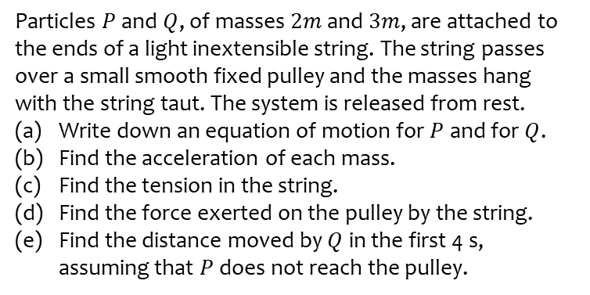
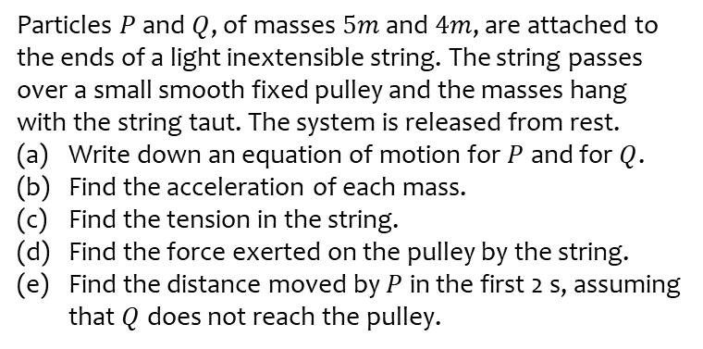
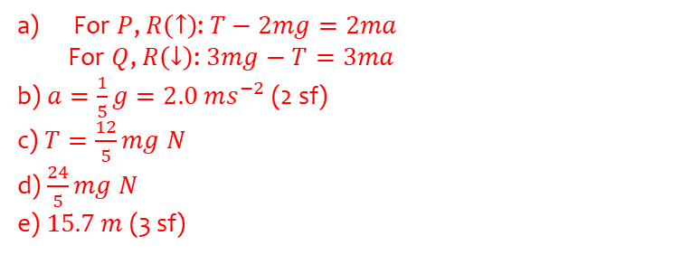
Worked example
Your turn
Particles $P$ and $Q$, of masses $5m$ and $4m$, are attached to the ends of a light inextensible string. The string passes over a small smooth fixed pulley and the masses hang with the string taut. The system is released from rest.
Write down an equation of motion for $P$ and for $Q$.
Find the acceleration of each mass.
Find the tension in the string.
Find the force exerted on the pulley by the string.
Find the distance moved by $P$ in the first 2 s, assuming that $Q$ does not reach the pulley.
Particles $P$ and $Q$, of masses $2m$ and $3m$, are attached to the ends of a light inextensible string. The string passes over a small smooth fixed pulley and the masses hang with the string taut. The system is released from rest.
Write down an equation of motion for $P$ and for $Q$.
Find the acceleration of each mass.
Find the tension in the string.
Find the force exerted on the pulley by the string.
Find the distance moved by $Q$ in the first 4 s, assuming that $P$ does not reach the pulley.
For $P$, $R\left(↑\right)$: $T−2mg=2ma$
For $Q$, $R\left(↓\right)$: $3mg−T=3ma$
b) $a=\frac{1}{5}g=2.0 ms^{−2}$ (2 sf)
c) $T=\frac{12}{5}mg N$
d) $\frac{24}{5}mg N$
e) $15.7 m$ (3 sf)

Slide 3
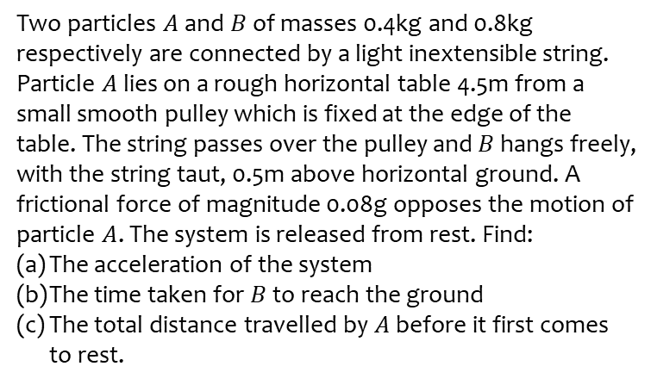
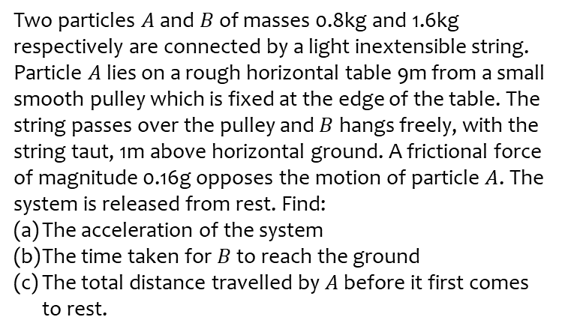
Worked example
Your turn
Two particles $A$ and $B$ of masses 0.8kg and 1.6kg respectively are connected by a light inextensible string. Particle $A$ lies on a rough horizontal table 9m from a small smooth pulley which is fixed at the edge of the table. The string passes over the pulley and $B$ hangs freely, with the string taut, 1m above horizontal ground. A frictional force of magnitude 0.16g opposes the motion of particle $A$. The system is released from rest. Find:
The acceleration of the system
The time taken for $B$ to reach the ground
The total distance travelled by $A$ before it first comes to rest.
Two particles $A$ and $B$ of masses 0.4kg and 0.8kg respectively are connected by a light inextensible string. Particle $A$ lies on a rough horizontal table 4.5m from a small smooth pulley which is fixed at the edge of the table. The string passes over the pulley and $B$ hangs freely, with the string taut, 0.5m above horizontal ground. A frictional force of magnitude 0.08g opposes the motion of particle $A$. The system is released from rest. Find:
The acceleration of the system
The time taken for $B$ to reach the ground
The total distance travelled by $A$ before it first comes to rest.
$0.6g=5.9 ms^{−2}$ (2 sf)
$0.41 s$ (2 sf)
$2.0 m$ (2 sf)

Slide 4
Worked example
Your turn
Two particles $A$ and $B$ have masses $10m$ and $km$ respectively, where $k<10$. The particles are connected by a light inextensible string which passes over a smooth light fixed pulley. The system is held at rest with the string taut, the hanging parts of the string vertical and with $A$ and $B$ at the same height above a horizontal plane.
The system is released from rest.
After release, $A$ descends with acceleration $\frac{1}{2}g$.
After descending for $2.4$ s, the particle $A$ reaches the plane.
It is immediately brought to rest by the impact with the plane.
The initial distance between $B$ and the pulley is such that, in the subsequent motion, $B$ does not reach the pulley.
Find the greatest height reached by $B$ above the plane.
Two particles $A$ and $B$ have masses $5m$ and $km$ respectively, where $k<5$. The particles are connected by a light inextensible string which passes over a smooth light fixed pulley. The system is held at rest with the string taut, the hanging parts of the string vertical and with $A$ and $B$ at the same height above a horizontal plane.
The system is released from rest.
After release, $A$ descends with acceleration $\frac{1}{4}g$.
After descending for $1.2$ s, the particle $A$ reaches the plane.
It is immediately brought to rest by the impact with the plane.
The initial distance between $B$ and the pulley is such that, in the subsequent motion, $B$ does not reach the pulley.
Find the greatest height reached by $B$ above the plane.
$$4.0 m$$

