Slide 1
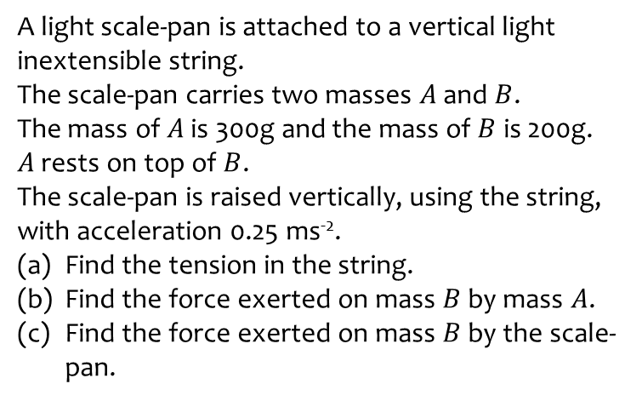
Worked example
Your turn
A light scale-pan is attached to a vertical light inextensible string.
The scale-pan carries two masses $A$ and $B$.
The mass of $A$ is 300g and the mass of $B$ is 200g.
$A$ rests on top of $B$.
The scale-pan is raised vertically, using the string, with acceleration 0.25 ms⁻².
Find the tension in the string.
Find the force exerted on mass $B$ by mass $A$.
Find the force exerted on mass $B$ by the scale-pan.
A light scale-pan is attached to a vertical light inextensible string.
The scale-pan carries two masses $A$ and $B$.
The mass of $A$ is 400g and the mass of $B$ is 600g.
$A$ rests on top of $B$.
The scale-pan is raised vertically, using the string, with acceleration 0.5 ms⁻².
Find the tension in the string.
Find the force exerted on mass $B$ by mass $A$.
Find the force exerted on mass $B$ by the scale-pan.
$10 N$ (2 sf)
$4.1 N$ (2 sf)
$10 N$ (2 sf)

Slide 2
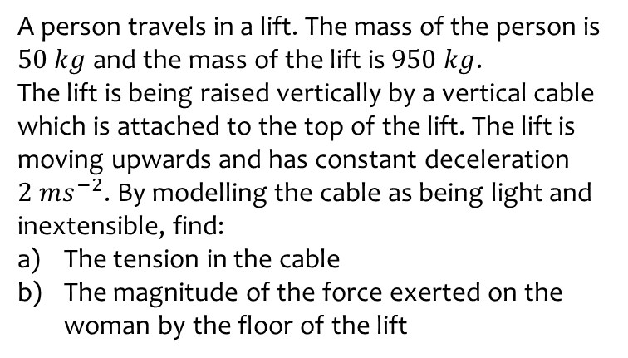
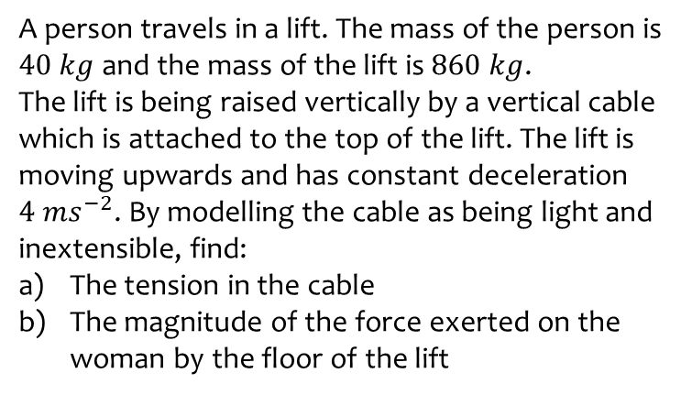
Worked example
Your turn
A person travels in a lift. The mass of the person is $40 kg$ and the mass of the lift is $860 kg$.
The lift is being raised vertically by a vertical cable which is attached to the top of the lift. The lift is moving upwards and has constant deceleration $4 ms^{−2}$. By modelling the cable as being light and inextensible, find:
The tension in the cable
The magnitude of the force exerted on the woman by the floor of the lift
A person travels in a lift. The mass of the person is $50 kg$ and the mass of the lift is $950 kg$.
The lift is being raised vertically by a vertical cable which is attached to the top of the lift. The lift is moving upwards and has constant deceleration $2 ms^{−2}$. By modelling the cable as being light and inextensible, find:
The tension in the cable
The magnitude of the force exerted on the woman by the floor of the lift
$7800 N$
$390 N$

