Slide 1
10.5) Connected particles

Slide 2
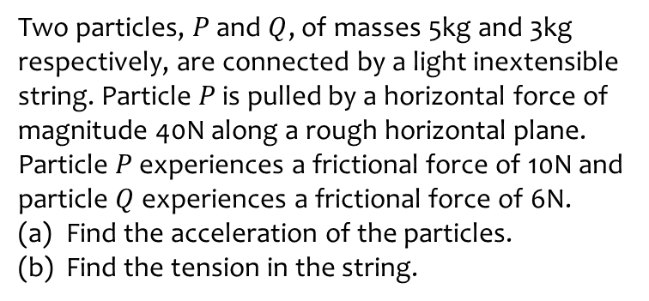
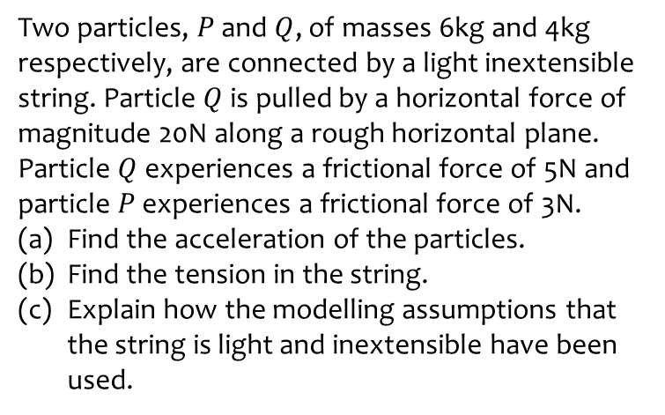
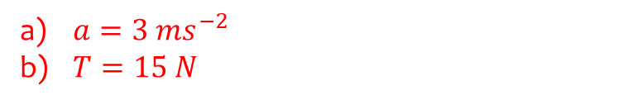
Worked example
Your turn
Two particles, $P$ and $Q$, of masses 6kg and 4kg respectively, are connected by a light inextensible string. Particle $Q$ is pulled by a horizontal force of magnitude 20N along a rough horizontal plane. Particle $Q$ experiences a frictional force of 5N and particle $P$ experiences a frictional force of 3N.
Find the acceleration of the particles.
Find the tension in the string.
Explain how the modelling assumptions that the string is light and inextensible have been used.
Two particles, $P$ and $Q$, of masses 5kg and 3kg respectively, are connected by a light inextensible string. Particle $P$ is pulled by a horizontal force of magnitude 40N along a rough horizontal plane. Particle $P$ experiences a frictional force of 10N and particle $Q$ experiences a frictional force of 6N.
Find the acceleration of the particles.
Find the tension in the string.
$a=3 ms^{−2}$
$T=15 N$

Slide 3
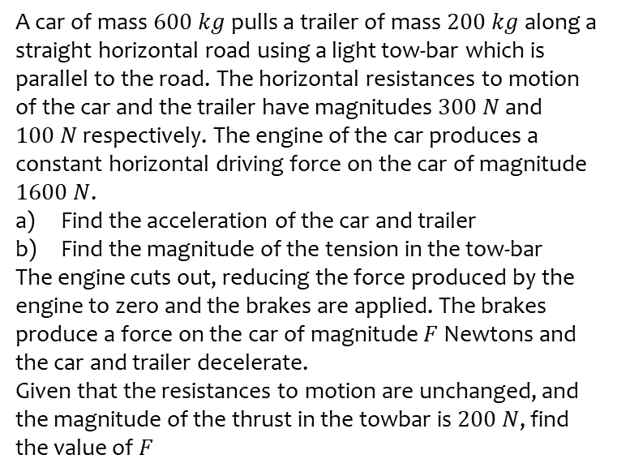
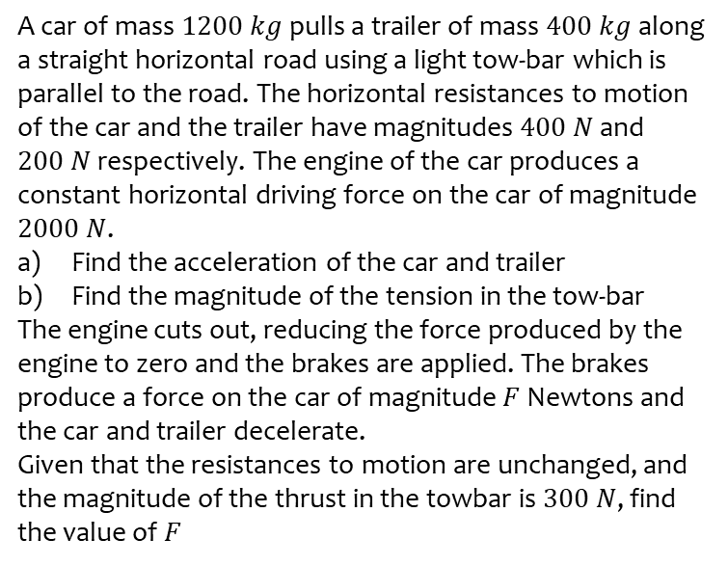
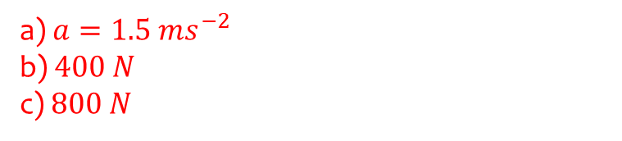
Worked example
Your turn
A car of mass $1200 kg$ pulls a trailer of mass $400 kg$ along a straight horizontal road using a light tow-bar which is parallel to the road. The horizontal resistances to motion of the car and the trailer have magnitudes $400 N$ and $200 N$ respectively. The engine of the car produces a constant horizontal driving force on the car of magnitude $2000 N$.
Find the acceleration of the car and trailer
Find the magnitude of the tension in the tow-bar
The engine cuts out, reducing the force produced by the engine to zero and the brakes are applied. The brakes produce a force on the car of magnitude $F$ Newtons and the car and trailer decelerate.
Given that the resistances to motion are unchanged, and the magnitude of the thrust in the towbar is $300 N$, find the value of $F$
A car of mass $600 kg$ pulls a trailer of mass $200 kg$ along a straight horizontal road using a light tow-bar which is parallel to the road. The horizontal resistances to motion of the car and the trailer have magnitudes $300 N$ and $100 N$ respectively. The engine of the car produces a constant horizontal driving force on the car of magnitude $1600 N$.
Find the acceleration of the car and trailer
Find the magnitude of the tension in the tow-bar
The engine cuts out, reducing the force produced by the engine to zero and the brakes are applied. The brakes produce a force on the car of magnitude $F$ Newtons and the car and trailer decelerate.
Given that the resistances to motion are unchanged, and the magnitude of the thrust in the towbar is $200 N$, find the value of $F$
a) $a=1.5 ms^{−2}$
b) $400 N$
c) $800 N$

