Slide 1
10.4) Simple trigonometric equations

Slide 2
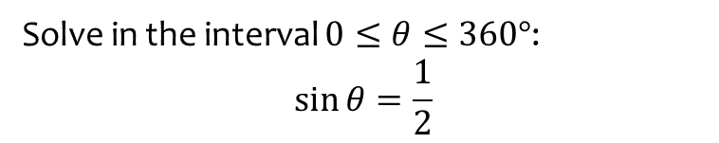

Worked example
Your turn
Solve in the interval $0≤θ≤360°$:
$$\sin{θ}=\frac{\sqrt{3}}{2}$$
$$\sin{θ}=−\frac{\sqrt{2}}{2}$$
Solve in the interval $0≤θ≤360°$:
$$\sin{θ}=\frac{1}{2}$$
$$θ=30°, 150°$$

Slide 3
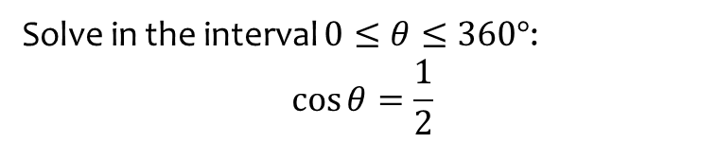

Worked example
Your turn
Solve in the interval $0≤θ≤360°$:
$$\cos{θ}=\frac{\sqrt{3}}{2}$$
$$\cos{θ}=−\frac{\sqrt{2}}{2}$$
Solve in the interval $0≤θ≤360°$:
$$\cos{θ}=\frac{1}{2}$$
$$θ=60°, 300°$$

Slide 4
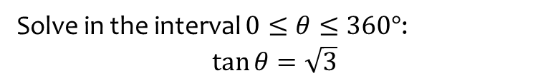

Worked example
Your turn
Solve in the interval $0≤θ≤360°$:
$$\tan{θ}=\frac{\sqrt{3}}{3}$$
$$\tan{θ}=−1$$
Solve in the interval $0≤θ≤360°$:
$$\tan{θ}=\sqrt{3}$$
$$θ=60°, 240°$$

Slide 5
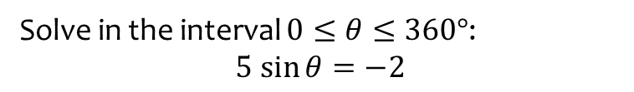


Worked example
Your turn
Solve in the interval $0≤θ≤360°$:
$$3 cos{θ}=−4$$
$$5\tan{θ}=7$$
Solve in the interval $0≤θ≤360°$:
$$5 sin{θ}=−2$$
$θ=204°, 336°$ (3 sf)

Slide 6
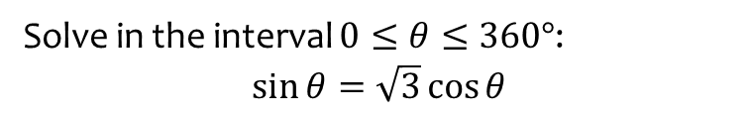
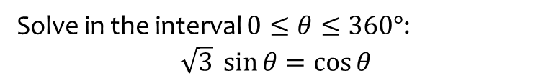
Worked example
Your turn
Solve in the interval $0≤θ≤360°$:
$$\sqrt{3} \sin{θ}=\cos{θ}$$
Solve in the interval $0≤θ≤360°$:
$$\sin{θ}=\sqrt{3}\cos{θ}$$
$$θ=60°, 240°$$

Slide 7
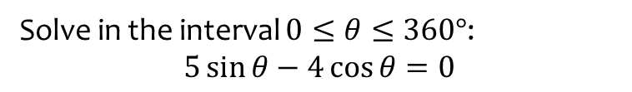
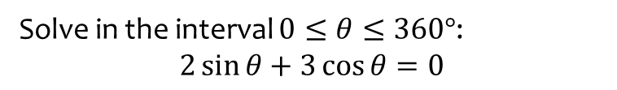

Worked example
Your turn
Solve in the interval $0≤θ≤360°$:
$$2\sin{θ}+3\cos{θ}=0$$
Solve in the interval $0≤θ≤360°$:
$$5\sin{θ}−4\cos{θ}=0$$
$θ=38.7°, 218.7°$ (1 dp)

Slide 8
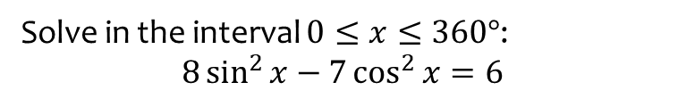
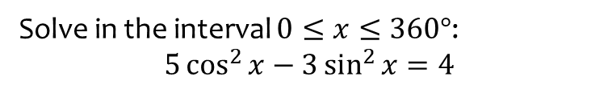

Worked example
Your turn
Solve in the interval $0≤x≤360°$:
$$5\cos^{2}{x}−3\sin^{2}{x}=4$$
Solve in the interval $0≤x≤360°$:
$$8\sin^{2}{x}−7\cos^{2}{x}=6$$
$x=84.6°, 95.4°, 256.0°, 264.6°$ (1 dp)

Slide 9
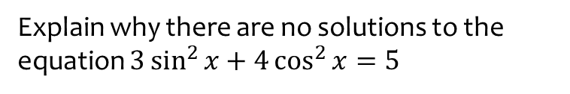
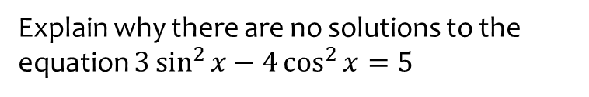
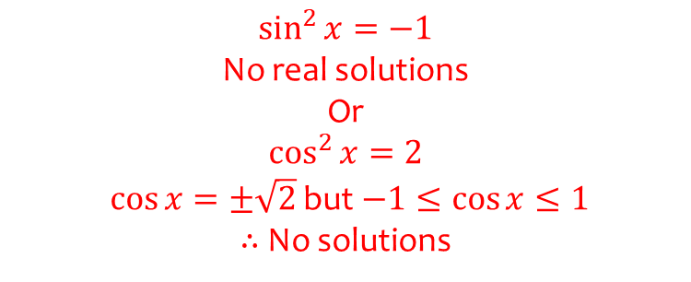
Worked example
Your turn
Explain why there are no solutions to the equation $3\sin^{2}{x}−4\cos^{2}{x}=5$
Explain why there are no solutions to the equation $3\sin^{2}{x}+4\cos^{2}{x}=5$
$\sin^{2}{x}=−1$
No real solutions
Or
$$\cos^{2}{x}=2$$
$\cos{x}=±\sqrt{2}$ but $−1≤\cos{x}≤1$
$∴$ No solutions

