Slide 1
10.4) Motion in 2 dimensions

Slide 2
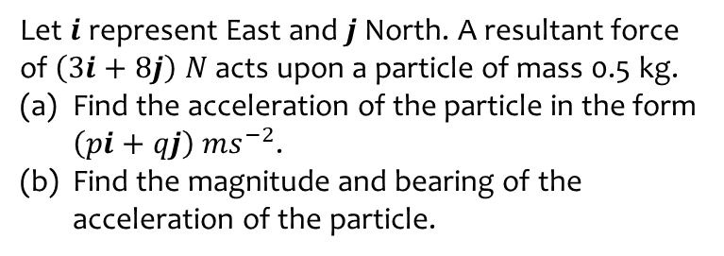
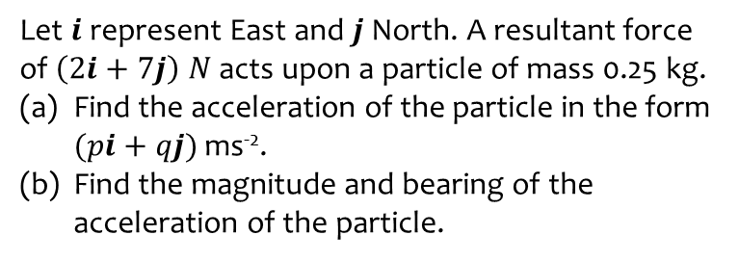
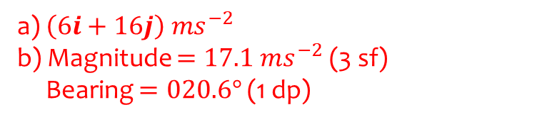
Worked example
Your turn
Let $i$ represent East and $j$ North. A resultant force of $\left(2i+7j\right)$ $N$ acts upon a particle of mass 0.25 kg.
Find the acceleration of the particle in the form $(pi+qj)$ ms⁻².
Find the magnitude and bearing of the acceleration of the particle.
Let $i$ represent East and $j$ North. A resultant force of $\left(3i+8j\right)$ $N$ acts upon a particle of mass 0.5 kg.
Find the acceleration of the particle in the form $\left(pi+qj\right) ms^{−2}$.
Find the magnitude and bearing of the acceleration of the particle.
a) $\left(6i+16j\right) ms^{−2}$
b) Magnitude $=17.1 ms^{−2}$ (3 sf)
Bearing $=020.6°$(1 dp)

Slide 3
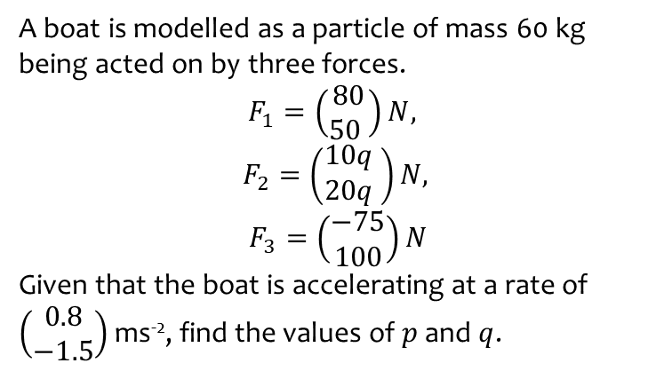
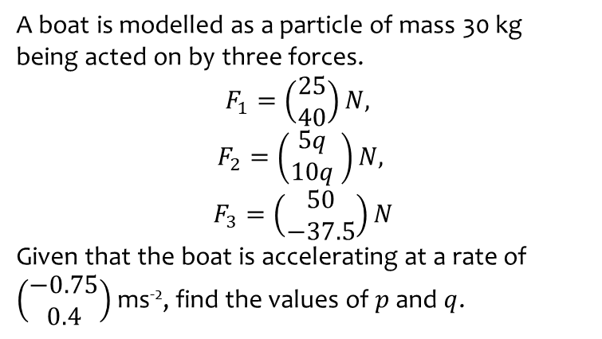
Worked example
Your turn
A boat is modelled as a particle of mass 30 kg being acted on by three forces.
$$F_{1}=\left(\begin{matrix}25 \\ 40\end{matrix}\right)N,$$
$$F_{2}=\left(\begin{matrix}5q \\ 10q\end{matrix} \right)N,$$
$$F_{3}=\left(\begin{matrix}50 \\ −37.5\end{matrix}\right)N$$
Given that the boat is accelerating at a rate of $\left(\begin{matrix}−0.75 \\ 0.4\end{matrix}\right)$ ms⁻², find the values of $p$ and $q$.
A boat is modelled as a particle of mass 60 kg being acted on by three forces.
$$F_{1}=\left(\begin{matrix}80 \\ 50 \end{matrix}\right)N,$$
$$F_{2}=\left(\begin{matrix}10q \\ 20q\end{matrix} \right)N,$$
$$F_{3}=\left(\begin{matrix}−75 \\ 100\end{matrix}\right)N$$
Given that the boat is accelerating at a rate of $\left(\begin{matrix}0.8 \\ −1.5\end{matrix}\right)$ ms⁻², find the values of $p$ and $q$.
$$p=4.3 , q=−12$$

Slide 4
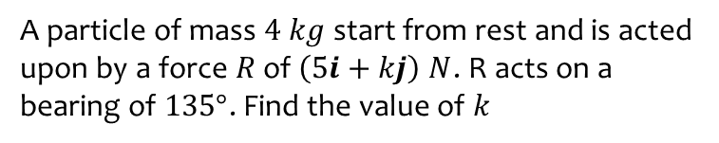
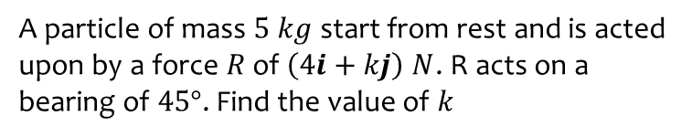
Worked example
Your turn
A particle of mass $5 kg$ start from rest and is acted upon by a force $R$ of $\left(4i+kj\right) N$. R acts on a bearing of $45°$. Find the value of $k$
A particle of mass $4 kg$ start from rest and is acted upon by a force $R$ of $\left(5i+kj\right) N$. R acts on a bearing of $135°$. Find the value of $k$
$$k=−5$$

Slide 5
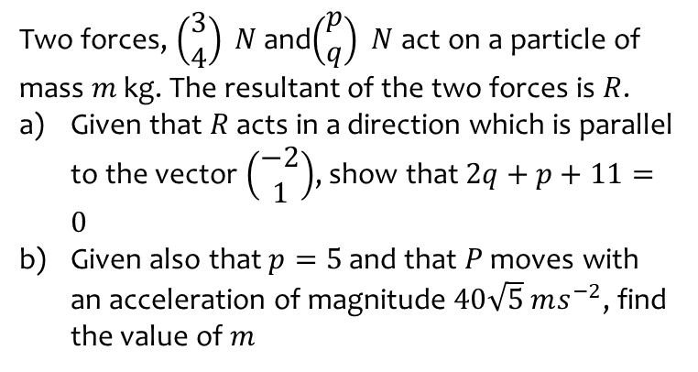
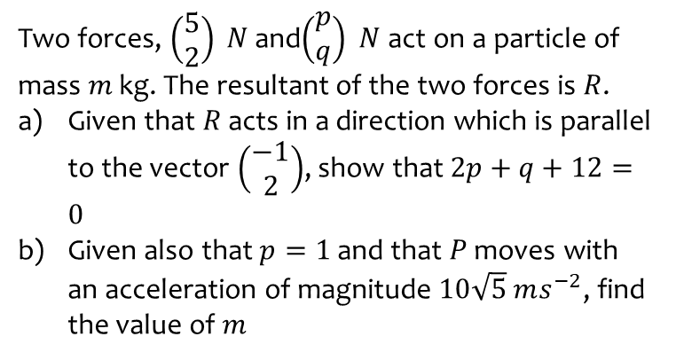
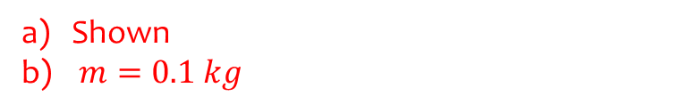
Worked example
Your turn
Two forces, $\left(\begin{matrix}5 \\ 2\end{matrix}\right) N$ and$\left(\begin{matrix}p \\ q\end{matrix}\right) N$ act on a particle of mass $m$ kg. The resultant of the two forces is $R$.
Given that $R$ acts in a direction which is parallel to the vector $\left(\begin{matrix}−1 \\ 2\end{matrix}\right)$, show that $2p+q+12=0$
Given also that $p=1$ and that $P$ moves with an acceleration of magnitude $10\sqrt{5} ms^{−2}$, find the value of $m$
Two forces, $\left(\begin{matrix}3 \\ 4\end{matrix}\right) N$ and$\left(\begin{matrix}p \\ q\end{matrix}\right) N$ act on a particle of mass $m$ kg. The resultant of the two forces is $R$.
Given that $R$ acts in a direction which is parallel to the vector $\left(\begin{matrix}−2 \\ 1\end{matrix}\right)$, show that $2q+p+11=0$
Given also that $p=5$ and that $P$ moves with an acceleration of magnitude $40\sqrt{5} ms^{−2}$, find the value of $m$
Shown
$m=0.1 kg$

