Slide 1
10.4) Applications to modelling

Slide 2
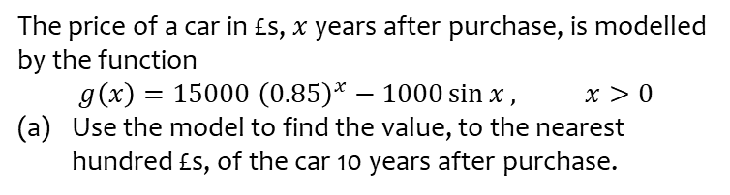
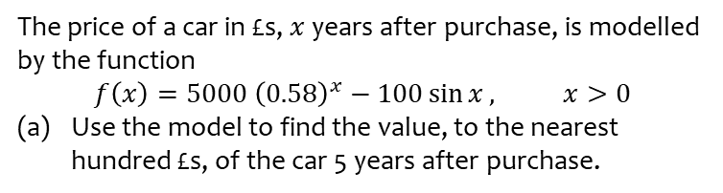
Worked example
Your turn
The price of a car in £s, $x$ years after purchase, is modelled by the function
$$f\left(x\right)=5000 {\left(0.58\right)}^{x}−100\sin{x}, x>0$$
Use the model to find the value, to the nearest hundred £s, of the car 5 years after purchase.
The price of a car in £s, $x$ years after purchase, is modelled by the function
$$g\left(x\right)=15000 {\left(0.85\right)}^{x}−1000\sin{x}, x>0$$
Use the model to find the value, to the nearest hundred £s, of the car 10 years after purchase.
(a) $£3500$

Slide 3
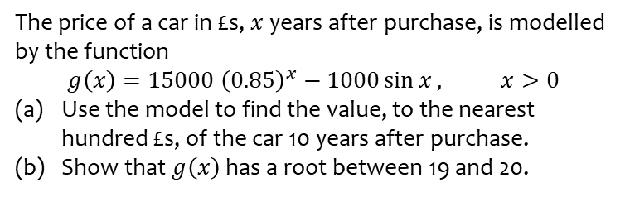
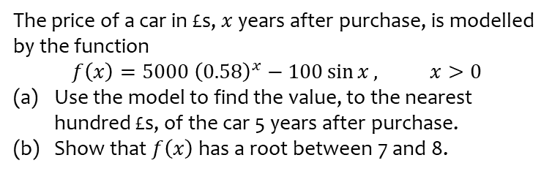
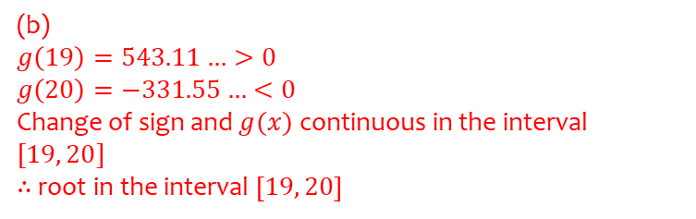
Worked example
Your turn
The price of a car in £s, $x$ years after purchase, is modelled by the function
$$f\left(x\right)=5000 {\left(0.58\right)}^{x}−100\sin{x}, x>0$$
Use the model to find the value, to the nearest hundred £s, of the car 5 years after purchase.
Show that $f\left(x\right)$ has a root between 7 and 8.
The price of a car in £s, $x$ years after purchase, is modelled by the function
$$g\left(x\right)=15000 {\left(0.85\right)}^{x}−1000\sin{x}, x>0$$
Use the model to find the value, to the nearest hundred £s, of the car 10 years after purchase.
Show that $g\left(x\right)$ has a root between 19 and 20.
(b)
$$g\left(19\right)=543.11…>0 \\ g\left(20\right)=−331.55…<0$$
Change of sign and $g(x)$ continuous in the interval $[19, 20]$
$∴$ root in the interval $\left[19, 20\right]$

Slide 4
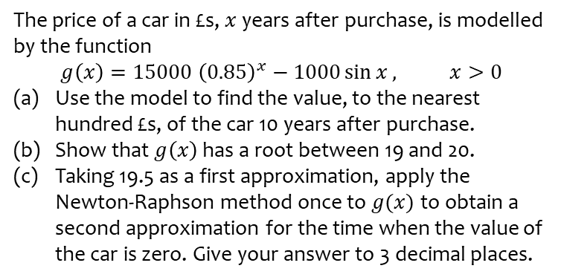
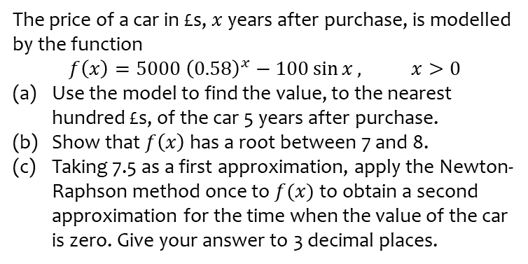
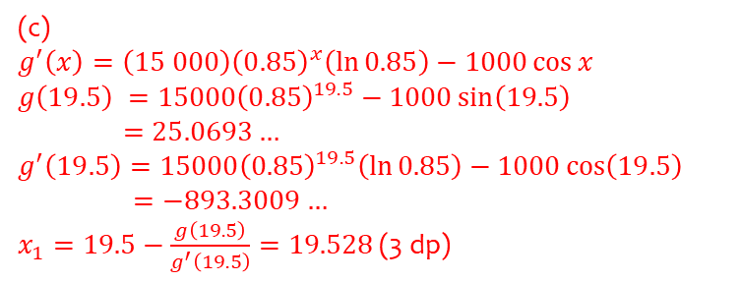
Worked example
Your turn
The price of a car in £s, $x$ years after purchase, is modelled by the function
$$f\left(x\right)=5000 {\left(0.58\right)}^{x}−100\sin{x}, x>0$$
Use the model to find the value, to the nearest hundred £s, of the car 5 years after purchase.
Show that $f\left(x\right)$ has a root between 7 and 8.
Taking 7.5 as a first approximation, apply the Newton-Raphson method once to $f(x)$ to obtain a second approximation for the time when the value of the car is zero. Give your answer to 3 decimal places.
The price of a car in £s, $x$ years after purchase, is modelled by the function
$$g\left(x\right)=15000 {\left(0.85\right)}^{x}−1000\sin{x}, x>0$$
Use the model to find the value, to the nearest hundred £s, of the car 10 years after purchase.
Show that $g\left(x\right)$ has a root between 19 and 20.
Taking 19.5 as a first approximation, apply the Newton-Raphson method once to $g(x)$ to obtain a second approximation for the time when the value of the car is zero. Give your answer to 3 decimal places.
(c)
$$g^{′}\left(x\right)=\left(15 000\right){\left(0.85\right)}^{x}\left(\ln{0.85}\right)−1000\cos{x}$$
$$g\left(19.5\right) =15000{\left(0.85\right)}^{19.5}−1000\sin\left(19.5\right)$$
$=25.0693…$
$$g^{′}\left(19.5\right)=15000{\left(0.85\right)}^{19.5}\left(\ln{0.85}\right)−1000\cos\left(19.5\right)$$
$$=−893.3009…$$
$x_{1}=19.5−\frac{g\left(19.5\right)}{g^{′}\left(19.5\right)}=19.528$ (3 dp)

Slide 5
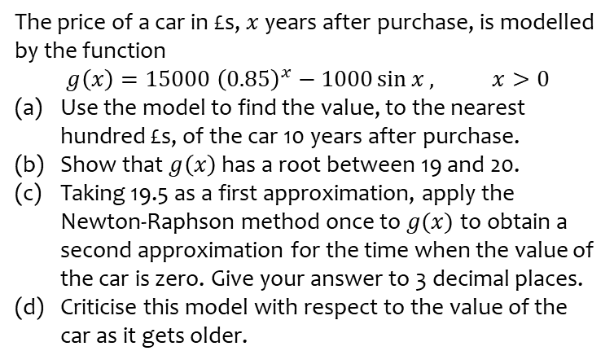
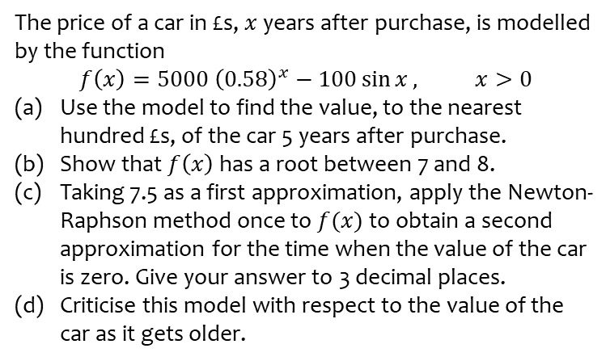
Worked example
Your turn
The price of a car in £s, $x$ years after purchase, is modelled by the function
$$f\left(x\right)=5000 {\left(0.58\right)}^{x}−100\sin{x}, x>0$$
Use the model to find the value, to the nearest hundred £s, of the car 5 years after purchase.
Show that $f\left(x\right)$ has a root between 7 and 8.
Taking 7.5 as a first approximation, apply the Newton-Raphson method once to $f(x)$ to obtain a second approximation for the time when the value of the car is zero. Give your answer to 3 decimal places.
Criticise this model with respect to the value of the car as it gets older.
The price of a car in £s, $x$ years after purchase, is modelled by the function
$$g\left(x\right)=15000 {\left(0.85\right)}^{x}−1000\sin{x}, x>0$$
Use the model to find the value, to the nearest hundred £s, of the car 10 years after purchase.
Show that $g\left(x\right)$ has a root between 19 and 20.
Taking 19.5 as a first approximation, apply the Newton-Raphson method once to $g(x)$ to obtain a second approximation for the time when the value of the car is zero. Give your answer to 3 decimal places.
Criticise this model with respect to the value of the car as it gets older.
(d) In reality, the car can never have a negative value so this model is not reasonable for cars that are approximately 20 or more years old.

