Slide 1
10.3) The Newton-Raphson method

Slide 2

Worked example
Your turn
Using the Newton-Raphson process, state the recurrence relation for the following functions:
$$f\left(x\right)=x^{4}−3$$
$$g\left(x\right)=\sec{x}$$
$$h\left(x\right)=x^{2}+x+3$$
Using the Newton-Raphson process, state the recurrence relation for the following functions:
$$f\left(x\right)=x^{3}−2$$
$$g\left(x\right)=\tan{x}$$
$$h\left(x\right)=x^{2}−x−1$$
$$x_{n+1}=x_{n}−\frac{{\left(x_{n}\right)}^{3}−2}{3{\left(x_{n}\right)}^{2}}$$
$$x_{n+1}=x_{n}−\frac{\tan{x_{n}}}{\sec^{2}{x_{n}}}=x_{n}−\frac{1}{2}\sin\left(2x_{n}\right)$$
$$x_{n+1}=x_{n}−\frac{{\left(x_{n}\right)}^{2}−x_{n}−1}{2x_{n}−1}$$

Slide 3
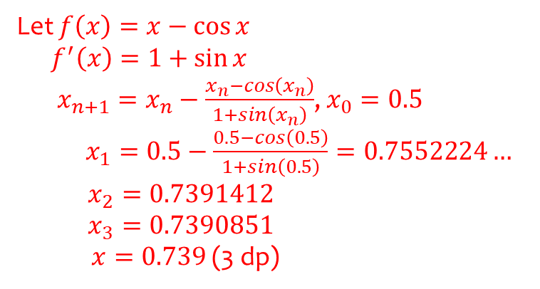
Worked example
Your turn
Using three iterations of the Newton-Raphson process, starting with $x_{0}=0.5$,
solve the equation
$$x=\sin{x}$$
Using three iterations of the Newton-Raphson process, starting with $x_{0}=0.5$,
solve the equation
$$x=\cos{x}$$
Let $f\left(x\right)=x−\cos{x}$
$f^{′}\left(x\right)=1+\sin{x}$
$x_{n+1}=x_{n}−\frac{x_{n}−cos\left(x_{n}\right)}{1+sin\left(x_{n}\right)}$, $x_{0}=0.5$
$x_{1}=0.5−\frac{0.5−cos\left(0.5\right)}{1+sin\left(0.5\right)}=0.7552224…$ $x_{2}=0.7391412$ $x_{3}=0.7390851$
$x=0.739$ (3 dp)

Slide 4
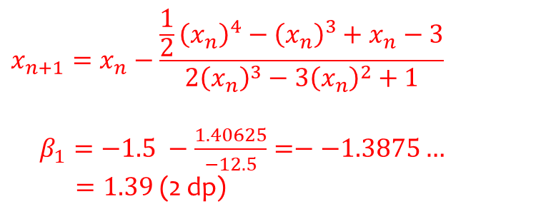
Worked example
Your turn
$$f\left(x\right)=\frac{1}{3}x^{4}−x^{2}+3x−1$$
The equation $f\left(x\right)=0$ has a root $α$ in the interval $[−2, −3]$
Taking $−2.5$ as a first approximation to $α$, apply the Newton-Raphson process once to $f(x)$ to obtain a second approximation to $α$.
Give your answer to 2 decimal places.
$$g\left(x\right)=\frac{1}{2}x^{4}−x^{3}+x−3$$
The equation $g\left(x\right)=0$ has a root $β$ in the interval $[−2, −1]$
Taking $−1.5$ as a first approximation to $β$, apply the Newton-Raphson process once to $g(x)$ to obtain a second approximation to $β$.
Give your answer to 2 decimal places.
$$x_{n+1}=x_{n}−\frac{\frac{1}{2}{\left(x_{n}\right)}^{4}−{\left(x_{n}\right)}^{3}+x_{n}−3}{2{\left(x_{n}\right)}^{3}−3{\left(x_{n}\right)}^{2}+1}$$
$β_{1}=−1.5 −\frac{1.40625}{−12.5}=−−1.3875…$
$=1.39$ (2 dp)

Slide 5
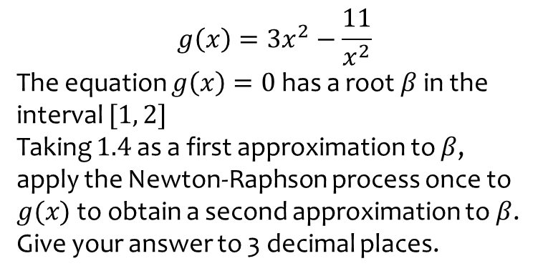
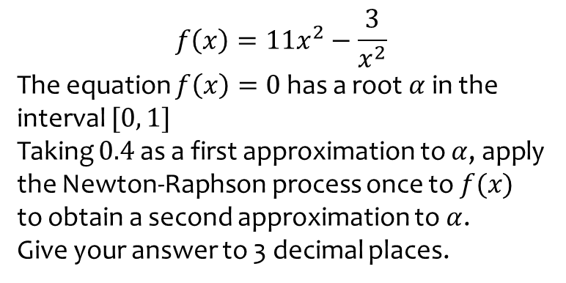
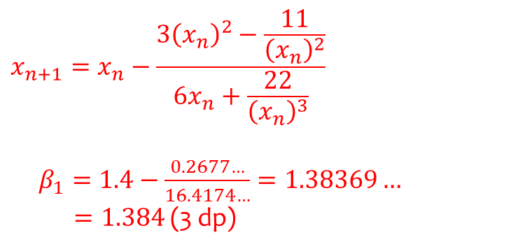
Worked example
Your turn
$$f\left(x\right)=11x^{2}−\frac{3}{x^{2}}$$
The equation $f\left(x\right)=0$ has a root $α$ in the interval $[0, 1]$
Taking $0.4$ as a first approximation to $α$, apply the Newton-Raphson process once to $f(x)$ to obtain a second approximation to $α$.
Give your answer to 3 decimal places.
$$g\left(x\right)=3x^{2}−\frac{11}{x^{2}}$$
The equation $g\left(x\right)=0$ has a root $β$ in the interval $[1, 2]$
Taking $1.4$ as a first approximation to $β$, apply the Newton-Raphson process once to $g(x)$ to obtain a second approximation to $β$.
Give your answer to 3 decimal places.
$$x_{n+1}=x_{n}−\frac{3{\left(x_{n}\right)}^{2}−\frac{11}{{\left(x_{n}\right)}^{2}}}{6x_{n}+\frac{22}{{\left(x_{n}\right)}^{3}}}$$
$β_{1}=1.4−\frac{0.2677…}{16.4174…}=1.38369…$
$=1.384$ (3 dp)

Slide 6
Worked example
Your turn
$$f\left(x\right)=x^{2}−5x+8$$
State why $x_{0}=2.5$ is not suitable to use as a first approximation to the roots of $f(x)$ when applying the Newton-Raphson method.
$$f\left(x\right)=x^{2}+7x+8$$
State why $x_{0}=−3.5$ is not suitable to use as a first approximation to the roots of $f(x)$ when applying the Newton-Raphson method.
$f^{′}\left(x\right)=2x+7=0$ -> $x=−3.5$
Turning point at $x=−3.5$
$$f^{′}\left(−3.5\right)=0$$
You cannot divide by $0$ in the Newton-Raphson method.
Also the tangent to $y=f(x)$ at $x=−3.5$ would be horizontal, and therefore never intersect the $x$-axis.

