Slide 1
10.3) Forces and acceleration

Slide 2
Worked example
Your turn
A car of 1000kg has a driving force of 1600N and forces of 400N resisting its motion.
Determine its acceleration.
A car of 2000kg has a driving force of 800N and forces of 200N resisting its motion.
Determine its acceleration.
$$0.3 ms^{−2}$$

Slide 3

Worked example
Your turn
An object of mass 140kg experiences air resistance of 600 N. Determine the object’s acceleration as it falls towards the ground.
An object of mass 70kg experiences air resistance of 300 N. Determine the object’s acceleration as it falls towards the ground.
$5.51 ms^{−2}$ (3 sf)

Slide 4
Worked example
Your turn
An adult has a mass of 100kg. What is the gravitational force (weight) acting on the adult?
A child has a mass of 50kg. What is the gravitational force (weight) acting on the child?
$$490 N$$

Slide 5
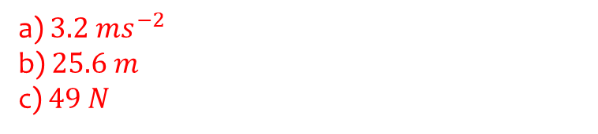
Worked example
Your turn
A body of mass 10kg is pulled along a rough horizontal table by a horizontal force of magnitude 40N against a constant friction force of magnitude 8N. Given that the body is initially at rest, find:
the acceleration of the body
the distance travelled by the body in the first 2 seconds
the magnitude of the normal reaction between the body and the table
A body of mass 5kg is pulled along a rough horizontal table by a horizontal force of magnitude 20N against a constant friction force of magnitude 4N. Given that the body is initially at rest, find:
the acceleration of the body
the distance travelled by the body in the first 4 seconds
the magnitude of the normal reaction between the body and the table
a) $3.2 ms^{−2}$
b) $25.6 m$
c) $49 N$

Slide 6
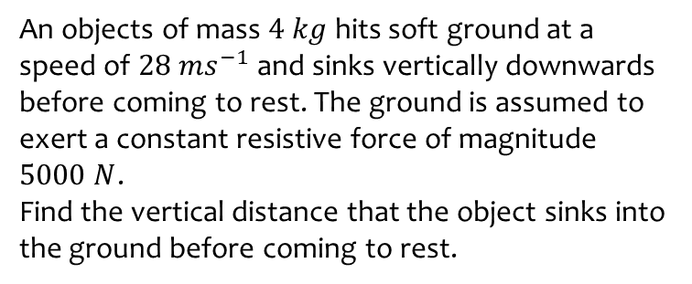
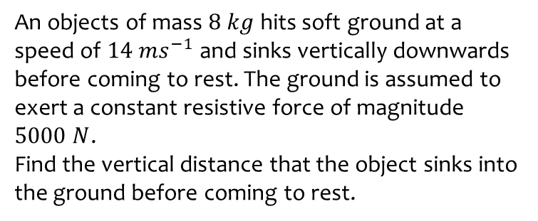

Worked example
Your turn
An objects of mass $8 kg$ hits soft ground at a speed of $14 ms^{−1}$ and sinks vertically downwards before coming to rest. The ground is assumed to exert a constant resistive force of magnitude $5000 N$.
Find the vertical distance that the object sinks into the ground before coming to rest.
An objects of mass $4 kg$ hits soft ground at a speed of $28 ms^{−1}$ and sinks vertically downwards before coming to rest. The ground is assumed to exert a constant resistive force of magnitude $5000 N$.
Find the vertical distance that the object sinks into the ground before coming to rest.
$0.32 m$ (2 sf)

Slide 7
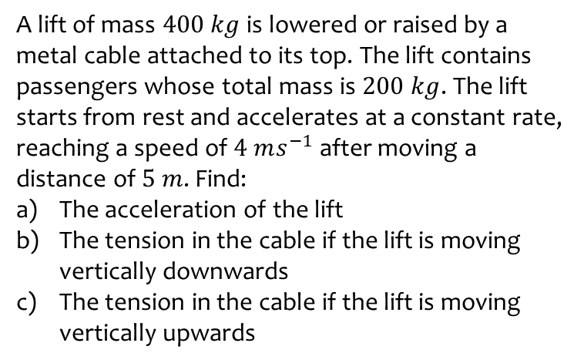
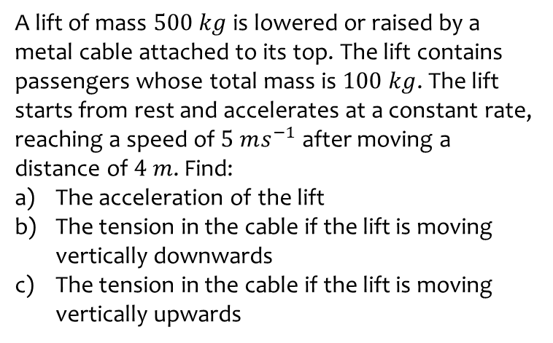
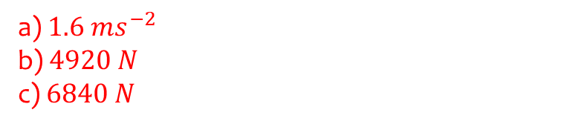
Worked example
Your turn
A lift of mass $500 kg$ is lowered or raised by a metal cable attached to its top. The lift contains passengers whose total mass is $100 kg$. The lift starts from rest and accelerates at a constant rate, reaching a speed of $5 ms^{−1}$ after moving a distance of $4 m$. Find:
The acceleration of the lift
The tension in the cable if the lift is moving vertically downwards
The tension in the cable if the lift is moving vertically upwards
A lift of mass $400 kg$ is lowered or raised by a metal cable attached to its top. The lift contains passengers whose total mass is $200 kg$. The lift starts from rest and accelerates at a constant rate, reaching a speed of $4 ms^{−1}$ after moving a distance of $5 m$. Find:
The acceleration of the lift
The tension in the cable if the lift is moving vertically downwards
The tension in the cable if the lift is moving vertically upwards
a) $1.6 ms^{−2}$
b) $4920 N$
c) $6840 N$

