Slide 1
10.2) Iteration

Slide 2
Worked example
Your turn
$$f\left(x\right)=x^{2}−5x−3$$
a) Show that $f\left(x\right)=0$ can be written as:
i) $x=\frac{x^{2}−3}{5}$ ii) $x=\sqrt{5x+3}$ iii) $x=5+\frac{3}{x}$
$$g\left(x\right)=x^{2}−6x+2$$
a) Show that $g\left(x\right)=0$ can be written as:
i) $x=\frac{x^{2}+2}{6}$ ii) $x=\sqrt{6x−2}$ iii) $x=6−\frac{2}{x}$
a) Shown

Slide 3
Worked example
Your turn
$$f\left(x\right)=x^{2}−5x−3$$
a) Show that $f\left(x\right)=0$ can be written as:
i) $x=\frac{x^{2}−3}{5}$ ii) $x=\sqrt{5x+3}$ iii) $x=5+\frac{3}{x}$
b) Starting with $x_{0}=3$ use each iterative
formula to find a root of the equation
$f\left(x\right)=0$, rounding your answers to 3
decimal places
$$g\left(x\right)=x^{2}−6x+2$$
a) Show that $g\left(x\right)=0$ can be written as:
i) $x=\frac{x^{2}+2}{6}$ ii) $x=\sqrt{6x−2}$ iii) $x=6−\frac{2}{x}$
b) Starting with $x_{0}=4$ use each iterative
formula to find a root of the equation
$g\left(x\right)=0$, rounding your answers to 3
decimal places
b) i) $x=0.354$ (3 dp)
ii) $x=5.646$ (3 dp)
iii) $x=5.646$ (3 dp)

Slide 4
Worked example
Your turn
$$f\left(x\right)=e^{x−2}+x−5$$
a) Show that $f\left(x\right)=0$ can be written as:
$$x=\ln{(5−x)}+2, x<5$$
$$f\left(x\right)=e^{x−1}+x−6$$
a) Show that $f\left(x\right)=0$ can be written as:
$$x=\ln{(6−x)}+1, x<6$$
a) Shown

Slide 5

Worked example
Your turn
$$f\left(x\right)=e^{x−2}+x−5$$
a) Show that $f\left(x\right)=0$ can be written as:
$$x=\ln{(5−x)}+2, x<5$$
The root of $f\left(x\right)=0$ is $α$.
The iterative formula
$$x_{n+1}=\ln{(5−x_{n})}+2, x_{0}=3$$
is used to find an approximate value for $α$
b) Calculate the values of $x_{1}, x_{2}$ and $x_{3}$ to four
decimal places.
$$f\left(x\right)=e^{x−1}+x−6$$
a) Show that $f\left(x\right)=0$ can be written as:
$$x=\ln{(6−x)}+1, x<6$$
The root of $f\left(x\right)=0$ is $β$.
The iterative formula
$$x_{n+1}=\ln{(6−x_{n})}+1, x_{0}=2$$
is used to find an approximate value for$β$
b) Calculate the values of $x_{1}, x_{2}$ and $x_{3}$ to four
decimal places.
b)
$$x_{0}=2 \\ x_{1}=\ln\left(6−2\right)+1$$
$=2.3863$ $$x_{2}=2.2847… \\ x_{3}=2.3125$$

Slide 6
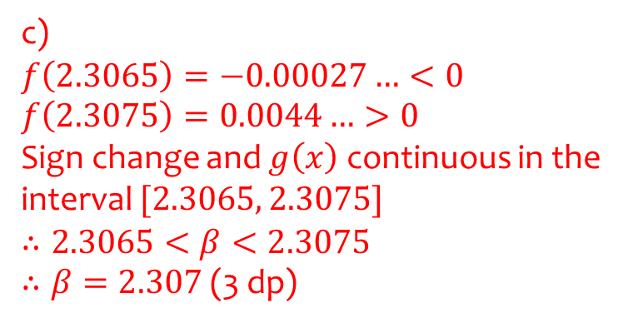
Worked example
Your turn
$$f\left(x\right)=e^{x−2}+x−5$$
a) Show that $f\left(x\right)=0$ can be written as:
$$x=\ln{(5−x)}+2, x<5$$
The root of $f\left(x\right)=0$ is $α$.
The iterative formula
$$x_{n+1}=\ln{(5−x_{n})}+2, x_{0}=3$$
is used to find an approximate value for $α$
b) Calculate the values of $x_{1}, x_{2}$ and $x_{3}$ to four
decimal places.
c) By choosing a suitable interval, show that
$α=2.792$ correct to 3 decimal places.
$$f\left(x\right)=e^{x−1}+x−6$$
a) Show that $f\left(x\right)=0$ can be written as:
$$x=\ln{(6−x)}+1, x<6$$
The root of $f\left(x\right)=0$ is $α$.
The iterative formula
$$x_{n+1}=\ln{(6−x_{n})}+1, x_{0}=2$$
is used to find an approximate value for $α$
b) Calculate the values of $x_{1}, x_{2}$ and $x_{3}$ to four
decimal places.
c) By choosing a suitable interval, show that
$β=2.307$ correct to 3 decimal places.
c)
$$f\left(2.3065\right)=−0.00027…<0 \\ f\left(2.3075\right)=0.0044…>0$$
Sign change and $g\left(x\right)$ continuous in the interval $[2.3065, 2.3075]$
$$∴2.3065<β<2.3075$$ $∴β=2.307$ (3 dp)

Slide 7
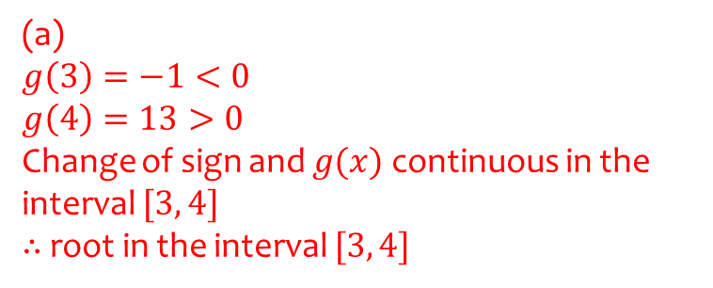
Worked example
Your turn
$$f\left(x\right)=x^{3}−5x^{2}−3x+2$$
Show that the equation $f\left(x\right)=0$ has a root in the interval $5<x<6$.
$$g\left(x\right)=x^{3}−3x^{2}−2x+5$$
Show that the equation $g\left(x\right)=0$ has a root in the interval $3<x<4$.
(a)
$$g\left(3\right)=−1<0$$
$$g\left(4\right)=13>0$$
Change of sign and $g(x)$ continuous in the interval $[3, 4]$
$∴$ root in the interval $[3, 4]$

Slide 8
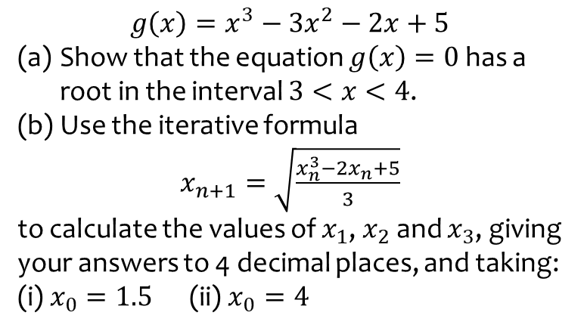
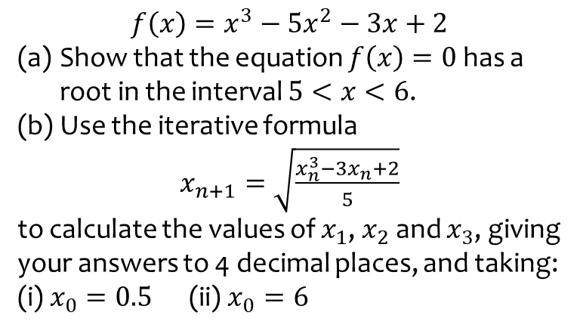
Worked example
Your turn
$$f\left(x\right)=x^{3}−5x^{2}−3x+2$$
Show that the equation $f\left(x\right)=0$ has a root in the interval $5<x<6$.
Use the iterative formula
$x_{n+1}=\sqrt{\frac{x_{n}^{3}−3x_{n}+2}{5}}$
to calculate the values of $x_{1}$, $x_{2}$ and $x_{3}$, giving your answers to 4 decimal places, and taking: (i) $x_{0}=0.5$ (ii) $x_{0}=6$
$$g\left(x\right)=x^{3}−3x^{2}−2x+5$$
Show that the equation $g\left(x\right)=0$ has a root in the interval $3<x<4$.
Use the iterative formula
$x_{n+1}=\sqrt{\frac{x_{n}^{3}−2x_{n}+5}{3}}$
to calculate the values of $x_{1}$, $x_{2}$ and $x_{3}$, giving your answers to 4 decimal places, and taking: (i) $x_{0}=1.5$ (ii) $x_{0}=4$
(b)
i)
$$x_{1}=\sqrt{\frac{{1.5}^{3}−2\left(1.5\right)+5}{3}}=1.3385… \\ x_{2}=1.2544…$$
$$x_{3}=1.2200…$$ Convergent as the change in the root on each iteration is decreasing. The iterative method will find the root.
ii)
$$x_{1}=\sqrt{\frac{4^{3}−2\left(4\right)+5}{3}}=4.5092… \\ x_{2}=5.4058 \\ x_{3}=7.1219…$$
Divergent as the change in the root on each iteration is increasing. The iterative method has failed to find the root.

Slide 9
Worked example
Your turn
$$f\left(x\right)=x^{3}+4x^{2}+3x−12$$
(a) Show that the equation can be written as
$$x=\sqrt{\frac{3(4−x)}{4+x}}, x≠−4$$
$$g\left(x\right)=x^{3}+3x^{2}+4x−12$$
(a) Show that the equation can be written as
$$x=\sqrt{\frac{4(3−x)}{3+x}}, x≠−3$$
(a) Shown

Slide 10

Worked example
Your turn
$$f\left(x\right)=x^{3}+4x^{2}+3x−12$$
(a) Show that the equation can be written as
$$x=\sqrt{\frac{3(4−x)}{4+x}}, x≠−4$$
The equation $f\left(x\right)=0$ has a single root between $1$ and $2$.
(b) Use the iterative formula
$x_{n+1}=\sqrt{\frac{4(3−x_{n})}{3+x_{n}}}, n≥0, x_{0}=1$
to calculate the values of $x_{1}$, $x_{2}$ and $x_{3}$, giving your answers to 2 decimal places.
$$g\left(x\right)=x^{3}+3x^{2}+4x−12$$
(a) Show that the equation can be written as
$$x=\sqrt{\frac{4(3−x)}{3+x}}, x≠−3$$
The equation $g\left(x\right)=0$ has a single root between $1$ and $2$.
(b) Use the iterative formula
$x_{n+1}=\sqrt{\frac{4(3−x_{n})}{3+x_{n}}}, n≥0, x_{0}=1$
to calculate the values of $x_{1}$, $x_{2}$ and $x_{3}$, giving your answers to 2 decimal places.
(b)
$$x_{1}=\sqrt{\frac{4(3−1)}{3+1}}=1.41$$ $x_{2}=1.20$
$$x_{3}=1.31$$

Slide 11
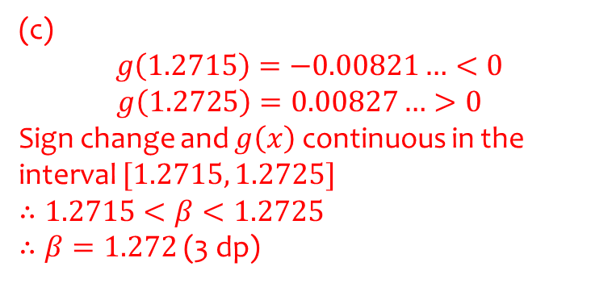
Worked example
Your turn
$$f\left(x\right)=x^{3}+4x^{2}+3x−12$$
(a) Show that the equation can be written as
$$x=\sqrt{\frac{3(4−x)}{4+x}}, x≠−4$$
The equation $f\left(x\right)=0$ has a single root between $1$ and $2$.
(b) Use the iterative formula
$x_{n+1}=\sqrt{\frac{4(3−x_{n})}{3+x_{n}}}, n≥0, x_{0}=1$
to calculate the values of $x_{1}$, $x_{2}$ and $x_{3}$, giving your answers to 2 decimal places.
(c) The root of $f\left(x\right)=0$ is $α$. By choosing a suitable interval, prove that $α=1.253$ (3 dp)
$$g\left(x\right)=x^{3}+3x^{2}+4x−12$$
(a) Show that the equation can be written as
$$x=\sqrt{\frac{4(3−x)}{3+x}}, x≠−3$$
The equation $g\left(x\right)=0$ has a single root between $1$ and $2$.
(b) Use the iterative formula
$x_{n+1}=\sqrt{\frac{4(3−x_{n})}{3+x_{n}}}, n≥0, x_{0}=1$
to calculate the values of $x_{1}$, $x_{2}$ and $x_{3}$, giving your answers to 2 decimal places.
(c) The root of $g\left(x\right)=0$ is $β$. By choosing a suitable interval, prove that $β=1.272$ (3 dp)
(c)
$$g\left(1.2715\right)=−0.00821…<0$$
$$g\left(1.2725\right)=0.00827…>0$$
Sign change and $g\left(x\right)$ continuous in the interval $[1.2715, 1.2725]$
$$∴1.2715<β<1.2725$$ $∴β=1.272$ (3 dp)

Slide 12
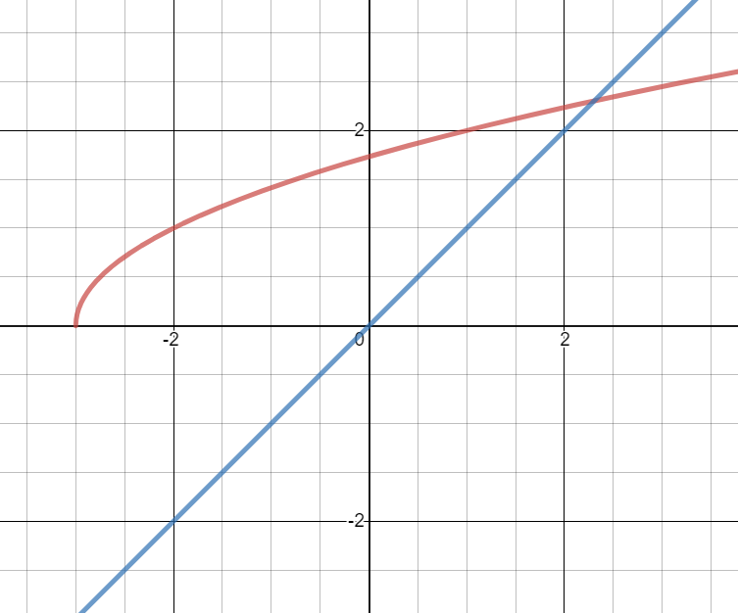
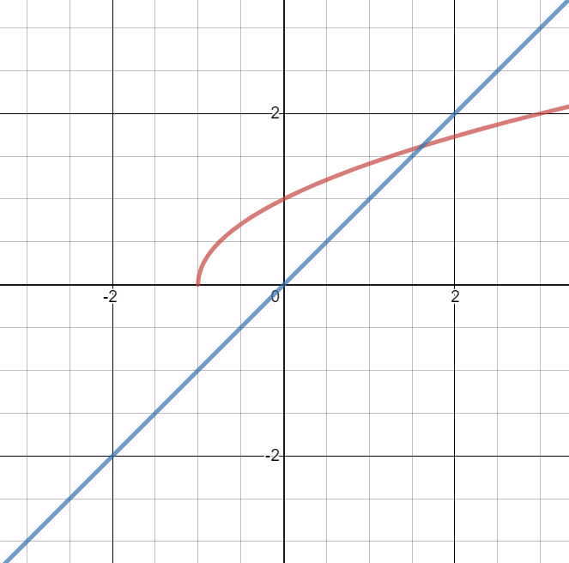
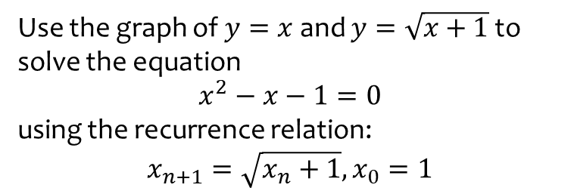
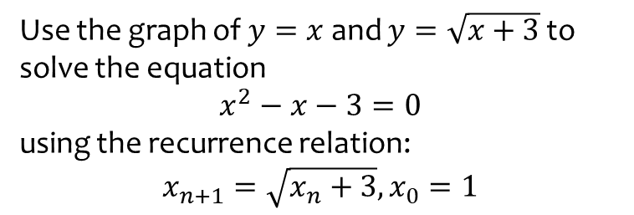
Worked example
Your turn
Use the graph of $y=x$ and $y=\sqrt{x+3}$ to solve the equation
$$x^{2}−x−3=0$$
using the recurrence relation:
$$x_{n+1}=\sqrt{x_{n}+3}, x_{0}=1$$
Use the graph of $y=x$ and $y=\sqrt{x+1}$ to solve the equation
$$x^{2}−x−1=0$$
using the recurrence relation:
$$x_{n+1}=\sqrt{x_{n}+1}, x_{0}=1$$
Staircase diagram converging to root
Graphs used with permission from DESMOS: https://www.desmos.com/

Slide 13
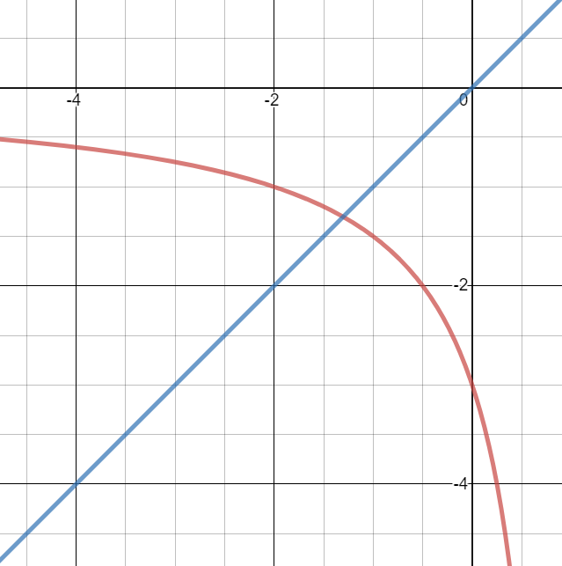
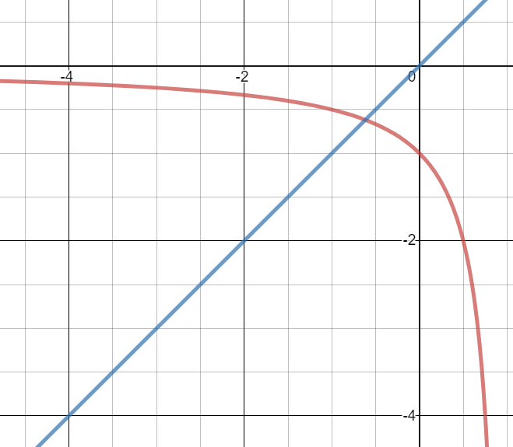
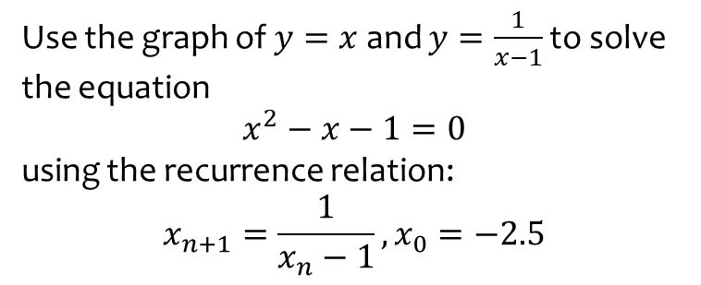
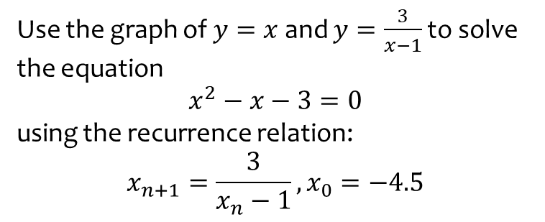
Worked example
Your turn
Use the graph of $y=x$ and $y=\frac{3}{x−1}$ to solve the equation
$$x^{2}−x−3=0$$
using the recurrence relation:
$$x_{n+1}=\frac{3}{x_{n}−1},x_{0}=−4.5$$
Use the graph of $y=x$ and $y=\frac{1}{x−1}$ to solve the equation
$$x^{2}−x−1=0$$
using the recurrence relation:
$$x_{n+1}=\frac{1}{x_{n}−1}, x_{0}=−2.5$$
Cobweb diagram converging to root
Graphs used with permission from DESMOS: https://www.desmos.com/

Slide 14
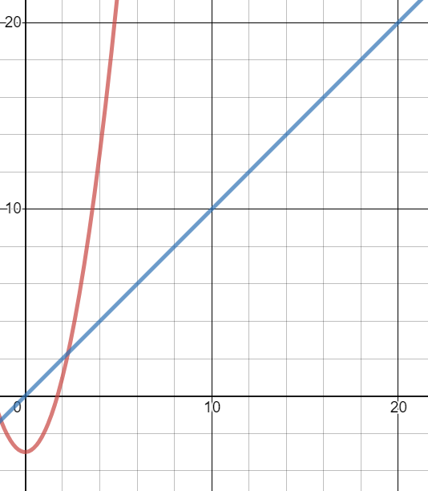
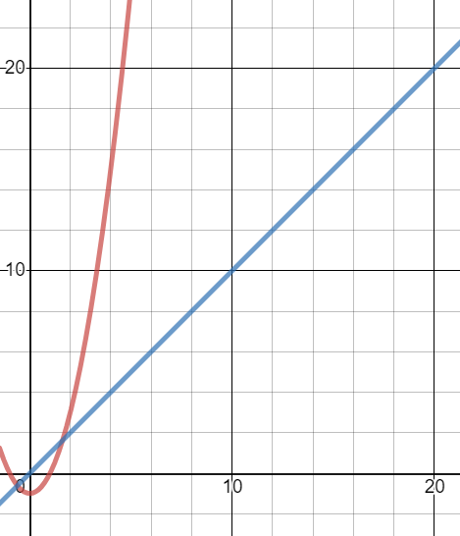
Worked example
Your turn
Use the graph of $y=x$ and $y=x^{2}−3$ to solve the equation
$$x^{2}−x−3=0$$
using the recurrence relation:
$$x_{n+1}=x_{n}^{2}−3, x_{0}=3$$
Use the graph of $y=x$ and $y=x^{2}−1$ to solve the equation
$$x^{2}−x−1=0$$
using the recurrence relation:
$$x_{n+1}=x_{n}^{2}−1,x_{0}=2$$
Root approximations diverging – iterative method fails
Graphs used with permission from DESMOS: https://www.desmos.com/

