Slide 1
10.2) Forces as vectors

Slide 2
Worked example
Your turn
The forces $3i−2j$, $−4i+j$, $−2i−3j$ and $ai+bj$ act on an object which is in equilibrium. Find the values of $a$ and $b$.
The forces $2i+3j$, $4i−j$, $−3i+2j$ and $ai+bj$ act on an object which is in equilibrium. Find the values of $a$ and $b$.
$$a=−3,b=−4$$

Slide 3
Worked example
Your turn
The vector $i$ is due east and $j$ due north.
A particle begins at rest at the origin.
It is acted on by three forces $\left(3i−j\right)$ N, $\left(2i+3j\right)$ N and $\left(−4i+j\right)$ N.
Find the resultant force in the form $pi+qj$.
Work out the magnitude and bearing of the resultant force.
The vector $i$ is due east and $j$ due north.
A particle begins at rest at the origin.
It is acted on by three forces $\left(2i+j\right)$ N, $\left(3i−2j\right)$ N and $\left(−i+4j\right)$ N.
Find the resultant force in the form $pi+qj$.
Work out the magnitude and bearing of the resultant force.
a) $4i+3j$
b) $053.1°$ (1 dp)

Slide 4
Worked example
Your turn
Three forces $F_{1}, F_{2}$ and $F_{3}$ acting on a particle $P$ are:
$$F_{1}=\left(9i−7j\right) N$$
$$F_{2}=\left(6i+5j\right) N$$
$$F_{3}=\left(pi+qj\right) N$$
where $p$ and $q$ are constants.
Given that $P$ is in equilibrium,
a) Find the value of $p$ and the value of $q$
The force $F_{3}$ is now removed. The resultant of $F_{1}$ and $F_{2}$ is $R$. Find:
b) The magnitude of $R$
c) The angle, to the nearest degree, that the
direction of $R$ makes with $j$.
Three forces $F_{1}, F_{2}$ and $F_{3}$ acting on a particle $P$ are:
$$F_{1}=\left(7i−9j\right) N$$
$$F_{2}=\left(5i+6j\right) N$$
$$F_{3}=\left(pi+qj\right) N$$
where $p$ and $q$ are constants.
Given that $P$ is in equilibrium,
a) Find the value of $p$ and the value of $q$
The force $F_{3}$ is now removed. The resultant of $F_{1}$ and $F_{2}$ is $R$. Find:
b) The magnitude of $R$
c) The angle, to the nearest degree, that the
direction of $R$ makes with $j$.
a) $p=−12, q=3$
b) $12.4 N$ (3 sf)
c) $104°$

Slide 5
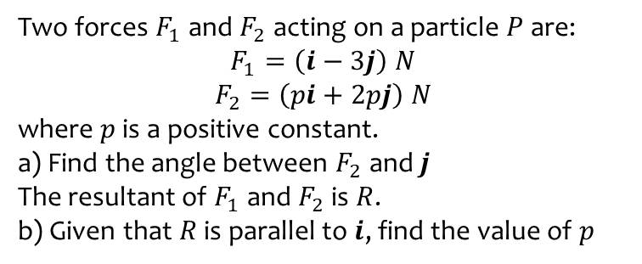
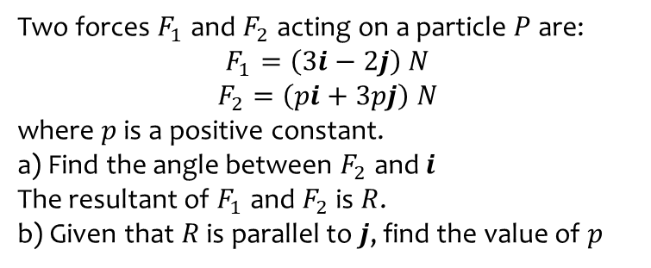
Worked example
Your turn
Two forces $F_{1}$and $F_{2}$ acting on a particle $P$ are:
$$F_{1}=\left(3i−2j\right) N$$
$$F_{2}=\left(pi+3pj\right) N$$
where $p$ is a positive constant.
a) Find the angle between $F_{2}$ and $i$
The resultant of $F_{1}$and $F_{2}$ is $R$.
b) Given that $R$ is parallel to $j$, find the value of $p$
Two forces $F_{1}$and $F_{2}$ acting on a particle $P$ are:
$$F_{1}=\left(i−3j\right) N$$
$$F_{2}=\left(pi+2pj\right) N$$
where $p$ is a positive constant.
a) Find the angle between $F_{2}$ and $j$
The resultant of $F_{1}$and $F_{2}$ is $R$.
b) Given that $R$ is parallel to $i$, find the value of $p$
a) $26.6°$
b) $p=\frac{3}{2}$

Slide 6
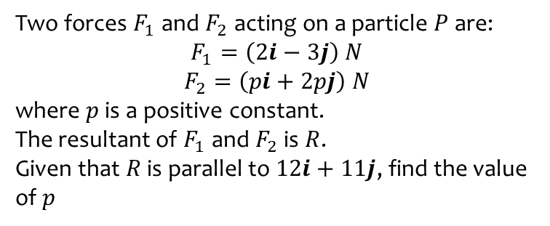
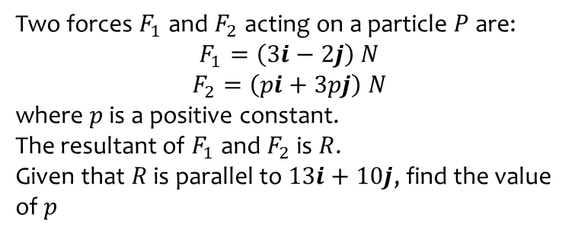
Worked example
Your turn
Two forces $F_{1}$and $F_{2}$ acting on a particle $P$ are:
$$F_{1}=\left(3i−2j\right) N$$
$$F_{2}=\left(pi+3pj\right) N$$
where $p$ is a positive constant.
The resultant of $F_{1}$and $F_{2}$ is $R$.
Given that $R$ is parallel to $13i+10j$, find the value of $p$
Two forces $F_{1}$and $F_{2}$ acting on a particle $P$ are:
$$F_{1}=\left(2i−3j\right) N$$
$$F_{2}=\left(pi+2pj\right) N$$
where $p$ is a positive constant.
The resultant of $F_{1}$and $F_{2}$ is $R$.
Given that $R$ is parallel to $12i+11j$, find the value of $p$
$$p=\frac{58}{13}$$

