Slide 1
10.1) Locating roots

Slide 2
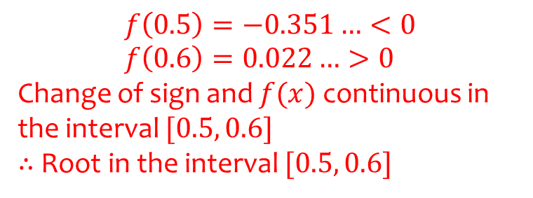
Worked example
Your turn
Show that ${f\left(x\right)=e}^{x}+3x−2$ has a root between $x=0.2$ and $x=0.3$
Show that ${f\left(x\right)=e}^{x}+2x−3$ has a root between $x=0.5$ and $x=0.6$
$$f\left(0.5\right)=−0.351…<0 \\ f\left(0.6\right)=0.022…>0$$
Change of sign and $f(x)$ continuous in the interval $[0.5, 0.6]$
$∴$ Root in the interval $[0.5, 0.6]$

Slide 3
Worked example
Your turn
Explain why there are no real roots to
$f\left(x\right)=\frac{1}{x−2}$ between $x=1$ and $x=3$
Explain why there are no real roots to
$f\left(x\right)=\frac{1}{x}$ between $x=−1$ and $x=1$
$f(x)$ not continuous in the interval $[−1, 1]$

Slide 4
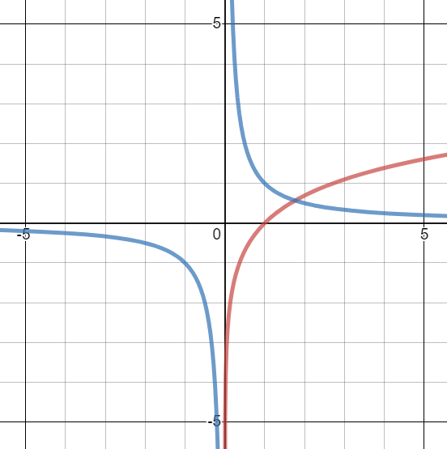
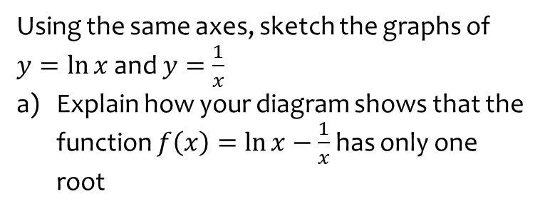
Worked example
Your turn
Using the same axes, sketch the graphs of
$y=e^{x}$ and $y=\frac{1}{x}$
Explain how your diagram shows that the function $f\left(x\right)=e^{x}−\frac{1}{x}$has only one root
Using the same axes, sketch the graphs of
$y=\ln{x}$ and $y=\frac{1}{x}$
Explain how your diagram shows that the function $f\left(x\right)=\ln{x}−\frac{1}{x}$has only one root
a) The lines intersect where $\ln{x}=\frac{1}{x}$ → $\ln{x}−\frac{1}{x}=0$
Thus the roots of $f(x)$ correspond to the points of intersection, and there is only one point of intersection on the graph.
Graphs used with permission from DESMOS: https://www.desmos.com/

Slide 5
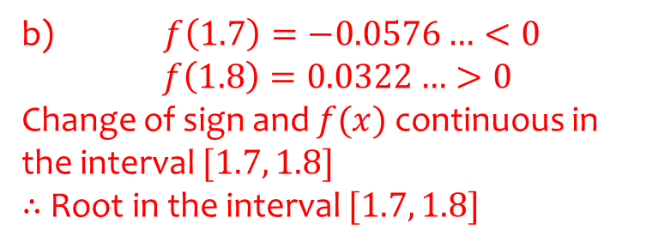
Worked example
Your turn
Using the same axes, sketch the graphs of
$y=e^{x}$ and $y=\frac{1}{x}$
Explain how your diagram shows that the function $f\left(x\right)=e^{x}−\frac{1}{x}$has only one root
Show that this root lies in the interval $0.5<x<0.6$
Using the same axes, sketch the graphs of
$y=\ln{x}$ and $y=\frac{1}{x}$
Explain how your diagram shows that the function $f\left(x\right)=\ln{x}−\frac{1}{x}$has only one root
Show that this root lies in the interval $1.7<x<1.8$
b) $f\left(1.7\right)=−0.0576…<0$ $f\left(1.8\right)=0.0322…>0$
Change of sign and $f(x)$ continuous in the interval $[1.7, 1.8]$
$∴$ Root in the interval $[1.7, 1.8]$

Slide 6
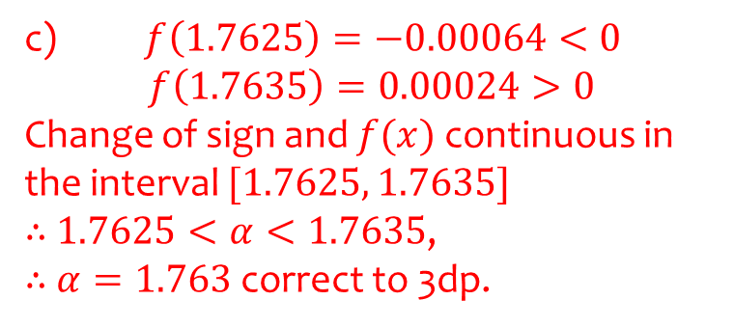
Worked example
Your turn
Using the same axes, sketch the graphs of
$y=e^{x}$ and $y=\frac{1}{x}$
Explain how your diagram shows that the function $f\left(x\right)=e^{x}−\frac{1}{x}$has only one root
Show that this root lies in the interval $0.5<x<0.6$
Show that the root is $0.567$ to 3 decimal places
Using the same axes, sketch the graphs of
$y=\ln{x}$ and $y=\frac{1}{x}$
Explain how your diagram shows that the function $f\left(x\right)=\ln{x}−\frac{1}{x}$has only one root
Show that this root lies in the interval $1.7<x<1.8$
Show that the root is $1.763$ to 3 decimal places
c) $f\left(1.7625\right)=−0.00064<0$ $$f\left(1.7635\right)=0.00024>0$$
Change of sign and $f(x)$ continuous in the interval $[1.7625, 1.7635]$
$∴$ $1.7625<α<1.7635$,
$∴$ $α=1.763$ correct to 3dp.

