Slide 1
10.1) Force diagrams

Slide 2
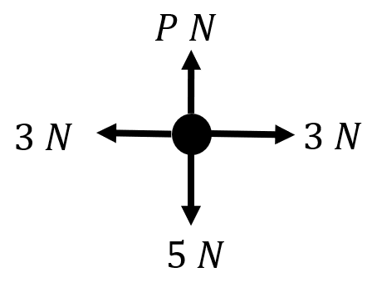
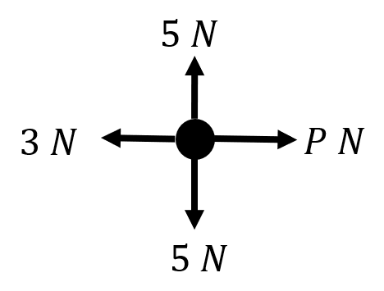
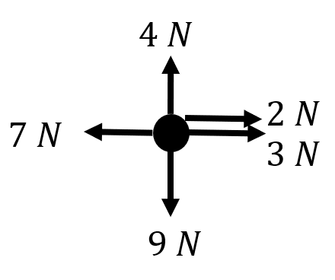
Worked example
Your turn
Draw a force diagram to represent the resultant force:
Draw a force diagram to represent the resultant force:
$R\left(↑\right):$ $0 N$
$R\left(→\right):$ $\left(P−3\right)N$
Diagrams/Graphs used with permission from DrFrostMaths: https://www.drfrostmaths.com/

Slide 3
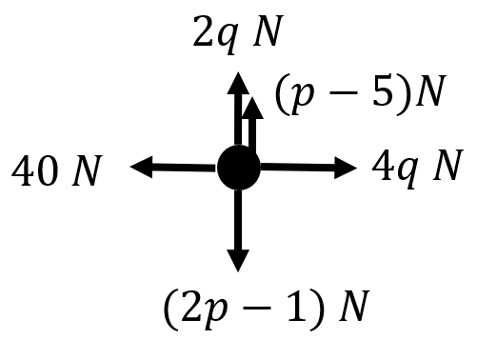
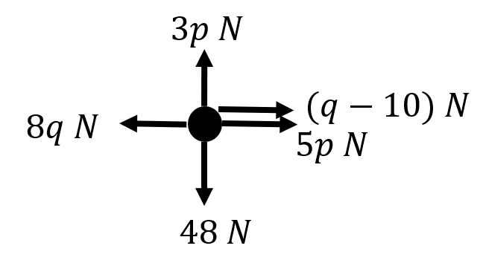
Worked example
Your turn
A particle is acted on a by a set of forces.
Given that the particle is at rest, find the values of $p$ and $q$
A particle is acted on a by a set of forces.
Given that the particle is at rest, find the values of $p$ and $q$
$$p=16, q=10$$
Diagrams/Graphs used with permission from DrFrostMaths: https://www.drfrostmaths.com/

Slide 4
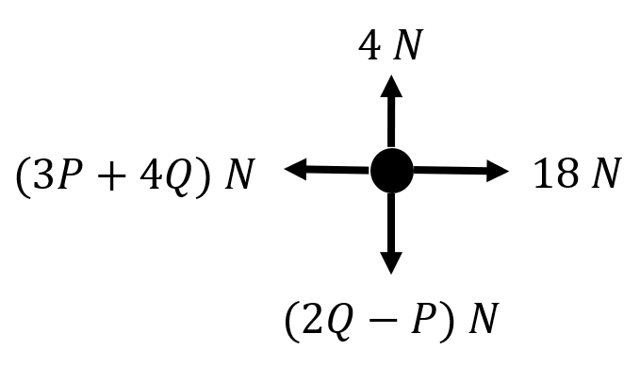
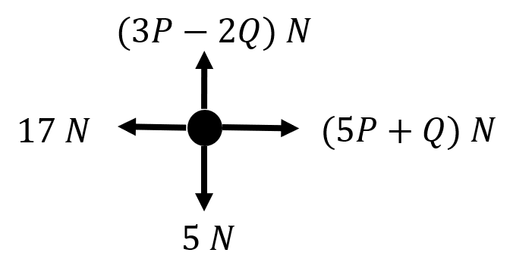
Worked example
Your turn
Given that the particle is moving with constant velocity, find the values of $P$ and $Q$
Given that the particle is moving with constant velocity, find the values of $P$ and $Q$
$$P=3, Q=2$$
Diagrams/Graphs used with permission from DrFrostMaths: https://www.drfrostmaths.com/

