Slide 1
10) Numerical methods
10.1) Locating roots
10.2) Iteration
10.3) The Newton-Raphson method
10.4) Applications to modelling

Slide 2
10.1) Locating roots
Chapter CONTENTS

Slide 3
Worked example
Your turn
Show that ${f\left(x\right)=e}^{x}+3x−2$ has a root between $x=0.2$ and $x=0.3$
Show that ${f\left(x\right)=e}^{x}+2x−3$ has a root between $x=0.5$ and $x=0.6$
$$f\left(0.5\right)=−0.351…<0 \\ f\left(0.6\right)=0.022…>0$$
Change of sign and $f(x)$ continuous in the interval $[0.5, 0.6]$
$∴$ Root in the interval $[0.5, 0.6]$

Slide 4
Worked example
Your turn
Explain why there are no real roots to
$f\left(x\right)=\frac{1}{x−2}$ between $x=1$ and $x=3$
Explain why there are no real roots to
$f\left(x\right)=\frac{1}{x}$ between $x=−1$ and $x=1$
$f(x)$ not continuous in the interval $[−1, 1]$

Slide 5
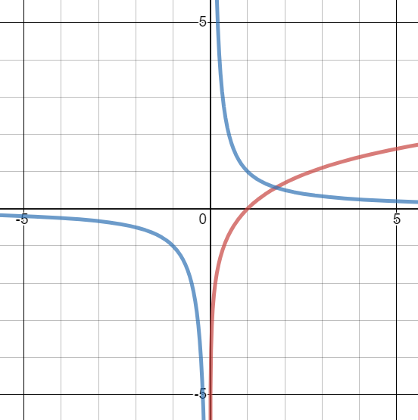
Worked example
Your turn
Using the same axes, sketch the graphs of
$y=e^{x}$ and $y=\frac{1}{x}$
Explain how your diagram shows that the function $f\left(x\right)=e^{x}−\frac{1}{x}$has only one root
Using the same axes, sketch the graphs of
$y=\ln{x}$ and $y=\frac{1}{x}$
Explain how your diagram shows that the function $f\left(x\right)=\ln{x}−\frac{1}{x}$has only one root
a) The lines intersect where $\ln{x}=\frac{1}{x}$ → $\ln{x}−\frac{1}{x}=0$
Thus the roots of $f(x)$ correspond to the points of intersection, and there is only one point of intersection on the graph.
Graphs used with permission from DESMOS: https://www.desmos.com/

Slide 6
Worked example
Your turn
Using the same axes, sketch the graphs of
$y=e^{x}$ and $y=\frac{1}{x}$
Explain how your diagram shows that the function $f\left(x\right)=e^{x}−\frac{1}{x}$has only one root
Show that this root lies in the interval $0.5<x<0.6$
Using the same axes, sketch the graphs of
$y=\ln{x}$ and $y=\frac{1}{x}$
Explain how your diagram shows that the function $f\left(x\right)=\ln{x}−\frac{1}{x}$has only one root
Show that this root lies in the interval $1.7<x<1.8$
b) $f\left(1.7\right)=−0.0576…<0$ $f\left(1.8\right)=0.0322…>0$
Change of sign and $f(x)$ continuous in the interval $[1.7, 1.8]$
$∴$ Root in the interval $[1.7, 1.8]$

Slide 7
Worked example
Your turn
Using the same axes, sketch the graphs of
$y=e^{x}$ and $y=\frac{1}{x}$
Explain how your diagram shows that the function $f\left(x\right)=e^{x}−\frac{1}{x}$has only one root
Show that this root lies in the interval $0.5<x<0.6$
Show that the root is $0.567$ to 3 decimal places
Using the same axes, sketch the graphs of
$y=\ln{x}$ and $y=\frac{1}{x}$
Explain how your diagram shows that the function $f\left(x\right)=\ln{x}−\frac{1}{x}$has only one root
Show that this root lies in the interval $1.7<x<1.8$
Show that the root is $1.763$ to 3 decimal places
c) $f\left(1.7625\right)=−0.00064<0$ $$f\left(1.7635\right)=0.00024>0$$
Change of sign and $f(x)$ continuous in the interval $[1.7625, 1.7635]$
$∴$ $1.7625<α<1.7635$,
$∴$ $α=1.763$ correct to 3dp.

Slide 8
10.2) Iteration
Chapter CONTENTS

Slide 9
Worked example
Your turn
$$f\left(x\right)=x^{2}−5x−3$$
a) Show that $f\left(x\right)=0$ can be written as:
i) $x=\frac{x^{2}−3}{5}$ ii) $x=\sqrt{5x+3}$ iii) $x=5+\frac{3}{x}$
$$g\left(x\right)=x^{2}−6x+2$$
a) Show that $g\left(x\right)=0$ can be written as:
i) $x=\frac{x^{2}+2}{6}$ ii) $x=\sqrt{6x−2}$ iii) $x=6−\frac{2}{x}$
a) Shown

Slide 10
Worked example
Your turn
$$f\left(x\right)=x^{2}−5x−3$$
a) Show that $f\left(x\right)=0$ can be written as:
i) $x=\frac{x^{2}−3}{5}$ ii) $x=\sqrt{5x+3}$ iii) $x=5+\frac{3}{x}$
b) Starting with $x_{0}=3$ use each iterative
formula to find a root of the equation
$f\left(x\right)=0$, rounding your answers to 3
decimal places
$$g\left(x\right)=x^{2}−6x+2$$
a) Show that $g\left(x\right)=0$ can be written as:
i) $x=\frac{x^{2}+2}{6}$ ii) $x=\sqrt{6x−2}$ iii) $x=6−\frac{2}{x}$
b) Starting with $x_{0}=4$ use each iterative
formula to find a root of the equation
$g\left(x\right)=0$, rounding your answers to 3
decimal places
b) i) $x=0.354$ (3 dp)
ii) $x=5.646$ (3 dp)
iii) $x=5.646$ (3 dp)

Slide 11
Worked example
Your turn
$$f\left(x\right)=e^{x−2}+x−5$$
a) Show that $f\left(x\right)=0$ can be written as:
$$x=\ln{(5−x)}+2, x<5$$
$$f\left(x\right)=e^{x−1}+x−6$$
a) Show that $f\left(x\right)=0$ can be written as:
$$x=\ln{(6−x)}+1, x<6$$
a) Shown

Slide 12
Worked example
Your turn
$$f\left(x\right)=e^{x−2}+x−5$$
a) Show that $f\left(x\right)=0$ can be written as:
$$x=\ln{(5−x)}+2, x<5$$
The root of $f\left(x\right)=0$ is $α$.
The iterative formula
$$x_{n+1}=\ln{(5−x_{n})}+2, x_{0}=3$$
is used to find an approximate value for $α$
b) Calculate the values of $x_{1}, x_{2}$ and $x_{3}$ to four
decimal places.
$$f\left(x\right)=e^{x−1}+x−6$$
a) Show that $f\left(x\right)=0$ can be written as:
$$x=\ln{(6−x)}+1, x<6$$
The root of $f\left(x\right)=0$ is $β$.
The iterative formula
$$x_{n+1}=\ln{(6−x_{n})}+1, x_{0}=2$$
is used to find an approximate value for$β$
b) Calculate the values of $x_{1}, x_{2}$ and $x_{3}$ to four
decimal places.
b)
$$x_{0}=2 \\ x_{1}=\ln\left(6−2\right)+1$$
$=2.3863$ $$x_{2}=2.2847… \\ x_{3}=2.3125$$

Slide 13
Worked example
Your turn
$$f\left(x\right)=e^{x−2}+x−5$$
a) Show that $f\left(x\right)=0$ can be written as:
$$x=\ln{(5−x)}+2, x<5$$
The root of $f\left(x\right)=0$ is $α$.
The iterative formula
$$x_{n+1}=\ln{(5−x_{n})}+2, x_{0}=3$$
is used to find an approximate value for $α$
b) Calculate the values of $x_{1}, x_{2}$ and $x_{3}$ to four
decimal places.
c) By choosing a suitable interval, show that
$α=2.792$ correct to 3 decimal places.
$$f\left(x\right)=e^{x−1}+x−6$$
a) Show that $f\left(x\right)=0$ can be written as:
$$x=\ln{(6−x)}+1, x<6$$
The root of $f\left(x\right)=0$ is $α$.
The iterative formula
$$x_{n+1}=\ln{(6−x_{n})}+1, x_{0}=2$$
is used to find an approximate value for $α$
b) Calculate the values of $x_{1}, x_{2}$ and $x_{3}$ to four
decimal places.
c) By choosing a suitable interval, show that
$β=2.307$ correct to 3 decimal places.
c)
$$f\left(2.3065\right)=−0.00027…<0 \\ f\left(2.3075\right)=0.0044…>0$$
Sign change and $g\left(x\right)$ continuous in the interval $[2.3065, 2.3075]$
$$∴2.3065<β<2.3075$$ $∴β=2.307$ (3 dp)

Slide 14
Worked example
Your turn
$$f\left(x\right)=x^{3}−5x^{2}−3x+2$$
Show that the equation $f\left(x\right)=0$ has a root in the interval $5<x<6$.
$$g\left(x\right)=x^{3}−3x^{2}−2x+5$$
Show that the equation $g\left(x\right)=0$ has a root in the interval $3<x<4$.
(a)
$$g\left(3\right)=−1<0$$
$$g\left(4\right)=13>0$$
Change of sign and $g(x)$ continuous in the interval $[3, 4]$
$∴$ root in the interval $[3, 4]$

Slide 15
Worked example
Your turn
$$f\left(x\right)=x^{3}−5x^{2}−3x+2$$
Show that the equation $f\left(x\right)=0$ has a root in the interval $5<x<6$.
Use the iterative formula
$x_{n+1}=\sqrt{\frac{x_{n}^{3}−3x_{n}+2}{5}}$
to calculate the values of $x_{1}$, $x_{2}$ and $x_{3}$, giving your answers to 4 decimal places, and taking: (i) $x_{0}=0.5$ (ii) $x_{0}=6$
$$g\left(x\right)=x^{3}−3x^{2}−2x+5$$
Show that the equation $g\left(x\right)=0$ has a root in the interval $3<x<4$.
Use the iterative formula
$x_{n+1}=\sqrt{\frac{x_{n}^{3}−2x_{n}+5}{3}}$
to calculate the values of $x_{1}$, $x_{2}$ and $x_{3}$, giving your answers to 4 decimal places, and taking: (i) $x_{0}=1.5$ (ii) $x_{0}=4$
(b)
i)
$$x_{1}=\sqrt{\frac{{1.5}^{3}−2\left(1.5\right)+5}{3}}=1.3385… \\ x_{2}=1.2544…$$
$$x_{3}=1.2200…$$ Convergent as the change in the root on each iteration is decreasing. The iterative method will find the root.
ii)
$$x_{1}=\sqrt{\frac{4^{3}−2\left(4\right)+5}{3}}=4.5092… \\ x_{2}=5.4058 \\ x_{3}=7.1219…$$
Divergent as the change in the root on each iteration is increasing. The iterative method has failed to find the root.

Slide 16
Worked example
Your turn
$$f\left(x\right)=x^{3}+4x^{2}+3x−12$$
(a) Show that the equation can be written as
$$x=\sqrt{\frac{3(4−x)}{4+x}}, x≠−4$$
$$g\left(x\right)=x^{3}+3x^{2}+4x−12$$
(a) Show that the equation can be written as
$$x=\sqrt{\frac{4(3−x)}{3+x}}, x≠−3$$
(a) Shown

Slide 17
Worked example
Your turn
$$f\left(x\right)=x^{3}+4x^{2}+3x−12$$
(a) Show that the equation can be written as
$$x=\sqrt{\frac{3(4−x)}{4+x}}, x≠−4$$
The equation $f\left(x\right)=0$ has a single root between $1$ and $2$.
(b) Use the iterative formula
$x_{n+1}=\sqrt{\frac{4(3−x_{n})}{3+x_{n}}}, n≥0, x_{0}=1$
to calculate the values of $x_{1}$, $x_{2}$ and $x_{3}$, giving your answers to 2 decimal places.
$$g\left(x\right)=x^{3}+3x^{2}+4x−12$$
(a) Show that the equation can be written as
$$x=\sqrt{\frac{4(3−x)}{3+x}}, x≠−3$$
The equation $g\left(x\right)=0$ has a single root between $1$ and $2$.
(b) Use the iterative formula
$x_{n+1}=\sqrt{\frac{4(3−x_{n})}{3+x_{n}}}, n≥0, x_{0}=1$
to calculate the values of $x_{1}$, $x_{2}$ and $x_{3}$, giving your answers to 2 decimal places.
(b)
$$x_{1}=\sqrt{\frac{4(3−1)}{3+1}}=1.41$$ $x_{2}=1.20$
$$x_{3}=1.31$$

Slide 18
Worked example
Your turn
$$f\left(x\right)=x^{3}+4x^{2}+3x−12$$
(a) Show that the equation can be written as
$$x=\sqrt{\frac{3(4−x)}{4+x}}, x≠−4$$
The equation $f\left(x\right)=0$ has a single root between $1$ and $2$.
(b) Use the iterative formula
$x_{n+1}=\sqrt{\frac{4(3−x_{n})}{3+x_{n}}}, n≥0, x_{0}=1$
to calculate the values of $x_{1}$, $x_{2}$ and $x_{3}$, giving your answers to 2 decimal places.
(c) The root of $f\left(x\right)=0$ is $α$. By choosing a suitable interval, prove that $α=1.253$ (3 dp)
$$g\left(x\right)=x^{3}+3x^{2}+4x−12$$
(a) Show that the equation can be written as
$$x=\sqrt{\frac{4(3−x)}{3+x}}, x≠−3$$
The equation $g\left(x\right)=0$ has a single root between $1$ and $2$.
(b) Use the iterative formula
$x_{n+1}=\sqrt{\frac{4(3−x_{n})}{3+x_{n}}}, n≥0, x_{0}=1$
to calculate the values of $x_{1}$, $x_{2}$ and $x_{3}$, giving your answers to 2 decimal places.
(c) The root of $g\left(x\right)=0$ is $β$. By choosing a suitable interval, prove that $β=1.272$ (3 dp)
(c)
$$g\left(1.2715\right)=−0.00821…<0$$
$$g\left(1.2725\right)=0.00827…>0$$
Sign change and $g\left(x\right)$ continuous in the interval $[1.2715, 1.2725]$
$$∴1.2715<β<1.2725$$ $∴β=1.272$ (3 dp)

Slide 19
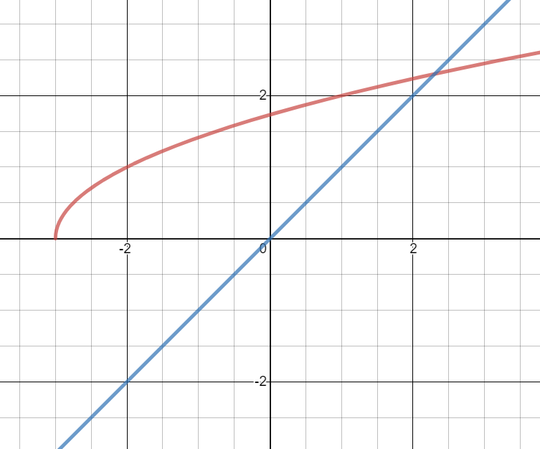
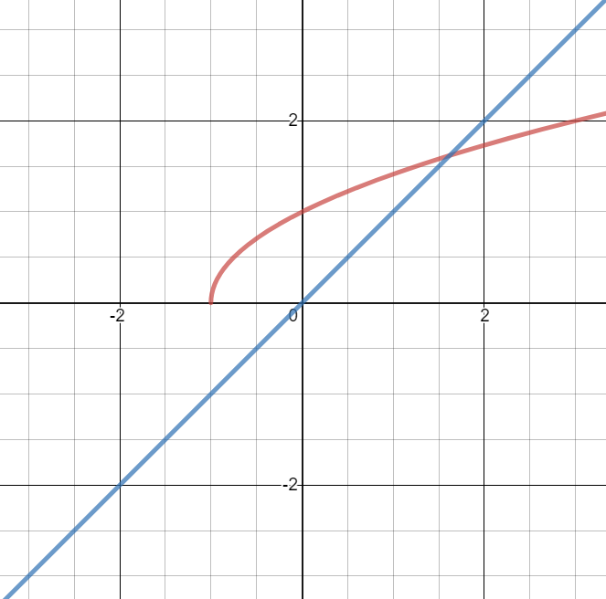
Worked example
Your turn
Use the graph of $y=x$ and $y=\sqrt{x+3}$ to solve the equation
$$x^{2}−x−3=0$$
using the recurrence relation:
$$x_{n+1}=\sqrt{x_{n}+3}, x_{0}=1$$
Use the graph of $y=x$ and $y=\sqrt{x+1}$ to solve the equation
$$x^{2}−x−1=0$$
using the recurrence relation:
$$x_{n+1}=\sqrt{x_{n}+1}, x_{0}=1$$
Staircase diagram converging to root
Graphs used with permission from DESMOS: https://www.desmos.com/

Slide 20
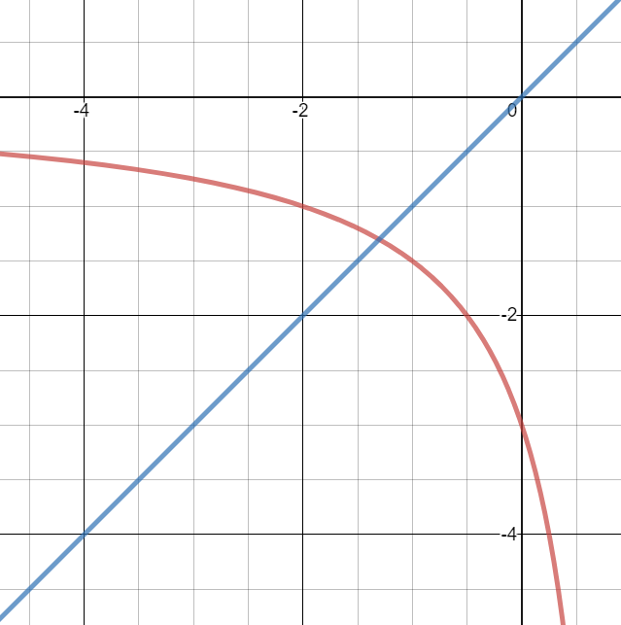
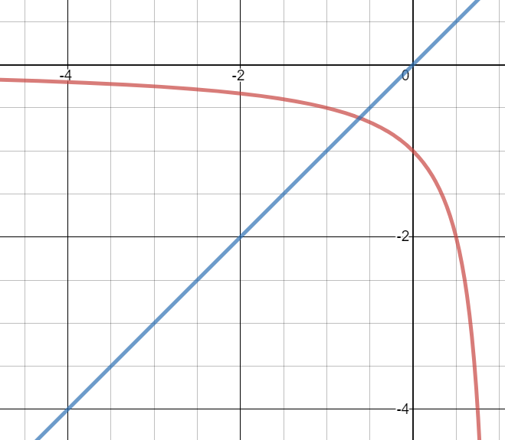
Worked example
Your turn
Use the graph of $y=x$ and $y=\frac{3}{x−1}$ to solve the equation
$$x^{2}−x−3=0$$
using the recurrence relation:
$$x_{n+1}=\frac{3}{x_{n}−1},x_{0}=−4.5$$
Use the graph of $y=x$ and $y=\frac{1}{x−1}$ to solve the equation
$$x^{2}−x−1=0$$
using the recurrence relation:
$$x_{n+1}=\frac{1}{x_{n}−1}, x_{0}=−2.5$$
Cobweb diagram converging to root
Graphs used with permission from DESMOS: https://www.desmos.com/

Slide 21
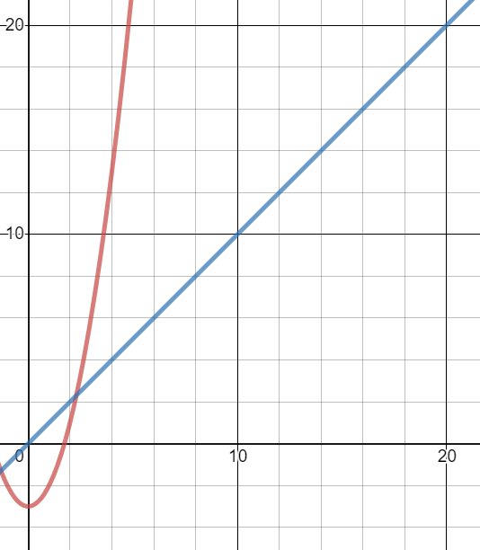
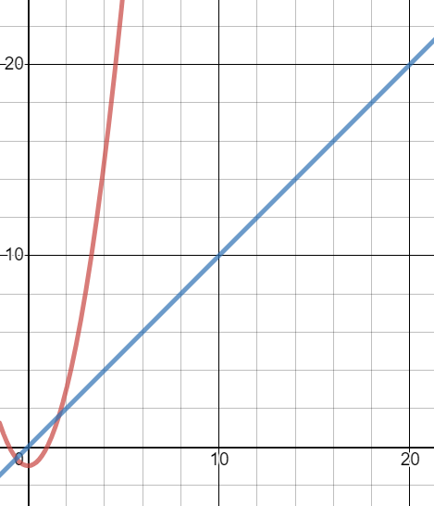
Worked example
Your turn
Use the graph of $y=x$ and $y=x^{2}−3$ to solve the equation
$$x^{2}−x−3=0$$
using the recurrence relation:
$$x_{n+1}=x_{n}^{2}−3, x_{0}=3$$
Use the graph of $y=x$ and $y=x^{2}−1$ to solve the equation
$$x^{2}−x−1=0$$
using the recurrence relation:
$$x_{n+1}=x_{n}^{2}−1,x_{0}=2$$
Root approximations diverging – iterative method fails
Graphs used with permission from DESMOS: https://www.desmos.com/

Slide 22
10.3) The Newton-Raphson method
Chapter CONTENTS

Slide 23
Worked example
Your turn
Using the Newton-Raphson process, state the recurrence relation for the following functions:
$$f\left(x\right)=x^{4}−3$$
$$g\left(x\right)=\sec{x}$$
$$h\left(x\right)=x^{2}+x+3$$
Using the Newton-Raphson process, state the recurrence relation for the following functions:
$$f\left(x\right)=x^{3}−2$$
$$g\left(x\right)=\tan{x}$$
$$h\left(x\right)=x^{2}−x−1$$
$$x_{n+1}=x_{n}−\frac{{\left(x_{n}\right)}^{3}−2}{3{\left(x_{n}\right)}^{2}}$$
$$x_{n+1}=x_{n}−\frac{\tan{x_{n}}}{\sec^{2}{x_{n}}}=x_{n}−\frac{1}{2}\sin\left(2x_{n}\right)$$
$$x_{n+1}=x_{n}−\frac{{\left(x_{n}\right)}^{2}−x_{n}−1}{2x_{n}−1}$$

Slide 24
Worked example
Your turn
Using three iterations of the Newton-Raphson process, starting with $x_{0}=0.5$,
solve the equation
$$x=\sin{x}$$
Using three iterations of the Newton-Raphson process, starting with $x_{0}=0.5$,
solve the equation
$$x=\cos{x}$$
Let $f\left(x\right)=x−\cos{x}$
$f^{′}\left(x\right)=1+\sin{x}$
$x_{n+1}=x_{n}−\frac{x_{n}−cos\left(x_{n}\right)}{1+sin\left(x_{n}\right)}$, $x_{0}=0.5$
$x_{1}=0.5−\frac{0.5−cos\left(0.5\right)}{1+sin\left(0.5\right)}=0.7552224…$ $x_{2}=0.7391412$ $x_{3}=0.7390851$
$x=0.739$ (3 dp)

Slide 25
Worked example
Your turn
$$f\left(x\right)=\frac{1}{3}x^{4}−x^{2}+3x−1$$
The equation $f\left(x\right)=0$ has a root $α$ in the interval $[−2, −3]$
Taking $−2.5$ as a first approximation to $α$, apply the Newton-Raphson process once to $f(x)$ to obtain a second approximation to $α$.
Give your answer to 2 decimal places.
$$g\left(x\right)=\frac{1}{2}x^{4}−x^{3}+x−3$$
The equation $g\left(x\right)=0$ has a root $β$ in the interval $[−2, −1]$
Taking $−1.5$ as a first approximation to $β$, apply the Newton-Raphson process once to $g(x)$ to obtain a second approximation to $β$.
Give your answer to 2 decimal places.
$$x_{n+1}=x_{n}−\frac{\frac{1}{2}{\left(x_{n}\right)}^{4}−{\left(x_{n}\right)}^{3}+x_{n}−3}{2{\left(x_{n}\right)}^{3}−3{\left(x_{n}\right)}^{2}+1}$$
$β_{1}=−1.5 −\frac{1.40625}{−12.5}=−−1.3875…$
$=1.39$ (2 dp)

Slide 26
Worked example
Your turn
$$f\left(x\right)=11x^{2}−\frac{3}{x^{2}}$$
The equation $f\left(x\right)=0$ has a root $α$ in the interval $[0, 1]$
Taking $0.4$ as a first approximation to $α$, apply the Newton-Raphson process once to $f(x)$ to obtain a second approximation to $α$.
Give your answer to 3 decimal places.
$$g\left(x\right)=3x^{2}−\frac{11}{x^{2}}$$
The equation $g\left(x\right)=0$ has a root $β$ in the interval $[1, 2]$
Taking $1.4$ as a first approximation to $β$, apply the Newton-Raphson process once to $g(x)$ to obtain a second approximation to $β$.
Give your answer to 3 decimal places.
$$x_{n+1}=x_{n}−\frac{3{\left(x_{n}\right)}^{2}−\frac{11}{{\left(x_{n}\right)}^{2}}}{6x_{n}+\frac{22}{{\left(x_{n}\right)}^{3}}}$$
$β_{1}=1.4−\frac{0.2677…}{16.4174…}=1.38369…$
$=1.384$ (3 dp)

Slide 27
Worked example
Your turn
$$f\left(x\right)=x^{2}−5x+8$$
State why $x_{0}=2.5$ is not suitable to use as a first approximation to the roots of $f(x)$ when applying the Newton-Raphson method.
$$f\left(x\right)=x^{2}+7x+8$$
State why $x_{0}=−3.5$ is not suitable to use as a first approximation to the roots of $f(x)$ when applying the Newton-Raphson method.
$f^{′}\left(x\right)=2x+7=0$ -> $x=−3.5$
Turning point at $x=−3.5$
$$f^{′}\left(−3.5\right)=0$$
You cannot divide by $0$ in the Newton-Raphson method.
Also the tangent to $y=f(x)$ at $x=−3.5$ would be horizontal, and therefore never intersect the $x$-axis.

Slide 28
10.4) Applications to modelling
Chapter CONTENTS

Slide 29
Worked example
Your turn
The price of a car in £s, $x$ years after purchase, is modelled by the function
$$f\left(x\right)=5000 {\left(0.58\right)}^{x}−100\sin{x}, x>0$$
Use the model to find the value, to the nearest hundred £s, of the car 5 years after purchase.
The price of a car in £s, $x$ years after purchase, is modelled by the function
$$g\left(x\right)=15000 {\left(0.85\right)}^{x}−1000\sin{x}, x>0$$
Use the model to find the value, to the nearest hundred £s, of the car 10 years after purchase.
(a) $£3500$

Slide 30
Worked example
Your turn
The price of a car in £s, $x$ years after purchase, is modelled by the function
$$f\left(x\right)=5000 {\left(0.58\right)}^{x}−100\sin{x}, x>0$$
Use the model to find the value, to the nearest hundred £s, of the car 5 years after purchase.
Show that $f\left(x\right)$ has a root between 7 and 8.
The price of a car in £s, $x$ years after purchase, is modelled by the function
$$g\left(x\right)=15000 {\left(0.85\right)}^{x}−1000\sin{x}, x>0$$
Use the model to find the value, to the nearest hundred £s, of the car 10 years after purchase.
Show that $g\left(x\right)$ has a root between 19 and 20.
(b)
$$g\left(19\right)=543.11…>0 \\ g\left(20\right)=−331.55…<0$$
Change of sign and $g(x)$ continuous in the interval $[19, 20]$
$∴$ root in the interval $\left[19, 20\right]$

Slide 31
Worked example
Your turn
The price of a car in £s, $x$ years after purchase, is modelled by the function
$$f\left(x\right)=5000 {\left(0.58\right)}^{x}−100\sin{x}, x>0$$
Use the model to find the value, to the nearest hundred £s, of the car 5 years after purchase.
Show that $f\left(x\right)$ has a root between 7 and 8.
Taking 7.5 as a first approximation, apply the Newton-Raphson method once to $f(x)$ to obtain a second approximation for the time when the value of the car is zero. Give your answer to 3 decimal places.
The price of a car in £s, $x$ years after purchase, is modelled by the function
$$g\left(x\right)=15000 {\left(0.85\right)}^{x}−1000\sin{x}, x>0$$
Use the model to find the value, to the nearest hundred £s, of the car 10 years after purchase.
Show that $g\left(x\right)$ has a root between 19 and 20.
Taking 19.5 as a first approximation, apply the Newton-Raphson method once to $g(x)$ to obtain a second approximation for the time when the value of the car is zero. Give your answer to 3 decimal places.
(c)
$$g^{′}\left(x\right)=\left(15 000\right){\left(0.85\right)}^{x}\left(\ln{0.85}\right)−1000\cos{x}$$
$$g\left(19.5\right) =15000{\left(0.85\right)}^{19.5}−1000\sin\left(19.5\right)$$
$=25.0693…$
$$g^{′}\left(19.5\right)=15000{\left(0.85\right)}^{19.5}\left(\ln{0.85}\right)−1000\cos\left(19.5\right)$$
$$=−893.3009…$$
$x_{1}=19.5−\frac{g\left(19.5\right)}{g^{′}\left(19.5\right)}=19.528$ (3 dp)

Slide 32
Worked example
Your turn
The price of a car in £s, $x$ years after purchase, is modelled by the function
$$f\left(x\right)=5000 {\left(0.58\right)}^{x}−100\sin{x}, x>0$$
Use the model to find the value, to the nearest hundred £s, of the car 5 years after purchase.
Show that $f\left(x\right)$ has a root between 7 and 8.
Taking 7.5 as a first approximation, apply the Newton-Raphson method once to $f(x)$ to obtain a second approximation for the time when the value of the car is zero. Give your answer to 3 decimal places.
Criticise this model with respect to the value of the car as it gets older.
The price of a car in £s, $x$ years after purchase, is modelled by the function
$$g\left(x\right)=15000 {\left(0.85\right)}^{x}−1000\sin{x}, x>0$$
Use the model to find the value, to the nearest hundred £s, of the car 10 years after purchase.
Show that $g\left(x\right)$ has a root between 19 and 20.
Taking 19.5 as a first approximation, apply the Newton-Raphson method once to $g(x)$ to obtain a second approximation for the time when the value of the car is zero. Give your answer to 3 decimal places.
Criticise this model with respect to the value of the car as it gets older.
(d) In reality, the car can never have a negative value so this model is not reasonable for cars that are approximately 20 or more years old.

