Slide 1
10) Forces and motion
10.1) Force diagrams
10.2) Forces as vectors
10.3) Forces and acceleration
10.4) Motion in 2 dimensions
10.5) Connected particles
10.6) Pulleys

Slide 2
10.1) Force diagrams
Chapter CONTENTS

Slide 3
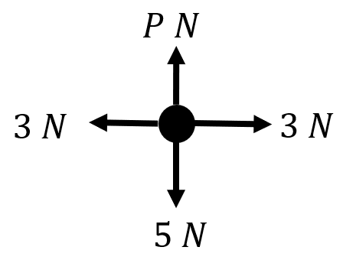
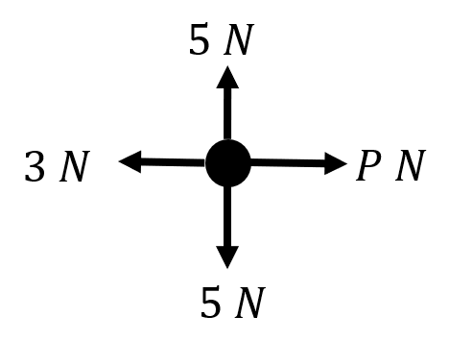
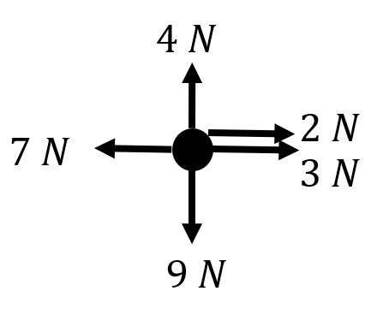
Worked example
Your turn
Draw a force diagram to represent the resultant force:
Draw a force diagram to represent the resultant force:
$R\left(↑\right):$ $0 N$
$R\left(→\right):$ $\left(P−3\right)N$
Diagrams/Graphs used with permission from DrFrostMaths: https://www.drfrostmaths.com/

Slide 4
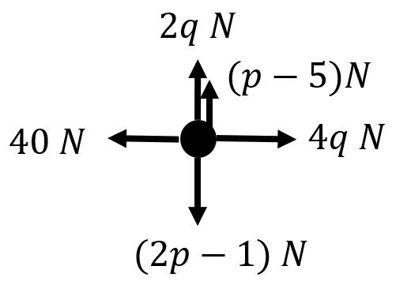
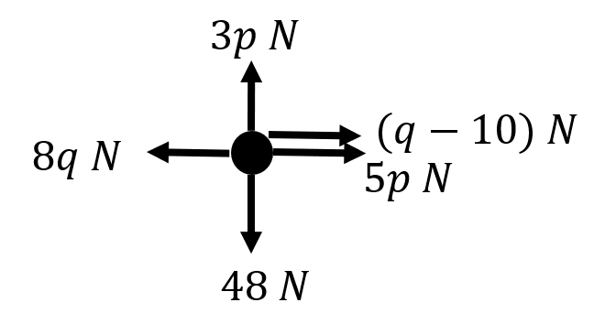
Worked example
Your turn
A particle is acted on a by a set of forces.
Given that the particle is at rest, find the values of $p$ and $q$
A particle is acted on a by a set of forces.
Given that the particle is at rest, find the values of $p$ and $q$
$$p=16, q=10$$
Diagrams/Graphs used with permission from DrFrostMaths: https://www.drfrostmaths.com/

Slide 5
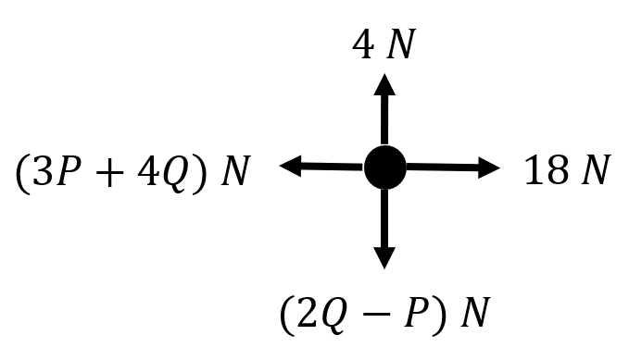
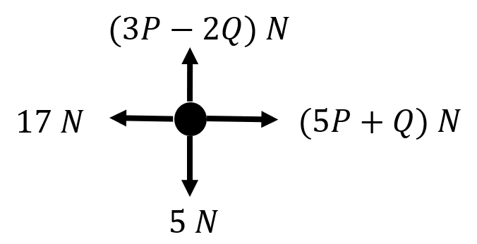
Worked example
Your turn
Given that the particle is moving with constant velocity, find the values of $P$ and $Q$
Given that the particle is moving with constant velocity, find the values of $P$ and $Q$
$$P=3, Q=2$$
Diagrams/Graphs used with permission from DrFrostMaths: https://www.drfrostmaths.com/

Slide 6
10.2) Forces as vectors
Chapter CONTENTS

Slide 7
Worked example
Your turn
The forces $3i−2j$, $−4i+j$, $−2i−3j$ and $ai+bj$ act on an object which is in equilibrium. Find the values of $a$ and $b$.
The forces $2i+3j$, $4i−j$, $−3i+2j$ and $ai+bj$ act on an object which is in equilibrium. Find the values of $a$ and $b$.
$$a=−3,b=−4$$

Slide 8
Worked example
Your turn
The vector $i$ is due east and $j$ due north.
A particle begins at rest at the origin.
It is acted on by three forces $\left(3i−j\right)$ N, $\left(2i+3j\right)$ N and $\left(−4i+j\right)$ N.
Find the resultant force in the form $pi+qj$.
Work out the magnitude and bearing of the resultant force.
The vector $i$ is due east and $j$ due north.
A particle begins at rest at the origin.
It is acted on by three forces $\left(2i+j\right)$ N, $\left(3i−2j\right)$ N and $\left(−i+4j\right)$ N.
Find the resultant force in the form $pi+qj$.
Work out the magnitude and bearing of the resultant force.
a) $4i+3j$
b) $053.1°$ (1 dp)

Slide 9
Worked example
Your turn
Three forces $F_{1}, F_{2}$ and $F_{3}$ acting on a particle $P$ are:
$$F_{1}=\left(9i−7j\right) N$$
$$F_{2}=\left(6i+5j\right) N$$
$$F_{3}=\left(pi+qj\right) N$$
where $p$ and $q$ are constants.
Given that $P$ is in equilibrium,
a) Find the value of $p$ and the value of $q$
The force $F_{3}$ is now removed. The resultant of $F_{1}$ and $F_{2}$ is $R$. Find:
b) The magnitude of $R$
c) The angle, to the nearest degree, that the
direction of $R$ makes with $j$.
Three forces $F_{1}, F_{2}$ and $F_{3}$ acting on a particle $P$ are:
$$F_{1}=\left(7i−9j\right) N$$
$$F_{2}=\left(5i+6j\right) N$$
$$F_{3}=\left(pi+qj\right) N$$
where $p$ and $q$ are constants.
Given that $P$ is in equilibrium,
a) Find the value of $p$ and the value of $q$
The force $F_{3}$ is now removed. The resultant of $F_{1}$ and $F_{2}$ is $R$. Find:
b) The magnitude of $R$
c) The angle, to the nearest degree, that the
direction of $R$ makes with $j$.
a) $p=−12, q=3$
b) $12.4 N$ (3 sf)
c) $104°$

Slide 10
Worked example
Your turn
Two forces $F_{1}$and $F_{2}$ acting on a particle $P$ are:
$$F_{1}=\left(3i−2j\right) N$$
$$F_{2}=\left(pi+3pj\right) N$$
where $p$ is a positive constant.
a) Find the angle between $F_{2}$ and $i$
The resultant of $F_{1}$and $F_{2}$ is $R$.
b) Given that $R$ is parallel to $j$, find the value of $p$
Two forces $F_{1}$and $F_{2}$ acting on a particle $P$ are:
$$F_{1}=\left(i−3j\right) N$$
$$F_{2}=\left(pi+2pj\right) N$$
where $p$ is a positive constant.
a) Find the angle between $F_{2}$ and $j$
The resultant of $F_{1}$and $F_{2}$ is $R$.
b) Given that $R$ is parallel to $i$, find the value of $p$
a) $26.6°$
b) $p=\frac{3}{2}$

Slide 11
Worked example
Your turn
Two forces $F_{1}$and $F_{2}$ acting on a particle $P$ are:
$$F_{1}=\left(3i−2j\right) N$$
$$F_{2}=\left(pi+3pj\right) N$$
where $p$ is a positive constant.
The resultant of $F_{1}$and $F_{2}$ is $R$.
Given that $R$ is parallel to $13i+10j$, find the value of $p$
Two forces $F_{1}$and $F_{2}$ acting on a particle $P$ are:
$$F_{1}=\left(2i−3j\right) N$$
$$F_{2}=\left(pi+2pj\right) N$$
where $p$ is a positive constant.
The resultant of $F_{1}$and $F_{2}$ is $R$.
Given that $R$ is parallel to $12i+11j$, find the value of $p$
$$p=\frac{58}{13}$$

Slide 12
10.3) Forces and acceleration
Chapter CONTENTS

Slide 13
Worked example
Your turn
A car of 1000kg has a driving force of 1600N and forces of 400N resisting its motion.
Determine its acceleration.
A car of 2000kg has a driving force of 800N and forces of 200N resisting its motion.
Determine its acceleration.
$$0.3 ms^{−2}$$

Slide 14
Worked example
Your turn
An object of mass 140kg experiences air resistance of 600 N. Determine the object’s acceleration as it falls towards the ground.
An object of mass 70kg experiences air resistance of 300 N. Determine the object’s acceleration as it falls towards the ground.
$5.51 ms^{−2}$ (3 sf)

Slide 15
Worked example
Your turn
An adult has a mass of 100kg. What is the gravitational force (weight) acting on the adult?
A child has a mass of 50kg. What is the gravitational force (weight) acting on the child?
$$490 N$$

Slide 16
Worked example
Your turn
A body of mass 10kg is pulled along a rough horizontal table by a horizontal force of magnitude 40N against a constant friction force of magnitude 8N. Given that the body is initially at rest, find:
the acceleration of the body
the distance travelled by the body in the first 2 seconds
the magnitude of the normal reaction between the body and the table
A body of mass 5kg is pulled along a rough horizontal table by a horizontal force of magnitude 20N against a constant friction force of magnitude 4N. Given that the body is initially at rest, find:
the acceleration of the body
the distance travelled by the body in the first 4 seconds
the magnitude of the normal reaction between the body and the table
a) $3.2 ms^{−2}$
b) $25.6 m$
c) $49 N$

Slide 17
Worked example
Your turn
An objects of mass $8 kg$ hits soft ground at a speed of $14 ms^{−1}$ and sinks vertically downwards before coming to rest. The ground is assumed to exert a constant resistive force of magnitude $5000 N$.
Find the vertical distance that the object sinks into the ground before coming to rest.
An objects of mass $4 kg$ hits soft ground at a speed of $28 ms^{−1}$ and sinks vertically downwards before coming to rest. The ground is assumed to exert a constant resistive force of magnitude $5000 N$.
Find the vertical distance that the object sinks into the ground before coming to rest.
$0.32 m$ (2 sf)

Slide 18
Worked example
Your turn
A lift of mass $500 kg$ is lowered or raised by a metal cable attached to its top. The lift contains passengers whose total mass is $100 kg$. The lift starts from rest and accelerates at a constant rate, reaching a speed of $5 ms^{−1}$ after moving a distance of $4 m$. Find:
The acceleration of the lift
The tension in the cable if the lift is moving vertically downwards
The tension in the cable if the lift is moving vertically upwards
A lift of mass $400 kg$ is lowered or raised by a metal cable attached to its top. The lift contains passengers whose total mass is $200 kg$. The lift starts from rest and accelerates at a constant rate, reaching a speed of $4 ms^{−1}$ after moving a distance of $5 m$. Find:
The acceleration of the lift
The tension in the cable if the lift is moving vertically downwards
The tension in the cable if the lift is moving vertically upwards
a) $1.6 ms^{−2}$
b) $4920 N$
c) $6840 N$

Slide 19
10.4) Motion in 2 dimensions
Chapter CONTENTS

Slide 20
Worked example
Your turn
Let $i$ represent East and $j$ North. A resultant force of $\left(2i+7j\right)$ $N$ acts upon a particle of mass 0.25 kg.
Find the acceleration of the particle in the form $(pi+qj)$ ms⁻².
Find the magnitude and bearing of the acceleration of the particle.
Let $i$ represent East and $j$ North. A resultant force of $\left(3i+8j\right)$ $N$ acts upon a particle of mass 0.5 kg.
Find the acceleration of the particle in the form $\left(pi+qj\right) ms^{−2}$.
Find the magnitude and bearing of the acceleration of the particle.
a) $\left(6i+16j\right) ms^{−2}$
b) Magnitude $=17.1 ms^{−2}$ (3 sf)
Bearing $=020.6°$(1 dp)

Slide 21
Worked example
Your turn
A boat is modelled as a particle of mass 30 kg being acted on by three forces.
$$F_{1}=\left(\begin{matrix}25 \\ 40\end{matrix}\right)N,$$
$$F_{2}=\left(\begin{matrix}5q \\ 10q\end{matrix} \right)N,$$
$$F_{3}=\left(\begin{matrix}50 \\ −37.5\end{matrix}\right)N$$
Given that the boat is accelerating at a rate of $\left(\begin{matrix}−0.75 \\ 0.4\end{matrix}\right)$ ms⁻², find the values of $p$ and $q$.
A boat is modelled as a particle of mass 60 kg being acted on by three forces.
$$F_{1}=\left(\begin{matrix}80 \\ 50 \end{matrix}\right)N,$$
$$F_{2}=\left(\begin{matrix}10q \\ 20q\end{matrix} \right)N,$$
$$F_{3}=\left(\begin{matrix}−75 \\ 100\end{matrix}\right)N$$
Given that the boat is accelerating at a rate of $\left(\begin{matrix}0.8 \\ −1.5\end{matrix}\right)$ ms⁻², find the values of $p$ and $q$.
$$p=4.3 , q=−12$$

Slide 22
Worked example
Your turn
A particle of mass $5 kg$ start from rest and is acted upon by a force $R$ of $\left(4i+kj\right) N$. R acts on a bearing of $45°$. Find the value of $k$
A particle of mass $4 kg$ start from rest and is acted upon by a force $R$ of $\left(5i+kj\right) N$. R acts on a bearing of $135°$. Find the value of $k$
$$k=−5$$

Slide 23
Worked example
Your turn
Two forces, $\left(\begin{matrix}5 \\ 2\end{matrix}\right) N$ and$\left(\begin{matrix}p \\ q\end{matrix}\right) N$ act on a particle of mass $m$ kg. The resultant of the two forces is $R$.
Given that $R$ acts in a direction which is parallel to the vector $\left(\begin{matrix}−1 \\ 2\end{matrix}\right)$, show that $2p+q+12=0$
Given also that $p=1$ and that $P$ moves with an acceleration of magnitude $10\sqrt{5} ms^{−2}$, find the value of $m$
Two forces, $\left(\begin{matrix}3 \\ 4\end{matrix}\right) N$ and$\left(\begin{matrix}p \\ q\end{matrix}\right) N$ act on a particle of mass $m$ kg. The resultant of the two forces is $R$.
Given that $R$ acts in a direction which is parallel to the vector $\left(\begin{matrix}−2 \\ 1\end{matrix}\right)$, show that $2q+p+11=0$
Given also that $p=5$ and that $P$ moves with an acceleration of magnitude $40\sqrt{5} ms^{−2}$, find the value of $m$
Shown
$m=0.1 kg$

Slide 24
10.5) Connected particles
Chapter CONTENTS

Slide 25
Worked example
Your turn
Two particles, $P$ and $Q$, of masses 6kg and 4kg respectively, are connected by a light inextensible string. Particle $Q$ is pulled by a horizontal force of magnitude 20N along a rough horizontal plane. Particle $Q$ experiences a frictional force of 5N and particle $P$ experiences a frictional force of 3N.
Find the acceleration of the particles.
Find the tension in the string.
Explain how the modelling assumptions that the string is light and inextensible have been used.
Two particles, $P$ and $Q$, of masses 5kg and 3kg respectively, are connected by a light inextensible string. Particle $P$ is pulled by a horizontal force of magnitude 40N along a rough horizontal plane. Particle $P$ experiences a frictional force of 10N and particle $Q$ experiences a frictional force of 6N.
Find the acceleration of the particles.
Find the tension in the string.
$a=3 ms^{−2}$
$T=15 N$

Slide 26
Worked example
Your turn
A light scale-pan is attached to a vertical light inextensible string.
The scale-pan carries two masses $A$ and $B$.
The mass of $A$ is 300g and the mass of $B$ is 200g.
$A$ rests on top of $B$.
The scale-pan is raised vertically, using the string, with acceleration 0.25 ms⁻².
Find the tension in the string.
Find the force exerted on mass $B$ by mass $A$.
Find the force exerted on mass $B$ by the scale-pan.
A light scale-pan is attached to a vertical light inextensible string.
The scale-pan carries two masses $A$ and $B$.
The mass of $A$ is 400g and the mass of $B$ is 600g.
$A$ rests on top of $B$.
The scale-pan is raised vertically, using the string, with acceleration 0.5 ms⁻².
Find the tension in the string.
Find the force exerted on mass $B$ by mass $A$.
Find the force exerted on mass $B$ by the scale-pan.
$10 N$ (2 sf)
$4.1 N$ (2 sf)
$10 N$ (2 sf)

Slide 27
Worked example
Your turn
A person travels in a lift. The mass of the person is $40 kg$ and the mass of the lift is $860 kg$.
The lift is being raised vertically by a vertical cable which is attached to the top of the lift. The lift is moving upwards and has constant deceleration $4 ms^{−2}$. By modelling the cable as being light and inextensible, find:
The tension in the cable
The magnitude of the force exerted on the woman by the floor of the lift
A person travels in a lift. The mass of the person is $50 kg$ and the mass of the lift is $950 kg$.
The lift is being raised vertically by a vertical cable which is attached to the top of the lift. The lift is moving upwards and has constant deceleration $2 ms^{−2}$. By modelling the cable as being light and inextensible, find:
The tension in the cable
The magnitude of the force exerted on the woman by the floor of the lift
$7800 N$
$390 N$

Slide 28
Worked example
Your turn
A car of mass $1200 kg$ pulls a trailer of mass $400 kg$ along a straight horizontal road using a light tow-bar which is parallel to the road. The horizontal resistances to motion of the car and the trailer have magnitudes $400 N$ and $200 N$ respectively. The engine of the car produces a constant horizontal driving force on the car of magnitude $2000 N$.
Find the acceleration of the car and trailer
Find the magnitude of the tension in the tow-bar
The engine cuts out, reducing the force produced by the engine to zero and the brakes are applied. The brakes produce a force on the car of magnitude $F$ Newtons and the car and trailer decelerate.
Given that the resistances to motion are unchanged, and the magnitude of the thrust in the towbar is $300 N$, find the value of $F$
A car of mass $600 kg$ pulls a trailer of mass $200 kg$ along a straight horizontal road using a light tow-bar which is parallel to the road. The horizontal resistances to motion of the car and the trailer have magnitudes $300 N$ and $100 N$ respectively. The engine of the car produces a constant horizontal driving force on the car of magnitude $1600 N$.
Find the acceleration of the car and trailer
Find the magnitude of the tension in the tow-bar
The engine cuts out, reducing the force produced by the engine to zero and the brakes are applied. The brakes produce a force on the car of magnitude $F$ Newtons and the car and trailer decelerate.
Given that the resistances to motion are unchanged, and the magnitude of the thrust in the towbar is $200 N$, find the value of $F$
a) $a=1.5 ms^{−2}$
b) $400 N$
c) $800 N$

Slide 29
10.6) Pulleys
Chapter CONTENTS

Slide 30
Worked example
Your turn
Particles $P$ and $Q$, of masses $5m$ and $4m$, are attached to the ends of a light inextensible string. The string passes over a small smooth fixed pulley and the masses hang with the string taut. The system is released from rest.
Write down an equation of motion for $P$ and for $Q$.
Find the acceleration of each mass.
Find the tension in the string.
Find the force exerted on the pulley by the string.
Find the distance moved by $P$ in the first 2 s, assuming that $Q$ does not reach the pulley.
Particles $P$ and $Q$, of masses $2m$ and $3m$, are attached to the ends of a light inextensible string. The string passes over a small smooth fixed pulley and the masses hang with the string taut. The system is released from rest.
Write down an equation of motion for $P$ and for $Q$.
Find the acceleration of each mass.
Find the tension in the string.
Find the force exerted on the pulley by the string.
Find the distance moved by $Q$ in the first 4 s, assuming that $P$ does not reach the pulley.
For $P$, $R\left(↑\right)$: $T−2mg=2ma$
For $Q$, $R\left(↓\right)$: $3mg−T=3ma$
b) $a=\frac{1}{5}g=2.0 ms^{−2}$ (2 sf)
c) $T=\frac{12}{5}mg N$
d) $\frac{24}{5}mg N$
e) $15.7 m$ (3 sf)

Slide 31
Worked example
Your turn
Two particles $A$ and $B$ of masses 0.8kg and 1.6kg respectively are connected by a light inextensible string. Particle $A$ lies on a rough horizontal table 9m from a small smooth pulley which is fixed at the edge of the table. The string passes over the pulley and $B$ hangs freely, with the string taut, 1m above horizontal ground. A frictional force of magnitude 0.16g opposes the motion of particle $A$. The system is released from rest. Find:
The acceleration of the system
The time taken for $B$ to reach the ground
The total distance travelled by $A$ before it first comes to rest.
Two particles $A$ and $B$ of masses 0.4kg and 0.8kg respectively are connected by a light inextensible string. Particle $A$ lies on a rough horizontal table 4.5m from a small smooth pulley which is fixed at the edge of the table. The string passes over the pulley and $B$ hangs freely, with the string taut, 0.5m above horizontal ground. A frictional force of magnitude 0.08g opposes the motion of particle $A$. The system is released from rest. Find:
The acceleration of the system
The time taken for $B$ to reach the ground
The total distance travelled by $A$ before it first comes to rest.
$0.6g=5.9 ms^{−2}$ (2 sf)
$0.41 s$ (2 sf)
$2.0 m$ (2 sf)

Slide 32
Worked example
Your turn
Two particles $A$ and $B$ have masses $10m$ and $km$ respectively, where $k<10$. The particles are connected by a light inextensible string which passes over a smooth light fixed pulley. The system is held at rest with the string taut, the hanging parts of the string vertical and with $A$ and $B$ at the same height above a horizontal plane.
The system is released from rest.
After release, $A$ descends with acceleration $\frac{1}{2}g$.
After descending for $2.4$ s, the particle $A$ reaches the plane.
It is immediately brought to rest by the impact with the plane.
The initial distance between $B$ and the pulley is such that, in the subsequent motion, $B$ does not reach the pulley.
Find the greatest height reached by $B$ above the plane.
Two particles $A$ and $B$ have masses $5m$ and $km$ respectively, where $k<5$. The particles are connected by a light inextensible string which passes over a smooth light fixed pulley. The system is held at rest with the string taut, the hanging parts of the string vertical and with $A$ and $B$ at the same height above a horizontal plane.
The system is released from rest.
After release, $A$ descends with acceleration $\frac{1}{4}g$.
After descending for $1.2$ s, the particle $A$ reaches the plane.
It is immediately brought to rest by the impact with the plane.
The initial distance between $B$ and the pulley is such that, in the subsequent motion, $B$ does not reach the pulley.
Find the greatest height reached by $B$ above the plane.
$$4.0 m$$

