Slide 1
1) Data collection
1.1) Populations and samples
1.2) Sampling
1.3) Non-random sampling
1.4) Types of data

Slide 2
1.1) Populations and samples
Chapter CONTENTS

Slide 3
Worked example
Your turn
A shop wants to test a delivery of candles for how long they burn by lighting them.
Suggest a reason why the shop should not test all the candles
The shop tests a sample of 10 candles and finds that 7 of them burn for the required length of time. They estimate that 70% of the avocados in the deliver are ripe. Suggest one way that the shop could improve their estimate.
A supermarket wants to test a delivery of avocados for ripeness by cutting them in half.
Suggest a reason why the supermarket should not test all the avocados in the delivery.
The supermarket tests a sample of 5 avocados and finds that 4 of them are ripe. They estimate that 80% of the avocados in the deliver are ripe. Suggest one way that the supermarket could improve their estimate.
Testing the avocados destroys them (and thus can’t be sold).
Use a larger sample size (which would be a better estimate of the proportion of ripe avocados).

Slide 4
1.2) Sampling
Chapter CONTENTS

Slide 5
Worked example
Your turn
There are 46 girls and 65 boys in a school. Explain briefly how you could take a random sample of 12 pupils using a simple random sample.
There are 64 girls and 56 boys in a school. Explain briefly how you could take a random sample of 15 pupils using a simple random sample.
Allocate a number between 1 and 120 to each pupil.
Use random number tables, computer, calculator, to generate random numbers between 1 and 120 inclusive.
If a number generated is a repeat, ignore it, and generate an extra random number.
Repeat the process until there are 15 distinct numbers.
Pupils corresponding to these numbers are the sample.

Slide 6
Worked example
Your turn
There are 46 girls and 65 boys in a school. Explain briefly how you could take a random sample of 12 pupils using a simple random sample using lottery sampling.
There are 64 girls and 56 boys in a school. Explain briefly how you could take a random sample of 15 pupils using a simple random sample using lottery sampling.
Allocate a number between 1 and 120 to each pupil, or use their name, written on identical cards.
Place these cards into a hat.
Draw out cards from the hat, and do not put the cards back in the hat, once drawn.
Repeat until there are 15 cards.
The 15 pupils corresponding to these cards are the sample.

Slide 7
Worked example
Your turn
A telephone directory contains 5000 names. A researcher wishes to select a systematic sample of 1000 names from the directory. Explain in detail how the researcher should obtain such a sample.
A telephone directory contains 50000 names. A researcher wishes to select a systematic sample of 100 names from the directory. Explain in detail how the researcher should obtain such a sample.
Randomly select a number between 001 and 500.
This number corresponds to the first person in the sample.
After this select every 500th person in the telephone directory.

Slide 8
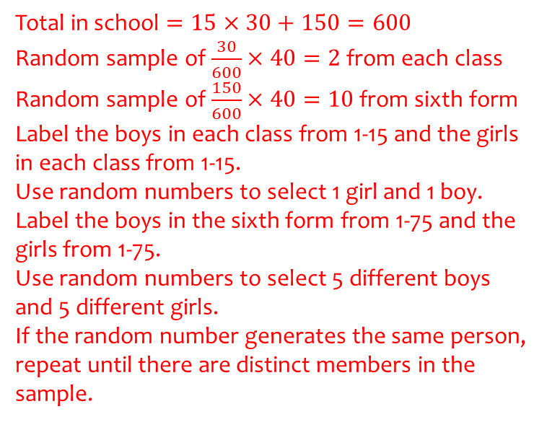
Worked example
Your turn
A school has 30 classes and a sixth form.
In each class there are 60 students.
In the sixth form there are 300 students.
There are equal numbers of boys and girls in each class.
There are equal numbers of boys and girls in the sixth form.
The head teacher wishes to obtain the opinions of the students about school uniforms.
Explain how the head teacher would take a stratified sample of size 140.
A school has 15 classes and a sixth form.
In each class there are 30 students.
In the sixth form there are 150 students.
There are equal numbers of boys and girls in each class.
There are equal numbers of boys and girls in the sixth form.
The head teacher wishes to obtain the opinions of the students about school uniforms.
Explain how the head teacher would take a stratified sample of size 40.
Total in school $=15×30+150=600$
Random sample of $\frac{30}{600}×40=2$ from each class
Random sample of $\frac{150}{600}×40=10$ from sixth form
Label the boys in each class from 1-15 and the girls in each class from 1-15.
Use random numbers to select 1 girl and 1 boy.
Label the boys in the sixth form from 1-75 and the girls from 1-75.
Use random numbers to select 5 different boys and 5 different girls.
If the random number generates the same person, repeat until there are distinct members in the sample.

Slide 9
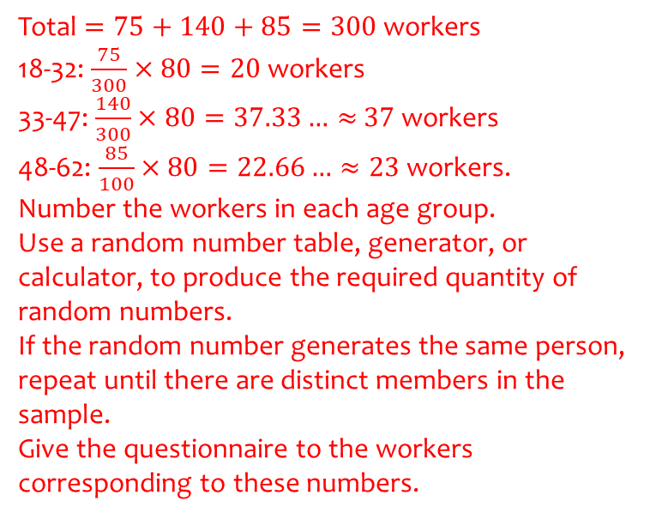
Worked example
Your turn
A company wants to survey the opinions of workers.
The manager decides to give a questionnaire to a sample of 40 workers.
There are 50 workers between ages 18 and 32.
There are 180 workers between 33 and 47.
There are 70 workers between 48 and 62.
Explain how the manager could obtain a stratified sample of worker opinions.
A company wants to survey the opinions of workers.
The manager decides to give a questionnaire to a sample of 80 workers.
There are 75 workers between ages 18 and 32.
There are 140 workers between 33 and 47.
There are 85 workers between 48 and 62.
Explain how the manager could obtain a stratified sample of worker opinions.
Total $=75+140+85=300$ workers
18-32: $\frac{75}{300}×80=20$ workers
33-47: $\frac{140}{300}×80=37.33…≈$ $37$ workers
48-62: $\frac{85}{100}×80=22.66…≈23$ workers.
Number the workers in each age group.
Use a random number table, generator, or calculator, to produce the required quantity of random numbers.
If the random number generates the same person, repeat until there are distinct members in the sample.
Give the questionnaire to the workers corresponding to these numbers.

Slide 10
1.3) Non-random sampling
Chapter CONTENTS

Slide 11
Worked example
Your turn
Explain how you would use opportunity sampling to survey 30 library users.
Explain how you would use opportunity sampling to survey 50 supermarket shoppers.
Stand outside a supermarket at a specific date and time and survey the first 50 people you see carrying shopping bags.
If the person rejects the survey, repeat until you have surveyed 50 different shoppers.

Slide 12
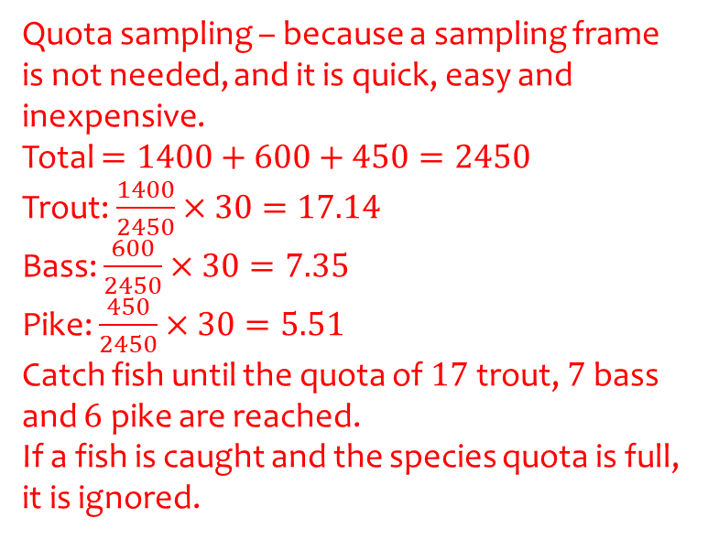
Worked example
Your turn
A lake contains 3 species of fish.
There are estimated to be 700 bream, 1200 carp and 600 roach in the lake.
A survey of the health of the fish in the lake is carried out and a sample of 40 fish chosen.
Explain how you would use an appropriate sampling method.
A lake contains 3 species of fish.
There are estimated to be 1400 trout, 600 bass and 450 pike in the lake.
A survey of the health of the fish in the lake is carried out and a sample of 30 fish chosen.
Explain how you would use an appropriate sampling method.
Quota sampling – because a sampling frame is not needed, and it is quick, easy and inexpensive.
Total $=1400+600+450=2450$
Trout: $\frac{1400}{2450}×30=17.14$
Bass: $\frac{600}{2450}×30=7.35$
Pike: $\frac{450}{2450}×30=5.51$
Catch fish until the quota of $17$ trout, $7$ bass and $6$ pike are reached.
If a fish is caught and the species quota is full, it is ignored.

Slide 13
1.4) Types of data
Chapter CONTENTS

Slide 14

Worked example
Your turn
State the type of data:
Type of tree
Number of people on a train
Time required to run $200m$
State the type of data:
Human shoe size measured as 1, 2 or 3 etc.
Height of a tree
Favourite colour
Quantitative, discrete
Quantitative, continuous
Qualitative

