Slide 1
1) Momentum and impulse
1.1) Momentum in one direction
1.2) Conservation of momentum
1.3) Momentum as a vector

Slide 2
1.1) Momentum in one direction
Chapter CONTENTS

Slide 3
Worked example
Your turn
Momentum = Mass x Velocity
Momentum = Mass x Velocity
Mass | Velocity | Momentum
6 kg | 5 m/s
 | 13 ms⁻¹ | 65 kgms⁻¹
523 kg |  | 0 Ns
3kg | 4i + 7j ms⁻¹
Mass | Velocity | Momentum
523 kg |  | 0 Ns
 | 7i + 7j ms⁻¹ | 1.4i + 1.4j kgms⁻¹
0.002 tonnes |  | 6i + 18j Ns
600g | 36 km/h
Mass | Velocity | Momentum
523 kg | 0 ms⁻¹ | 0 Ns
0.2 kg | 7i + 7j ms⁻¹ | 1.4i + 1.4j kgms⁻¹
0.002 tonnes | 3i + 9j ms⁻¹ | 6i + 18j Ns
600g | 36 km/h | 6 Ns

Slide 4
Worked example
Your turn
Calculate the impulse exerted on the object:
A force of $30 N$ exerted on an object for $0.5$ seconds
A ball of mass $3 kg$ was travelling at $10 ms^{−1}$, is hit, and slows to $6 ms^{−1}$ without changing direction
The momentum before impact is 6i + 3j Ns and the momentum after impact is 10i + 5j Ns
Calculate the impulse exerted on the object:
A rocket of mass $100 kg$ travelling at $2000 ms^{−1}$ hits the ground and stops.
A ball of mass $3 kg$ was travelling at $10 ms^{−1}$, is hit and returns in the opposite direction at a speed of $6 ms^{−1}$
The momentum before impact is 6i - 5j Ns and the momentum after impact is -10i + 5j Ns
$$200000 Ns$$
$$48 Ns$$
$$−16i+10j Ns$$

Slide 5
Worked example
Your turn
A ball of mass 0.4 kg hits a vertical wall at right angles with a speed of 7 ms⁻¹.
The ball rebounds with speed 5 ms⁻¹.
Find the magnitude of the impulse exerted on the wall by the ball.
A ball of mass 0.2 kg hits a vertical wall at right angles with a speed of 3.5 ms⁻¹.
The ball rebounds with speed 2.5 ms⁻¹.
Find the magnitude of the impulse exerted on the wall by the ball.
$$1.2 Ns$$

Slide 6
Worked example
Your turn
Two particles $A$ and $B$, of mass $0.6 kg$ and $m$ kg respectively, are moving in opposite directions along the same straight horizontal line so that the particles collide directly.
Immediately before the collision, the speeds of $A$ and $B$ are $4 ms^{−1}$ and $2 ms^{−1}$ respectively.
In the collision the direction of motion of each particle is reversed and, immediately after the collision, the speed of each particle is $2 ms^{−1}$.
Find the magnitude of the impulse exerted by $B$on $A$in the collision.
Two particles $A$ and $B$, of mass $0.3 kg$ and $m$ kg respectively, are moving in opposite directions along the same straight horizontal line so that the particles collide directly.
Immediately before the collision, the speeds of $A$ and $B$ are $8 ms^{−1}$ and $4 ms^{−1}$ respectively.
In the collision the direction of motion of each particle is reversed and, immediately after the collision, the speed of each particle is $2 ms^{−1}$.
Find the magnitude of the impulse exerted by $B$on $A$in the collision.
$$3 Ns$$

Slide 7
1.2) Conservation of momentum
Chapter CONTENTS

Slide 8
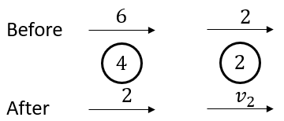
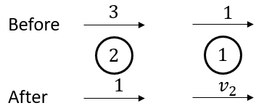
Worked example
Your turn
Calculate the value of the unknown in the following isolated systems. All velocities are marked in $ms^{−1}$ and all masses in $kg$.
Calculate the value of the unknown in the following isolated systems. All velocities are marked in $ms^{−1}$ and all masses in $kg$.
$$v_{2}=5 {ms}^{−1}$$
Diagrams used with permission from DrFrostMaths: https://www.drfrostmaths.com/

Slide 9
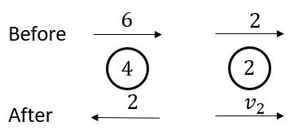
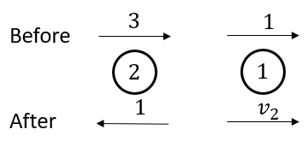
Worked example
Your turn
Calculate the value of the unknown in the following isolated systems. All velocities are marked in $ms^{−1}$ and all masses in $kg$.
Calculate the value of the unknown in the following isolated systems. All velocities are marked in $ms^{−1}$ and all masses in $kg$.
$$v_{2}=9 {ms}^{−1}$$
Diagrams used with permission from DrFrostMaths: https://www.drfrostmaths.com/

Slide 10
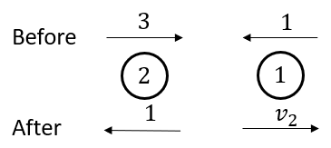
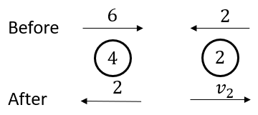
Worked example
Your turn
Calculate the value of the unknown in the following isolated systems. All velocities are marked in $ms^{−1}$ and all masses in $kg$.
Calculate the value of the unknown in the following isolated systems. All velocities are marked in $ms^{−1}$ and all masses in $kg$.
$$v_{2}=7{ ms}^{−1}$$
Diagrams used with permission from DrFrostMaths: https://www.drfrostmaths.com/

Slide 11
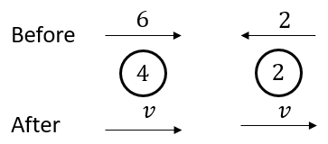
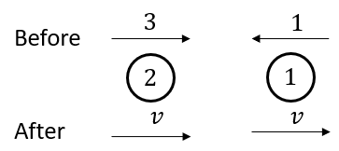
Worked example
Your turn
Calculate the value of the unknown in the following isolated systems. All velocities are marked in $ms^{−1}$ and all masses in $kg$.
Calculate the value of the unknown in the following isolated systems. All velocities are marked in $ms^{−1}$ and all masses in $kg$.
$v=1.67 ms^{−1}$ (3 sf)
Diagrams used with permission from DrFrostMaths: https://www.drfrostmaths.com/

Slide 12
Worked example
Your turn
A particle $P$ of mass $4 kg$ is moving with speed $6 ms^{−1}$ on a smooth horizontal plane.
Particle $Q$ of mass $6 kg$ is at rest on the plane.
Particle $P$collides with particle $Q$ and after the collision $Q$ moves with speed $\frac{14}{3}ms^{−1}$. Find:
a) The speed and direction of motion of $P$after the collision
b) The magnitude of the impulse received by $P$ in the collision
A particle $P$ of mass $2 kg$ is moving with speed $3 ms^{−1}$ on a smooth horizontal plane.
Particle $Q$ of mass $3 kg$ is at rest on the plane.
Particle $P$collides with particle $Q$ and after the collision $Q$ moves with speed $\frac{7}{3}ms^{−1}$. Find:
a) The speed and direction of motion of $P$after the collision
b) The magnitude of the impulse received by $P$ in the collision
a) $0.5 ms^{−1}$ ; direction of motion is reversed.
b) $7 Ns$

Slide 13
Worked example
Your turn
Two particles $A$ and $B$ of masses $2 kg$ and $4 kg$ respectively are moving towards each other in opposite directions along the same straight line on a smooth horizontal surface.
The particles collide.
Before the collision the speeds of $A$ and $B$ are $3 ms^{−1}$ and $2 ms^{−1}$ respectively.
After the collision the direction of motion of $A$ is reversed and its speed is $2 ms^{−1}$. Find:
a) The speed and direction of $B$ after the collision
b) The magnitude of the impulse given by $A$ to $B$ in the collision
Two particles $A$ and $B$ of masses $2 kg$ and $4 kg$ respectively are moving towards each other in opposite directions along the same straight line on a smooth horizontal surface.
The particles collide.
Before the collision the speeds of $A$ and $B$ are $3 ms^{−1}$ and $2 ms^{−1}$ respectively.
After the collision the direction of motion of $A$ is reversed and its speed is $2 ms^{−1}$. Find:
a) The speed and direction of $B$ after the collision
b) The magnitude of the impulse given by $A$ to $B$ in the collision
a) $0.5 ms^{−1}$ ; direction of motion is reversed.
b) $10 Ns$

Slide 14
Worked example
Your turn
Two particles P and Q, of masses 8kg and 4kg respectively, are connected by a light inextensible string.
The particles are at rest on a smooth horizontal plane with the string slack.
Particle P is projected directly away from Q with speed 2$ms^{−1}$.
Find the common speed of the particles after the string goes taut.
Find the magnitude of the impulse transmitted through the string when it goes taught.
Two particles P and Q, of masses 8kg and 2kg respectively, are connected by a light inextensible string.
The particles are at rest on a smooth horizontal plane with the string slack.
Particle P is projected directly away from Q with speed 4$ms^{−1}$.
Find the common speed of the particles after the string goes taut.
Find the magnitude of the impulse transmitted through the string when it goes taught.
a) $3.2 ms^{−1}$
b) $6.4 Ns$

Slide 15
Worked example
Your turn
Two particles $A$ and $B$ of masses $4 kg$and $2 kg$ respectively are moving towards each other in opposite directions along the same straight line on a smooth horizontal surface. The particles collide.
Before the collision the speeds of $A$ and $B$ are $6 ms^{−1}$ and $4 ms^{−1}$ respectively.
Given that the magnitude of the impulse due to the collision is $14 Ns$, find:
The velocity of $A$ after the collision
The velocity of $B$ after the collision
Two particles $A$ and $B$ of masses $2 kg$and $4 kg$ respectively are moving towards each other in opposite directions along the same straight line on a smooth horizontal surface. The particles collide.
Before the collision the speeds of $A$ and $B$ are $3 ms^{−1}$ and $2 ms^{−1}$ respectively.
Given that the magnitude of the impulse due to the collision is $7 Ns$, find:
The velocity of $A$ after the collision
The velocity of $B$ after the collision
a) $0.5 ms^{−1}$ ; direction of motion is reversed
b) $0.25 ms^{−1}$ ; direction of motion is unchanged.

Slide 16
Worked example
Your turn
A truck $P$ of mass $4M$ is moving with speed $U$ on smooth straight horizontal rails. It collides directly with another truck $Q$ of mass $6M$ which is moving with speed $2U$ in the opposite direction on the same rails. The trucks join so that immediately after the collision they move together. By modelling the trucks as particles, find:
The speed of the trucks immediately after the collision
The magnitude of the impulse exerted on P by Q in the collision
A truck $P$ of mass $2M$ is moving with speed $U$ on smooth straight horizontal rails. It collides directly with another truck $Q$ of mass $3M$ which is moving with speed $4U$ in the opposite direction on the same rails. The trucks join so that immediately after the collision they move together. By modelling the trucks as particles, find:
The speed of the trucks immediately after the collision
The magnitude of the impulse exerted on P by Q in the collision
a) $2U$
b) $6MU$

Slide 17
1.3) Momentum as a vector
Chapter CONTENTS

Slide 18
Worked example
Your turn
A particle of mass 0.4kg is moving with velocity (5i –10j) ${ms}^{−1}$ when it receives an impulse (2i – 3j)Ns. Find the new velocity of the particle.
A particle of mass 0.2kg is moving with velocity (10i – 5j) ${ms}^{−1}$ when it receives an impulse (3i – 2j)Ns. Find the new velocity of the particle.
$$\left(25i−15j\right) ms^{−1}$$

Slide 19
Worked example
Your turn
An ice hockey puck of mass 0.34 kg receives an impulse Q Ns .
Immediately before the impulse the velocity of the puck is (5i + 10j) $ms^{−1}$ and immediately afterwards its velocity is (7i – 15j) $ms^{−1}$.
Find the magnitude of Q and the angle between Q and i.
An ice hockey puck of mass 0.17 kg receives an impulse Q Ns .
Immediately before the impulse the velocity of the puck is (10i + 5j) $ms^{−1}$ and immediately afterwards its velocity is (15i – 7j) $ms^{−1}$.
Find the magnitude of Q and the angle between Q and i.
$$\left|Q\right|=2.21$$
Angle between $Q$ and $i=67.4°$ (1 dp)

Slide 20
Worked example
Your turn
A squash ball of mass $0.05 kg$ is moving with velocity $\left(44i+74j\right) ms^{−1}$ when it hits a wall.
It rebounds with velocity $\left(20i−22j\right) ms^{−1}$.
Find the impulse exerted by the wall on the squash ball.
A squash ball of mass $0.025 kg$ is moving with velocity $\left(22i+37j\right) ms^{−1}$ when it hits a wall.
It rebounds with velocity $\left(10i−11j\right) ms^{−1}$.
Find the impulse exerted by the wall on the squash ball.
$$\left(−0.3i−1.2j\right) Ns$$

Slide 21
Worked example
Your turn
A particle of mass $0.3 kg$ is moving with velocity $\left(10i−20j\right) ms^{−1}$ when it collides with a particle of mass $0.5 kg$ moving with velocity $\left(8i−16j\right) ms^{−1}$.
The two particles coalesce and move as one particle of mass $0.8 kg$.
Find the velocity of the combined particle.
A particle of mass $0.15 kg$ is moving with velocity $\left(20i−10j\right) ms^{−1}$ when it collides with a particle of mass $0.25 kg$ moving with velocity $\left(16i−8j\right) ms^{−1}$.
The two particles coalesce and move as one particle of mass $0.4 kg$.
Find the velocity of the combined particle.
$$\left(17.5i−8.75j\right) ms^{−1}$$

