Slide 1
1) Algebraic methods
1.2) Algebraic fractions
1.3) Partial fractions
1.4) Repeated factors
1.5) Algebraic division

Slide 2
1.2) Algebraic fractions
Chapter CONTENTS

Slide 3
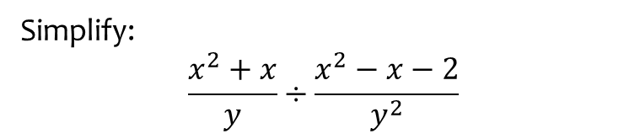
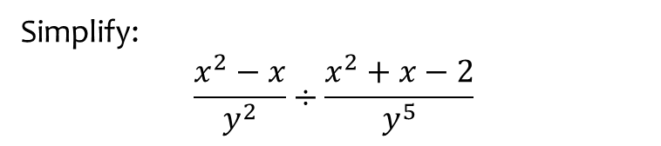

Worked example
Your turn
Simplify:
$$\frac{x^{2}−x}{y^{2}}÷\frac{x^{2}+x−2}{y^{5}}$$
Simplify:
$$\frac{x^{2}+x}{y}÷\frac{x^{2}−x−2}{y^{2}}$$
$$\frac{xy}{x−2}$$

Slide 4
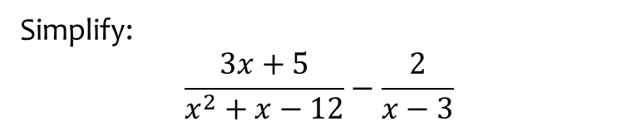
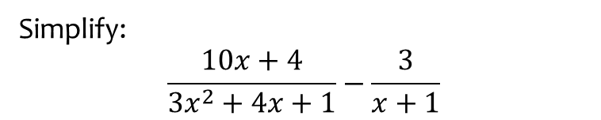

Worked example
Your turn
Simplify:
$$\frac{10x+4}{3x^{2}+4x+1}−\frac{3}{x+1}$$
Simplify:
$$\frac{3x+5}{x^{2}+x−12}−\frac{2}{x−3}$$
$$\frac{1}{x+4}$$

Slide 5

Worked example
Your turn
Simplify:
$$\frac{x^{2}+6x+5}{x^{2}+3x−10}$$
$$\frac{x^{2}−7x−8}{x^{2}−1}$$
Simplify:
$$\frac{x^{2}−6x+5}{x^{2}+4x−5}$$
$$\frac{x−5}{x+5}$$

Slide 6
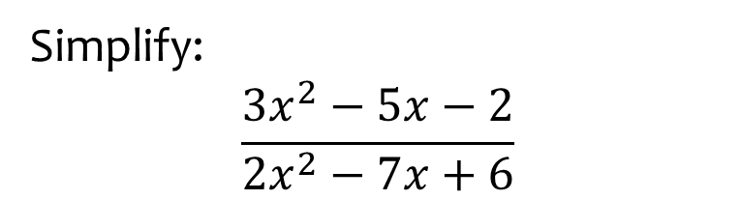

Worked example
Your turn
Simplify:
$$\frac{2x^{2}−5x−3}{3x^{2}−11x+6}$$
$$\frac{3x^{2}−x−10}{x^{2}−4}$$
Simplify:
$$\frac{3x^{2}−5x−2}{2x^{2}−7x+6}$$
$$\frac{3x+1}{2x−3}$$

Slide 7
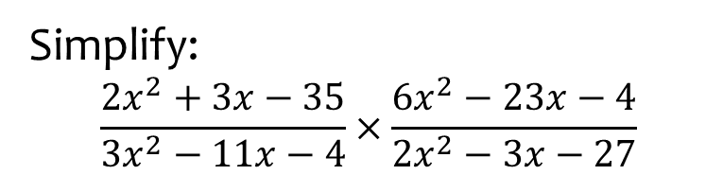

Worked example
Your turn
Simplify:
$$\frac{3x^{2}+2x−8}{6x^{2}−23x−35}×\frac{7x^{2}−29x−30}{4x^{2}+5x−6}$$
$$\frac{6x^{2}+37x−35}{3x^{2}−10x−8}×\frac{3x^{2}+14x+8}{42x^{2}+35x}$$
Simplify:
$$\frac{2x^{2}+3x−35}{3x^{2}−11x−4}×\frac{6x^{2}−23x−4}{2x^{2}−3x−27}$$
$$\frac{\left(x+5\right)\left(2x−7\right)\left(6x+1\right)}{\left(3x+1\right)\left(2x−9\right)\left(x+3\right)}$$

Slide 8
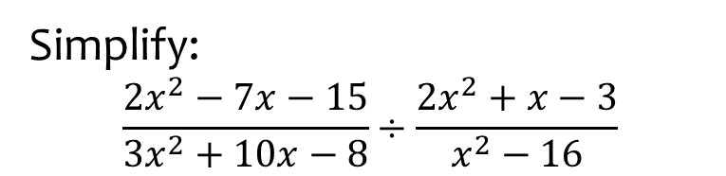
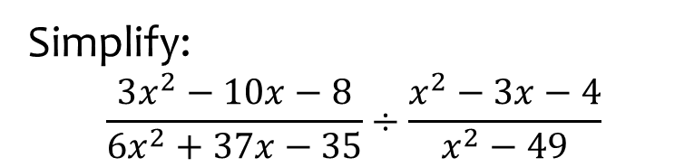
Worked example
Your turn
Simplify:
$$\frac{3x^{2}−10x−8}{6x^{2}+37x−35}÷\frac{x^{2}−3x−4}{x^{2}−49}$$
Simplify:
$$\frac{2x^{2}−7x−15}{3x^{2}+10x−8}÷\frac{2x^{2}+x−3}{x^{2}−16}$$
$$\frac{\left(x−5\right)\left(x−4\right)}{\left(3x−2\right)\left(x−1\right)}$$

Slide 9
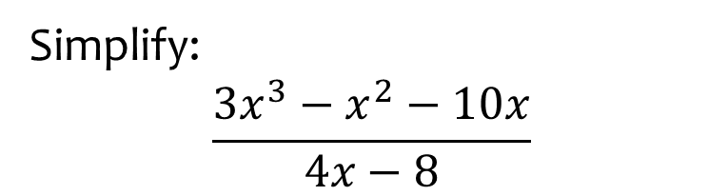
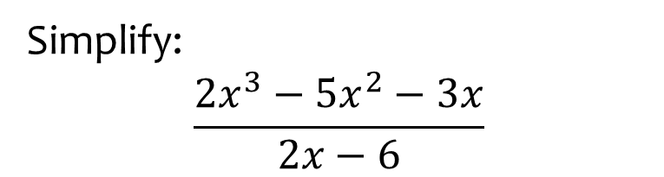
Worked example
Your turn
Simplify:
$$\frac{{2x}^{3}−5x^{2}−3x}{2x−6}$$
Simplify:
$$\frac{3x^{3}−x^{2}−10x}{4x−8}$$
$$\frac{x\left(3x+5\right)}{4}$$

Slide 10
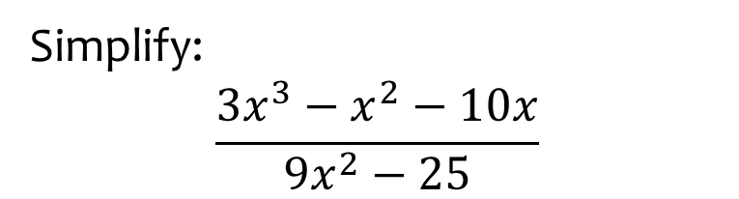
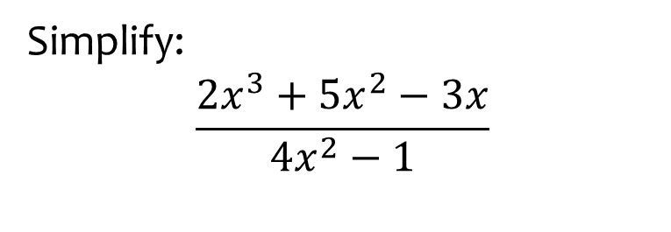
Worked example
Your turn
Simplify:
$$\frac{2x^{3}+5x^{2}−3x}{4x^{2}−1}$$
Simplify:
$$\frac{3x^{3}−x^{2}−10x}{9x^{2}−25}$$
$$\frac{x\left(x−2\right)}{3x−5}$$

Slide 11
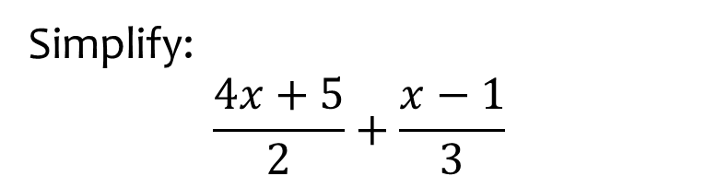

Worked example
Your turn
Write as a single fraction:
$$\frac{5x+2}{3}+\frac{x−3}{2}$$
$$\frac{x−5}{4}+\frac{2x+1}{3}$$
Simplify:
$$\frac{4x+5}{2}+\frac{x−1}{3}$$
$$\frac{14x+13}{6}$$

Slide 12
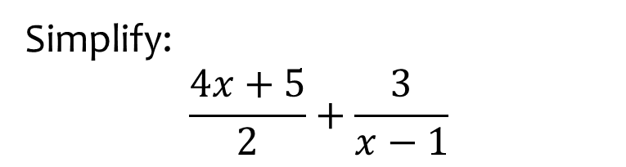

Worked example
Your turn
Write as a single fraction:
$$\frac{5x+2}{3}+\frac{2}{x−3}$$
$$\frac{x−5}{4}+\frac{3}{2x+1}$$
Simplify:
$$\frac{4x+5}{2}+\frac{3}{x−1}$$
$$\frac{4x^{2}+x+1}{2\left(x−1\right)}$$

Slide 13
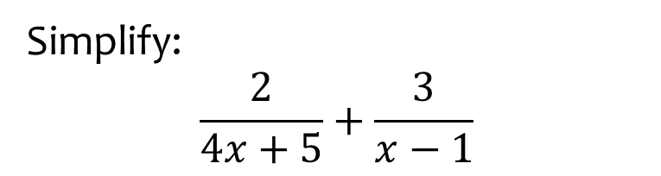

Worked example
Your turn
Write as a single fraction:
$$\frac{3}{5x+2}+\frac{2}{x−3}$$
$$\frac{4}{x−5}+\frac{3}{2x+1}$$
Simplify:
$$\frac{2}{4x+5}+\frac{3}{x−1}$$
$$\frac{10x+13}{\left(4x+5\right)\left(x−1\right)}$$

Slide 14
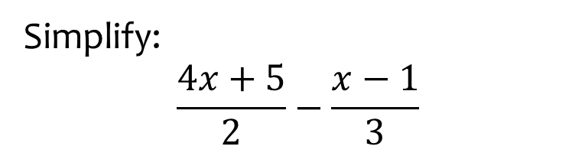

Worked example
Your turn
Write as a single fraction:
$$\frac{5x+2}{3}−\frac{x−3}{2}$$
$$\frac{x−5}{4}−\frac{2x+1}{3}$$
Simplify:
$$\frac{4x+5}{2}−\frac{x−1}{3}$$
$$\frac{10x+17}{6}$$

Slide 15
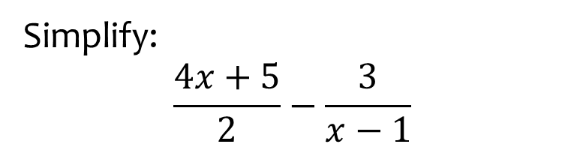

Worked example
Your turn
Write as a single fraction:
$$\frac{5x+2}{3}−\frac{2}{x−3}$$
$$\frac{x−5}{4}−\frac{3}{2x+1}$$
Simplify:
$$\frac{4x+5}{2}−\frac{3}{x−1}$$
$$\frac{4x^{2}+x−11}{2\left(x−1\right)}$$

Slide 16
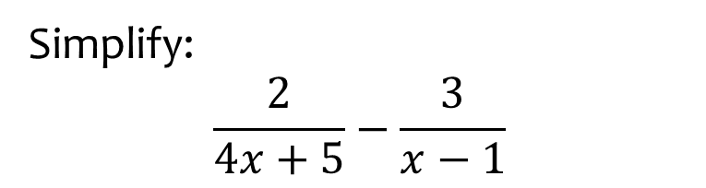

Worked example
Your turn
Write as a single fraction:
$$\frac{3}{5x+2}−\frac{2}{x−3}$$
$$\frac{4}{x−5}−\frac{3}{2x+1}$$
Simplify:
$$\frac{2}{4x+5}−\frac{3}{x−1}$$
$$\frac{−10x−17}{\left(4x+5\right)\left(x−1\right)}$$

Slide 17
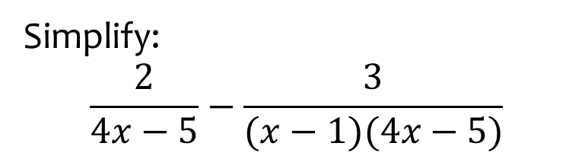

Worked example
Your turn
Write as a single fraction:
$$\frac{3}{(5x+2)(x−3)}−\frac{2}{x−3}$$
$$\frac{4}{(2x+1)(x−5)}−\frac{3}{2x+1}$$
Simplify:
$$\frac{2}{4x−5}−\frac{3}{(x−1)(4x−5)}$$
$$\frac{2x−5}{\left(x−1\right)\left(4x−5\right)}$$

Slide 18


Worked example
Your turn
Write as a single fraction:
$$3+\frac{5}{2x−1}$$
$$2−\frac{3}{5x+4}$$
Write as a single fraction:
$$5−\frac{3}{x+2}$$
$$\frac{5x+7}{x+2}$$

Slide 19
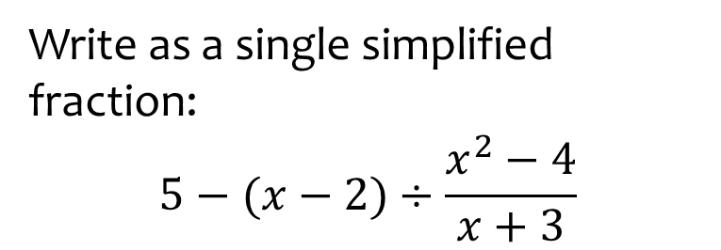
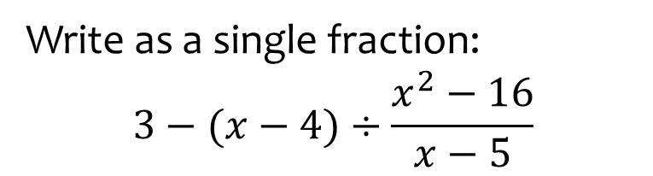
Worked example
Your turn
Write as a single fraction:
$$3−(x−4)÷\frac{x^{2}−16}{x−5}$$
Write as a single simplified fraction:
$$5−(x−2)÷\frac{x^{2}−4}{x+3}$$
$$\frac{4x−13}{x−2}$$

Slide 20
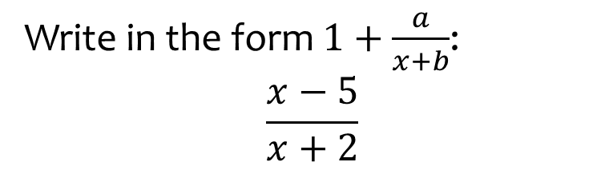

Worked example
Your turn
Write in the form $1+\frac{a}{x+b}$:
$$\frac{x+3}{x−5}$$
$$\frac{x−2}{x+7}$$
Write in the form $1+\frac{a}{x+b}$:
$$\frac{x−5}{x+2}$$
$$1−\frac{7}{x+2}$$

Slide 21
1.3) Partial fractions
Chapter CONTENTS

Slide 22
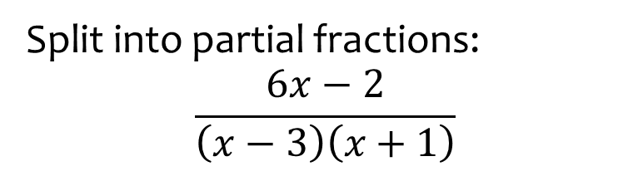
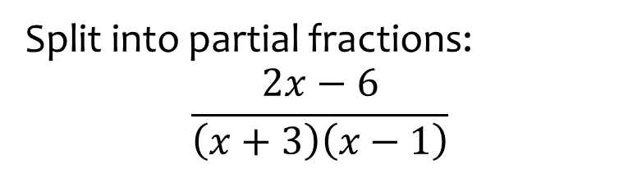

Worked example
Your turn
Split into partial fractions:
$$\frac{2x−6}{\left(x+3\right)\left(x−1\right)}$$
Split into partial fractions:
$$\frac{6x−2}{\left(x−3\right)\left(x+1\right)}$$
$$\frac{4}{x−3}+\frac{2}{x+1}$$

Slide 23
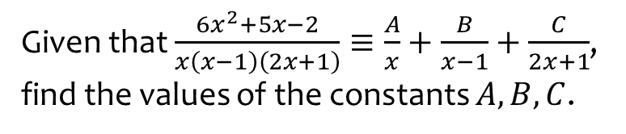
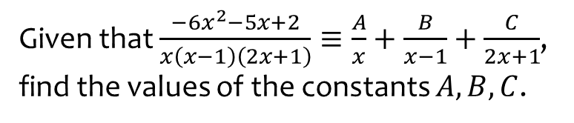

Worked example
Your turn
Given that $\frac{−6x^{2}−5x+2}{x\left(x−1\right)\left(2x+1\right)}≡\frac{A}{x}+\frac{B}{x−1}+\frac{C}{2x+1}$, find the values of the constants $A,B,C$.
Given that $\frac{6x^{2}+5x−2}{x\left(x−1\right)\left(2x+1\right)}≡\frac{A}{x}+\frac{B}{x−1}+\frac{C}{2x+1}$, find the values of the constants $A,B,C$.
$$A=2, B=3, C=−4$$

Slide 24
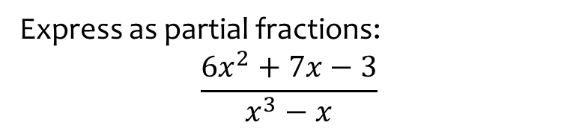
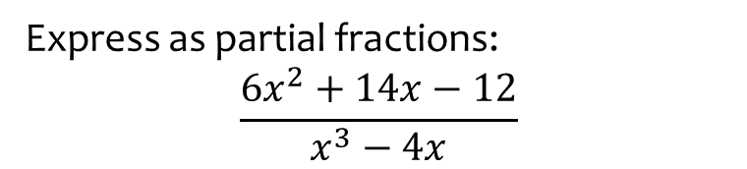

Worked example
Your turn
Express as partial fractions:
$$\frac{6x^{2}+14x−12}{x^{3}−4x}$$
Express as partial fractions:
$$\frac{6x^{2}+7x−3}{x^{3}−x}$$
$$\frac{3}{x}−\frac{2}{x+1}+\frac{5}{x−1}$$

Slide 25
1.4) Repeated factors
Chapter CONTENTS

Slide 26
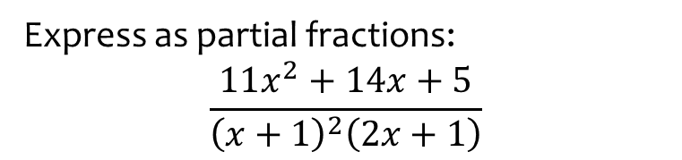
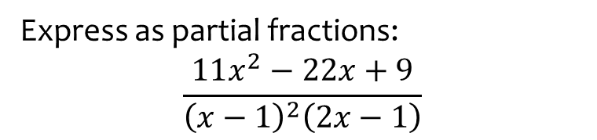
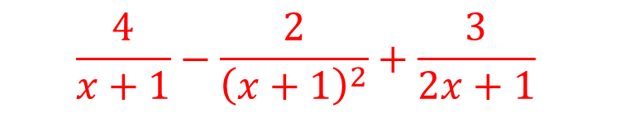
Worked example
Your turn
Express as partial fractions:
$$\frac{11x^{2}−22x+9}{{\left(x−1\right)}^{2}\left(2x−1\right)}$$
Express as partial fractions:
$$\frac{11x^{2}+14x+5}{{\left(x+1\right)}^{2}\left(2x+1\right)}$$
$$\frac{4}{x+1}−\frac{2}{{\left(x+1\right)}^{2}}+\frac{3}{2x+1}$$

Slide 27
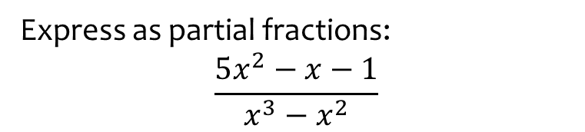
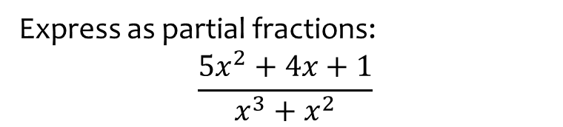

Worked example
Your turn
Express as partial fractions:
$$\frac{5x^{2}+4x+1}{x^{3}+x^{2}}$$
Express as partial fractions:
$$\frac{5x^{2}−x−1}{x^{3}−x^{2}}$$
$$\frac{2}{x}+\frac{1}{x^{2}}+\frac{3}{x−1}$$

Slide 28
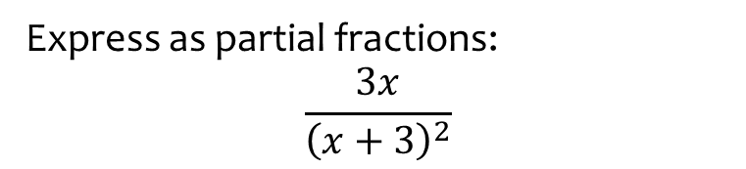
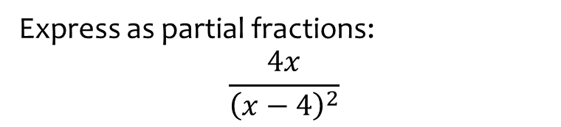

Worked example
Your turn
Express as partial fractions:
$$\frac{4x}{{\left(x−4\right)}^{2}}$$
Express as partial fractions:
$$\frac{3x}{{\left(x+3\right)}^{2}}$$
$$\frac{3}{x+3}−\frac{9}{{\left(x+3\right)}^{2}}$$

Slide 29
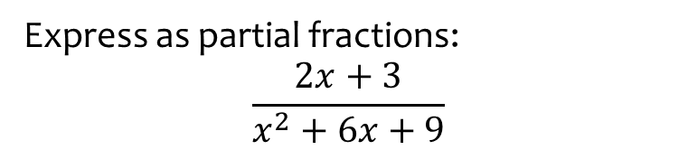
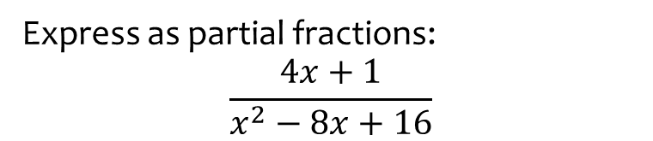

Worked example
Your turn
Express as partial fractions:
$$\frac{4x+1}{x^{2}−8x+16}$$
Express as partial fractions:
$$\frac{2x+3}{x^{2}+6x+9}$$
$$\frac{2}{x+3}−\frac{3}{{\left(x+3\right)}^{2}}$$

Slide 30
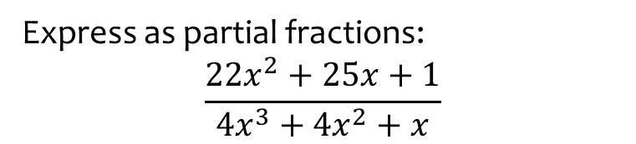


Worked example
Your turn
Express as partial fractions:
$$\frac{15x^{2}−5x+2}{9x^{3}−6x^{2}+x}$$
Express as partial fractions:
$$\frac{22x^{2}+25x+1}{4x^{3}+4x^{2}+x}$$
$$\frac{6}{x}−\frac{1}{2x+1}+\frac{2}{{\left(2x+1\right)}^{2}}$$

Slide 31
1.5) Algebraic division
Chapter CONTENTS

Slide 32



Worked example
Your turn
Find the values of $A, B$ and $C$:
$$\frac{x^{2}+9x−5}{x+3}=Ax+B+\frac{C}{x+3}$$
Find the values of $A, B$ and $C$:
$$\frac{x^{2}+5x−9}{x+2}=Ax+B+\frac{C}{x+2}$$
$$A=1, B=3, C=−15$$

Slide 33



Worked example
Your turn
Find the values of $A, B$ and $C\text{:}$
$$\frac{x^{2}−5x+9}{x−2}=Ax+B+\frac{C}{x−2}$$
Find the values of $A, B$ and $C\text{:}$
$$\frac{x^{2}+5x−9}{x−3}=Ax+B+\frac{C}{x−3}$$
$$A=1, B=8, C=15$$

Slide 34



Worked example
Your turn
Find the values of $A, B, C$ and $D\text{:}$
$$\frac{x^{3}−x^{2}+7}{x+3}=Ax^{2}+Bx+C+\frac{D}{x+3}$$
Find the values of $A, B, C$ and $D\text{:}$
$$\frac{x^{3}+x^{2}−7}{x+2}=Ax^{2}+Bx+C+\frac{D}{x+2}$$
$$A=1, B=−1, C=2, D=−11$$

Slide 35



Worked example
Your turn
Find the values of $A, B, C$ and $D\text{:}$
$$\frac{x^{3}−x^{2}+7}{x−2}=Ax^{2}+Bx+C+\frac{D}{x−2}$$
Find the values of $A, B, C$ and $D\text{:}$
$$\frac{x^{3}+x^{2}−7}{x−3}=Ax^{2}+Bx+C+\frac{D}{x−3}$$
$$A=1, B=4, C=12, D=29$$

Slide 36


Worked example
Your turn
Find the values of $A, B, C,D$ and $E\text{:}$
$$\frac{x^{4}−x^{3}−x+10}{x^{2}−2x−3}=Ax^{2}+Bx+C+\frac{Dx+E}{x^{2}+2x−3}$$
Find the values of $A, B, C,D$ and $E\text{:}$
$$\frac{x^{4}+x^{3}+x−10}{x^{2}+2x−3}=Ax^{2}+Bx+C+\frac{Dx+E}{x^{2}+2x−3}$$
$$A=1, B=−1, C=5, D=−12, E=5$$

Slide 37


Worked example
Your turn
Find the values of $A, B, C$ and $D$
$$\frac{2x^{3}+3x^{2}−4x+5}{x−3}=Ax^{2}+Bx+C+\frac{D}{x−3}$$
Find the values of $A, B, C$ and $D$
$$\frac{2x^{3}−3x^{2}+4x−5}{x+3}=Ax^{2}+Bx+C+\frac{D}{x+3}$$
$$A=2, B=−9, C=31, D=−160$$

Slide 38


Worked example
Your turn
Find the values of $A, B, C,D$ and $E\text{:}$
$$\frac{{3x}^{4}−2x^{3}+5x^{2}−4}{x^{2}−16}=Ax^{2}+Bx+C+\frac{Dx+E}{x^{2}−16}$$
Find the values of $A, B, C,D$ and $E\text{:}$
$$\frac{{3x}^{4}−2x^{3}−5x^{2}−4}{x^{2}−4}=Ax^{2}+Bx+C+\frac{Dx+E}{x^{2}−4}$$
$$A=3, B=−2, C=7, D=−8, E=24$$

Slide 39


Worked example
Your turn
Simplify:
$$\frac{x^{4}−81}{x+3}$$
Simplify:
$$\frac{x^{4}−16}{x+2}$$
$$\left(x−1\right)\left(x^{2}+1\right)$$

Slide 40



Worked example
Your turn
Split into partial fractions:
$$\frac{3x^{2}−3x−2}{\left(x+1\right)\left(x−2\right)}$$
Split into partial fractions:
$$\frac{3x^{2}−3x−2}{\left(x−1\right)\left(x−2\right)}$$
$$3+\frac{2}{x−1}+\frac{4}{x−2}$$

Slide 41



Worked example
Your turn
Split into partial fractions:
$$\frac{9x^{2}+20x−10}{\left(x−2\right)\left(3x+1\right)}$$
Split into partial fractions:
$$\frac{9x^{2}+20x−10}{\left(x+2\right)\left(3x−1\right)}$$
$$3+\frac{2}{x+2}−\frac{1}{3x−1}$$

Slide 42



Worked example
Your turn
Split into partial fractions:
$$\frac{9x^{2}+16}{9x^{2}−16}$$
Split into partial fractions:
$$\frac{16x^{2}+9}{16x^{2}−9}$$
$$1−\frac{3}{4x+3}+\frac{3}{4x−3}$$

Slide 43



Worked example
Your turn
Split into partial fractions:
$$\frac{16x^{3}−36x^{2}+4x+22}{4x^{2}−12x+9}$$
Split into partial fractions:
$$\frac{18x^{3}−15x^{2}+5x+2}{9x^{2}−12x+4}$$
$$2x+1+\frac{3}{3x−2}+\frac{4}{{\left(3x−2\right)}^{2}}$$

Slide 44



Worked example
Your turn
Split into partial fractions:
$$\frac{5x^{4}−9x^{2}−7x^{2}+4x−10}{x^{2}−x−2}$$
Split into partial fractions:
$$\frac{5x^{4}+9x^{3}−6x^{2}−2x−6}{x^{2}+x−2}$$
$$5x^{2}+4x+3+\frac{2}{x+2}+\frac{1}{x−1}$$

