Slide 1
1) Algebraic expressions
1.1) Index laws
1.2) Expanding brackets
1.3) Factorising
1.4) Negative and fractional indices
1.5) Surds
1.6) Rationalising denominators

Slide 2
1.1) Index Laws
Chapter CONTENTS

Slide 3



Worked example
Your turn
Simplify:
$${\left(a^{5}\right)}^{3}×4a^{7}$$
$${\left(5xy^{4}\right)}^{3}$$
Simplify:
$${\left(a^{3}\right)}^{2}×2a^{2}$$
$${\left(4x^{3}y\right)}^{3}$$
$$2a^{8}$$
$$64x^{9}y^{3}$$

Slide 4



Worked example
Your turn
Simplify:
$$7x^{3}\left(6−5x\right)−4x\left(3−2x^{3}\right)$$
$$\frac{5x^{4}+3x^{2}}{6x^{3}}$$
Simplify:
$$2x^{2}\left(3+5x\right)−x\left(4−x^{2}\right)$$
$$\frac{x^{3}−2x}{3x^{2}}$$
$$11x^{3}+6x^{2}−4x$$
$$\frac{1}{3}x−\frac{2}{3x}$$

Slide 5



Worked example
Your turn
Simplify:
$$4^{x}×5^{x}$$
$$7^{x+1}×6^{x+1}$$
Simplify:
$$2^{x−4}×3^{x−4}$$
$$6^{x−4}$$

Slide 6
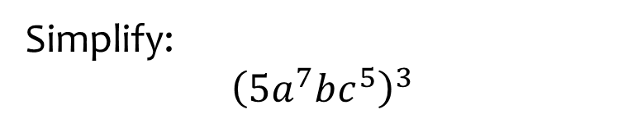


Worked example
Your turn
Simplify:
$${\left(x^{2}\right)}^{3}$$
$${\left(2x^{3}y^{4}\right)}^{5}$$
$${\left(4ab^{2}c^{4}\right)}^{3}$$
Simplify:
$${\left(5a^{7}bc^{5}\right)}^{3}$$
$$125a^{21}b^{3}c^{15}$$

Slide 7
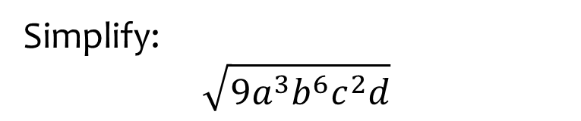


Worked example
Your turn
Simplify:
$$\sqrt{16x^{2}y^{6}z^{4}}$$
$$\sqrt[3]{27x^{4}y^{6}z}$$
Simplify:
$$\sqrt{9a^{3}b^{6}c^{2}d}$$
$$3a^{\frac{3}{2}}b^{3}cd^{\frac{1}{2}}$$

Slide 8



Worked example
Your turn
Write in index form:
$$32×128$$
$$3×27×81$$
Write in index form:
$$5×25×625$$
$$5^{7}$$

Slide 9


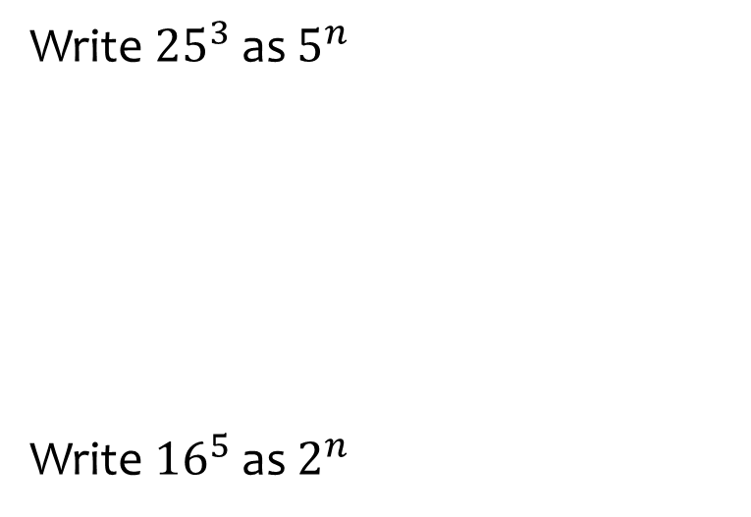
Worked example
Your turn
Write ${25}^{3}$ as $5^{n}$
Write ${16}^{5}$as $2^{n}$
Write${27}^{4}$ as $3^{n}$
$$3^{12}$$

Slide 10



Worked example
Your turn
Write ${81}^{4}×9^{7}$ as $3^{n}$
Write $8^{\frac{1}{2}}×{128}^{−\frac{3}{4}}$ as $2^{n}$
Write ${25}^{\frac{1}{3}}×{125}^{−\frac{2}{5}}$ as $5^{n}$
$$5^{−\frac{8}{15}}$$

Slide 11



Worked example
Your turn
Write ${0.04}^{5}×{0.2}^{3}$ as $5^{n}$
Write ${0.125}^{3}×{0.5}^{7}$ as $2^{n}$
$$2^{−16}$$

Slide 12



Worked example
Your turn
Write $\frac{{81}^{4}}{9^{7}}$ as $3^{n}$
Write $\frac{{16}^{3}}{{32}^{7}}$ as $2^{n}$
Write $\frac{{25}^{4}}{{125}^{6}}$ as $5^{n}$
$$5^{−10}$$

Slide 13
1.2) Expanding brackets
Chapter CONTENTS

Slide 14
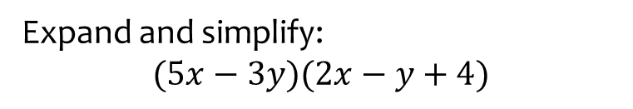
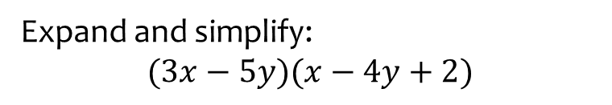

Worked example
Your turn
Expand and simplify:
$$(3x−5y)(x−4y+2)$$
Expand and simplify:
$$(5x−3y)(2x−y+4)$$
$$10x^{2}−11xy+20x+3y^{2}−12y$$

Slide 15
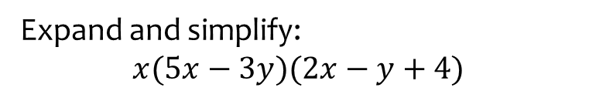
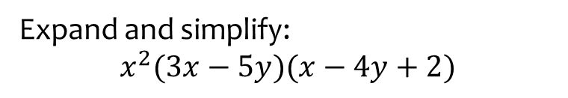
Worked example
Your turn
Expand and simplify:
$$x^{2}(3x−5y)(x−4y+2)$$
Expand and simplify:
$$x(5x−3y)(2x−y+4)$$
$$10x^{3}−11x^{2}y+20x^{2}+3xy^{2}−12xy$$

Slide 16
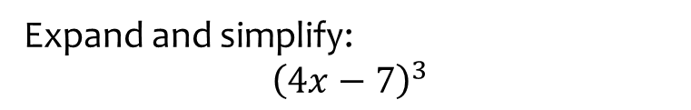
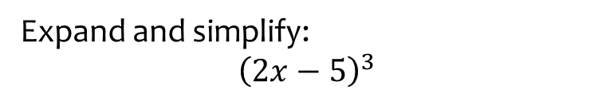
Worked example
Your turn
Expand and simplify:
$${\left(2x−5\right)}^{3}$$
Expand and simplify:
$${\left(4x−7\right)}^{3}$$
$$64x^{3}−336x^{2}+588x−343$$

Slide 17
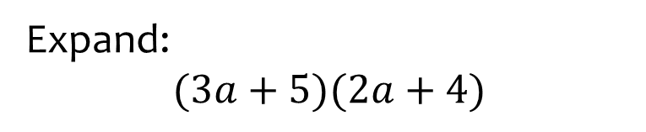


Worked example
Your turn
Expand:
$$(2x+3)(4x+5)$$
$$\left(5x+3\right)(4x+1)$$
Expand:
$$(3a+5)(2a+4)$$
$$6a^{2}+22a+20$$

Slide 18
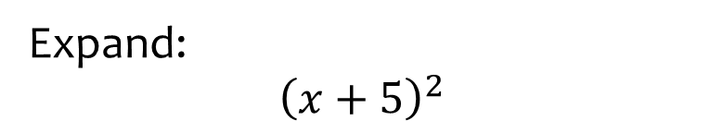


Worked example
Your turn
Expand:
$${\left(x+3\right)}^{2}$$
$${\left(x+4\right)}^{2}$$
Expand:
$${\left(x+5\right)}^{2}$$
$$x^{2}+10x+25$$

Slide 19
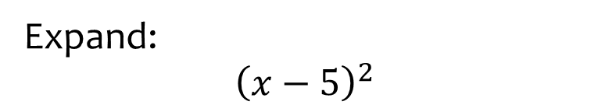


Worked example
Your turn
Expand:
$${\left(x−3\right)}^{2}$$
$${\left(x−4\right)}^{2}$$
Expand:
$${\left(x−5\right)}^{2}$$
$$x^{2}−10x+25$$

Slide 20
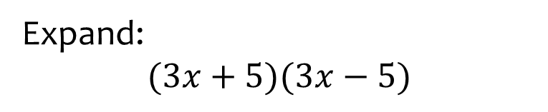


Worked example
Your turn
Expand:
$$\left(4x+3\right)\left(4x−3\right)$$
$$(5x+4)(5x−4)$$
Expand:
$$(3x+5)(3x−5)$$
$$9x^{2}−25$$

Slide 21
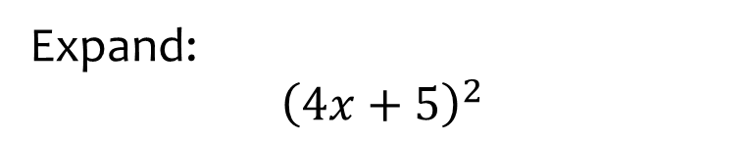


Worked example
Your turn
Expand:
$${\left(3x+4\right)}^{2}$$
$${\left(5x+6\right)}^{2}$$
Expand:
$${\left(4x+5\right)}^{2}$$
$$16x^{2}+40x+25$$

Slide 22
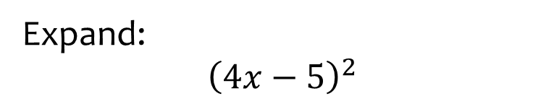


Worked example
Your turn
Expand:
$${\left(3x−4\right)}^{2}$$
$${\left(5x−6\right)}^{2}$$
Expand:
$${\left(4x−5\right)}^{2}$$
$$16x^{2}−40x+25$$

Slide 23
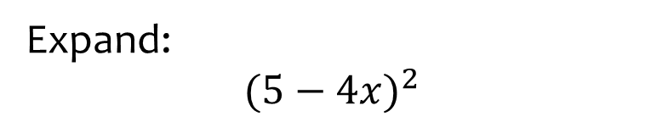

Worked example
Your turn
Expand:
$${\left(4−3x\right)}^{2}$$
$${\left(6−5x\right)}^{2}$$
Expand:
$${(5−4x)}^{2}$$
$$16x^{2}−40x+25$$

Slide 24
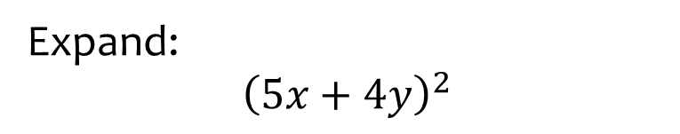


Worked example
Your turn
Expand:
$${\left(3x+2y\right)}^{2}$$
$${\left(4x+3y\right)}^{2}$$
Expand:
$${\left(5x+4y\right)}^{2}$$
$$25x^{2}+40xy+16y^{2}$$

Slide 25
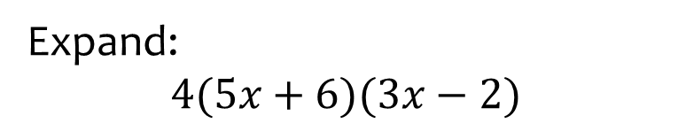


Worked example
Your turn
Expand:
$$2\left(4x+3\right)\left(5x−6\right)$$
$$3(7x+2)(8x−5)$$
Expand:
$$4(5x+6)(3x−2)$$
$$60x^{2}+32x−48$$

Slide 26
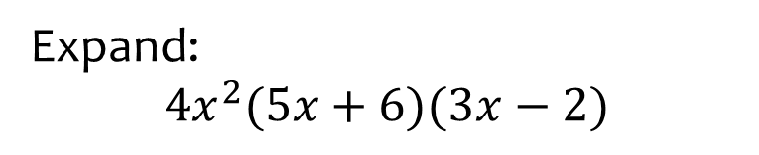


Worked example
Your turn
Expand:
$$2x\left(4x+3\right)\left(5x−6\right)$$
$$3x^{2}(7x+2)(8x−5)$$
Expand:
$$4x^{2}(5x+6)(3x−2)$$
$$60x^{4}+32x^{3}−48x^{2}$$

Slide 27
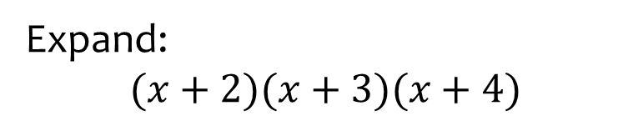
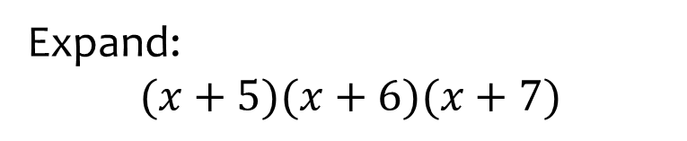

Worked example
Your turn
Expand:
$$(x+5)(x+6)(x+7)$$
Expand:
$$(x+2)(x+3)(x+4)$$
$$x^{3}+9x^{2}+26x+24$$

Slide 28
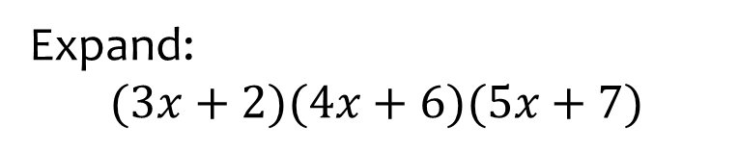
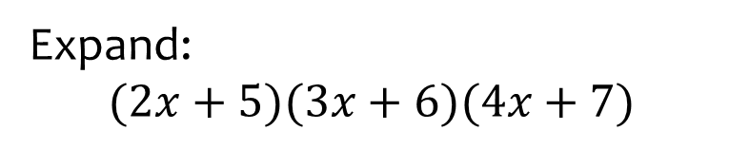

Worked example
Your turn
Expand:
$$(2x+5)(3x+6)(4x+7)$$
Expand:
$$(3x+2)(4x+6)(5x+7)$$
$$60x^{3}+214x^{2}+242x+84$$

Slide 29
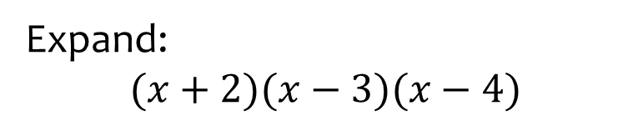
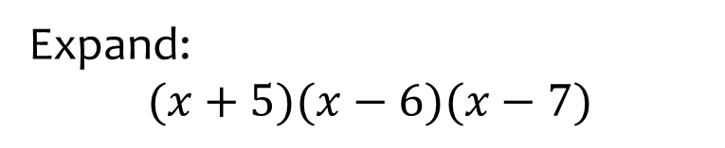

Worked example
Your turn
Expand:
$$(x+5)(x−6)(x−7)$$
Expand:
$$(x+2)(x−3)(x−4)$$
$$x^{3}−5x^{2}−2x+24$$

Slide 30
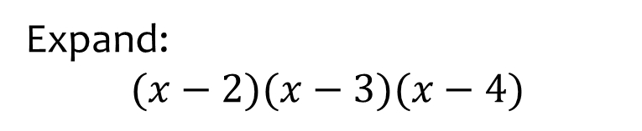
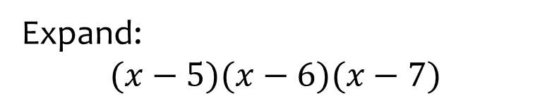

Worked example
Your turn
Expand:
$$(x−5)(x−6)(x−7)$$
Expand:
$$(x−2)(x−3)(x−4)$$
$$x^{3}−9x^{2}+26x−24$$

Slide 31
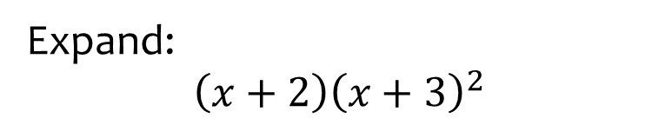


Worked example
Your turn
Expand:
$$\left(x+5\right){\left(x+6\right)}^{2}$$
Expand:
$$\left(x+2\right){\left(x+3\right)}^{2}$$
$$x^{3}+8x^{2}+21x+18$$

Slide 32



Worked example
Your turn
Expand:
$$\left(x−5\right){\left(x−6\right)}^{2}$$
Expand:
$$\left(x−2\right){\left(x−3\right)}^{2}$$
$$x^{3}−8x^{2}+21x−18$$

Slide 33



Worked example
Your turn
Expand:
$${\left(x+5\right)}^{3}$$
$${\left(x+6\right)}^{3}$$
Expand:
$${\left(x+4\right)}^{3}$$
$$x^{3}+12x^{2}+48x+64$$

Slide 34



Worked example
Your turn
Expand:
$${\left(x−5\right)}^{3}$$
$${\left(x−6\right)}^{3}$$
Expand:
$${\left(x−4\right)}^{3}$$
$$x^{3}−12x^{2}+48x−64$$

Slide 35



Worked example
Your turn
Expand:
$$\left(5−2x\right){\left(3x−4\right)}^{2}$$
Expand:
$$\left(7−3x\right){\left(4x−5\right)}^{2}$$
$$−48x^{3}+232x^{2}−355x+175$$

Slide 36
1.3) Factorising
Chapter CONTENTS

Slide 37



Worked example
Your turn
Factorise:
$$21x^{4}+29x^{3}−10x^{2}$$
Factorise:
$$10x^{3}+29x^{2}−21x$$
$$x(5x−3)(2x+7)$$

Slide 38



Worked example
Your turn
Factorise:
$$x^{3}−x$$
Factorise:
$$x^{3}−x$$
$$x(x−1)(x+1)$$

Slide 39



Worked example
Your turn
Factorise:
$$x^{2}+4x$$
$$x^{2}−6x$$
$${2x}^{2}−6x$$
Factorise:
$${3x}^{2}−12x$$
$$3x(x−4)$$

Slide 40



Worked example
Your turn
Factorise:
$$x^{2}+x−2$$
$$x^{2}−x−2$$
$$x^{2}−x−6$$
$$x^{2}+x−12$$
Factorise:
$$x^{2}−x−20$$
$$(x−5)(x+4)$$

Slide 41



Worked example
Your turn
Factorise:
$$2x^{2}−13x+15$$
$$3x^{2}−17x+10$$
Factorise:
$$3x^{2}−11x+10$$
$$(3x−5)(x−2)$$

Slide 42



Worked example
Your turn
Factorise:
$$2x^{2}+2x−12$$
$$3x^{2}−12x−15$$
Factorise:
$$5x^{2}−15x+10$$
$$5(x−2)(x−1)$$

Slide 43



Worked example
Your turn
Factorise:
$$3x^{2}+10x+3$$
$$3x^{2}+10x+8$$
$$3x^{2}+14x+8$$
Factorise:
$$5x^{2}+8x+3$$
$$5x^{2}+16x+12$$
$$5x^{2}+32x+12$$
$$\left(5x+3\right)\left(x+1\right)$$
$$\left(5x+6\right)\left(x+2\right)$$
$$(5x+2)(x+6)$$

Slide 44



Worked example
Your turn
Factorise:
$$\left(x^{2}−y^{2}\right)−{\left(x−y\right)}^{2}$$
Factorise:
$$\left(n^{2}−a^{2}\right)−{\left(n−a\right)}^{2}$$
$$2a(n−a)$$

Slide 45



Worked example
Your turn
Factorise:
$${\left(x+y\right)}^{2}+\left(x+y\right)\left(2x+5y\right)$$
$${\left(a+b\right)}^{2}−(a+b)(2a−3b)$$
Factorise:
$${\left(p+q\right)}^{2}+(p+q)(4p+9q)$$
$$5(p+q)(p+2q)$$

Slide 46



Worked example
Your turn
Factorise:
$$a^{2}−9$$
$$b^{2}−16$$
Factorise:
$$c^{2}−25$$
$$(c+5)(c−5)$$

Slide 47



Worked example
Your turn
Factorise:
$$9−x^{2}$$
$$16−x^{2}$$
Factorise:
$$25−x^{2}$$
$$(5+x)(5−x)$$

Slide 48



Worked example
Your turn
Factorise:
$${2x}^{2}−18$$
$$3x^{2}−48$$
Factorise:
$${4x}^{2}−100$$
$$4(x+5)(x−5)$$

Slide 49



Worked example
Your turn
Factorise:
$$4x^{2}−9$$
$$9x^{2}−16$$
Factorise:
$$25x^{2}−36$$
$$(5x+6)(5x−6)$$

Slide 50



Worked example
Your turn
Factorise:
$$9x^{2}−1$$
$$1−16x^{2}$$
Factorise:
$$25x^{2}−1$$
$$(5x+1)(5x−1)$$

Slide 51



Worked example
Your turn
Factorise:
$$9x^{2}−y^{2}$$
$$a^{2}−25b^{2}$$
Factorise:
$$16c^{2}−d^{2}$$
$$(4c+d)(4c−d)$$

Slide 52



Worked example
Your turn
Factorise:
$$4x^{2}−9y^{2}$$
$$9x^{2}−16y^{2}$$
Factorise:
$$25x^{2}−36y^{2}$$
$$\left(5x+6y\right)(5x−6y)$$

Slide 53



Worked example
Your turn
Factorise:
$$5m^{2}−20p^{2}$$
$$32x^{2}−98y^{2}$$
Factorise:
$$50a^{2}−72b^{2}$$
$$2(5a+6b)(5a−6b)$$

Slide 54



Worked example
Your turn
Factorise:
$$x^{4}−1$$
$$x^{6}−16$$
$$x^{8}−25$$
Factorise:
$$x^{10}−49$$
$$(x^{5}+7)(x^{5}−7)$$

Slide 55



Worked example
Your turn
Factorise:
$$4x^{4}−9y^{2}$$
$$9x^{8}−16y^{6}$$
Factorise:
$$25x^{12}−36y^{6}$$
$$(5x^{6}+6y^{3})(5x^{6}−6y^{3})$$

Slide 56



Worked example
Your turn
Factorise:
$$x^{3}−8$$
Factorise:
$$x^{3}−1$$
$$(x−1)(x^{2}+x+1)$$

Slide 57
1.4) Negative and fractional indices
Chapter CONTENTS

Slide 58


Worked example
Your turn
Prove that:
$$x^{\frac{1}{2}}=\sqrt{x}$$
$$x^{\frac{1}{3}}=\sqrt[3]{x}$$
Prove that:
$$x^{\frac{1}{4}}=\sqrt[4]{x}$$
Proof

Slide 59



Worked example
Your turn
Evaluate:
$${64}^{−\frac{2}{3}}$$
$${81}^{−\frac{5}{4}}$$
Evaluate:
$${64}^{−\frac{3}{2}}$$
$$\frac{1}{512}$$

Slide 60



Worked example
Your turn
Given that $y=\frac{1}{125}x^{3}$ express the following in the form $kx^{n}$ where $k$ and $n$ are constants
a) $y^{\frac{1}{3}}$
b) $5y^{−2}$
Given that $y=\frac{1}{16}x^{2}$ express the following in the form $kx^{n}$ where $k$ and $n$ are constants:
a) $y^{\frac{1}{2}}$
b) $4y^{−1}$
a) $\frac{x}{4}$
b) $64x^{−2}$

Slide 61



Worked example
Your turn
If $125\sqrt{5}=5^{k}$, determine the value of $k$.
If $9\sqrt{3}=3^{k}$, determine the value of $k$.
$$k=\frac{5}{2}$$

Slide 62



Worked example
Your turn
Given that
$${\left(3^{\frac{1}{4}}\right)}^{n}=\frac{3^{x}}{{81}^{y}}$$
Express $n$ in terms of $x$ and $y$.
Given that
$${\left(2^{\frac{1}{2}}\right)}^{n}=\frac{2^{x}}{8^{y}}$$
Express $n$ in terms of $x$ and $y$.
$$n=2x−6y$$

Slide 63



Worked example
Your turn
Given that $y=3^{x}$, express the following in terms of $y$.
$$\frac{1}{{27}^{5x−2}}$$
Write your expression in its simplest form.
Given that $y=2^{x}$, express the following in terms of $y$.
$$\frac{1}{4^{2x−3}}$$
Write your expression in its simplest form.
$$\frac{64}{y^{4}}$$

Slide 64


Worked example
Your turn
Simplify:
$${\left(16x^{2}y^{6}z^{4}\right)}^{\frac{1}{2}}$$
$${\left(27x^{4}y^{6}z\right)}^{\frac{1}{3}}$$
Simplify:
$${\left(9a^{3}b^{6}c^{2}d\right)}^{\frac{1}{2}}$$
$$3a^{\frac{3}{2}}b^{3}cd^{\frac{1}{2}}$$

Slide 65



Worked example
Your turn
Convert to fraction form:
$$9^{−1}$$
$$5^{−2}$$
$$2^{−3}$$
$$x^{−5}$$
$$3y^{−4}$$
Convert to fraction form:
$$5b^{−2}$$
$$\frac{5}{b^{2}}$$

Slide 66



Worked example
Your turn
Convert to index form:
$$\frac{1}{2}$$
$$\frac{1}{100}$$
$$\frac{3}{x}$$
$$\frac{9}{x^{2}}$$
$$\frac{15}{\sqrt{x}}$$
Convert to index form:
$$\frac{7}{x^{3}}$$
$$\frac{12}{\sqrt[3]{x}}$$
$$7x^{−3}$$
$$12x^{−\frac{1}{3}}$$

Slide 67



Worked example
Your turn
Evaluate:
$2^{4}$ $3^{5}$
$4^{0}$ $5^{−1}$
$6^{−2}$ $7^{−3}$
$9^{\frac{1}{2}}$ $8^{\frac{1}{3}}$
${16}^{−\frac{1}{2}}$ ${125}^{−\frac{1}{3}}$
${25}^{\frac{3}{2}}$ ${64}^{−\frac{2}{3}}$
Evaluate:
$${36}^{−\frac{1}{2}}$$
$${123456789}^{0}$$
$${27}^{−\frac{4}{3}}$$
$$\frac{1}{6}$$
$$1$$
$$\frac{1}{81}$$

Slide 68



Worked example
Your turn
Write $\frac{1}{243}$ as $3^{n}$
Write $0.04$ as $5^{n}$
Write $0.125$ as $2^{n}$
$$2^{−3}$$

Slide 69



Worked example
Your turn
Evaluate:
$$3^{−4}$$
$$2^{−5}$$
Evaluate:
$$5^{−3}$$
$$\frac{1}{125}$$

Slide 70



Worked example
Your turn
Write as a fraction:
$$x^{−5}$$
$$y^{−4}$$
Write as a fraction:
$$z^{−3}$$
$$\frac{1}{z^{3}}$$

Slide 71



Worked example
Your turn
Write as a fraction:
$${3x}^{−5}$$
$$5y^{−4}$$
Write as a fraction:
$${2z}^{−3}$$
$$\frac{2}{z^{3}}$$

Slide 72



Worked example
Your turn
Simplify the following:
$${\left(r^{−3}\right)}^{4}$$
$${\left(s^{5}\right)}^{−2}$$
Simplify the following:
$${\left(t^{−4}\right)}^{5}$$
$$t^{−20}$$

Slide 73



Worked example
Your turn
Simplify the following:
$${\left(2r^{−3}\right)}^{4}$$
$${\left(3s^{−4}\right)}^{−2}$$
$${\left(5t^{−2}\right)}^{3}$$
Simplify the following:
$${\left(3u^{−4}\right)}^{−3}$$
$$\frac{u^{12}}{27}$$

Slide 74



Worked example
Your turn
Simplify the following:
$${\left(2r^{−3}s^{4}\right)}^{5}$$
$${\left(3{t^{−4}u}^{5}\right)}^{−2}$$
Simplify the following:
$${\left(5x^{3}y^{−2}\right)}^{−3}$$
$$\frac{y^{6}}{125x^{9}}$$

Slide 75



Worked example
Your turn
Simplify the following:
$$\frac{15x^{7}}{3x^{−4}}$$
$$\frac{56y^{−8}}{8y^{−7}}$$
Simplify the following:
$$\frac{42x^{−5}}{6x^{−3}}$$
$$7x^{−2}=\frac{7}{x^{2}}$$

Slide 76



Worked example
Your turn
Simplify the following:
$${\left(\frac{a^{2}b^{−3}}{c^{4}}\right)}^{5}$$
Simplify the following:
$${\left(\frac{a^{−4}b^{3}}{c^{2}}\right)}^{3}$$
$$\frac{b^{9}}{a^{12}c^{6}}$$

Slide 77



Worked example
Your turn
Simplify the following:
$${\left(3a^{\frac{4}{5}}\right)}^{5}$$
Simplify the following:
$${\left(4b^{\frac{2}{3}}\right)}^{3}$$
$$64b^{2}$$

Slide 78



Worked example
Your turn
Evaluate:
$${64}^{\frac{1}{2}}$$
$${64}^{\frac{1}{3}}$$
$${64}^{−\frac{1}{2}}$$
Simplify the following:
$${125}^{−\frac{1}{3}}$$
$$\frac{1}{5}$$

Slide 79



Worked example
Your turn
Evaluate:
$${64}^{\frac{3}{2}}$$
$${64}^{\frac{2}{3}}$$
$${64}^{−\frac{3}{2}}$$
Simplify the following:
$${125}^{−\frac{2}{3}}$$
$$\frac{1}{125}$$

Slide 80



Worked example
Your turn
Evaluate:
$${81}^{\frac{1}{2}}$$
$${81}^{\frac{1}{4}}$$
$${81}^{−\frac{1}{2}}$$
Simplify the following:
$${27}^{−\frac{1}{3}}$$
$$\frac{1}{3}$$

Slide 81



Worked example
Your turn
Evaluate:
$${81}^{\frac{3}{2}}$$
$${81}^{\frac{3}{4}}$$
$${81}^{−\frac{3}{2}}$$
Simplify the following:
$${27}^{−\frac{4}{3}}$$
$$\frac{1}{81}$$

Slide 82



Worked example
Your turn
Evaluate:
$${\left(\frac{32}{243}\right)}^{−\frac{3}{5}}$$
Simplify the following:
$${\left(\frac{64}{125}\right)}^{−\frac{2}{3}}$$
$$\frac{25}{16}$$

Slide 83



Worked example
Your turn
Write in index form:
$$\sqrt[3]{25}$$
$$\sqrt{27}$$
Write in index form:
$$\sqrt[4]{32}$$
$$2^{\frac{5}{4}}$$

Slide 84



Worked example
Your turn
Write in index form:
$$\frac{1}{\sqrt[3]{25}}$$
$$\frac{1}{\sqrt{27}}$$
Write in index form:
$$\frac{1}{\sqrt[4]{32}}$$
$$2^{−\frac{5}{4}}$$

Slide 85



Worked example
Your turn
Simplify:
$${\left(64a^{6}\right)}^{\frac{3}{2}}$$
$${\left(64a^{6}\right)}^{\frac{2}{3}}$$
Simplify:
$${\left(27b^{6}\right)}^{\frac{2}{3}}$$
$$9b^{4}$$

Slide 86



Worked example
Your turn
Evaluate:
$${\left(\sqrt{\frac{3}{2}}\right)}^{4}$$
$${\left(\sqrt{\frac{5}{7}}\right)}^{4}$$
Evaluate:
$${\left(\sqrt{\frac{3}{8}}\right)}^{4}$$
$$\frac{9}{64}$$

Slide 87



Worked example
Your turn
Express $243$ as a power of $9$
Express $32$ as a power of $4$
Express $125$ as a power of $25$
$${25}^{\frac{3}{2}}$$

Slide 88



Worked example
Your turn
Express in index form:
$$\sqrt[3]{x^{4}}$$
$$\sqrt{x^{5}}$$
Express in index form:
$$\sqrt[4]{x^{7}}$$
$$x^{\frac{7}{4}}$$

Slide 89



Worked example
Your turn
Express in index form:
$$\frac{1}{x}$$
$$\frac{1}{x^{2}}$$
$$\frac{1}{x^{3}}$$
Express in index form:
$$\frac{1}{x^{4}}$$
$$x^{−4}$$

Slide 90



Worked example
Your turn
Express in index form:
$$\frac{1}{\sqrt{x}}$$
$$\frac{1}{\sqrt[3]{x}}$$
$$\frac{1}{\sqrt[5]{x}}$$
Express in index form:
$$\frac{1}{\sqrt[7]{x}}$$
$$x^{−\frac{1}{7}}$$

Slide 91



Worked example
Your turn
Express in index form:
$$\frac{2}{x}$$
$$\frac{3}{x^{2}}$$
$$\frac{5}{x^{3}}$$
Express in index form:
$$\frac{7}{x^{4}}$$
$$7x^{−4}$$

Slide 92



Worked example
Your turn
Express in index form:
$$\frac{2}{\sqrt{x}}$$
$$\frac{5}{\sqrt[3]{x}}$$
$$\frac{7}{\sqrt[5]{x}}$$
Express in index form:
$$\frac{3}{\sqrt[7]{x}}$$
$$3x^{−\frac{1}{7}}$$

Slide 93



Worked example
Your turn
Express in index form:
$$\frac{2}{3\sqrt{x}}$$
$$\frac{5}{7\sqrt[3]{x}}$$
$$\frac{1}{4\sqrt[5]{x}}$$
Express in index form:
$$\frac{2}{5\sqrt[7]{x}}$$
$$\frac{2}{5}x^{−\frac{1}{7}}$$

Slide 94



Worked example
Your turn
Simplify fully:
$$\sqrt{a^{\frac{2}{3}}×a^{\frac{4}{7}}}$$
$$\sqrt{b^{\frac{2}{5}}×b^{\frac{6}{7}}}$$
Simplify fully:
$$\sqrt{a^{\frac{3}{4}}×a^{\frac{3}{5}}}$$
$$a^{\frac{27}{40}}$$

Slide 95



Worked example
Your turn
Solve:
$$5^{x}=125$$
$$2^{x}=16$$
$$3^{x}=243$$
Solve:
$$7^{x}=343$$
$$x=3$$

Slide 96



Worked example
Your turn
Solve:
$$5^{x−2}=25$$
$$2^{2x+3}=32$$
$$3^{1−3x}=81$$
Solve:
$$2^{2−5x}=16$$
$$x=−\frac{2}{5}$$

Slide 97



Worked example
Your turn
Solve:
$$5={25}^{x}$$
$$3={27}^{x}$$
$$2={16}^{x−1}$$
Solve:
$$7={343}^{x−2}$$
$$x=\frac{7}{3}$$

Slide 98



Worked example
Your turn
Solve:
$$5^{x}=\frac{1}{125}$$
$$3^{x}=\frac{1}{9}$$
$$2^{x}=\frac{1}{16}$$
Solve:
$$7^{x}=\frac{1}{343}$$
$$x=−3$$

Slide 99



Worked example
Your turn
Solve:
$$5^{−x}=\frac{1}{125}$$
$$3^{−x}=\frac{1}{9}$$
$$2^{−x}=\frac{1}{16}$$
Solve:
$$7^{−x}=\frac{1}{343}$$
$$x=3$$

Slide 100



Worked example
Your turn
Solve:
$$5^{−x}=125$$
$$3^{−x}=9$$
$$2^{−x}=16$$
Solve:
$$7^{−x}=343$$
$$x=−3$$

Slide 101



Worked example
Your turn
Solve:
$${125}^{x}=\frac{1}{5}$$
$$9^{x}=\frac{1}{3}$$
$$8^{x}=\frac{1}{2}$$
Solve:
$${343}^{x}=\frac{1}{7}$$
$$x=−\frac{1}{3}$$

Slide 102



Worked example
Your turn
Solve:
$$2^{3x−2}=\frac{1}{64}$$
$$3^{2−5x}=\frac{1}{81}$$
Solve:
$$5^{3−2x}=\frac{1}{25}$$
$$x=\frac{5}{2}$$

Slide 103



Worked example
Your turn
Solve:
$$2^{x}=\sqrt[3]{16}$$
$$3^{x−2}=\sqrt{27}$$
Solve:
$$5^{x+1}=\sqrt[4]{25}$$
$$x=−\frac{1}{2}$$

Slide 104



Worked example
Your turn
Solve:
$$2^{3x−1}=\sqrt[4]{32}$$
$$3^{2−5x}=\sqrt{243}$$
Solve:
$$5^{3−2x}=\sqrt[3]{25}$$
$$x=\frac{7}{6}$$

Slide 105



Worked example
Your turn
Solve:
$$2^{3x−5}=\frac{16}{\sqrt[5]{64}}$$
Solve:
$$3^{2x−5}=\frac{27}{\sqrt{243}}$$
$$x=\frac{11}{4}$$

Slide 106



Worked example
Your turn
Solve:
$$16×2^{3x−1}=\frac{1}{\sqrt{32}}$$
Solve:
$$27×3^{5x−2}=\frac{1}{\sqrt[3]{9}}$$
$$x=−\frac{1}{3}$$

Slide 107



Worked example
Your turn
Solve:
$${\left({16}^{x}\right)}^{3}=\frac{1}{8}$$
Solve:
$${\left(9^{x}\right)}^{5}=\frac{1}{27}$$
$$x=−\frac{3}{10}$$

Slide 108



Worked example
Your turn
Solve:
$$\sqrt{2}×8^{2x−5}=\frac{1}{16}$$
Solve:
$$\sqrt{3}×9^{4x−3}=\frac{1}{27}$$
$$x=\frac{5}{16}$$

Slide 109



Worked example
Your turn
Solve:
$$\frac{{16}^{4x−3}}{8^{5−2x}}=4$$
Solve:
$$\frac{9^{3−5x}}{{27}^{4x−3}}=81$$
$$x=\frac{1}{2}$$

Slide 110



Worked example
Your turn
Express $y$ in terms of $x$, given:
$$2^{x}×2^{y}=8$$
$$3^{x}×3^{y}=\sqrt{27}$$
Express $y$ in terms of $x$, given:
$$5^{x}×5^{y}=125$$
$$y=3−x$$

Slide 111



Worked example
Your turn
Express $y$ in terms of $x$, given:
$$2^{3x}×8^{5y}=\frac{1}{4}$$
Express $y$ in terms of $x$, given:
$$5^{3x}×{25}^{4y}=\frac{1}{\sqrt{125 }}$$
$$y=−\frac{3}{8}x−\frac{3}{16}$$

Slide 112



Worked example
Your turn
Express $y$ in terms of $x$, given:
$$\frac{2^{3x}}{2^{5y}}=2\sqrt{2}$$
$$\frac{3^{4x}}{3^{2y}}=\frac{1}{27}$$
Express $y$ in terms of $x$, given:
$$\frac{5^{x}}{5^{4y}}=125\sqrt{5}$$
$$y=\frac{x}{4}−\frac{7}{8}$$

Slide 113



Worked example
Your turn
Express $y$ in terms of $x$, given:
$$\frac{2^{3x}}{8^{5y}}=2\sqrt{2}$$
$$\frac{3^{4x}}{9^{2y}}=\frac{1}{27}$$
Express $y$ in terms of $x$, given:
$$\frac{5^{x}}{{25}^{4y}}=125\sqrt{5}$$
$$y=\frac{x}{8}−\frac{7}{16}$$

Slide 114




Worked example
Your turn
Solve ${\left(\frac{1}{2}\right)}^{x}=8$
Solve ${25}^{3−4x}=\frac{1}{125}$
Solve ${\left(\frac{1}{3}\right)}^{x}=9$
Solve $9^{4−3x}=\frac{1}{81}$
$$x=−2$$
$$x=2$$

Slide 115



Worked example
Your turn
Solve $x^{\frac{1}{2}}=5$
Solve $x^{\frac{1}{3}}=6$
Solve $x^{\frac{1}{4}}=2$
$$x=16$$

Slide 116



Worked example
Your turn
Solve $x^{−2}=25$
Solve $x^{−3}=216$
Solve $x^{−4}=16$
$$x=\frac{1}{2}$$

Slide 117



Worked example
Your turn
Given that $5^{−n}=0.4$, find the value of ${\left(5^{3}\right)}^{n}$
Given that $3^{−n}=0.2$, find the value of ${\left(3^{4}\right)}^{n}$
$$625$$

Slide 118



Worked example
Your turn
Express $\frac{{\left(3+\sqrt[3]{x}\right)}^{2}}{x}$ as powers of $x$.
Express $\frac{{\left(2+\sqrt{x}\right)}^{2}}{x}$ as powers of $x$.
$$4x^{−1}+4x^{−\frac{1}{2}}+1$$

Slide 119



Worked example
Your turn
Express $\frac{{\left(x+\sqrt[3]{x}\right)}^{2}}{4\sqrt[3]{x}}$ as powers of $x$.
Express $\frac{{\left(x+\sqrt{x}\right)}^{2}}{2\sqrt{x}}$ as powers of $x$.
$$\frac{1}{2}x^{\frac{3}{2}}+x+\frac{1}{2}x^{\frac{1}{2}}$$

Slide 120
1.5) Surds
Chapter CONTENTS

Slide 121



Worked example
Your turn
$$\sqrt{x}×\sqrt{x}$$
$$\sqrt[3]{y}×\sqrt[3]{y}×\sqrt[3]{y}$$
$$\sqrt[4]{z}×\sqrt[4]{z}×\sqrt[4]{z}×\sqrt[4]{z}$$
$$z$$

Slide 122



Worked example
Your turn
$$2\sqrt{x}×3\sqrt{x}$$
$$\sqrt[3]{y}×3\sqrt[3]{y}×4\sqrt[3]{y}$$
$$2\sqrt[4]{z}×3\sqrt[4]{z}×4\sqrt[4]{z}×\sqrt[4]{z}$$
$$24z$$

Slide 123



Worked example
Your turn
Simplify:
$$\sqrt{72}−\sqrt{18}$$
$$\sqrt{125}−\sqrt{45}$$
Simplify:
$$\sqrt{75}−\sqrt{12}$$
$$3\sqrt{3}$$

Slide 124



Worked example
Your turn
Express in the form $a+b\sqrt{3}$:
$${\left(5+3\sqrt{3}\right)}^{2}$$
Express in the form $a+b\sqrt{5}$:
$${\left(2+7\sqrt{5}\right)}^{2}$$
$$249+28\sqrt{5}$$

Slide 125



Worked example
Your turn
Express in the form $a+b\sqrt{3}$:
$${\left(2\sqrt{3}−5\right)}^{2}$$
Express in the form $a+b\sqrt{5}$:
$${\left(3\sqrt{5}−2\right)}^{2}$$
$$49−12\sqrt{5}$$

Slide 126



Worked example
Your turn
Simplify:
$$\left(\sqrt{7}+1\right)\left(\sqrt{7}−1\right)$$
$$(\sqrt{5}−2)(\sqrt{5}+2)$$
Simplify:
$$(\sqrt{11}−3)(\sqrt{11}+3)$$
$$2$$

Slide 127



Worked example
Your turn
Simplify:
$$\left(7+4\sqrt{2}\right)\left(7−4\sqrt{2}\right)$$
$$\left(5−2\sqrt{3}\right)\left(5+2\sqrt{3}\right)$$
Simplify:
$$\left(9−3\sqrt{5}\right)\left(9+3\sqrt{5}\right)$$
$$36$$

Slide 128



Worked example
Your turn
Simplify:
$$\left(7\sqrt{3}+4\sqrt{2}\right)\left(7\sqrt{3}−4\sqrt{2}\right)$$
$$\left(5\sqrt{7}−2\sqrt{3}\right)\left(5\sqrt{7}+2\sqrt{3}\right)$$
Simplify:
$$\left(11\sqrt{5}−3\sqrt{7}\right)\left(11\sqrt{5}+3\sqrt{7}\right)$$
$$542$$

Slide 129



Worked example
Your turn
Express in the form $a+b\sqrt{3}$:
$$(4+\sqrt{3})(1+2\sqrt{3})$$
Express in the form $a+b\sqrt{5}$:
$$(2+\sqrt{5})(3+4\sqrt{5})$$
$$26+11\sqrt{5}$$

Slide 130


Worked example
Your turn
Given that $a>0$, show that
$$\sqrt{5a}\left(\sqrt{20a}+a\sqrt{5a}\right)$$
Is always a multiple of $3$
$$\text{Given} \text{that} a>0\text{, }\text{show} \text{that}$$
$$\sqrt{3a}\left(\sqrt{12a}+a\sqrt{3a}\right)$$
$$\text{i}\text{s} \text{always} \text{a} \text{multiple} \text{of} 3$$
Shown

Slide 131



Worked example
Your turn
Simplify
$${\left(3+\sqrt{2}\right)}^{2}−{\left(3−\sqrt{2}\right)}^{2}$$
$${\left(4+\sqrt{5}\right)}^{2}−{\left(4−\sqrt{5}\right)}^{2}$$
Simplify
$${\left(2+\sqrt{3}\right)}^{2}−{\left(2−\sqrt{3}\right)}^{2}$$
$$8\sqrt{3}$$

Slide 132



Worked example
Your turn
Find the value of $a$ and $b$:
$${\left(a−3\sqrt{5}\right)}^{2}=b−42\sqrt{5}$$
Express $b$ and $c$ in terms of $a$
$${\left(a−2\sqrt{3}\right)}^{2}=b−20\sqrt{3}$$
$$a=5, b=37$$

Slide 133



Worked example
Your turn
Expand and simplify:
$$\left(\sqrt{7}−3\right)\left(\sqrt{7}+2\right)\left(\sqrt{7}+1\right)$$
Expand and simplify:
$$\left(\sqrt{5}+3\right)\left(\sqrt{5}−2\right)\left(\sqrt{5}+1\right)$$
$$4$$

Slide 134
Worked example
Your turn
Expand and simplify:
$$\left(\sqrt{7}−3\right)\left(\sqrt{7}+2\right)\left(\sqrt{7}+1\right)$$
Expand and simplify:
$$\left(\sqrt{5}+3\right)\left(\sqrt{5}−2\right)\left(\sqrt{5}+1\right)$$
$$4$$

Slide 135
1.6) Rationalising denominators
Chapter CONTENTS

Slide 136



Worked example
Your turn
Rationalise the denominator:
$$\frac{1}{\sqrt{2}}$$
$$\frac{2}{\sqrt{3}}$$
$$\frac{3}{\sqrt{5}}$$
Rationalise the denominator:
$$\frac{4}{\sqrt{7}}$$
$$\frac{4\sqrt{7}}{7}$$

Slide 137



Worked example
Your turn
Rationalise the denominator and simplify:
$$\frac{4}{3\sqrt{2}}$$
$$\frac{6}{5\sqrt{3}}$$
Rationalise the denominator and simplify:
$$\frac{10}{2\sqrt{7}}$$
$$\frac{5\sqrt{7}}{7}$$

Slide 138



Worked example
Your turn
Rationalise the denominator and simplify:
$$\frac{2−7\sqrt{3}}{\sqrt{3}}$$
$$\frac{3−5\sqrt{11}}{\sqrt{11}}$$
Rationalise the denominator and simplify:
$$\frac{9−3\sqrt{5}}{\sqrt{5}}$$
$$\frac{9\sqrt{5}−15}{5}$$

Slide 139



Worked example
Your turn
Rationalise the denominator and simplify:
$$\frac{3}{5+\sqrt{2}}$$
$$\frac{4}{1+\sqrt{3}}$$
Rationalise the denominator and simplify:
$$\frac{18}{1+\sqrt{7}}$$
$$−3+3\sqrt{7}$$

Slide 140



Worked example
Your turn
Rationalise the denominator and simplify:
$$\frac{3}{5−\sqrt{2}}$$
$$\frac{4}{1−\sqrt{3}}$$
Rationalise the denominator and simplify:
$$\frac{18}{1−\sqrt{7}}$$
$$−3−3\sqrt{7}$$

Slide 141



Worked example
Your turn
Rationalise the denominator and simplify:
$$\frac{3}{\sqrt{2}−5}$$
$$\frac{4}{−1+\sqrt{3}}$$
Rationalise the denominator and simplify:
$$\frac{18}{\sqrt{7}−1}$$
$$3+3\sqrt{7}$$

Slide 142



Worked example
Your turn
Rationalise the denominator and simplify:
$$\frac{3+\sqrt{2}}{\sqrt{2}−5}$$
$$\frac{5−\sqrt{3}}{−1+\sqrt{3}}$$
Rationalise the denominator and simplify:
$$\frac{2−\sqrt{7}}{\sqrt{7}−1}$$
$$\frac{−5+\sqrt{7}}{6}$$

Slide 143



Worked example
Your turn
Rationalise the denominator and simplify:
$$\frac{2\sqrt{3}+5}{\sqrt{3}−2}$$
Rationalise the denominator and simplify:
$$\frac{2\sqrt{2}+1}{\sqrt{2}−3}$$
$$−1−\sqrt{2}$$

Slide 144



Worked example
Your turn
Rationalise the denominator and simplify:
$$\frac{3\sqrt{3}−5}{2\sqrt{3}−7}$$
Rationalise the denominator and simplify:
$$\frac{5\sqrt{5}−2}{2\sqrt{5}−3}$$
$$4+\sqrt{5}$$

Slide 145



Worked example
Your turn
Rationalise the denominator and simplify:
$$\frac{11+3\sqrt{2}}{3\sqrt{7}+5}$$
Rationalise:
$$\frac{7+2\sqrt{3}}{11\sqrt{5}+2}$$
$$\frac{77\sqrt{5}+22\sqrt{15}−4\sqrt{3}−14}{601}$$

Slide 146



Worked example
Your turn
Rationalise the denominator and simplify:
$$\frac{\left(3+\sqrt{2}\right)\left(3−\sqrt{2}\right)}{\sqrt{7}}$$
$$\frac{\left(7+\sqrt{5}\right)\left(7−\sqrt{5}\right)}{\sqrt{11}}$$
Rationalise the denominator and simplify:
$$\frac{\left(5+\sqrt{3}\right)\left(5−\sqrt{3}\right)}{\sqrt{22}}$$
$$\sqrt{22}$$

Slide 147



Worked example
Your turn
Simplify, giving your answer in the form $a\sqrt{b}$:
$$\frac{\sqrt{54}}{3}+\frac{12}{\sqrt{6}}$$
Simplify, giving your answer in the form $a\sqrt{b}$:
$$\frac{\sqrt{63}}{3}+\frac{21}{\sqrt{7}}$$
$$4\sqrt{7}$$

Slide 148



Worked example
Your turn
Show that $\frac{1}{\frac{1}{\sqrt{3}}+1}=\frac{3}{2}−\frac{1}{2}\sqrt{3}$
Show that $\frac{1}{1+\frac{1}{\sqrt{2}}}=2−\sqrt{2}$
$$=\frac{\sqrt{2}}{\sqrt{2}+1}$$
$$=\frac{\sqrt{2}}{\sqrt{2}+1}×\frac{\sqrt{2}−1}{\sqrt{2}−1}$$
$$=\frac{2−\sqrt{2}}{2+\sqrt{2}−\sqrt{2}−1}$$
$$=\frac{2−\sqrt{2}}{1}$$
$$=2−\sqrt{2}$$

Slide 149



Worked example
Your turn
A rectangle has an area of $\left(15−6\sqrt{3}\right) cm^{2}$ and a width of $(2\sqrt{3}−3)$ $cm$. Find the length of the rectangle in the form $a+b\sqrt{3}$
A rectangle has an area of $\left(2+\sqrt{2}\right) cm^{2}$ and a width of $(3\sqrt{2}−4)$ $cm$. Find the length of the rectangle in the form $a+b\sqrt{2}$
$7+5\sqrt{2}$ $cm$

Slide 150



Worked example
Your turn
Solve $y\left(2+\sqrt{3}\right)−\sqrt{3}=4$
Solve $y\left(1+\sqrt{2}\right)−\sqrt{2}=3$
$$y=2\sqrt{2}−1$$

Slide 151



Worked example
Your turn
Simplify:
$$\frac{\sqrt{a+2}−\sqrt{a}}{\sqrt{a+2}+\sqrt{a}}$$
Simplify:
$$\frac{\sqrt{a+1}−\sqrt{a}}{\sqrt{a+1}+\sqrt{a}}$$
$$2a+1−2\sqrt{a}\sqrt{a+1}$$

Slide 152



Worked example
Your turn
Solve:
$$\frac{\sqrt[5]{8}}{\sqrt[4]{32}}=\sqrt[x]{2}$$
Solve:
$$\frac{\sqrt[4]{9}}{\sqrt[5]{27}}=\sqrt[x]{3}$$
$$x=−10$$

