Slide 1
Old Spec Q’s
Work-Energy Principle
SAM
SAM
2018
2019
2019
see also:
Impulse and Momentum
Collisions: Two Spheres Direct Impact

Slide 2
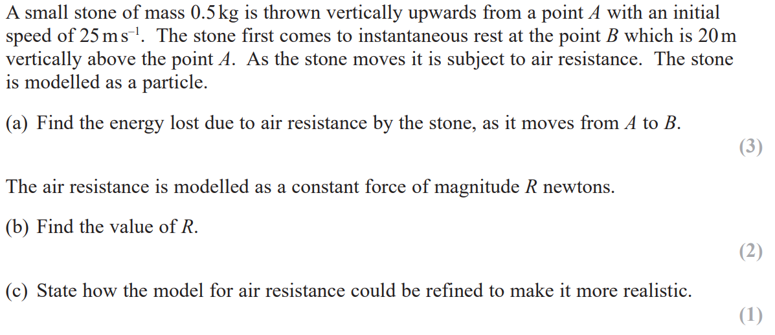
SAM

Slide 3
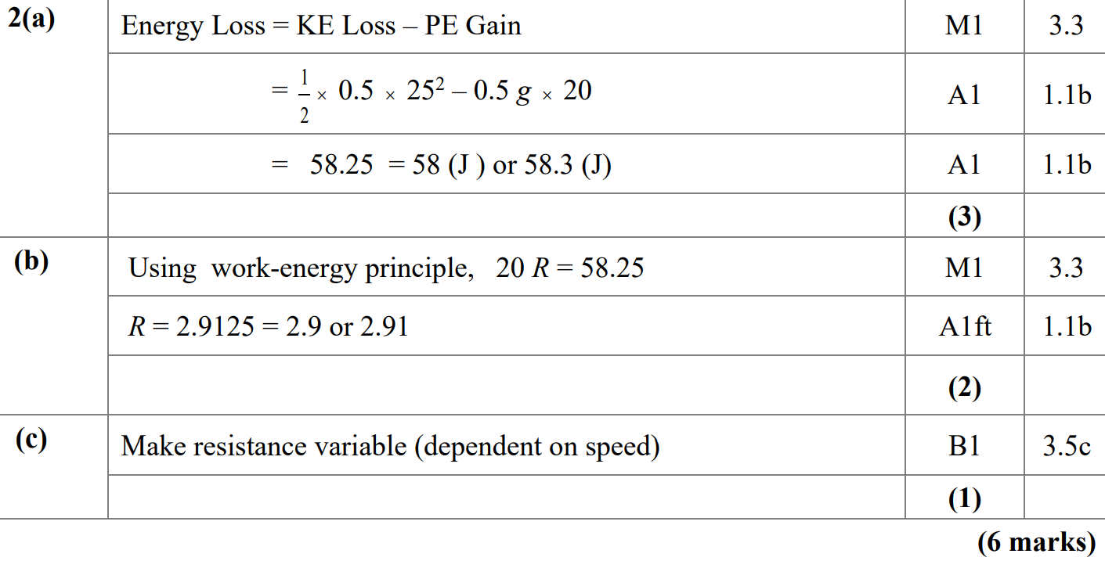
SAM
A
B
c

Slide 4
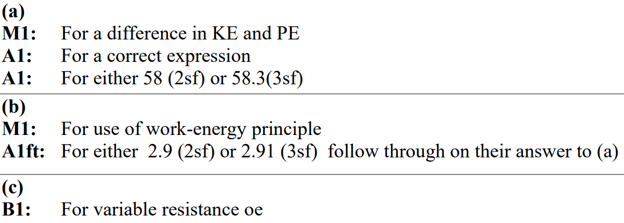
SAM
A notes
B notes
C notes

Slide 5
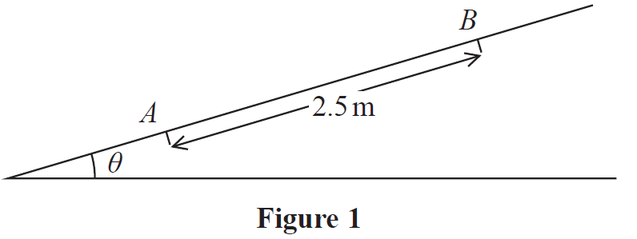
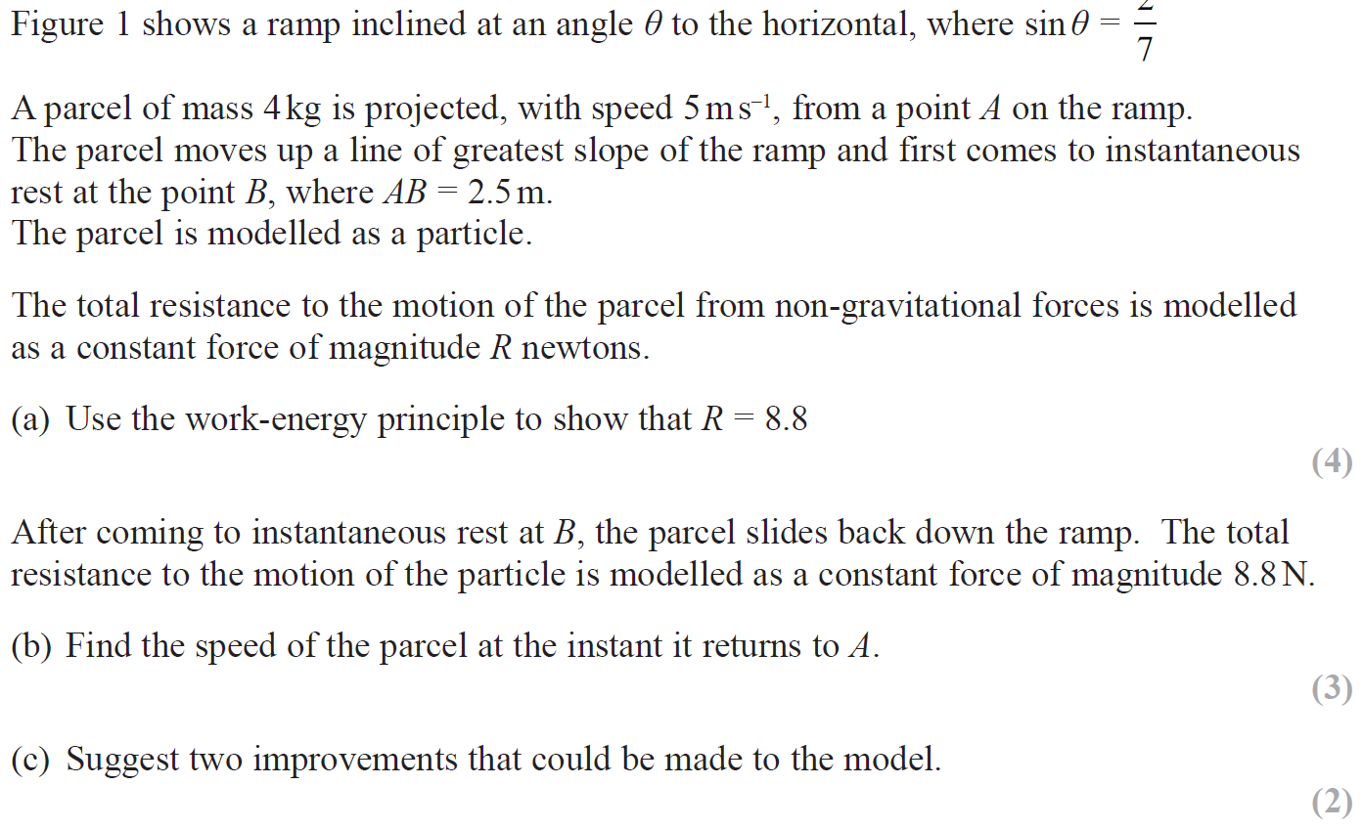
2018

Slide 6
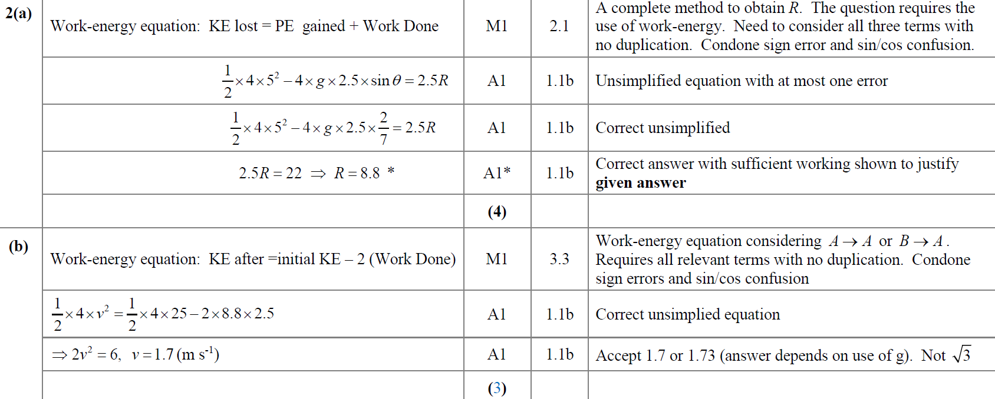
2018
A
B
B Alternative 1

Slide 7
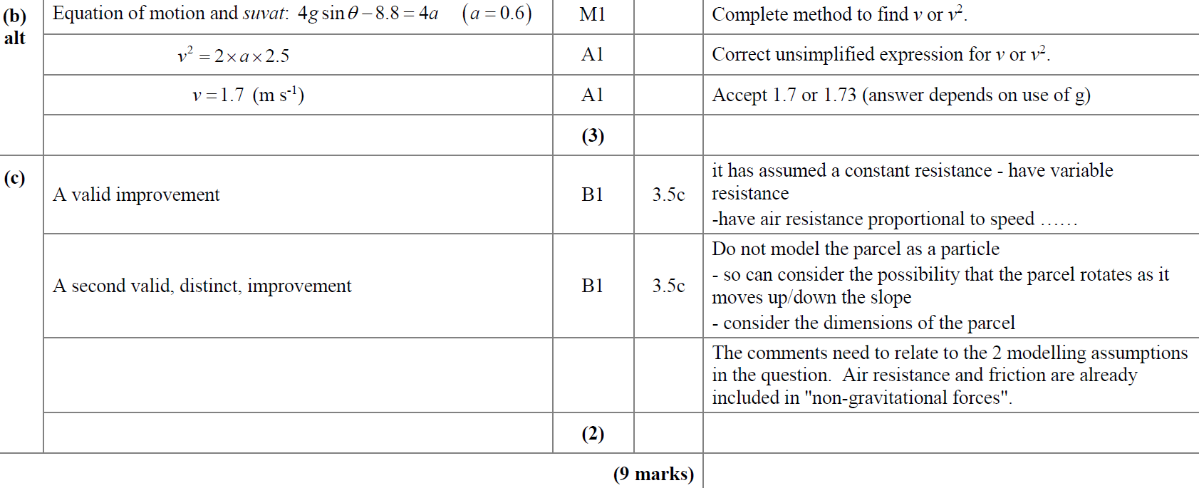
2018
B Alternative 2
C

Slide 8
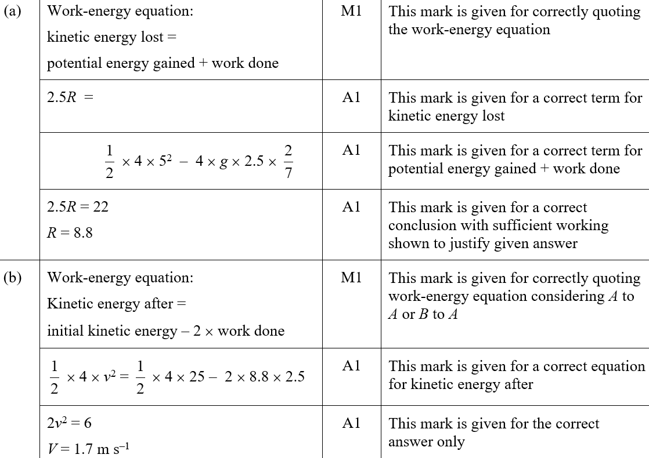
2018
A (SF)
B (SF)

Slide 9
2018
C (SF)

Slide 10
2019

Slide 11
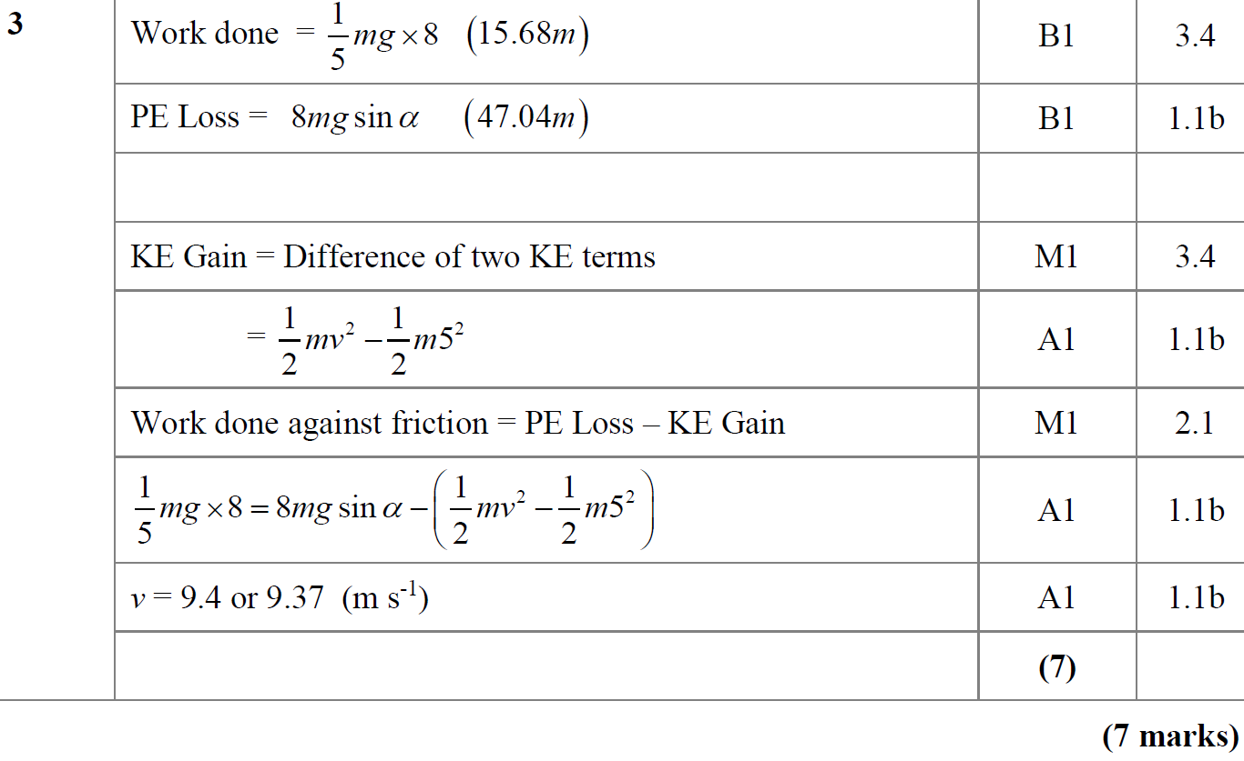
2019
A

Slide 12
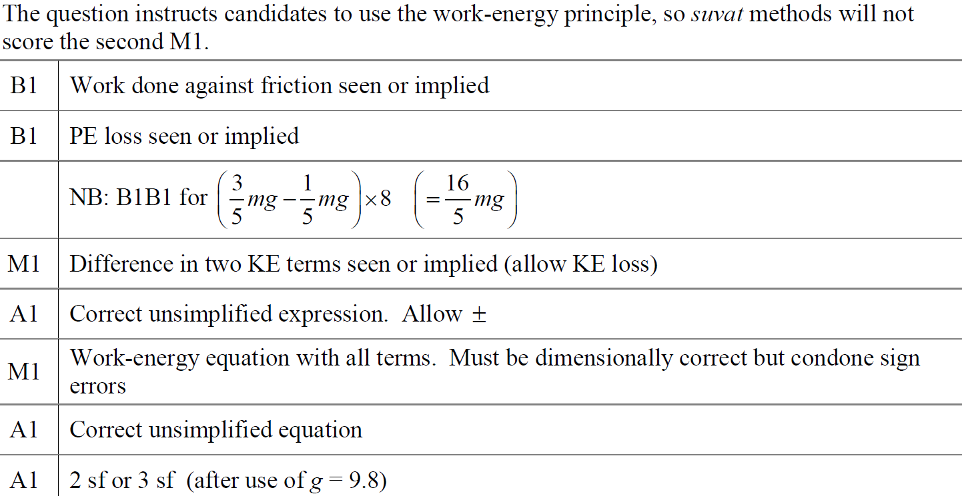
2019
A notes

Slide 13
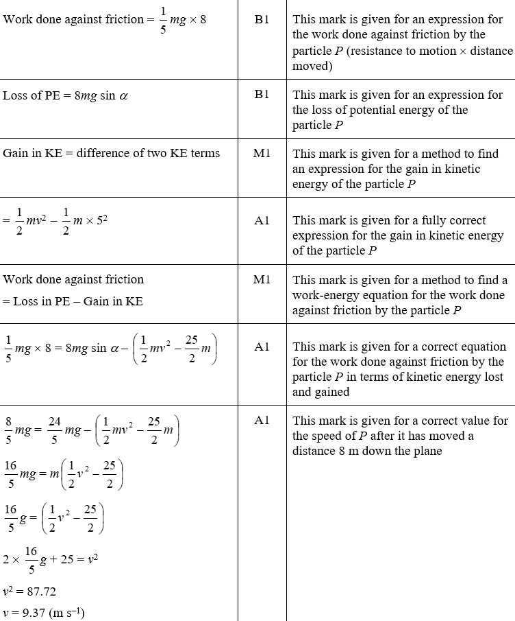
2019
A (SF)

Slide 14
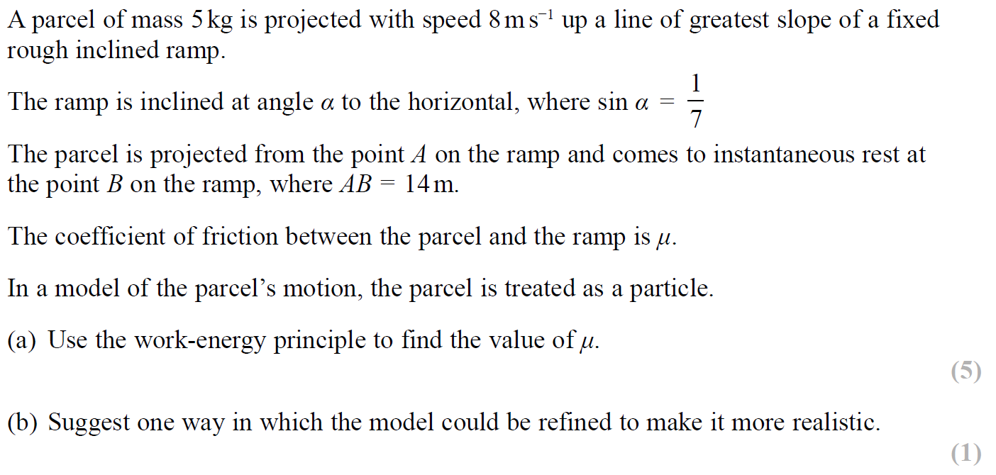
SAM

Slide 15
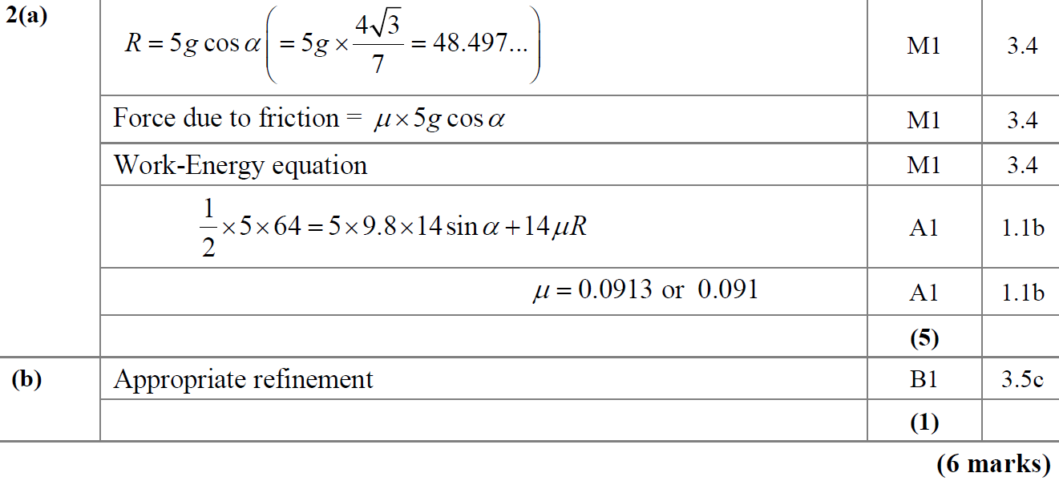
SAM
A
B

Slide 16
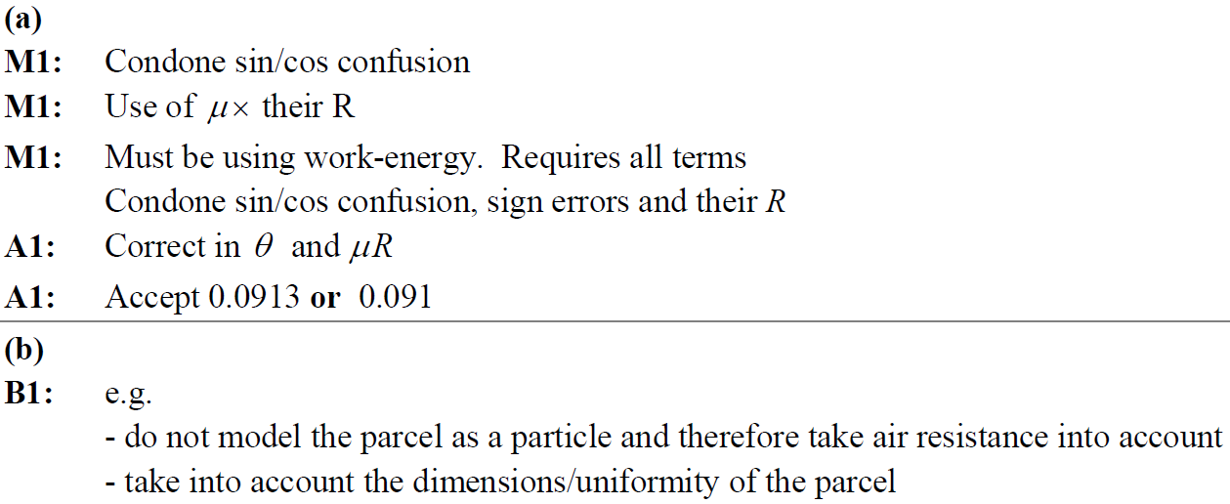
SAM
A notes
B notes

Slide 17
2019

Slide 18
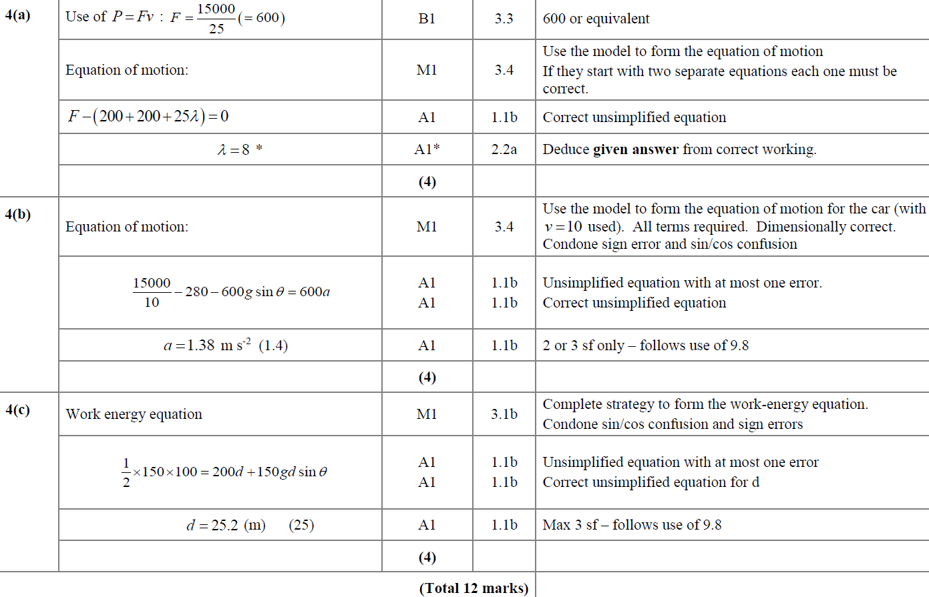
2019
A
B
C

Slide 19
New Spec Q’s
Old Spec Work-Energy Principle
June 2001
June 2005
May 2008
Jan 2012
June 2015
Jan 2002
Jan 2006
Jan 2009
May 2012
June 2016
June 2002
June 2006
May 2009
Jan 2013
June 2017
Jan 2003
Jan 2007
Jan 2010
June 2013 (a only)
June 2019
Jan 2004
June 2007 (i)
June 2010
June 2013 (R)
June 2004 (part a only)
June 2007 (ii) [C only]
Jan 2011
June 2014
Jan 2005
Jan 2008
June 2011
June 2014 (R)
see also:
Impulse and Momentum

Slide 20
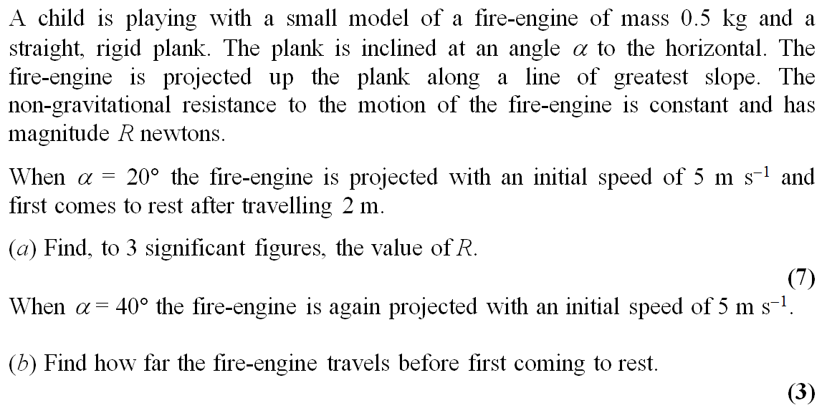
June 2001

Slide 21
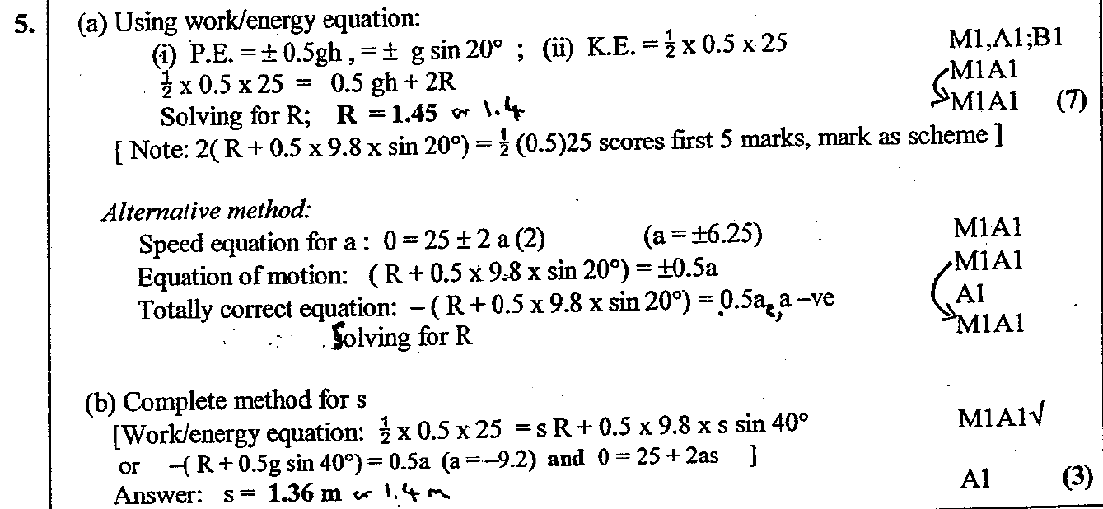
June 2001
A
B

Slide 22
Jan 2002

Slide 23
Jan 2002
A

Slide 24
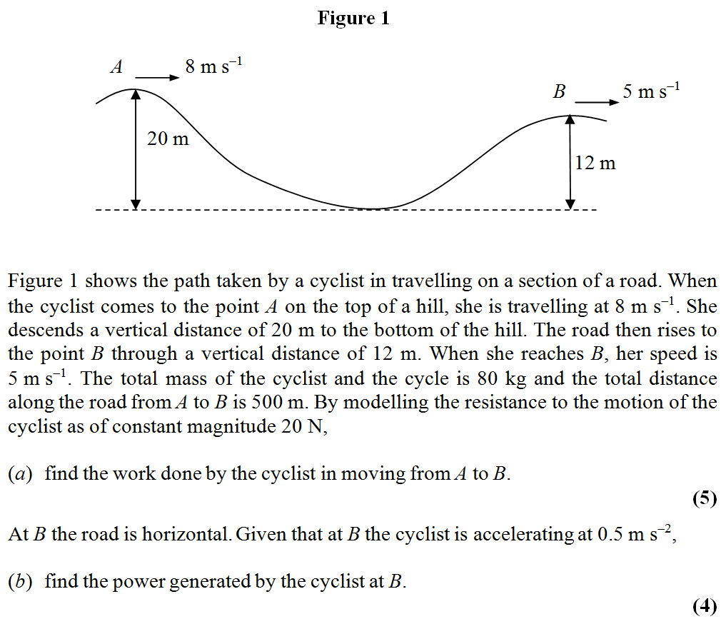
June 2002

Slide 25
June 2002
A
B

Slide 26
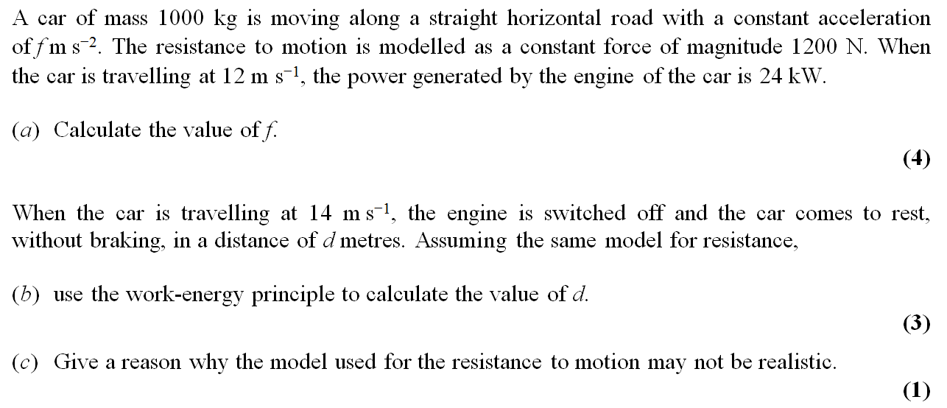
Jan 2003

Slide 27
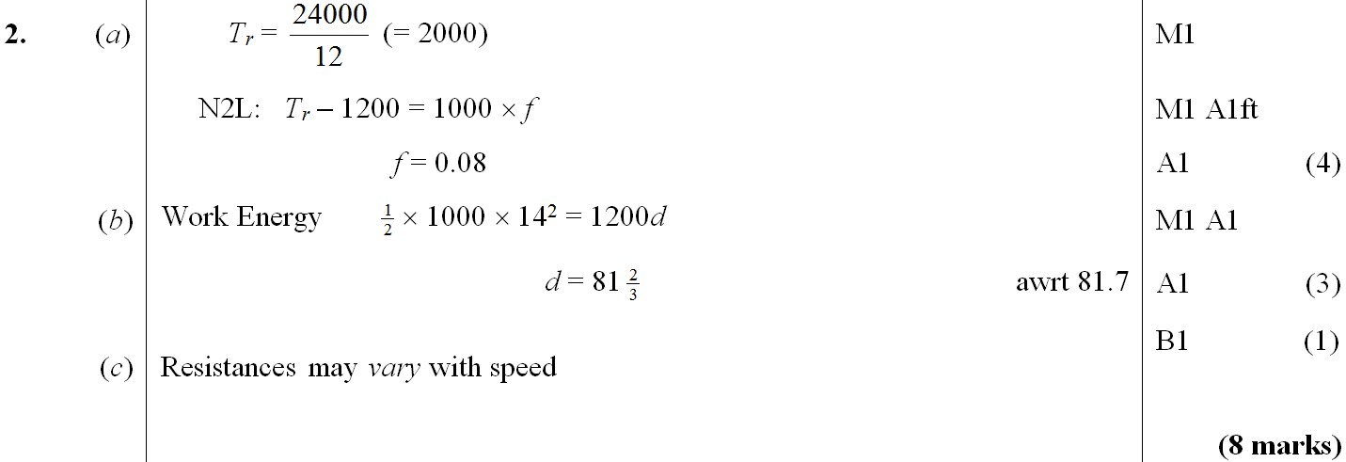
Jan 2003
A
B
C

Slide 28
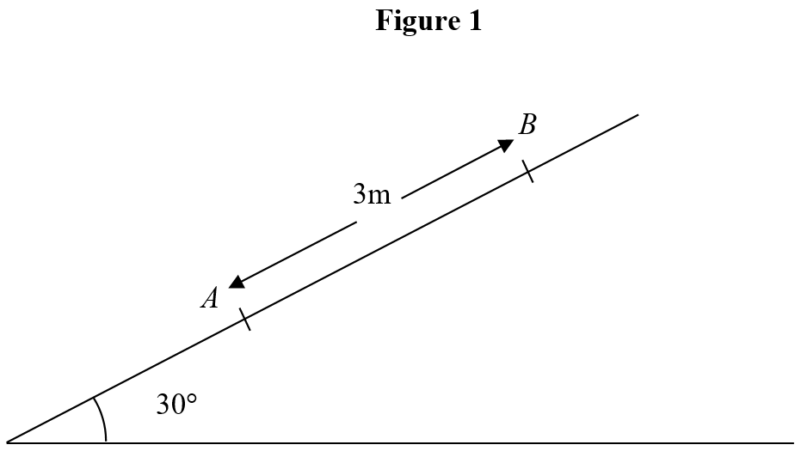
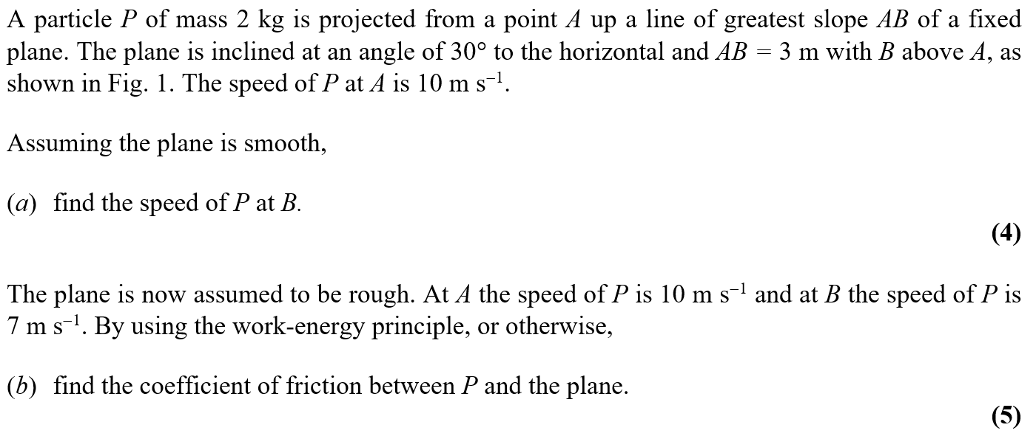
Jan 2004

Slide 29
Jan 2004
A

Slide 30
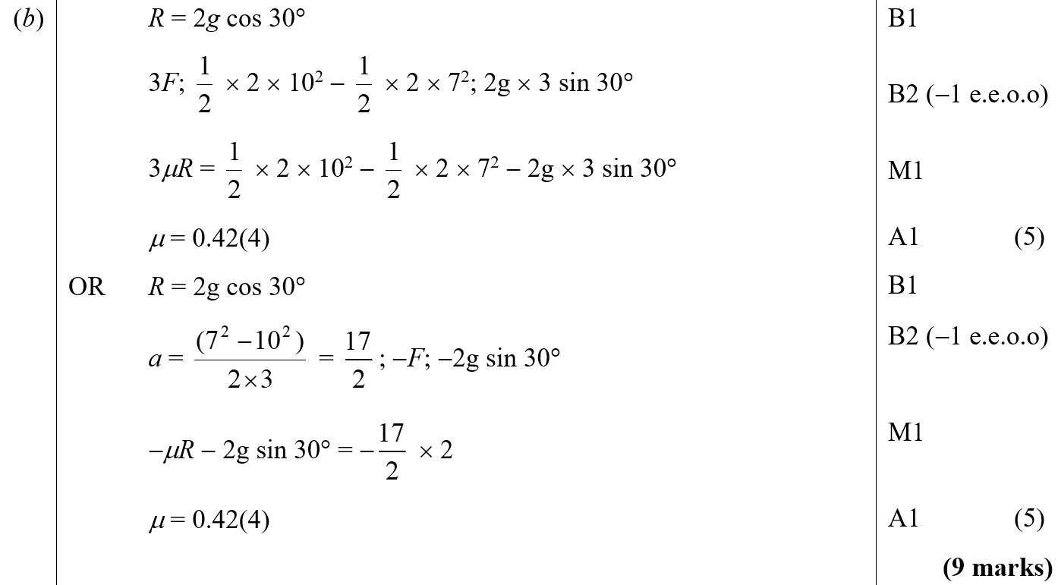
Jan 2004
B

Slide 31
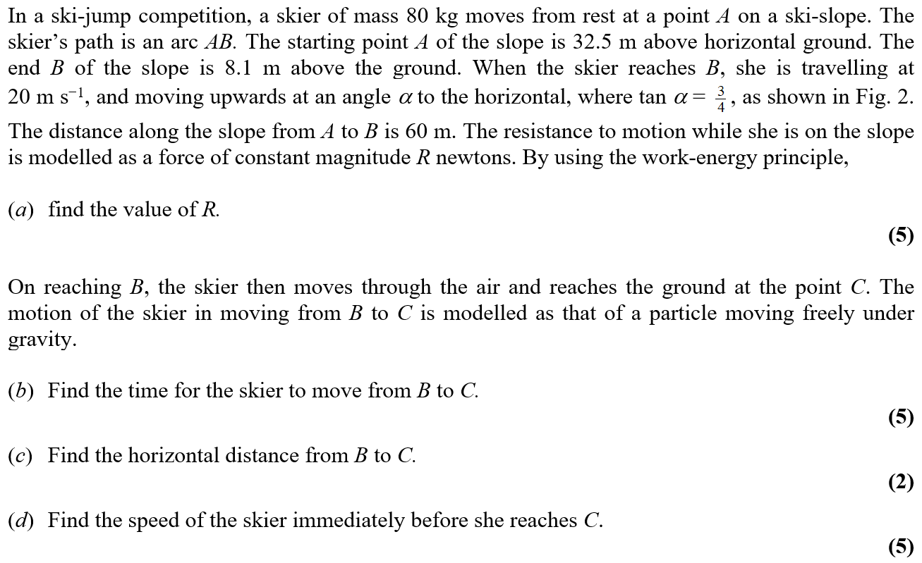
June 2004

Slide 32
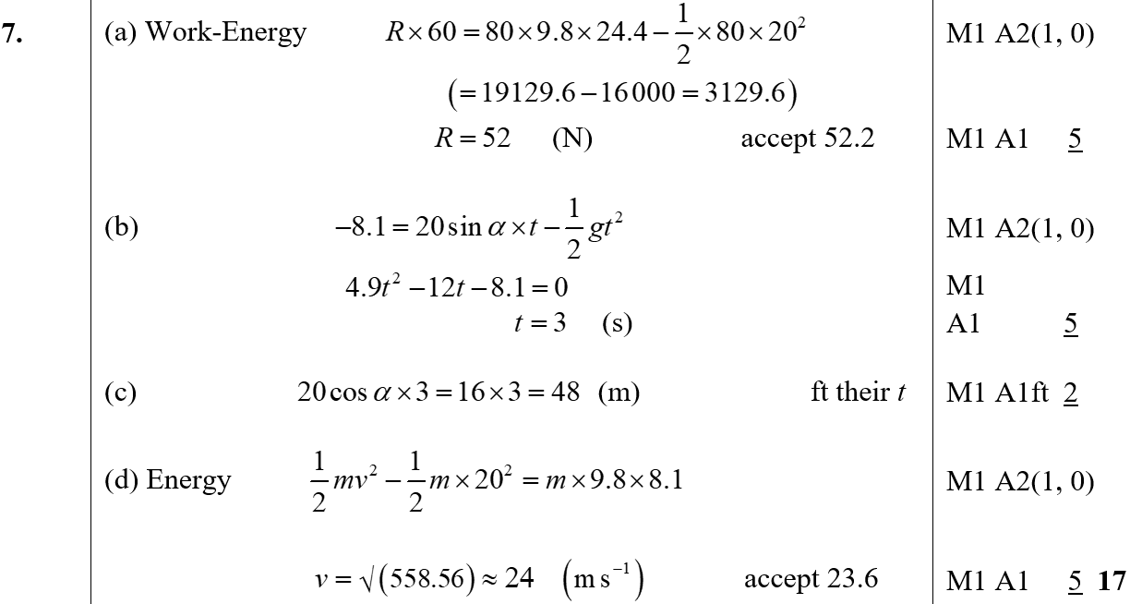
June 2004
A
B
C
D
D Alternative

Slide 33
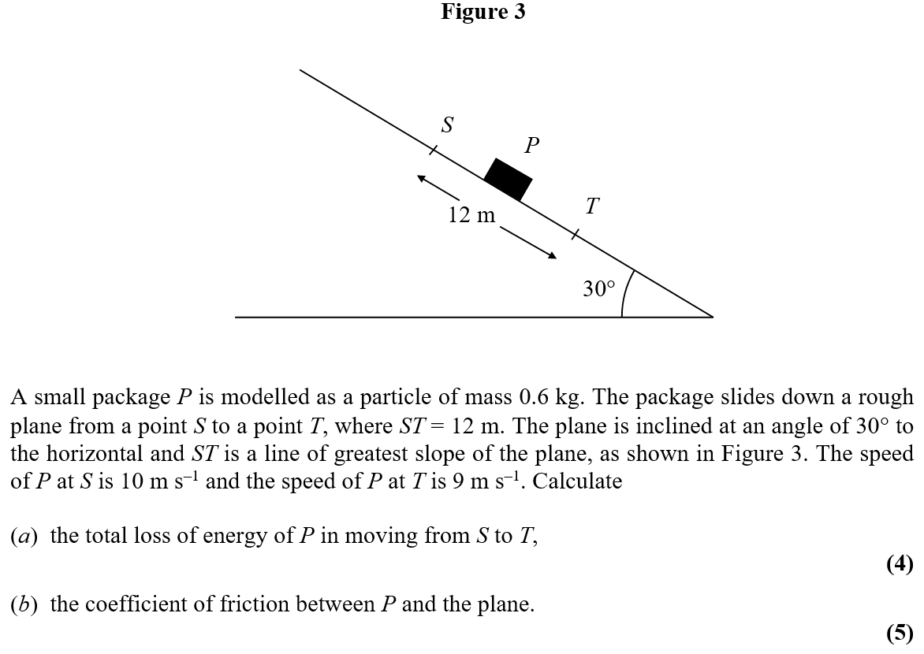
Jan 2005

Slide 34
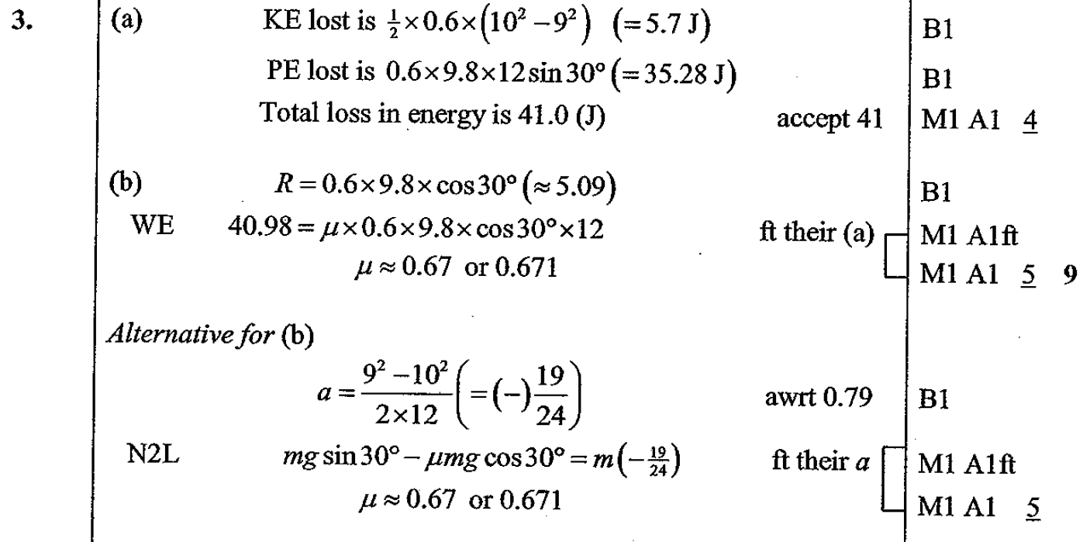
Jan 2005
A
B

Slide 35
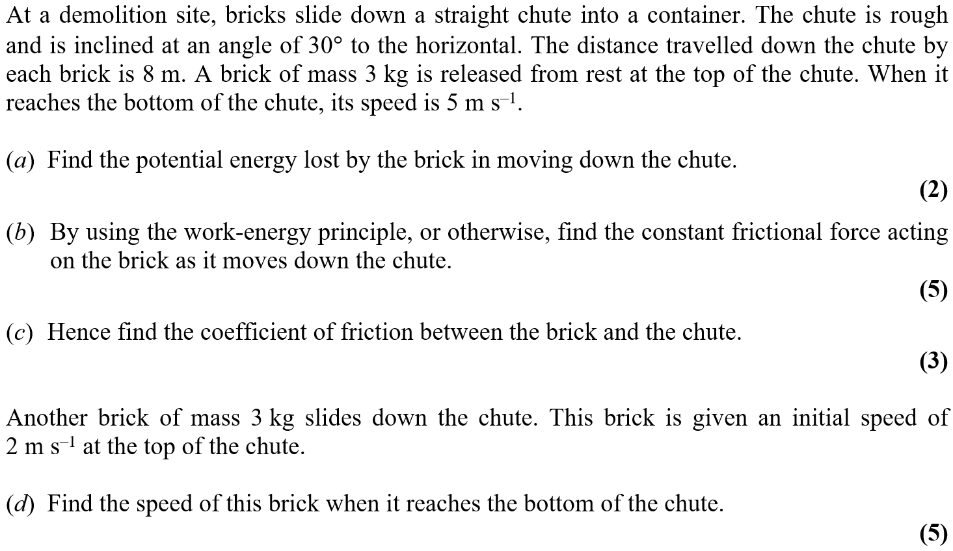
June 2005

Slide 36
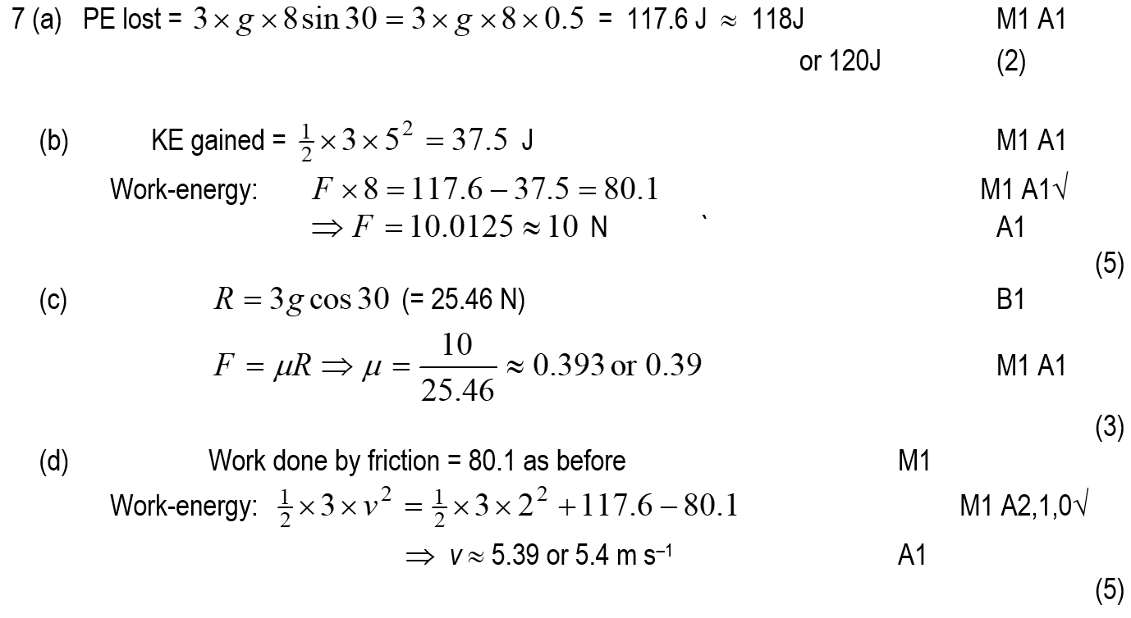
June 2005
A
B
C
D

Slide 37
Jan 2006

Slide 38
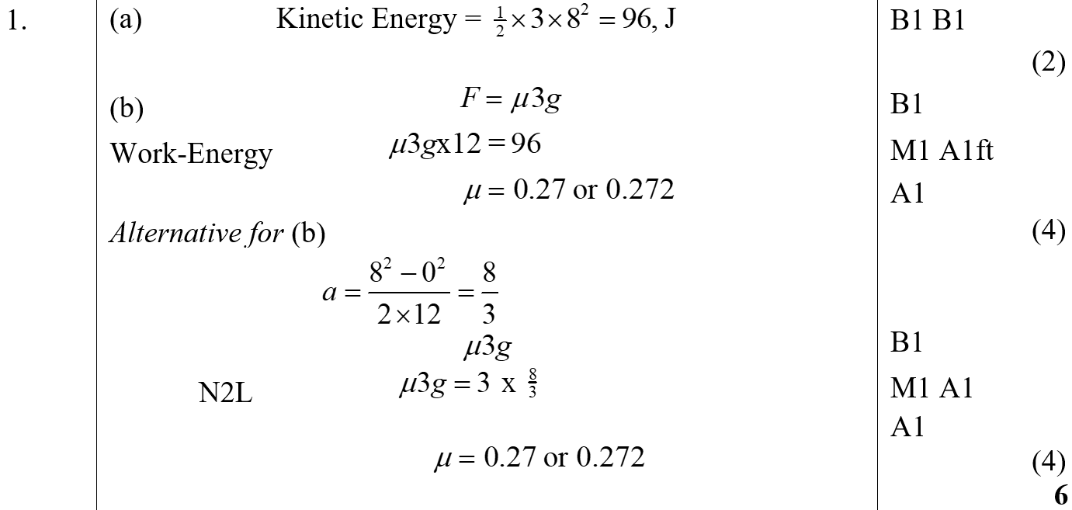
Jan 2006
A
B

Slide 39
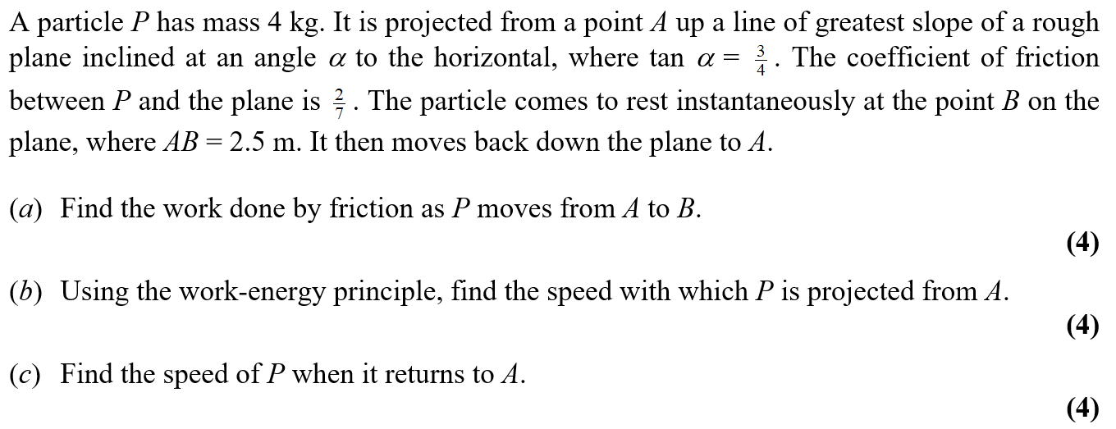
June 2006

Slide 40
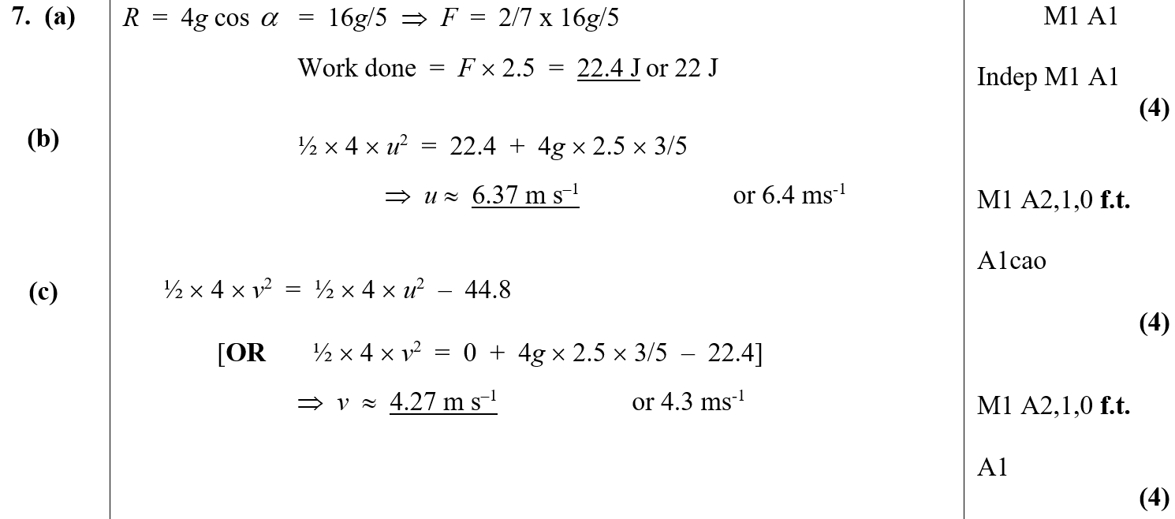
June 2006
A
B
C

Slide 41
Jan 2007

Slide 42
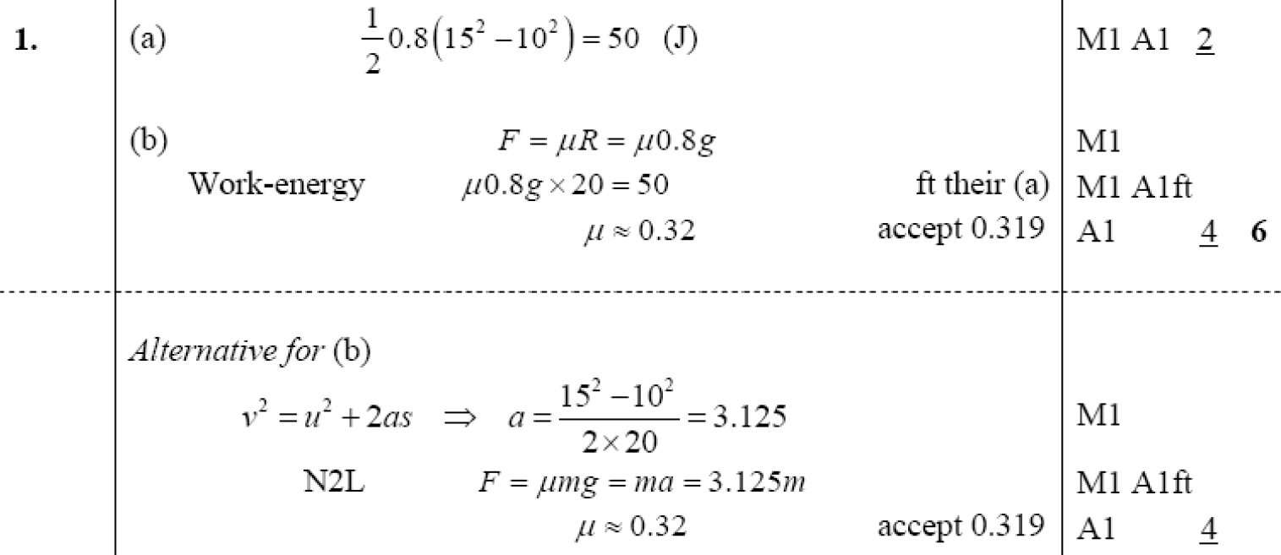
Jan 2007
A
B
B Alternative (i)

Slide 43
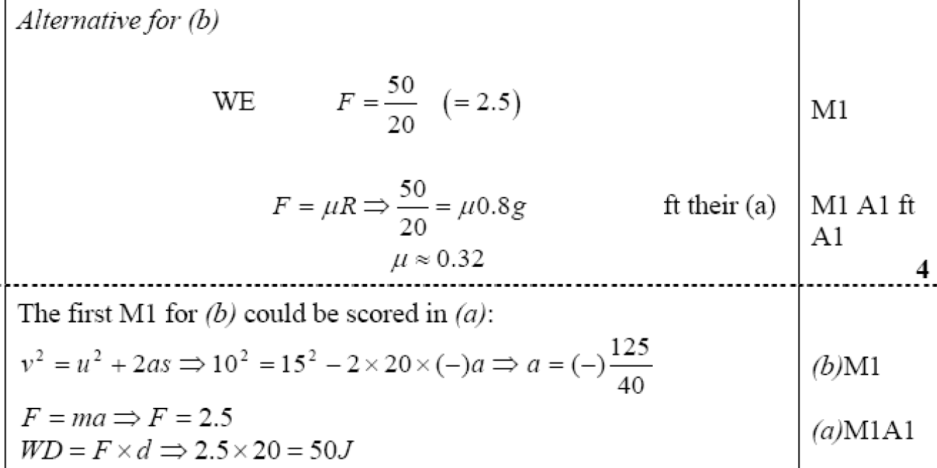
Jan 2007
B Alternative (ii)
Notes

Slide 44
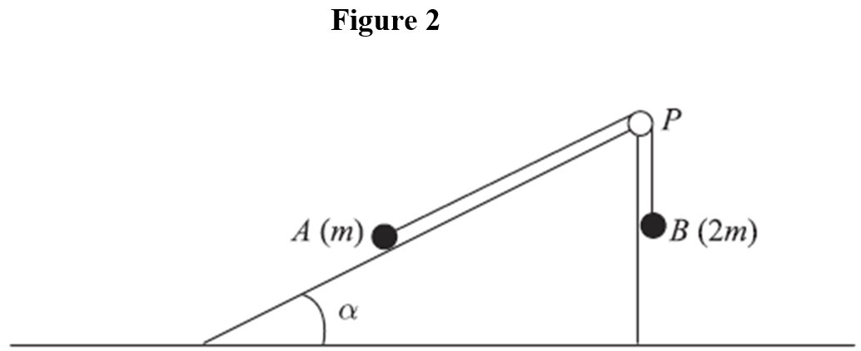
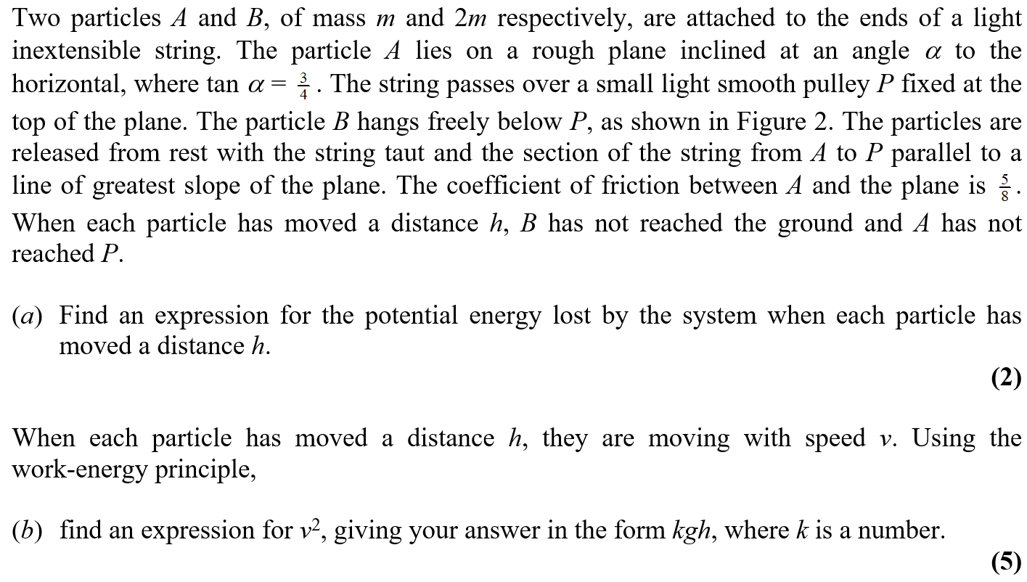
June 2007

Slide 45
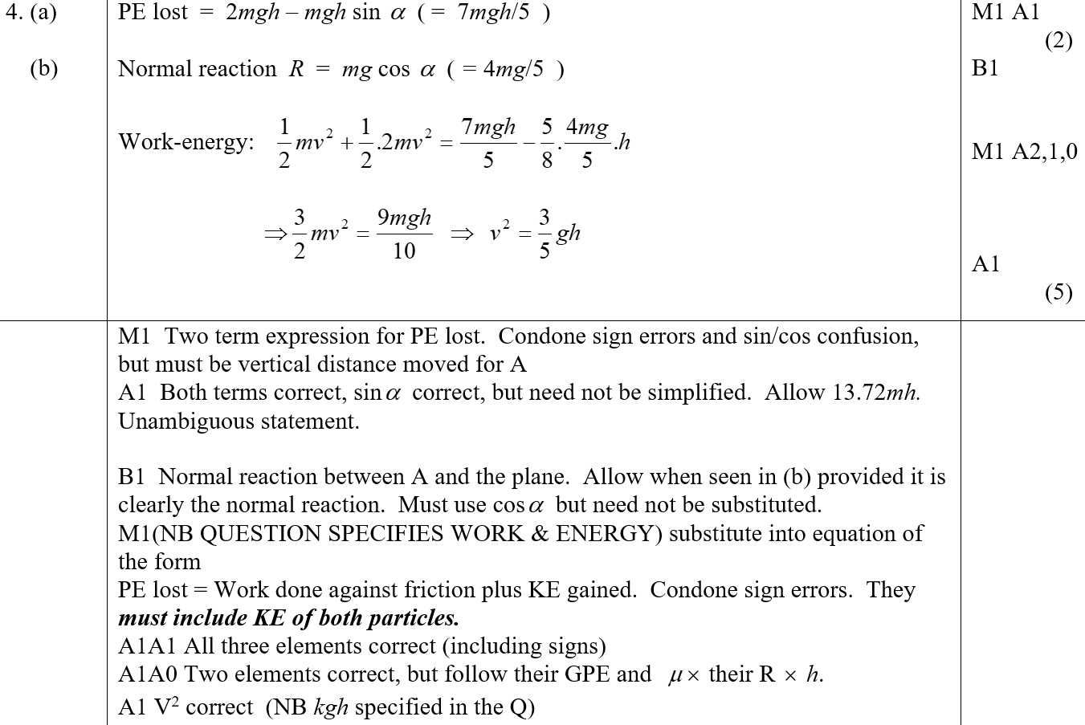
June 2007
A
B
A Notes
B Notes

Slide 46
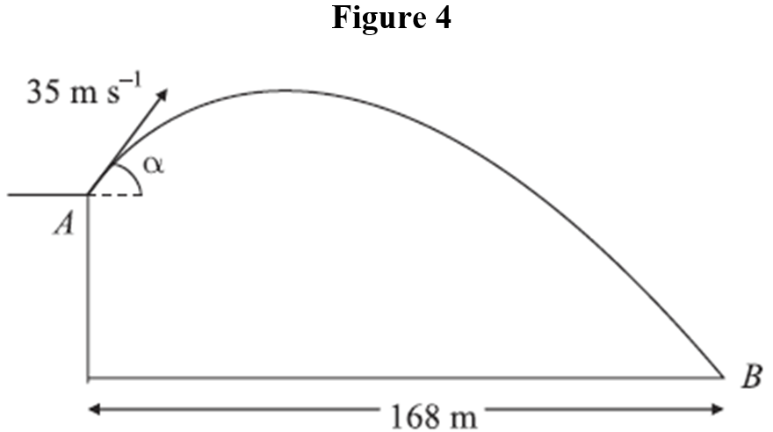
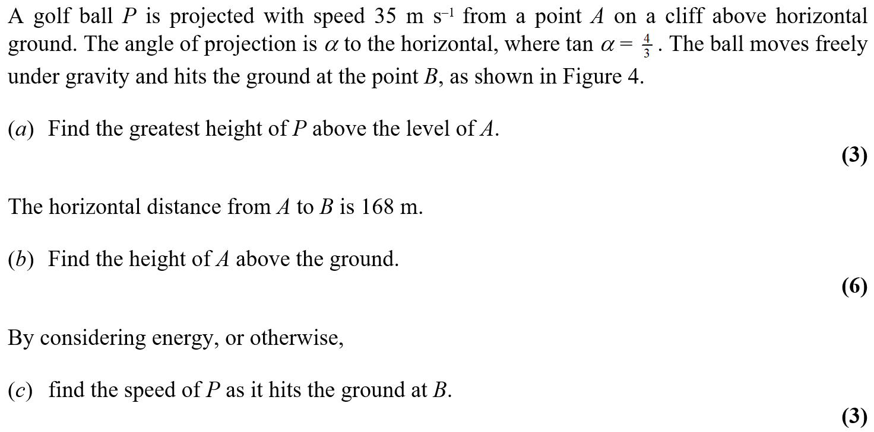
June 2007

Slide 47
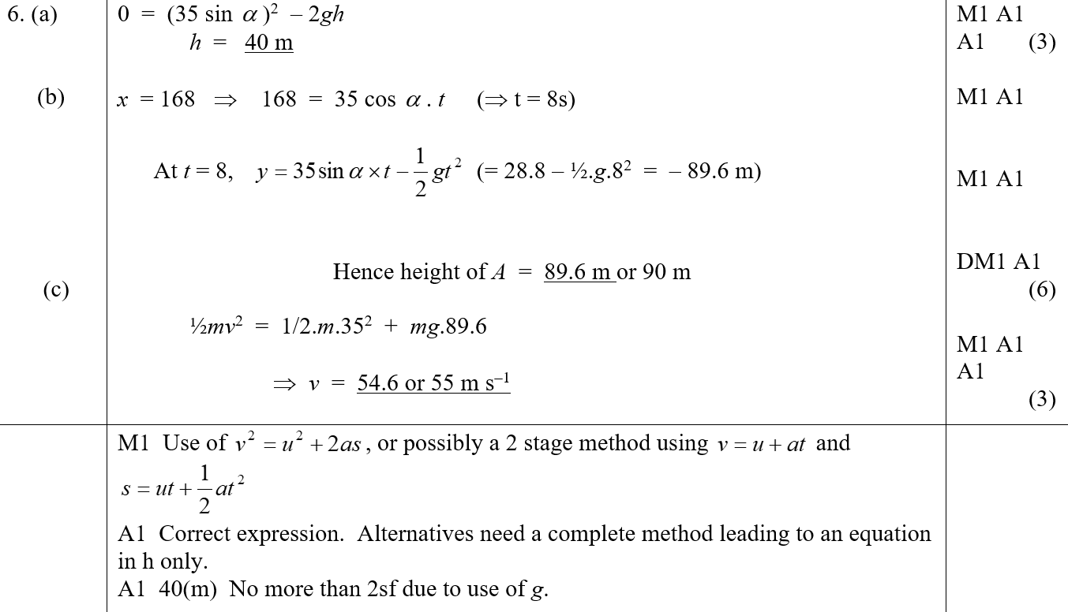
June 2007
A
B
C
A Notes

Slide 48
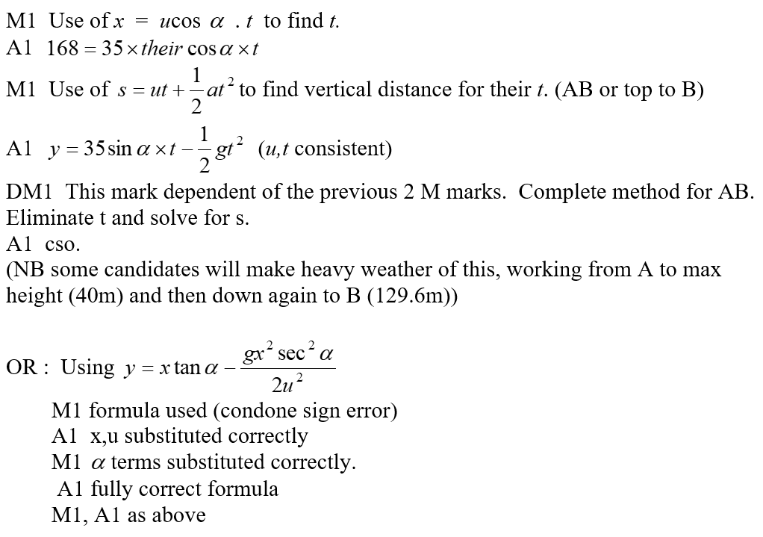
June 2007
B Notes

Slide 49
June 2007
C Notes

Slide 50
Jan 2008

Slide 51
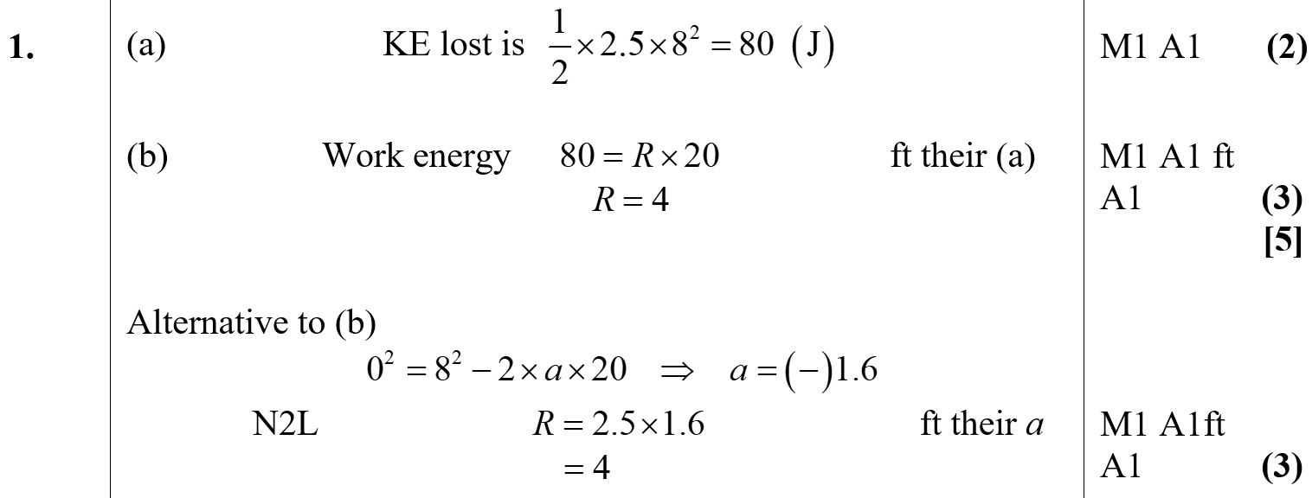
Jan 2008
A
B

Slide 52
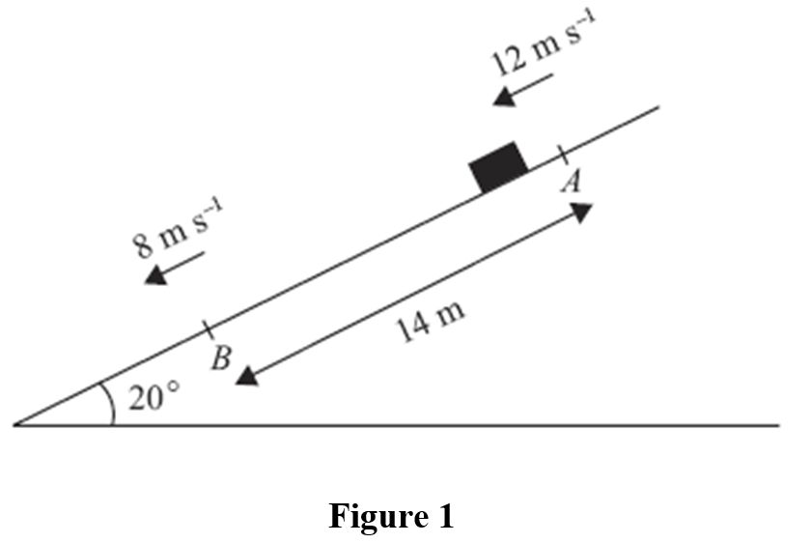
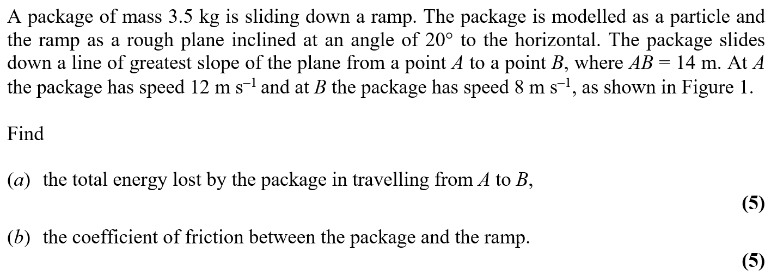
May 2008

Slide 53
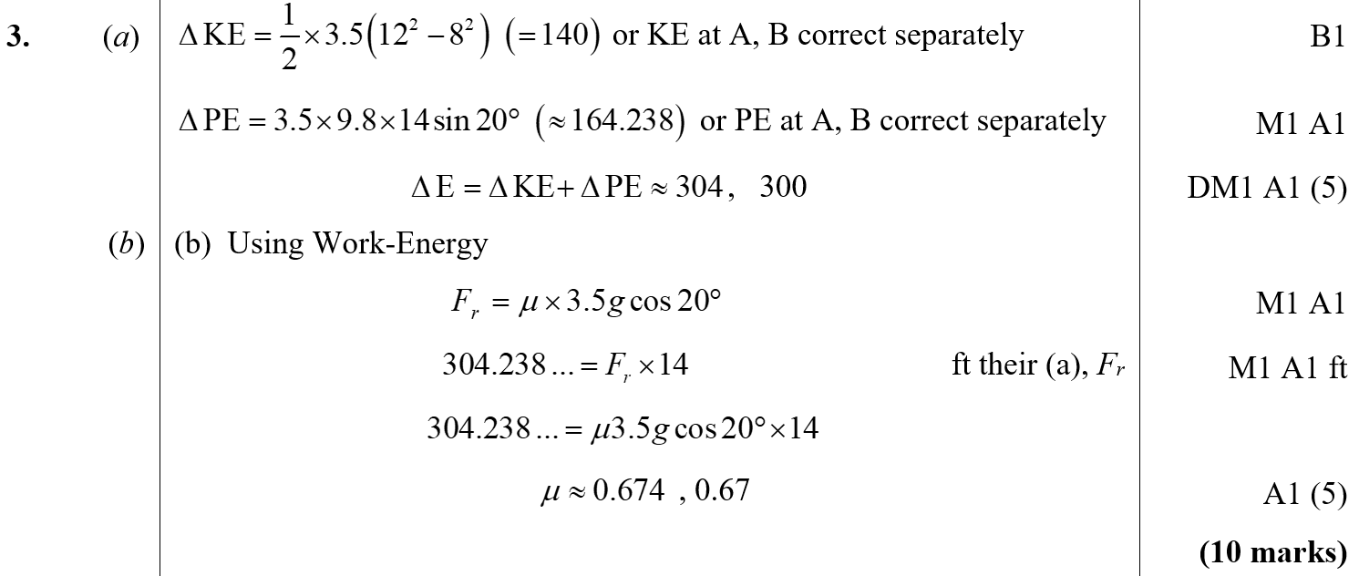
May 2008
A
B

Slide 54
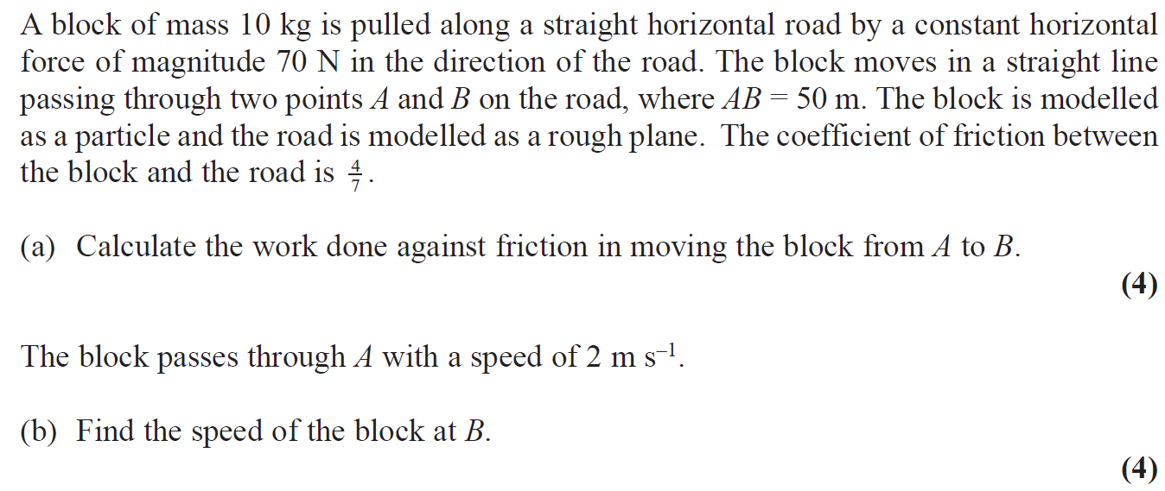
Jan 2009

Slide 55
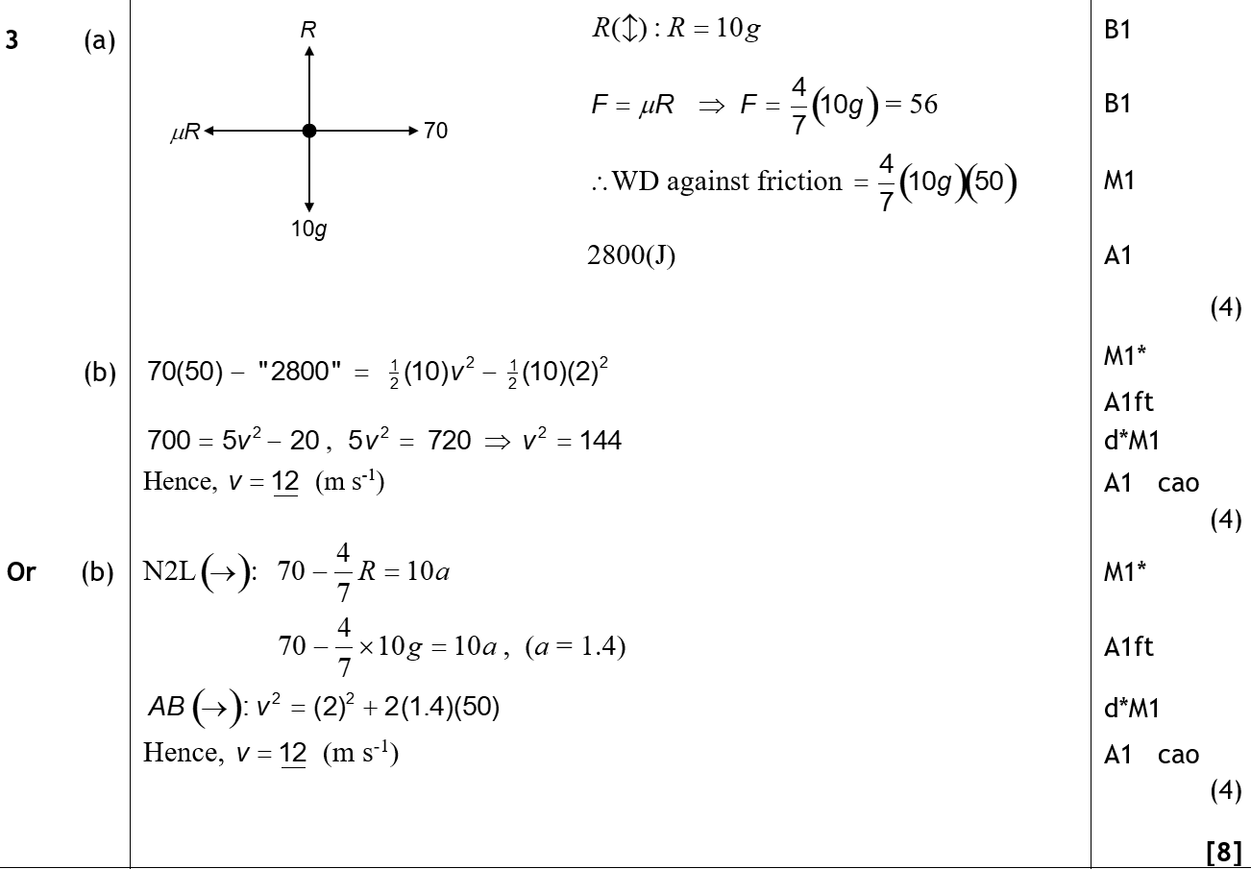
Jan 2009
A
B

Slide 56
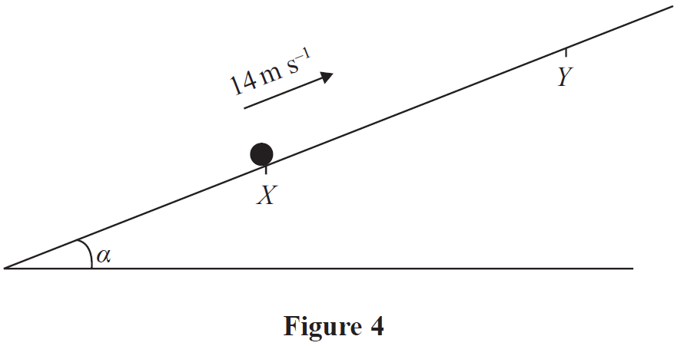
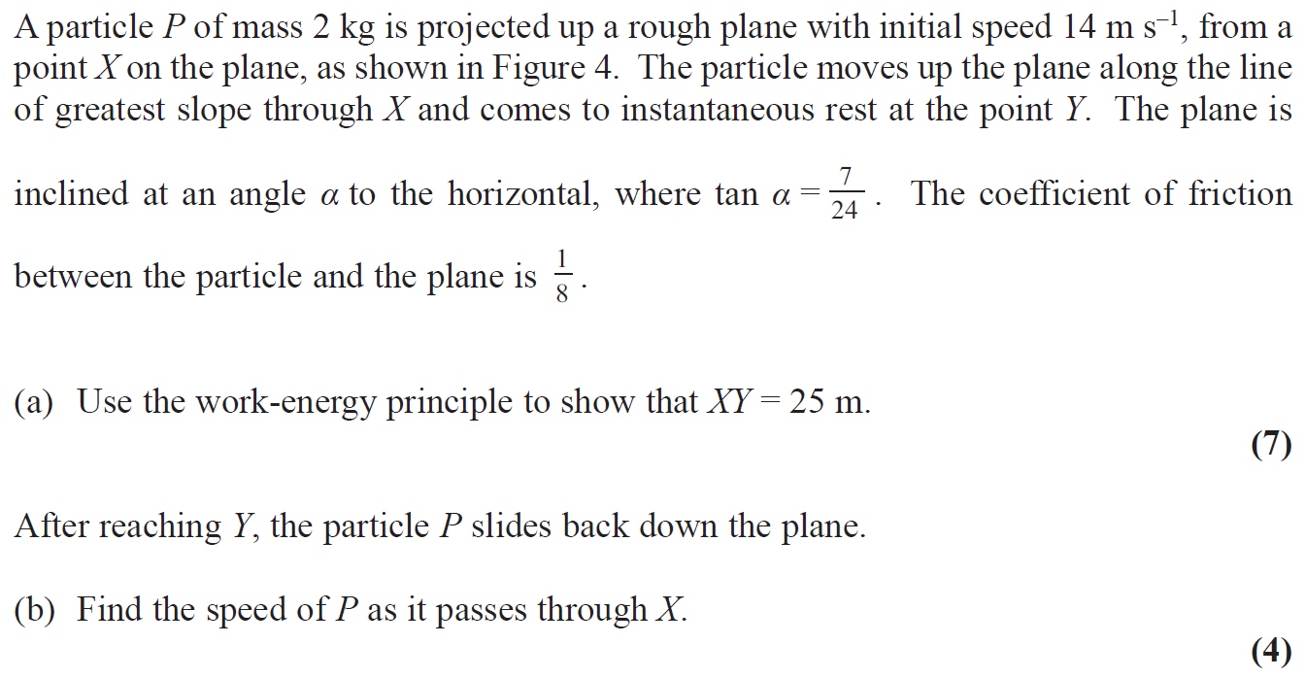
May 2009

Slide 57
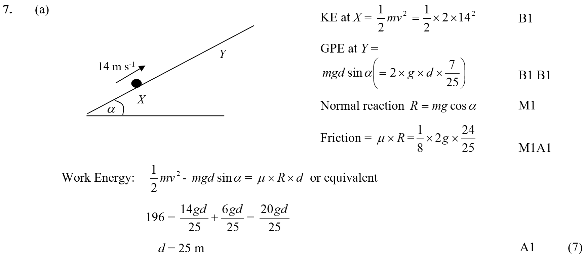
May 2009
A

Slide 58
May 2009
B

Slide 59
Jan 2010

Slide 60
Jan 2010
A

Slide 61
June 2010

Slide 62
June 2010
A

Slide 63
June 2010
B

Slide 64
Jan 2011

Slide 65
Jan 2011
A
B

Slide 66
June 2011

Slide 67
June 2011
A

Slide 68
June 2011
B

Slide 69
Jan 2012

Slide 70
Jan 2012
A
B

Slide 71
May 2012

Slide 72
May 2012
A
B
A Alternative
B Alternative

Slide 73
May 2012
C

Slide 74
Jan 2013

Slide 75
Jan 2013
A
B

Slide 76
Jan 2013
C

Slide 77
June 2013

Slide 78
June 2013
A
B
C

Slide 79
June 2013 (R)

Slide 80
June 2013 (R)
A

Slide 81
June 2014

Slide 82
June 2014
A
B

Slide 83
June 2014 (R)

Slide 84
June 2014 (R)
A
B
C

Slide 85
June 2015

Slide 86
June 2015
A
B

Slide 87
June 2016

Slide 88
June 2016
A
B

Slide 89
June 2017

Slide 90
June 2017
A

Slide 91
June 2017
B
C

Slide 92
June 2019

Slide 93
June 2019
A
B

