Slide 1
Volume & Surface Area
Volume & Surface Area
Old Spec Q’s
NTSQ
Q7
Jan 2019
2H Q22
NTSQ
Q8
Jan 2019
1HR Q17
SAM
1H Q19
May 2019
1H Q21
June 2018
2H Q11
June 2019
2H Q18*
May 2018
1HR Q22
Jan 2019
1H Q15
Mainly Differentiation*
With Circles

Slide 2
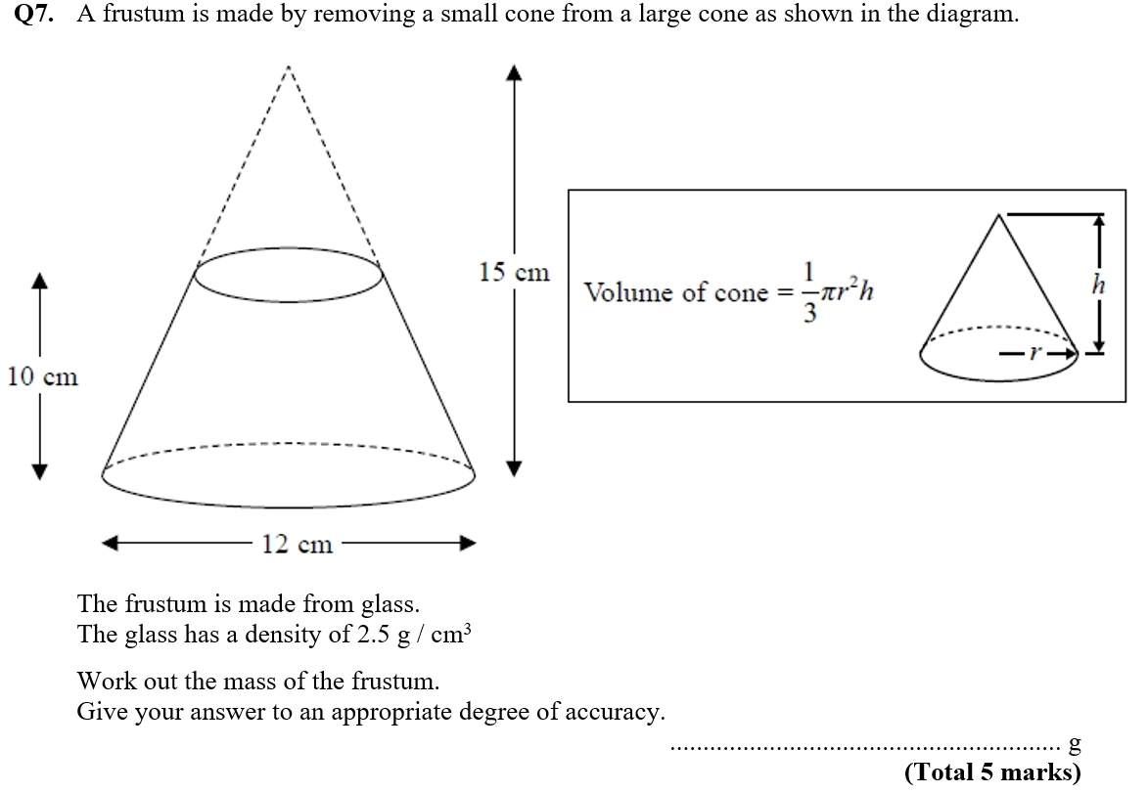
Volume & Surface Area
NTSQ Q7

Slide 3
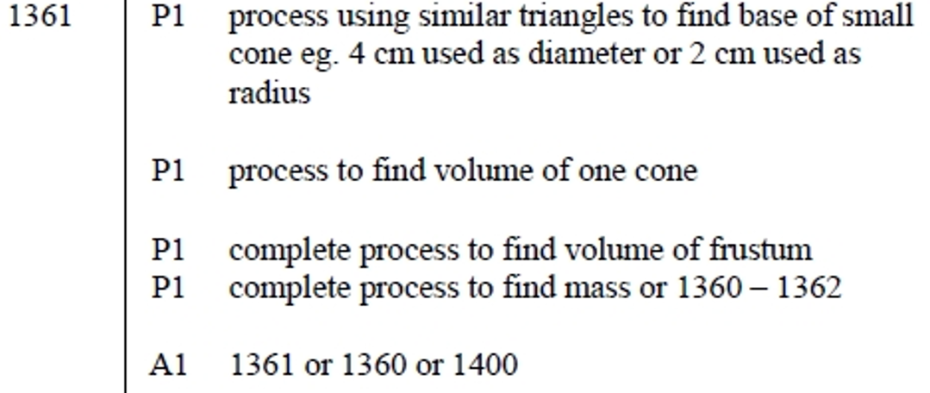
Volume & Surface Area
NTSQ Q7
A

Slide 4
Volume & Surface Area
NTSQ Q8

Slide 5
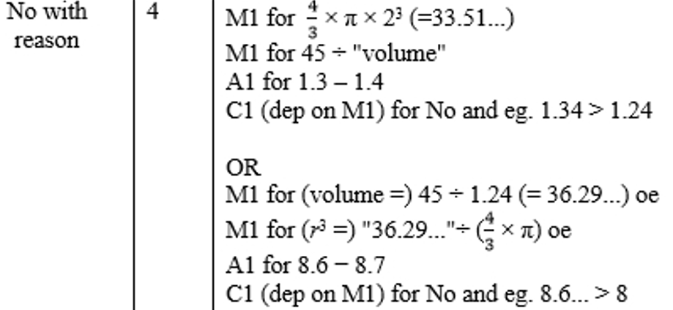
Volume & Surface Area
NTSQ Q8
A

Slide 6
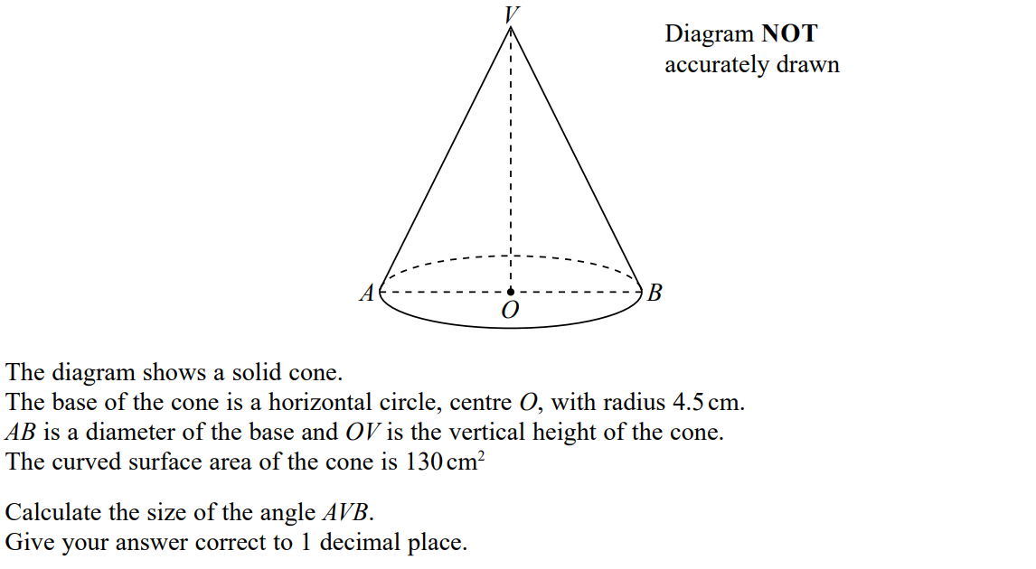
Volume & Surface Area
SAM 1H Q19

Slide 7
Volume & Surface Area
SAM 1H Q19
A

Slide 8
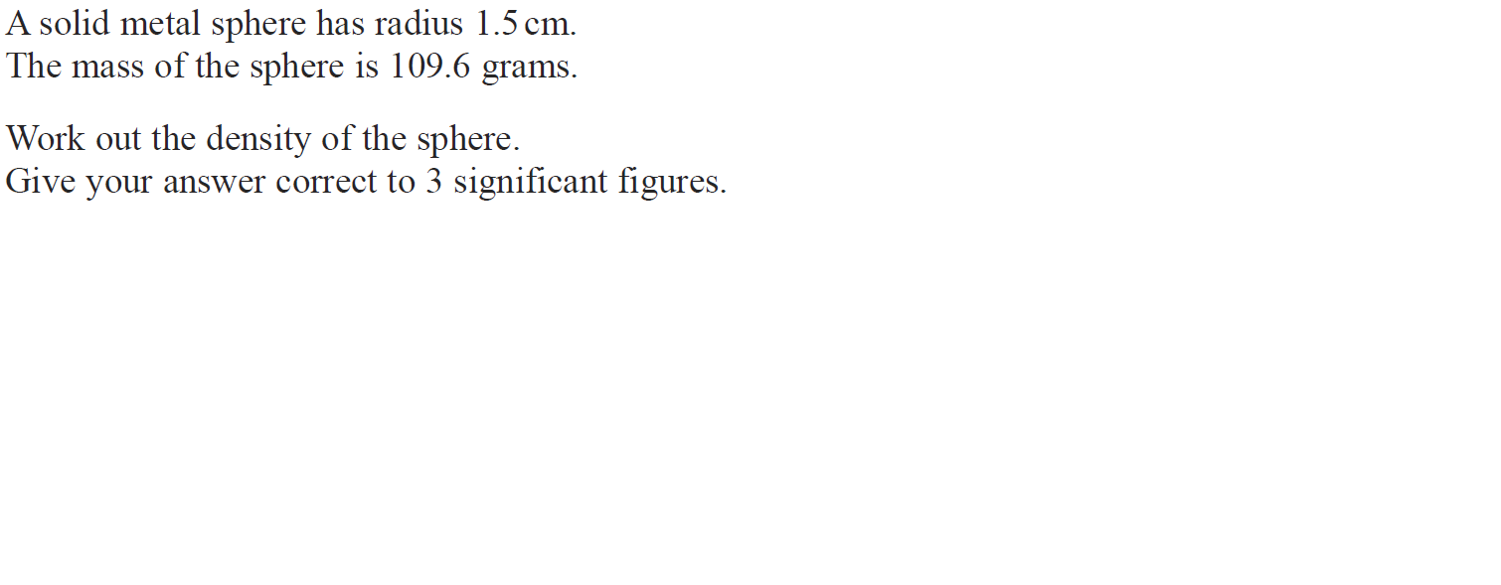
Volume & Surface Area
June 2018 2H Q11

Slide 9
Volume & Surface Area
June 2018 2H Q11
A

Slide 10
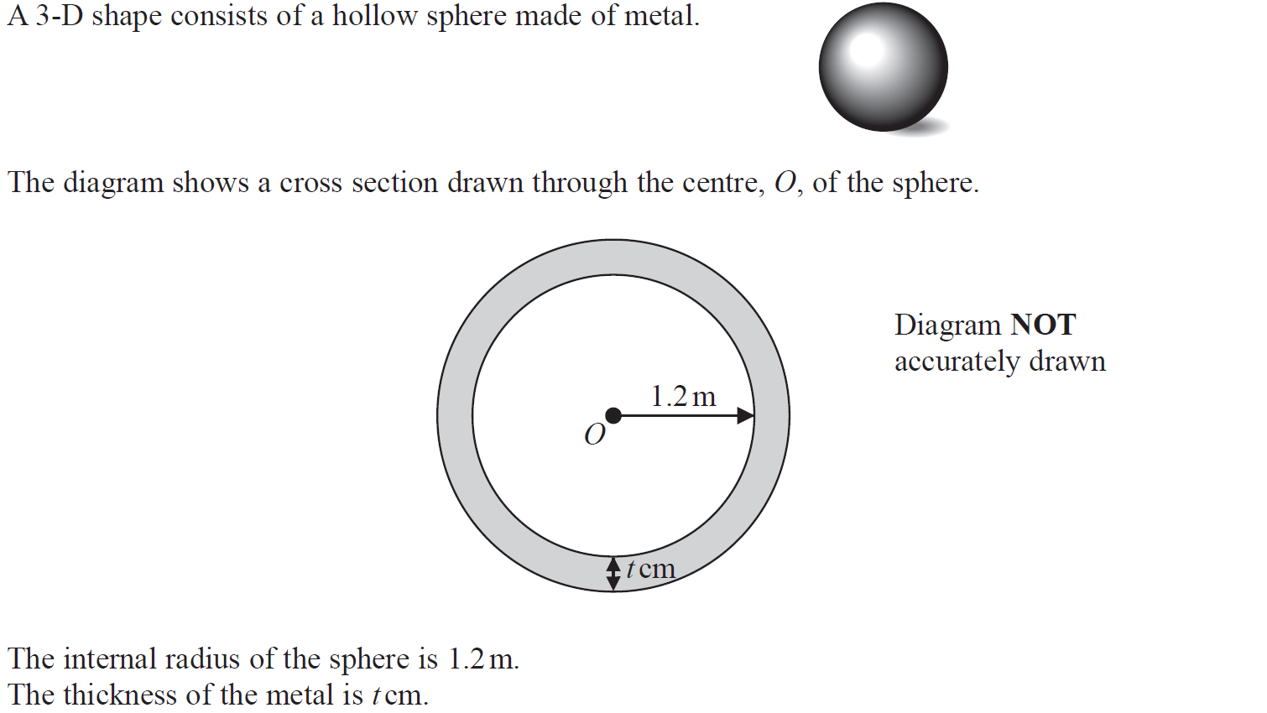
Volume & Surface Area
May 2018 1HR Q22

Slide 11
Volume & Surface Area
May 2018 1HR Q22
A

Slide 12
Volume & Surface Area
Jan 2019 1H Q15

Slide 13
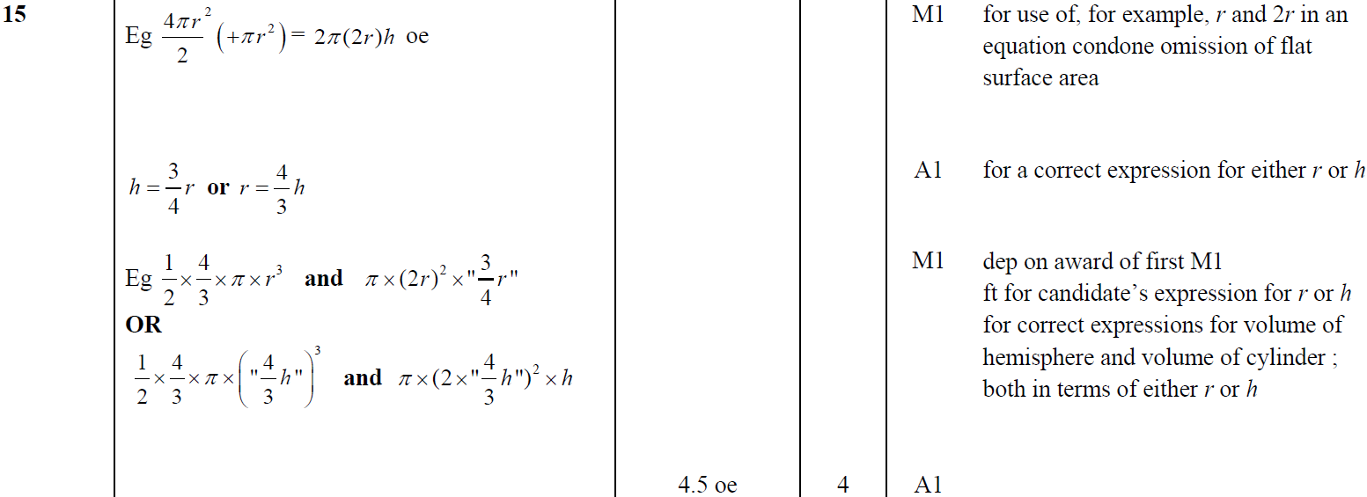
Volume & Surface Area
Jan 2019 1H Q15
A

Slide 14
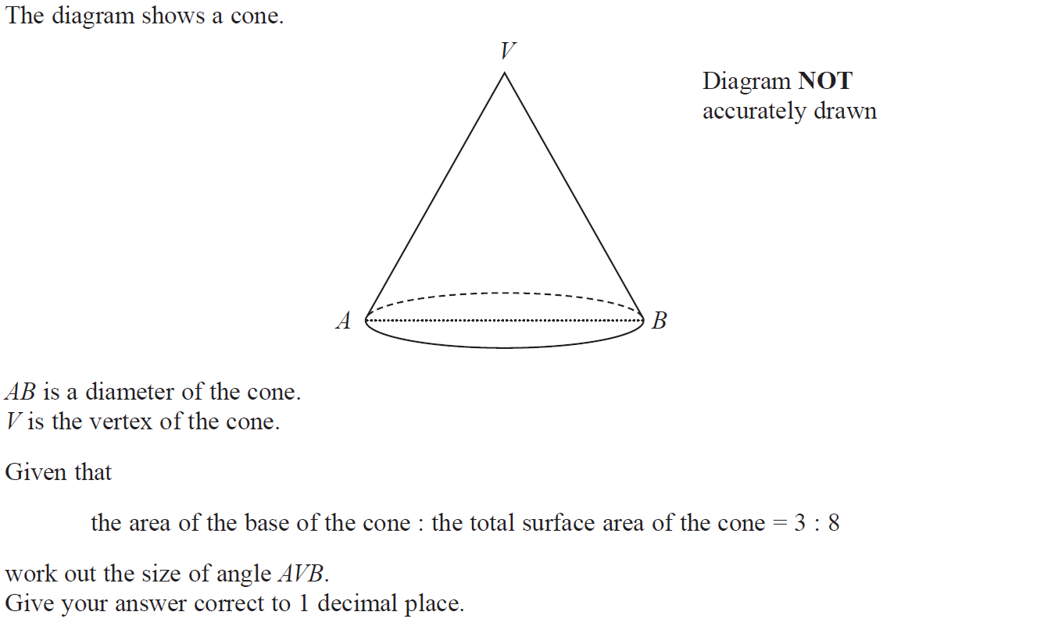
Volume & Surface Area
Jan 2019 2H Q22

Slide 15
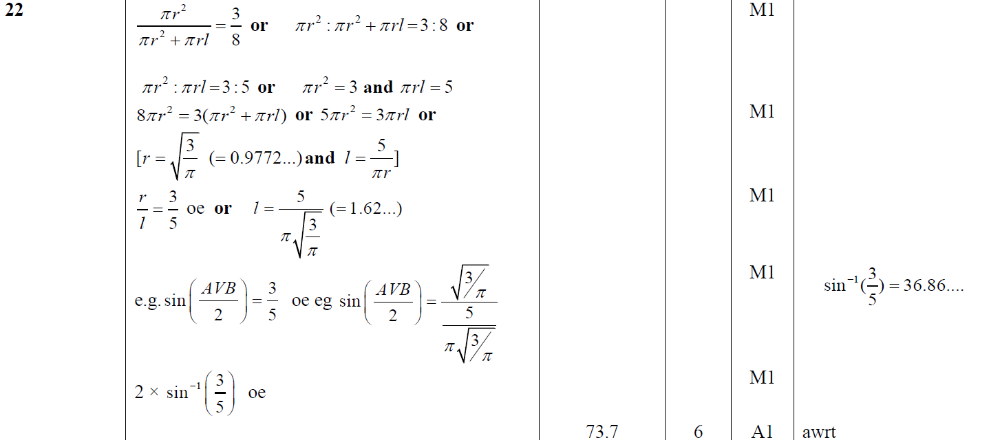
Volume & Surface Area
Jan 2019 2H Q22
A

Slide 16
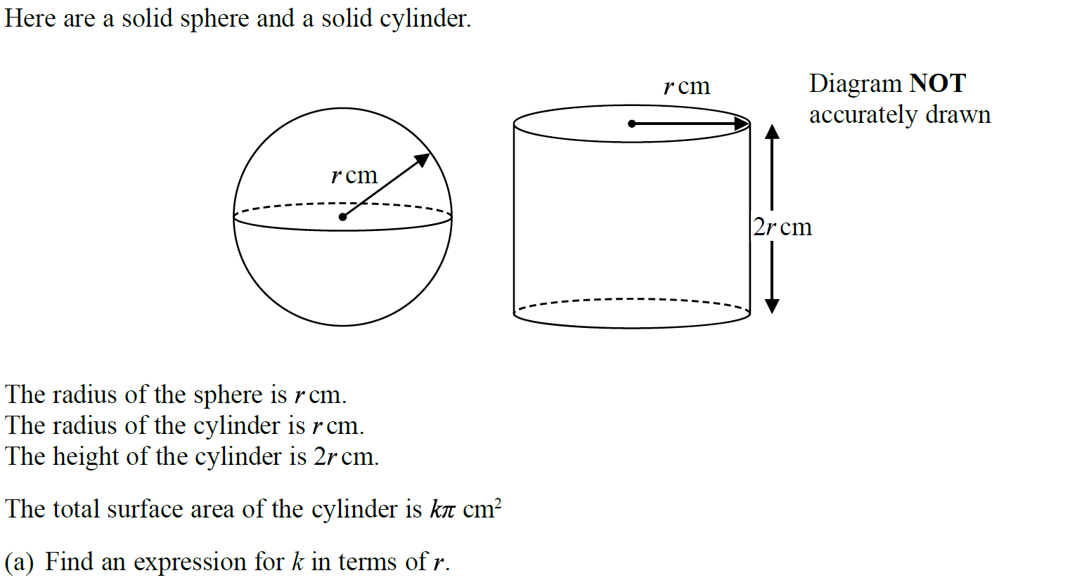
Volume & Surface Area
Jan 2019 1HR Q17

Slide 17
Volume & Surface Area
Jan 2019 1HR Q17
A
B

Slide 18
Volume & Surface Area
May 2019 1H Q21

Slide 19
Volume & Surface Area
May 2019 1H Q21
A

Slide 20
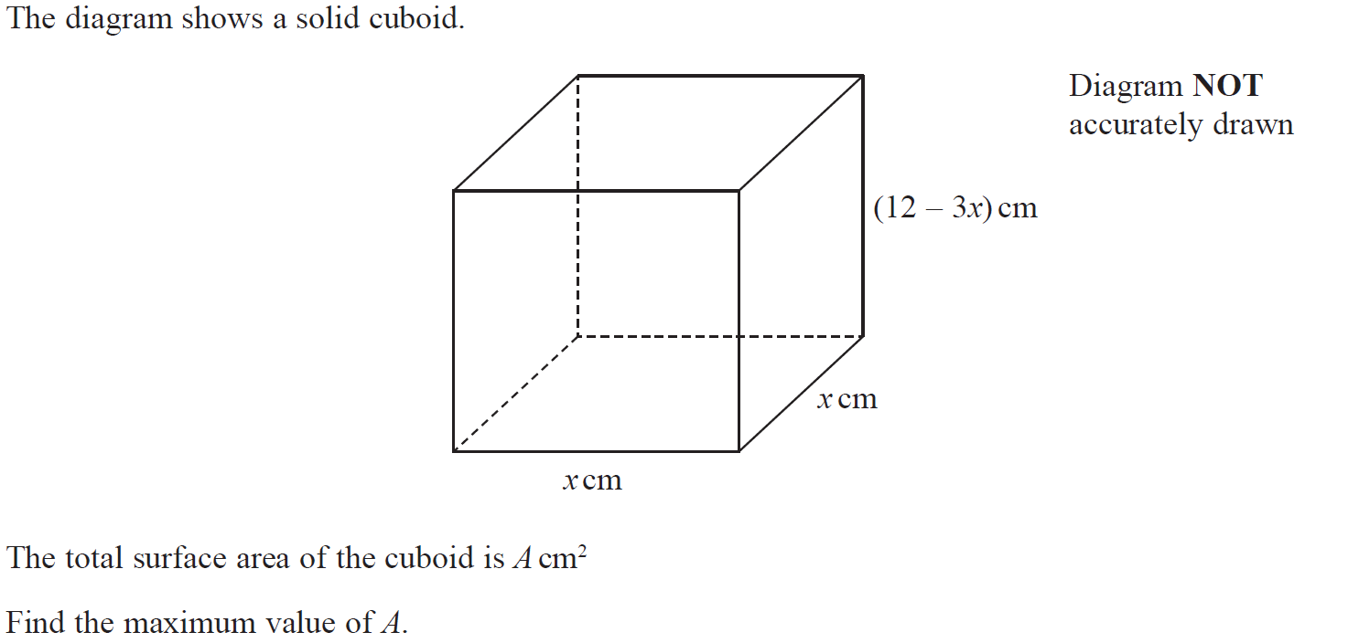
Volume & Surface Area
June 2019 2H Q18

Slide 21
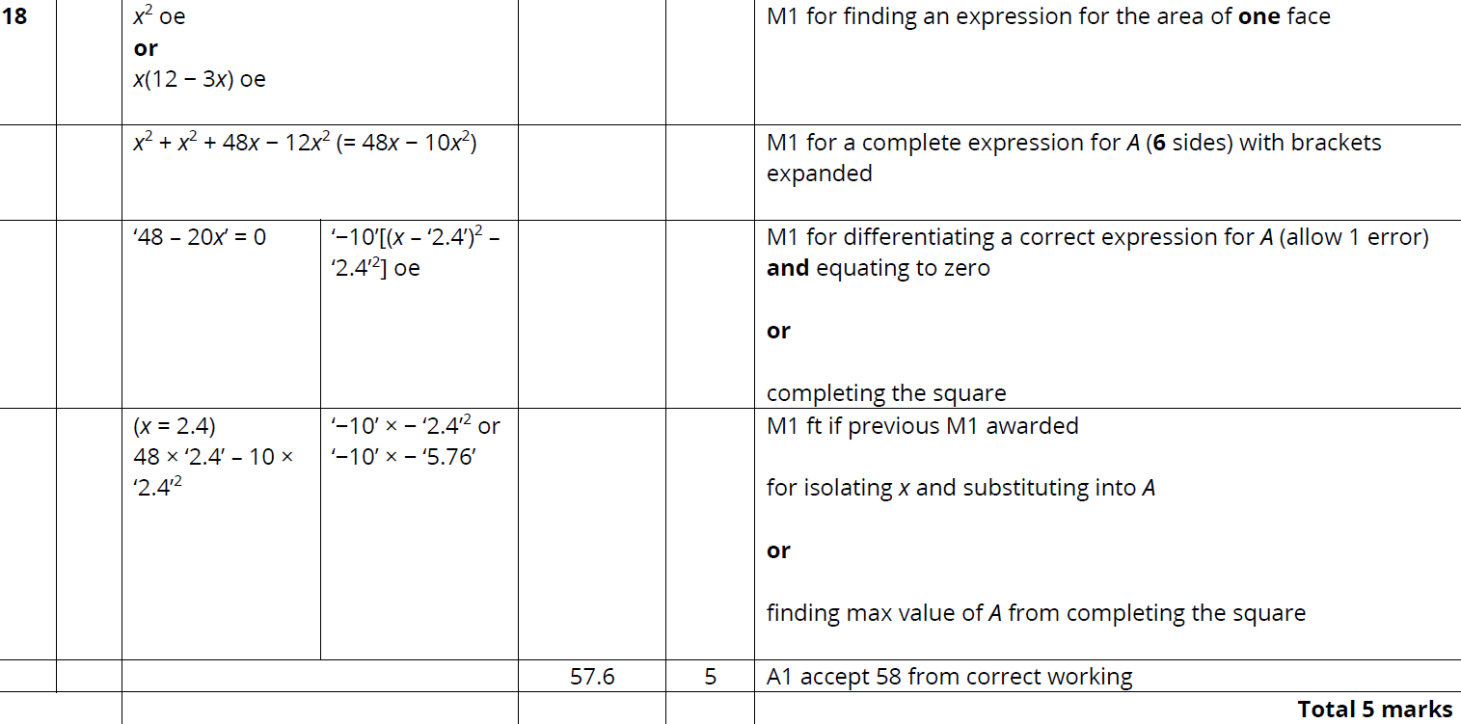
Volume & Surface Area
June 2019 2H Q18
A

Slide 22
Volume & Surface Area
Volume & Surface Area
New Spec Q’s
May 2004
4H Q20
June 2010
4H Q19
May 2014 4HR Q20
Jan 2017 4HR Q19
Nov 2005
3H Q18
Nov 2010
3H Q15
Jan 2015 3H Q21
June 2017 4H Q23
May 2006
3H Q22
June 2011 3H Q23
Jan 2015 4H Q21
May 2017 3HR Q19
Nov 2006
3H Q9
Jan 2012 4H Q20
Jan 2015 3HR Q18
Jan 2018 4H Q21
Nov 2006
3H Q15
May 2012 4H Q22
Jan 2016 3H Q19
Jan 2018 3HR Q22
May 2007
3H Q18
May 2013 4HR Q19
Jan 2016 3HR Q15
May 2018 3H Q19
Nov 2007
4H Q26
Jan 2014 4HR Q21
May 2016 3H Q20
June 2018 4H Q11
May 2009
3H Q16
May 2014 4H Q21
June 2016 4H Q20
June 2018 4HR Q25
With Circles

Slide 23
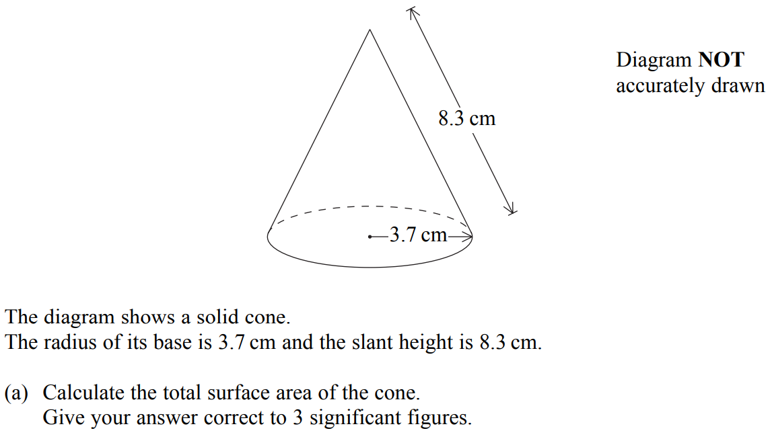
Volume & Surface Area
May 2004 4H Q20

Slide 24
Volume & Surface Area
May 2004 4H Q20
A
B

Slide 25
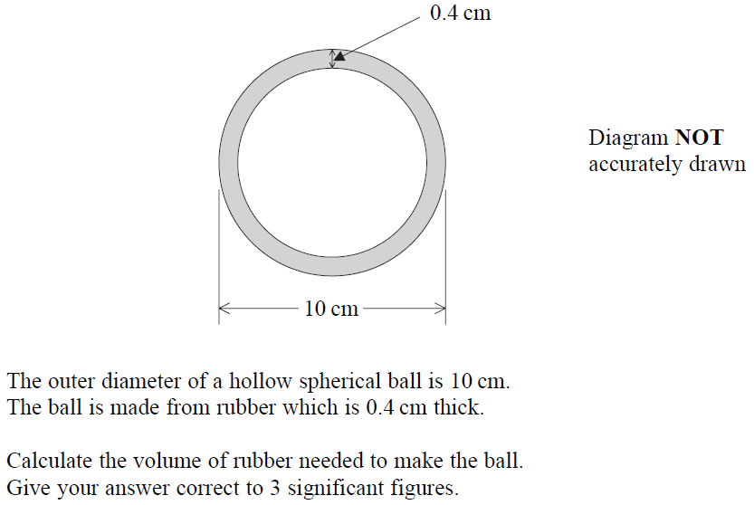
Volume & Surface Area
Nov 2005 3H Q18

Slide 26
Volume & Surface Area
Nov 2005 3H Q18
A

Slide 27
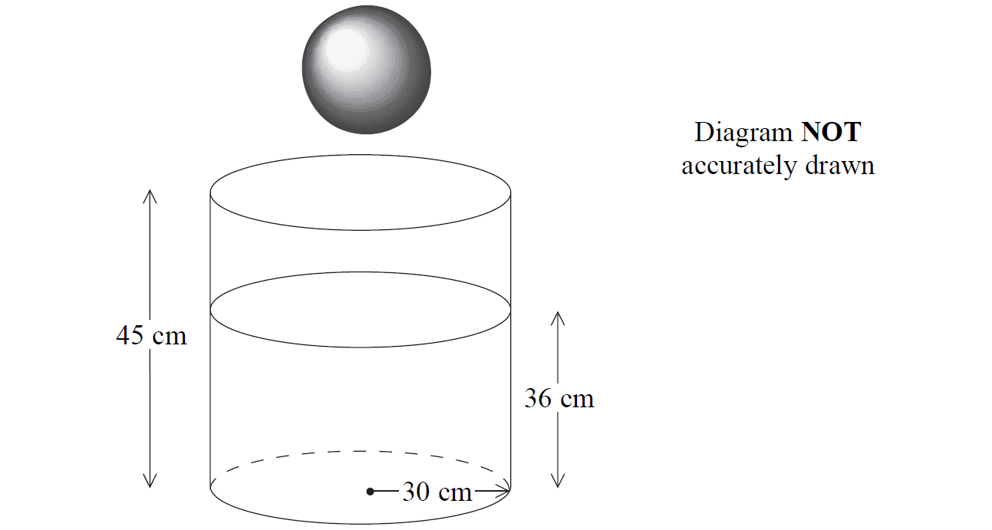
Volume & Surface Area
May 2006 3H Q22

Slide 28
Volume & Surface Area
May 2006 3H Q22
A

Slide 29
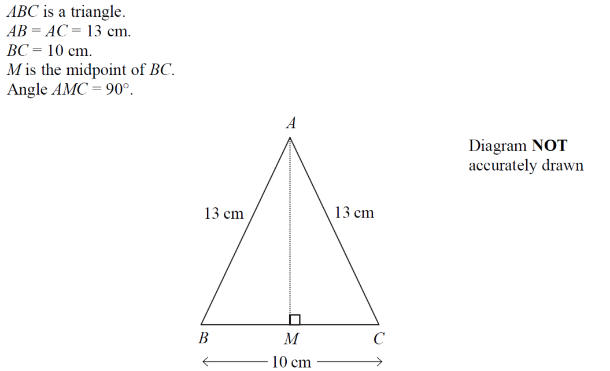
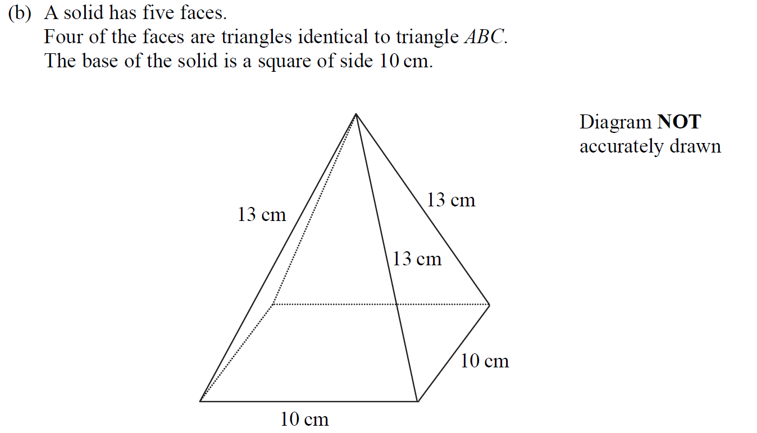
Volume & Surface Area
Nov 2006 3H Q9

Slide 30
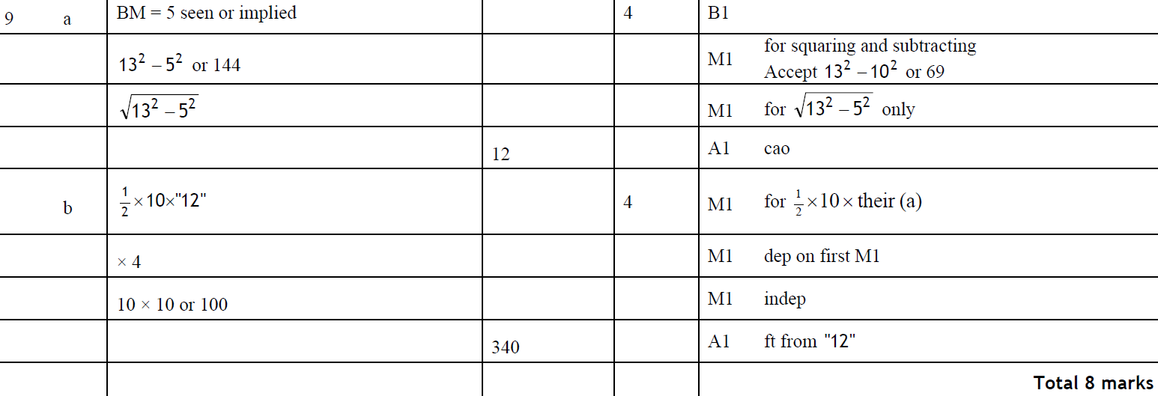
Volume & Surface Area
Nov 2006 3H Q9
A
B

Slide 31
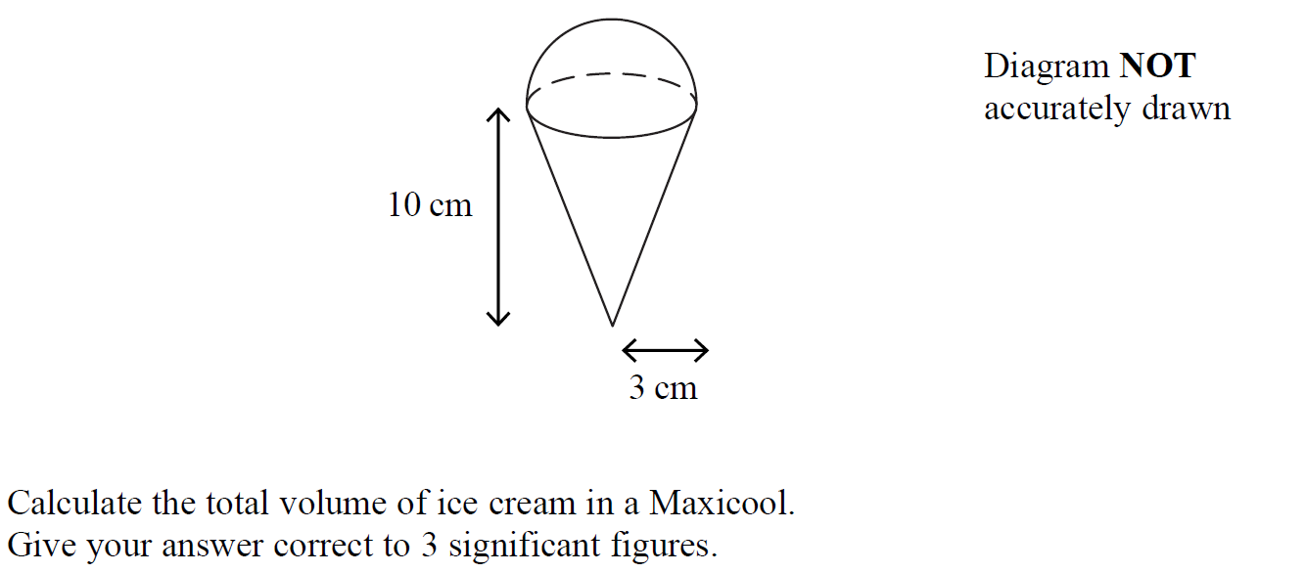
Volume & Surface Area
Nov 2006 3H Q15

Slide 32
Volume & Surface Area
Nov 2006 3H Q15
A

Slide 33
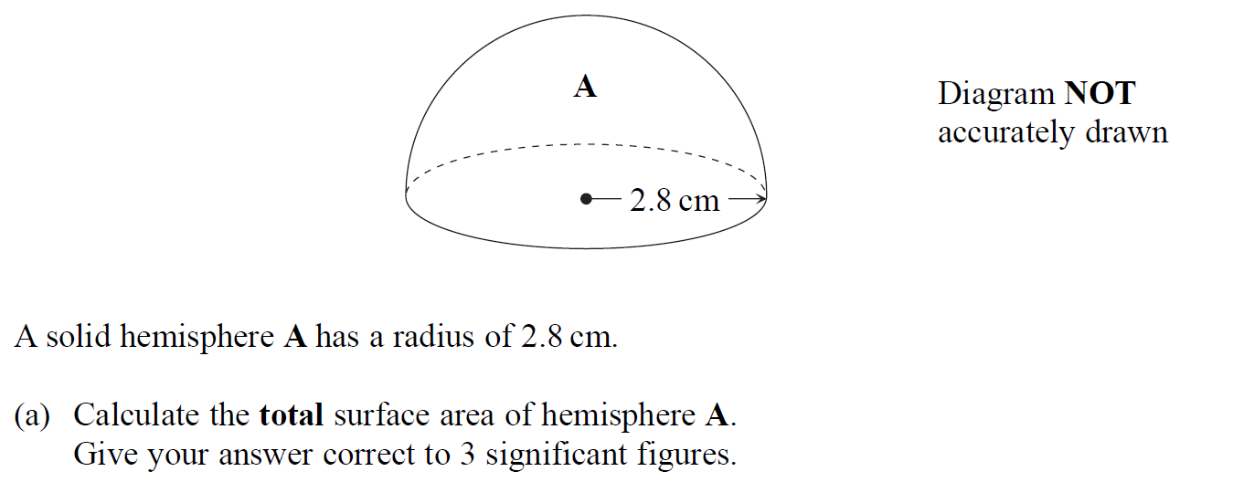
Volume & Surface Area
May 2007 3H Q18

Slide 34
Volume & Surface Area
May 2007 3H Q18
A
B

Slide 35
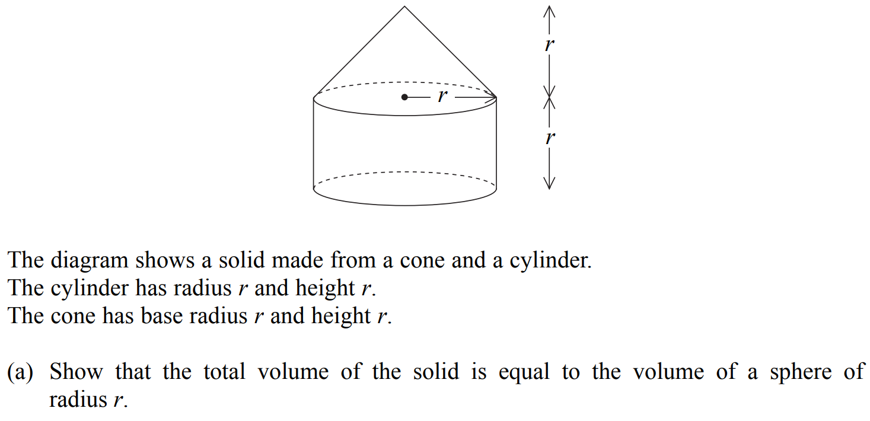
Volume & Surface Area
Nov 2007 4H Q26

Slide 36
Volume & Surface Area
Nov 2007 4H Q26
A
B

Slide 37
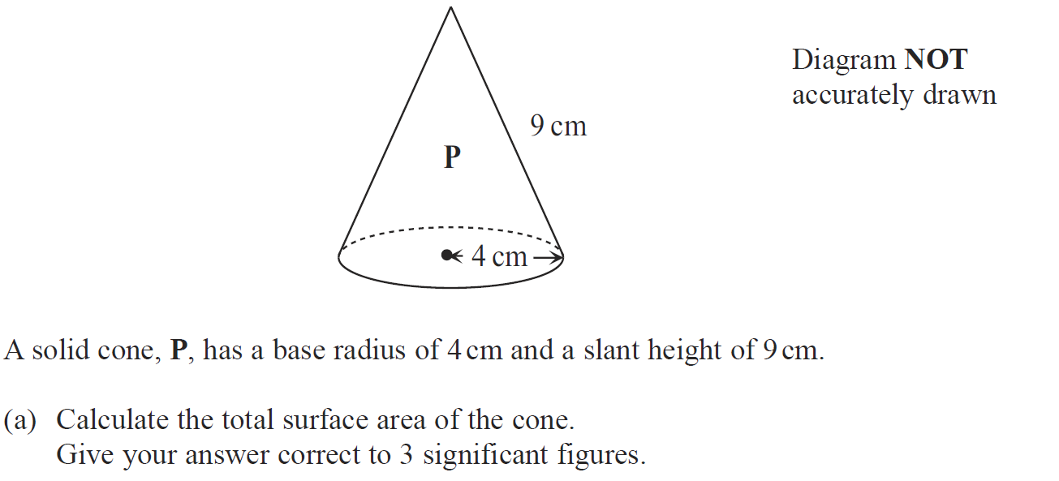
Volume & Surface Area
May 2009 3H Q16

Slide 38
Volume & Surface Area
May 2009 3H Q16
A
B

Slide 39
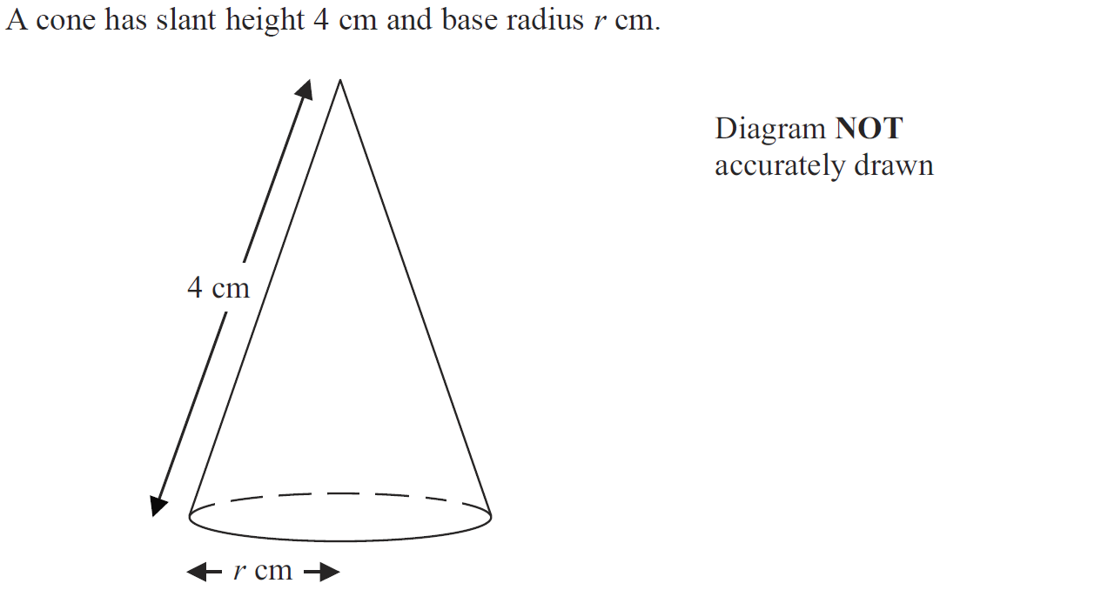
Volume & Surface Area
June 2010 4H Q19

Slide 40
Volume & Surface Area
June 2010 4H Q19
A

Slide 41
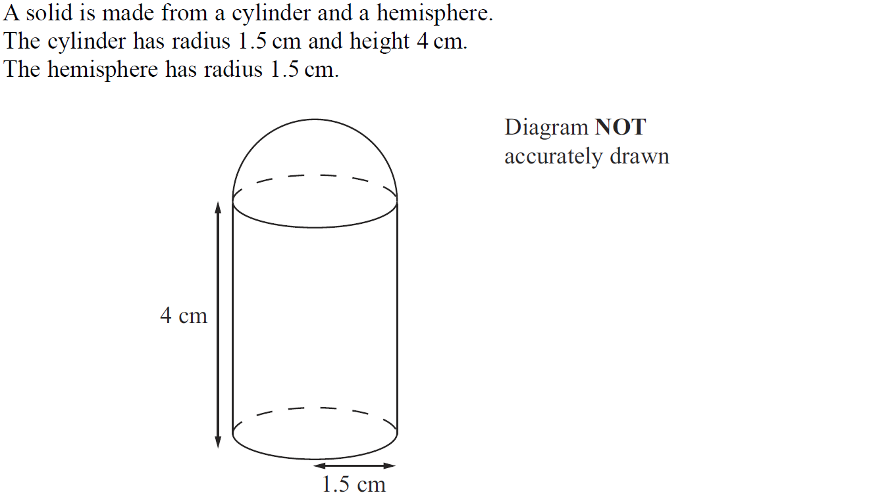
Volume & Surface Area
Nov 2010 3H Q15

Slide 42
Volume & Surface Area
Nov 2010 3H Q15
A

Slide 43
Volume & Surface Area
June 2011 3H Q23

Slide 44
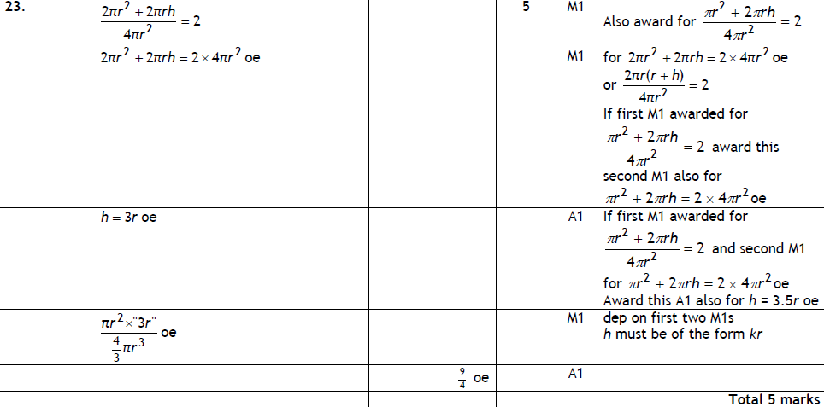
Volume & Surface Area
June 2011 3H Q23
A

Slide 45
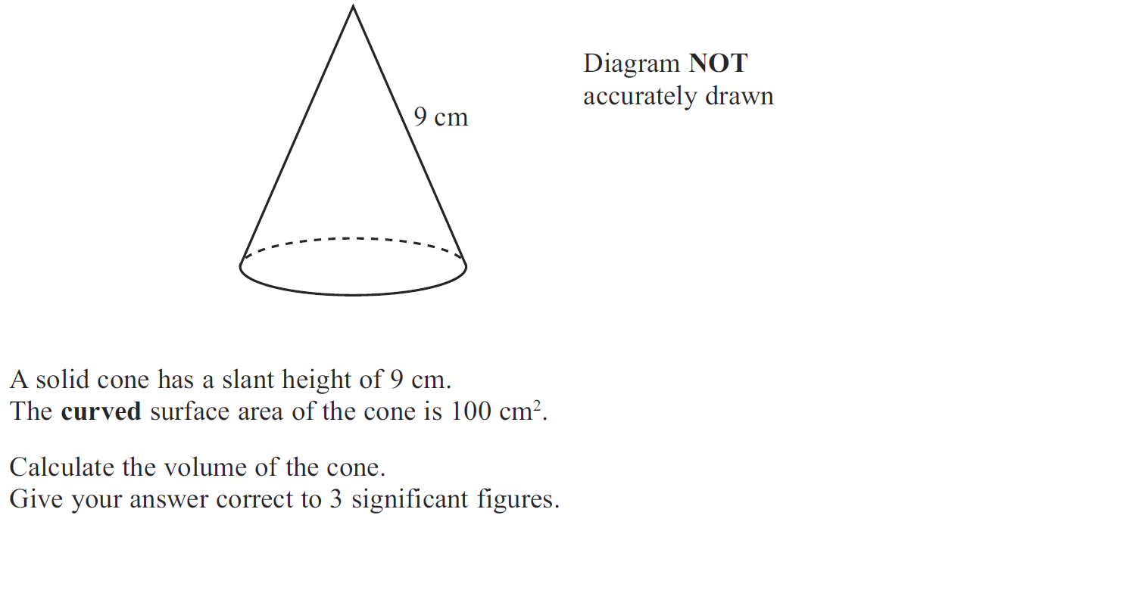
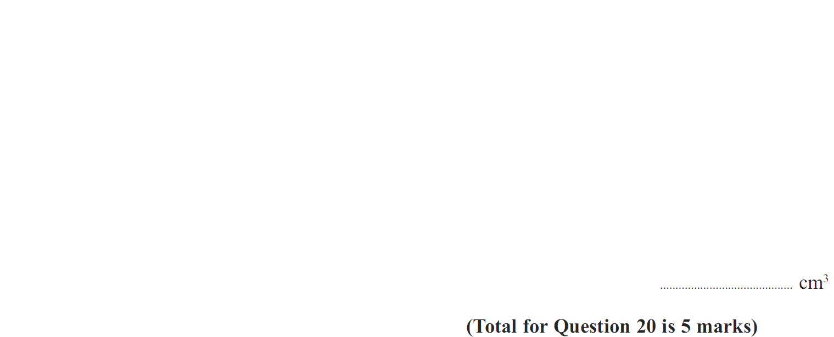
Volume & Surface Area
Jan 2012 4H Q20

Slide 46
Volume & Surface Area
Jan 2012 4H Q20
A

Slide 47
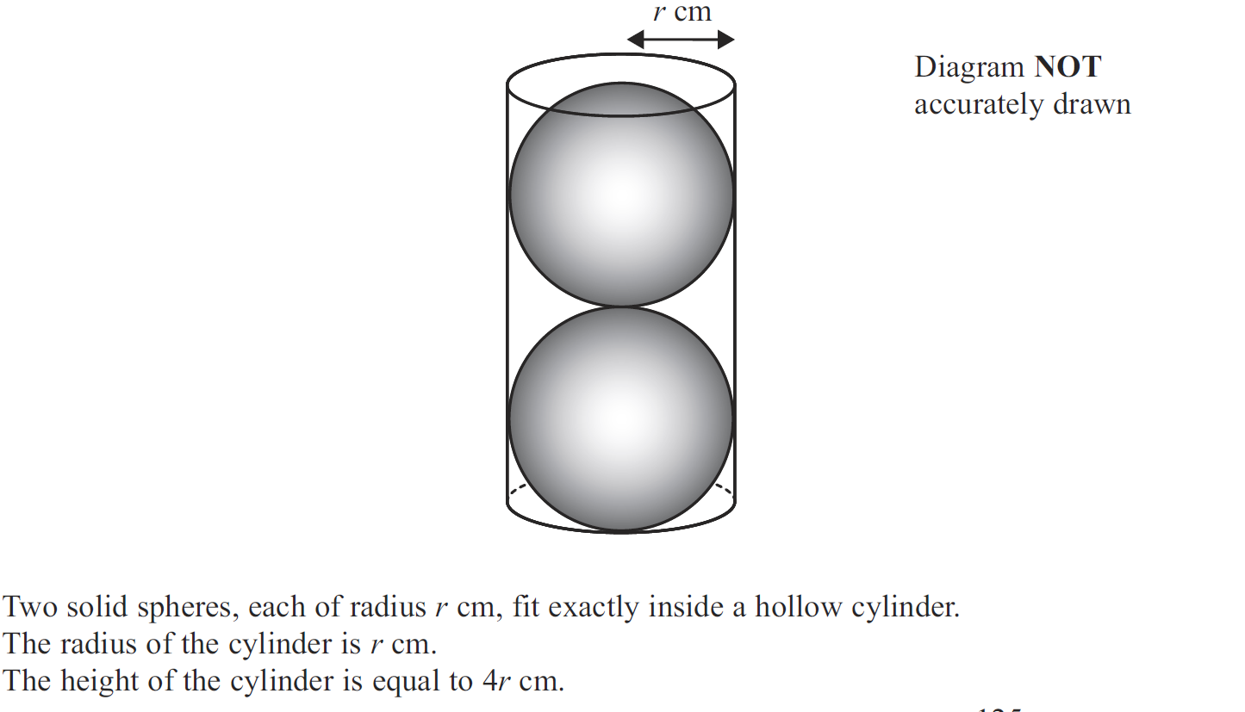
Volume & Surface Area
May 2012 4H Q22

Slide 48
Volume & Surface Area
May 2012 4H Q22
A

Slide 49
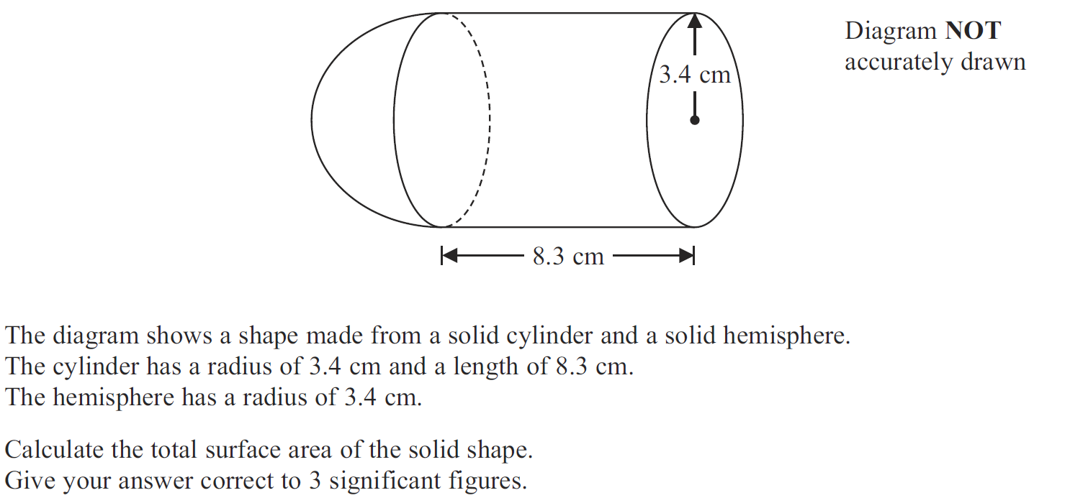
Volume & Surface Area
May 2013 4HR Q19

Slide 50
Volume & Surface Area
May 2013 4HR Q19
A

Slide 51
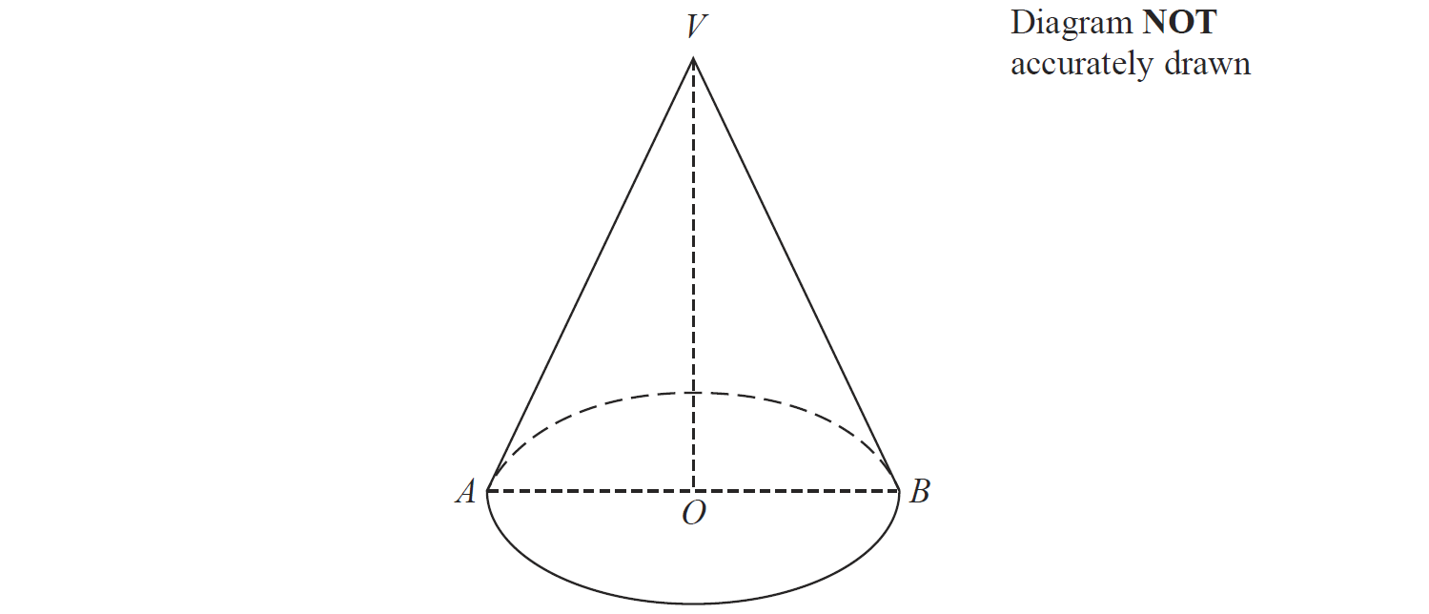
Volume & Surface Area
Jan 2014 4HR Q21

Slide 52
Volume & Surface Area
Jan 2014 4HR Q21
A

Slide 53
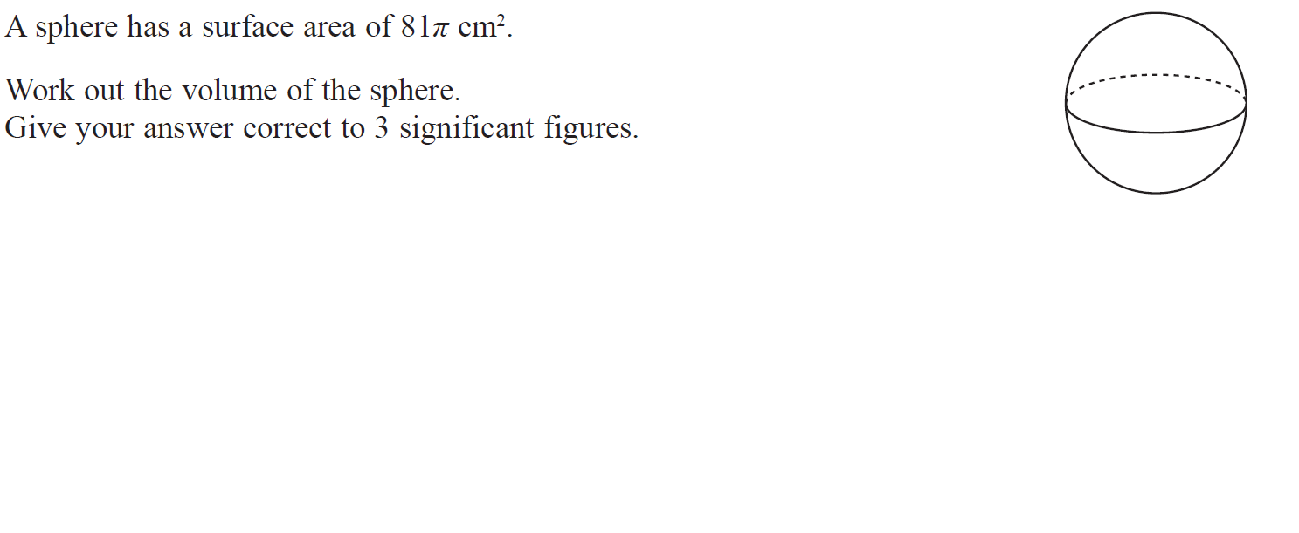
Volume & Surface Area
May 2014 4H Q21

Slide 54
Volume & Surface Area
May 2014 4H Q21
A

Slide 55
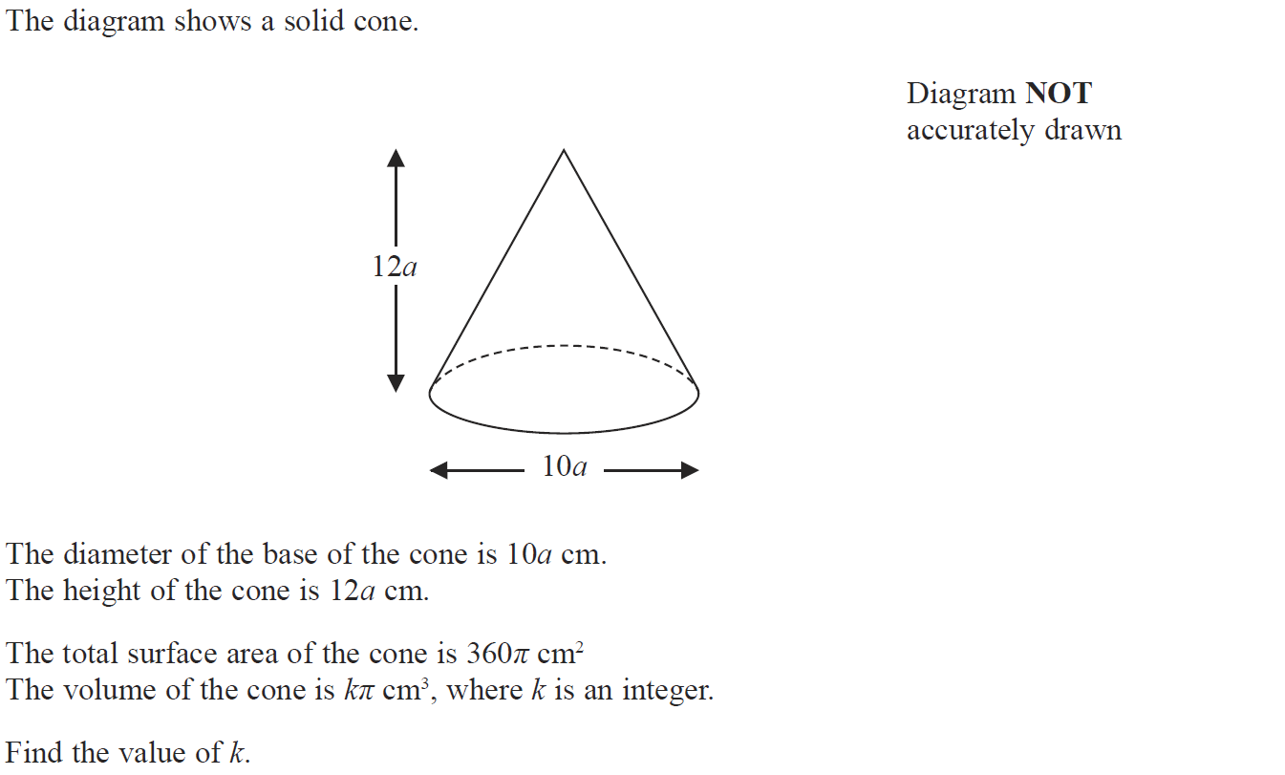
Volume & Surface Area
May 2014 4HR Q20

Slide 56
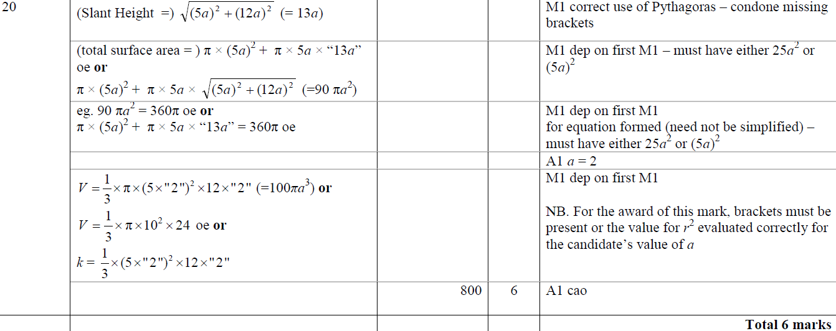
Volume & Surface Area
May 2014 4HR Q20
A

Slide 57
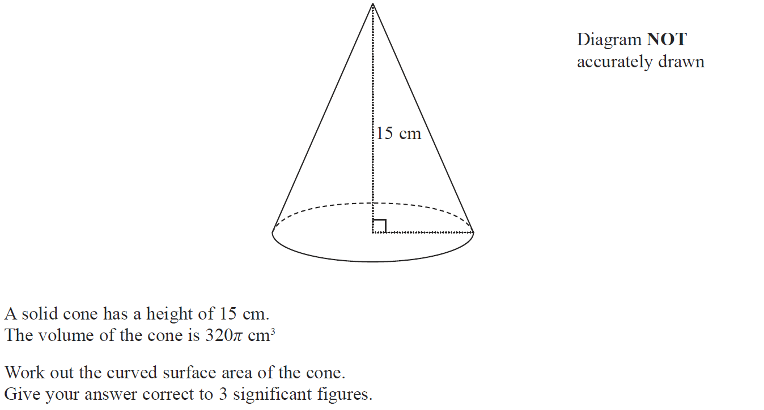
Volume & Surface Area
Jan 2015 3H Q21

Slide 58
Volume & Surface Area
Jan 2015 3H Q21
A

Slide 59
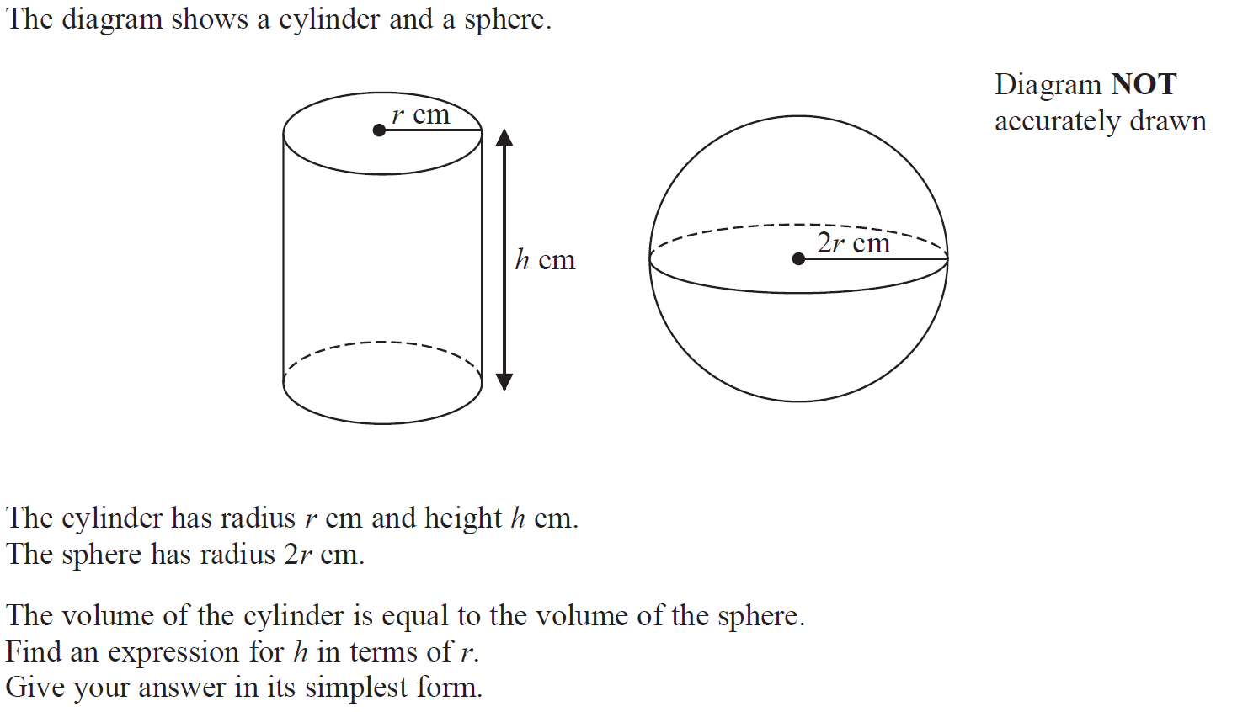
Volume & Surface Area
Jan 2015 4H Q21

Slide 60
Volume & Surface Area
Jan 2015 4H Q21
A

Slide 61
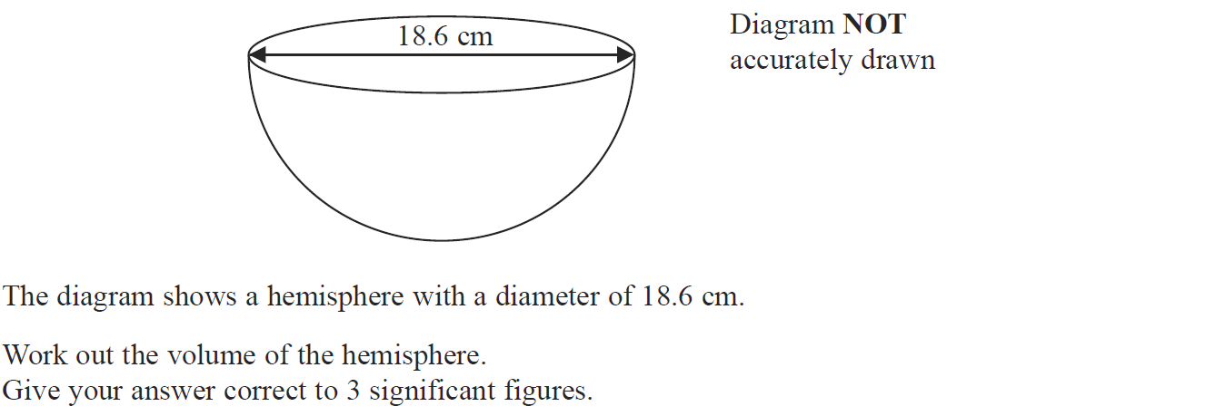
Volume & Surface Area
Jan 2015 3HR Q18

Slide 62
Volume & Surface Area
Jan 2015 3HR Q18
A

Slide 63
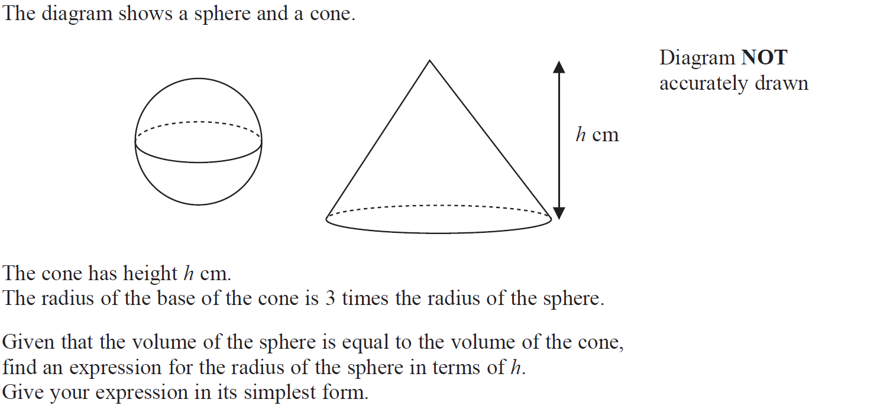
Volume & Surface Area
Jan 2016 3H Q19

Slide 64
Volume & Surface Area
Jan 2016 3H Q19
A

Slide 65
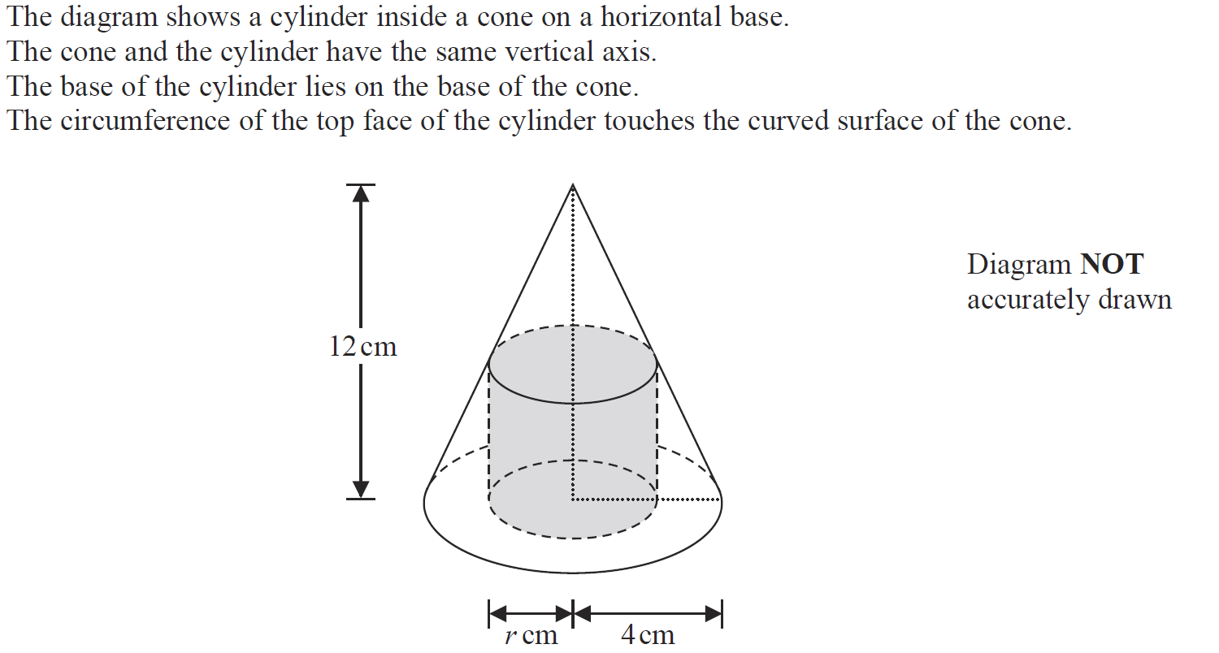
Volume & Surface Area
Jan 2016 3HR Q15

Slide 66
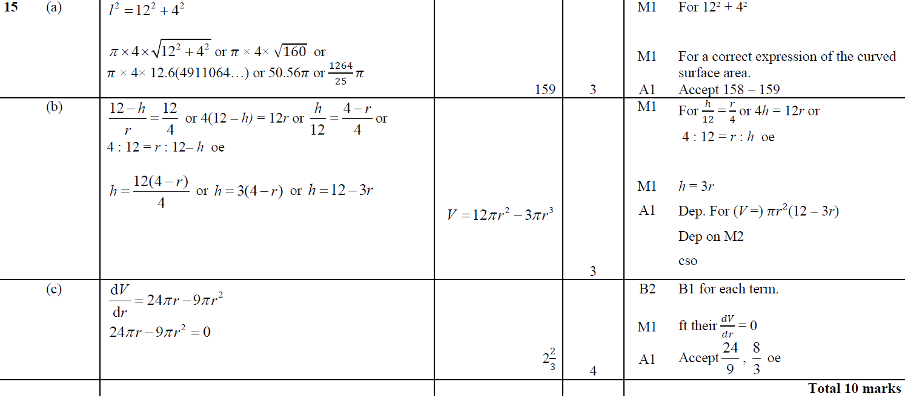
Volume & Surface Area
Jan 2016 3HR Q15
A
B
C

Slide 67
Volume & Surface Area
May 2016 3H Q20

Slide 68
Volume & Surface Area
May 2016 3H Q20
A

Slide 69
Volume & Surface Area
June 2016 4H Q20

Slide 70
Volume & Surface Area
June 2016 4H Q20
A

Slide 71
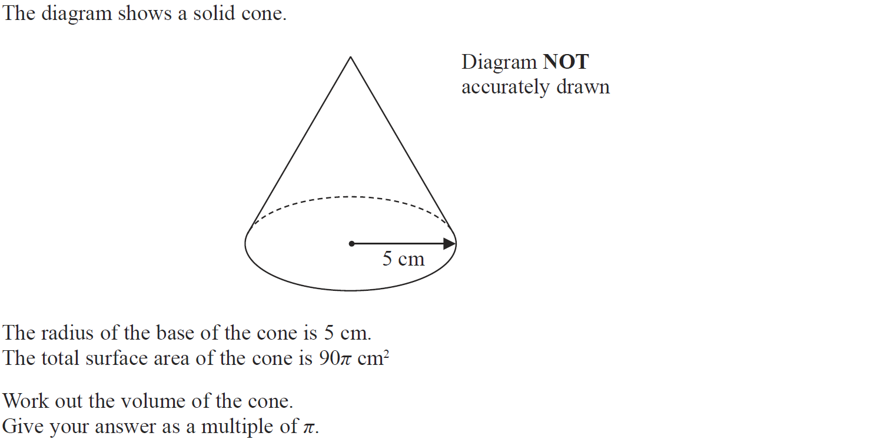
Volume & Surface Area
Jan 2017 4HR Q19

Slide 72
Volume & Surface Area
Jan 2017 4HR Q19
A

Slide 73
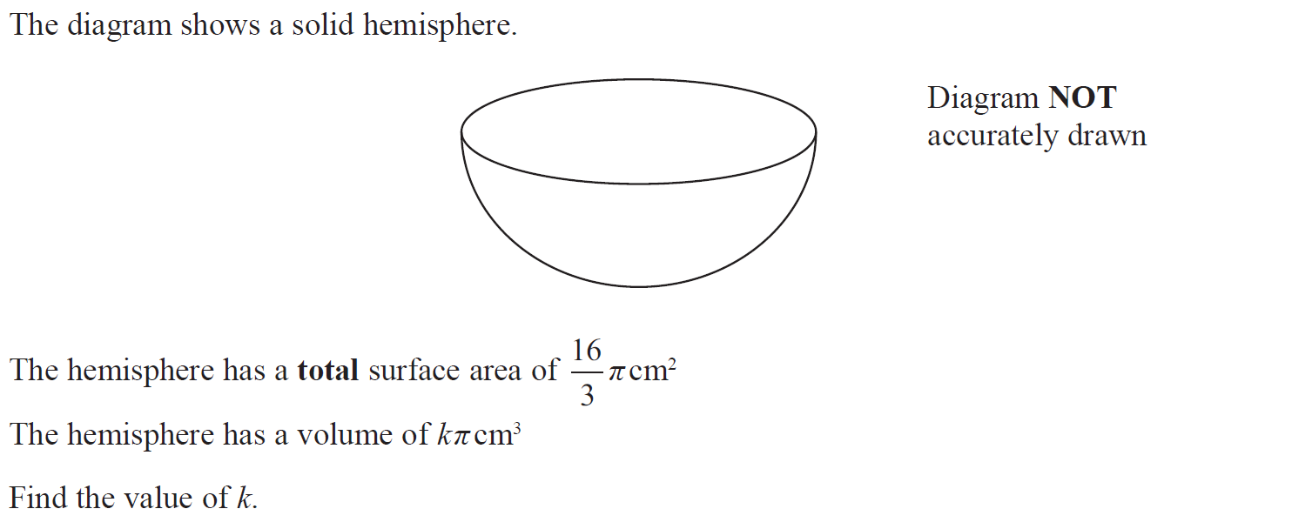
Volume & Surface Area
June 2017 4H Q23

Slide 74
Volume & Surface Area
June 2017 4H Q23
A

Slide 75
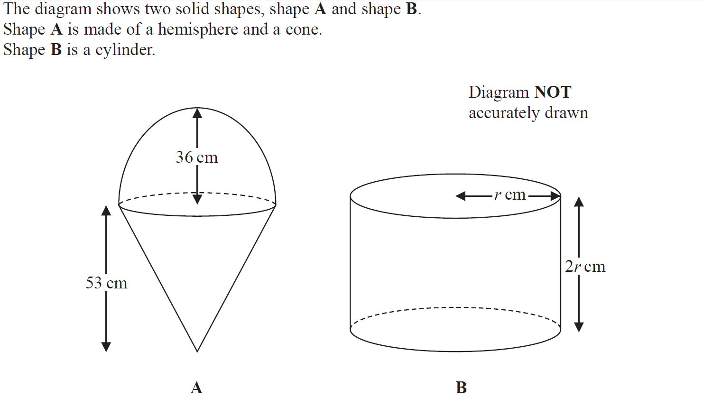
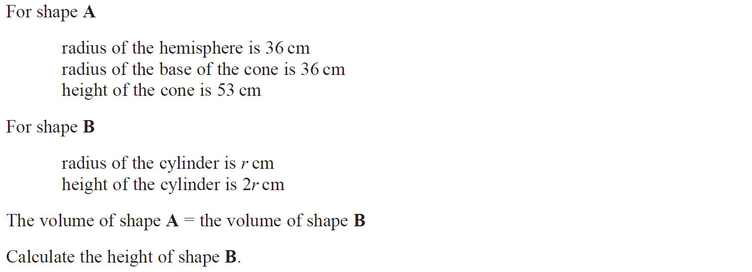
Volume & Surface Area
May 2017 3HR Q19

Slide 76
Volume & Surface Area
May 2017 3HR Q19
A

Slide 77
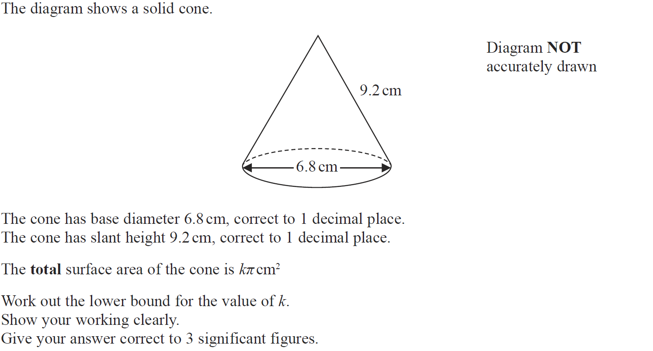
Volume & Surface Area
Jan 2018 4H Q21

Slide 78
Volume & Surface Area
Jan 2018 4H Q21
A

Slide 79
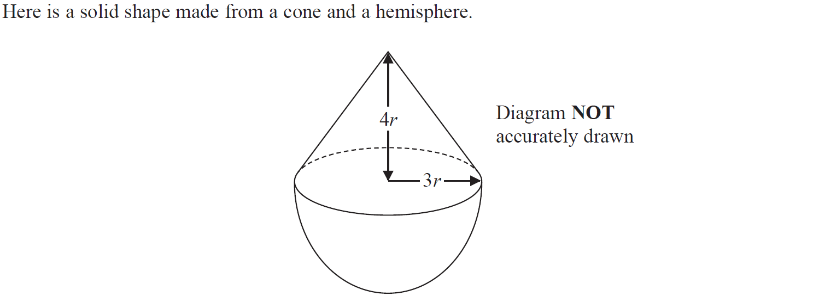
Volume & Surface Area
Jan 2018 3HR Q22

Slide 80
Volume & Surface Area
Jan 2018 3HR Q22
A

Slide 81
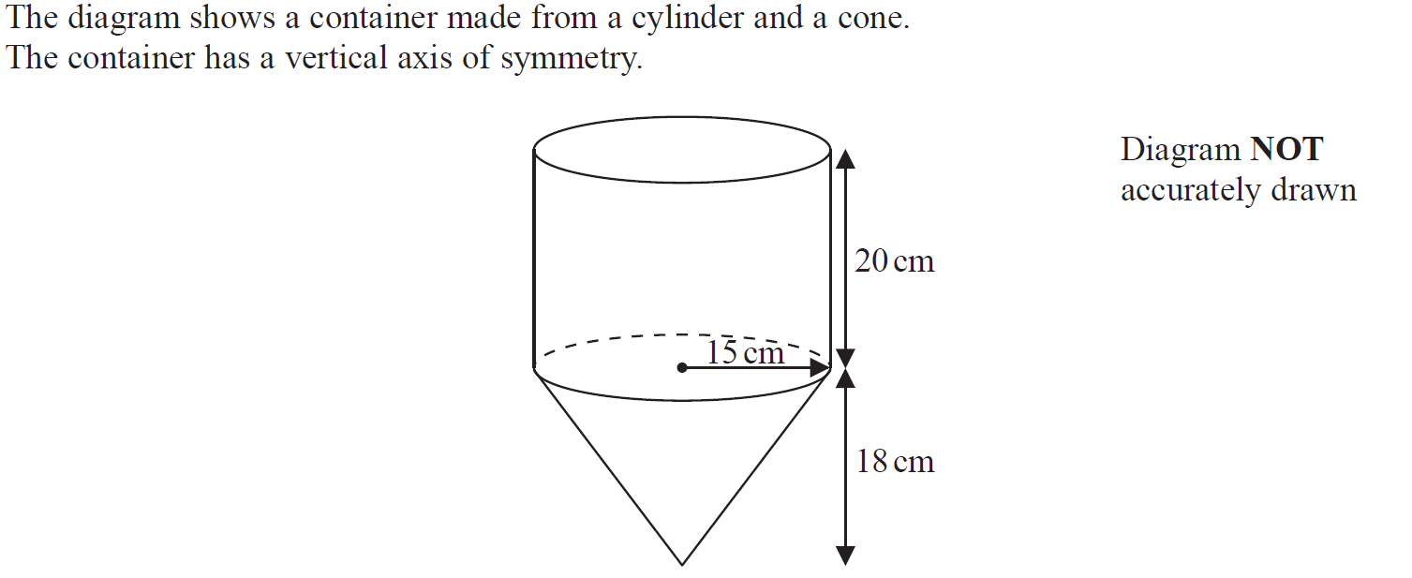
Volume & Surface Area
Jan 2018 3H Q19

Slide 82
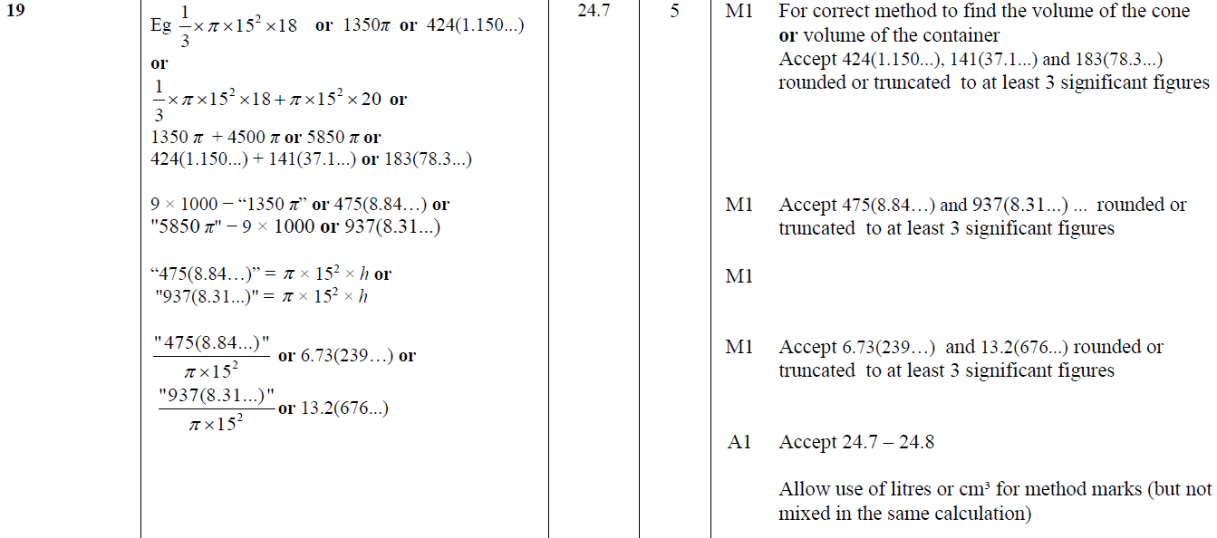
Volume & Surface Area
Jan 2018 3H Q19
A

Slide 83
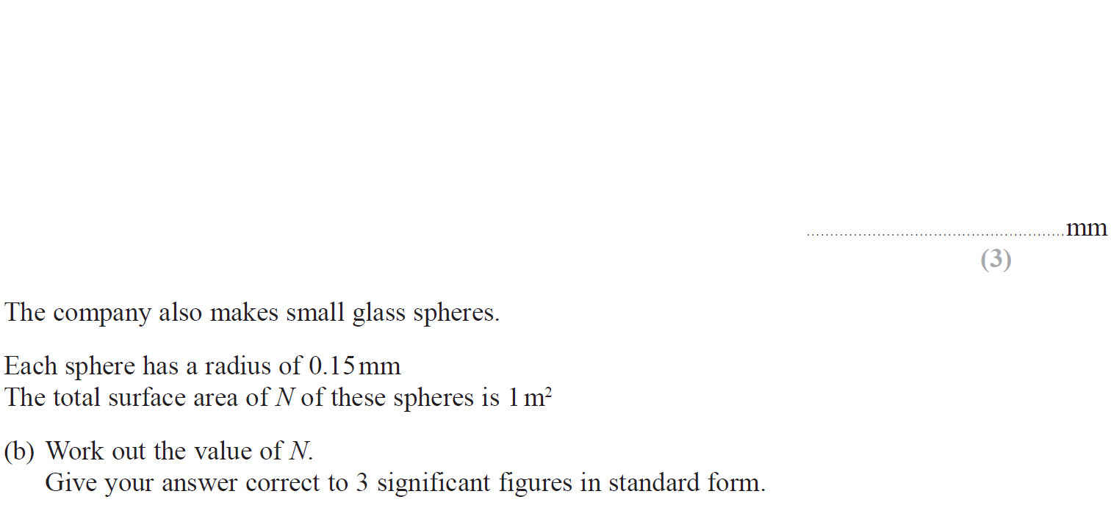
Volume & Surface Area
June 2018 4H Q11

Slide 84
Volume & Surface Area
June 2018 4H Q11
A
B

Slide 85
Volume & Surface Area
June 2018 4HR Q25

Slide 86
Volume & Surface Area
June 2018 4HR Q25
A

