Slide 1
Volume & Surface Area
Volume & Surface Area
SAM
1H Q6
May 2017
1H Q15
SAM
2H Q22
June 2017
2H Q3
SAM
3H Q16
May 2018
1H Q5
Spec 1
1H Q18
June 2018
2H Q19
Spec 1
3H Q17
Nov 2018
2H Q20
Spec 2
1H Q11
May 2019
1H Q4
Spec 2
3H Q2
May 2019
1H Q15
Viewing angles
With Formulae

Slide 2
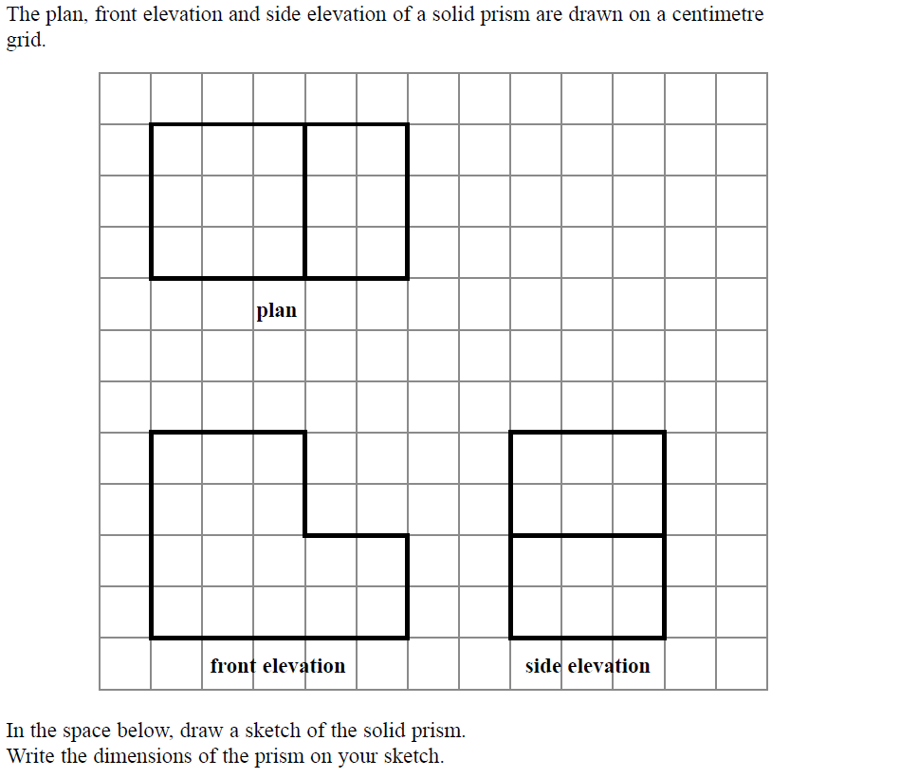
Volume & Surface Area
SAM 1H Q6

Slide 3
Volume & Surface Area
SAM 1H Q6
A
3 cm
2 cm
4 cm
2 cm
2 cm
3 cm
5 cm

Slide 4
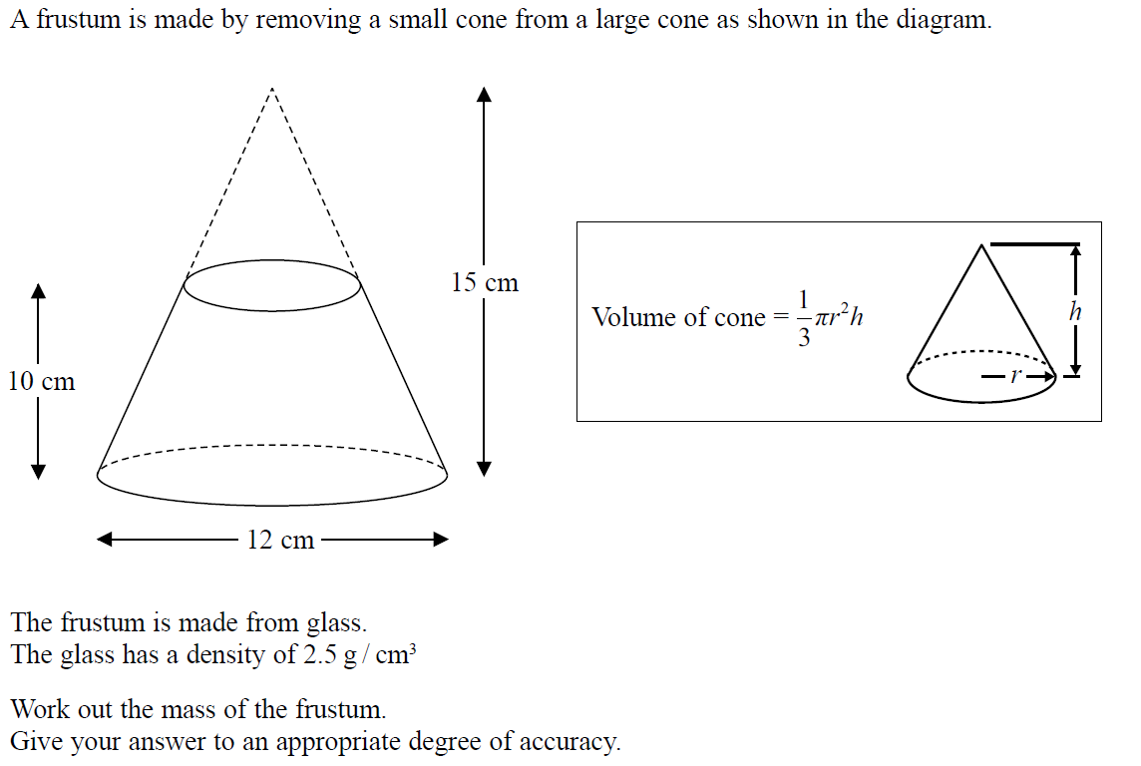
Volume & Surface Area
SAM 2H Q22

Slide 5
Volume & Surface Area
SAM 2H Q22
A

Slide 6
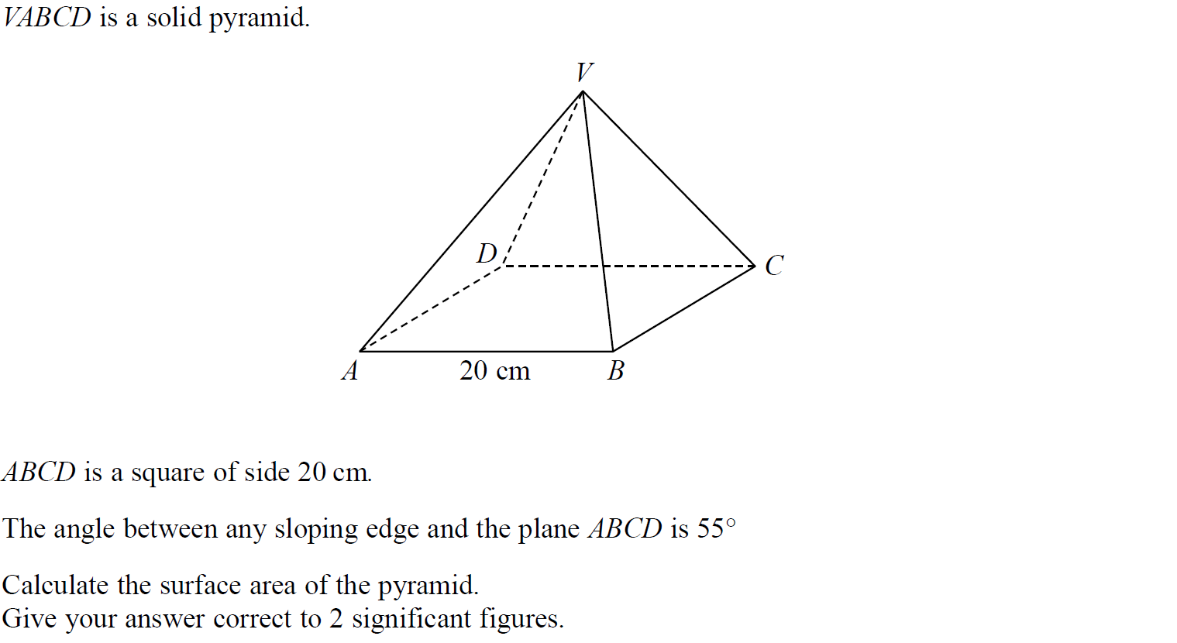
Volume & Surface Area
SAM 3H Q16

Slide 7
Volume & Surface Area
SAM 3H Q16
A

Slide 8
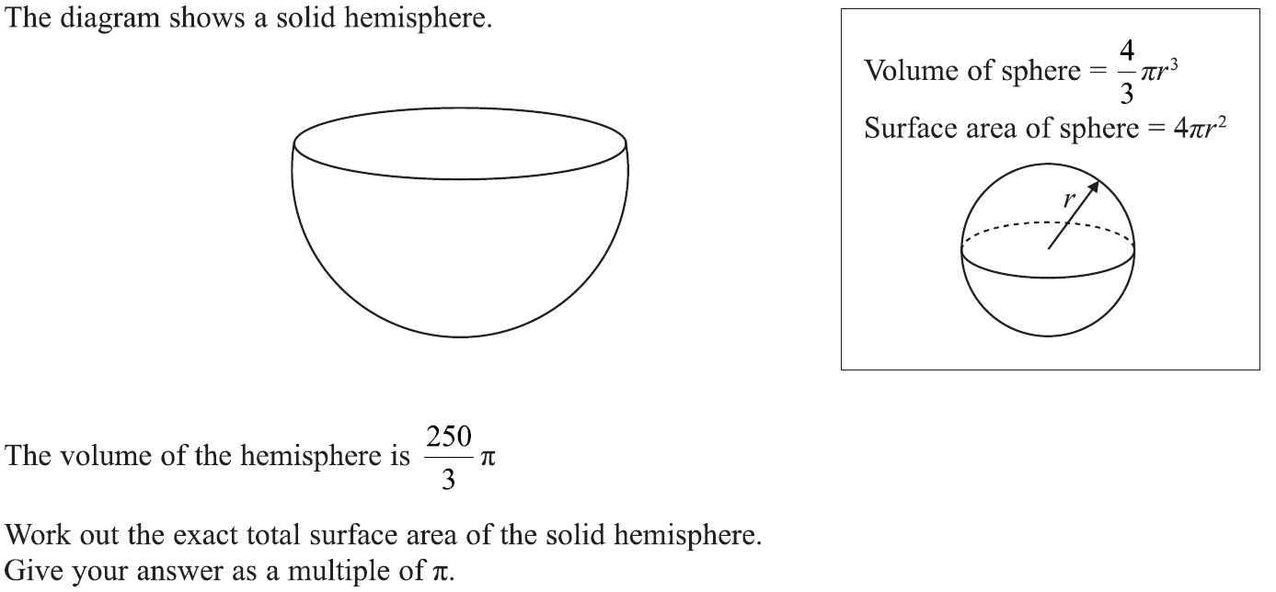
Volume & Surface Area
Specimen Set 1 1H Q18

Slide 9
Volume & Surface Area
Specimen Set 1 1H Q18
A

Slide 10
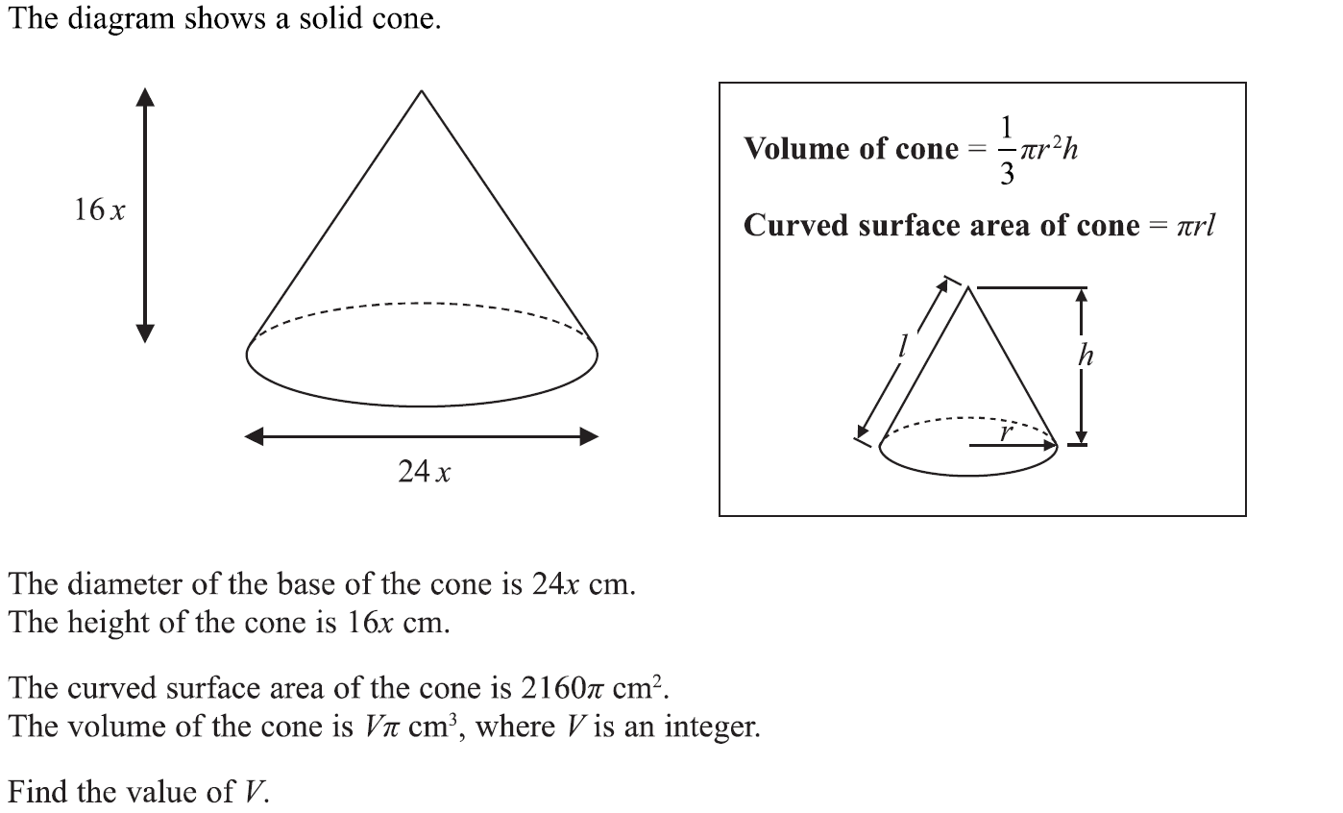
Volume & Surface Area
Specimen Set 1 3H Q17

Slide 11
Volume & Surface Area
Specimen Set 1 3H Q17
A

Slide 12
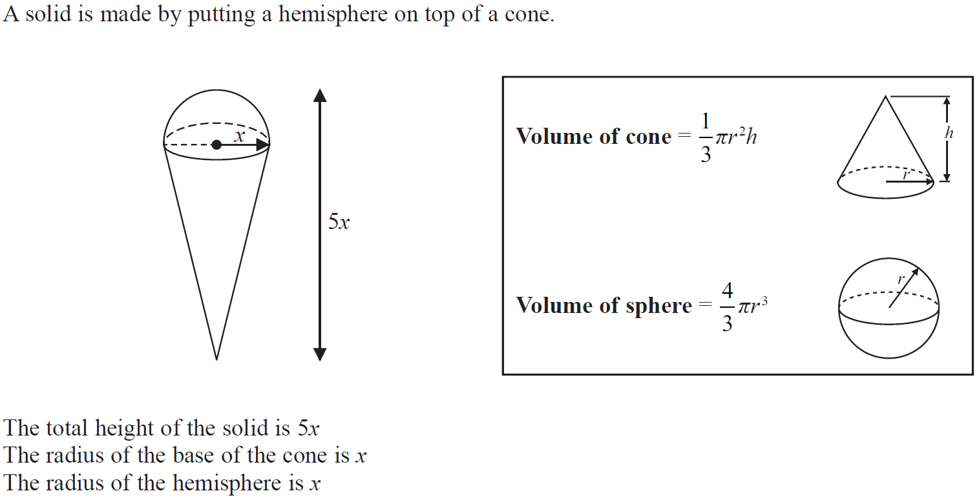
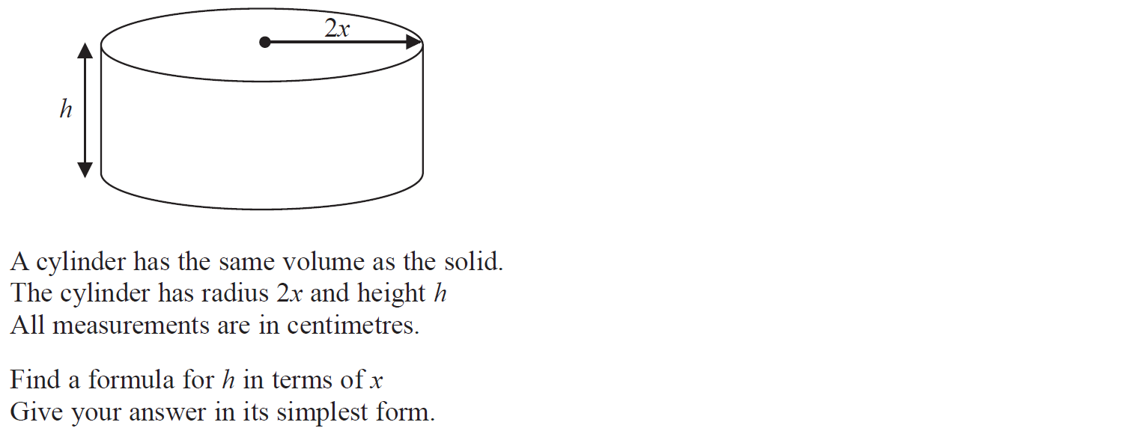
Volume & Surface Area
Specimen Set 2 1H Q11

Slide 13
Volume & Surface Area
Specimen Set 2 1H Q11
A

Slide 14
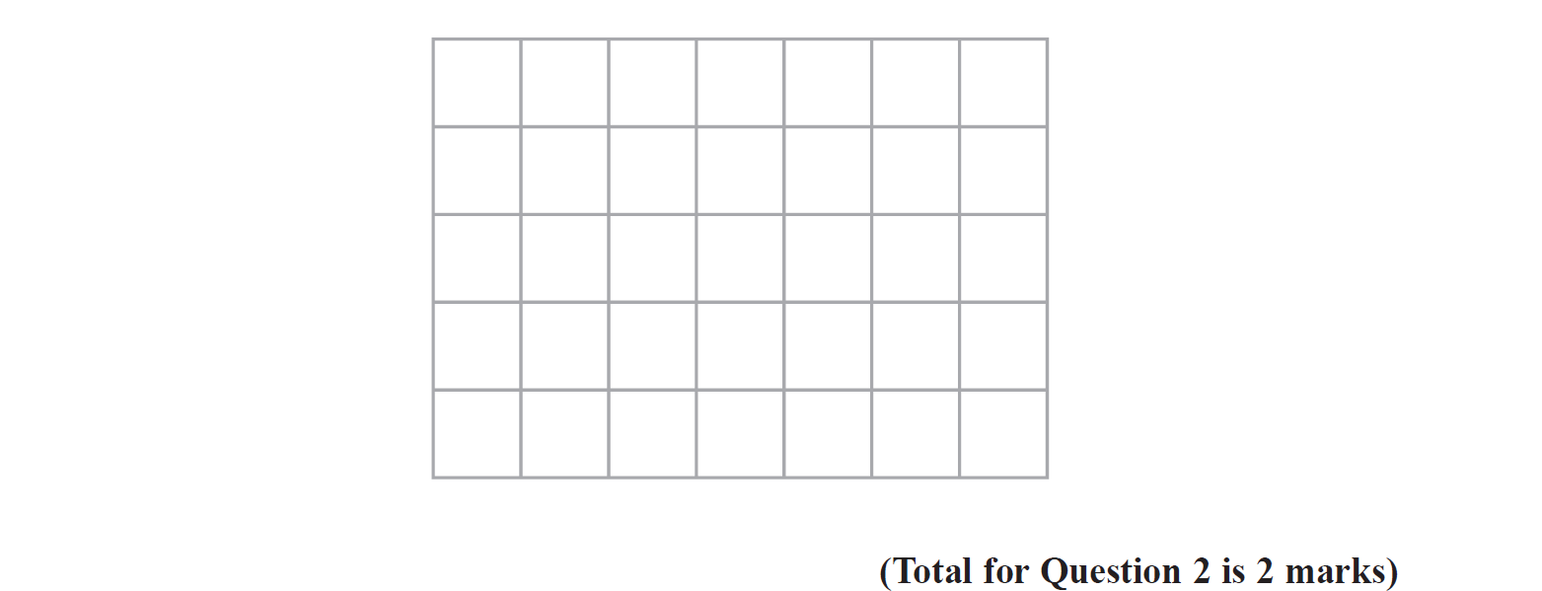
Volume & Surface Area
Specimen Set 2 3H Q2
Reveal plan
Hide plan

Slide 15
Volume & Surface Area
Specimen Set 2 3H Q2
A

Slide 16
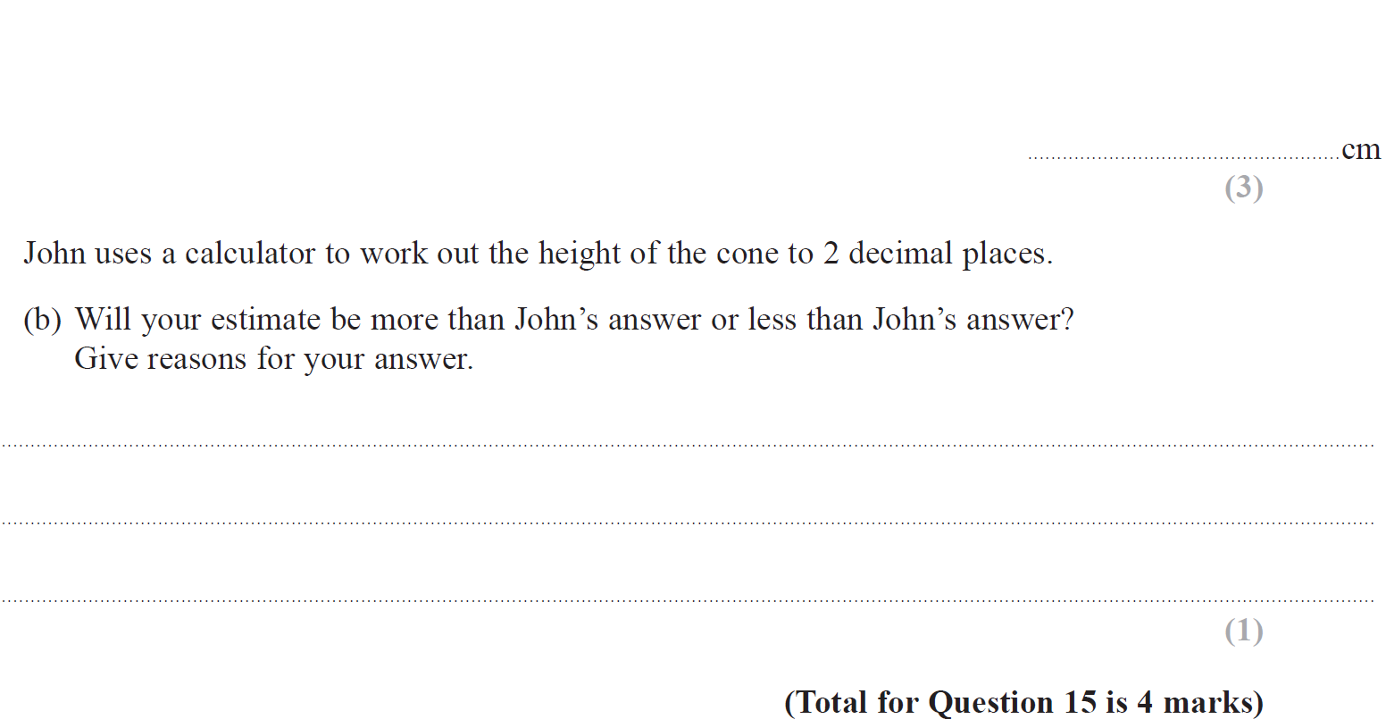
Volume & Surface Area
May 2017 1H Q15

Slide 17
Volume & Surface Area
May 2017 1H Q15
A
B

Slide 18
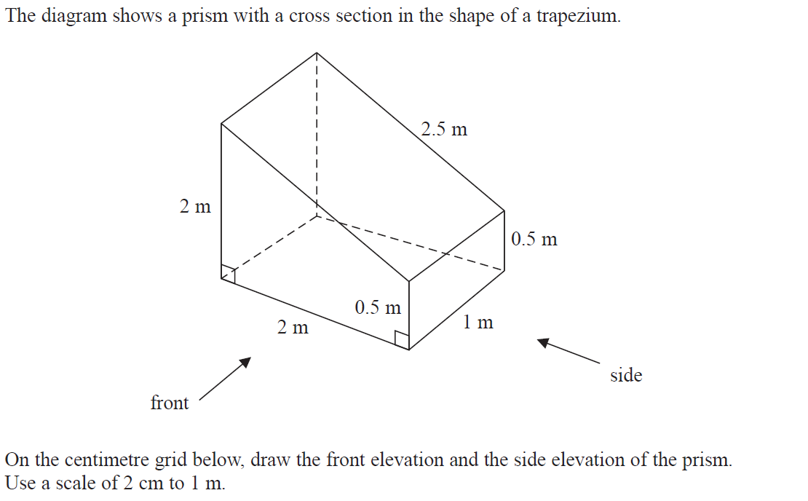
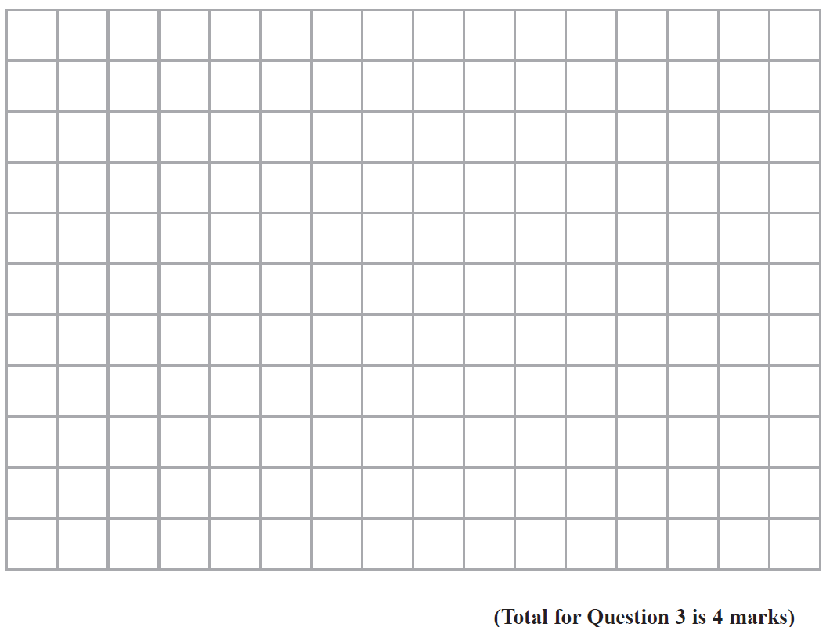
Volume & Surface Area
June 2017 2H Q3
Front
Side
Reveal front
Reveal side
Hide front
Hide side

Slide 19
Volume & Surface Area
June 2017 2H Q3
A

Slide 20
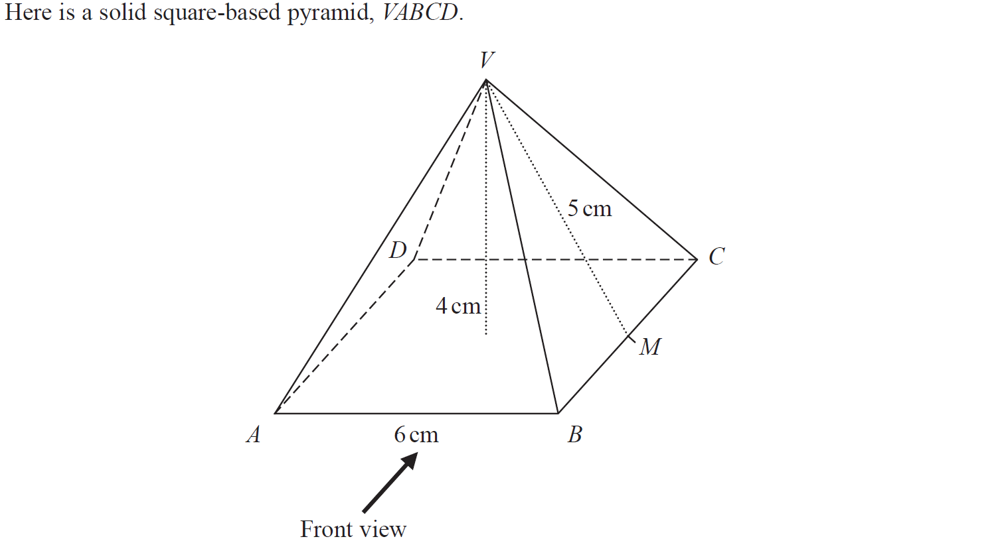
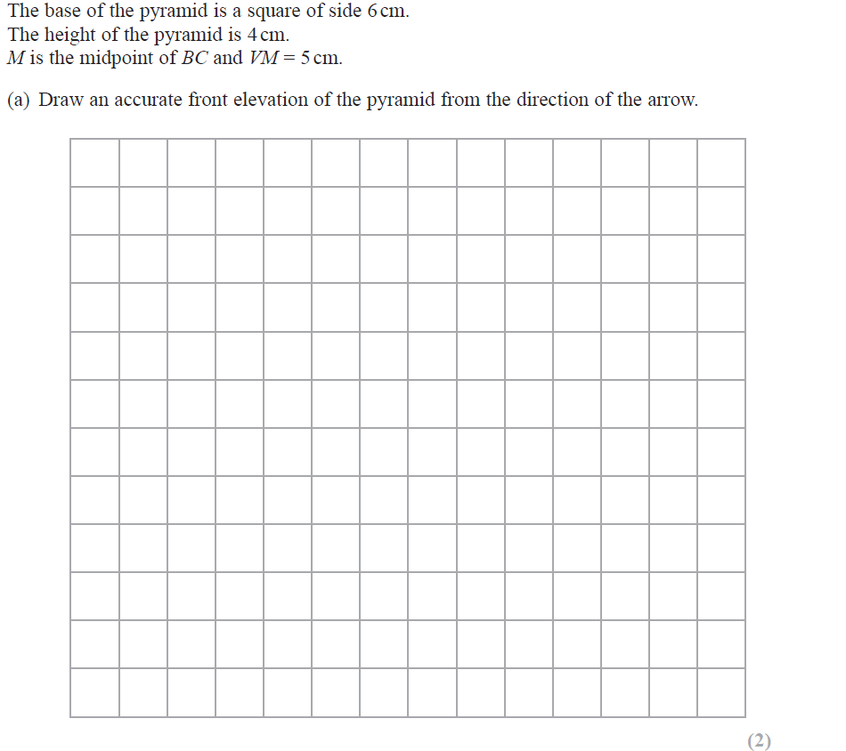
Volume & Surface Area
May 2018 1H Q5
Reveal front
Hide front

Slide 21
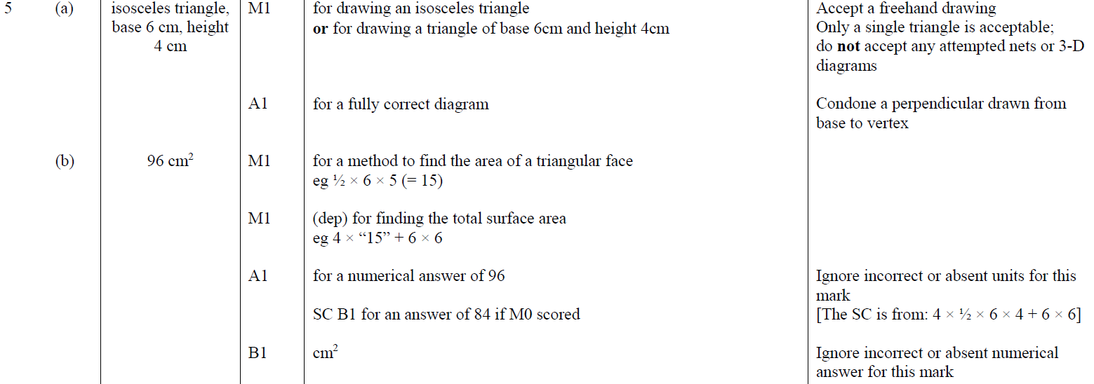
Volume & Surface Area
May 2018 1H Q5
A
B

Slide 22
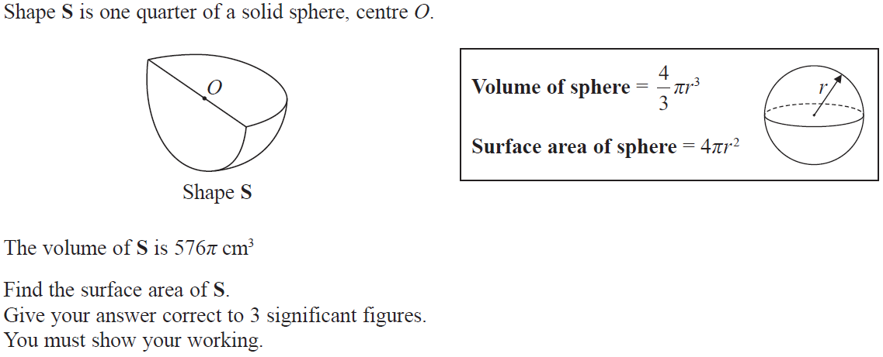
Volume & Surface Area
June 2018 2H Q19

Slide 23
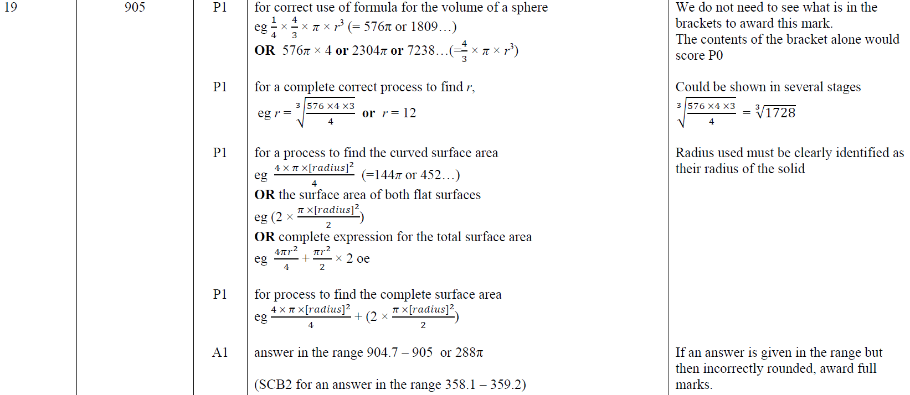
Volume & Surface Area
June 2018 2H Q19
A

Slide 24
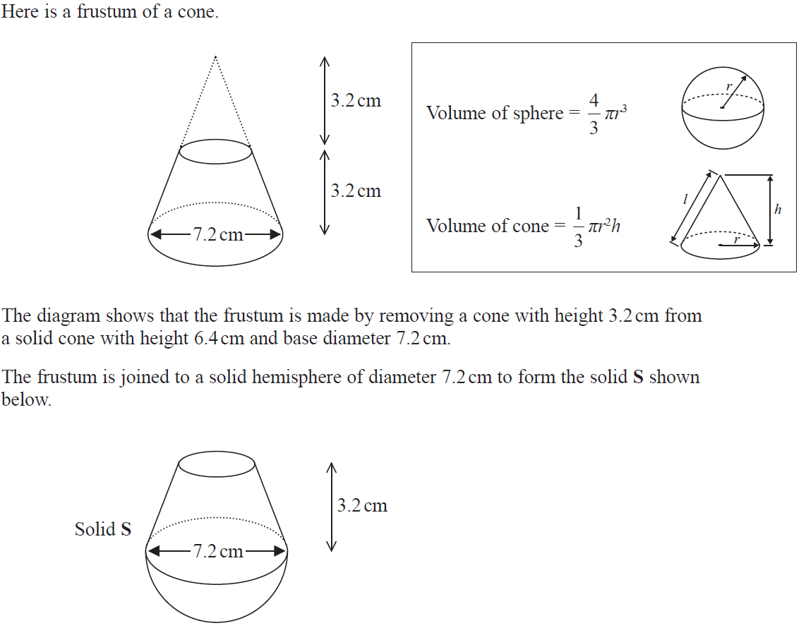
Volume & Surface Area
Nov 2018 2H Q20

Slide 25
Volume & Surface Area
Nov 2018 2H Q20
A

Slide 26
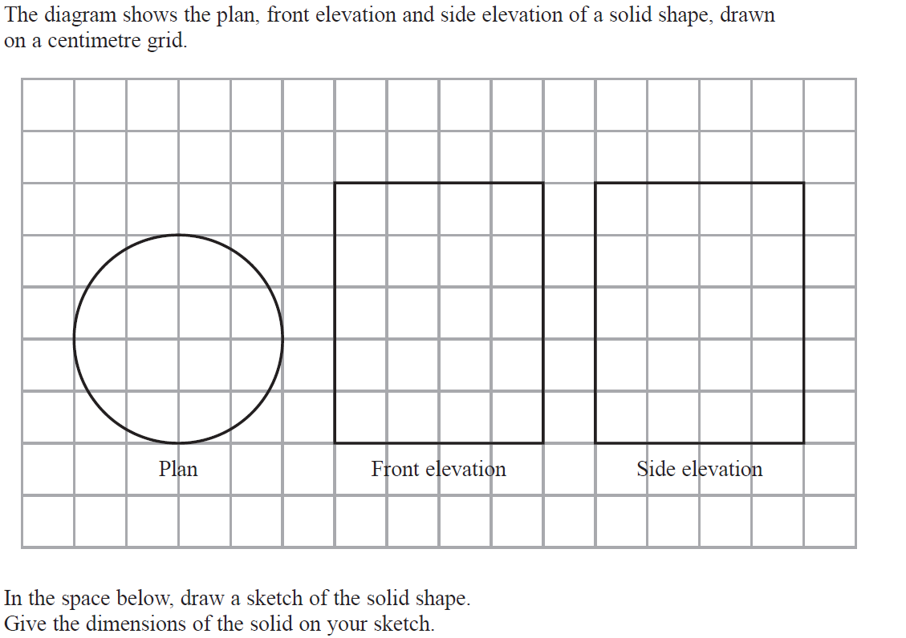
Volume & Surface Area
May 2019 1H Q4

Slide 27
Volume & Surface Area
May 2019 1H Q4
A
A SF

Slide 28
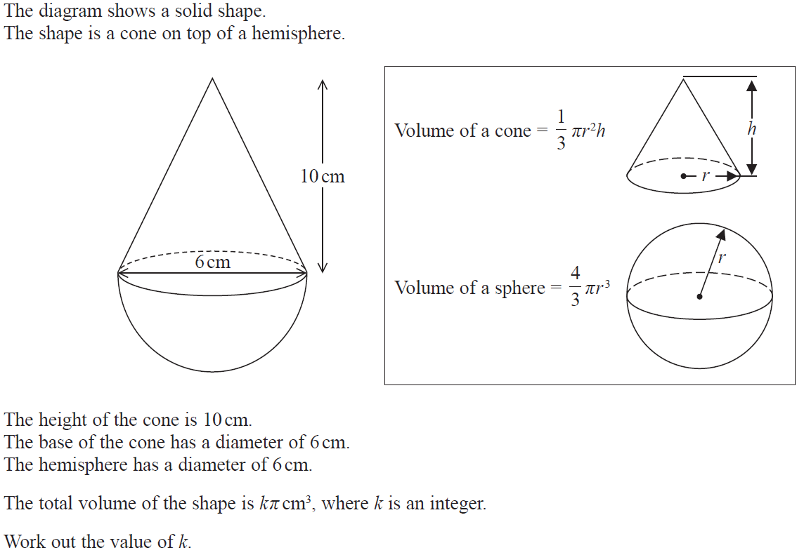
Volume & Surface Area
May 2019 1H Q15

Slide 29
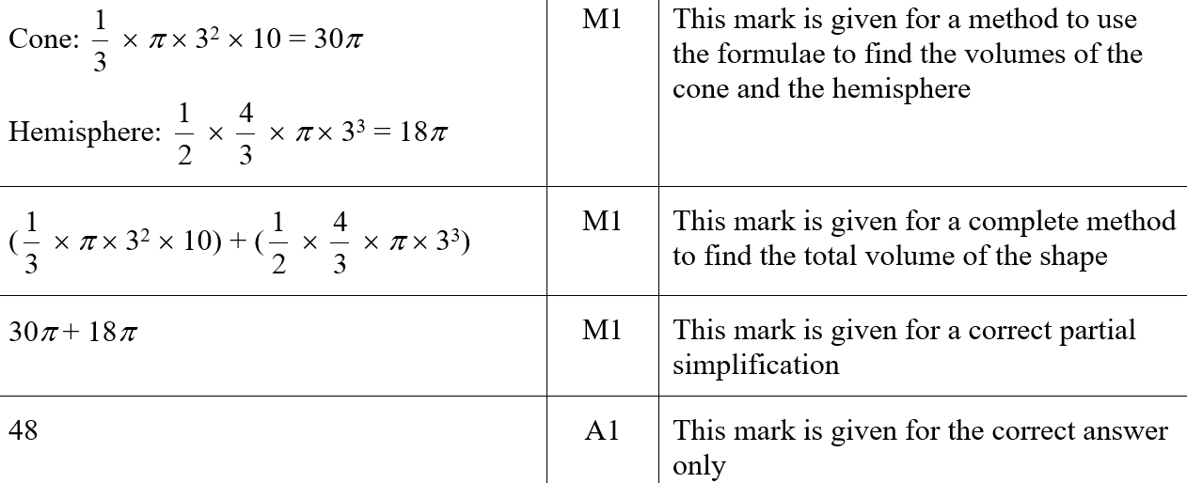
Volume & Surface Area
May 2019 1H Q15
A
A SF

