Slide 1
Volume & Surface Area
Volume & Surface Area
May 2017
1H Q28
June 2018
2H Q10
SAM
2H Q23
June 2018
2H Q20
1 Marker
Nov 2018
3H Q15
Nov 2018
3H Q24
Viewing angles
With Formulae

Slide 2
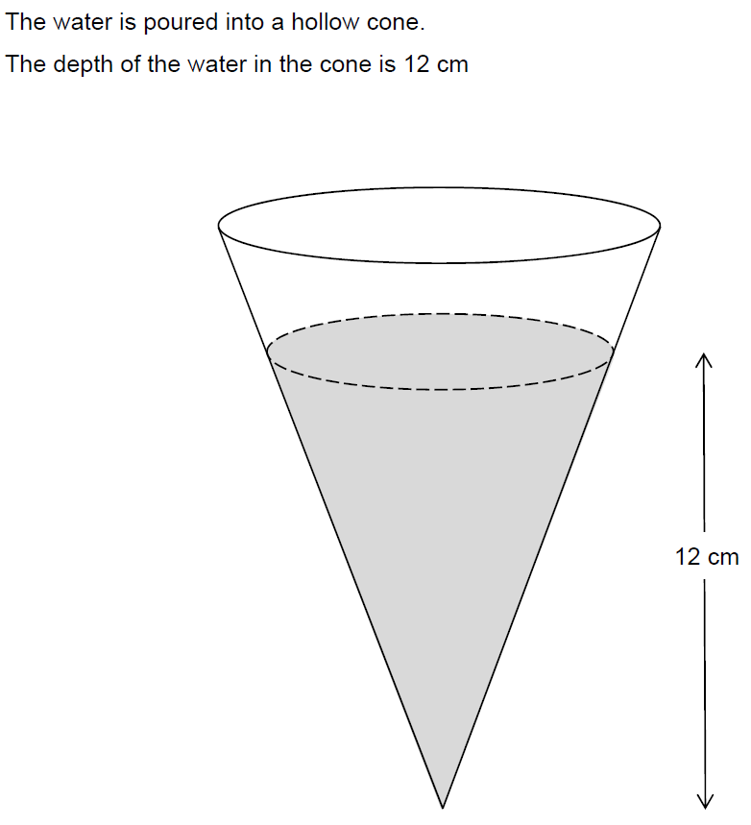
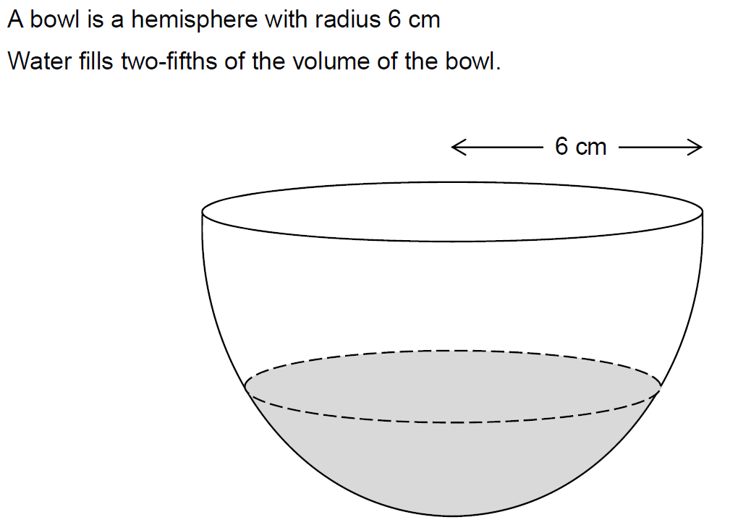
Volume & Surface Area
SAM 2H Q23

Slide 3
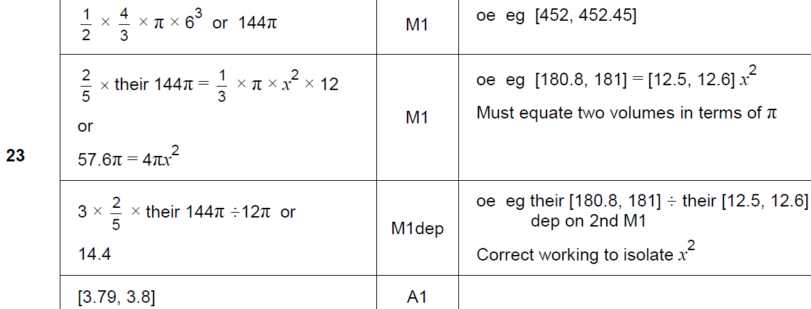
Volume & Surface Area
SAM 2H Q23
A

Slide 4
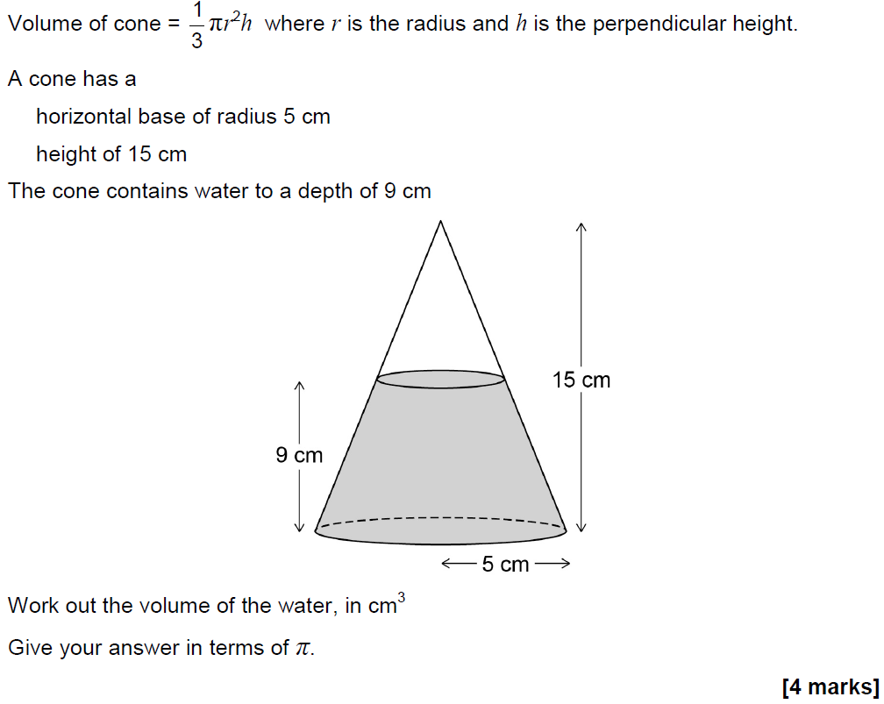
Volume & Surface Area
May 2017 1H Q28

Slide 5
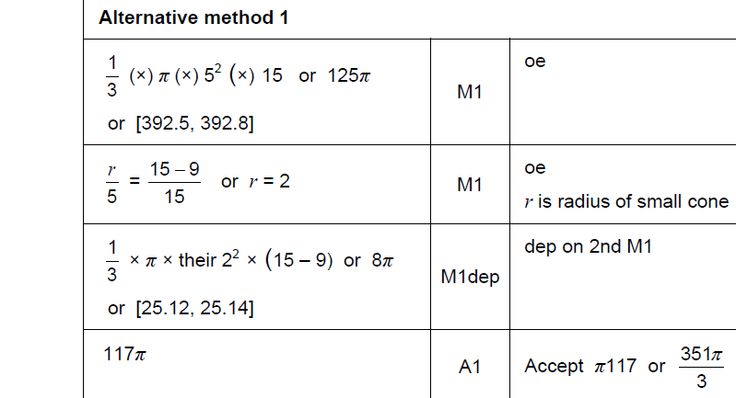
Volume & Surface Area
May 2017 1H Q28
A

Slide 6
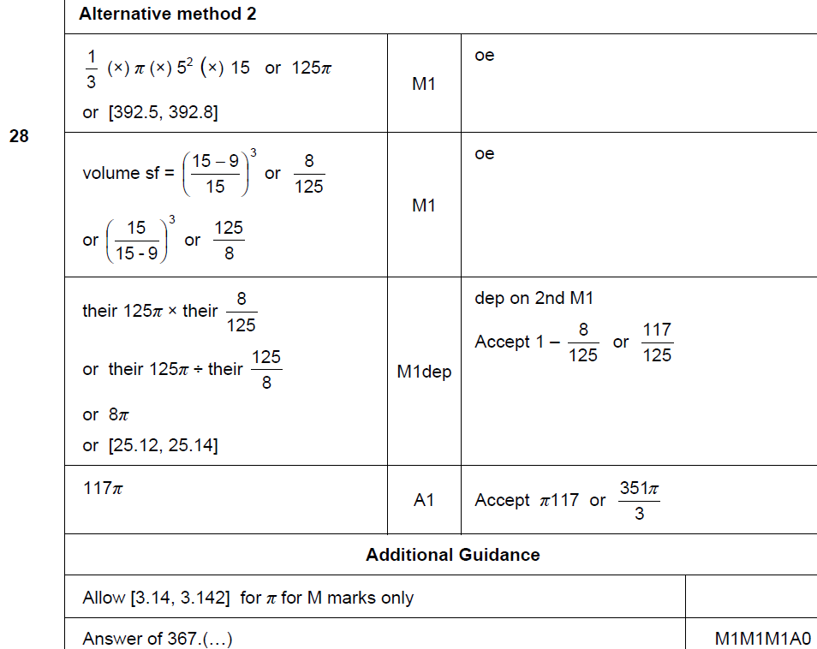
Volume & Surface Area
May 2017 1H Q28
A Alternative & notes

Slide 7
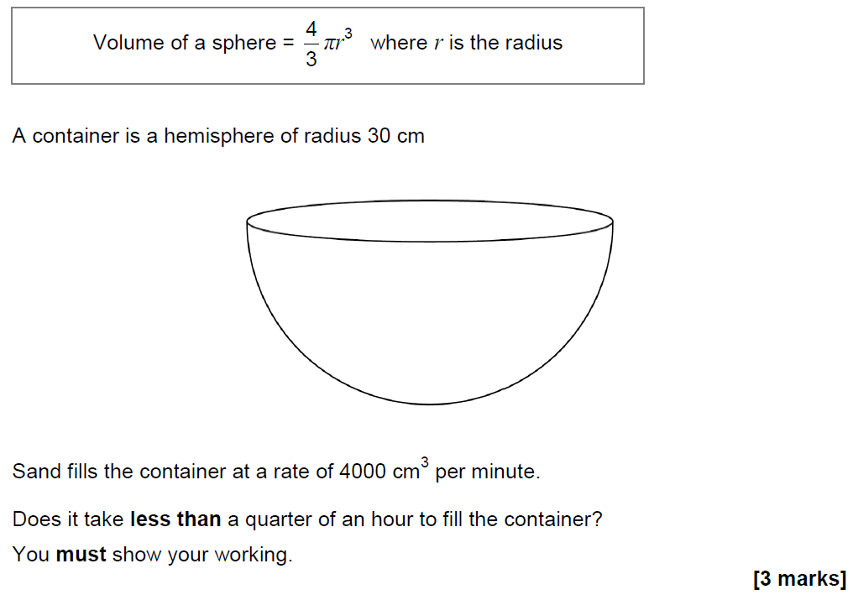
Volume & Surface Area
June 2018 2H Q10

Slide 8
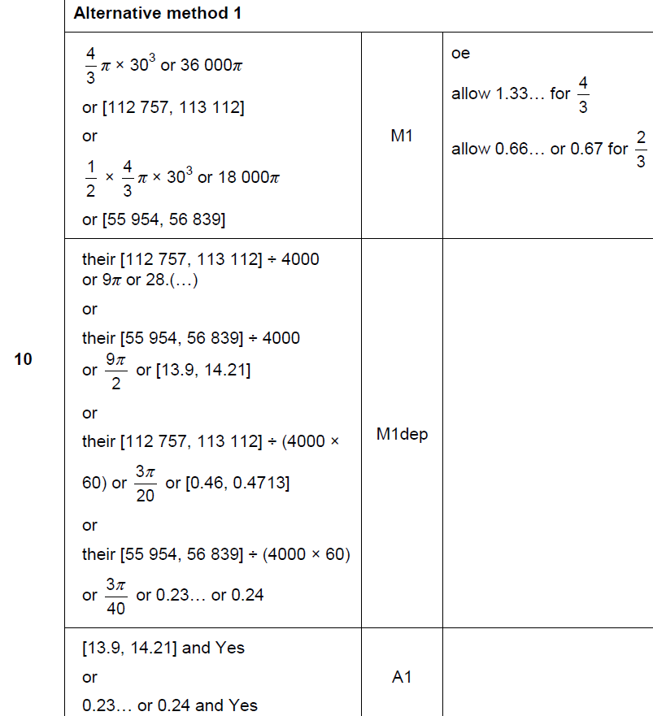
Volume & Surface Area
June 2018 2H Q10
A

Slide 9
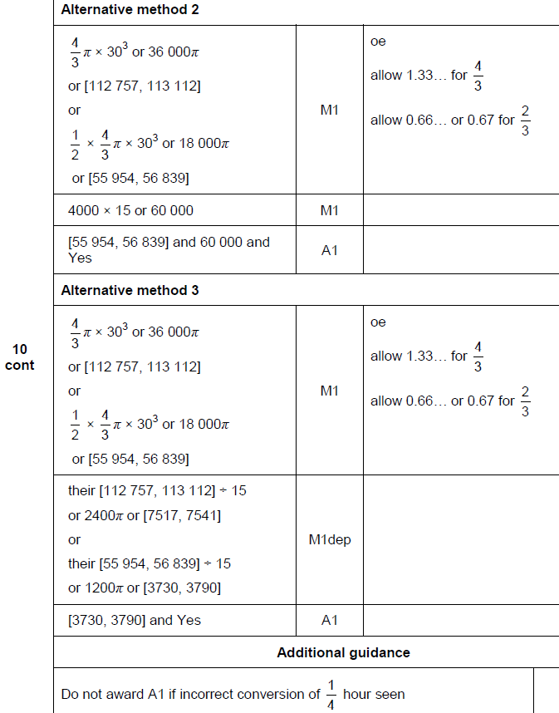
Volume & Surface Area
June 2018 2H Q10
A Alternative & notes

Slide 10
Volume & Surface Area
June 2018 2H Q20

Slide 11
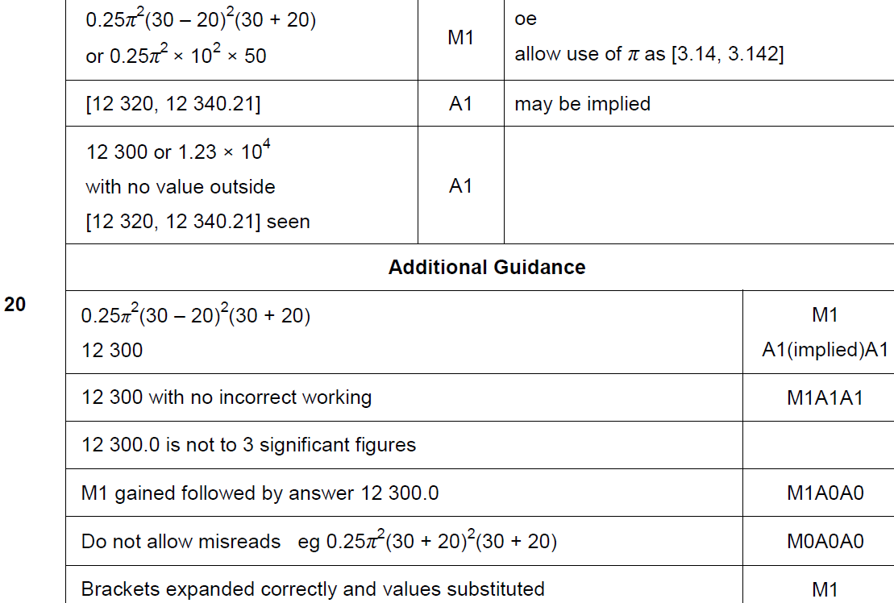
Volume & Surface Area
June 2018 2H Q20
A

Slide 12
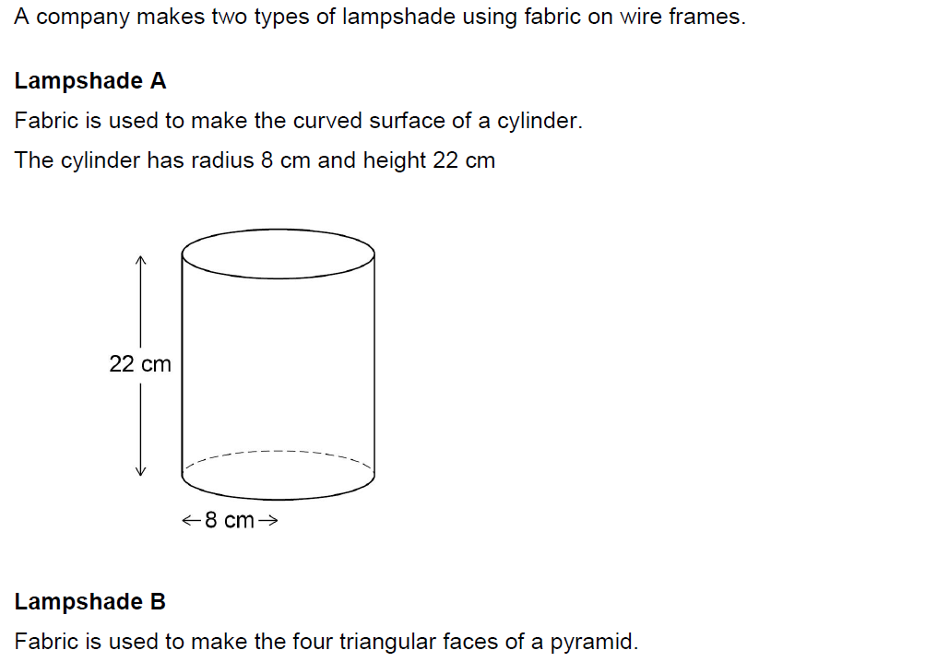
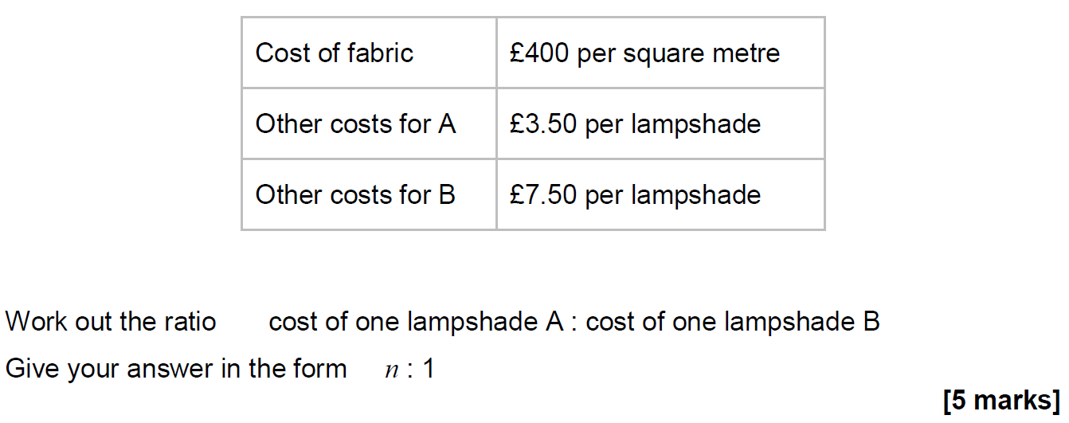
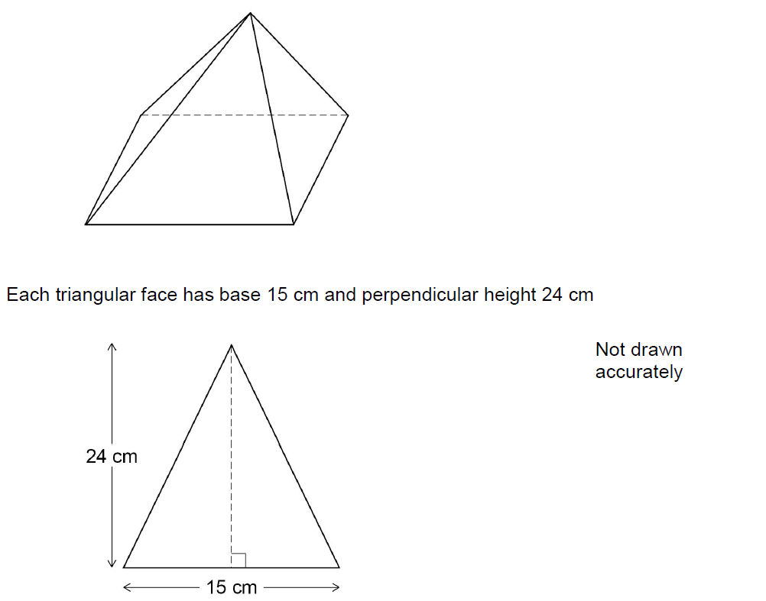
Volume & Surface Area
Nov 2018 3H Q15

Slide 13
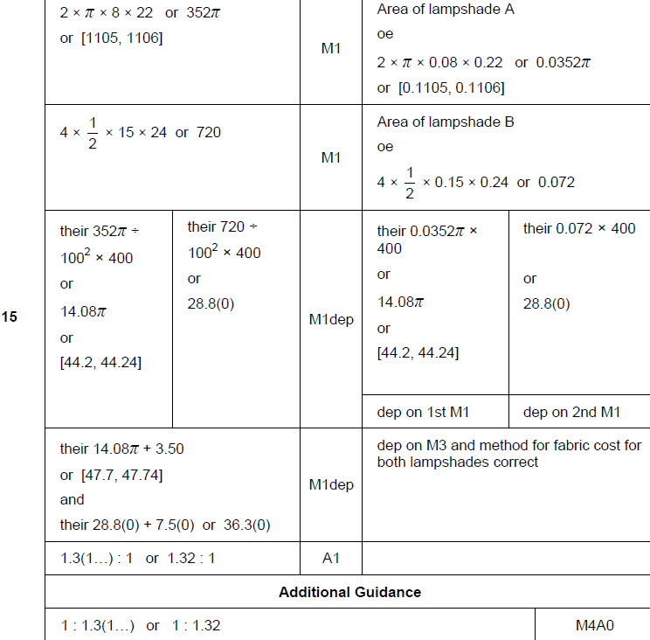
Volume & Surface Area
Nov 2018 3H Q15
A

Slide 14
Volume & Surface Area
Nov 2018 3H Q24

Slide 15
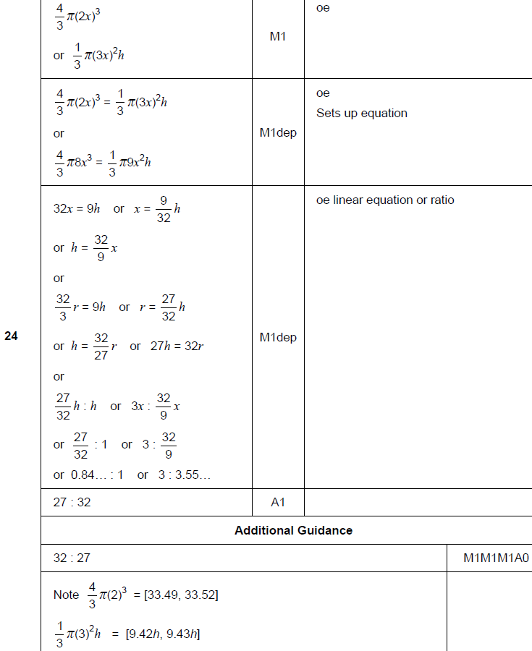
Volume & Surface Area
Nov 2018 3H Q24
A

