Slide 1
Volume & Surface Area
Volume & Surface Area
SAM
1H Q6
May 2017
1H Q15
SAM
2H Q22
June 2017
2H Q3
Edexcel
SAM
3H Q16
May 2018
1H Q5
AQA
Spec 1
1H Q18
June 2018
2H Q19
OCR
Spec 1
3H Q17
Nov 2018
2H Q20
Spec 2
1H Q11
May 2019
1H Q4
Spec 2
3H Q2
May 2019
1H Q15
Viewing angles
With Formulae

Slide 2
Volume & Surface Area
Volume & Surface Area
May 2017
1H Q28
Edexcel
June 2018
2H Q10
AQA
SAM
2H Q23
June 2018
2H Q20
1 Marker
OCR
Nov 2018
3H Q15
Nov 2018
3H Q24
Viewing angles
With Formulae

Slide 3
Volume & Surface Area
Volume & Surface Area
June 2017
3H Q8
Edexcel
SAM
1H Q13
Nov 2017
3H Q15
AQA
SAM
2H Q10
June 2018
2H Q14
OCR
Practice
2H Q17
June 2018
3H Q13
Nov 2018
1H Q6
Viewing angles
With Formulae

Slide 4
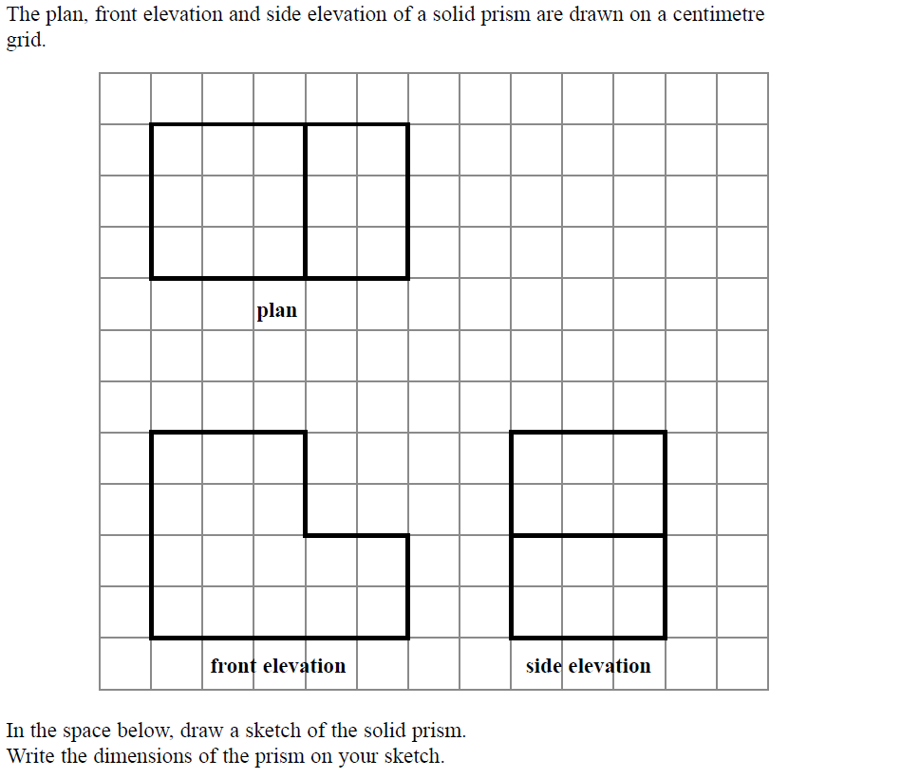
Volume & Surface Area
SAM 1H Q6

Slide 5
Volume & Surface Area
SAM 1H Q6
A
3 cm
2 cm
4 cm
2 cm
2 cm
3 cm
5 cm

Slide 6
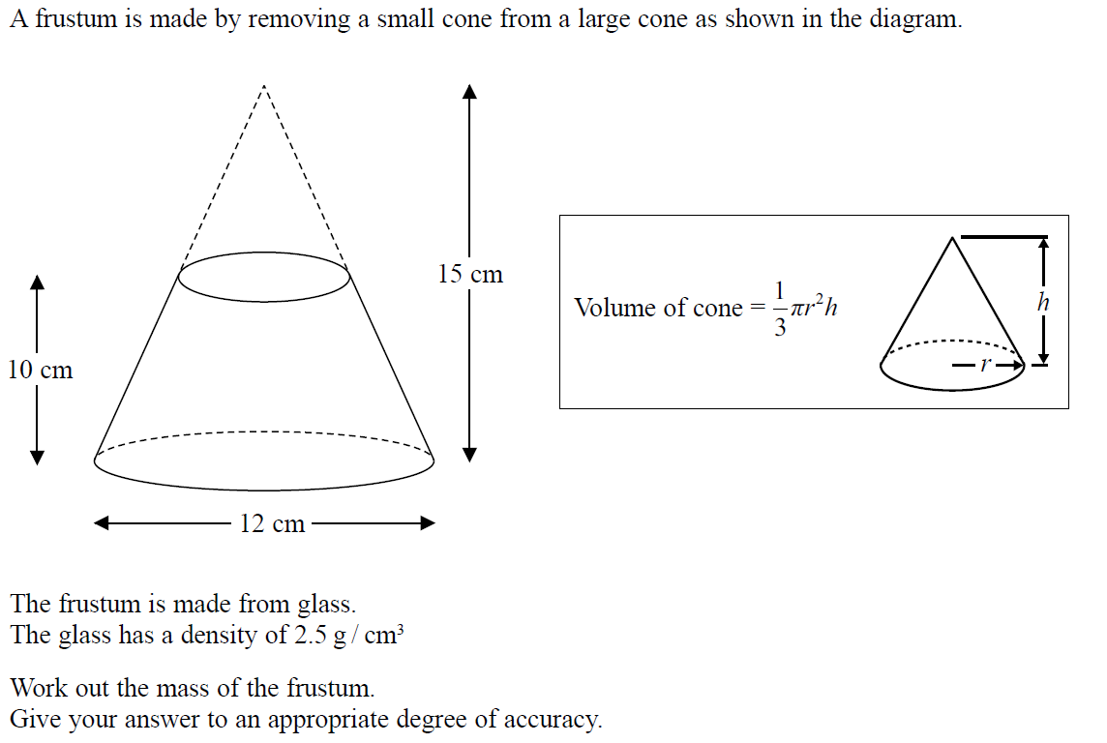
Volume & Surface Area
SAM 2H Q22

Slide 7
Volume & Surface Area
SAM 2H Q22
A

Slide 8
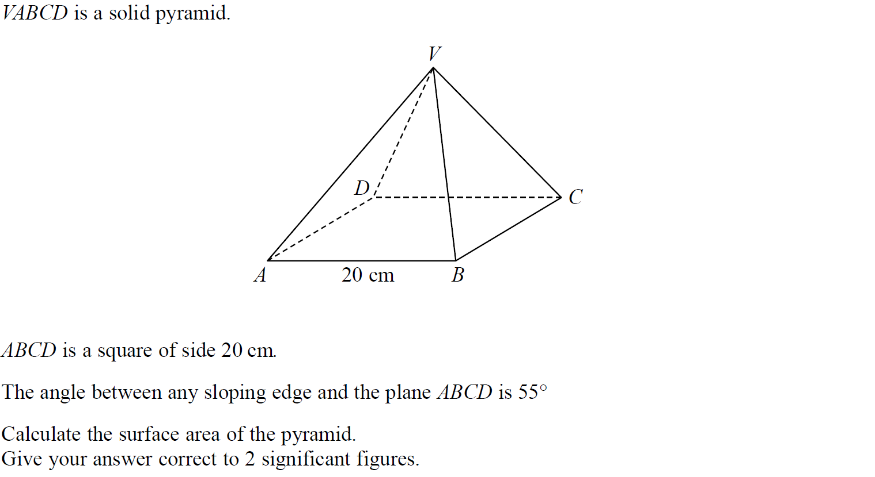
Volume & Surface Area
SAM 3H Q16

Slide 9
Volume & Surface Area
SAM 3H Q16
A

Slide 10
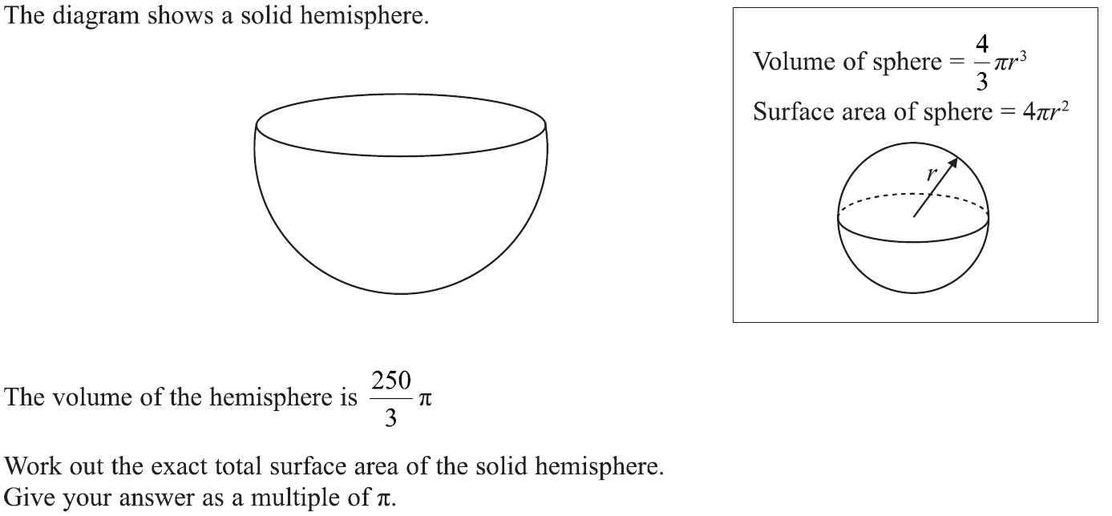
Volume & Surface Area
Specimen Set 1 1H Q18

Slide 11
Volume & Surface Area
Specimen Set 1 1H Q18
A

Slide 12
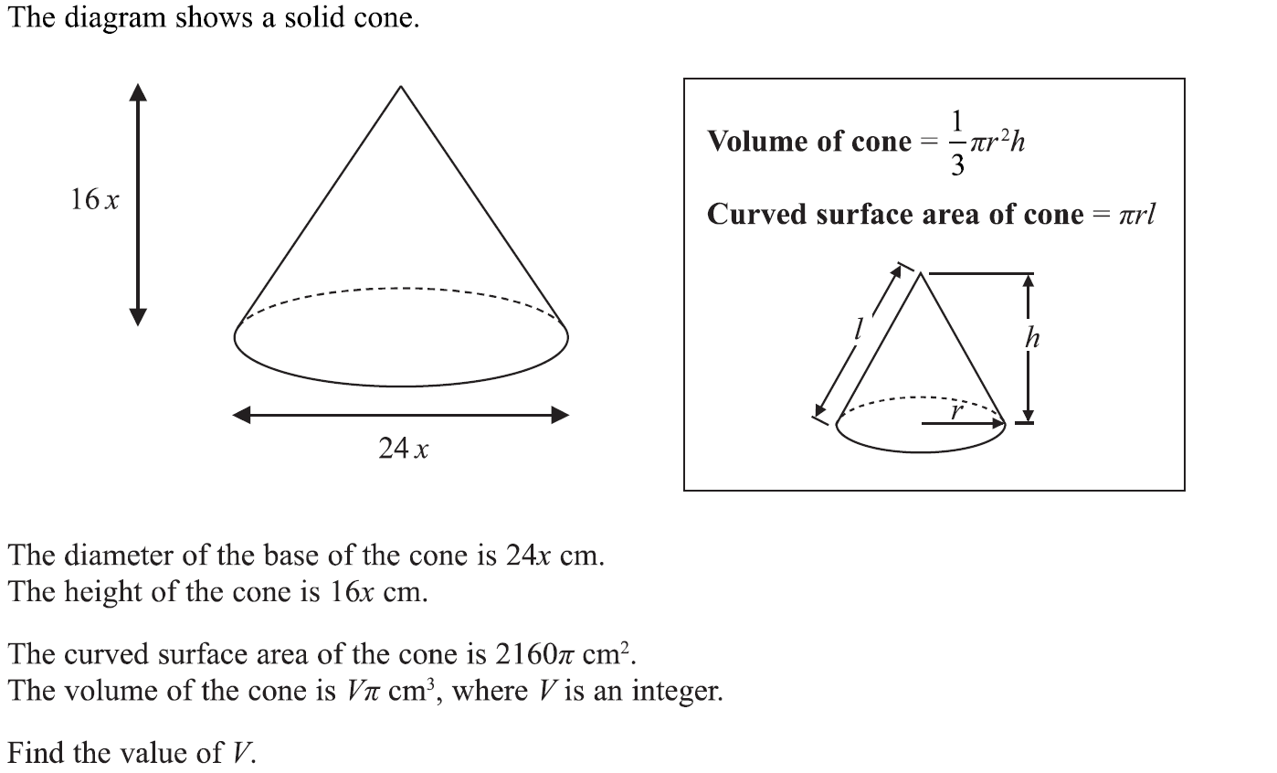
Volume & Surface Area
Specimen Set 1 3H Q17

Slide 13
Volume & Surface Area
Specimen Set 1 3H Q17
A

Slide 14
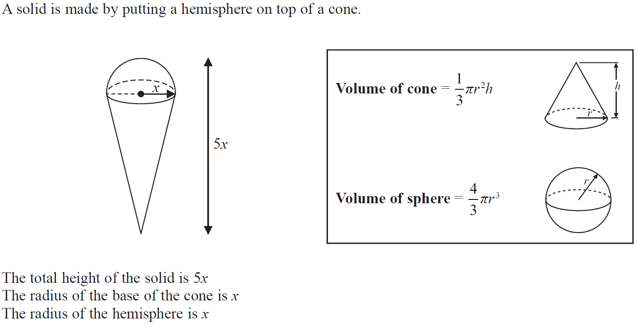
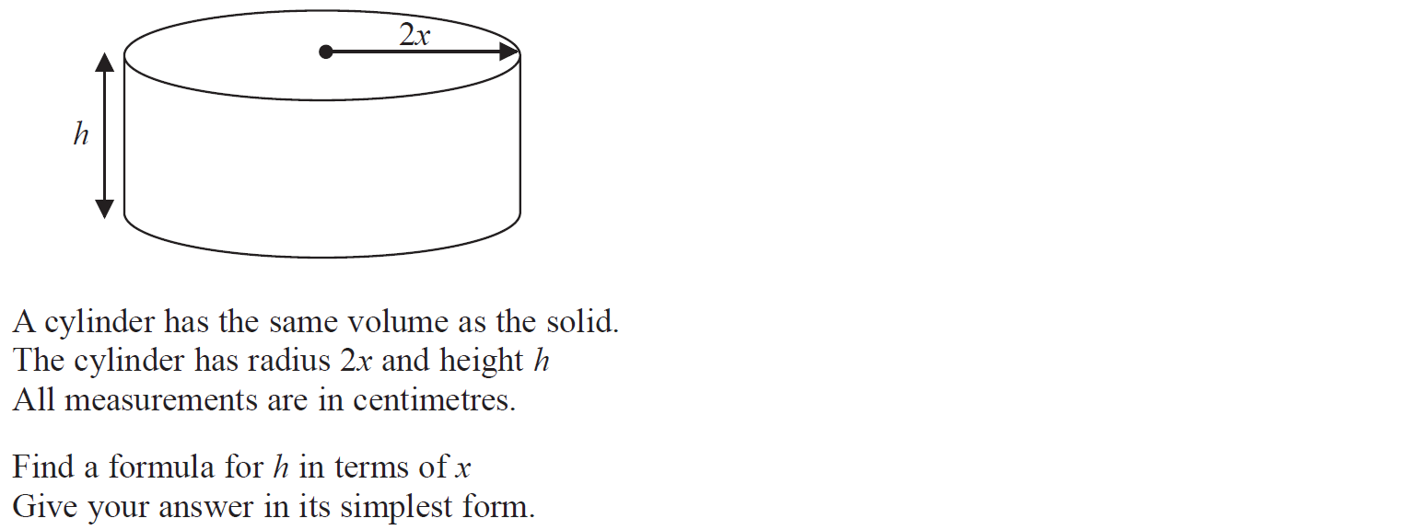
Volume & Surface Area
Specimen Set 2 1H Q11

Slide 15
Volume & Surface Area
Specimen Set 2 1H Q11
A

Slide 16
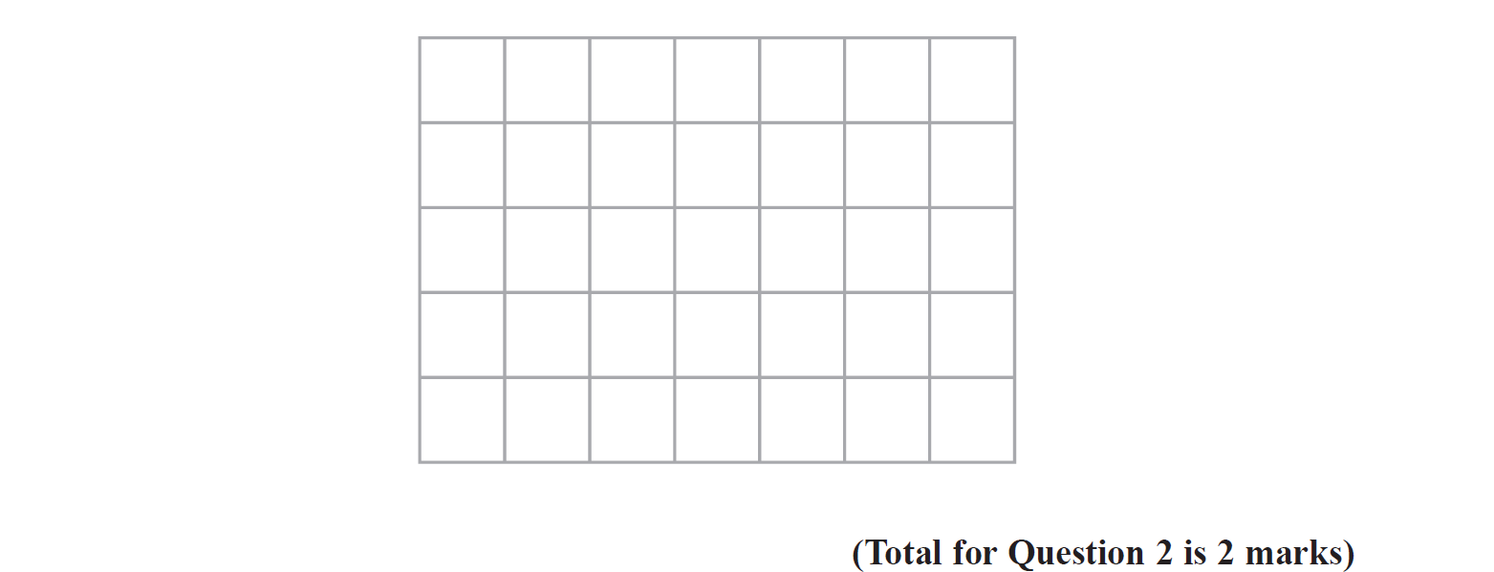
Volume & Surface Area
Specimen Set 2 3H Q2
Reveal plan
Hide plan

Slide 17
Volume & Surface Area
Specimen Set 2 3H Q2
A

Slide 18
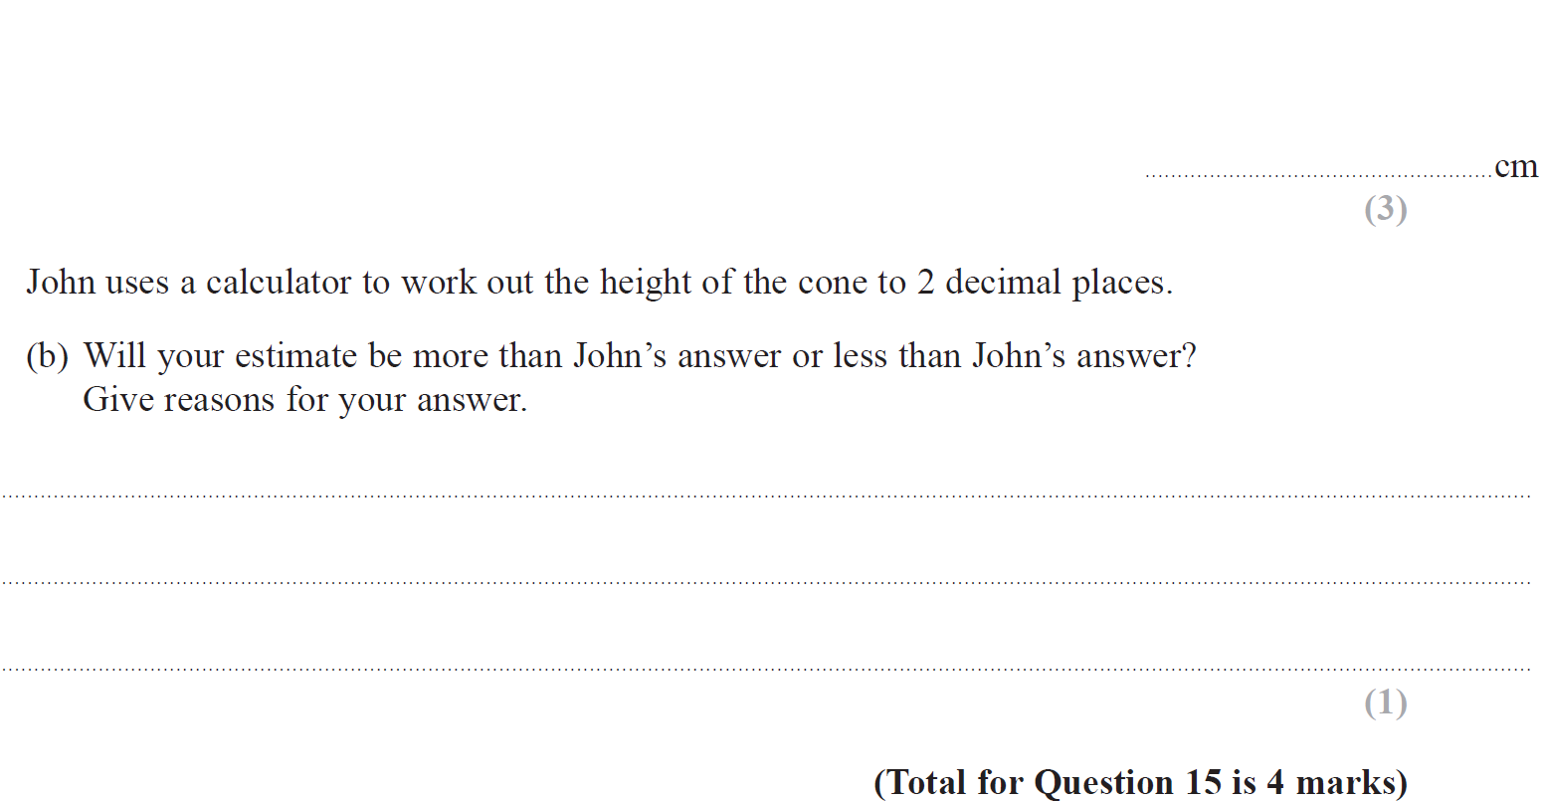
Volume & Surface Area
May 2017 1H Q15

Slide 19
Volume & Surface Area
May 2017 1H Q15
A
B

Slide 20
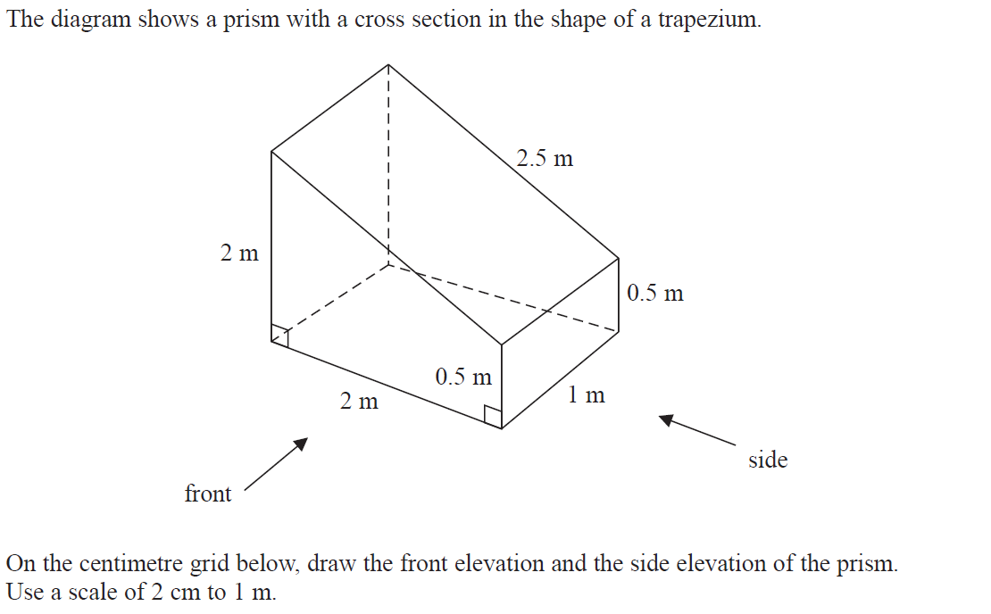
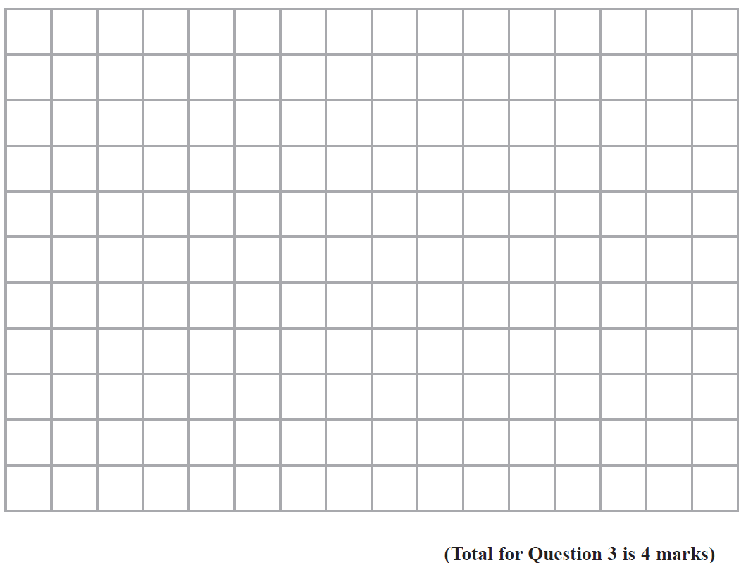
Volume & Surface Area
June 2017 2H Q3
Front
Side
Reveal front
Reveal side
Hide front
Hide side

Slide 21
Volume & Surface Area
June 2017 2H Q3
A

Slide 22
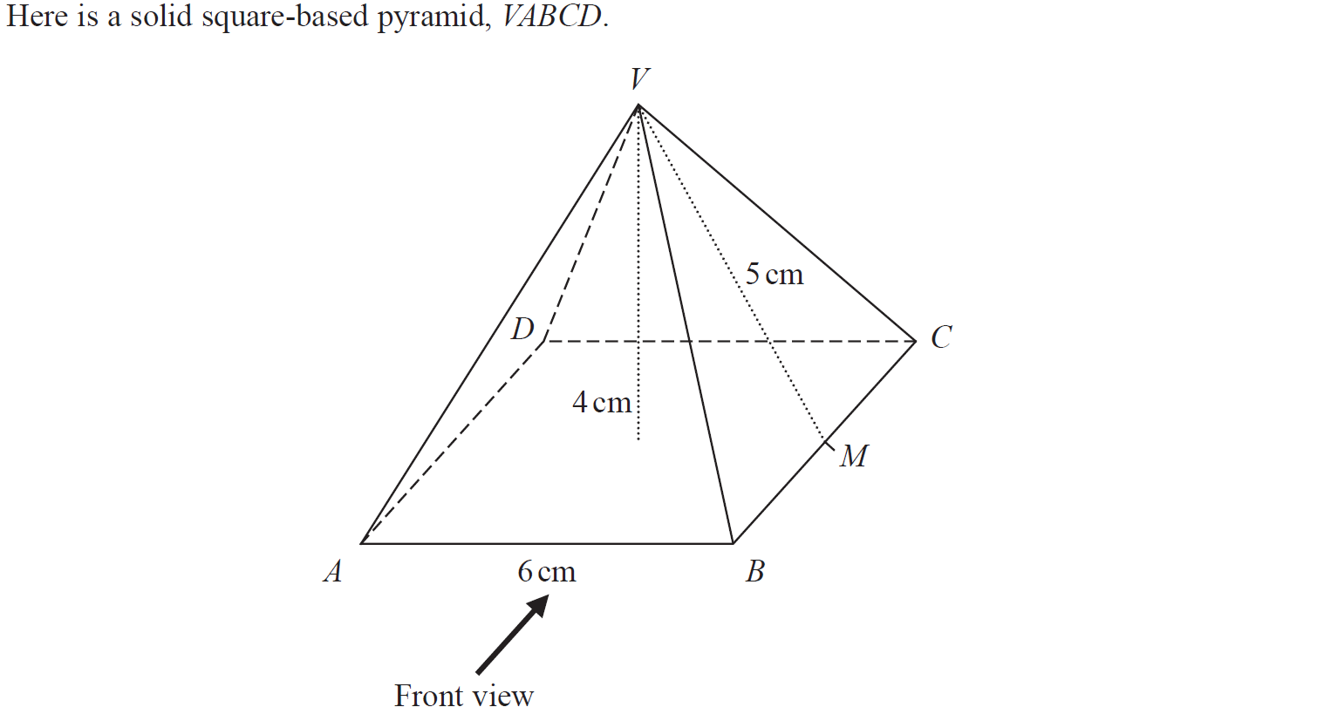
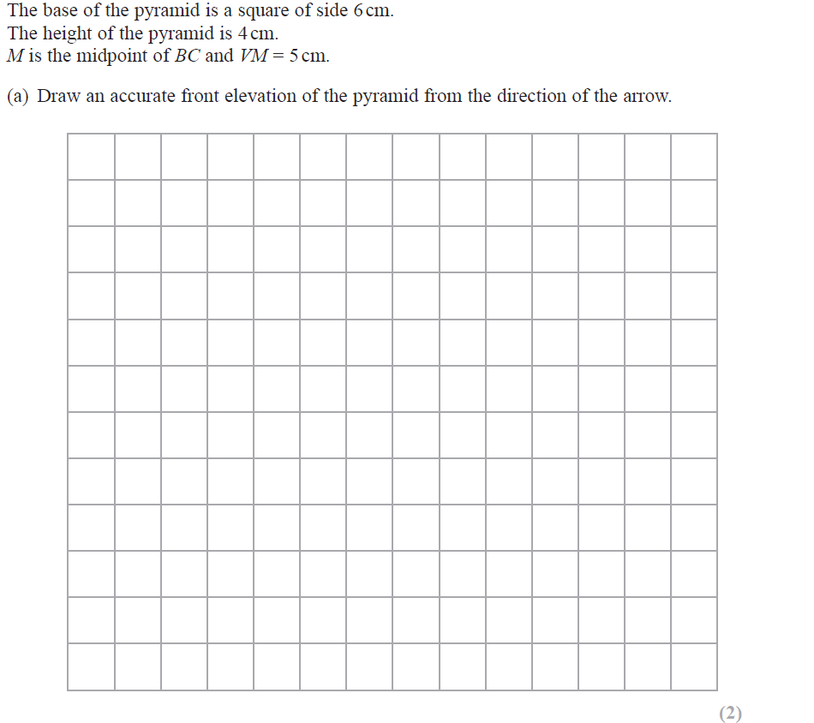
Volume & Surface Area
May 2018 1H Q5
Reveal front
Hide front

Slide 23
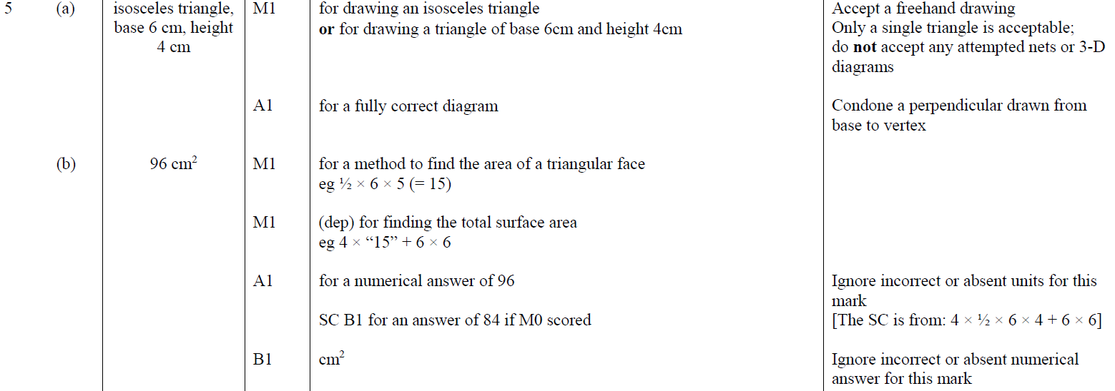
Volume & Surface Area
May 2018 1H Q5
A
B

Slide 24
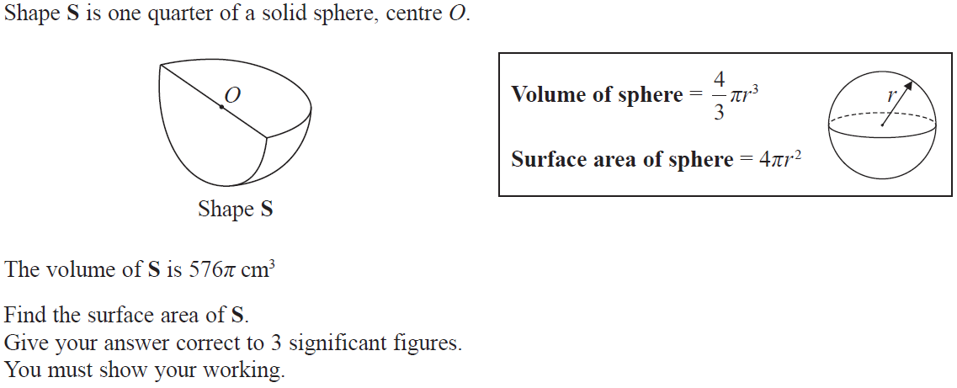
Volume & Surface Area
June 2018 2H Q19

Slide 25
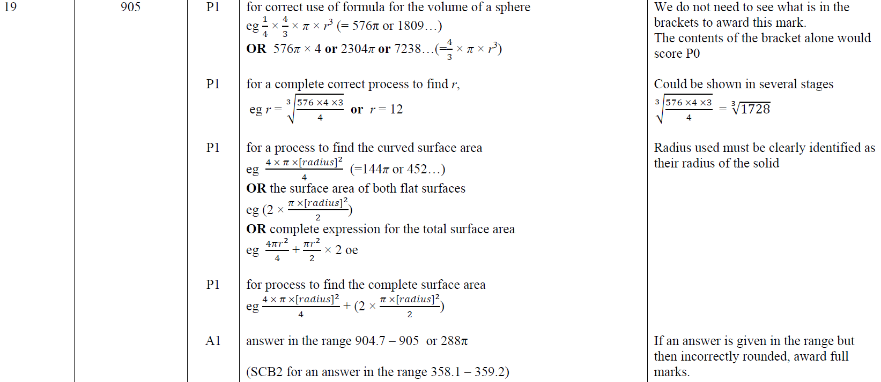
Volume & Surface Area
June 2018 2H Q19
A

Slide 26
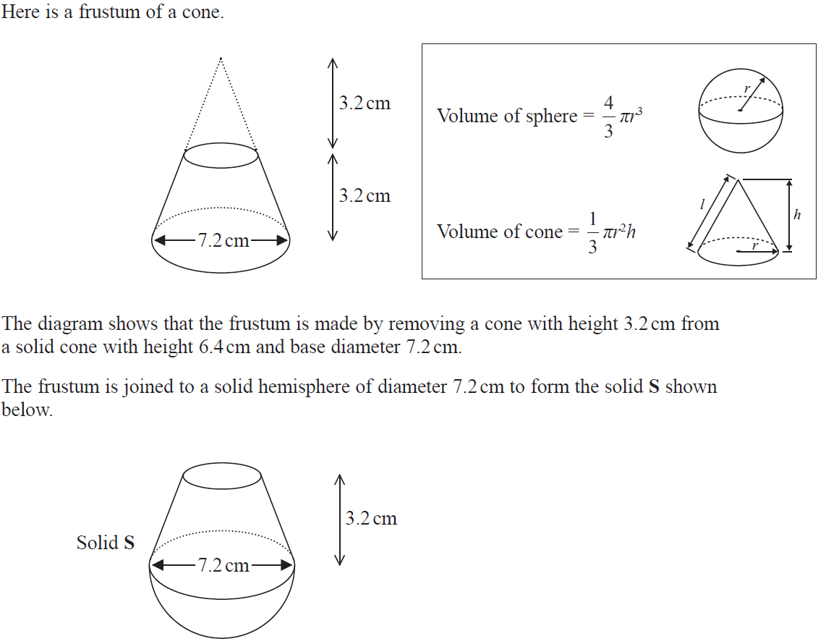
Volume & Surface Area
Nov 2018 2H Q20

Slide 27
Volume & Surface Area
Nov 2018 2H Q20
A

Slide 28
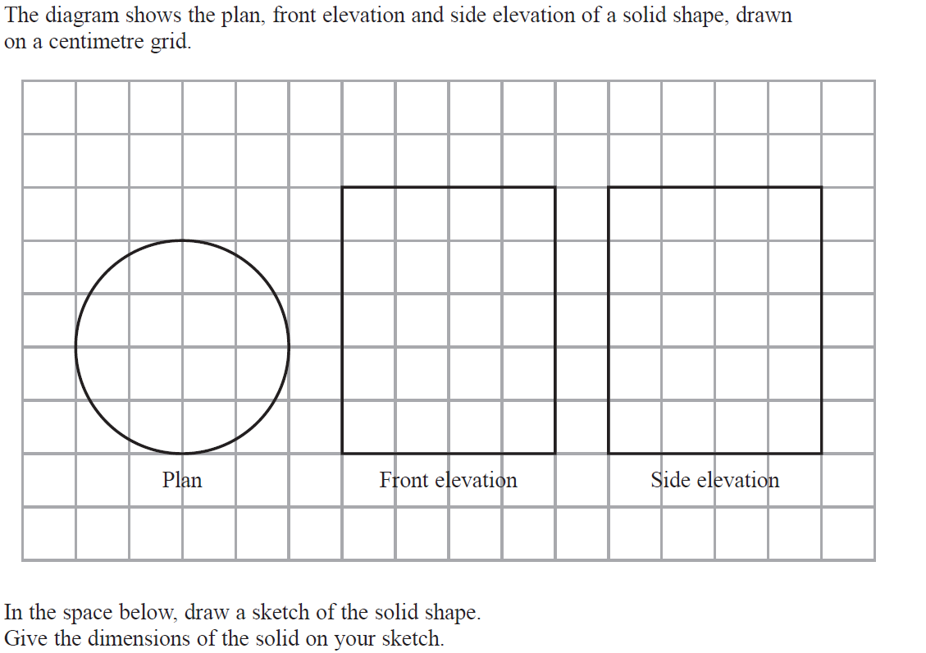
Volume & Surface Area
May 2019 1H Q4

Slide 29
Volume & Surface Area
May 2019 1H Q4
A
A SF

Slide 30
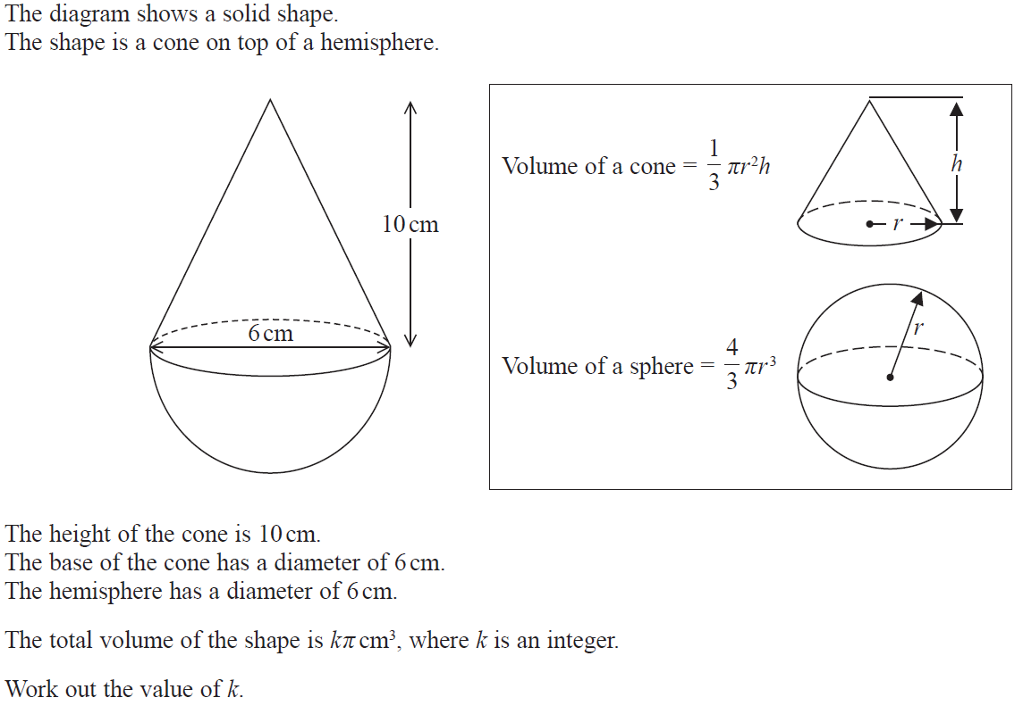
Volume & Surface Area
May 2019 1H Q15

Slide 31
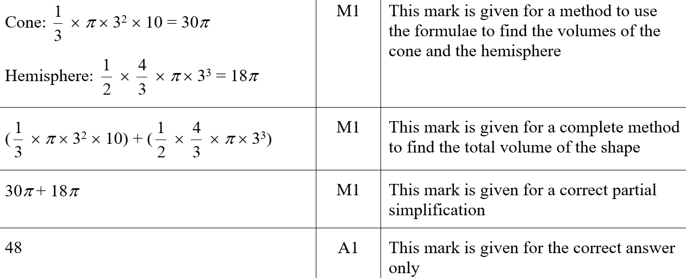
Volume & Surface Area
May 2019 1H Q15
A
A SF

Slide 32
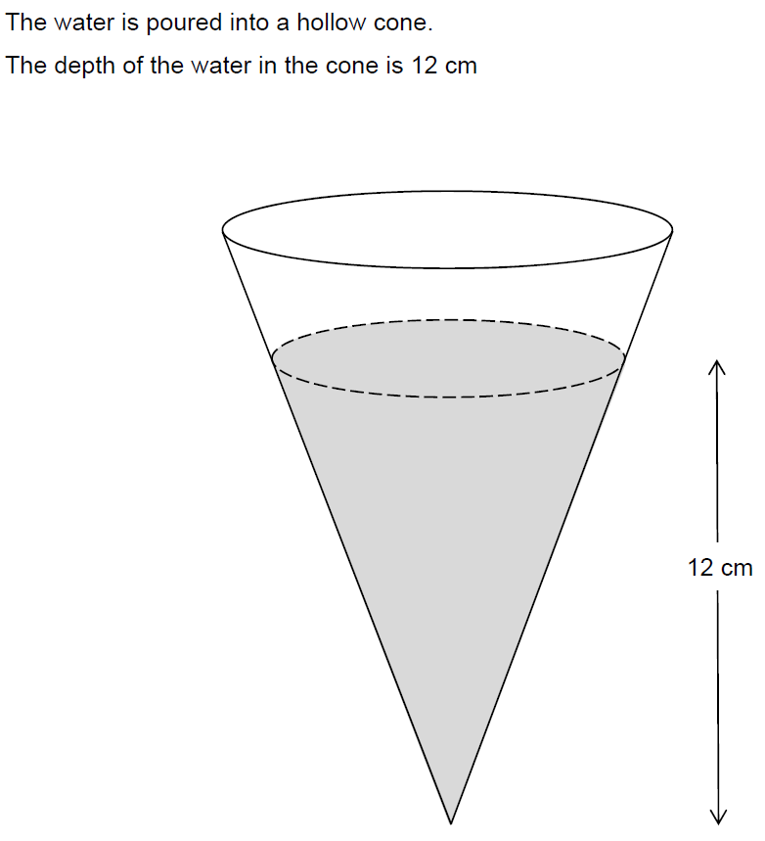
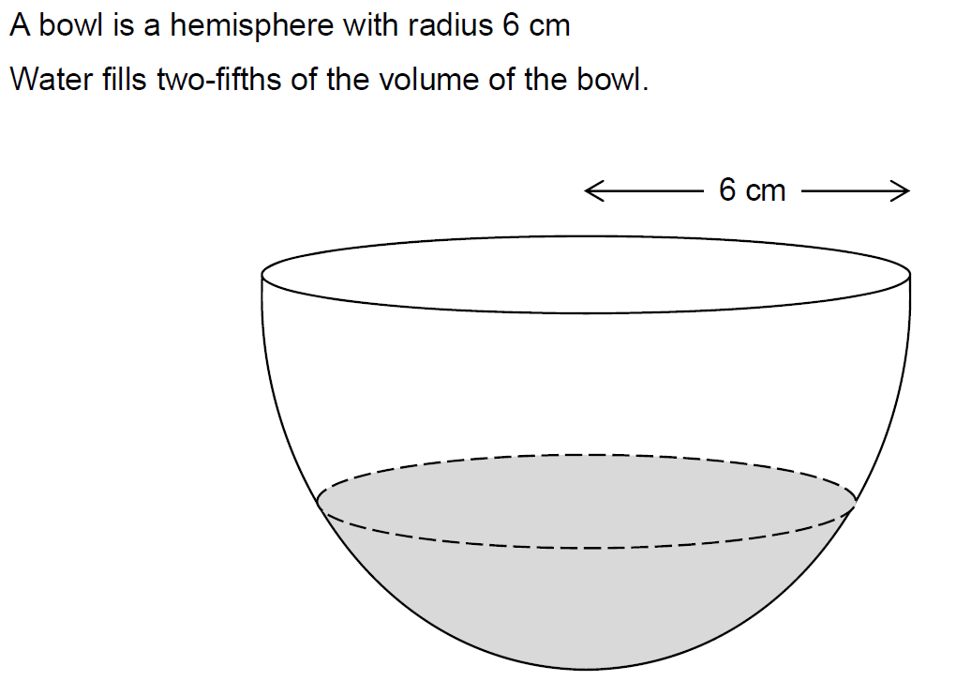
Volume & Surface Area
SAM 2H Q23

Slide 33
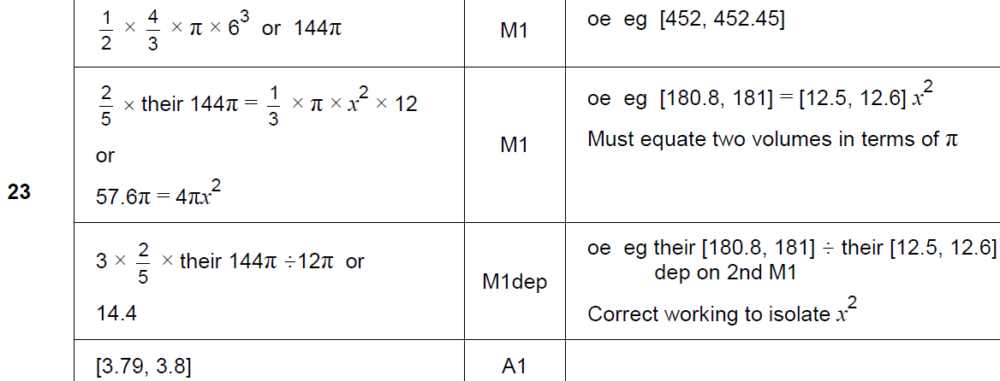
Volume & Surface Area
SAM 2H Q23
A

Slide 34
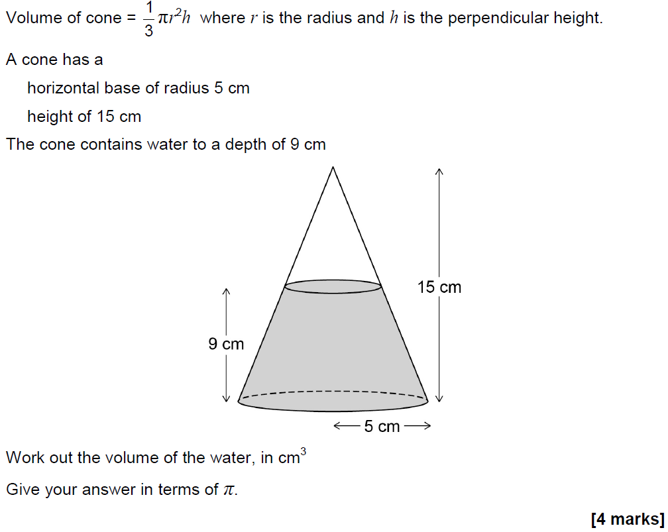
Volume & Surface Area
May 2017 1H Q28

Slide 35
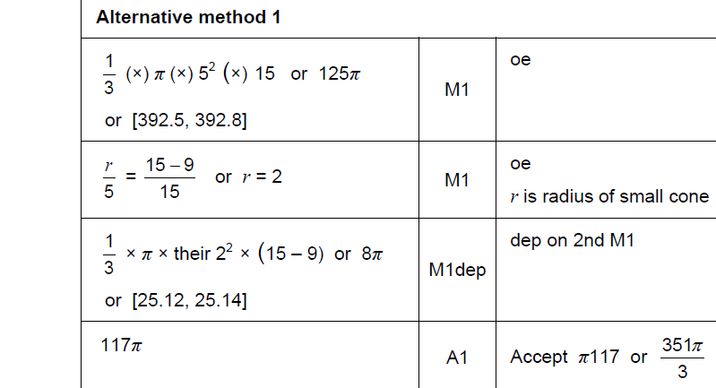
Volume & Surface Area
May 2017 1H Q28
A

Slide 36
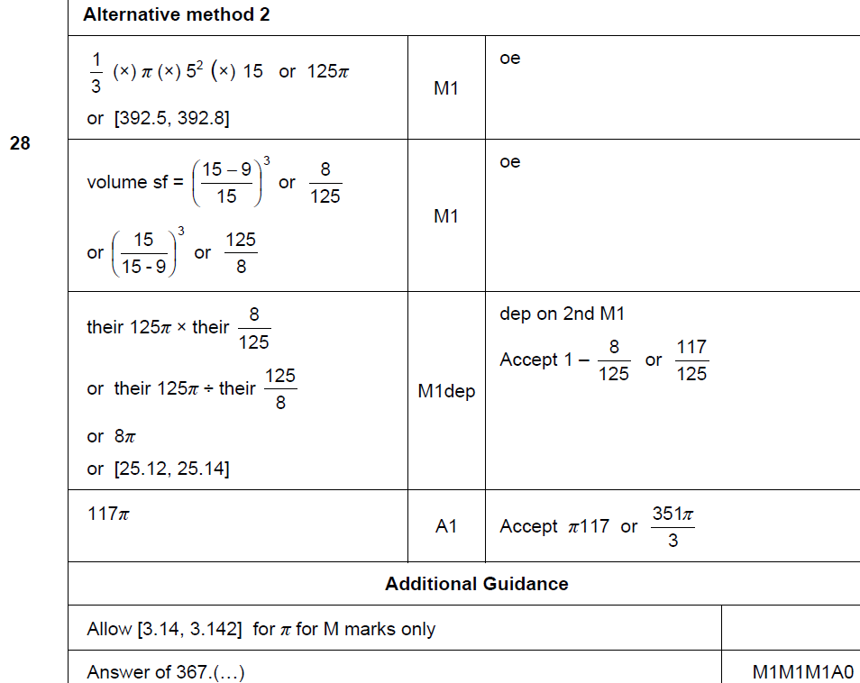
Volume & Surface Area
May 2017 1H Q28
A Alternative & notes

Slide 37
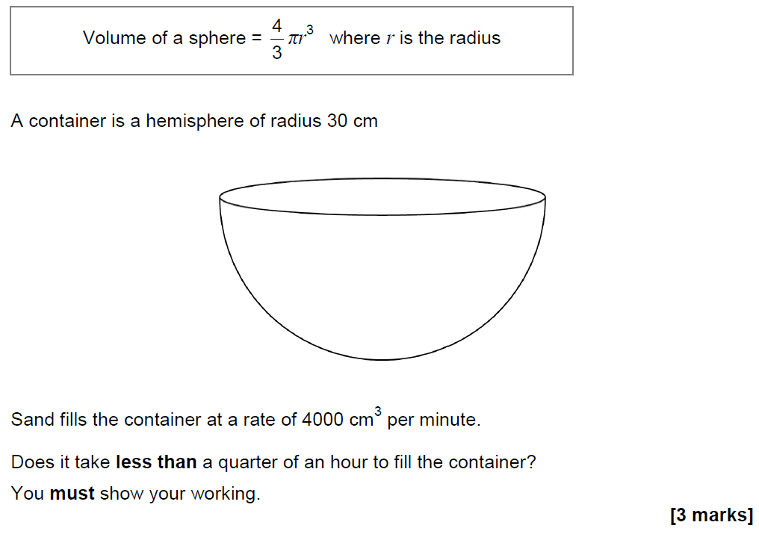
Volume & Surface Area
June 2018 2H Q10

Slide 38
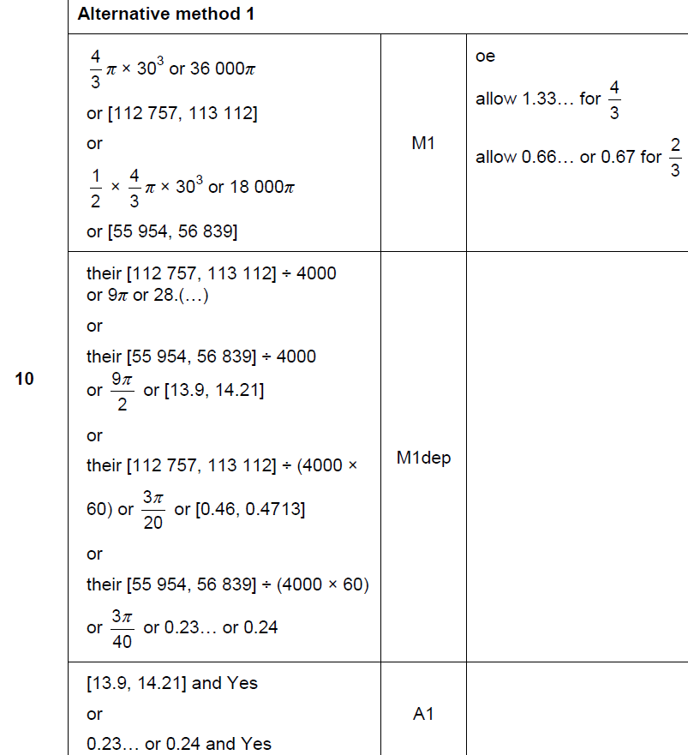
Volume & Surface Area
June 2018 2H Q10
A

Slide 39
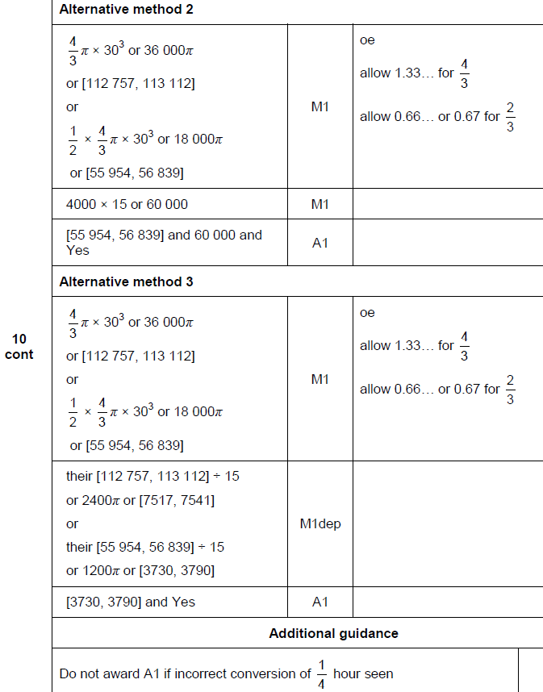
Volume & Surface Area
June 2018 2H Q10
A Alternative & notes

Slide 40
Volume & Surface Area
June 2018 2H Q20

Slide 41
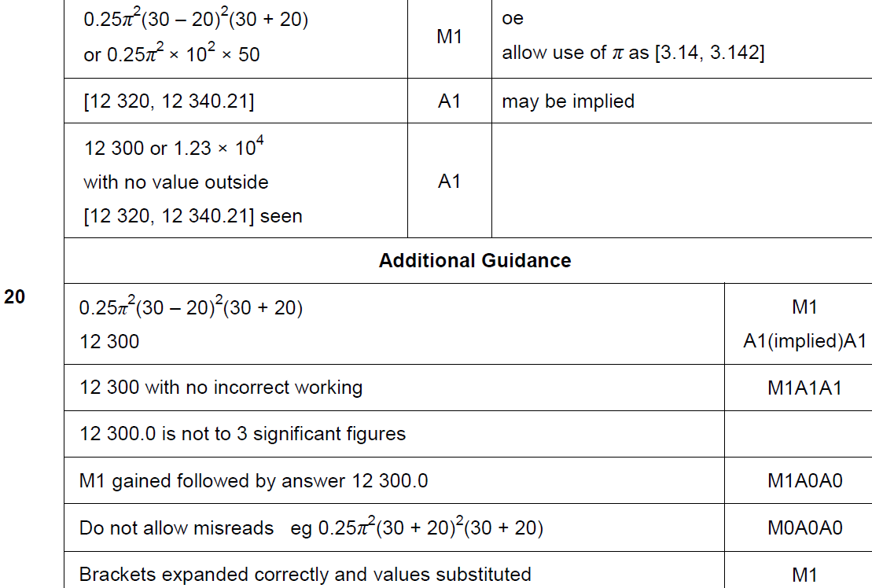
Volume & Surface Area
June 2018 2H Q20
A

Slide 42
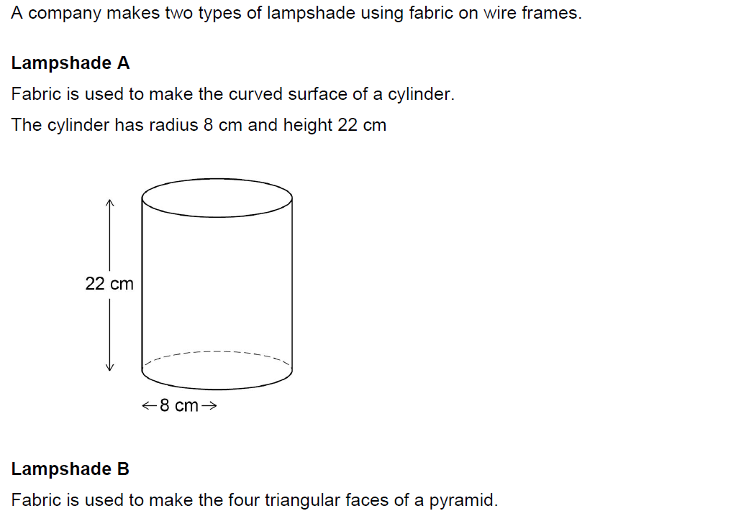
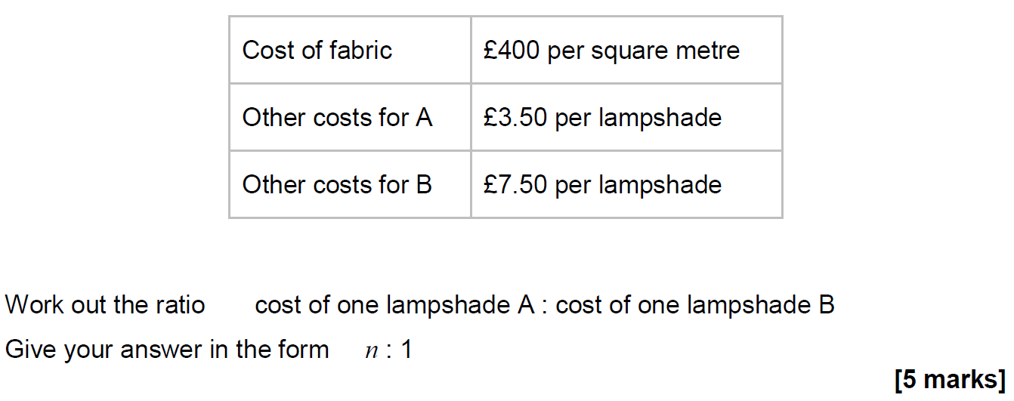
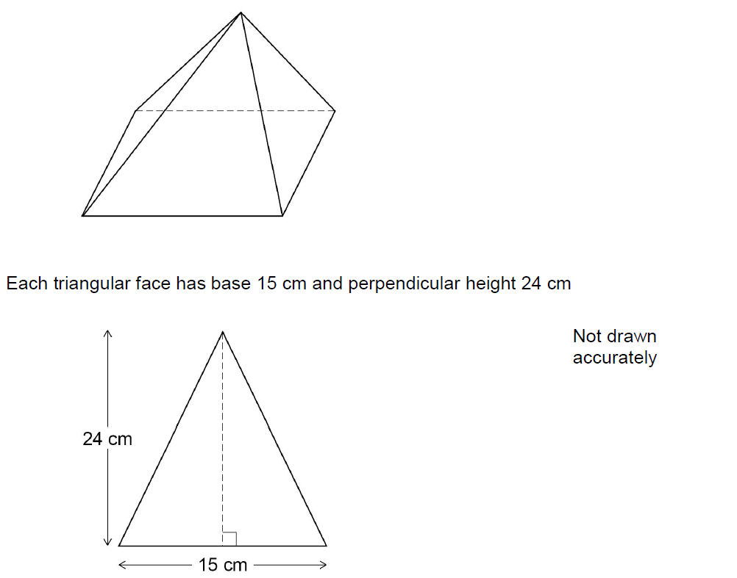
Volume & Surface Area
Nov 2018 3H Q15

Slide 43
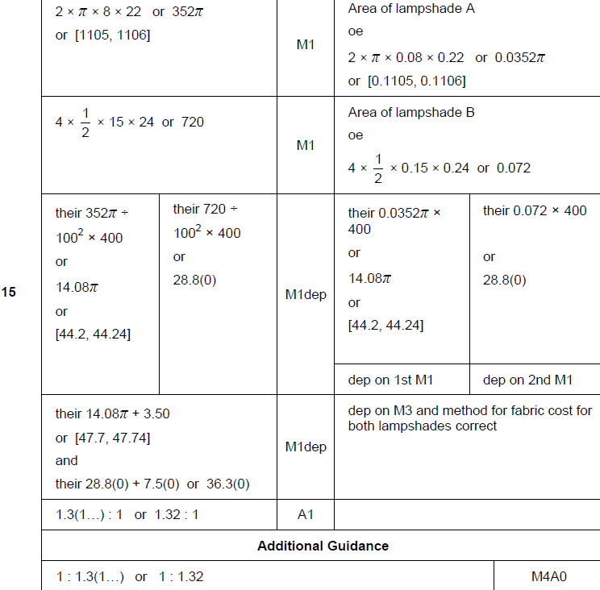
Volume & Surface Area
Nov 2018 3H Q15
A

Slide 44
Volume & Surface Area
Nov 2018 3H Q24

Slide 45
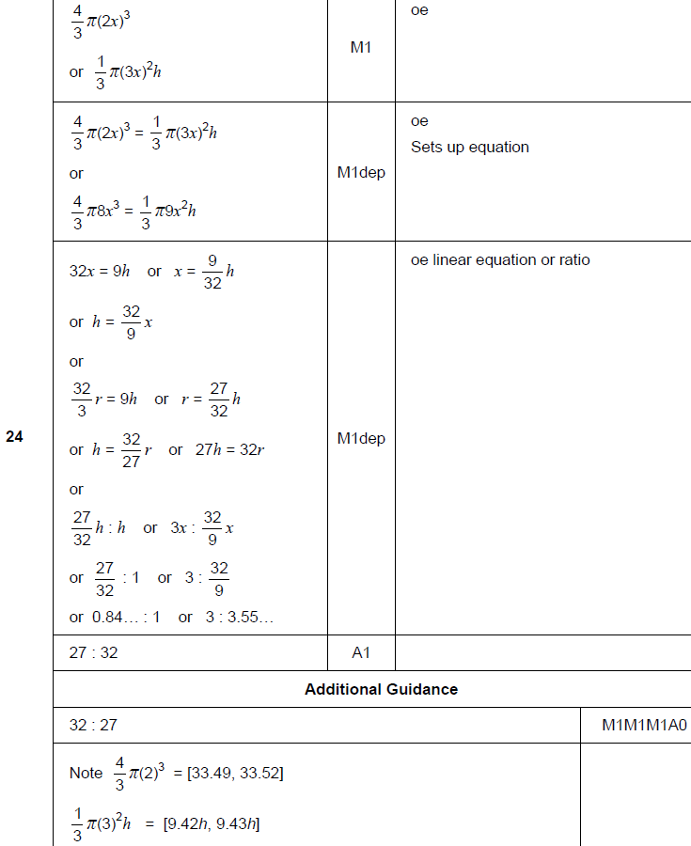
Volume & Surface Area
Nov 2018 3H Q24
A

Slide 46
Volume & Surface Area
SAM 1H Q13

Slide 47
Volume & Surface Area
SAM 1H Q13
A

Slide 48
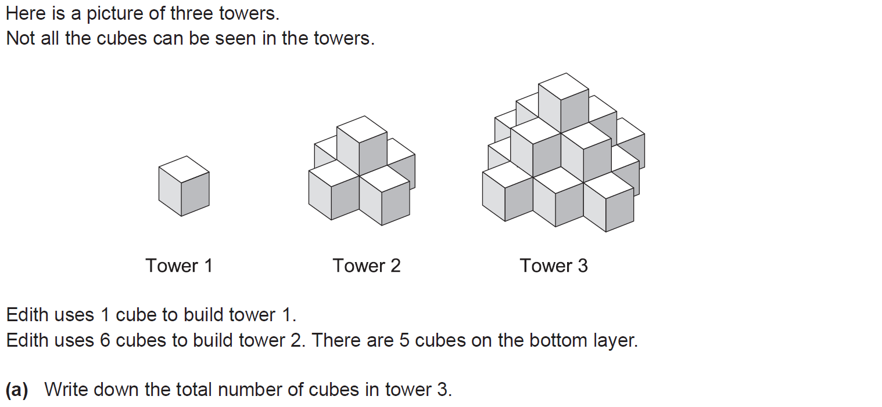
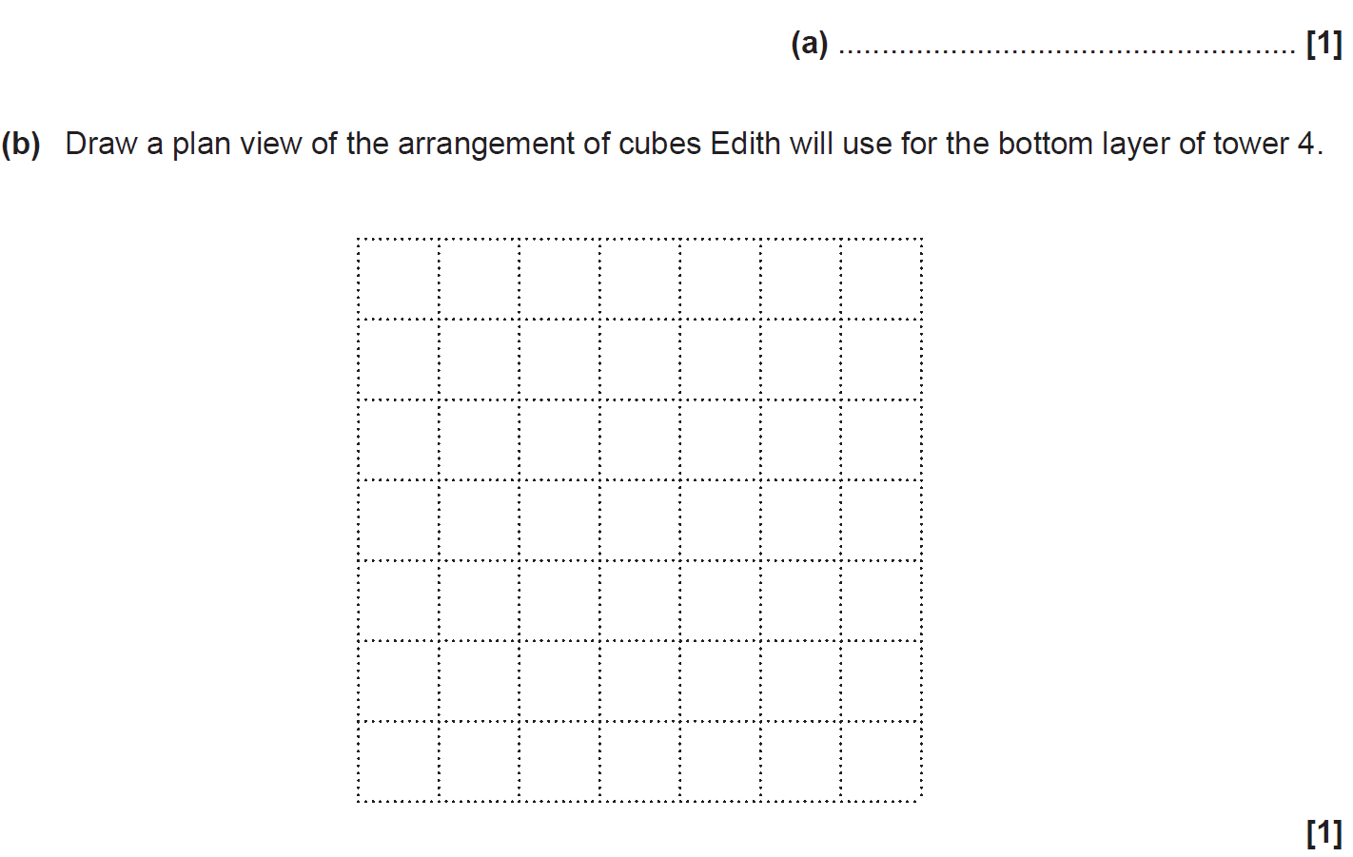
Volume & Surface Area
SAM 2H Q10

Slide 49
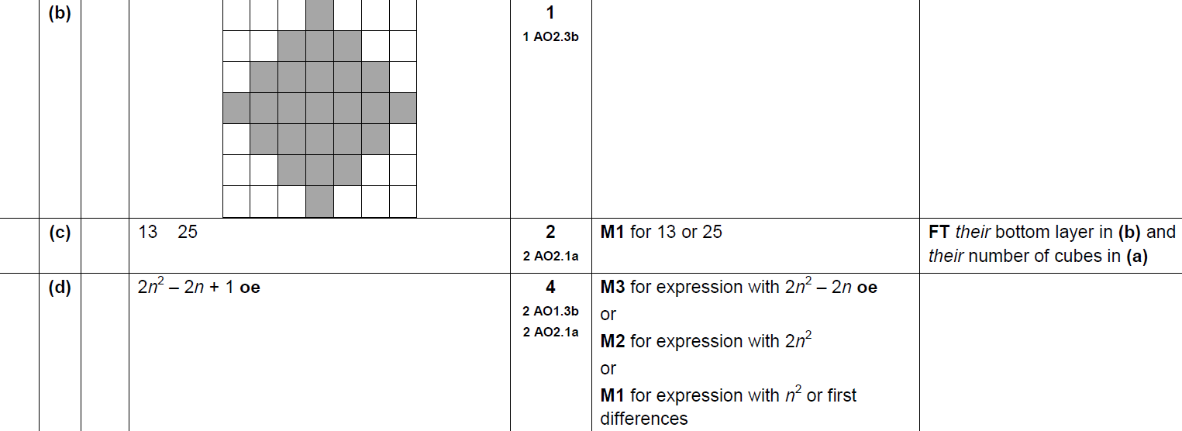
Volume & Surface Area
SAM 2H Q10
A
B
C
D

Slide 50
Volume & Surface Area
Practice 2H Q17

Slide 51
Volume & Surface Area
Practice 2H Q17
A

Slide 52
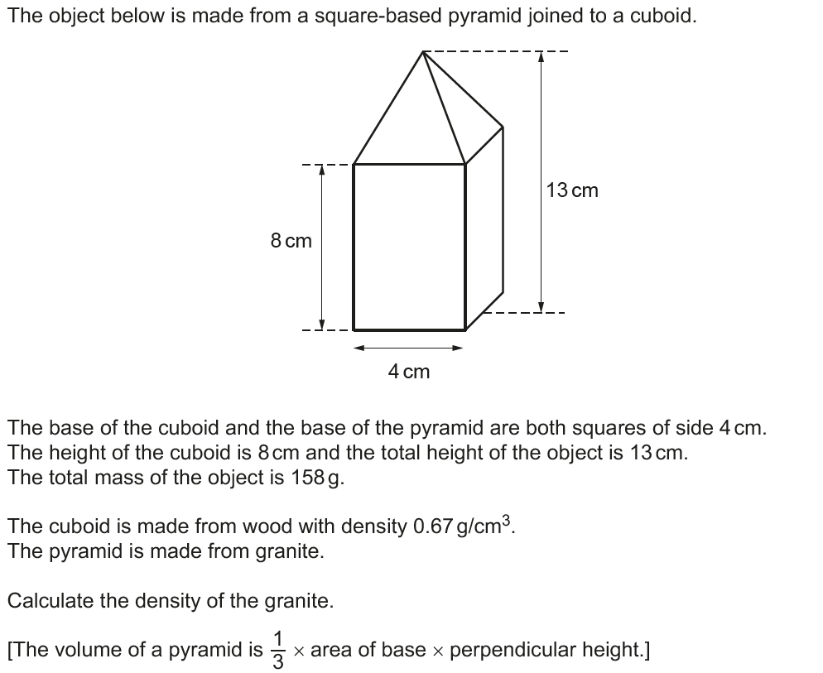
Volume & Surface Area
June 2017 3H Q8

Slide 53
Volume & Surface Area
June 2017 3H Q8
A

Slide 54
Volume & Surface Area
Nov 2017 3H Q15

Slide 55
Volume & Surface Area
Nov 2017 3H Q15
A

Slide 56
Volume & Surface Area
June 2018 2H Q14

Slide 57
Volume & Surface Area
June 2018 2H Q14
A

Slide 58
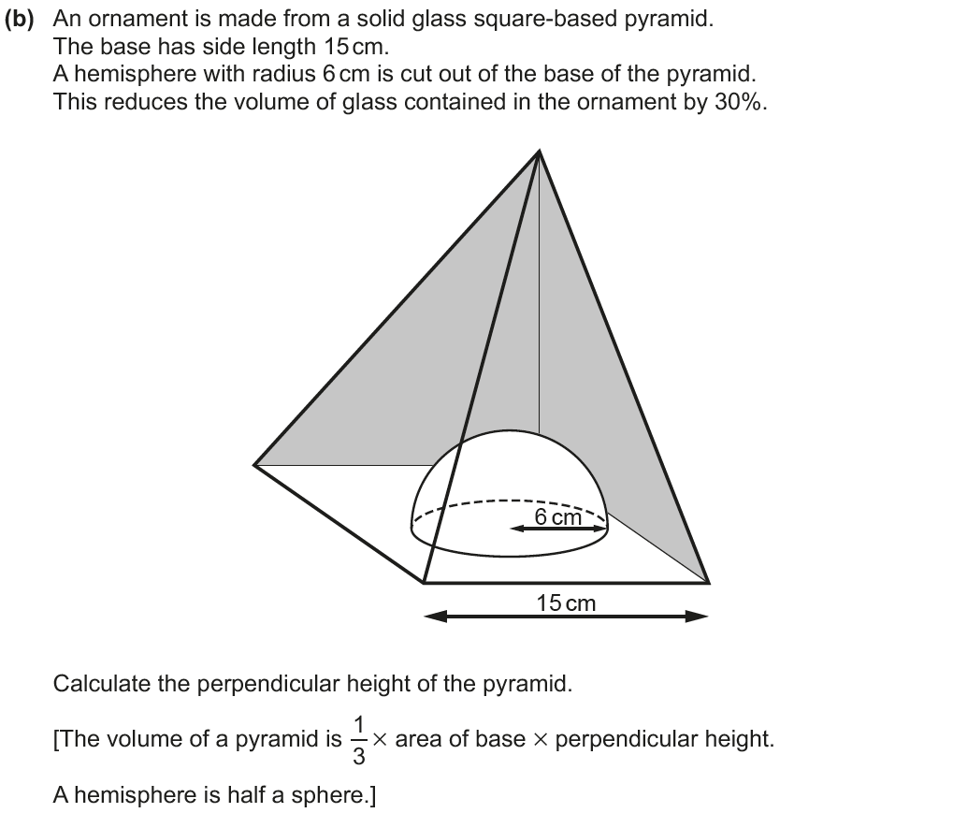
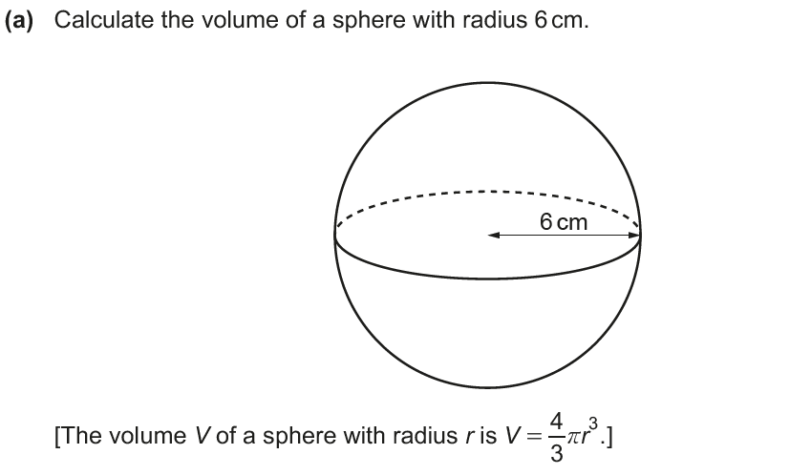
Volume & Surface Area
June 2018 3H Q13

Slide 59
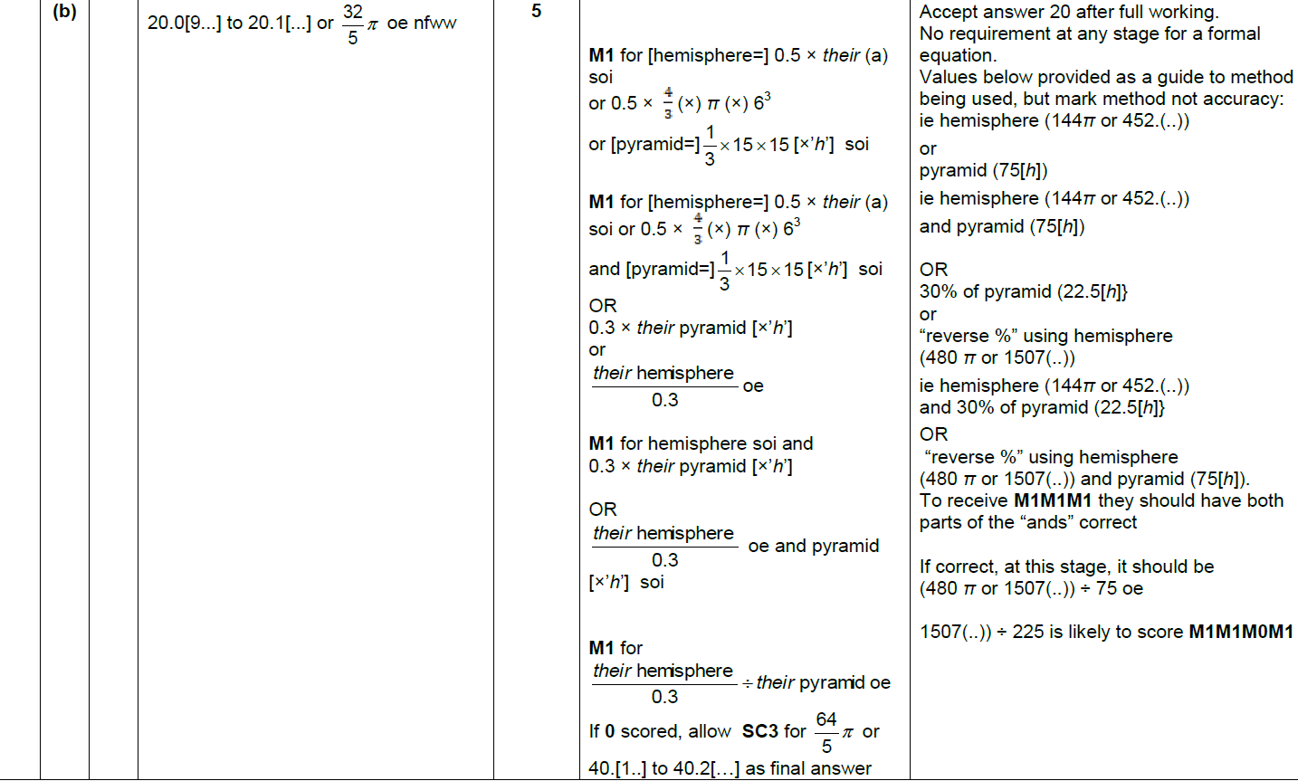
Volume & Surface Area
June 2018 3H Q13
A
B

Slide 60
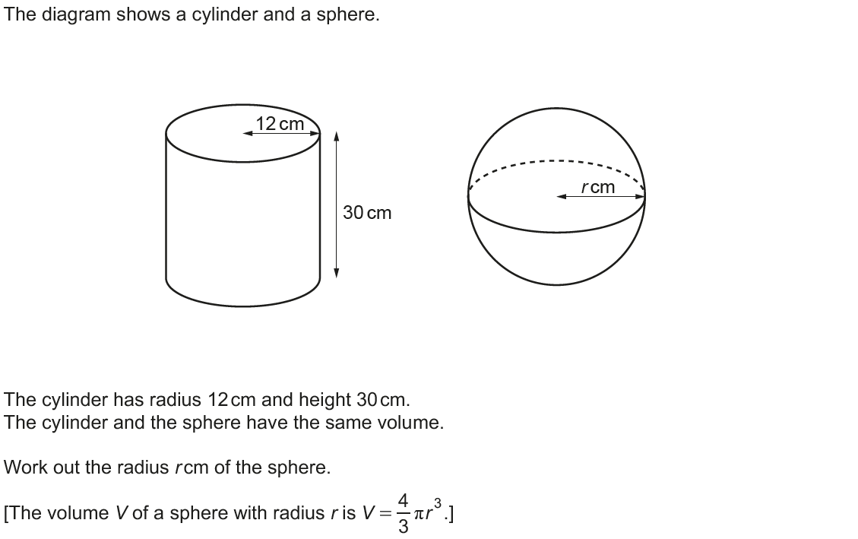
Volume & Surface Area
Nov 2018 1H Q6

Slide 61
Volume & Surface Area
Nov 2018 1H Q6
A

