Slide 1
Vectors
Vectors
June 2017
2H Q23
June 2017
3H Q1
SAM
3H Q2
1 Marker
Nov 2017
2H Q26
SAM
3H Q25
June 2018
3H Q11
Nov 2018
2H Q23
Show/ Prove that

Slide 2
Vectors
SAM 3H Q2

Slide 3
Vectors
SAM 3H Q2
A

Slide 4
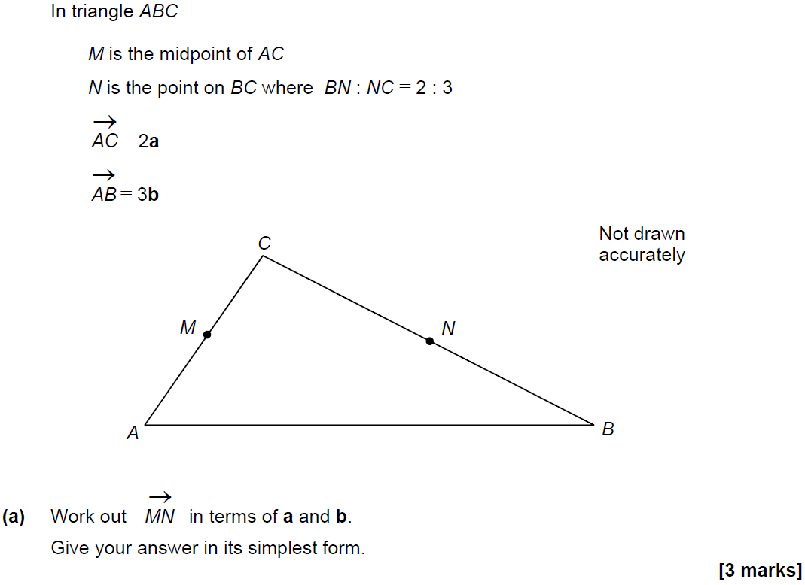
Vectors
SAM 3H Q25

Slide 5
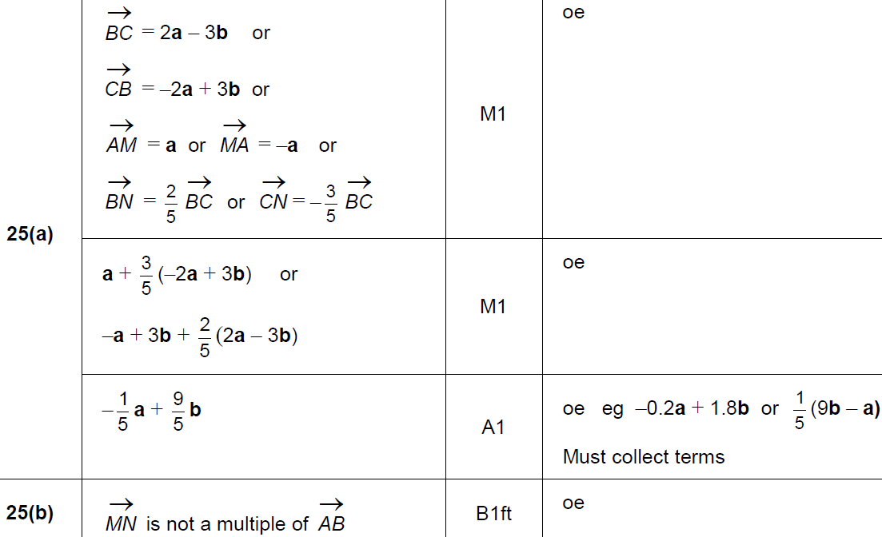
Vectors
SAM 3H Q25
A
B

Slide 6
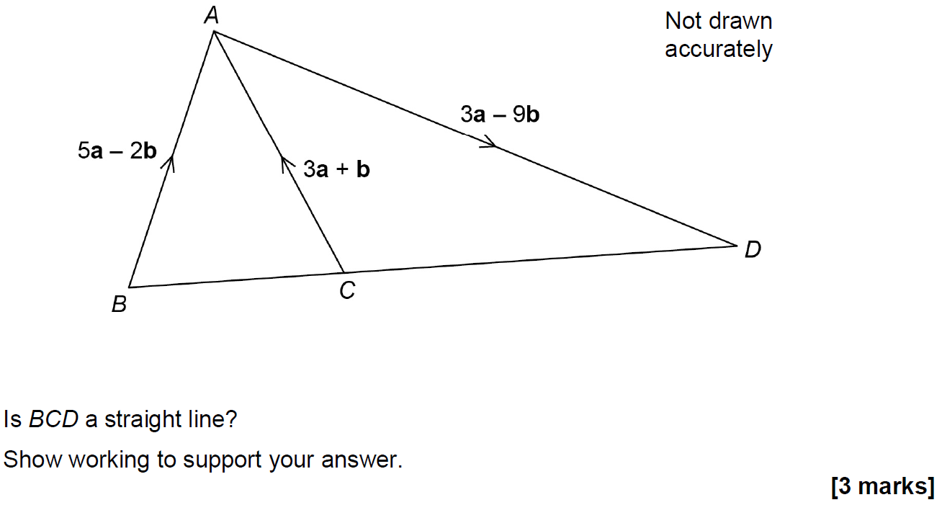
Vectors
June 2017 2H Q23

Slide 7
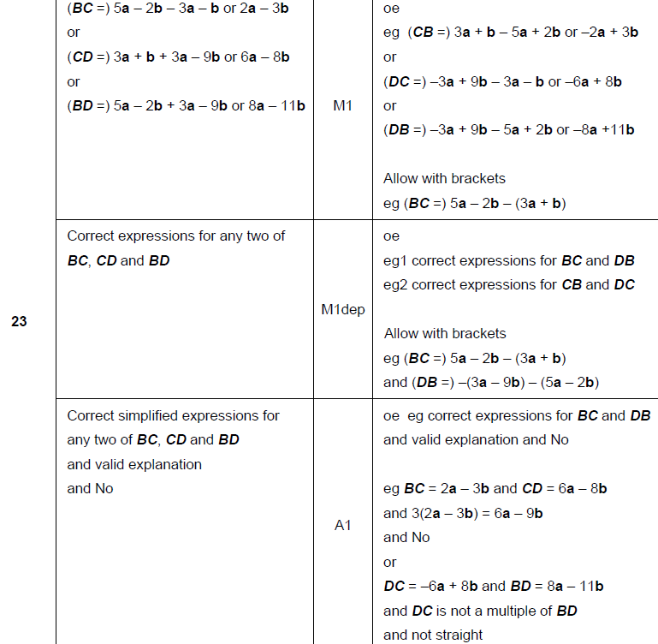
Vectors
June 2017 2H Q23
A

Slide 8
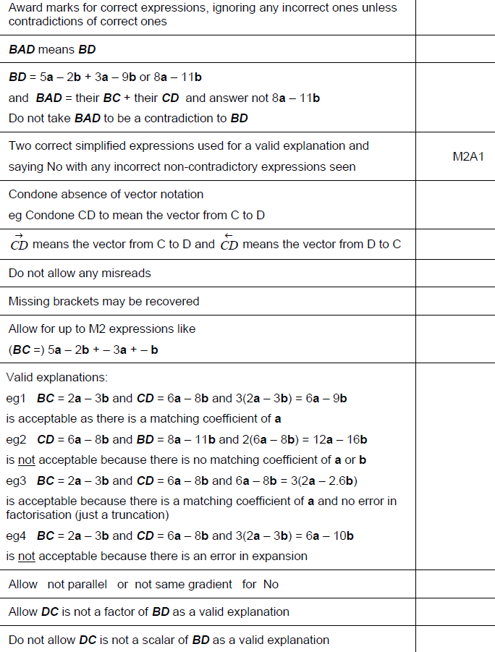
Vectors
June 2017 2H Q23
A notes

Slide 9
Vectors
June 2017 3H Q1

Slide 10
Vectors
June 2017 3H Q1
A

Slide 11
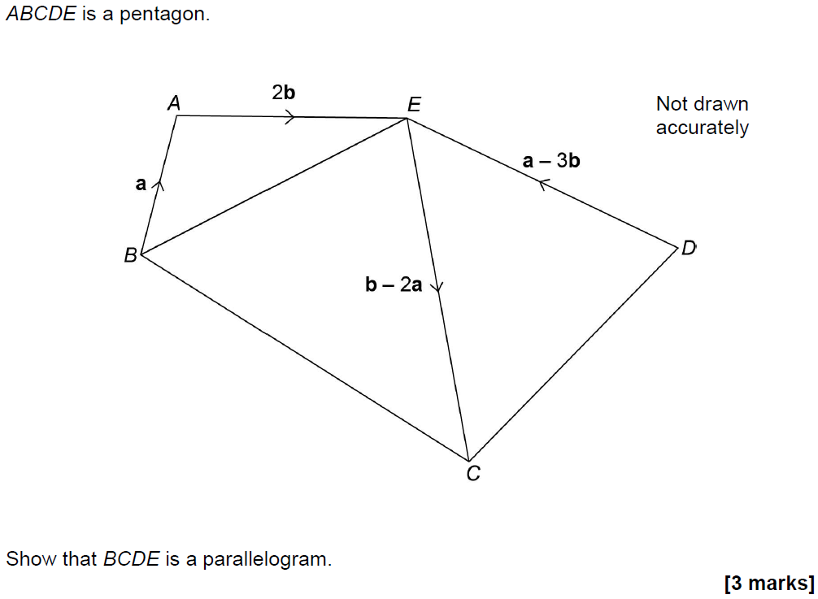
Vectors
Nov 2017 2H Q26

Slide 12
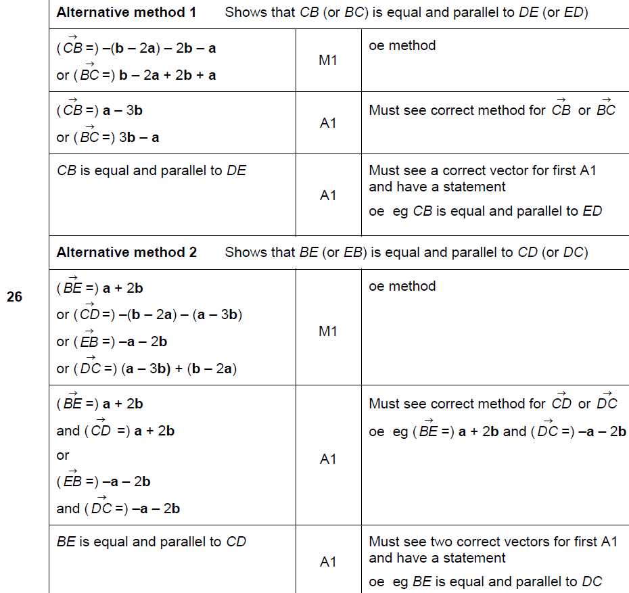
Vectors
Nov 2017 2H Q26
A

Slide 13
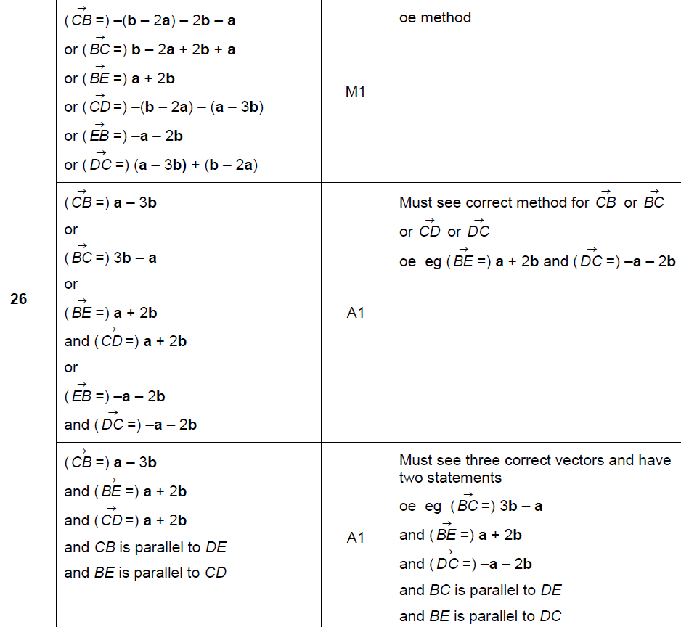
Vectors
Nov 2017 2H Q26
A Alternative 2

Slide 14
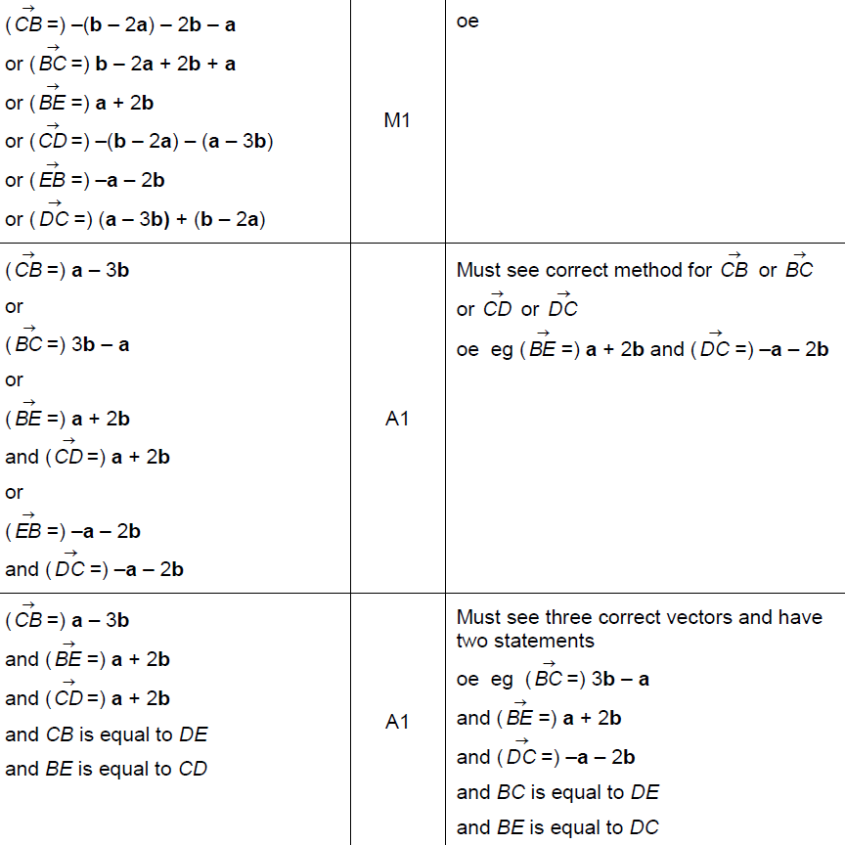
Vectors
Nov 2017 2H Q26
A Alternative 2

Slide 15
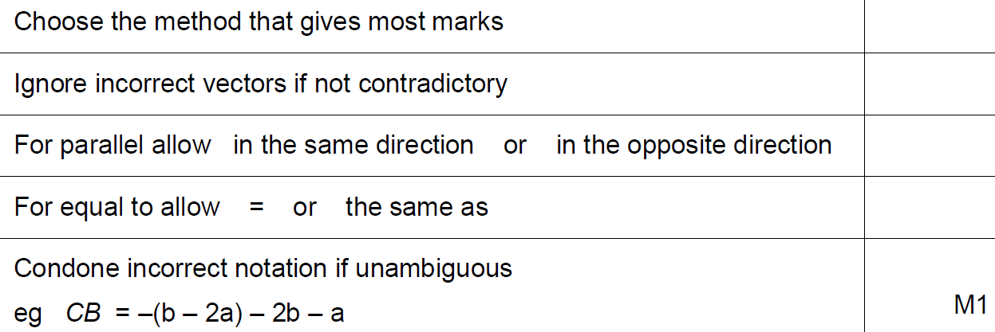
Vectors
Nov 2017 2H Q26
A notes

Slide 16
Vectors
June 2018 3H Q11

Slide 17
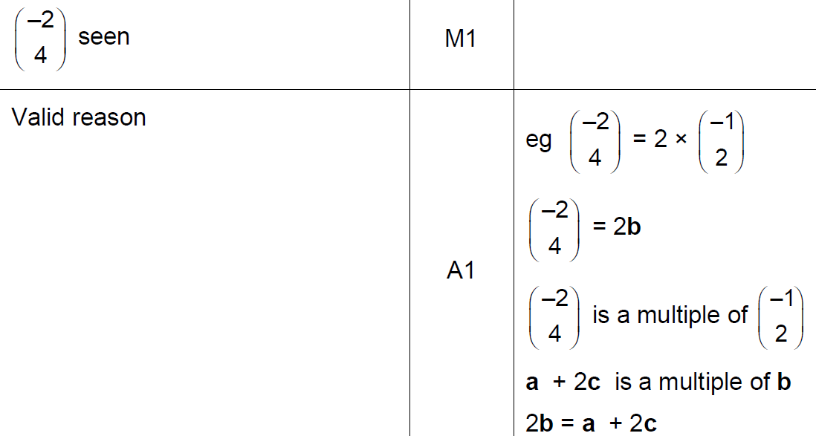
Vectors
June 2018 3H Q11
A
B

Slide 18
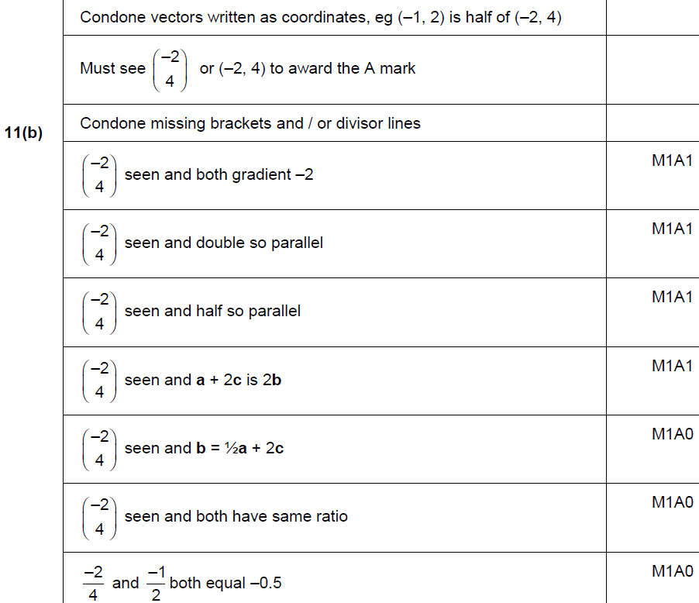
Vectors
June 2018 3H Q11
B

Slide 19
Vectors
Nov 2017 2H Q26
A Alternative 2

Slide 20
Vectors
Nov 2017 2H Q26
A notes

Slide 21
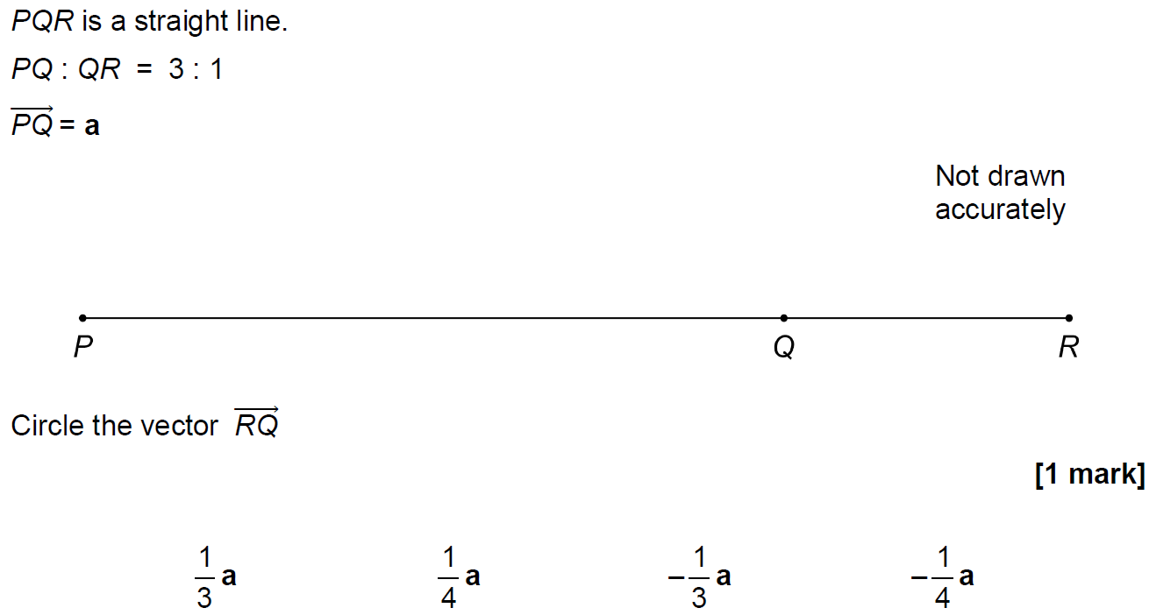
Vectors
Nov 2018 2H Q23

Slide 22
Vectors
Nov 2018 2H Q23
A

