Slide 1
Vectors
Vectors
Old Spec Q’s
SAM
1H Q22
SAM
2H Q23
May 2018
1H Q17
June 2018
2HR Q23
Jan 2019
2H Q23
Jan 2019
1HR Q22
June 2019
2H Q14
Show/ Prove that

Slide 2
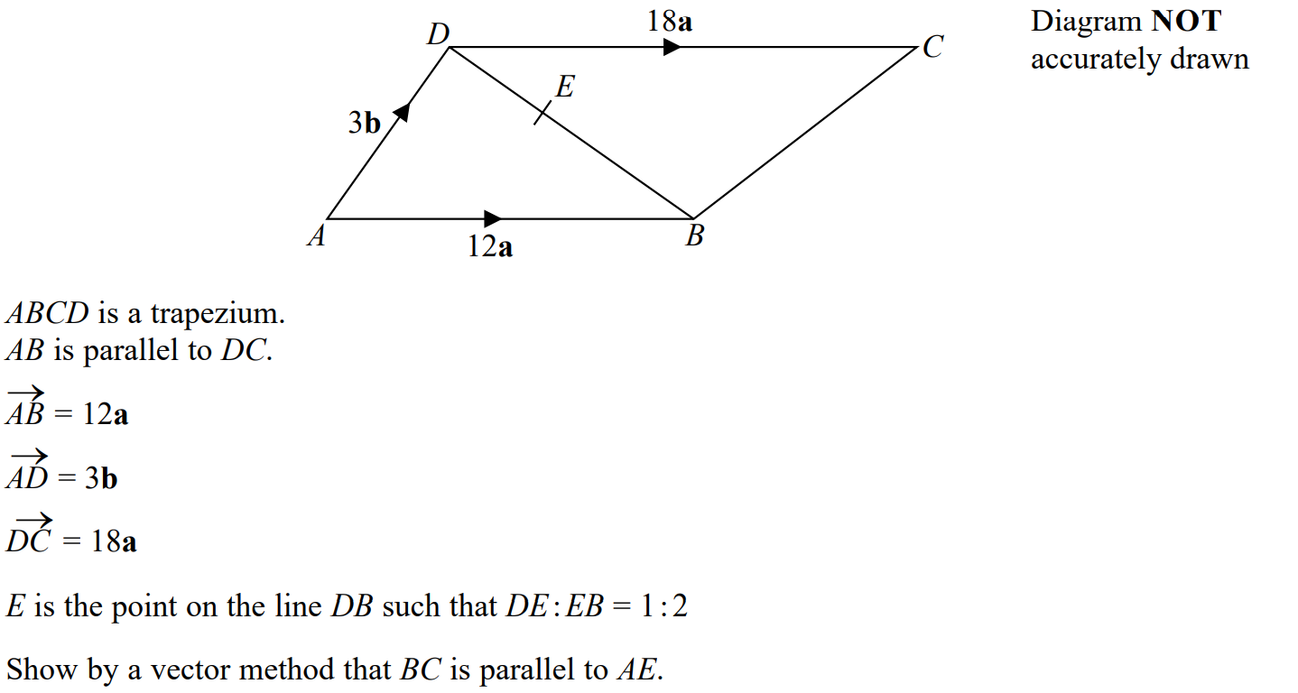
Vectors
SAM 1H Q22

Slide 3
Vectors
SAM 1H Q22
A

Slide 4
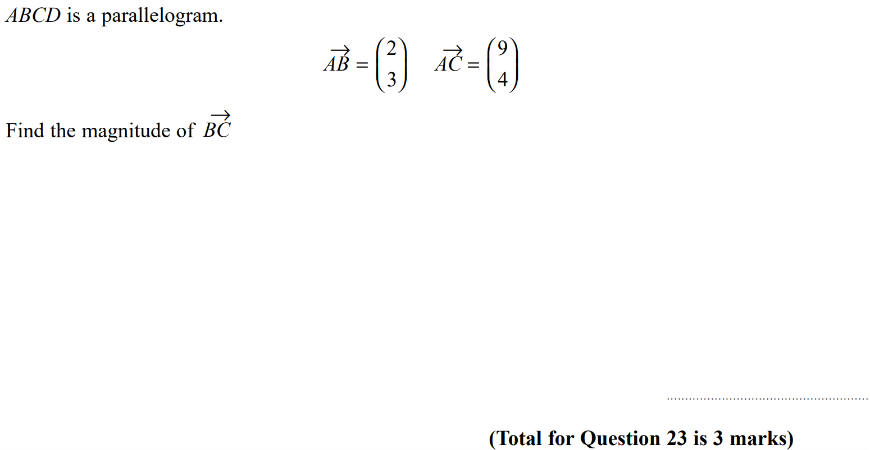
Vectors
SAM 2H Q23

Slide 5
Vectors
SAM 2H Q23
A

Slide 6
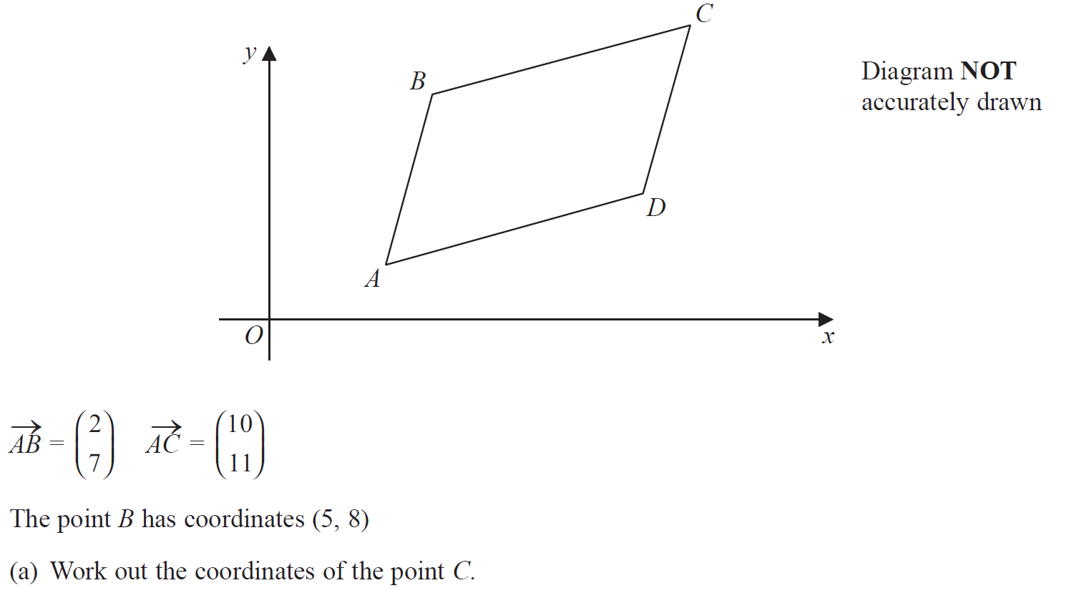
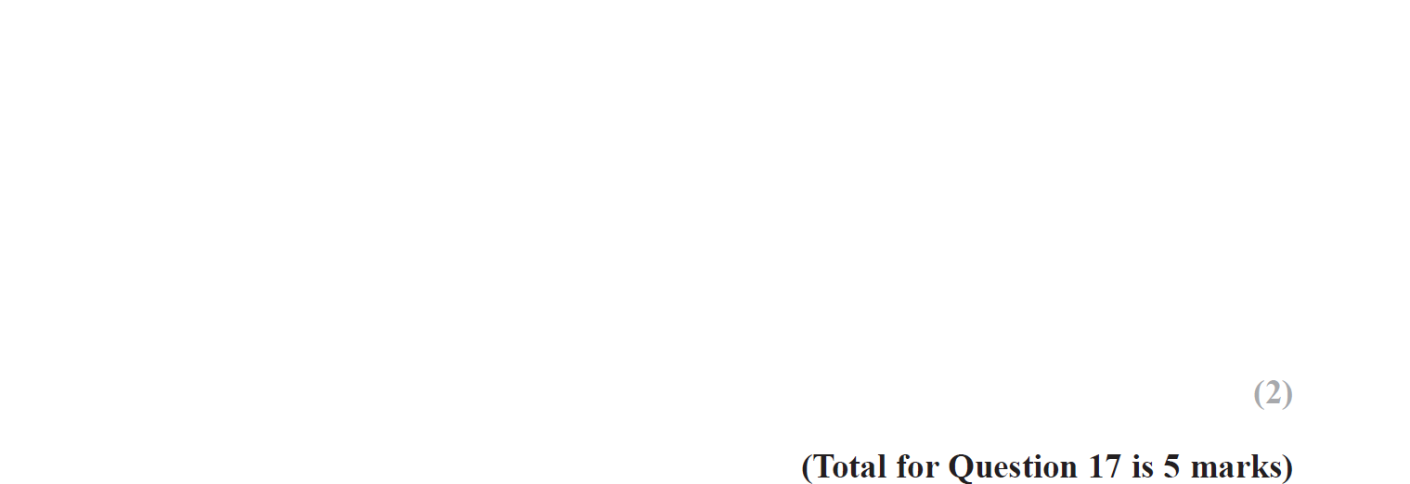
Vectors
May 2018 1H Q17

Slide 7
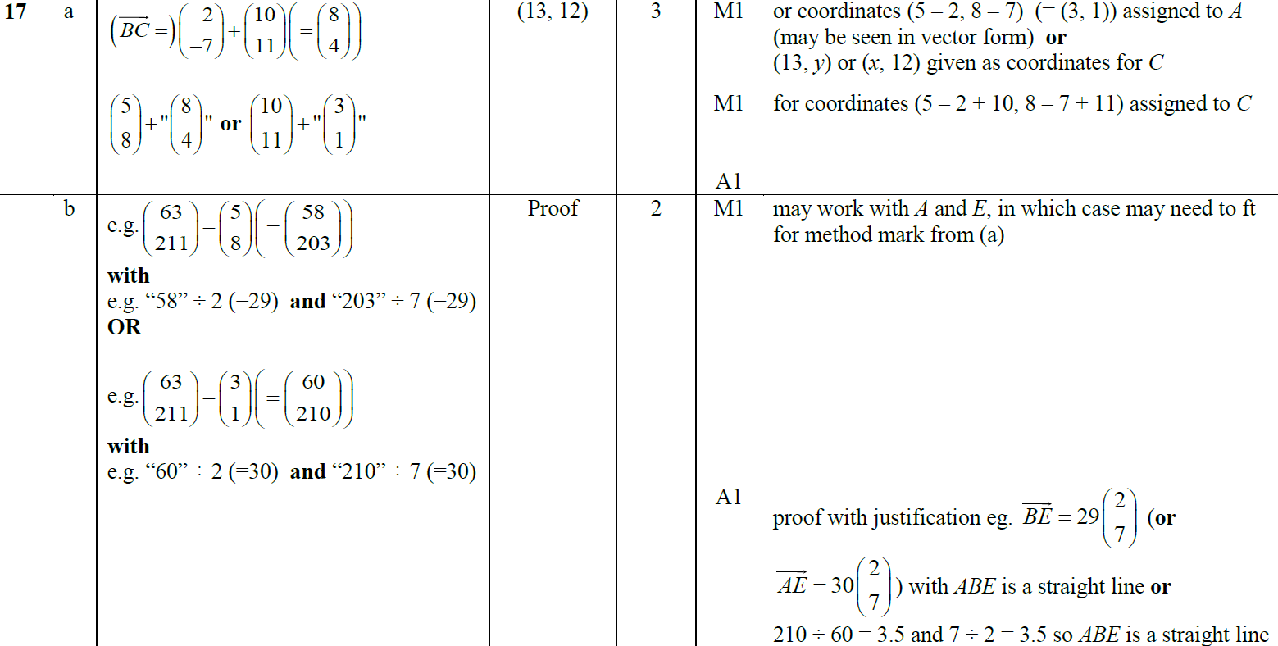
Vectors
May 2018 1H Q17
A
B

Slide 8
Vectors
June 2018 2HR Q23

Slide 9
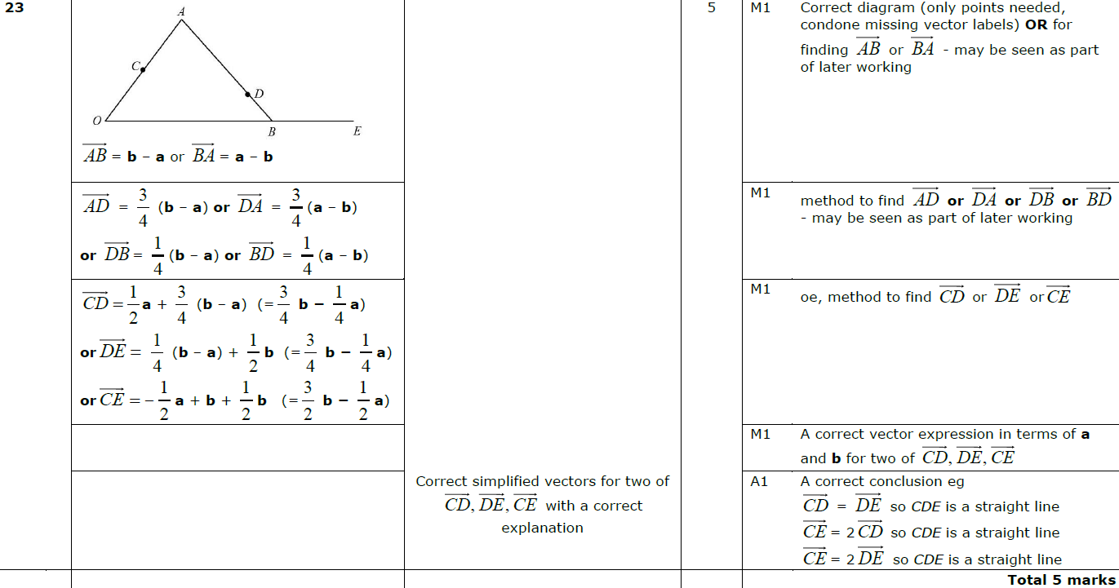
Vectors
June 2018 2HR Q23
A

Slide 10
Vectors
Jan 2019 2H Q23

Slide 11
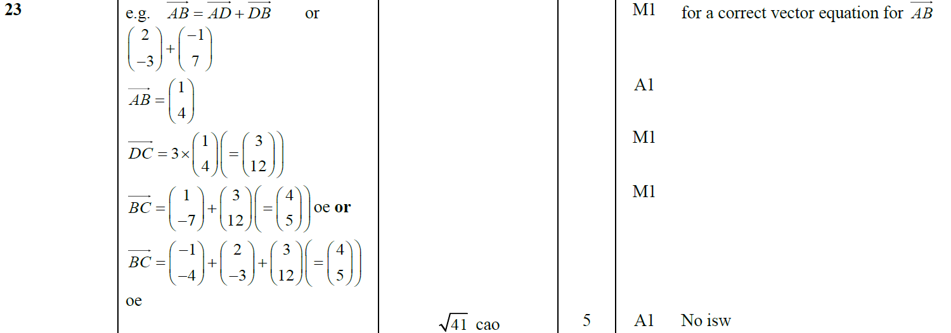
Vectors
Jan 2019 2H Q23
A

Slide 12
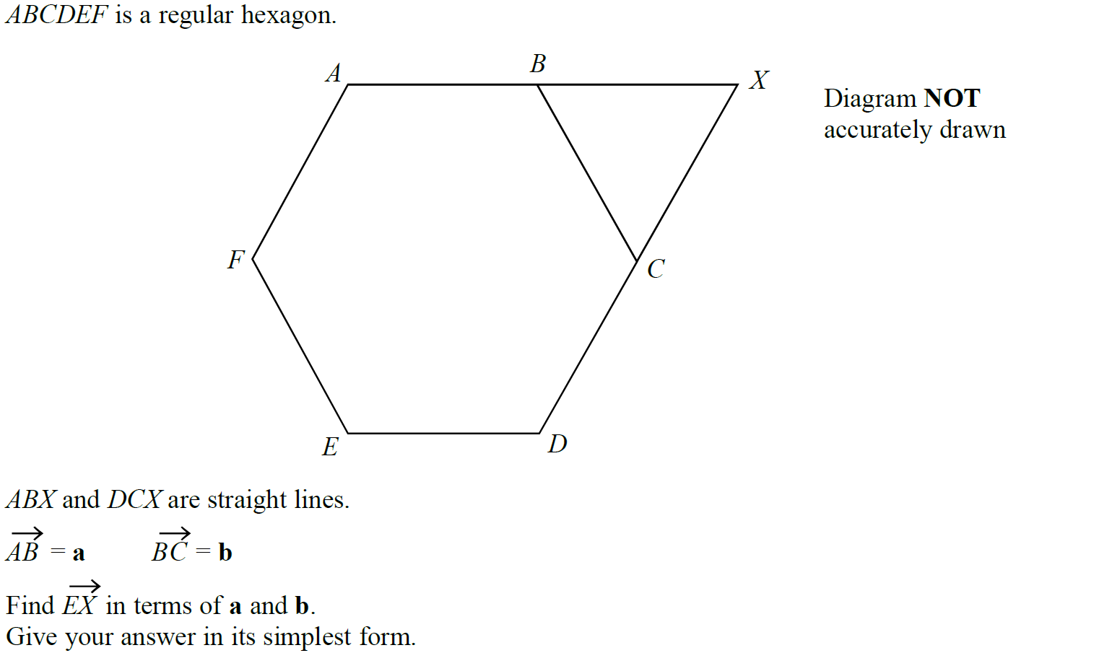
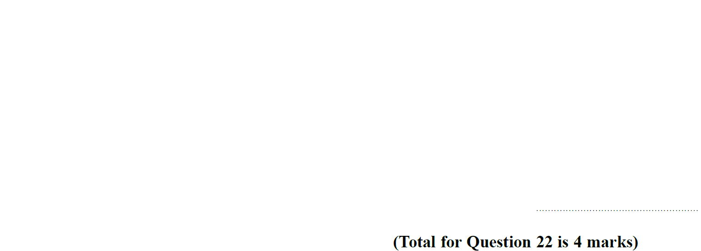
Vectors
Jan 2019 1HR Q22

Slide 13
Vectors
Jan 2019 1HR Q22
A

Slide 14
Vectors
June 2019 2H Q14

Slide 15
Vectors
June 2019 2H Q14
A

Slide 16
Vectors
Vectors
New Spec Q’s
May 2004
4H Q22
June 2010
4H Q21
Jan 2014 4HR Q18
Jan 2016 3HR Q19
Jan 2018 4H Q18
May 2005
4H Q16
Nov 2010
4H Q21
May 2014 3HR Q12
June 2016 4H Q22
Jan 2018 4HR Q17
Nov 2005
4H Q20
June 2011 4H Q24
Jan 2015 4H Q19
June 2016 4HR Q19
June 2018 4H Q10
May 2006
4H Q14
Jan 2012 4H Q22
Jan 2015 4HR Q15
Jan 2017 4H Q15
May 2007
3H Q16
Jan 2013 3H Q20
May 2015 3H Q24
Jan 2017 3HR Q23
May 2008
4H Q21
May 2013 4H Q21
June 2015 4H Q17
May 2017 3H Q17
Nov 2008
4H Q19
May 2013 3HR Q23
May 2015 3HR Q18
June 2017 4HR Q21
June 2009
4H Q18
Jan 2014 3H Q21
Jan 2016 3H Q23
Jan 2018 3H Q24
Show/ Prove that

Slide 17
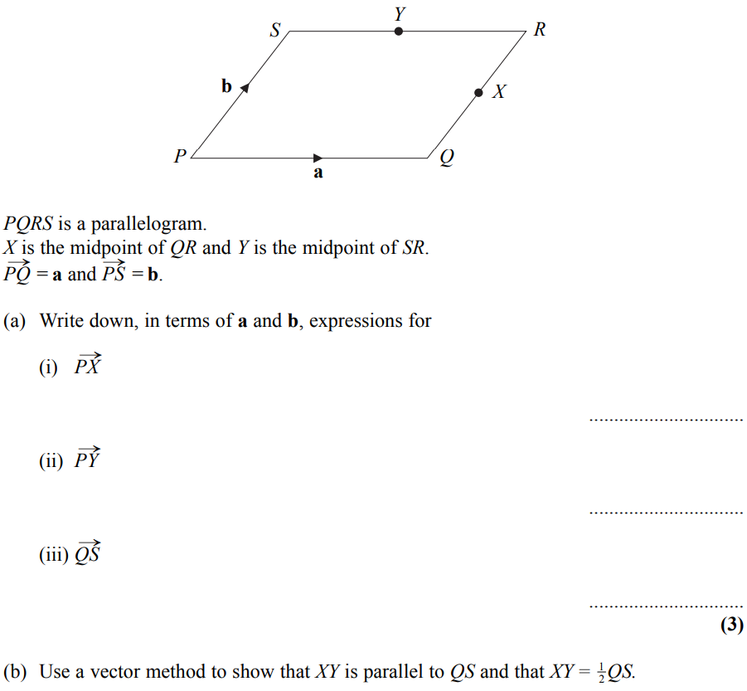
Vectors
May 2004 4H Q22

Slide 18
Vectors
May 2004 4H Q22
A (i)
A (ii)
A (iii)
B

Slide 19
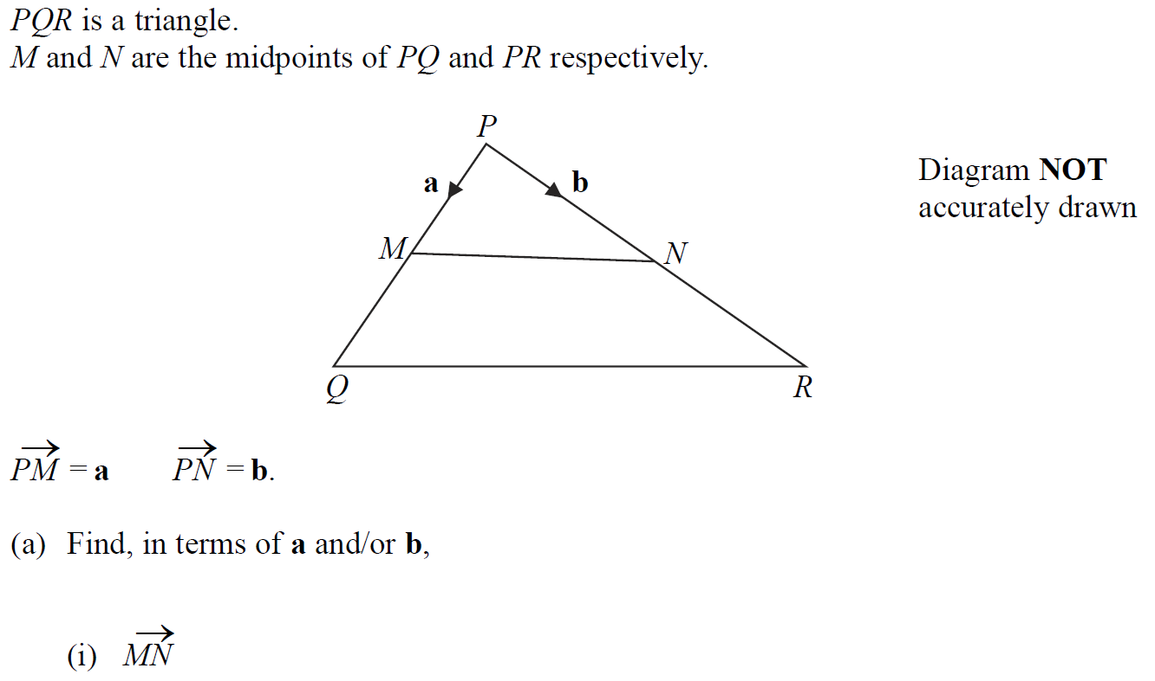
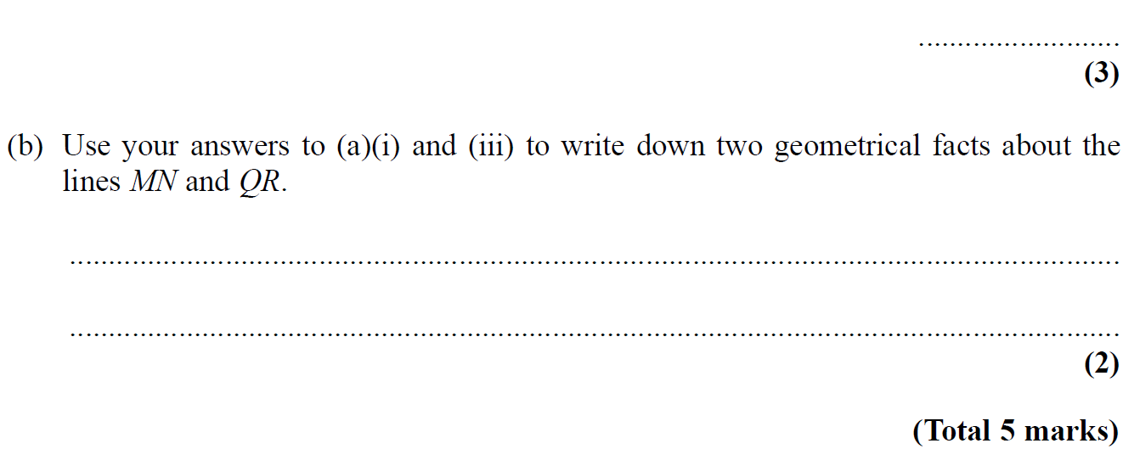
Vectors
May 2005 4H Q16

Slide 20
Vectors
May 2005 4H Q16
A (i)
A (ii)
A (iii)
B

Slide 21
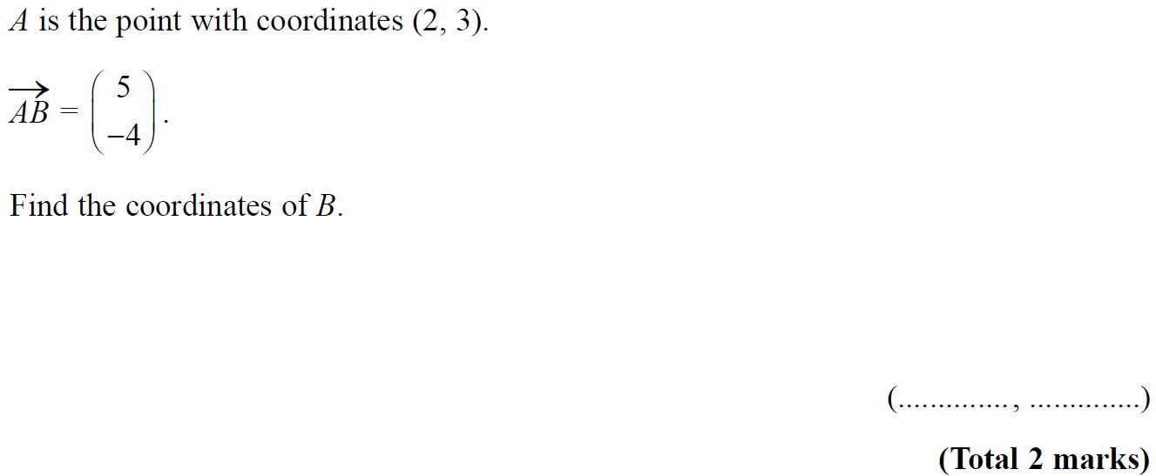
Vectors
Nov 2005 4H Q20

Slide 22
Vectors
Nov 2005 4H Q20
A

Slide 23
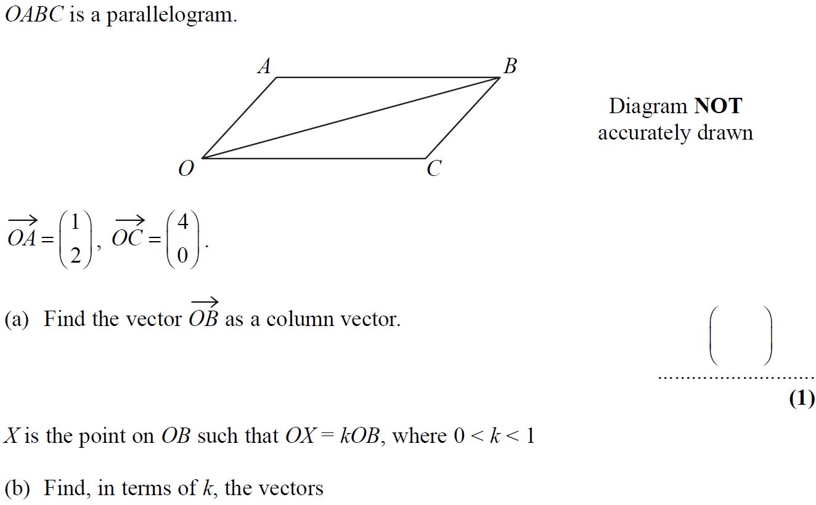
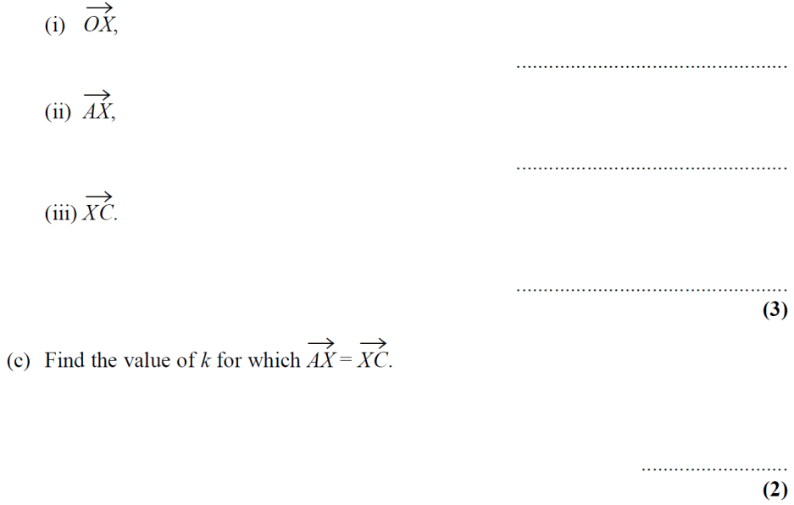
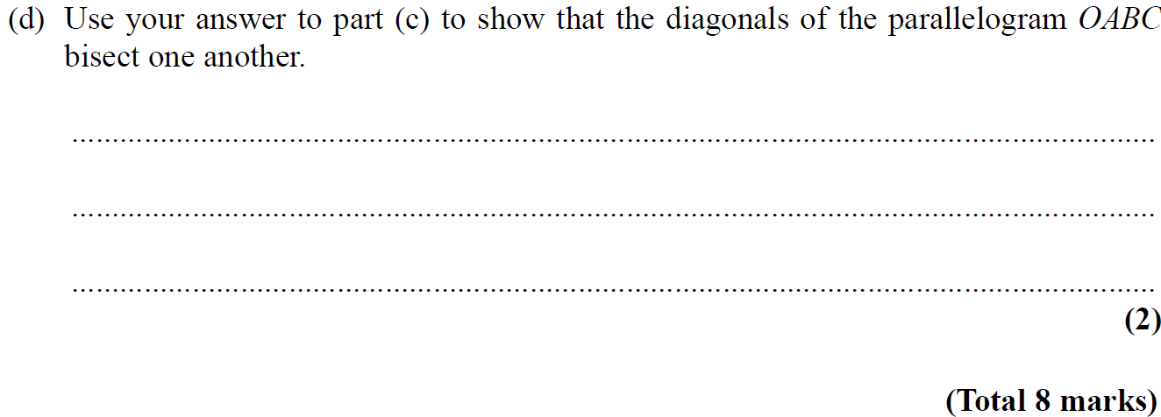
Vectors
May 2006 4H Q14

Slide 24
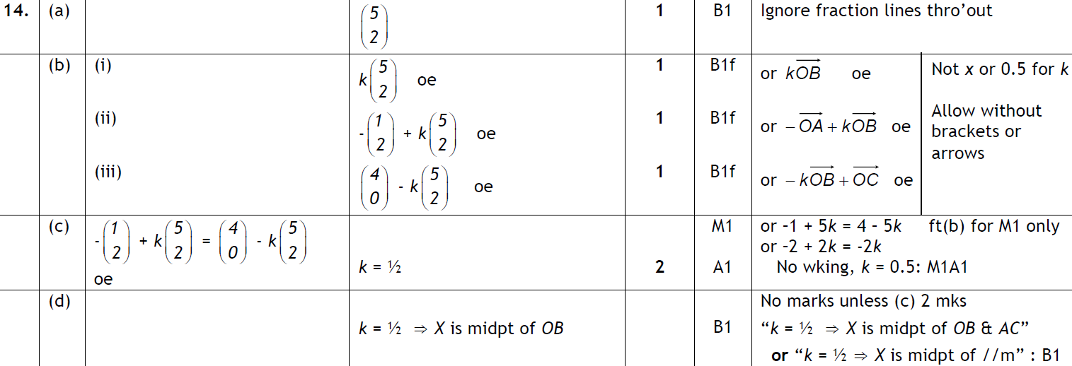
Vectors
May 2006 4H Q14
A
B
C
D

Slide 25
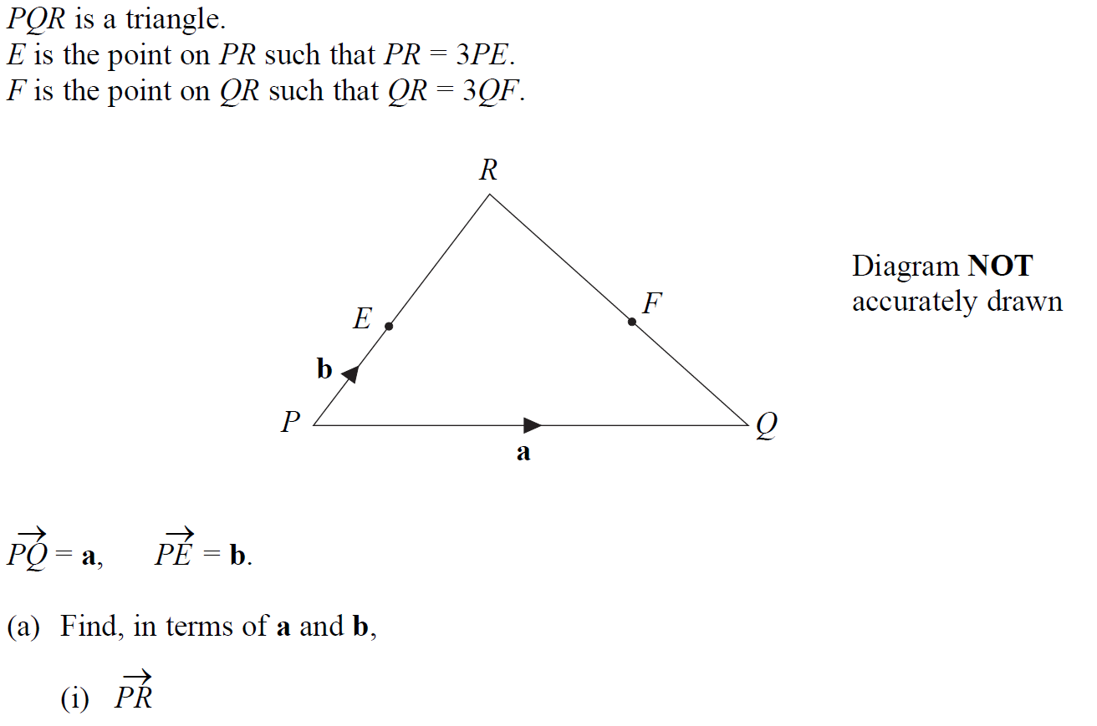
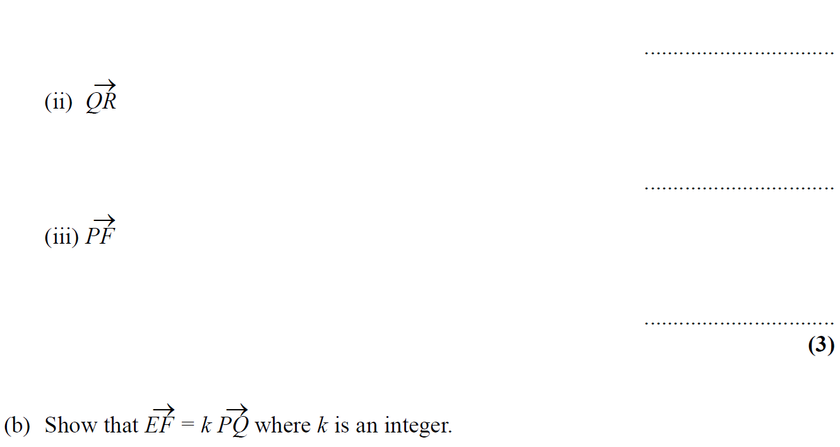
Vectors
May 2007 3H Q16

Slide 26
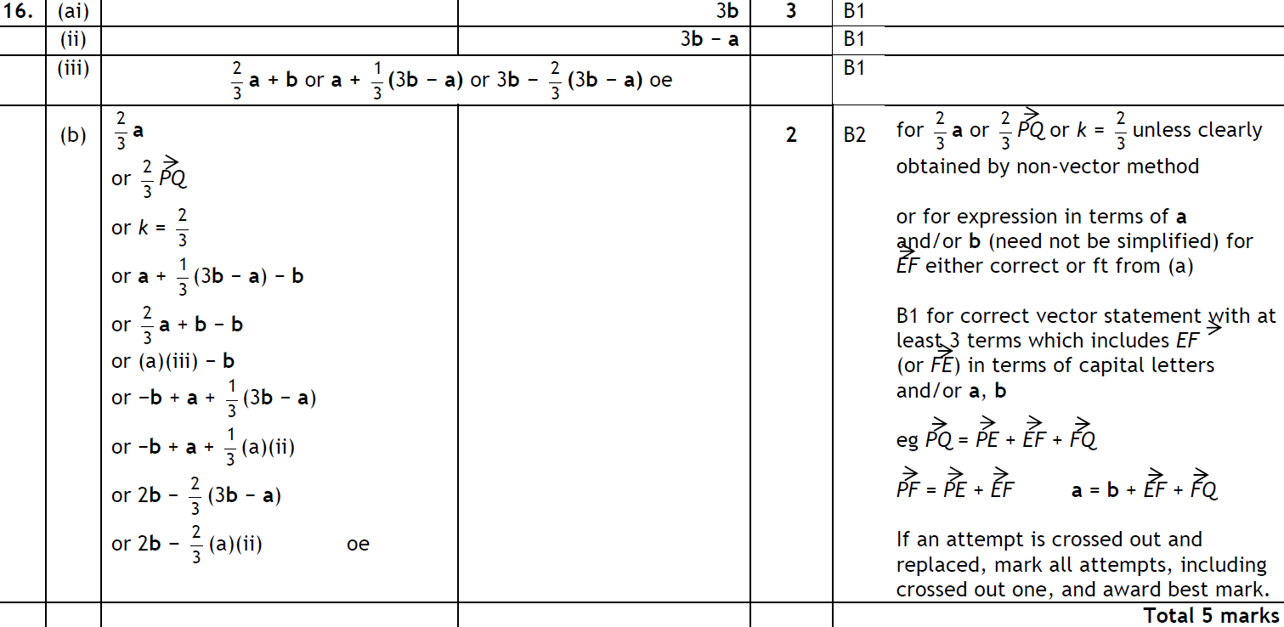
Vectors
May 2007 3H Q16
A (i)
A (ii)
A (iii)
B

Slide 27
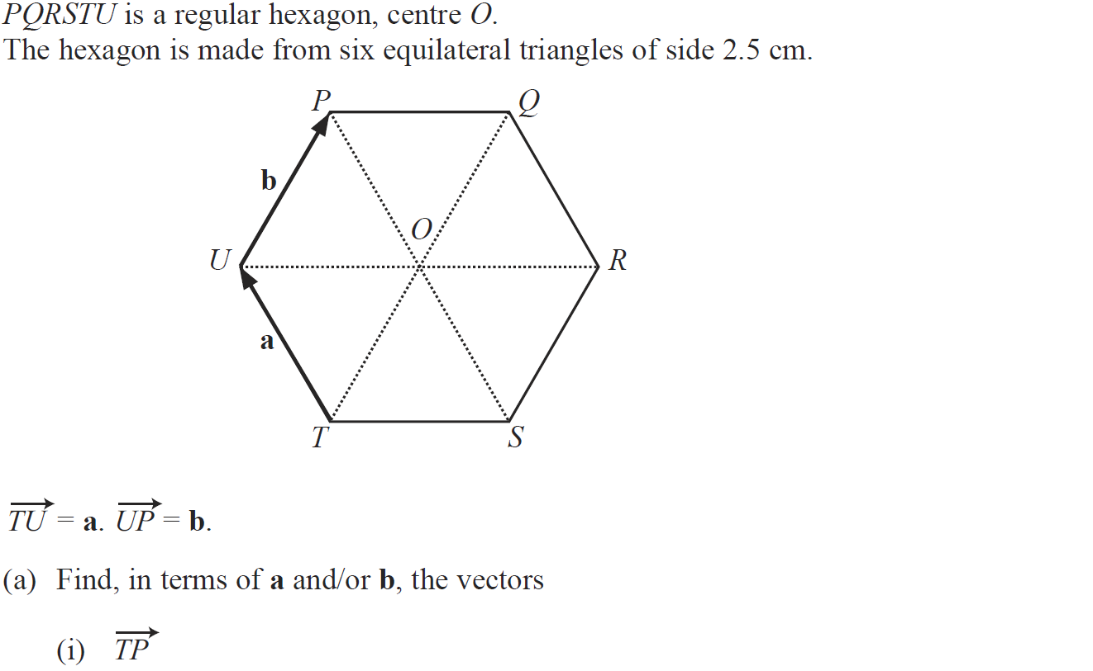
Vectors
May 2008 4H Q21

Slide 28
Vectors
May 2008 4H Q21
A (i)
A (ii)
A (iii)
B

Slide 29
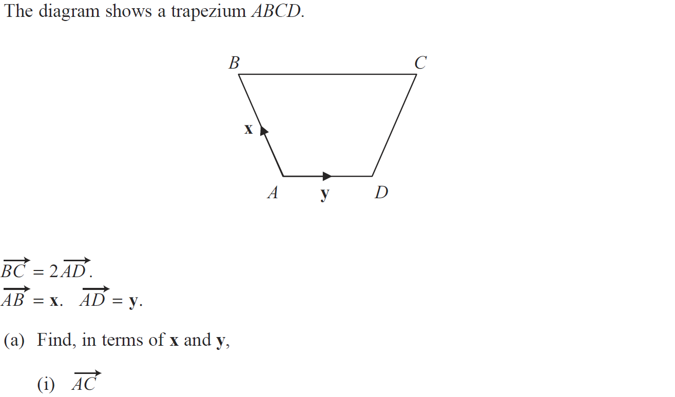
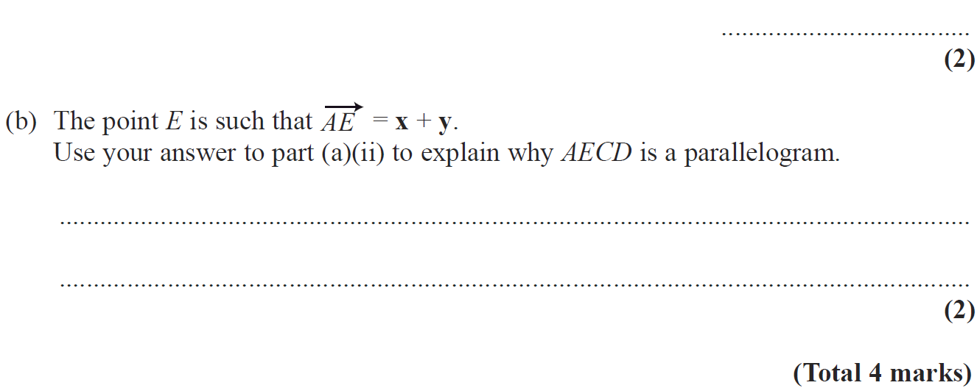
Vectors
Nov 2008 4H Q19

Slide 30
Vectors
Nov 2008 4H Q19
A (i)
A (ii)
B

Slide 31
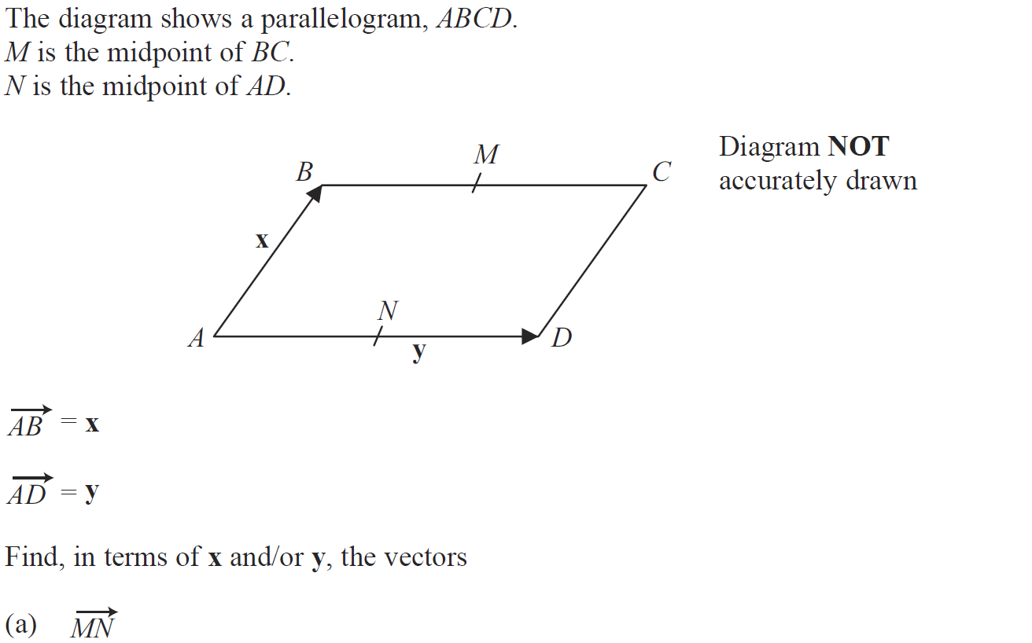
Vectors
June 2009 4H Q18

Slide 32
Vectors
June 2009 4H Q18
A
B
C

Slide 33
Vectors
June 2010 4H Q21

Slide 34
Vectors
June 2010 4H Q21
A
B
C (i)
C (ii)

Slide 35
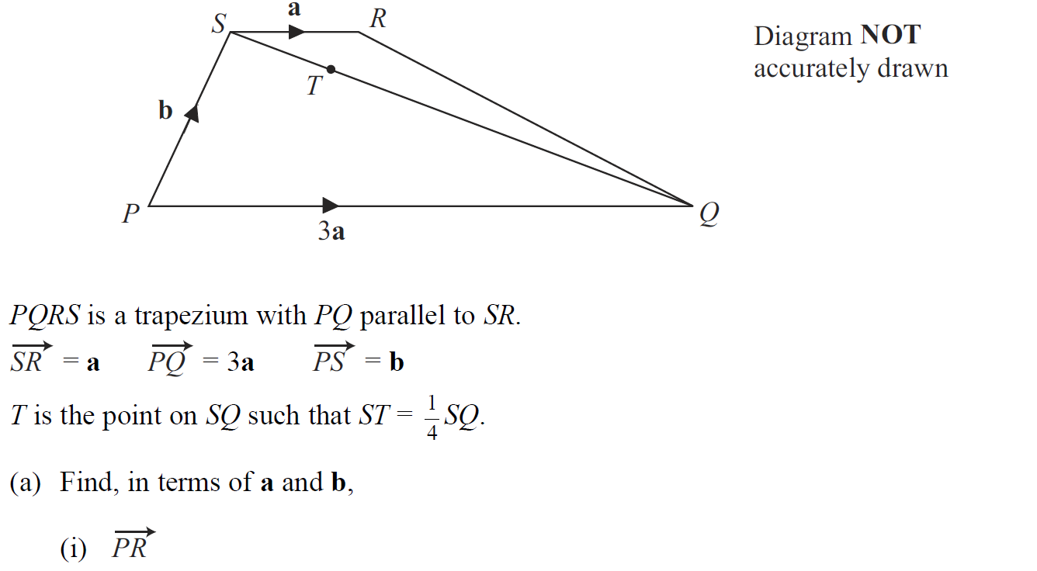
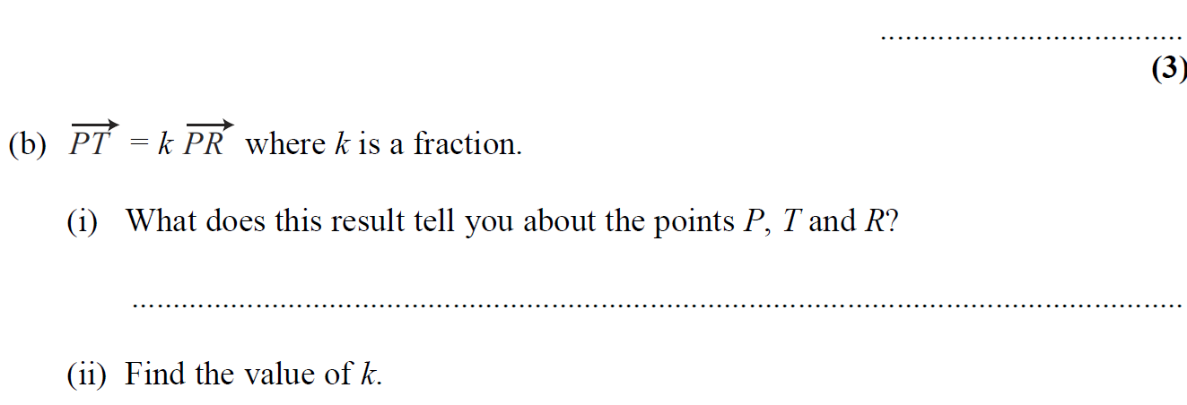
Vectors
Nov 2010 4H Q21

Slide 36
Vectors
Nov 2010 4H Q21
A (i)
A (ii)
A (iii)
B (i)
B (ii)

Slide 37
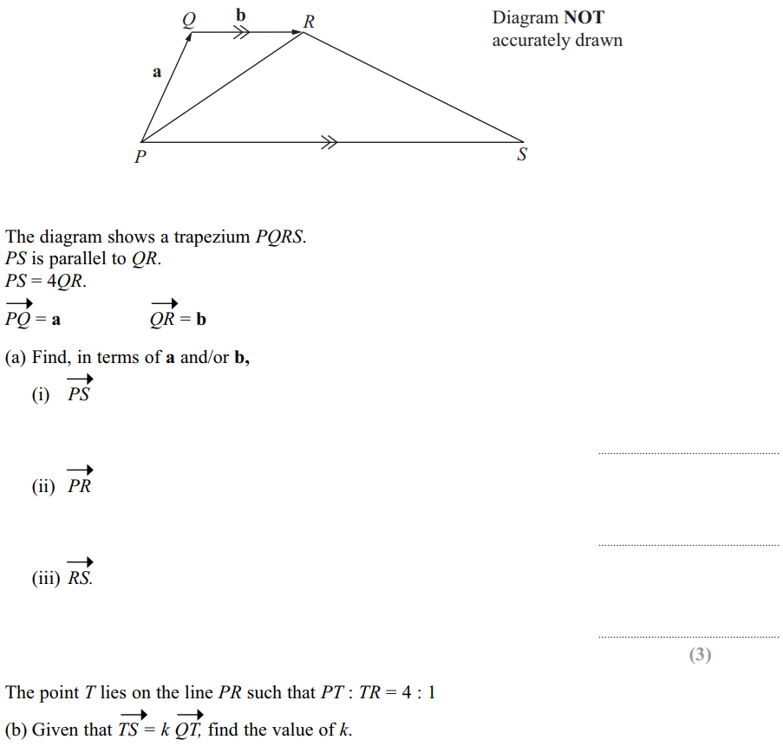
Vectors
June 2011 4H Q24

Slide 38
Vectors
June 2011 4H Q24
A (i)
A (ii)
A (iii)
B

Slide 39
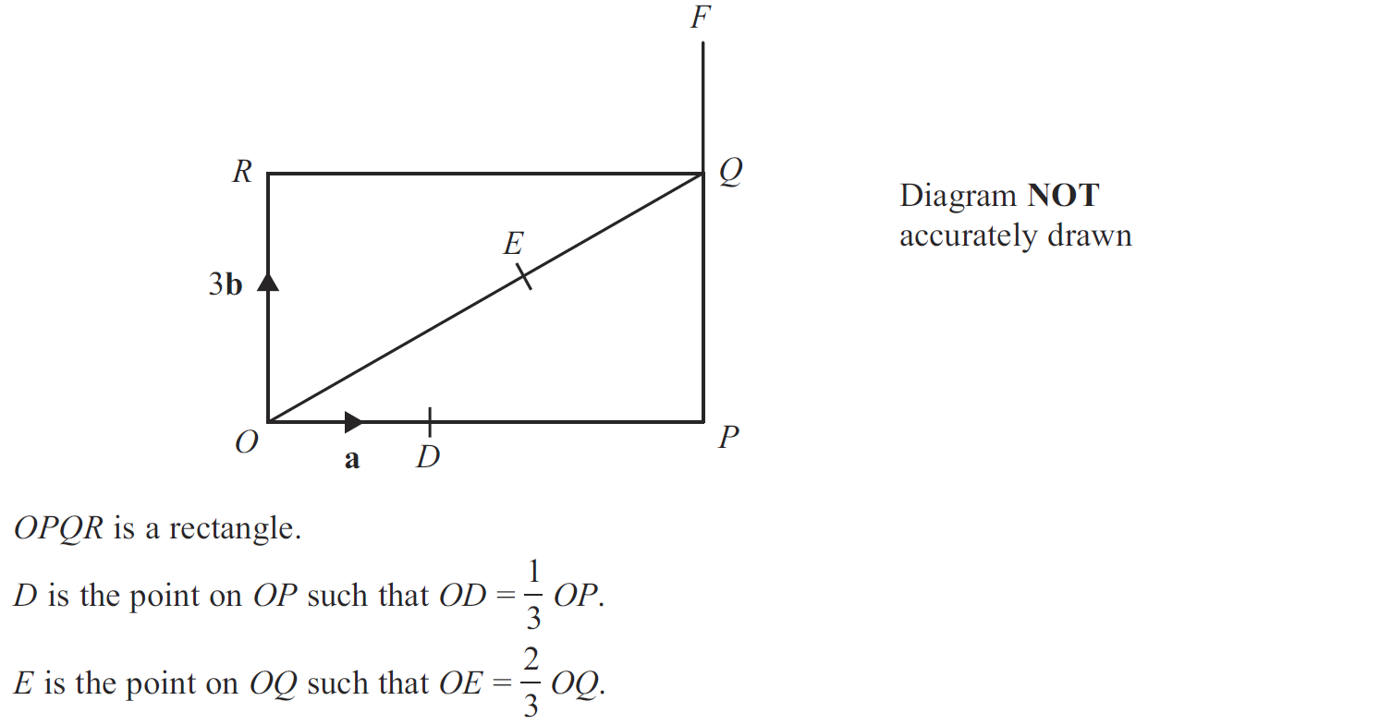
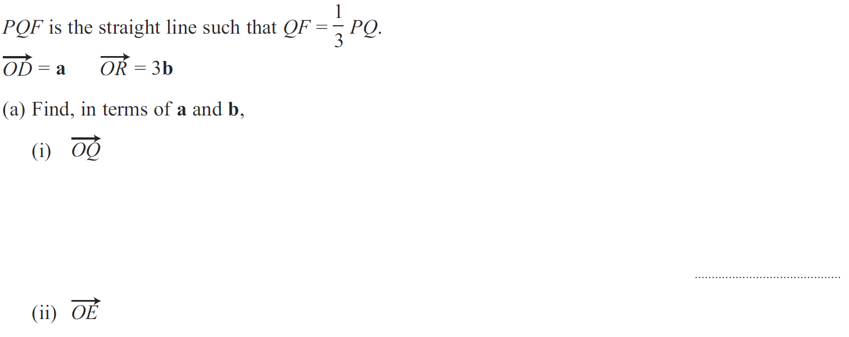
Vectors
Jan 2012 4H Q22

Slide 40
Vectors
Jan 2012 4H Q22
A (i)
A (ii)
A (iii)
B

Slide 41
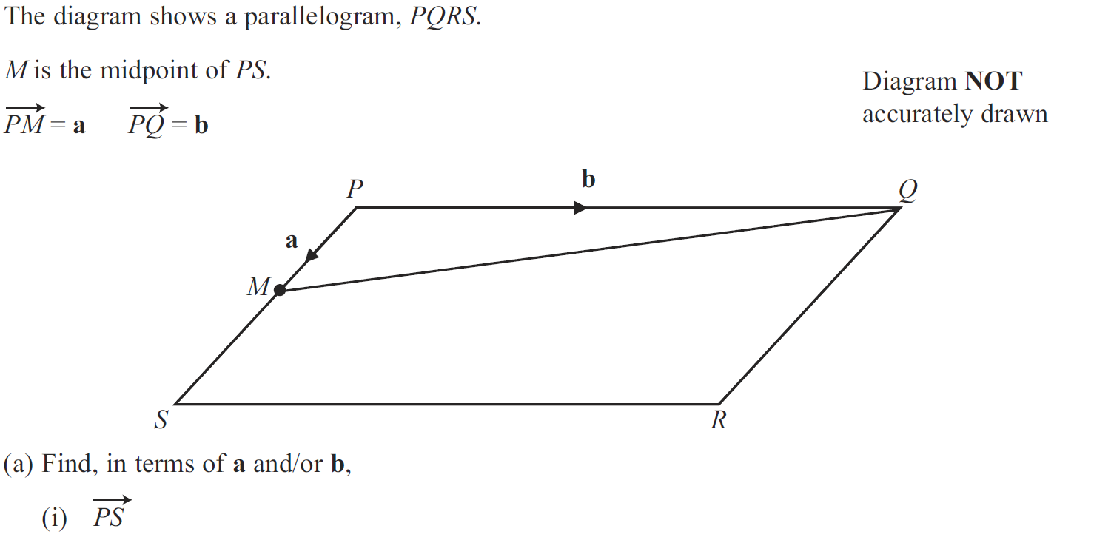
Vectors
Jan 2013 3H Q20

Slide 42
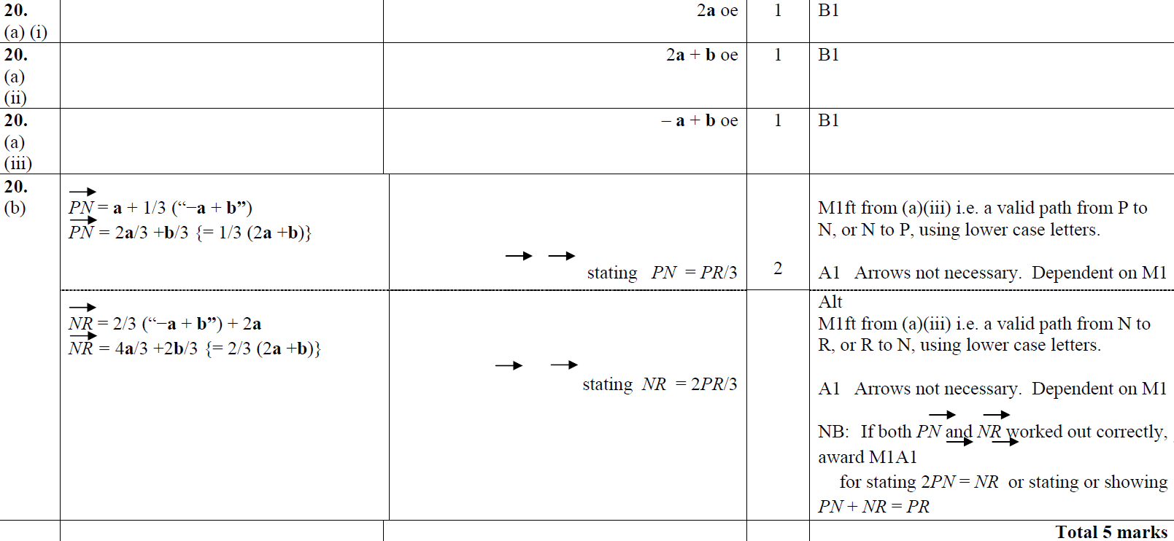
Vectors
Jan 2013 3H Q20
A (i)
A (ii)
A (iii)
B

Slide 43
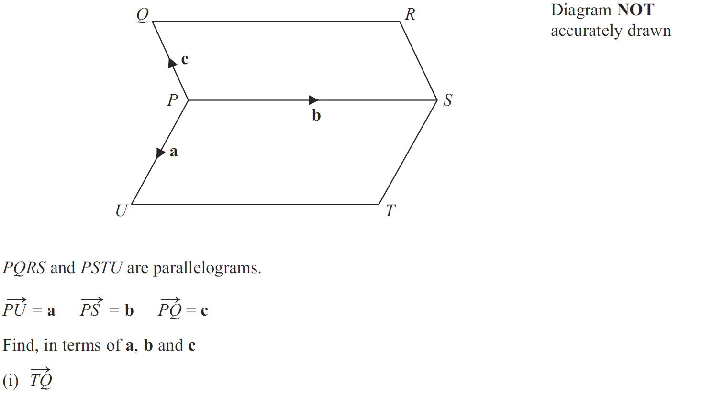
Vectors
May 2013 4H Q21

Slide 44
Vectors
May 2013 4H Q21
(i)
(ii)

Slide 45
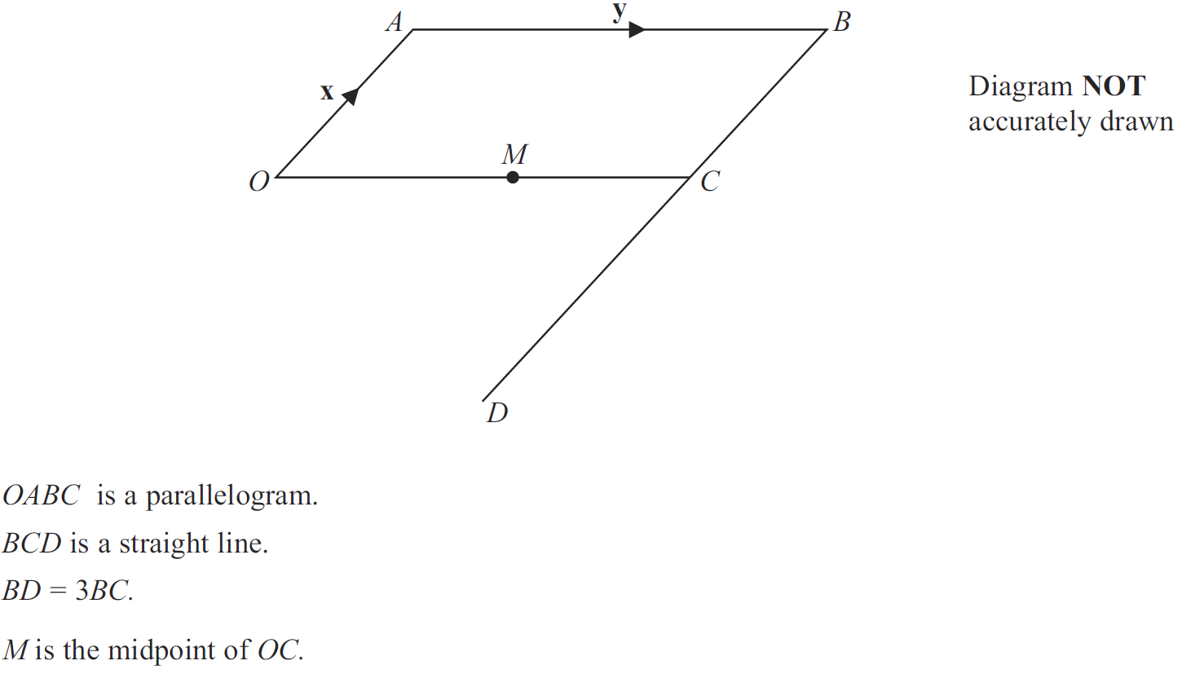
Vectors
May 2013 3HR Q23

Slide 46
Vectors
May 2013 3HR Q23
A (i)
A (ii)
B

Slide 47
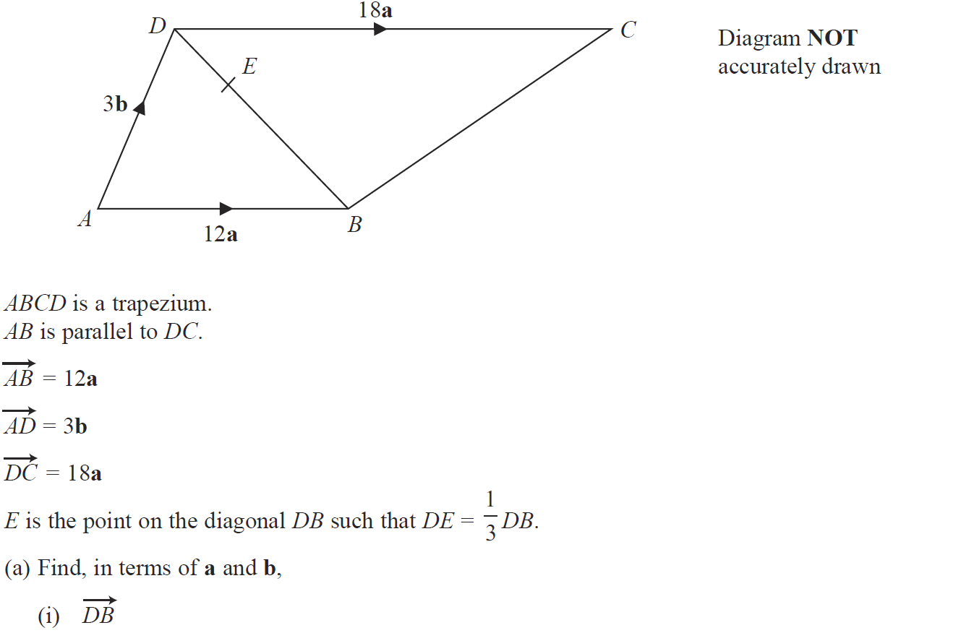
Vectors
Jan 2014 3H Q21

Slide 48
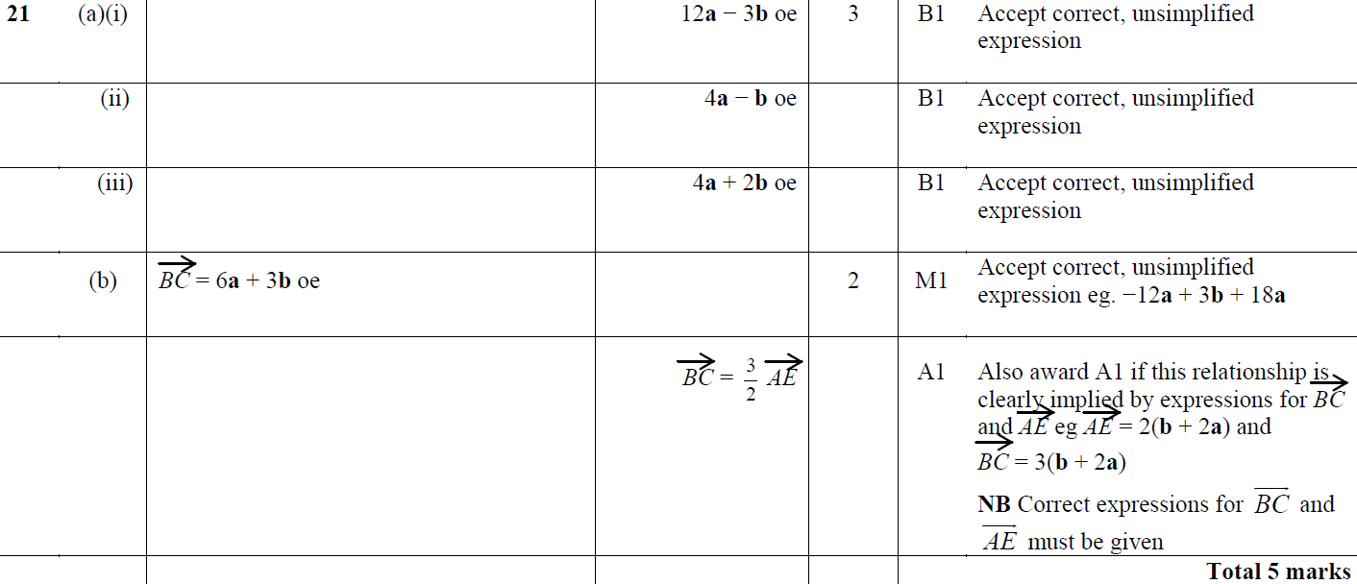
Vectors
Jan 2014 3H Q21
A (i)
A (ii)
A (iii)
B

Slide 49
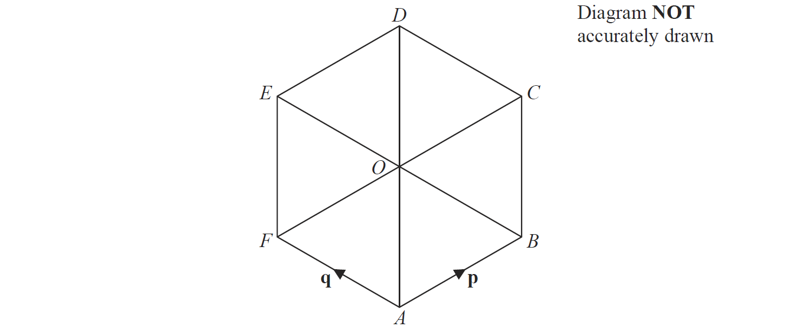
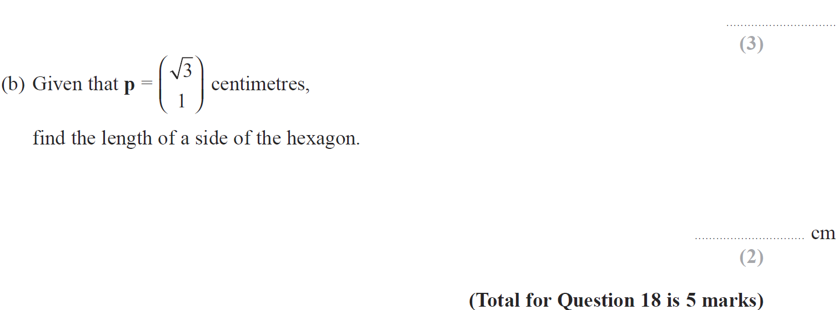
Vectors
Jan 2014 4HR Q18

Slide 50
Vectors
Jan 2014 4HR Q18
A (i)
A (ii)
A (iii)
B

Slide 51
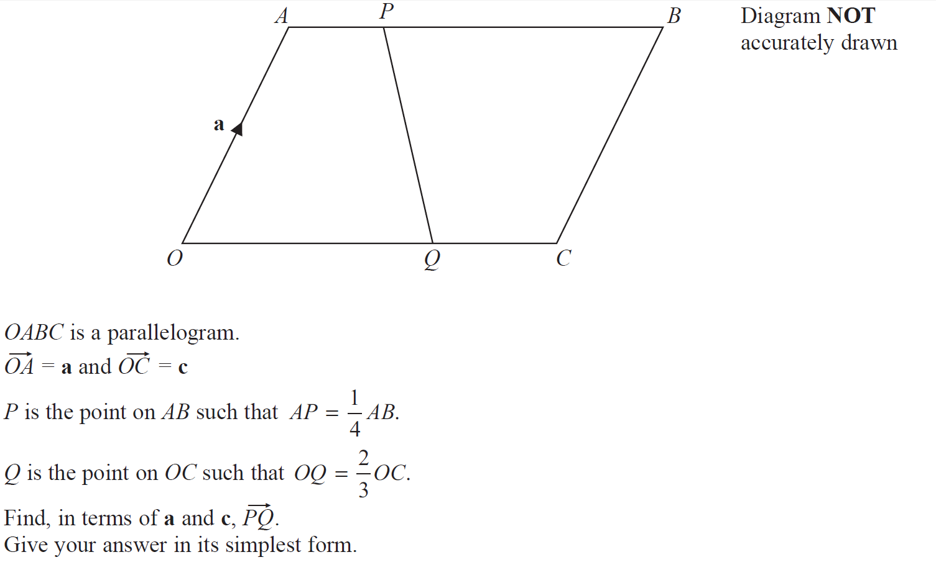
Vectors
May 2014 3HR Q21

Slide 52
Vectors
May 2014 3HR Q21
A

Slide 53
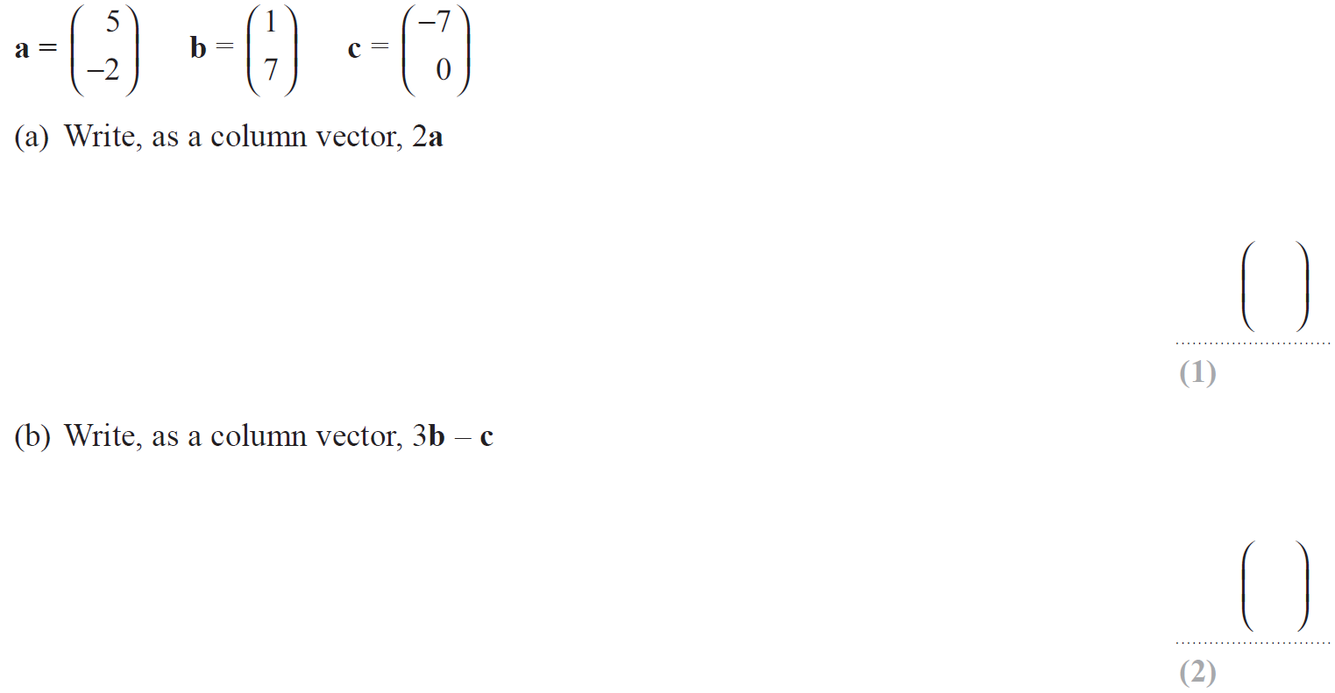
Vectors
Jan 2015 4H Q19

Slide 54
Vectors
Jan 2015 4H Q19
A
B
C

Slide 55
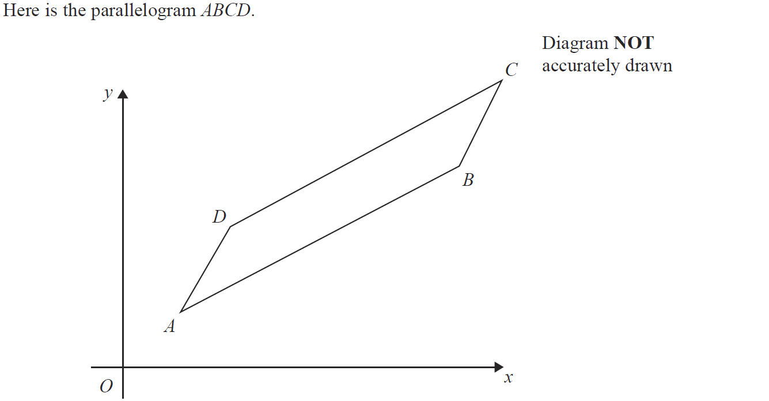
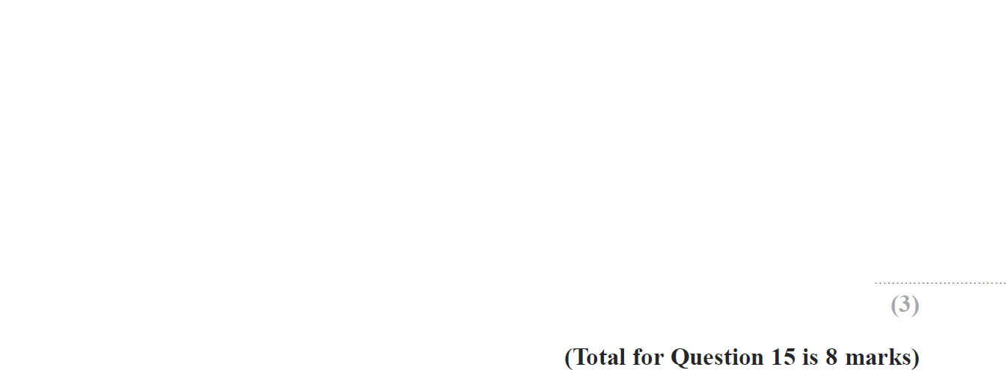
Vectors
Jan 2015 4HR Q15

Slide 56
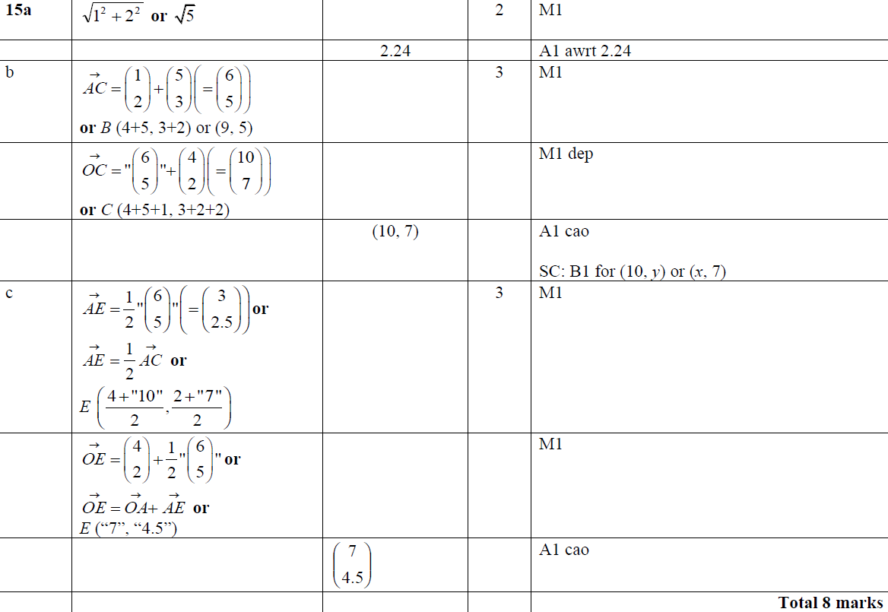
Vectors
Jan 2015 4HR Q15
A
B
C

Slide 57
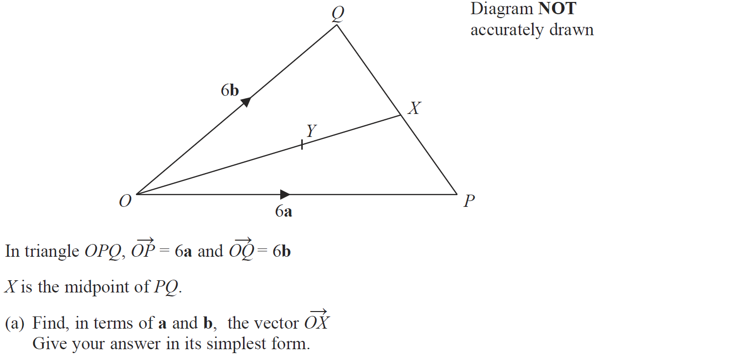
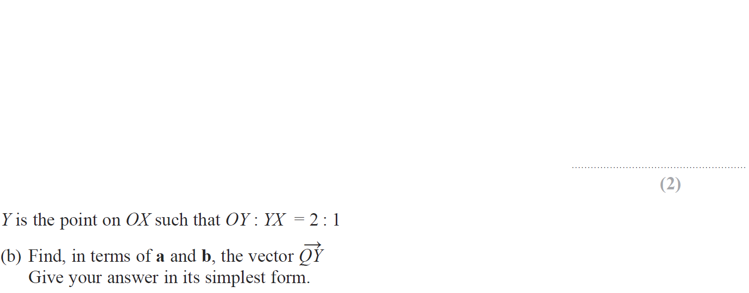
Vectors
May 2015 3H Q24

Slide 58
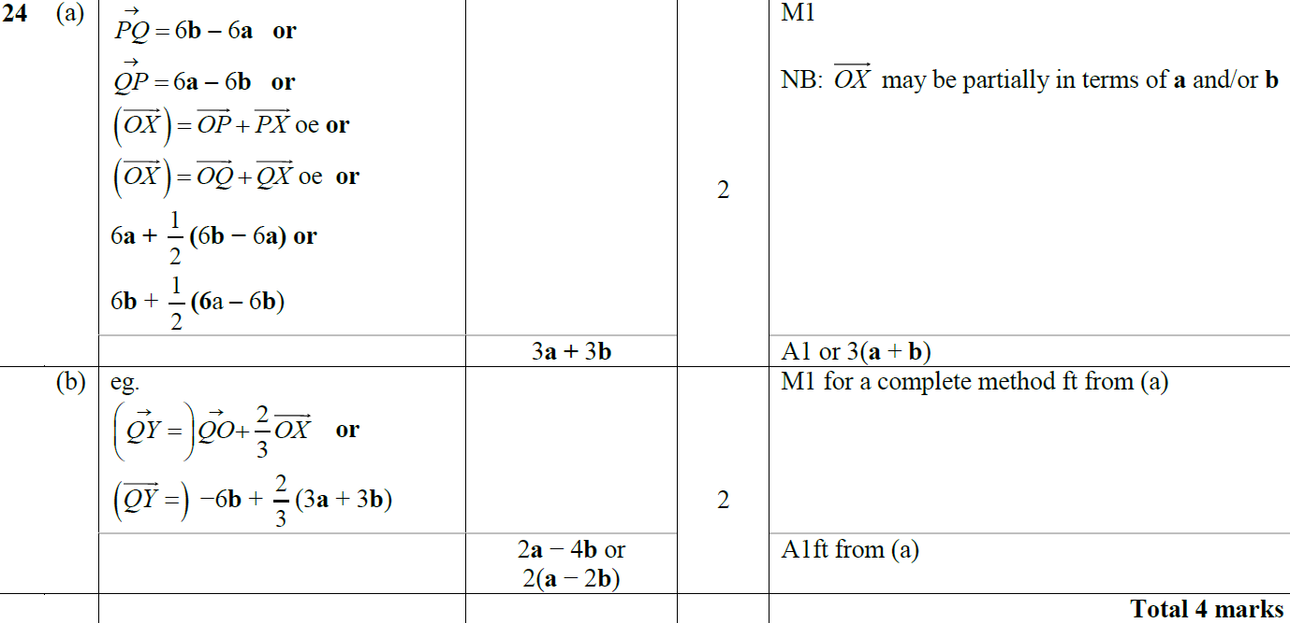
Vectors
May 2015 3H Q24
A
B

Slide 59
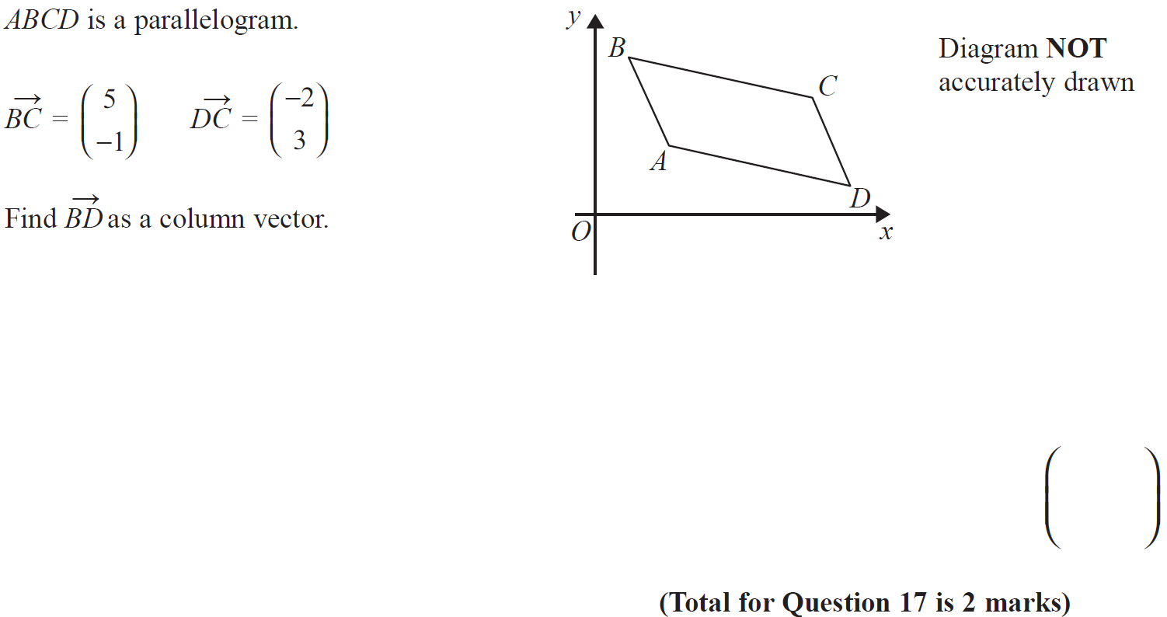
Vectors
June 2015 4H Q17

Slide 60
Vectors
June 2015 4H Q17
A

Slide 61
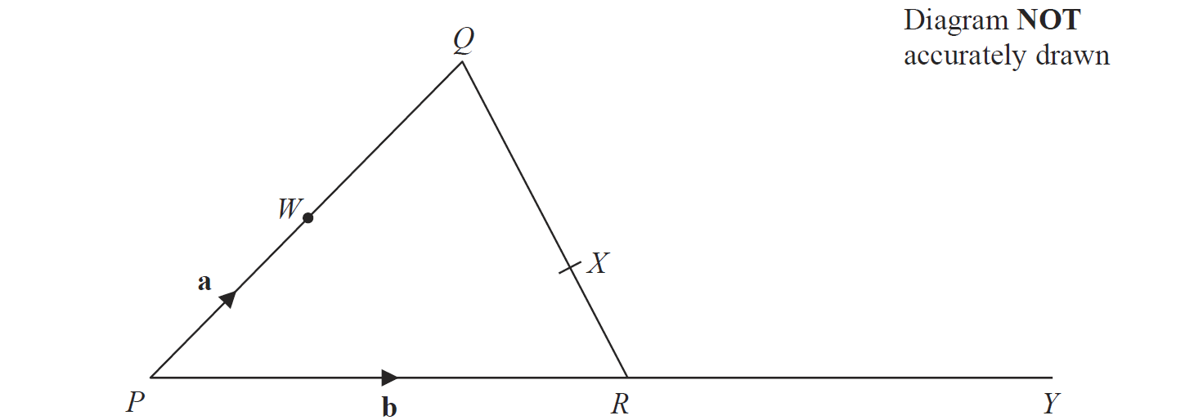
Vectors
May 2015 3HR Q18

Slide 62
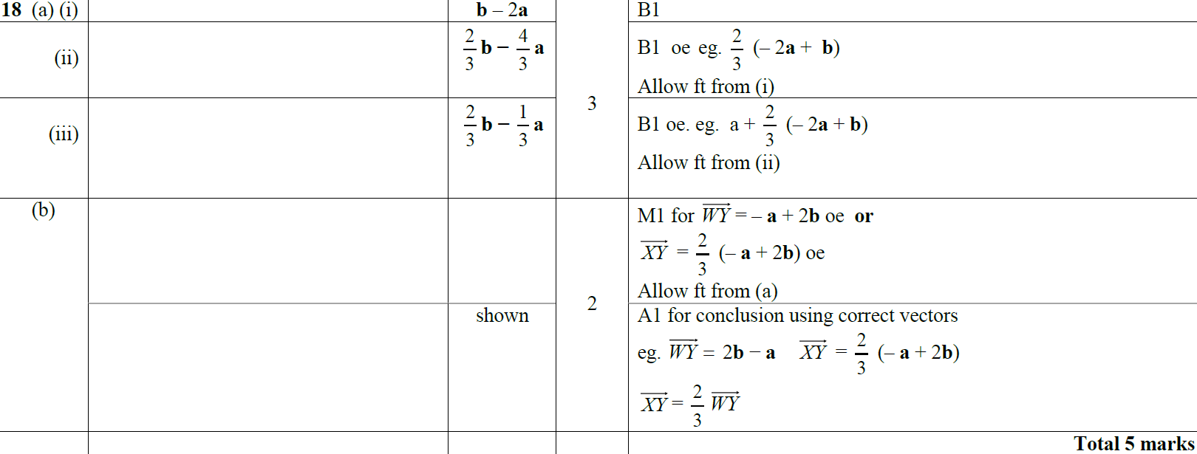
Vectors
May 2015 3HR Q18
A (i)
A (ii)
A (iii)
B

Slide 63
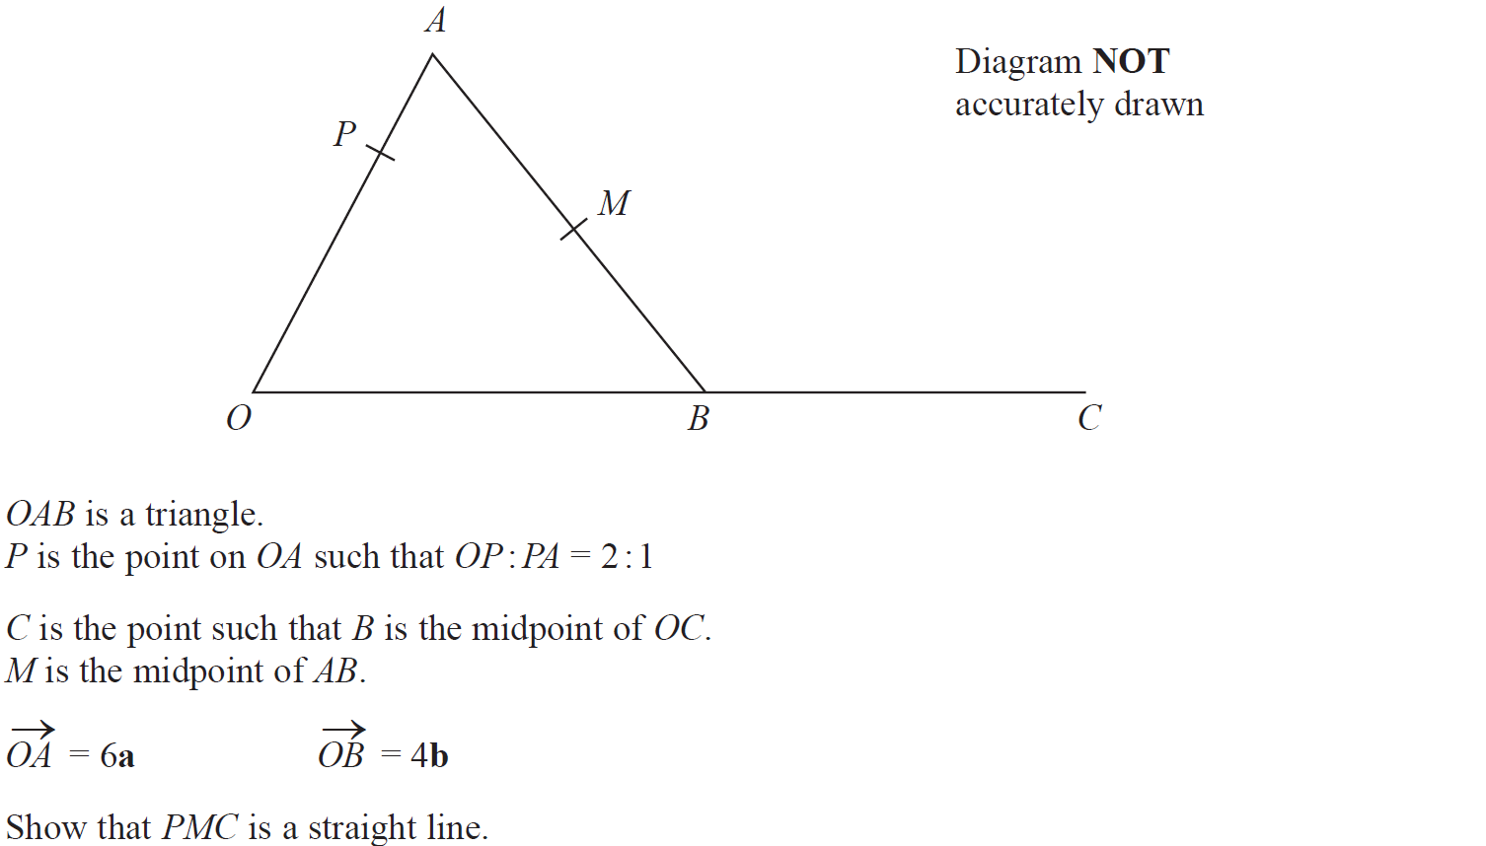
Vectors
Jan 2016 3H Q23

Slide 64
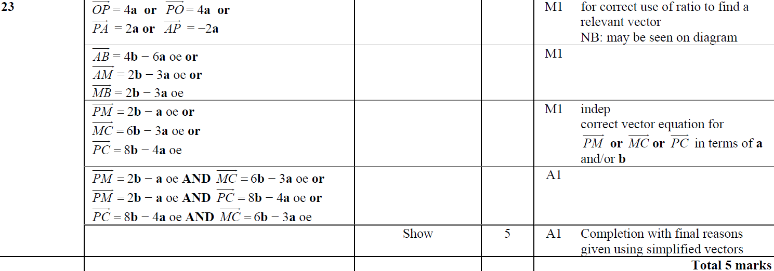
Vectors
Jan 2016 3H Q23
A

Slide 65
Vectors
Jan 2016 3HR Q19

Slide 66
Vectors
Jan 2016 3HR Q19
A
B
C
D

Slide 67
Vectors
June 2016 4H Q22

Slide 68
Vectors
June 2016 4H Q22
A (i)
A (ii)
B

Slide 69
Vectors
June 2016 4HR Q19

Slide 70
Vectors
June 2016 4HR Q19
A
B

Slide 71
Vectors
Jan 2017 4H Q15

Slide 72
Vectors
Jan 2017 4H Q15
A
B

Slide 73
Vectors
Jan 2017 3HR Q23

Slide 74
Vectors
Jan 2017 3HR Q23
A
B

Slide 75
Vectors
May 2017 3H Q17

Slide 76
Vectors
May 2017 3H Q17
A (i)
A (ii)
A (iii)
B

Slide 77
Vectors
June 2017 4HR Q21

Slide 78
Vectors
June 2017 4HR Q21
A (i)
A (ii)
A (iii)
B

Slide 79
Vectors
Jan 2018 3H Q24

Slide 80
Vectors
Jan 2018 3H Q24
A

Slide 81
Vectors
Jan 2018 4H Q18

Slide 82
Vectors
Jan 2018 4H Q18
A
B

Slide 83
Vectors
Jan 2018 4HR Q17

Slide 84
Vectors
Jan 2018 4HR Q17
A (i)
A (ii)
B
C

Slide 85
Vectors
June 2018 4H Q10

Slide 86
Vectors
June 2018 4H Q10
A
B

