Slide 1
Vectors
Vectors
May 2017
1H Q19
SAM
3H Q18
Nov 2017
3H Q21
Spec 1
1H Q22
June 2018
2H Q10
Spec 2
3H Q20
Nov 2018
1H Q21
June 2019
2H Q20
Show/ Prove that

Slide 2
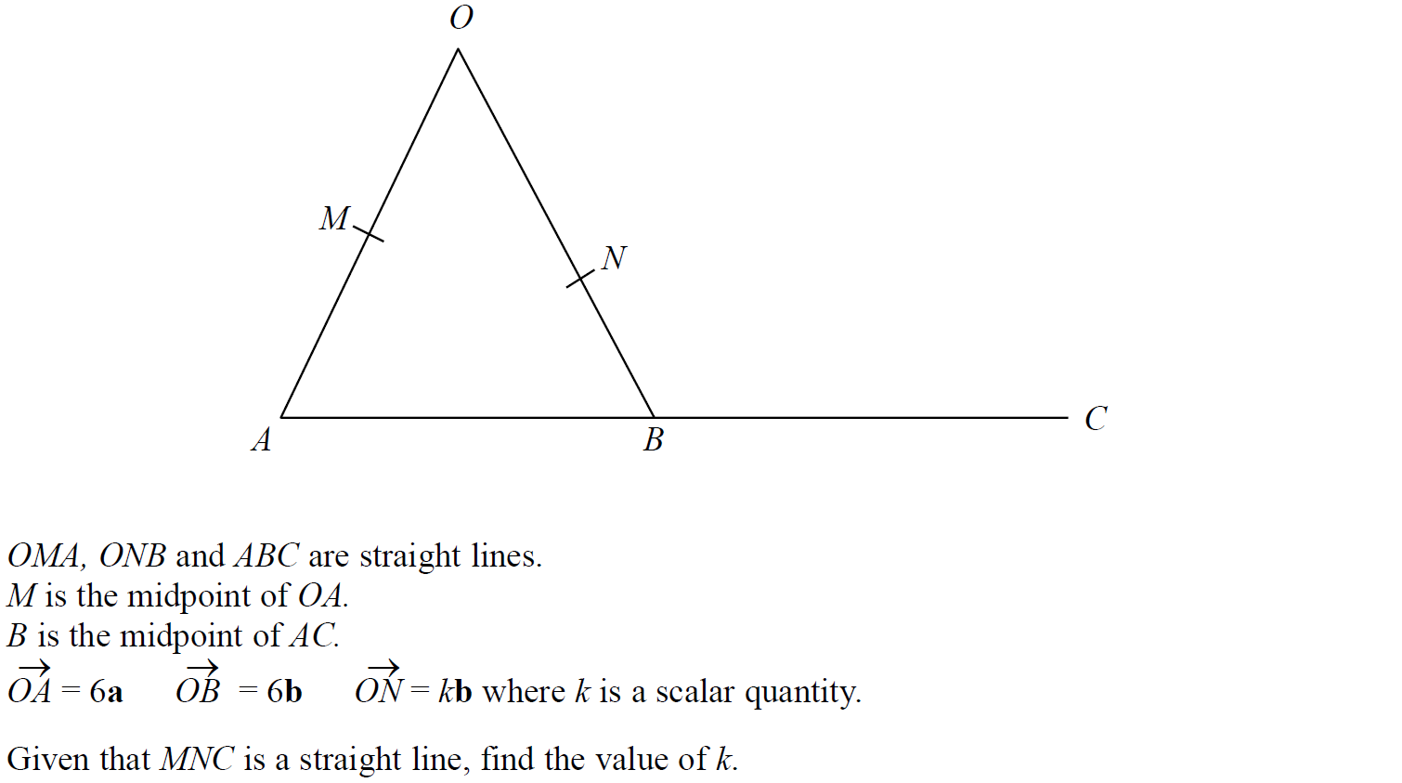
Vectors
SAM 3H Q18

Slide 3
Vectors
SAM 3H Q18
A

Slide 4
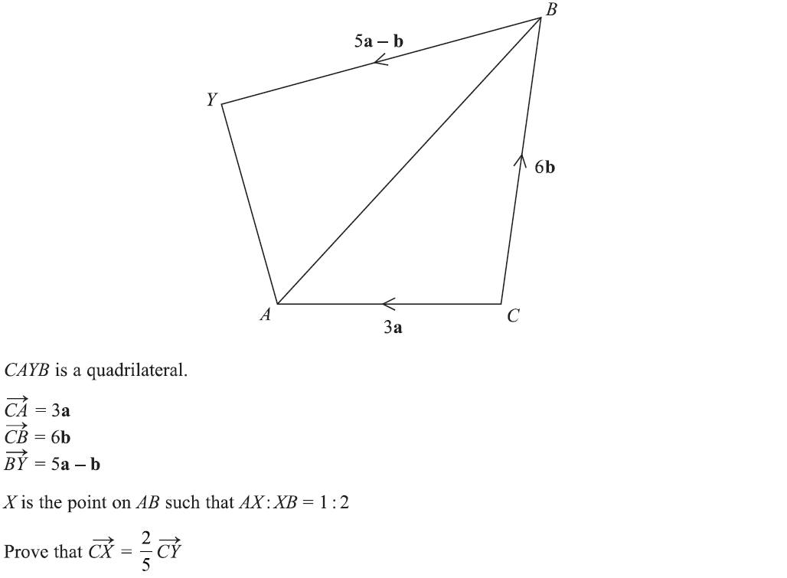
Vectors
Specimen Set 1 1H Q22

Slide 5
Vectors
Specimen Set 1 1H Q22
A

Slide 6
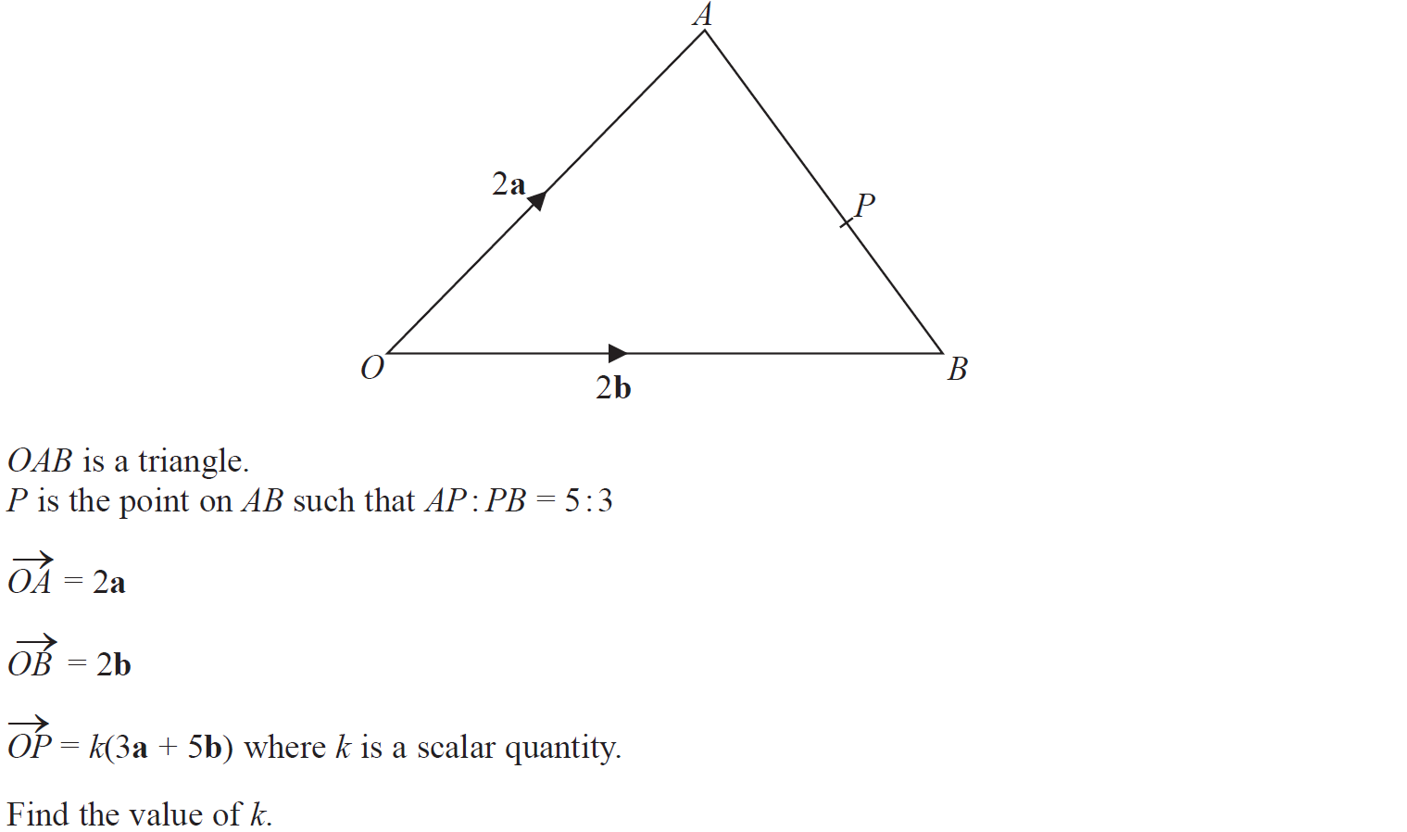
Vectors
Specimen Set 2 3H Q20

Slide 7
Vectors
Specimen Set 2 3H Q20
A

Slide 8
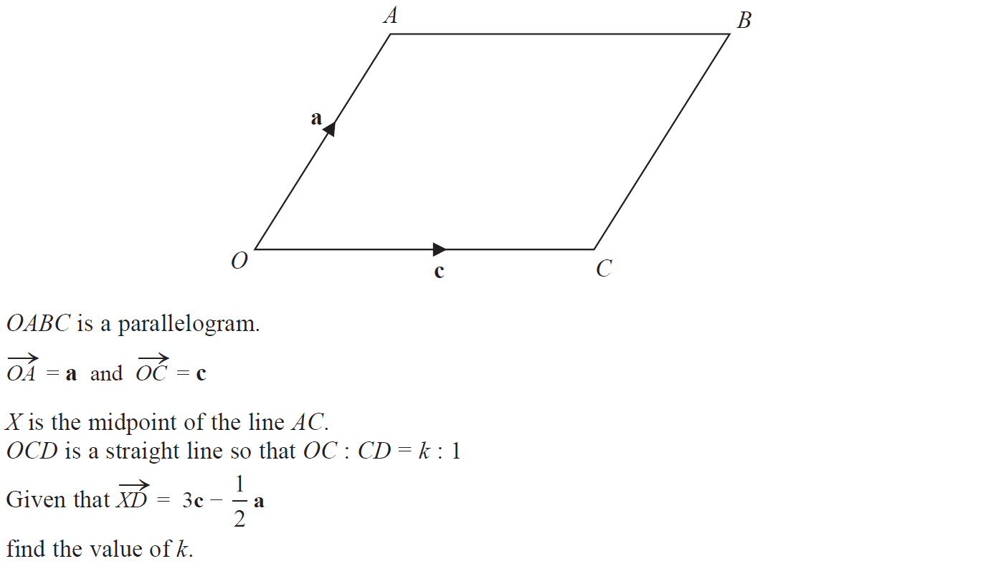
Vectors
May 2017 1H Q19

Slide 9
Vectors
May 2017 1H Q19
A

Slide 10
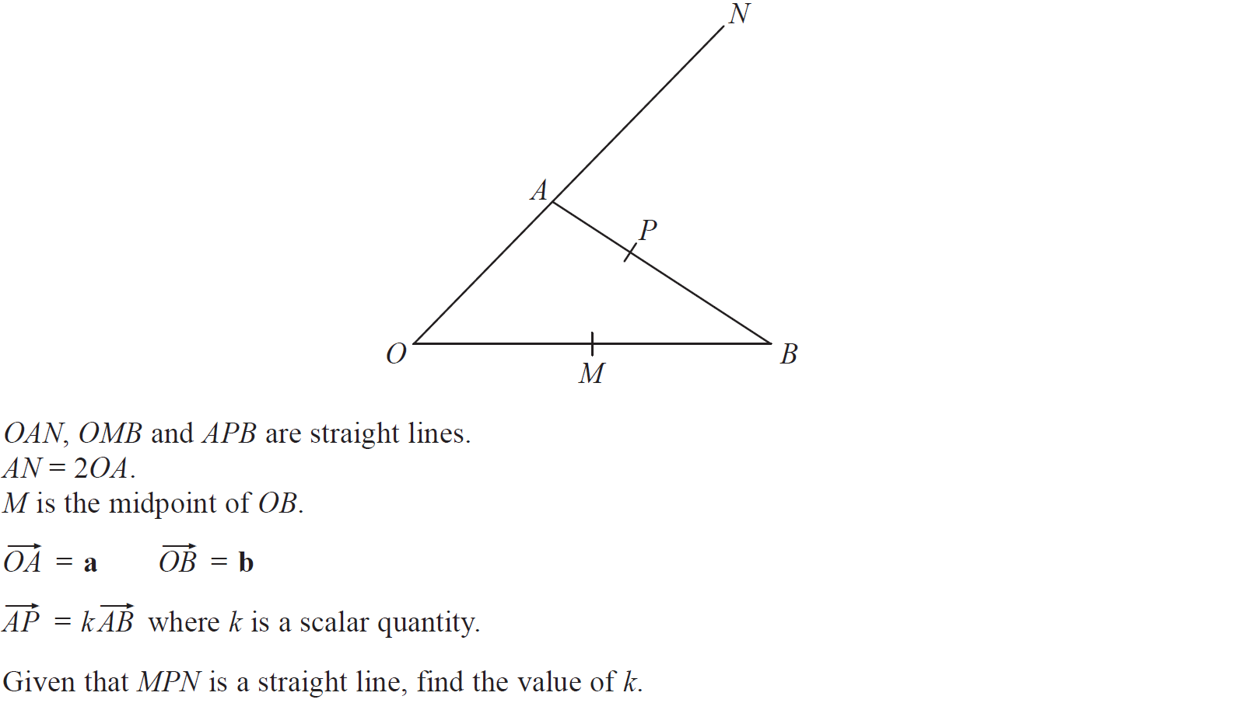
Vectors
Nov 2017 3H Q21

Slide 11
Vectors
Nov 2017 3H Q21
A

Slide 12
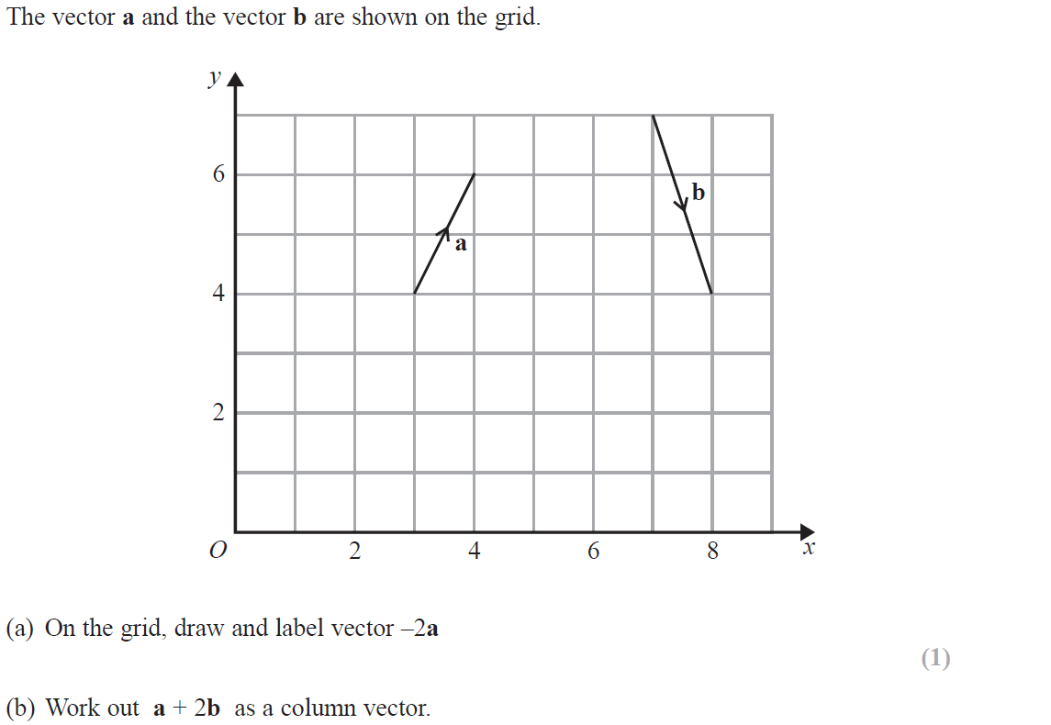
Vectors
June 2018 2H Q10
Reveal example for (a)

Slide 13
Vectors
June 2018 2H Q10
A
B

Slide 14
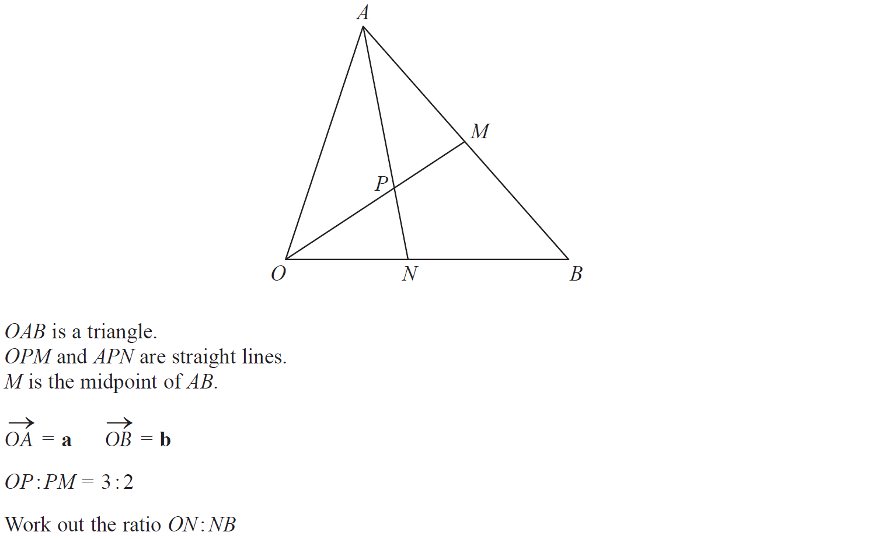
Vectors
Nov 2018 1H Q21

Slide 15
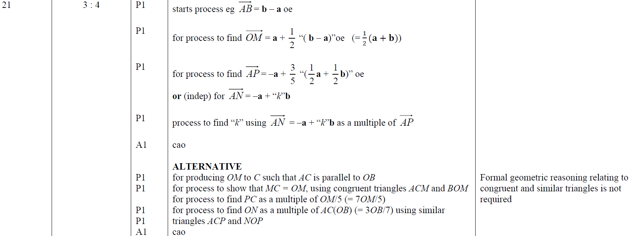
Vectors
Nov 2018 1H Q21
A

Slide 16
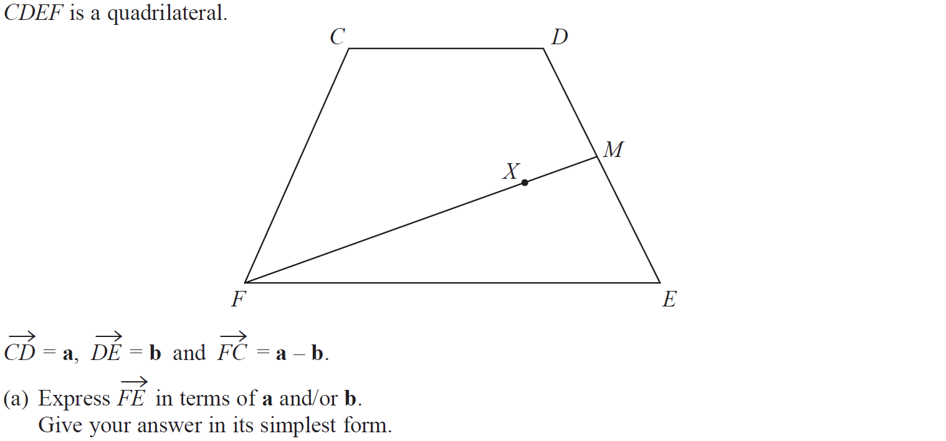
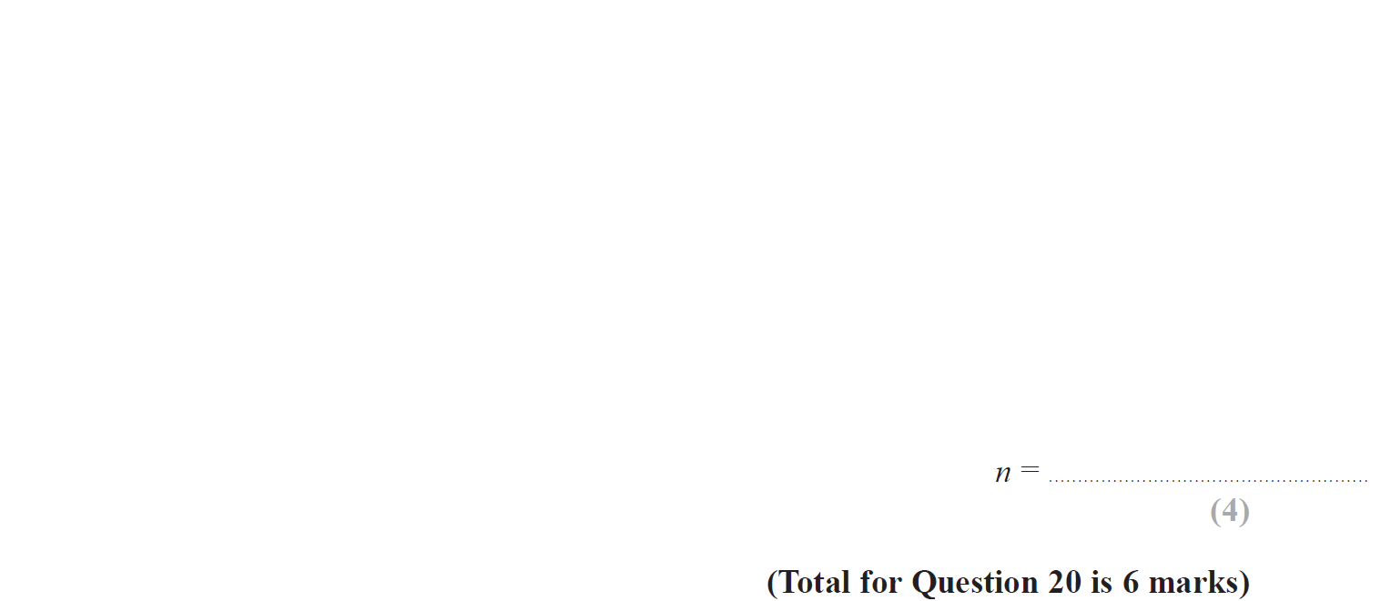
Vectors
June 2019 2H Q20

Slide 17
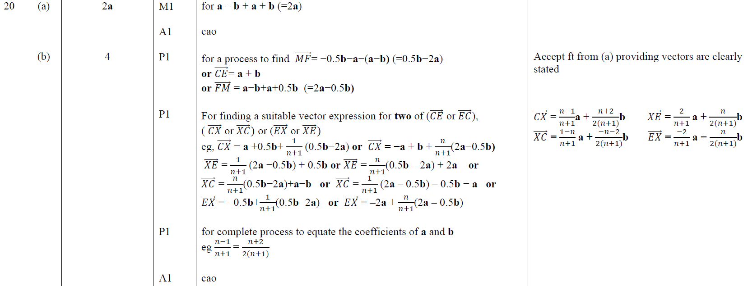
Vectors
June 2019 2H Q20
A
B

Slide 18
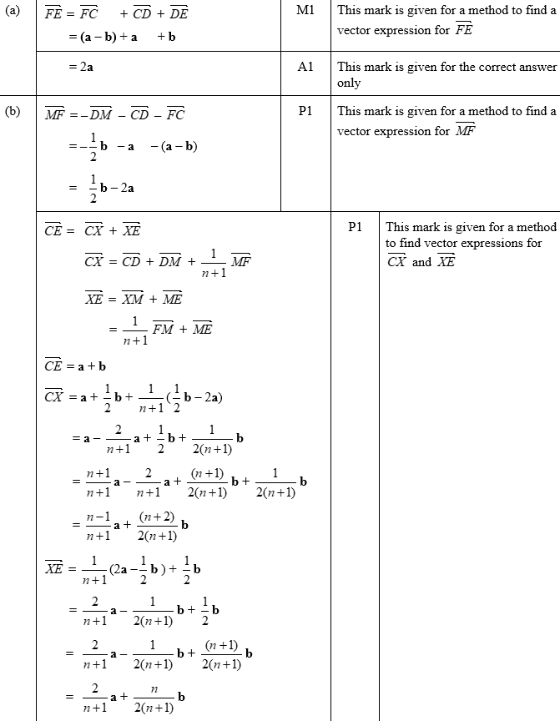
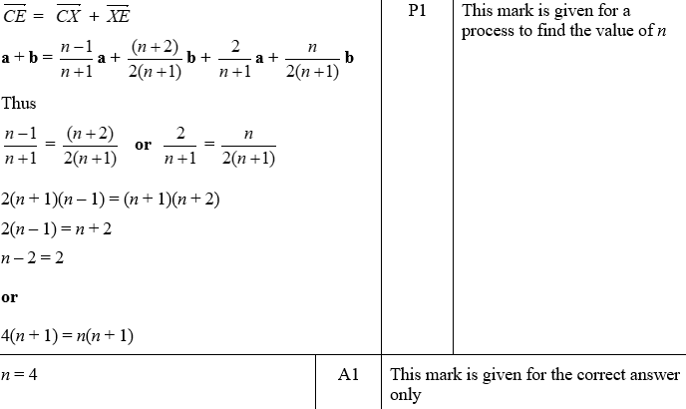
Vectors
June 2019 2H Q20
A SF
B SF

